Slide 1
UNIT-VI
Advanced Behavioral Modeling:
Events and Signals
State Machines
State chart Diagrams
Architectural Modeling:
Component Diagrams
Deployment Diagrams

Slide 2
Events and Signals
Events:
An event is the specification of a significant occurrence that has a location in time and space.
In the context of state machines, an event is an occurrence of a stimulus that can trigger a state transition.
An event may be internal or external.
External events are those that pass between the system and the actors.
Pushing of a button
Interrupt from a collision sensor

Slide 3
Internal events are those that pass among the objects that live inside the system.
Ex: Overflow Exception.
Four Types of Events
Call Events(Calls) Synchronous Event
Signal Events (or shortly known as Signals)
Time events(Passing of time), and Asynchronous Events
Change Events(change in state).

Slide 4
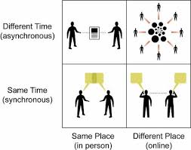
Synchronous vs Asynchronous

Slide 5
Figure : Events

Slide 6
Signals
A signal is a kind of event that represents the specification of an asynchronous stimulus communicated between instances.
A signal represents a named object that is dispatched (thrown) asynchronously by one object and then received (caught) by another.
Exceptions are the most common kind of internal signals

Slide 7
Signals have a lot in common with classes.
They may have instances. They may enter into generalization relationships.
May have attributes and operations.
May be sent as an action of a state transition in a state machine or the sending of a message in as interaction.
Operations can send signals ( e.g., exceptions)

Slide 8
Figure : Signals

Slide 9
Call Events
A call event represents the dispatch of an operation.
A call event is synchronous. This means that the control is transferred from the sender to the receiver.
The operation is completed.
The receiver moves to a new state, and control returns to the sender.
In UML, the notation of a call event is not distinguished from a signal event.
A signal will be handled by its state machine, and a call event will be handled by a method.

Slide 10
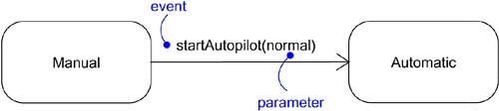
Figure : Call Events

Slide 11
Time and Change Events
A time event is an event that represents the passage of time.
As shown in the figure , time event by using the keyword after followed by some expression that evaluates to a period of time.
A change event is an event that represents a change in state or the satisfaction of some condition.
As shown in the figure, a change event by using the keyword when followed by some Boolean expression.

Slide 12
Figure : Time and Change Events

Slide 13
Common Modeling Techniques:
To model a family of signals:-
Consider all the different kinds of signals to which a given set of active objects may respond.
Look for the common kinds of signals and place them in a generalization/specialization hierarchy using inheritance. Elevate more general ones and lower more specialized ones.
Look for the opportunity for polymorphism in the state machines of these active objects. Where you find polymorphism, adjust the hierarchy as necessary by introducing intermediate abstract signals.

Slide 14
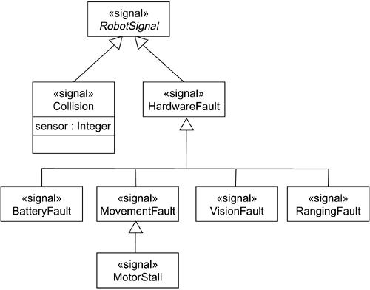
Modeling Families of Signals

Slide 15
Modeling Exceptions
To model exceptions:-
For each class and interface, and for each operation of such elements, consider the exceptional conditions that may be raised.
Arrange these exceptions in a hierarchy. Elevate general ones, lower specialized ones, and introduce intermediate exceptions, as necessary.
For each operation, specify the exceptions that it may raise. You can do so explicitly (by showing send dependencies from an operation to its exceptions) or you can put this in the operation's specification.

Slide 16
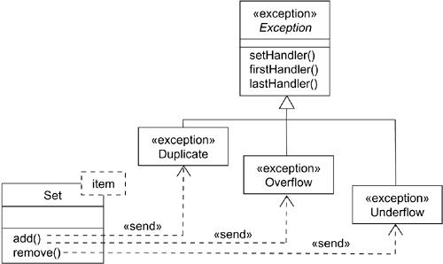
Modeling Exceptions

Slide 17
Ch- 21 State Machines
A state machine is a behavior that specifies the sequence of states an object goes through during its lifetime in response to events.
A state is a condition or situation during the life of an object during which it satisfies some condition, performs some activity.
An event is the specification of a significant occurrence that has a location in time and space.

Slide 18
A transition is a relationship between two states indicating that an object in the first state will perform certain actions and enter the second state when a specified event occurs and specified conditions are satisfied.
An activity is ongoing nonatomic execution within a state machine.
An action is an executable atomic computation that results in a change in state of the model or the return of a value.

Slide 19
Graphically, a state is rendered as a rectangle with rounded corners.
A transition is rendered as a solid directed line.

Slide 20
States:
A state is a condition or situation during the life of an object during which it satisfies some condition, performs some activity, or waits for some event. An object remains in a state for a finite amount of time.
A state has several parts.
1. Name: A textual string that distinguishes the state from other states; a state may be anonymous, meaning that it has no name.
2. Entry/exit actions: Actions executed on entering and exiting the state, respectively
3. Internal transitions: Transitions that are handled without causing a change in state
4. Substates :The nested structure of a state, involving disjoint (sequentially active) or concurrent (concurrently active) substates
5. Deferred events: A list of events that are not handled in that state but, rather, are postponed and queued for handling by the object in another state

Slide 21
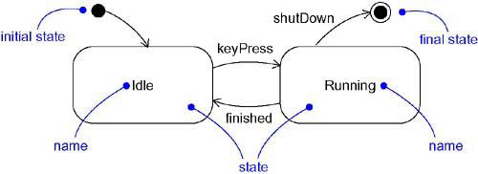
States

Slide 22
Initial and Final States
Initial state indicates the starting place for the state machine or substate. An initial state is represented as a filled black circle.
Final state indicates that the execution of the state machine (or the enclosing state) has been completed. A final state is represented as a filled black circle surrounded by an unfilled circle (Bull’s eye notation).

Slide 23
Transitions:
A transition is a relationship between two states indicating that an object in the first state will perform certain actions and enter the second state when a specified event occurs and specified conditions are satisfied.
On such a change of state, the transition fires. Until the transition fires, the object is said to be in the source state; after it fires, it is said to be in the target state.

Slide 24
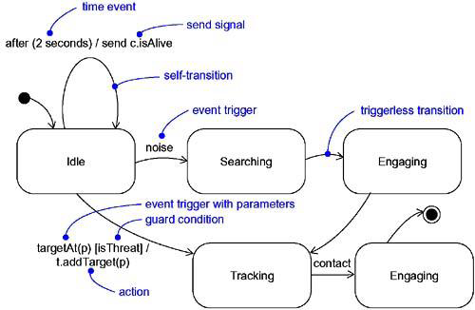
Transitions

Slide 25
A transition has five parts.
Source state The state affected by the transition; if an object is in the source state, an outgoing transition may fire when the object receives the trigger event of the transition and if the guard condition, if any, is satisfied.
2. Event trigger The event whose reception by the object in the source state makes the transition eligible to fire, providing its guard condition is satisfied.
3. Guard condition A Boolean expression that is evaluated when the transition is triggered by the reception of the event trigger; if the expression evaluates True, the transition fires; if False, the transition does not fire and the event is lost.
It is rendered as a Boolean expression enclosed in square brackets.

Slide 26
4. Action An executable atomic computation that may directly act on the object that owns the state machine, and indirectly on other objects that are visible to the object
5. Target state The state that is active after the completion of the transition. A transition is rendered as a solid directed line from the source to the target state. A self-transition is a transition whose source and target states are the same.

Slide 27
Advanced States and Transitions:
UML's state machines provides a no. of advanced features that help us to manage complex behavioral models.
These features often
reduce the no. of states & transitions
codify a number of common and complex idioms
Advanced features include: Entry and exit actions, internal transitions, activities, and deferred events.

Slide 28
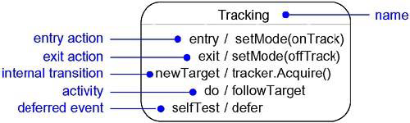
Advanced States and Transitions

Slide 29
Entry and Exit Actions
In the state symbol, we can include an entry action (marked by the keyword event entry) and an exit action (marked by the keyword event exit), together with an appropriate action.
Whenever we enter the state, its entry action is dispatched; whenever we leave the state, its exit action is dispatched.
Entry and exit actions may not have arguments or guard conditions.

Slide 30
Internal Transitions
Transitions handled without causing a change in state are called internal transitions.
Whenever we are in the state and that event is triggered, the corresponding action is dispatched without leaving and then reentering the state. Therefore, the event is handled without dispatching the state's exit and then entry actions.
Internal transitions may have events with parameters and guard conditions. Internal transitions are similar to interrupts.

Slide 31
Activities
While in a state, the object does some work that will continue until it is interrupted by an event.
We use “do” transition to specify the work that's to be done inside a state after the entry action is dispatched. The activity of a do transition might name another state machine..

Slide 32
Deferred Events
A deferred event is a list of events whose occurrence in the state is postponed.
Substates
A substate is a state that's nested inside another one.
A simple state is a state that has no substructure.
A state that has substates i.e, nested states is called a composite state. A composite state may be
Sequential substates.
Concurrent substates.

Slide 33
Sequential Substates

Slide 34
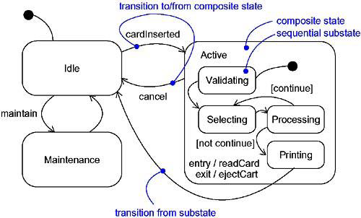

Slide 35
History States
History state is the state that remembers the last substate that was active prior to leaving the composite state.
History states are used, if we want a transition to activate the last substate.
Show a transition from outside the composite state directly to the history state. The first time we enter a composite state, it has no history.

Slide 36
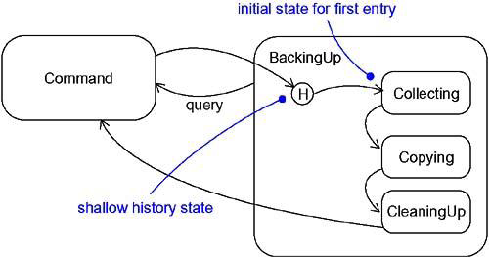
History States

Slide 37
History states are of 2 types:
Shallow History state (H)
Deep History state (H*)
Shallow history state is denoted by H, which remembers only the history of the immediate nested state machine.
Deep history state is denoted by H*, which remembers down to the innermost nested state at any depth.
If we have only one level of nesting, shallow and deep history states are semantically similar.
If we have more than one level of nesting, shallow history remembers only the outermost nested state; deep history remembers the innermost nested state at any depth.

Slide 38
Concurrent Substates (similar to Fork & join):
Sequential substates are the most common kind of nested state machine. In certain modeling situations, however, you'll want to specify concurrent substates.
These substates let you specify two or more state machines that execute in parallel in the context of the enclosing object.

Slide 39
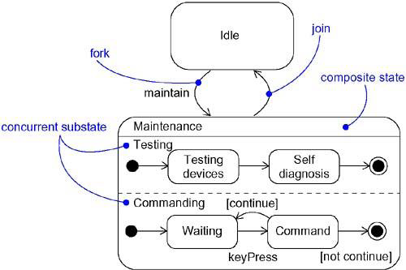
Concurrent Substates

Slide 40
Modeling the Lifetime of an Object
•Set the context for the state machine, whether it is a class, a use case, or the system as a whole.
1. If the context is a class or a use case, collect the neighboring classes,including
any parents of the class and any classes reachable by associations or dependences. These neighbors are candidate targets for actions and are candidates for including in guard conditions.
2. If the context is the system as a whole, narrow your focus to one behavior of the system. Theoretically, every object in the system may be a participant in a model
of the system's lifetime, and except for the most trivial systems, a complete model would be intractable.
• Establish the initial and final states for the object.
• Decide on the events to which this object may respond. If already specified, you'll find these in the object's interfaces; if not already specified, you'll have to consider which objects may interact with the object in your context, and then which events they may possibly dispatch.

Slide 41
• Starting from the initial state to the final state, lay out the top-level states the
Object may be in.
• Identify any entry or exit actions .
• Expand these states as necessary by using substates.
• Check that all events mentioned in the state machine match events expected by
the interface of the object.
• Check that all actions mentioned in the state machine are sustained by the
relationships, methods, and operations of the enclosing object.
• Trace through the state machine, either manually or by using tools, to check it
against expected sequences of events and their responses. Be especially
diligent in looking for unreachable states and states in which the machine may
get stuck.
• After rearranging your state machine, check it against expected sequences
again to ensure that you have not changed the object's semantics.

Slide 42
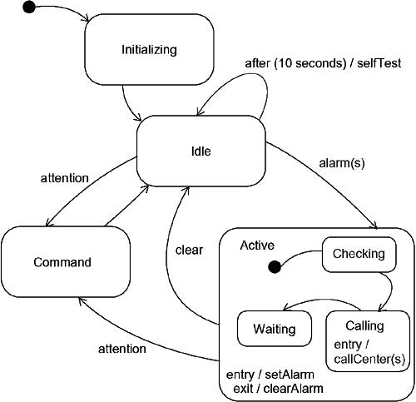

Slide 43
Ch-24 Statechart Diagrams
Statechart diagrams are one of the five diagrams in the UML for modeling the dynamic aspects of systems.
A statechart diagram shows a state machine.
An activity diagram is a special case of a statechart diagram in which all or most of the states are activity states and all or most of the transitions are triggered by completion of activities in the source state.
Thus, both activity and statechart diagrams are useful in modeling the lifetime of an object.
An activity diagram shows flow of control from activity to activity, a statechart diagram shows flow of control from state to state.

Slide 44
Statechart diagrams are not only important for modeling the dynamic aspects of a system, but also for constructing executable systems through forward and reverse engineering.
A statechart diagram shows a state machine, emphasizing the flow of control from state to state.
A state machine is a behavior that specifies the sequences of states an object goes through during its lifetime in response to events, together with its responses to those events.
A state is a condition or situation in the life of an object during which it satisfies some condition, performs some activity, or waits for some event.
An event is the specification of a significant occurrence that has a location in time and space. In the context of state machines, an event is an occurrence of a stimulus that can trigger a state transition

Slide 45
A transition is a relationship between two states indicating that an object in the first state will perform certain actions and enter the second state when a specified event occurs and specified conditions are satisfied.
An activity is ongoing nonatomic execution within a state machine.
An action is an executable atomic computation that results in a change in state of the model or the return of a value.
Graphically, a statechart diagram is a collection of vertices and arcs.

Slide 46
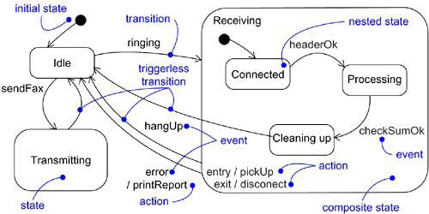
Statechart Diagram

Slide 47
Statechart diagrams commonly contain
Simple states and composite states
Transitions, including events and actions
A statechart diagram may contain conditions (branches), concurrent substates (forks & joins), action states, activity states, objects, initial states, final states, history states, and so on.
Common Uses
We use statechart diagrams to model the dynamic aspects of a system. These dynamic aspects may involve the event-ordered behavior an object.
When we model the dynamic aspects of a system, a class, or a use case, we'll typically use statechart diagrams in one way.

Slide 48
Modeling Reactive Objects
To model a reactive object,
• Choose the context for the state machine, whether it is a class, a use case, or the system as a whole.
• Choose the initial and final states for the object. To guide the rest of your model, possibly state the pre- and postconditions of the initial and final states, respectively.
• Decide on the stable states of the object by considering the conditions in which the object may exist for some identifiable period of time. Start with the high-level states of the object and only then consider its possible substates.
• Decide on the meaningful partial ordering of stable states over the lifetime of the object.
• Decide on the events that may trigger a transition from state to state. Model these events as triggers to transitions that move from one legal ordering of states to another.
• Attach actions to these transitions (as in a Mealy machine) and/or to these states (as in a Moore machine).
• Consider ways to simplify your machine by using substates, branches, forks, joins, and history states.
• Check that all states are reachable under some combination of events.
• Check that no state is a dead end from which no combination of events will transition the object out of that state.
• Trace through the state machine, either manually or by using tools, to check it against expected sequences of events and their responses.

Slide 49
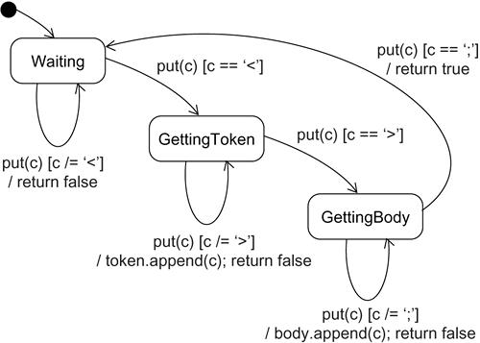
Modeling Reactive Objects

Slide 50
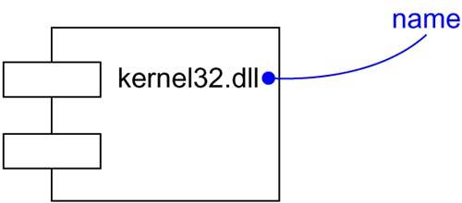
Components
A component is a physical and replaceable part of a system that conforms to and provides the realization of a set of interfaces.
Components are used to model the physical things that may reside on a node, such as executables, libraries, tables, files, and documents.

Slide 51
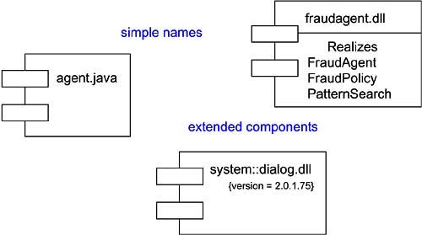
Typical Components

Slide 52
Components and Classes
• Classes represent logical abstractions; components represent physical things that live in the world of bits. In short, components may live on nodes, classes may not.
• Components represent the physical packaging of otherwise logical components and are at a different level of abstraction.
• Classes may have attributes and operations directly. In general, components only have operations that are reachable only through their interfaces.

Slide 53
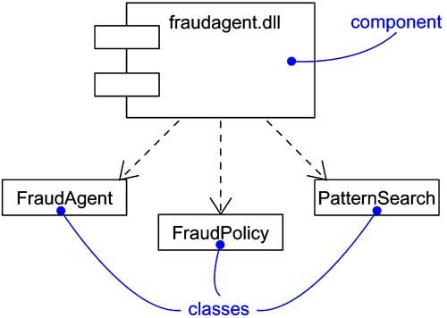
Components and Classes

Slide 54
Components Characteristics
First, a component is physical. It lives in the world of bits, not concepts.
Second, a component is replaceable.
A component is substitutable- it is possible to replace a component with another that conforms to the same interfaces.
Third, a component is part of a system.
A component rarely stands alone. Rather, a given component collaborates with other components and in so doing exists in the architectural or technology context in which it is intended to be used.
A component is logically and physically cohesive and thus denotes a meaningful structural and/or behavioral chunk of a larger system.
A component may be reused across many systems. Therefore, a component represents a fundamental building block on which systems can be designed and composed.

Slide 55
Kind of Components
Deployment components:
These are the components necessary and sufficient to form an executable system, such as dynamic libraries (DLLs) and executables (EXEs).
The UML's definition of component is broad enough to address classic object models, such as COM+, CORBA, and Enterprise Java Beans, as well as alternative object models, perhaps involving dynamic Web pages, database tables, and executables using proprietary communication mechanisms.

Slide 56
Work product components: These components are essentially the residue of the development process, consisting of things such as source code files and data files from which deployment components are created.
These components do not directly participate in an executable system but are the work products of development that are used to create the executable system.
Execution components:These components are created as a consequence of an executing system, such as a COM+ object, which is instantiated from a DLL.

Slide 57
Stereo Types
1. executable: Specifies a component that may be executed on a node
2. library: Specifies a static or dynamic object library
3. table: Specifies a component that represents a database table
4. file: Specifies a component that represents a document containing source code or data
5. document: Specifies a component that represents a document

Slide 58
Modeling Executables and Libraries
To model executables and libraries,
• Identify the partitioning of your physical system. Consider the impact of technical, configuration management, and reuse issues.
• Model any executables and libraries as components, using the appropriate standard elements. If your implementation introduces new kinds of components, introduce a new appropriate stereotype.
• If it's important for you to manage the seams in your system, model the significant interfaces that some components use and others realize.
• As necessary to communicate your intent, model the relationships among these executables, libraries, and interfaces. Most often, you'll want to model the dependencies among these parts in order to visualize the impact of change.

Slide 59
Figure shows a set of components drawn from a personal productivity tool that runs on a single personal compute

Slide 60
Modeling Tables, Files, and Documents
To model tables, files, and documents,
• Identify the ancillary components that are part of the physical implementation of your system.
• Model these things as components. If your implementation introduces new kinds of artifacts, introduce a new appropriate stereotype.
• As necessary to communicate your intent, model the relationships among these ancillary components and the other executables, libraries, and interfaces in your system.

Slide 61
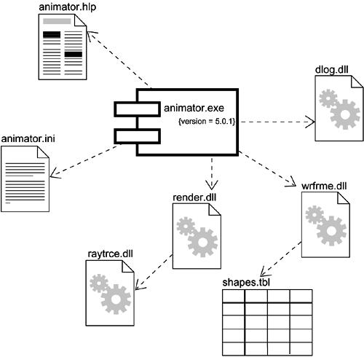

Slide 62
Modeling an API
To model an API,
Identify the programmatic seams in your system and model each seam as an interface, collecting the attributes and operations that form this edge.
Expose only those properties of the interface that are important to visualize in the given context; otherwise, hide these properties, keeping them in the interface's specification for reference, as necessary.
Model the realization of each API only insofar as it is important to show the configuration of a specific implementation.

Slide 64
Modeling Source Code
To model source code,
• Depending on the constraints imposed by your development tools, model the files used to store the details of all your logical elements, along with their compilation dependencies.
• If it's important for you to bolt these models to your configuration management and version control tools, you'll want to include tagged values, such as version, author, and check in/check out information, for each file that's under configuration management.
• As far as possible, let your development tools manage the relationships among these files, and use the UML only to visualize and document these relationships.

Slide 66
Component Diagram
A component diagram shows a set of components and their relationships. Graphically, a component diagram is a collection of vertices and arcs.
A component diagram shows the organizations and dependencies among software components, including source code components, binary code components, and executable components.
Calling dependencies among components are shown as dependency relationships between components and interfaces on other components. Note that the interfaces actually belong to the logical view, but they can occur both in class diagrams and in component diagrams.

Slide 67
Contents of Component Diagram
Component diagrams commonly contain
• Components
A component represents a software module (source code, binary code, executable, DLL, etc.) with a well-defined interface. The interface of a component is represented by one or several interface elements that the component provides.
• Interfaces
An interface specifies the externally-visible operations of a class and/or component, and has no implementation of its own. An interface typically specifies only a limited part of the behavior of a class or component.
• Dependency, generalization, association, and realization relationships

Slide 68
Modeling Source Code
To model a system's source code,
• Either by forward or reverse engineering, identify the set of source code files of interest and model them as components stereotyped as files.
• For larger systems, use packages to show groups of source code files.
• Consider exposing a tagged value indicating such information as the version number of the source code file, its author, and the date it was last changed. Use tools to manage the value of this tag.
• Model the compilation dependencies among these files using dependencies. Again, use tools to help generate and manage these dependencies.

Slide 69
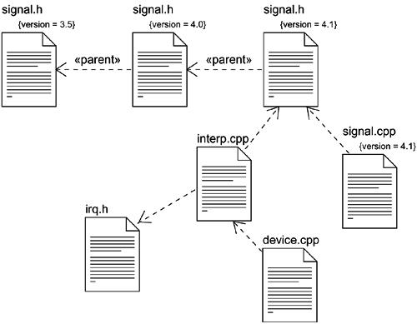
Modeling Source Code

Slide 70
Modeling an Executable Release
To model an executable release,
• Identify the set of components you'd like to model. Typically, this will involve some or all the components that live on one node, or the distribution of these sets of components across all the nodes in the system.
• Consider the stereotype of each component in this set. For most systems, you'll find a small number of different kinds of components.
• For each component in this set, consider its relationship to its neighbors. This will involve interfaces that are exported (realized) by certain components and then imported (used) by others.

Slide 71
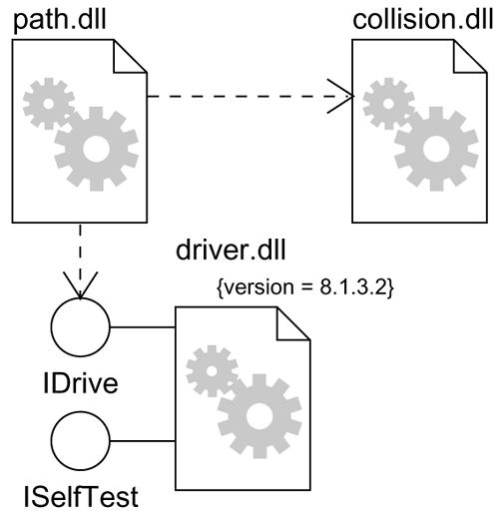
Modeling an Executable Release

Slide 72
Modeling a Physical Database
To model a physical database,
• Identify the classes in your model that represent your logical database schema.
• Select a strategy for mapping these classes to tables. You will also want to consider the physical distribution of your databases.
• To visualize, specify, construct, and document your mapping, create a component diagram that contains components stereotyped as tables.
• Where possible, use tools to help you transform your logical design into a physical design.

Slide 73
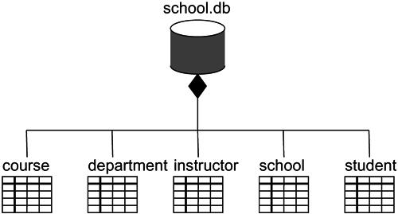
Modeling a Physical Database

Slide 74
Modeling Adaptable Systems
To model an adaptable system,
• Consider the physical distribution of the components that may migrate from node to node. You can specify the location of a component instance by marking it with a location tagged value, which you can then render in a component diagram.
• If you want to model the actions that cause a component to migrate, create a corresponding interaction diagram that contains component instances.

Slide 75
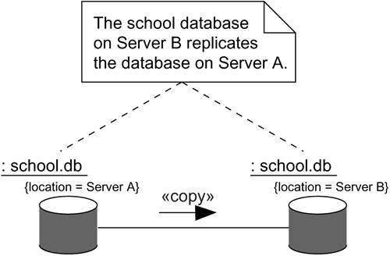
Modeling Adaptable Systems

Slide 76
Deployment
The components you develop or reuse as part of a software-intensive system must be deployed on some set of hardware in order to execute.
Node represents the hardware on which these components are deployed and execute.
A node is a physical element that exists at run time and represents a computational resource.

Slide 77
Nodes and Components
Between nodes and components.
• Components are things that participate in the execution of a system; nodes are things that execute components.
• Components represent the physical packaging of otherwise logical elements; nodes represent the physical deployment of components.

Slide 78
Organizing Nodes
We can organize nodes by grouping them in packages in the same manner in which you can organize classes and components.
We can also organize nodes by specifying dependency, generalization, and association (including aggregation) relationships among them.

Slide 79
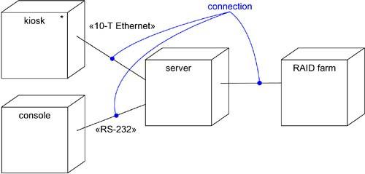
Connections
Nodes can be organized by specifying dependency and association relationship.
An association generally represents a physical connection among nodes, such as an Ethernet connection, a serial line, a satellite connection etc.

Slide 80
Modeling Processors and Devices
To model processors and devices,
Identify the computational elements of your system's deployment view and model each as a node.
If these elements represent generic processors and devices, then stereotype them as such .
Consider the attributes and operations that might apply to each node.

Slide 82
Modeling the Distribution of Components
To model the distribution of components,
• For each significant component in your system, allocate it to a given node.
• Consider duplicate locations for components. It's common for the same kind of component (such as specific executables and libraries) to reside on multiple nodes simultaneously.
• Render this allocation in one of three ways.
1. Don't make the allocation visible, but leave it as part of the backplane of your model.
2. Using dependency relationships, connect each node with the components it deploys.
3. List the components deployed on a node in an additional compartment.

Slide 83
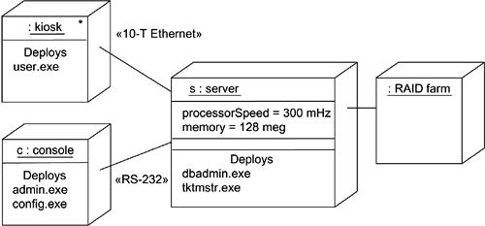
Modeling the Distribution of Components

Slide 84
Deployment diagram:
Deployment diagrams are one of the two kinds of diagrams used in modeling the physical aspects of an object-oriented system.
A deployment diagram shows the configuration of run time processing nodes and the components that live on them.
A deployment diagram shows processors, devices, and connections. Each model contains a single deployment diagram which shows the connections between its processors and devices, and the allocation of its processes to processors.

Slide 85
Contents of Deployment Diagram
Processor:-A processor is a hardware component capable of executing programs.
Devices:-A device is a hardware component with no computing power. Each device must have a name. Device names can be generic, such as "modem" or "terminal."

Slide 86
Connections:-A connection represents some type of hardware coupling between two entities. An entity is either a processor or a device. The hardware coupling can be direct, such as an RS232 cable, or indirect, such as satellite-to-ground communication. Connections are usually bi-directional.

Slide 87
Modeling an Embedded System
To model an embedded system,
• Identify the devices and nodes that are unique to your system.
• Provide visual cues, especially for unusual devices, by using the UML's extensibility mechanisms to define system-specific stereotypes with appropriate icons. At the very least, you'll want to distinguish processors (which contain software components) and devices (which, at that level of abstraction, don't directly contain software).
• Model the relationships among these processors and devices in a deployment diagram. Similarly, specify the relationship between the components in your system's implementation view and the nodes in your system's deployment view.
• As necessary, expand on any intelligent devices by modeling their structure with a more detailed deployment diagram.

Slide 88
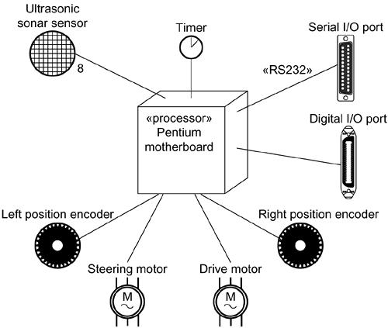
Modeling an Embedded System

Slide 89
Modeling a Client/Server System
To model a client/server system,
• Identify the nodes that represent your system's client and server processors.
• Highlight those devices that are germane to the behavior of your system. For example, you'll want to model special devices, such as credit card readers, badge readers, and display devices other than monitors, because their placement in the system's hardware topology are likely to be architecturally significant.
• Provide visual cues for these processors and devices via stereotyping.
• Model the topology of these nodes in a deployment diagram. Similarly, specify the relationship between the components in your system's implementation view and the nodes in your system's deployment view.

Slide 90
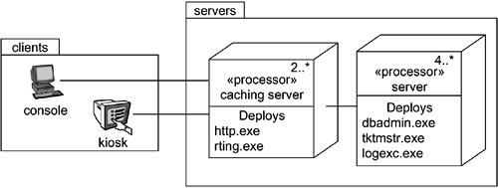
Modeling a Client/Server System

Slide 91
Modeling a Fully Distributed System
To model a fully distributed system,
• Identify the system's devices and processors as for simpler client/server systems.
• If you need to reason about the performance of the system's network or the impact of changes to the network, be sure to model these communication devices to the level of detail sufficient to make these assessments.
• Pay close attention to logical groupings of nodes, which you can specify by using packages.
• Model these devices and processors using deployment diagrams. Where possible, use tools that discover the topology of your system by walking your system's network.
• If you need to focus on the dynamics of your system, introduce use case diagrams to specify the kinds of behavior you are interested in, and expand on these use cases with interaction diagrams.

Slide 92
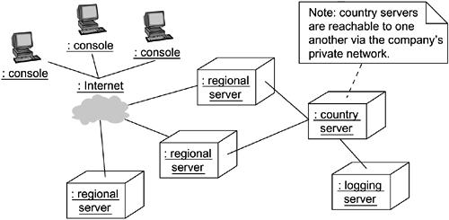
Modeling a Fully Distributed System

Slide 93
Forward and Reverse Engineering
To reverse engineer a deployment diagram,
• Choose the target that you want to reverse engineer. In some cases, you'll want to sweep across your entire network; in others, you can limit your search.
• Choose also the fidelity of your reverse engineering. In some cases, it's sufficient to reverse engineer just to the level of all the system's processors; in others, you'll want to reverse engineer the system's networking peripherals, as well.
• Use a tool that walks across your system, discovering its hardware topology. Record that topology in a deployment model.
• Along the way, you can use similar tools to discover the components that live on each node, which you can also record in a deployment model.
• Using your modeling tools, create a deployment diagram by querying the model.

