Slide 1
Activity Diagrams

Slide 2
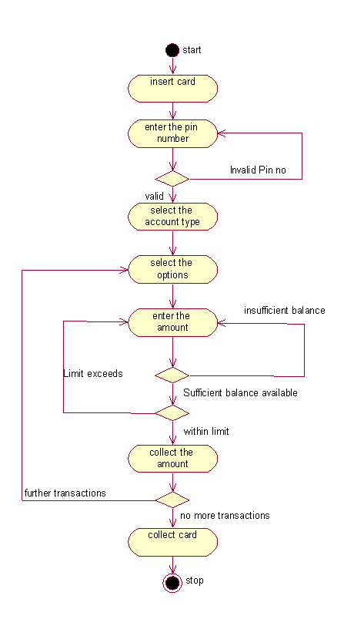
ATM(Simple)

Slide 3
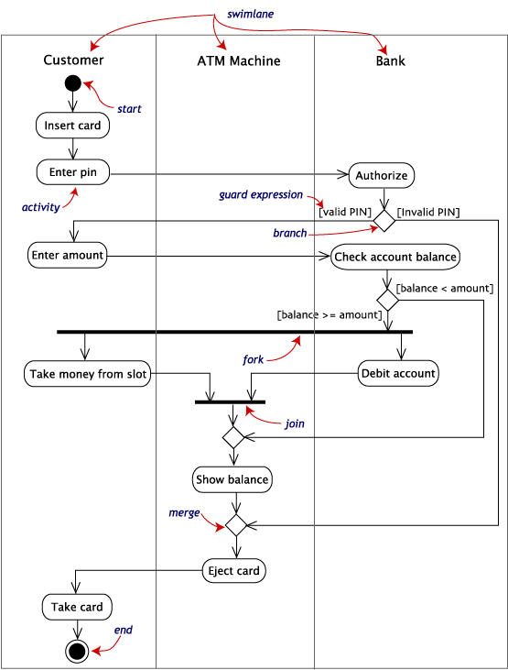
ATM(Swim Lanes)
Notes:
An activity diagram is essentially a fancy flowchart. Activity diagrams and statechart diagrams are related. While a statechart diagram focuses attention on an object undergoing a process (or on a process as an object), an activity diagram focuses on the flow of activities involved in a single process. The activity diagram shows the how those activities depend on one another. Activity diagrams can be divided into object swimlanes that determine which object is responsible for which activity. A single transition comes out of each activity, connecting it to the next activity.
A transition may branch into two or more mutually exclusive transitions. Guard expressions (inside [ ]) label the transitions coming out of a branch. A branch and its subsequent merge marking the end of the branch appear in the diagram as hollow diamonds.
A transition may fork into two or more parallel activities. The fork and the subsequent join of the threads coming out of the fork appear in the diagram as solid bars.

Slide 4
LMS

Slide 5
HMS

Slide 6
Online Railway Reservation

Slide 7
Online Book Shopping

