Slide 1
StateChartDiagrams

Slide 2
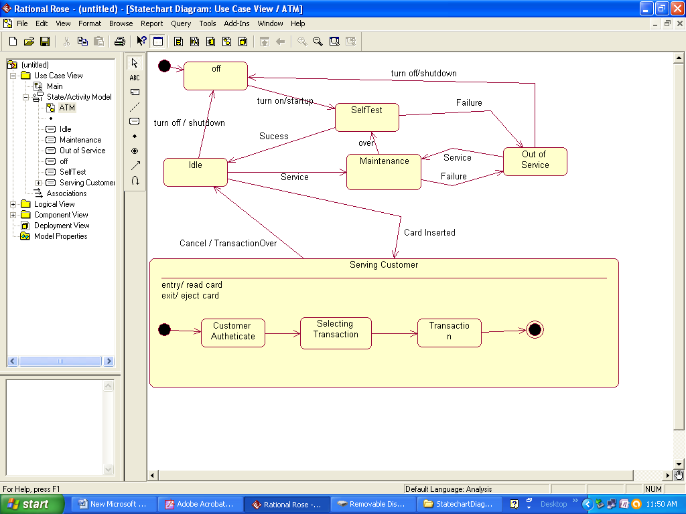
ATM

Slide 3
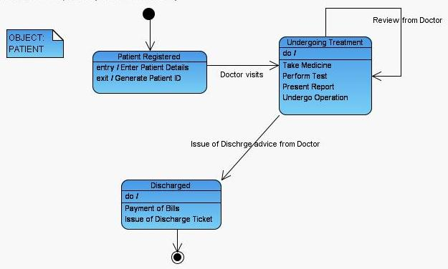
Hospital Mgmt Sys(Patient)

Slide 4
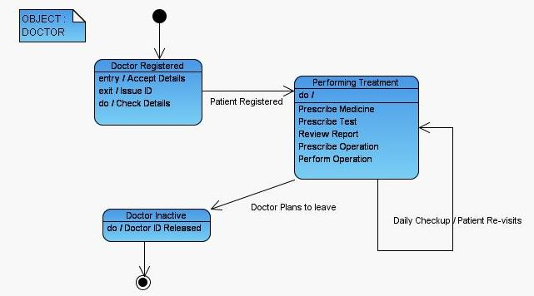
Hospital Mgmy Sys(Doctor)

Slide 5
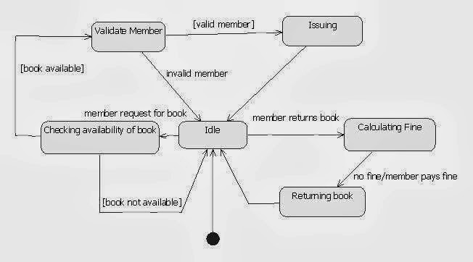
Library Mgmt Sys

Slide 6
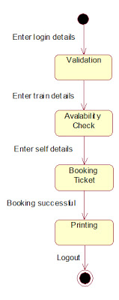
Railway Reservation System

Slide 7
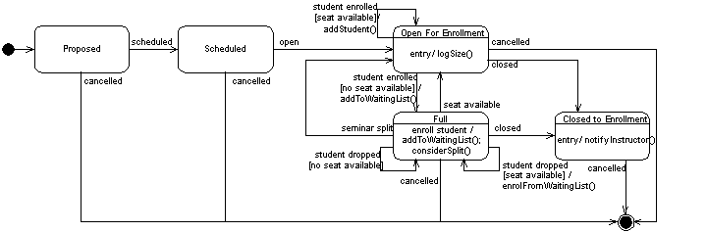
Student enrollment System

Slide 8
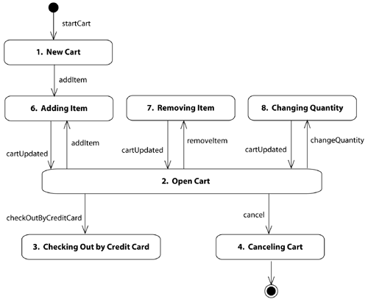
Online Book Shopping

Slide 9
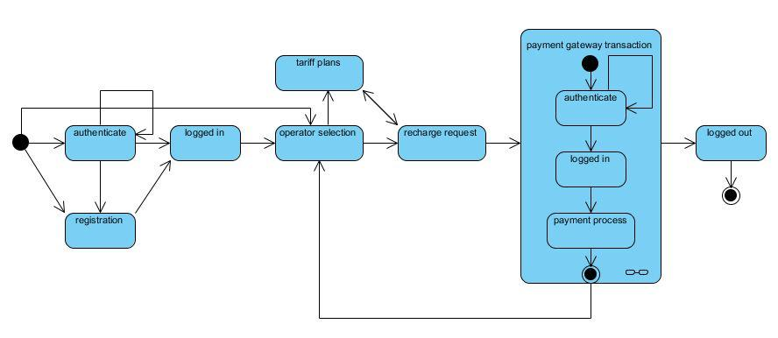
Mobile Recharge

