Slide 1
UNIT-2

Slide 2
CH-4 CLASSES
Classes are the most important building block of an object oriented system.
A class is a description of a set of objects that share the same attributes, operations, relationships and semantics.
A class implements one or more interfaces.

Slide 3
Classes are used to capture the vocabulary of the system you are developing.
Classes may include abstractions that are part of the problem domain.

Slide 4
The UML provides a graphical representation of class.
Name
Shape
origin
move( ) resize( ) display( )
Attributes
Operations
CLASS

Slide 5
Terms and concepts
A class is a description of a set of objects that share the same attributes, operations, relationships, and semantics.
NAME:-
Every class must have a name that distinguishes it from other classes.

Slide 6
A name is a textual string. That name alone is known as a Simple name; a path name is the class name prefixed by the name of the package in which that class lives.
A class may be drawn showing only its name.
Temperature Sensor
Customer
Wall
Simple Names

Slide 7
Capitalize the first letter of every word in a class name, as in Customer or TemperatureSensor.
Business Rules:: Fraud Agent
Java :: awt :: Rectangle
Path Names

Slide 8
ATTRIBUTES:-
An Attribute is a named property of a class .
A class may have any number of attributes or no attributes at
all.

Slide 9
An attribute represents some property of the thing you are modeling that is shared by all objects of that class.
Example: Customer has a name, address, phone number, and date of birth.
Customer
name address phone birthDate
Attributes

Slide 10
An attribute name may be text, just like a class name.
Wall
height: Float Width: Float Thickness: Float isLoadBearing: Boolean= False

Slide 11
OPERATION:-
An operation is the implementation of a service that can be requested from any object of the class to affect behavior.
In other words, an operation is an abstraction of something you can do to an object and that is shared by all objects of the class.
A class may have any number of operations or no operations at all.

Slide 12
Rectangle
add( ) grow( ) move( ) isEmpty( )
Operations

Slide 13
RESPONSIBILITIES:-
A responsibility is a contract or an obligation of the class.
Responsibilities are translated into a set of attributes and operations that best fulfill the class’s responsibilities.
Example: A TemperatureSensor class is responsible is responsible for measuring the temperature and raising the alarm if the temperature reaches a certain point.

Slide 14
Example:
Supplier
Responsibilities -- Receive the order from the customer --Supply the goods to the customer.

Slide 15
Common Modeling Techniques
1.Modeling the vocabulary of a system:-
Classes are used to model abstractions that are drawn from the problem. Each of these abstractions is a part of the vocabulary of the system.
use-case based analysis techniques are best methods to find these abstractions.

Slide 16
To model the vocabulary of a system:
Identify the things that users or implementers use to describe the problem or solution. Use use case-based analysis to help find these abstractions.
For each abstraction, identify the corresponding responsibilities.
For each class, provide the attributes and operations which are required to handle the responsibilities.

Slide 17
Example: Retail system.
Customer, order and product are the abstractions. A few other related abstractions drawn from the vocabulary of the problem, such as shipment( used to track orders), Invoice ( used to bill orders), and Warehouse (where products are located prior to shipment). There is also one solution related abstraction, Transaction, which applies to orders and shipments.

Slide 18
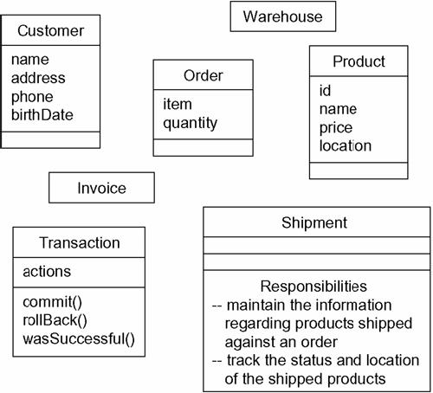

Slide 19
2. Modeling the distribution of responsibilities in a system:-
To model a system, the abstractions provide a balanced set of responsibilities. (What this means is that we don’t want any one class to be too big or too small.)
The UML is used to help us to visualize and specify this balance of responsibilities.

Slide 20
To model the distribution of responsibilities in a system:-
Identify the set of classes that work together to carry-out some behavior.
Identify the set of responsibilities for each of the classes.
Split classes that have too many responsibilities into smaller abstractions and reallocate responsibilities so that each abstraction reasonably stands on its own.

Slide 21
Find the collaborations among these classes and redistribute their responsibilities according so that no class within a collaboration does too much or too little.

Slide 22
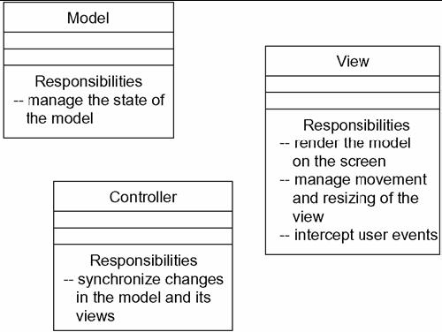
Modeling the Distribution of Responsibilities in a System

Slide 23
3. Modeling Non Software Things:-
Model the things, that are abstracting as a class.
(Example: Customer in a retail system)
Create a new building block by using stereotypes to specify the new semantics.
If the thing we are modeling is some kind of hardware that itself contains software, consider modeling it as a kind of node.

Slide 24
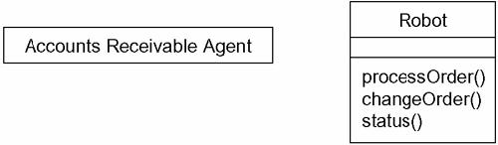
Modeling Nonsoftware Things

Slide 25
4. Modeling Primitive types:-
Model the thing we are abstracting as a type or an enumeration, which is represented using class notation with the appropriate stereotype.
Use constraints, to specify the range of values associated with the type.

Slide 26
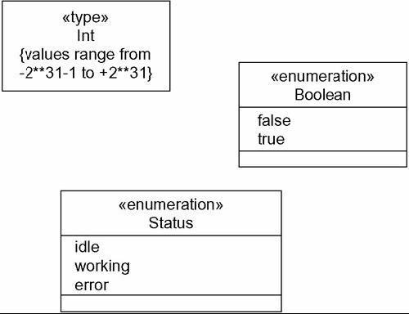
Modeling Primitive Types

