Slide 1
JavaScript
Client-side language.
Started at Netscape, a web browser developed in the 1990)

Slide 2
Need For JavaScript
  Limitations of HTML
    Static web pages
    No provision for validation of content
    Lack of dynamicity

Slide 3
What is JavaScript ?
An object-based programming language
Object oriented programming languages follow all concepts belonging to OOP.
Ex: Python, Ruby, Scala, Smalltalk, Java, C++, C#,
Object-based language doesn't support all the features of OOPs like Polymorphism and Inheritance . Has in-built object like JavaScript has window, document objects.
Ex: JavaScript, VB etc.
Allows creation of interactive web pages
Allows user entries to be processed as required

Slide 4
Features of JavaScript
Interpreted Language
Embedded Language
Browser dependent
Event-Driven
Loosely Typed Language

Slide 5
What a JavaScript can do?
Put dynamic text into an HTML page
React to events
Read and write HTML elements
Used to validate data
Used to detect the visitor's browser
Used to create cookies

Slide 6
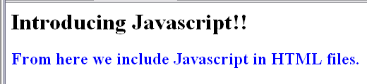
Example (simple_jsfile.html) with output
<HTML>
<HEAD>
<TITLE> A program in Javascript </TITLE>
<SCRIPT LANGUAGE="Javascript">
document.writeln("<H1>Introducing Javascript!!</H1>");
document.writeln("<H2 style='COLOR:blue'>From here we include Javascript in HTML files.</H2>");
</SCRIPT>
</HEAD>
<BODY>
</BODY>
</HTML>
Written with <script> tag.
HTML elements put in double quotes in document.write ().

Slide 7
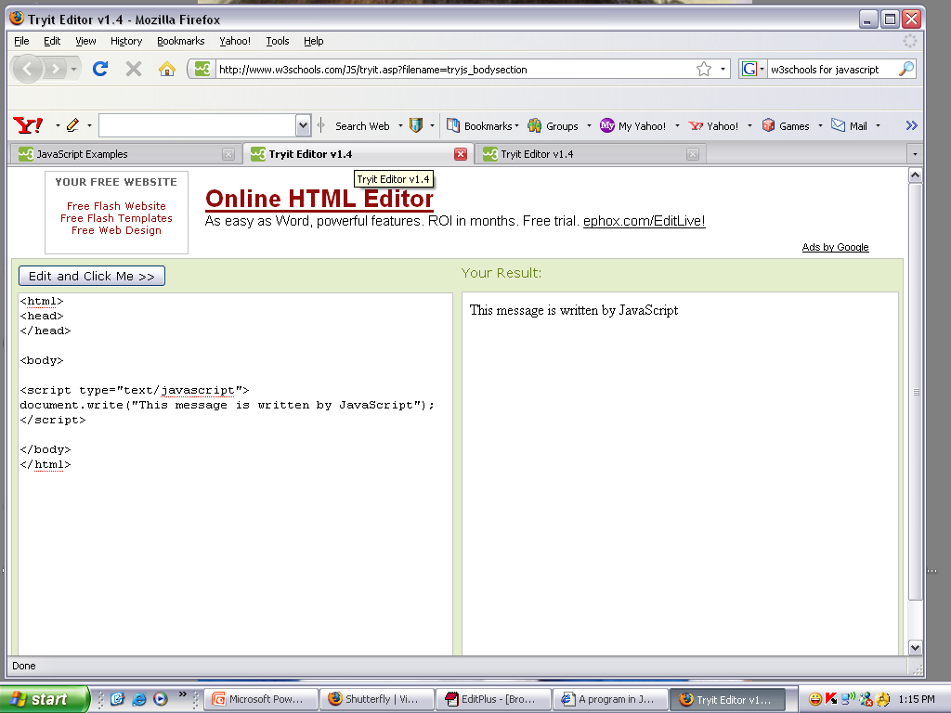
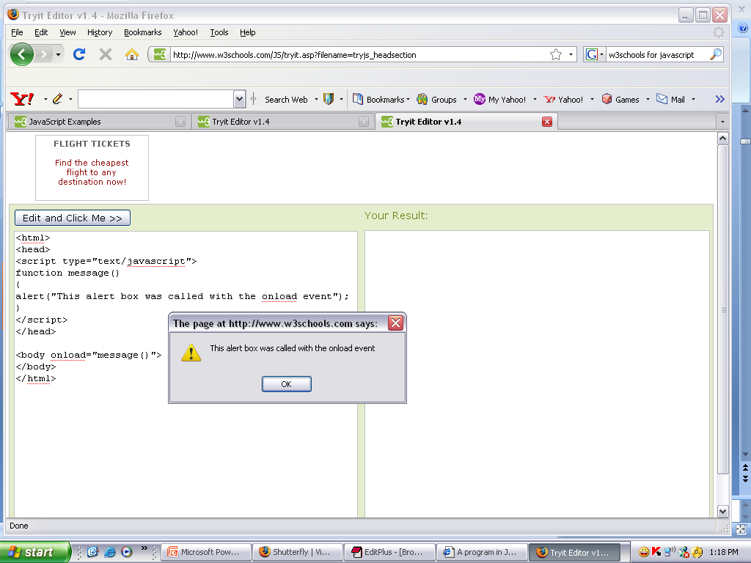
Example: Script in <body> and <head> sections

Slide 8
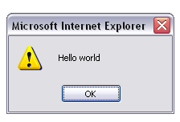
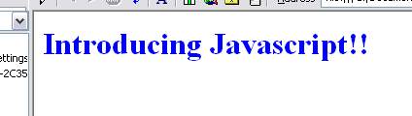
Example 4
<HTML>
<HEAD>
<TITLE> A program in Javascript </TITLE>
<SCRIPT LANGUAGE="Javascript">
alert("Hello world");
</SCRIPT>
</HEAD>
<BODY>
<H1 style='COLOR:blue'>Introducing Javascript!!</H1>
</BODY>
</HTML>

Slide 9
JavaScript has
Variables
Values
Literals
Expressions
Operators types

Slide 10
1. Variables
Use Symbolic names for values.
Declaring Variables
  Two ways
    E.g: x = 42
    E.g: var x = 42
    E.g: var number1,number2;
Naming Variables
  Must start with a letter or underscore(“_”)
  case-sensitive
Variable Scope
Local Variable
Global Variable

Slide 11
2. Values
Numbers
Logical values :true/false
Strings such as “Whats up”
Null (Special Keyword)
Undefined

Slide 12
3. Literals
Used to represent values in Javascript
Types of Literals
  Array literals
  Boolean literals
  Floating-point literals
  Integers literals
  Object literals
  String literals

Slide 13
4. Expressions
Expression
  Valid set of literals, variables and expressions that evaluates to a single value.

Slide 14
5. Operators - Types of operators
  Assignment
  Comparison
  Arithmetic
  Bitwise
  Logical
  String
  Special

Slide 15
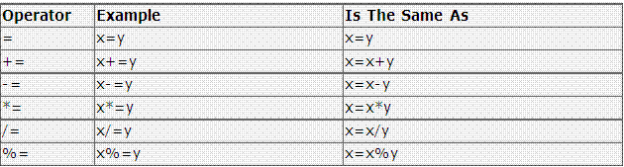
5.A Assignment Operators

Slide 16
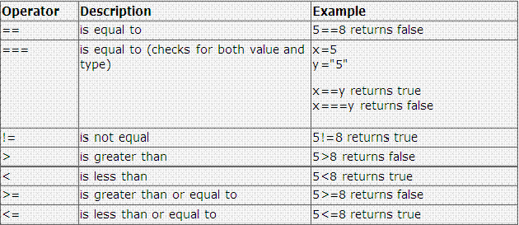
5.B Comparison Operators

Slide 17
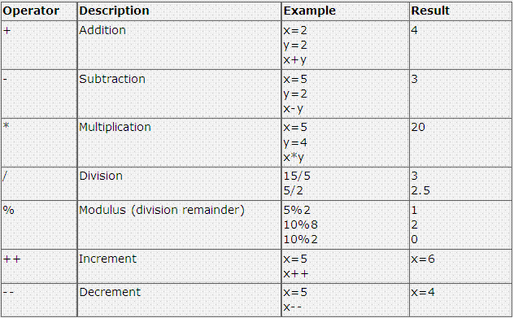
5.C Arithmetic Operators

Slide 18
5.D Bitwise Operators
Operator | Usage
Bitwise AND | a&b
Bitwise OR | a|b
Bitwise XOR | a^b
Bitwise NOT | ~a

Slide 19
5.E Logical Operators
Operator | Usage
&& | expr1 && expr2
|| | expr1 || expr2
! | ! expr1

Slide 20
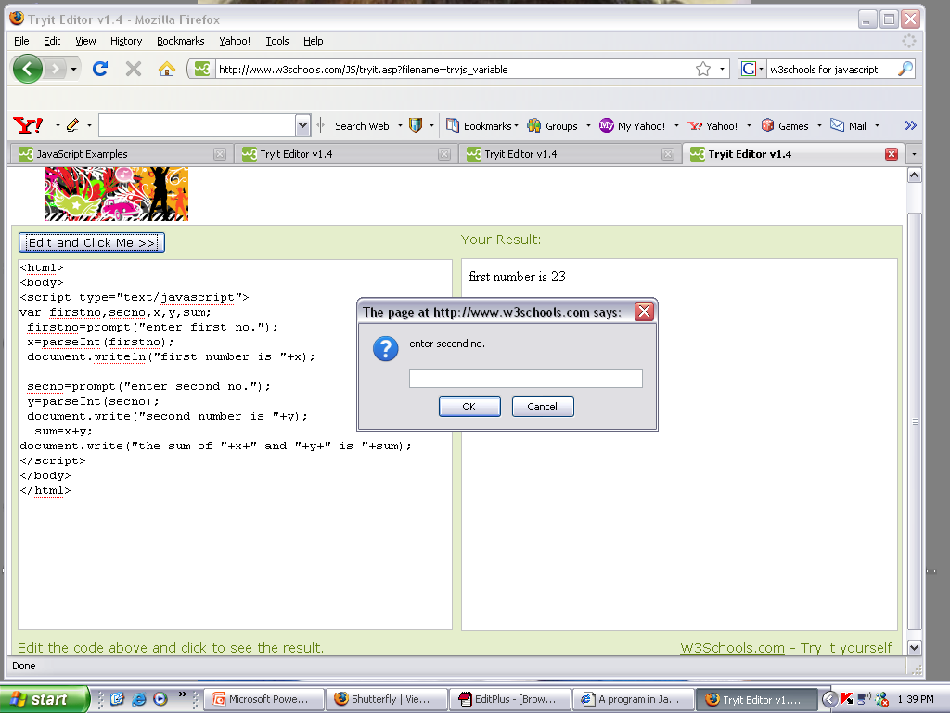
Example

Slide 21
5.F String Operators
Concatenation Operator (+)
For e.g:
  txt1="What a very"
  txt2=“ nice day!"
  txt3=txt1+txt2
  The variable txt3 now contains "What a very nice day!".

Slide 22
5.G Special Operators
conditional
comma
delete
new
this
typeof
void

Slide 23
Operator precedence table
Operator Type | Individual Operators
Comma | ,
Assignment | = += -= *= /= %= <<= >>= &= ^= |=
Conditional | ?:
Logical-operators | || &&
Bitwise-operators | | ^ &
Equality | == !=
Bitwise shift | << >> >>>
Addition / Subtraction | + -
Multiply / Divide | * / %
Negation / Increment | ! ~ - + ++ -- typeof void delete
Call | ()
Create Instance | new
Member | . []

Slide 24
Pop-up Boxes
Alert Box
  e.g.: alert(“hello!!”)
Confirm Box
  e.g.: confirm(“sometext”)
Prompt Box
  e.g: prompt(“sometext”,”defaultvalue”)

Slide 25
Statements
Three types of statements
  Conditional statements
    E.g.: if….else and switch
  Loop statements
    E.g.: for , while , do while,
    Terms used in looping: label, break and continue
  Object Manipulation Statements
    E.g.: for …..in and with

Slide 26
Working with Objects
Object is an entity, having state, behavior and identity.
State of an object represents what is its current state.
Behavior indicates what actions can be performed with that object.
Identity gives unique identification for the object.

Slide 27
Predefined Objects
Math String Date Array Boolean Number

Slide 28
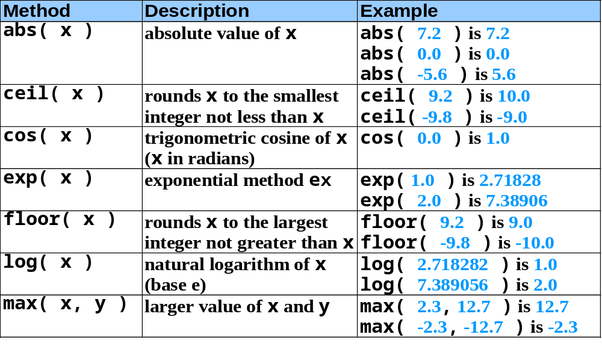
Math Object methods

Slide 29
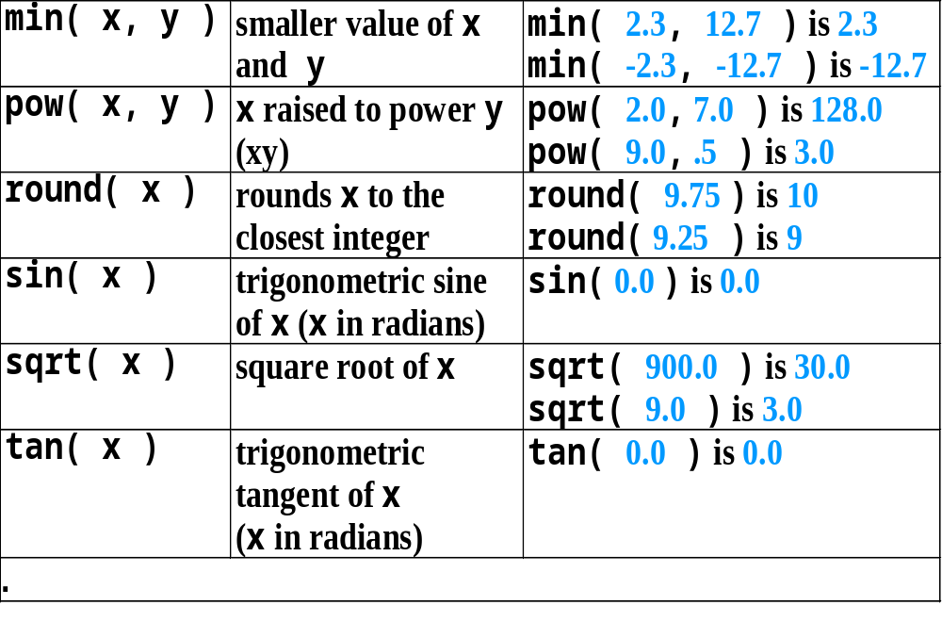
Math Object methods( contd.)

Slide 30
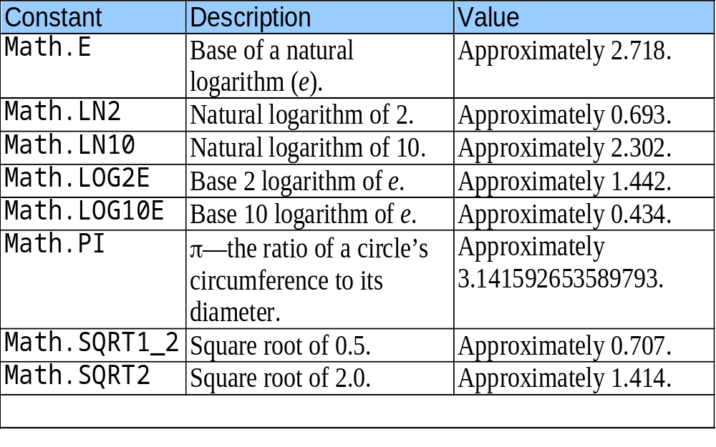
Math Object properties

Slide 31
String Object
Appropriate for processing names, addresses, credit card information, etc.
There are two ways to create String object.
  i) s=“welcome”;
  OR
  ii) s =new String(“welcome”);

Slide 32
Fundamentals of Characters and Strings
Characters
  Fundamental building blocks of JavaScript programs
String
  Series of characters treated as a single unit

Slide 33
Methods of the String Object
Method | Description
charAt() | Returns the character at the specified index (position)
charCodeAt() | Returns the Unicode of the character at the specified index
concat() | Joins two or more strings, and returns a new joined strings
endsWith() | Checks whether a string ends with specified string/characters
fromCharCode() | Converts Unicode values to characters
includes() | Checks whether a string contains the specified string/characters
indexOf() | Returns the position of the first found occurrence of a specified value in a string
lastIndexOf() | Returns the position of the last found occurrence of a specified value in a string
localeCompare() | Compares two strings in the current locale
match() | Searches a string for a match against a regular expression, and returns the matches

Slide 34
Methods of the String Object (Contd..)
Method | Description
repeat() | Returns a new string with a specified number of copies of an existing string
replace() | Searches a string for a specified value, or a regular expression, and returns a new string where the specified values are replaced
search() | Searches a string for a specified value, or regular expression, and returns the position of the match
slice() | Extracts a part of a string and returns a new string
split() | Splits a string into an array of substrings
startsWith() | Checks whether a string begins with specified characters
substr() | Extracts the characters from a string, beginning at a specified start position, and through the specified number of character
substring() | Extracts the characters from a string, between two specified indices

Slide 35
Methods of the String Object (Contd..)
Method | Description
toLocaleLowerCase() | Converts a string to lowercase letters, according to the host's locale
toLocaleUpperCase() | Converts a string to uppercase letters, according to the host's locale
toLowerCase() | Converts a string to lowercase letters
toString() | Returns the value of a String object
toUpperCase() | Converts a string to uppercase letters
trim() | Removes whitespace from both ends of a string
valueOf() | Returns the primitive value of a String object

Slide 36
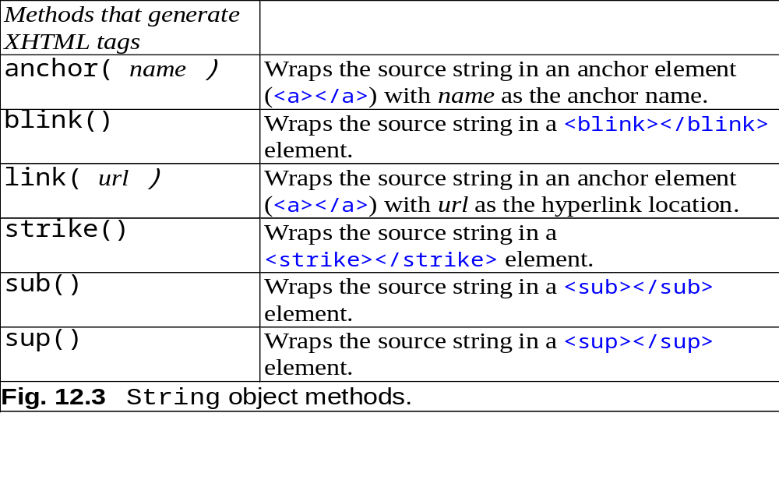
Methods of the String Object (contd.)

Slide 37
Properties of String Object
Name | Description
length | It gives the number of characters in the string.

Slide 38
Date Object
Provides methods for date and time manipulations.
There are two separate notions of time:
  i) UTC :- Universal time, also known as Greenwich Mean Time.
  ii) Local :- Local time is the time on the machine which is executing the script.

Slide 39
Creating Date object
There are different ways to create date object.
i) d=new Date()
ii) d=new Date(year,month,day[,hour,minute,second)
iii) d=new Date(milliseconds );
construct a new date object based upon the number of milliseconds elapsed since 00:00:00 hours on 01/01/1970.
iv) d=new Date(string )
ex:- d=new Date(“April 9, 1988 14:02.35”);

Slide 40
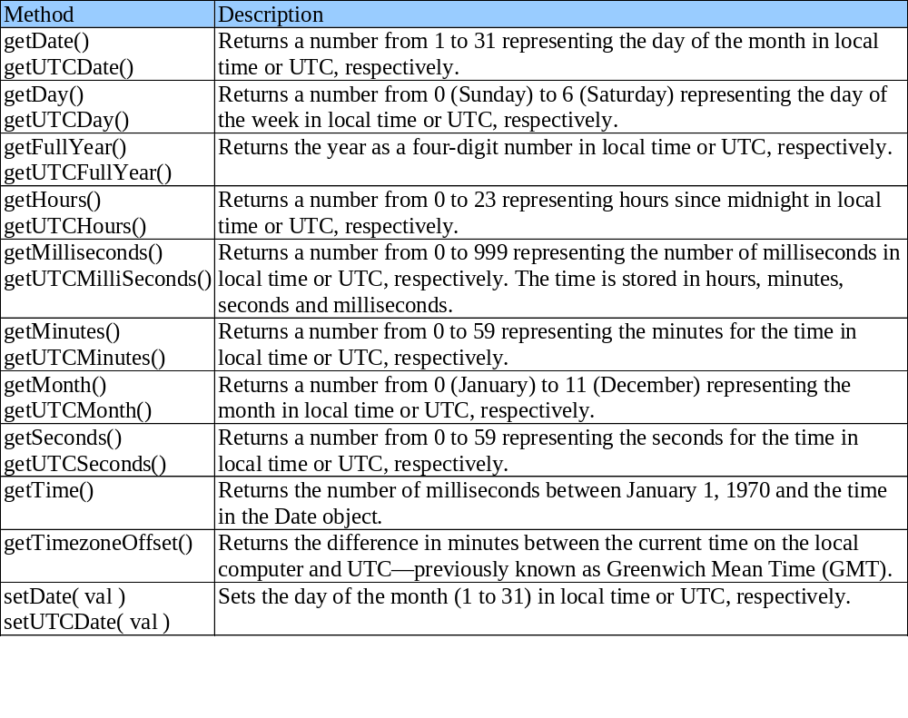
Date Object

Slide 41
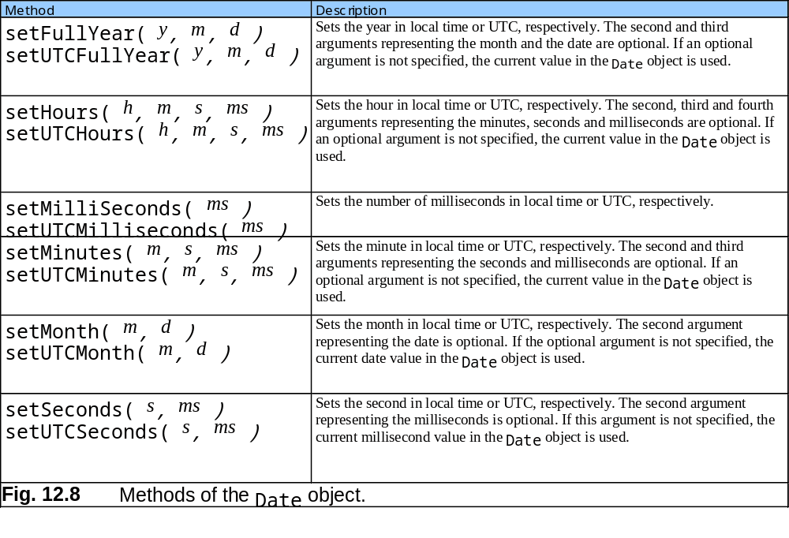
Date Object

Slide 42
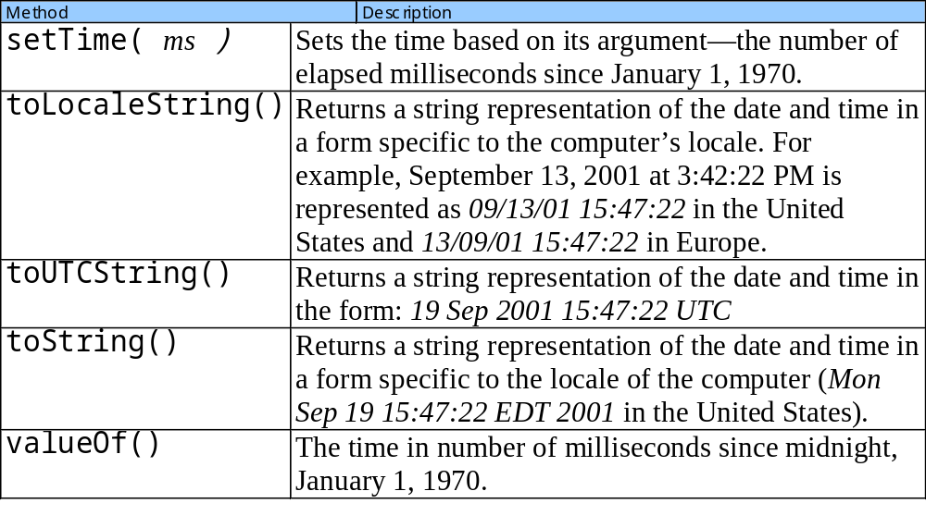
Date Object

Slide 43
Arrays
  Data structures of related items
    Also called Collections
  Dynamic
  Each element referenced by a number
    Start at “zeroth element”
    Subscript or index
  Accessing a specific element
    Name of array
    Brackets
    Number of element
  Arrays know their length
    length property

Slide 44
Arrays
Name of array
c[ 0 ]
-45
c[ 1 ]
6
c[ 2 ]
0
c[ 3 ]
72
c[ 4 ]
1543
c[ 5 ]
-89
c[ 6 ]
0
c[ 7 ]
62
c[ 8 ]
-3
c[ 9 ]
1
Position number (index
or subscript) of the
c[ 10 ]
6453
c
element within array
c[ 11 ]
78
Fig. 11.1 A 12-element array.

Slide 45
Declaring and Allocating Arrays
Arrays in memory
  Objects
  Operator new
    Allocates memory for objects
    Dynamic memory allocation operator
    var c;
    c = new Array( 12 );

Slide 46
Examples Using Arrays
Arrays grow dynamically
  Allocate more space as items are added
Must initialize array elements
  Default value is undefined

Slide 47
Examples Using Arrays
Possible to declare and initialize in one step
  Specify list of values
    Initializer list
  var n = [ 10, 20, 30, 40, 50 ];
  var n = new Array( 10, 20, 30, 40, 50 );
  Also possible to only initialize some values
    Leave uninitialized elements blank
    Uninitialized elements default to “undefined”
  var n = [ 10, 20, , 40, 50 ];

Slide 48
Examples Using Arrays
for…in statement
  Perform an action for each element in an array
  Iterates over array elements
  Ignores non-existent elements

Slide 49
Multidimensional Arrays
Two-dimensional arrays
  Rows and columns
    Specify row first, then column
  Two subscripts
Column 0
Column 1
Column 2
Column 3
Row 0
a[ 0 ][ 0 ]
a[ 0 ][ 1 ]
a[ 0 ][ 2 ]
a[ 0 ][ 3 ]
Row 1
a[ 1 ][ 0 ]
a[ 1 ][ 1 ]
a[ 1 ][ 2 ]
a[ 1 ][ 3 ]
Row 2
a[ 2 ][ 0 ]
a[ 2 ][ 1 ]
a[ 2 ][ 2 ]
a[ 2 ][ 3 ]
Column subscript (or index)
Row subscript (or index)
Array name
Fig. 11.12 Two-dimensional array with three rows and four columns.

Slide 50
Multidimensional Arrays- static creation
Declaring and initializing multidimensional arrays
  Group by row in square brackets
  Treated as arrays of arrays
  Creating array b with one row of two elements and a second row of three elements:
  var b = [ [ 1, 2 ], [ 3, 4, 5 ] ];

Slide 51
Multidimensional Arrays (contd..)
Also possible to use new operator
  Create array b with two rows, first with five columns and second with three:
var b;
b = new Array(2);
b[ 0 ] = new Array(5);
b[ 1 ] = new Array(3);

Slide 52
Methods of Array Object
reverse()
- It reverses the order of the elements.
join(string)
- Creates string containing all array elements.
  Specify separator
slice(start,end)
- It returns a sub-array.( excluding end argument char)
4. sort()
  Defaults to string comparison
  To sort numbers comparison function will be passed as an argument.
  This comparison function will exchange its arguments in the array if it returns positive value.

Slide 53
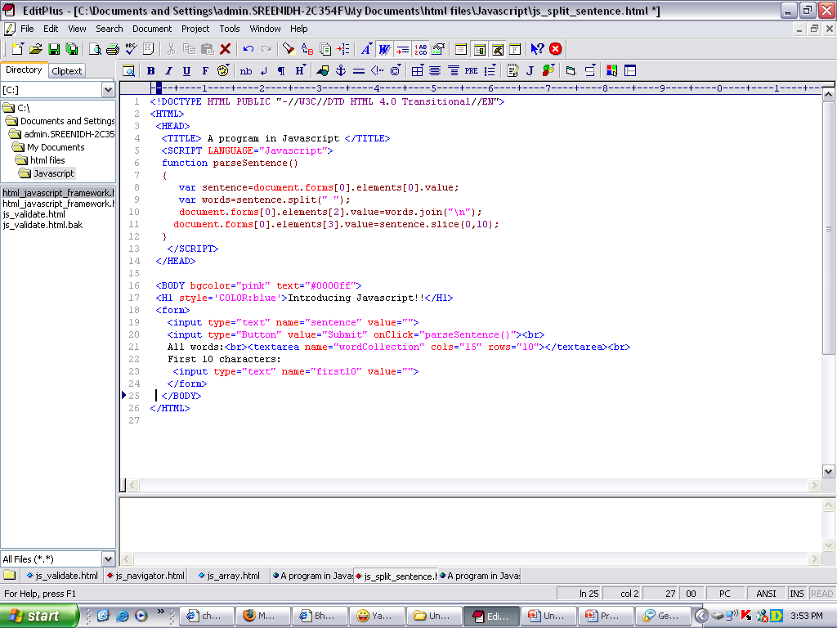
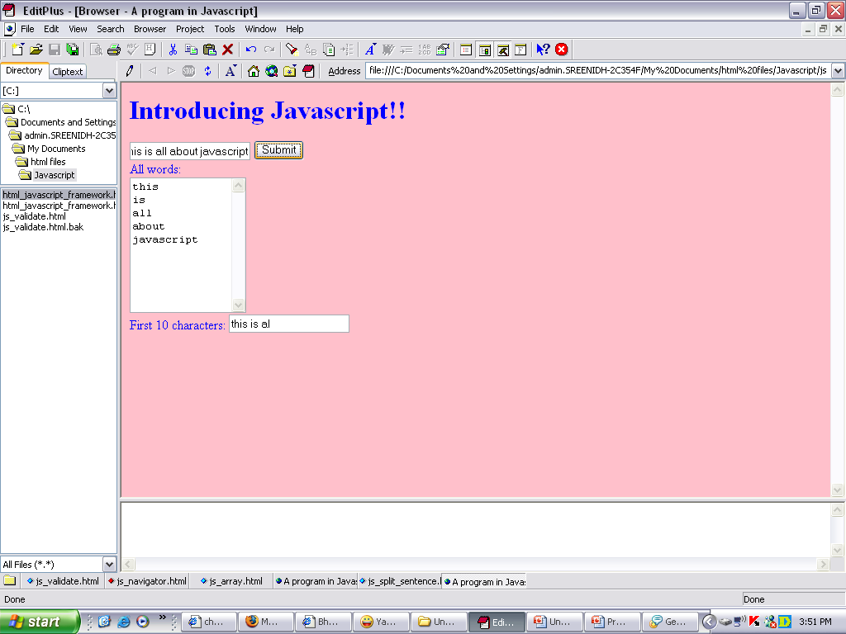
Example for Arrays and methods

