Slide 1
Unit III:
XML
eXtensible Markup Language

Slide 2
XML
XML is based on SGML: Standard Generalized Markup Language
HTML and XML are both based on SGML
In fact, XML is interoperable with HTML and SGML
SGML
HTML
XML

Slide 3
Diff b/w HTML & XML
HTML | XML
designed to display data, displaying information. focus on how data looks. | describe data store data Carry data exchange data

Slide 4
1. It describes the data
In HTML, the markup <b>415-555-1234</b> is quite meaningless.
  what is this number?
Is it a product number, a phone number, or an employee number?
Markup like
<phone_number>415-555-1234<phone_number>
is much more helpful. This is exactly what XML was designed for.

Slide 5
2. It can store the data
XML can also be used to store data in files or in databases.
Applications can be written to store and retrieve information from the store, and
generic applications can be used to display the data.

Slide 6
3. It can be used to exchange data
With XML, data can be exchanged between incompatible systems.
  In the real world, computer systems and databases contain data in incompatible formats.
    Challenges for developers has been to exchange data between such systems over the Internet.
  Solution: Convert the data to XML
    This can greatly reduce this complexity and
    Can be read by many different types of applications.

Slide 7

Goal: Strengthen Partnership by exchanging the data
Partner 1
Partner 2
DTD
information
information
XML
XML

Slide 8
4. It can carry the data
Other clients and applications can access your XML files as data sources, like they are accessing databases.

Slide 9
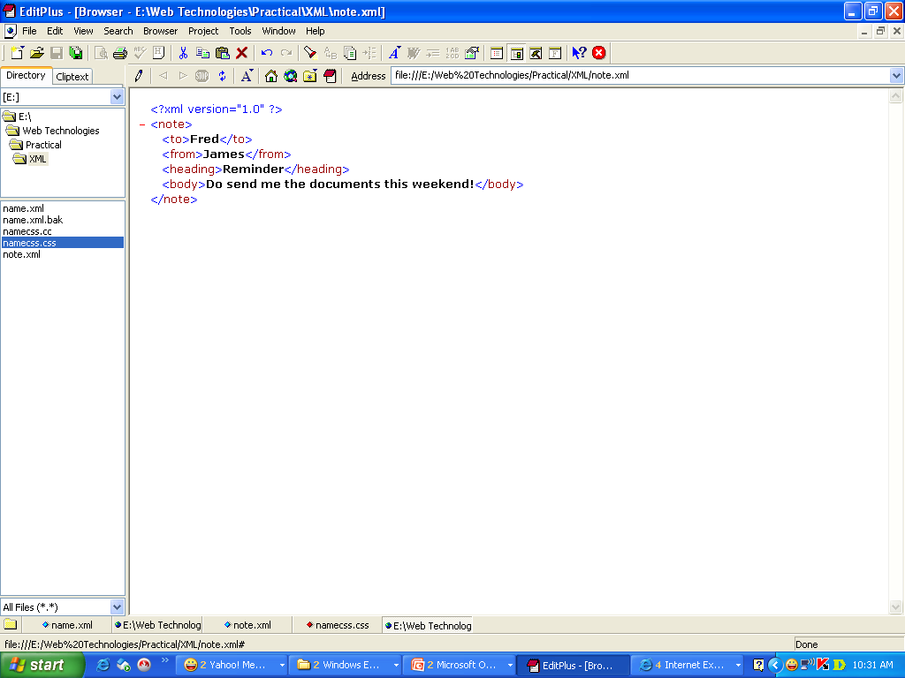
XML Example
<?xml version="1.0" encoding="ISO-8859-1"?>
  <note>
    <to>Fred</to>
    <from>James</from>
    <heading>Reminder</heading>
    <body>Do send me the documents this weekend!</body>
  </note>
Output →

Slide 10
XML Building Blocks
1. XML Elements
2. Control Information
3. Entities
Conditions
a. Processing Instructions
Internal
a. Attributes
Prolog
b. Document Type Definition (DTD)
External
b. Element Naming
Internal DTD
External DTD
Elements
c. Comments

Slide 11
1. Elements
Delimited by angle brackets
    General format: <element> … </element>
    Empty element: <empty-Element/>
        Ex. <ingredient/>

Slide 12
Conditions for using Elements
Condition | Example
1. All XML elements must have a closing tag it is illegal to omit the closing tag. | <p>This is a paragraph (valid in HTML) <p>This is a paragraph</p> (in XML)
2. XML tags are case sensitive Opening and closing tags must therefore be written with the same case: | With XML, the tag <Letter> is different from the tag <letter>. <Message>This is incorrect</message> <message>This is correct</message>
3. All XML elements must be properly nested Improper nesting of tags makes no sense to XML. | <b><i>This text is bold and italic</i></b>
4. All XML documents must have a root tag The first tag in an XML document is the root tag. All elements can have sub elements (children). | All other elements must be nested within the root element. <root> <child> <subchild>.....</subchild> </child> </root>

Slide 13
Condition | Example
5. XML Elements are extensible and they have relationships. XML documents can be extended to carry more information. | <note> <date>1999-08-01</date> <to>Tove</to> <from>Jani</from> <heading>Reminder</heading>
6. XML Elements have simple naming rules. Elements are related as parents and children. | Book Title: My First XML Chapter 1: Introduction to XML What is HTML What is XML <book> <title>My First XML</title> <chapter_no>Chapter 1</chapter_no> <chapter>Introduction to XML <para>What is HTML</para> <para>What is XML</para> </chapter> </book>

Slide 14
1.A Element Attributes
Name-value pairs that occur inside start-tags after element name, like: <element attribute=“value”>
Element Attributes conditions:
1. Attribute values must always be quoted With XML, it is illegal to omit quotation marks around attribute values. | <?xml version="1.0"?> <note date="12/11/99"> <to>Tove</to> <from>James</from> <heading>Reminder</heading> <body>Mail me this weekend!</body> </note> This is correct: date="12/11/99". This is incorrect: date=12/11/99.

Slide 15
1.b. Element Naming
XML elements must follow these naming rules:
  Names can contain letters, numbers, and other characters
  Names must not start with a number or other punctuation characters
  Names must not start with the letters xml (or XML or Xml ..)
  Names cannot contain spaces

Slide 16
2. Control Information
2. Control Information
Prolog: The part of an XML document
    that precedes the XML data
Includes
a. Processing Instructions :
XML declaration for version [, encoding, standalone]
b. Document Type declaration i.e DTD ( optional )
a. Processing Instructions
Prolog
b. Document Type Definition (DTD)
c. Comments
Example
<?xml version="1.0" encoding="ISO-8859-1"?> <!--comment-->
<!DOCTYPE note SYSTEM “InternalNote.dtd“>

Slide 17
2. a Processing Instructions:
XML Declaration for version
version :- Tells the XML parser which version to use .
  XML parser: program responsible for processing XML document.
encoding :- Defines the character encoding used in the document.
  ASCII :- 7 bits character set -128 characters.
  ISO-8859-1:- 8 bits character set – 256 characters
  ( ASCII + Western European letters and symbols ).

Slide 18

Standalone :- tells the XML processor whether they are any other files to load.
Syntax :-
<?xml name1=value1 name2=value2 name3=value3?>
Examples

Slide 19
Types of XML Documents
XML document
  Well Formed XML.
    Syntax is correct
  Valid XML.
    Well formed
    Validated against a DTD/Schema

Slide 20
2.B Document Type Definition ( DTD)
DTD defines the grammatical rules for the document.
DTD either held in a separate file so that it can be used by many documents, or placed in the same file.
  Ex. <!DOCTYPE Recipes SYSTEM “recipe.dtd”>
Here various parameters will be specified
  DTD declaration ( internal / external ).
  Name of the root element.
  System/Public
  url of DTD
  Entity declaration.
Syntax:- ( External DTD )
<!DOCTYPE root-element SYSTEM/PUBLIC url-of-dtd >

Slide 21
Contents of ( DTD)
Defines structure of the documents
  Allowable tags and their attributes
  Tag nesting order
  Number of occurrence of tags
  Constraints on attribute values
  Entity definitions

Slide 22
Ex:- ( External DTD )
<!DOCTYPE authorslist SYSTEM “authors.dtd”>
SYSTEM – DTDs defined by individuals and organizations.
PUBLIC – DTDs defined by International Organizations like W3C (standards)
some DTDs are available as international standards, such as those recommendations of W3C which relate to HTML.
Other DTDs are developed by individuals and organizations for their own use.

Slide 23
Internal DTD
Ex:- ( Internal DTD )
<!DOCTYPE authorslist
[
DTD definition
entity-definitions
]
>

Slide 24
<?xml version=“1.0” encoding=“US-ASCII” standalone=“no” ?>
<!DOCTYPE authorslist SYSTEM “authors.dtd” >
<authorslist>
  <name>
  <firstname>chris</firstname>
  <lastname>bates</lastname>
  <book>web programming</book>
  <year>1999</year>
  </name>
  <name>
  <firstname>subramanyam</firstname>
  <lastname>allamaraju</lastname>
  <book>java server programming</book>
  <year>2000</year>
  </name>
  </authorslist>

Slide 25
authors.dtd file
<!ELEMENT authorslist (name+)>
  <!ELEMENT name(firstname, lastname, book, year)>
    <!ELEMENT firstname(#PCDATA)>
    <!ELEMENT lastname(#PCDATA)>
    <!ELEMENT book(#PCDATA)>
    <!ELEMENT year(#PCDATA)>

Slide 26
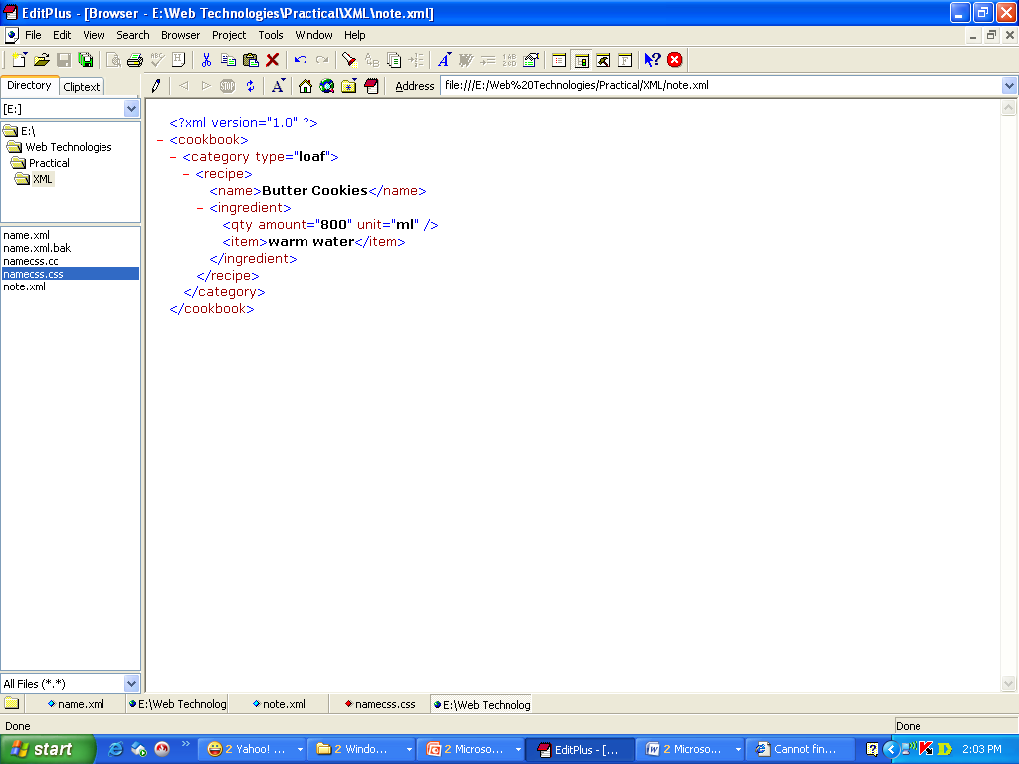
Operators used for element names
+: one/more occurrences
*: any number of occurrences
?: 0/1 occurrence
#PCDATA: parsed character data, may contain XML markup
CDATA : plain text character data, not passed thru’ parser engine
EX. Partial dtd for cookbook
<!ELEMENT ingredient(qty, item)> <!ELEMENT qty ( EMPTY)>
<!ATTLIST qty
    amount CDATA #REQUIRED
    unit CDATA “ml”>
  <!ELEMENT item (#PCDATA)>

Slide 27
Why Use a DTD?
Each of our XML files can carry a description of its own format.
Independent groups of people can agree to use a standard DTD for interchanging data.
Application can use a standard DTD to verify that the data we receive from the outside world is valid.
We can also use a DTD to verify our own data.

Slide 28
An XML Example
We will define a person like this:
  A person is required to be either male or female
  A person has a name which consists of:
  A first name
  A last name
  One (optional) nickname
  A person has an occupation

Slide 29
Representating in Xml
<person gender=“male” >
<name>
<first>Charles</first>
<last>Myers</last>
<nickname>C.R.</nickname>
</name>
<occupation> college professor </occupation>
</person>

Slide 30
An Inline DTD example:
<?xml version="1.0"?>
<!DOCTYPE person [
<!ELEMENT person (name, occupation) >
<!ELEMENT name (first, last, nickname?)>
<!ELEMENT first (#PCDATA)>
<!ELEMENT last (#PCDATA)>
<!ELEMENT nickname (#PCDATA)>
<!ELEMENT occupation (#PCDATA)>
<!ATTLIST person gender (male | female) #REQUIRED>
] >
<person gender=“male”>
<name>
<first>Charles</first>
<last>Myers</last>
<nickname>C.R.</nickname>
</name>
<occupation>college professor</occupation>
</person>

Slide 31
An External DTD example:
<?xml version="1.0"?>
<!DOCTYPE person SYSTEM “persons.dtd">
<person gender=“male”>
<name>
<first>Charles</first>
<last>Myers</last>
<nickname>C.R.</nickname>
</name>
<occupation>college professor</occupation>
</person>

Slide 32
persons.dtd
<!ELEMENT person (name, occupation)>
<!ELEMENT name (first, last, nickname?)>
<!ELEMENT first (#PCDATA)>
<!ELEMENT last (#PCDATA)>
<!ELEMENT nickname (#PCDATA)>
<!ELEMENT occupation (#PCDATA)>
<!ATTLIST person gender (male | female) #REQUIRED>

Slide 33
Element declarations
Syntax :-
<!ELEMENT name content-model >
content – model :–Represents what kind of content can be used inside that element.

Slide 34
Content Models of the elements
  <!ELEMENT a EMPTY>
  <!ELEMENT b ANY>
  <!ELEMENT either (one | theother)>
  <!ELEMENT ordered (first, second)>
  <!ELEMENT list (item+)>
  <!ELEMENT dl ((dt?, dd?)*)>
  <!ELEMENT text (#PCDATA)>
  <!ELEMENT mixed (#PCDATA | b | i | em)>

Slide 35
Declaring Elements
Occurrence Indicators
Term | Meaning | Example
, | Sequence Operators | a, b, c
| | Choice operators | a | b | c
+ | One or more | a+
* | Zero or more | a*
? | Single optional | a?
() | grouping | (a)

Slide 36
Declaring Attributes
General Syntax
<!ATTLIST elementName
attributeName1 attributeType defaultType1
attributeName2 attributeType defaultType2 >
Example
<!ATTLIST HDD speed CDATA “7200”>
<!ATTLIST HDD unit CDATA #IMPLIED>
<!ATTLIST price currency CDATA “INR”>
<!ATTLIST question number ID #REQUIRED>
<HDD speed=“6000”> … </HDD>
<price currency=“USD”>10</price>
<question number=“1”> … </question>

Slide 37
Declaring Attributes
The attribute-type can be one of the following:
Type | Description | Category
CDATA | The value is character data | String type
(en1|en2|..) | The value must be one from an enumerated list | Enumerated Type
ID | The value is a unique id | Tokenized Types
IDREF | The value is the id of another element
IDREFS | The value is a list of other ids separated by whitespace
NMTOKEN | The value is a valid XML name(no space, digits or special symbols)
NMTOKENS | The value is a list of valid XML names
ENTITY | The value is an entity | Entities
ENTITIES | The value is a list of entities
NOTATION | The value is a name of a notation | tool to execute non-character files
xml: | The value is a predefined xml value

Slide 38
Declaring Attributes
The default value can be one of the following:
Value | Explanation
value | The default value of the attribute
#REQUIRED | The attribute is required
#IMPLIED | The attribute is not required
#FIXED value | The attribute value is fixed
© Oxford University Press 2013

Slide 39
Inline DTD for Newspaper
<!DOCTYPE NEWSPAPER [
<!ELEMENT NEWSPAPER (ARTICLE+)>
<!ELEMENT ARTICLE (HEADLINE,BYLINE,LEAD,BODY,NOTES)>
<!ELEMENT HEADLINE (#PCDATA)>
<!ELEMENT BYLINE (#PCDATA)>
<!ELEMENT LEAD (#PCDATA)>
<!ELEMENT BODY (#PCDATA)>
<!ELEMENT NOTES (#PCDATA)>
<!ATTLIST ARTICLE AUTHOR CDATA #REQUIRED>
<!ATTLIST ARTICLE EDITOR CDATA #IMPLIED>
<!ATTLIST ARTICLE DATE CDATA #IMPLIED>
<!ATTLIST ARTICLE EDITION CDATA #IMPLIED>
]>

Slide 40

CDATA
  Any string of non-markup characters is legal
  markup characters ( < > ” ’ & ) will not be allowed.
  Content won’t be interpreted as markup
  Ex:-

Slide 41
String type: Enumeration
Enumerated value list
  An enumerated list of values that the attribute value must match.
  Ex:-
  <!ATTLIST schedule
  day ( mon | tue | wed | thu | fri | sat | sun ) “sun” >

Slide 42
Tokenized Types
ID : Used to establish a unique identifier for an element.
  Ex:- <!ATTLIST book myID ID #REQUIRED>
IDREF: Used to refer to the ID of another element.
  Ex:- <!ATTLIST title ref IDREF #IMPLIED>
IDREFS: the value is a list of other ids
  Ex:- <!ATTLIST title refs IDREFS #IMPLIED>

Slide 43
<tokenExamples>
<student rollno="A1" teacher="T101 T102">
<fname>Akshay</fname>
<lname>A</lname>
</student>
<student rollno="A2" teacher="T103">
<fname>Bobby</fname>
<lname>B</lname>
</student>
<staff staffcode="T101">
<name>Om Shekhar</name>
<subject>OOPS through Java</subject>
</staff>
<staff staffcode="T102">
<name>Dhanraj</name>
<subject>DBMS</subject>
</staff>
<staff staffcode="T103">
<name>Chetan</name>
<subject>Computer Networks</subject>
</staff>
</tokenExamples>
Example: ID,IDREFS, (IDREF)
<?xml version="1.0" ?>
<!DOCTYPE tokenExamples [
<!ELEMENT tokenExamples (student+, staff+)>
<!ELEMENT student (fname,lname)>
<!ELEMENT fname (#PCDATA)>
<!ELEMENT lname (#PCDATA)>
<!ELEMENT staff (name,subject)>
<!ELEMENT name (#PCDATA)>
<!ELEMENT subject (#PCDATA)>
<!ATTLIST student rollno ID #REQUIRED>
<!ATTLIST student teacher IDREFS #REQUIRED>
<!ATTLIST staff staffcode ID #REQUIRED>
] >
Click for Online Validation:
https://www.truugo.com/xml_validator/

Slide 44
3. Document Entities
(used as replacement text)
Entities are variables used to define shortcuts to standard text or special characters.
Types:
Entity references are references to entities
Entities can be declared internal or external
Syntax:
  General entity references start with & and end with ;
  The entity reference is replaced by its true value when parsed.
  The characters < > & “ ‘ require entity references to avoid conflicts with the XML application ( parser )

Slide 45
Types of Entity
Internal Entity
    Included in XML file
    Used to create small pieces of data;
    This can be used repeatedly through the schema.
    Ex: <!ENTITY POS “pinch of salt”>
    Instruction: <item> Finally add the &POS;</item>
2. External Entity
    Included in the different file and referred in the xml file.
    Ex: <!ENTITY myimage SYSTEM “winter.jpg” NDATA JPEG>
    NDATA: notation for the type of data.

Slide 46
Declaring Entities
General Syntax
<!ENTITY entityName “entityValue”>
Example
<!ENTITY euro “&#x20AC;”> //€
<!ENTITY language “XML”>
<!ENTITY W3C “World Wide Web Consortium”>
<!ENTITY copyright “&#x00A9;”> //©
<!ENTITY USD SYSTEM “currency.dtd”>
<tutorial>
&language; is standardized by &W3C;
&copyright; UKR
</tutorial>

Slide 47
Example for ENTITY and NOTATION
<?xml version = "1.0" encoding="UTF-8" standalone = "yes"?>
<!DOCTYPE document [
  <!ELEMENT document ANY>
  <!ELEMENT movie EMPTY>
  <!ATTLIST movie source ENTITY #REQUIRED>
  <!ENTITY BladeRunner SYSTEM "dvds/BR/br.mov">
  <!ATTLIST movie player NOTATION #REQUIRED>
  <!NOTATION mp SYSTEM "movPlayer.exe">
]>
<document>
<movie source = "&BladeRunner;" player = "mp"/>
</document>

Slide 48
Namespaces
The flexibility that XML brings can also be the cause for conflicts when combining documents.
Ex:
one document may use element named record to store data about vehicle registration, another may use record to represent employee details.
Namespace: Way of keeping the names used by applications separate from each other.

Slide 49
Embedding xml in html (2 ways)
Or a separate XML file can be embedded like this:
<xml id="note" src="note.xml">
</xml>
<html><body>
<xml id="note">
<note>
<to>Tove</to>
<from>Jani</from>
<heading>Reminder</heading>
<body>Submit Assignment</body>
</note>
</xml>
</html><body>
2
<xml> is an html element and not xml tag
1

Slide 50
Name Conflicts
In XML, element names are defined by the developer. This often results in a conflict when trying to mix XML documents from different XML applications.
This XML carries HTML table information:
<table>
<tr>
<td>Apples</td>
<td>Bananas</td>
</tr>
</table>
2. This XML carries information about a table (a piece of furniture):
<table>
<name>African Coffee Table</name>
<width>80</width>
<length>120</length>
</table>
Both contain a <table> element, but the elements have different content and meaning.

Slide 51
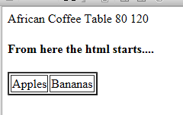
<html>
<body>
<xml Id = “msg”>
<table>
<title> An XML table (physical)</title>
<name> African Coffee Table </name>
<width> 80 </width>
<length> 120 </length>
</table>
</xml>
<h4>From here the html starts....</h4>
<table border="2">
<tbody>
<tr>
<td>Apples</td>
<td>Bananas</td>
</tr>
</tbody>
</table>
</body>
</html>
Example showing name conflicts.
What is the error in the o/p?

Slide 52

Solving the Name Conflict Using a Prefix
Name conflicts in XML can easily be avoided using a name prefix.
1. This XML carries information about an HTML table, and a piece of furniture:
<html><body>
<xml id = “msg”>
<p:table>
<p:title> An XML table (physical)</p:title>
<p:name> African Coffee Table </p:name>
<p:width> 80 </p:width>
<p:length> 120 </p:length>
</p:table>
</xml>
<h4>From here the html starts....</h4>
<table border="2">
<tbody> <tr>
<td>Apples</td>
<td>Bananas</td>
</tr></tbody>
</table></body></html>
In this example, there will be no conflict because the two <table> elements have different names.

Slide 53
XML Namespace
Its a collection of names, identified by a URI , used in XML document as element names and attribute names.
  Steps to create a namespace
  To begin using a namespace, declare it publicly.
  The namespace declaration occurs with an element .
  <prefix:element xmlns:prefix="URI“>
  Namespace is defined by the xmlns attribute in element start tag
  3. It can be applied to just a single element, or to an entire document by placing the declaration within a document’s root element.
  <root xmlns:h="http://www.w3.org/TR/html4/"
  xmlns:f="http://www.w3schools.com/furniture">

Slide 54
<root>
<h:table xmlns:h="http://www.w3.org/TR/html4/">
<h:tr>
<h:td>Apples</h:td>
<h:td>Bananas</h:td>
</h:tr>
</h:table>
<f:table xmlns:f="http://www.w3schools.com/furniture">
<f:name>African Coffee Table</f:name>
<f:width>80</f:width>
<f:length>120</f:length>
</f:table>
</root>
In the example above, the xmlns attribute in the <table> tag give the h: and f: prefixes a qualified namespace.
When a namespace is defined for an element, all child elements with the same prefix are associated with the same namespace.

Slide 55
Namespaces can be declared in the elements where they are used or in the XML root element:
<root
xmlns:h="http://www.w3.org/TR/html4/"
xmlns:f="http://www.w3schools.com/furniture">
<h:table>
<h:tr>
<h:td>Apples</h:td>
<h:td>Bananas</h:td>
</h:tr>
</h:table>
<f:table>
<f:name>African Coffee Table</f:name>
<f:width>80</f:width>
<f:length>120</f:length>
</f:table>
</root>

Slide 56
Example of a document combining two namespaces , myns and eq
<?xml version=“1.0”?>
<myns: journal xmlns:myns= “http://www.psycholabs.org/mynamespace/”>
<myns:experiment>
<myns:date>March 4,2001</myns:date>
<myns:abstract>xxxxxxxxxx</myns:abstract>
<eq:formula xmlns:eq= “http://www.mathsstuff.org/”>
<eq:valiable>p</eq:variable>
<eq:valiable>m</eq:variable>
<eq:valiable>M</eq:variable>
</eq:formula>
</myns:experiment>
</myns:journal>

Slide 57
XML Validation
"Well Formed" XML document
--correct XML syntax
"Valid" XML document
  “well formed”
  Conforms to the rules of a DTD (Document Type Definition)
XML DTD
  defines the legal building blocks of an XML document
  Can be inline in XML or as an external reference
XML Schema
  an XML based alternative to DTD, more powerful
  Support namespace and data types

Slide 58
XML Schema
Limitations of DTD
Language :- DTDs are written in a language which is dissimilar to XML syntax. Schemas are written in XML syntax.
2. Data Constraints:- DTDs have minimal data constraints available.
Ex:- In XML DTD , an element for pin code is constrained as PCDATA
<!ELEMENT pincode #PCDATA>
(Unfortunately) Valid XML: <pincode>ABC-123345-fbx</pincode>
though it does not represent a pincode in any form.
3. fixed set of content models:-
Designers are limited to a fixed set of content models.

Slide 59
XML Schema Advatages over DTD
Its an XML-based alternative to DTD.
Schemas provide User –Defined data types allowing greater flexibility in limiting and expressing content.
Describes the structure of an XML document.
The XML Schema language is also referred to as XML Schema Definition (XSD).

Slide 60
XML Schema
An XML Schema defines:
elements that can appear in a document
attributes that can appear in a document
which elements are child elements
the order of child elements
the number of child elements
whether an element is empty or can include text
data types for elements and attributes

Slide 61
There are two element types
1. Simple
2. Complex
  A simple type is one that does not contain attributes and other elements in the content.
  Otherwise, that element is called complex type.
  Syntax - Simple type :-
  <nr :element name=“element_name” type=“nr:datatype” />
Ex:
<to> Tony </to>
<xs:element name="to" type="xs:string"/>
XML Schema has a lot of built-in data types. The most common types are:
xs:string
xs:decimal
xs:integer
xs:boolean
xs:date
xs:time

Slide 62
Complex Type (when element is nested)
<nr :element name=“element_name”>
<nr:complexType>
<nr :sequence>
  <nr:attribute name=“attribute_name” type=“nr:datatype” />
  <nr: element name ="firstname" type="nr:string"/>
  <nr: element name ="lastname" type="nr:string"/>
  </nr :sequence>
</nr:complexType>
</nr :element>
nr = namespace_reference

Slide 63
Example- A Simple XML & DTD Documents
xml file
<?xml version="1.0"?>
<note>
<to> Tony </to>
<from> Jani </from>
<heading> Reminder </heading>
<body> Don't forget me this weekend! </body>
</note>
A DTD File
<!ELEMENT note (to, from, heading, body)>
<!ELEMENT to (#PCDATA)>
<!ELEMENT from (#PCDATA)>
<!ELEMENT heading (#PCDATA)>
<!ELEMENT body (#PCDATA)>
Write the .xml an the .xsd files

Slide 64
An XML Schema (note.xsd)
<?xml version="1.0"?>
<xs:schema xmlns:xs="http://www.w3.org/2001/XMLSchema" >
<xs:element name="note">
<xs:complexType>
<xs:sequence>
<xs:element name="to" type="xs:string"/> <xs:element name="from" type="xs:string"/> <xs:element name="heading" type="xs:string"/> <xs:element name="body" type="xs:string"/> </xs:sequence>
</xs:complexType>
</xs:element>
</xs:schema>

Slide 65
note.xml
<?xml version="1.0"?>
<note
xmlns:xs="http://www.w3.org/2001/XMLSchema-instance" xs:noNamespaceSchemaLocation="file:///C:/XMLFiles/note1.xsd">
<to>Tove</to>
<from>Jani</from>
<heading>Reminder</heading>
<body>Don't forget me this weekend!</body>
</note>

Slide 66
EX-2
<?xml version="1.0"?>
<!DOCTYPE person SYSTEM “persons.dtd">
<person gender=“male”>
<name>
<first>Charles</first>
<last>Myers</last>
<nickname>C.R.</nickname>
</name>
</person>

Slide 67
An XML Schema
<?xml version="1.0"?>
<xs:schema xmlns:xs="http://www.w3.org/2001/XMLSchema" >
<xs:element name=“person">
<xs:complexType>
<xs:attribute name=“gender” type=“xs:string”/>
<xs:sequence>
<xs:element name=“first" type="xs:string"/> <xs:element name=“last" type="xs:string"/> <xs:element name=“nickname" type="xs:string"/> </xs:sequence>
</xs:complexType>
</xs:element>
</xs:schema>

Slide 68
Datatype Reference
  xsd:anyURI - URI (Uniform Resource Identifier)
  xsd:base64Binary - Binary content coded as "base64"
  xsd:boolean - Boolean (true or false)
  xsd:byte - Signed value of 8 bits
  xsd:date - Gregorian calendar date
  xsd:dateTime - Instant of time (Gregorian calendar)
  xsd:decimal - Decimal numbers
  xsd:double - IEEE 64-bit floating-point
  xsd:duration - Time durations
  xsd:ENTITIES - Whitespace-separated list of unparsed entity references
  xsd:ENTITY - Reference to an unparsed entity
  xsd:float - IEEE 32-bit floating-point

Slide 69
  xsd:gDay - Recurring period of time: monthly day
  xsd:gMonth - Recurring period of time: yearly month
  xsd:gMonthDay - Recurring period of time: yearly day
  xsd:gYear - Period of one year
  xsd:gYearMonth - Period of one month
  xsd:hexBinary - Binary contents coded in hexadecimal
  xsd:ID - Definition of unique identifiers
  xsd:IDREF - Definition of references to unique identifiers
  xsd:IDREFS - Definition of lists of references to unique identifiers
  xsd:int - 32-bit signed integers
  xsd:integer - Signed integers of arbitrary length
  xsd:language - RFC 1766 language codes
  xsd:long - 64-bit signed integers
  xsd:Name - XML 1.O name
  xsd:NCName - Unqualified names
  xsd:negativeInteger - Strictly negative integers of arbitrary length

Slide 70
  xsd:NMTOKEN - XML 1.0 name token (NMTOKEN)
  xsd:NMTOKENS - List of XML 1.0 name tokens (NMTOKEN)
  xsd:nonNegativeInteger - Integers of arbitrary length positive or equal to zero
  xsd:nonPositiveInteger - Integers of arbitrary length negative or equal to zero
  xsd:normalizedString - Whitespace-replaced strings
  xsd:NOTATION - Emulation of the XML 1.0 feature
  xsd:positiveInteger - Strictly positive integers of arbitrary length
  xsd:QName - Namespaces in XML-qualified names
  xsd:short - 32-bit signed integers
  xsd:string - Any string
  xsd:time - Point in time recurring each day
  xsd:token - Whitespace-replaced and collapsed strings
  xsd:unsignedByte - Unsigned value of 8 bits
  xsd:unsignedInt - Unsigned integer of 32 bits
  xsd:unsignedLong - Unsigned integer of 64 bits
  xsd:unsignedShort - Unsigned integer of 16 bits

Slide 71
Diff b/w DTD & XSD
DTD supports types ID,IDREF,CDATA etc.,
Schema supports all primitive and user defined data types
Schema hava minOccurs and maxOccurs attributes
XML Schemas are extensible to future additions
XML Schemas are richer and more powerful than DTDs
XML Schemas are written in XML

Slide 72
XML Parsers
The parser is the engine for interpreting our XML documents
The parser reads the XML and prepares the information for your application.
How to use a parser
1. Create a parser object
2. Pass your XML document to the parser
3. Process the results

Slide 73
Types of Parsers
  DOM is the Document Object Model
  SAX is the Simple API for XML

Slide 74
Document Object Model (DOM)
DOM uses a tree based structure.
DOM reads an entire XML document and builds a Document Object.
  The Document object contains the tree structure.
  The top of the tree is the root node.
  The tree grows down from this root, defining the child elements.
  DOM is a W3C standard.
Using DOM, we can also perform insert nodes, update nodes, and deleting nodes.

Slide 75
XML example to construct DOM tree
<?xml version="1.0" encoding="ISO-8859-1"?>
<bookstore>
<book category="cooking">
<title lang="en">Everyday Italian</title>
<author>Giada De Laurentiis</author>
<year>2005</year>
<price>30.00</price>
</book>
<book category="children">
…… </book>
<book category="web">
….. </book>
Books.xml file
1
4
<book category="web" cover="paperback">
<title lang="en">Learning XML</title>
<author>Erik T. Ray</author>
<year>2003</year>
<price>39.95</price>
</book>
</bookstore>
2
3

Slide 76
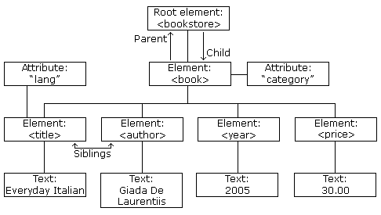
XML DOM Tree Example
XML DOM views an XML document as a node-tree.
All the nodes in the tree have a relationship to each other.

Slide 77
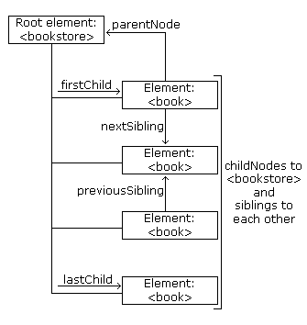
Look at the following XML fragment:
<bookstore>
<book category="cooking">
<title lang="en">Everyday Italian</title>
<author>Giada De Laurentiis</author>
<year>2005</year>
<price>30.00</price>
</book>
</bookstore>

Slide 78
XML DOM Parsing
Most browsers have a build-in XML parser to read and manipulate XML.
The parser converts XML into a JavaScript accessible object.
Parsing XML
XML DOM contains methods (functions) to traverse XML trees, access, insert, and delete nodes.
Before an XML document can be accessed and manipulated, it must be loaded into an XML DOM object.
parser reads XML into memory and converts it into an XML DOM object that can be accessed with JavaScript.

Slide 79
Load an XML Document
The following JavaScript fragment loads an XML document ("books.xml"):
var xmlDoc;
xmlDoc=new ActiveXObject("Microsoft.XMLDOM");
xmlDoc.async=false;
xmlDoc.load(“books.xml”);
var allbooks=xmlDoc.getElementsByTagName(“book”);
var book=allbooks[0].childNodes[0].nodeValue;
Output: Everyday Italian

Slide 80
DOM methods & Properties
Document.getDocumentElement()
  Returns the root element of the document
Node.firstChild() and Node.lastChild()
  Returns the first or last child of a given Node
Node.nextSibling() and Node.previousSibling()
  Returns the next or previous sibling of a given Node.
Node.childNodes
  Returns the child nodes of given Node
Node.getNodeName
  Returns tagname of a Node
Node.getNodeTypedValue
  Returns content of a Node

Slide 81
Example - Display the xml file contents onto the browser using the html and JavaScript
Step 1: Create xml file
Step 2: Create the corresponding dtd file.
Step 3: Check the well-formedness of both the files.
Step 4: Check if xml file is valid or not w.r.t dtd file.
Step 5: Create an html file.
Step 6: In the javascript code of the html:
  Create object of Microsoft’s XMLDOM parser for the xml document.
  Set xml document’s async property to false.
  Load the xml file.
var xmlDoc=new ActiveXObject("Microsoft.XMLDOM");
xmlDoc.async=false; //first load files completely and then pass the control to user
xmlDoc.load("book.xml");

Slide 82
<?xml version="1.0" encoding="ISO-8859-1" ?>
<!DOCTYPE book SYSTEM "bookdtd.dtd" >
<book>
  <chapter>
  <chapterno> chapter 1 </chapterno>
  <titles> HTML </titles>
  <contents> HTML is used for presentations of the data...</contents>
  </chapter>
  <chapter>
  <chapterno> chapter 2 </chapterno>
  <titles> Javascript </titles>
  <contents>Javascript is for the Client-side validation. It does not change any server side data.</contents>
  </chapter>
  <chapter>
  <chapterno> chapter 3 </chapterno>
  <titles> XML </titles>
  <contents>XML prperties are describe, exchange, store and carry</contents>
  </chapter>
</book>
book.xml

Slide 83
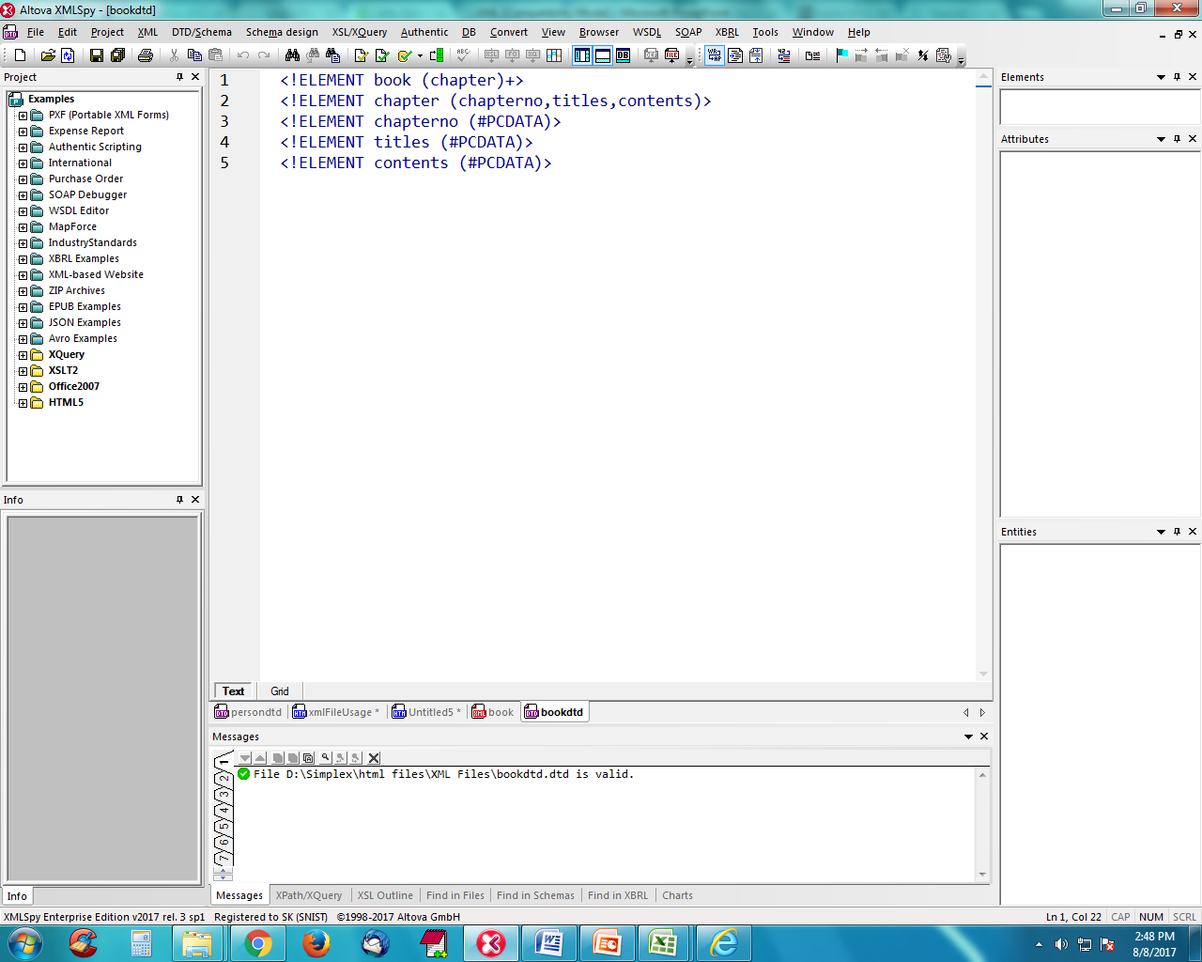

bookdtd.dtd file contents

Slide 84
HTML and JavaScript file to display xml file contents
<HTML> <BODY><script type="text/javascript">
//calling Microsoft DOM parser called XMLDOM
  var xmlDoc=new ActiveXObject("Microsoft.XMLDOM");
  xmlDoc.async=false;
  xmlDoc.load("book.xml");
//create a blank table
document.write("<table bgcolor=\"cyan\" border=\"2\" cellpadding=\"2\"><tbody><tr><th>Chapter No.</th><th>Title</th><th>Contents</th></tr></tbody>");
var i, chapterno,title,contents;

Slide 85
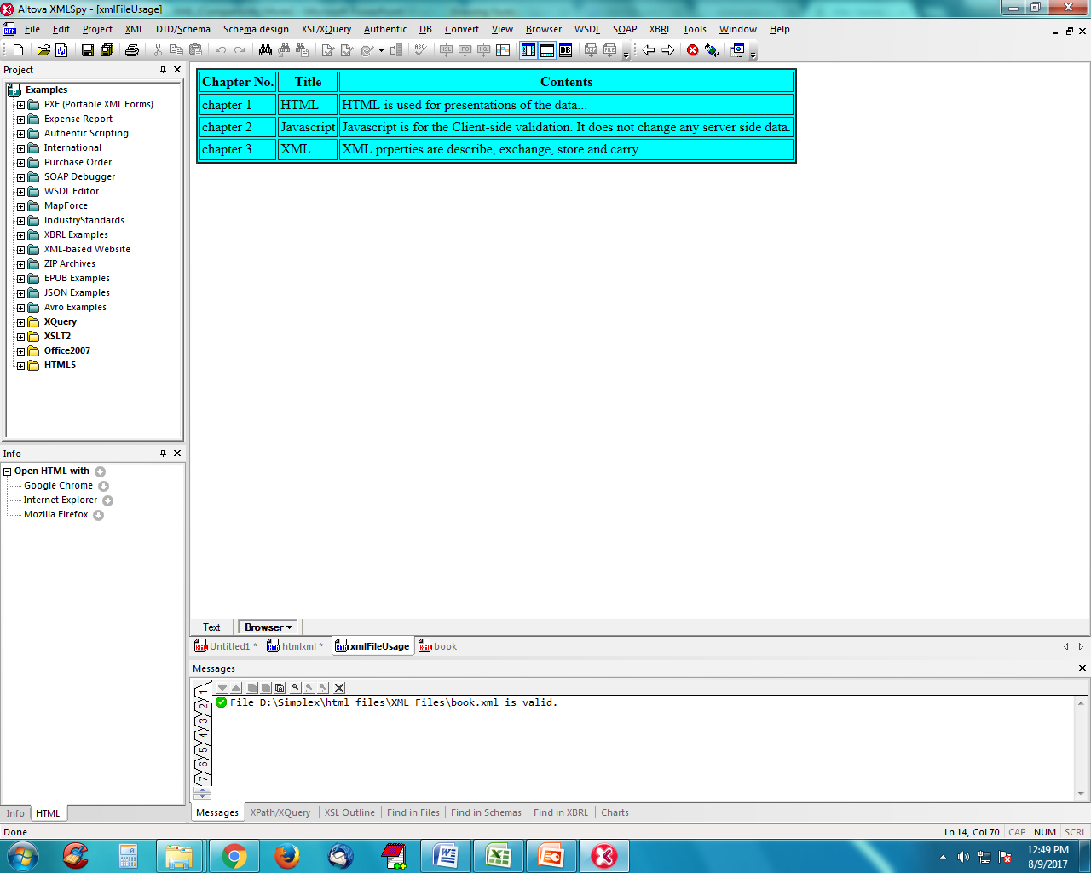
var chapternodes=xmlDoc.getElementsByTagName("chapter");
for(i=0;i<chapternodes.length;i++)
{
//retrieve the child node values of each chapter node.
cno=chapternodes[i].getElementsByTagName("chapterno")[0].childNodes[0].nodeValue;
title=chapternodes[i].getElementsByTagName("titles")[0].childNodes[0].nodeValue;
content=chapternodes[i].getElementsByTagName("contents")[0].childNodes[0].nodeValue;
//dump the above values in a row
  document.write("<tr><td>"+chapterno+"</td>");
  document.write("<td>"+title+"</td>");
  document.write("<td>"+contents+"</td></tr>");
}
document.write("</table>");
</script> </BODY></HTML>
HTML and JavaScript file to display xml file contents (contd..)

Slide 86
XML DOM Manipulations
Operation | Example
Get the Value of an Element | x = xmlDoc.getElementsByTagName("title")[0].childNodes[0].nodeValue;
get Value of an Attribute | txt=xmlDoc.getElementsByTagName("title")[0].getAttribute("lang");
Change the Value of an Element | x=xmlDoc.getElementsByTagName("title")[0].childNodes[0]; x.nodeValue="Easy Cooking";
Change the Value of an Attribute The setAttribute() method can be used | x=xmlDoc.getElementsByTagName("book"); for(i=0;i<x.length;i++) { x[i].setAttribute("edition","first"); }

Slide 87
Operation | Example
Create an Element createElement():creates a new element node. createTextNode(): creates a new text node. appendChild(): adds a child node to a node (after the last child). To create a new element with text content, it is necessary to create both an element node and a text node. Only server side scripting to be used for inserting into the xml file | newel=xmlDoc.createElement("edition"); newtext=xmlDoc.createTextNode("First"); newel.appendChild(newtext); x=xmlDoc.getElementsByTagName("book"); x[0].appendChild(newel); Example explained: Create an <edition> element Create a text node with value = "First" Append the text node to the <edition> element Append the <edition> element to the first <book> element
Remove an Element removeChild(): removes a specified node (or element). The following code fragment will remove the first node in the first <book> element: | x=xmlDoc.getElementsByTagName("book")[0]; x.removeChild(x.childNodes[0]);

Slide 88
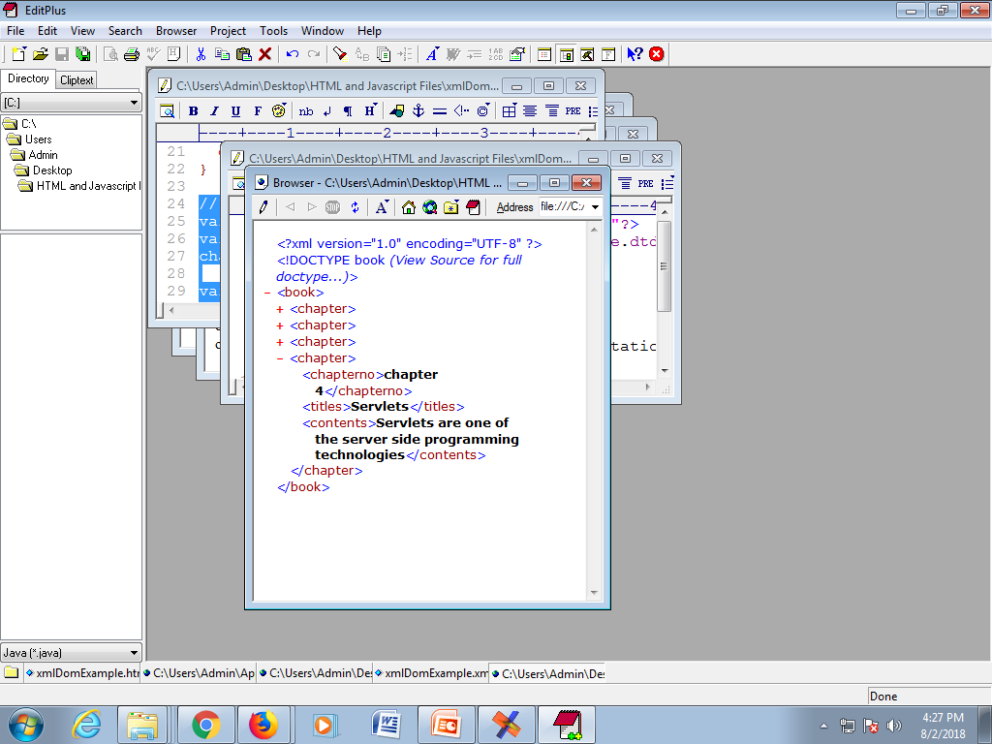
Inserting New Nodes
Code to insert new node
xml file
//Inserting new chapter node
var chapternoNode=x.createElement("chapterno");
var textNode=x.createTextNode("5");
chapternoNode.appendChild(textNode);
var titlesNode=x.createElement("titles");
var textNode=x.createTextNode("JSP");
titlesNode.appendChild(textNode);
var contentsNode=x.createElement("contents");
var textNode=x.createTextNode("JSP is also Server Side Technology, alternative to Servlets");
contentsNode.appendChild(textNode);
var chapterNode=x.createElement("chapter");
chapterNode.appendChild(chapternoNode);
chapterNode.appendChild(titlesNode);
chapterNode.appendChild(contentsNode);
x.getElementsByTagName("book")[0].appendChild(chapterNode);

Slide 89
SAX
SAX parsers are event-driven
  The parser fires an event as it parses each XML element/item.
  It is up to you to decide what you want to do with those events, if you ignore them the information in the event is discarded.
  The developer can write a java code that handles the events.

Slide 90
SAX events
The SAX API defines a number of events
startDocument
  Signals the start of the document.
endDocument
  Signals the end of the document
startElement
  Signals the start of an element. The parser fires this event when all of the contents of the opening tag have been processed. That includes the name of the tag and any attributes it might have.
endElement
  Signals the end of an element.

Slide 91
Diff b/w DOM & SAX
DOM | SAX
Uses more memory and has more functionality | Uses less memory and provides less functionality
The entire file is stored in an internal Document object. This may consume many resources | The developer must handle each SAX event before the next event is fired.
Slow execution | Fast execution
Generally used at client -side | General used at sever-side

Slide 92
Displaying XML
XML documents do not carry information about how to display the data
We can add display information to XML with
  CSS (Cascading Style Sheets)
  XSL (eXtensible Stylesheet Language) --- preferred

Slide 93
Displaying by using CSS
CSS important properties:
Position
left
right
top
font-style
font-size
color
background-color

Slide 94
display
Value | Description
none | The element will not be displayed
block | The element will be displayed as a block-level element, with a line break before and after the element
inline | Default. The element will be displayed as an inline element, with no line break before or after the element

Slide 95
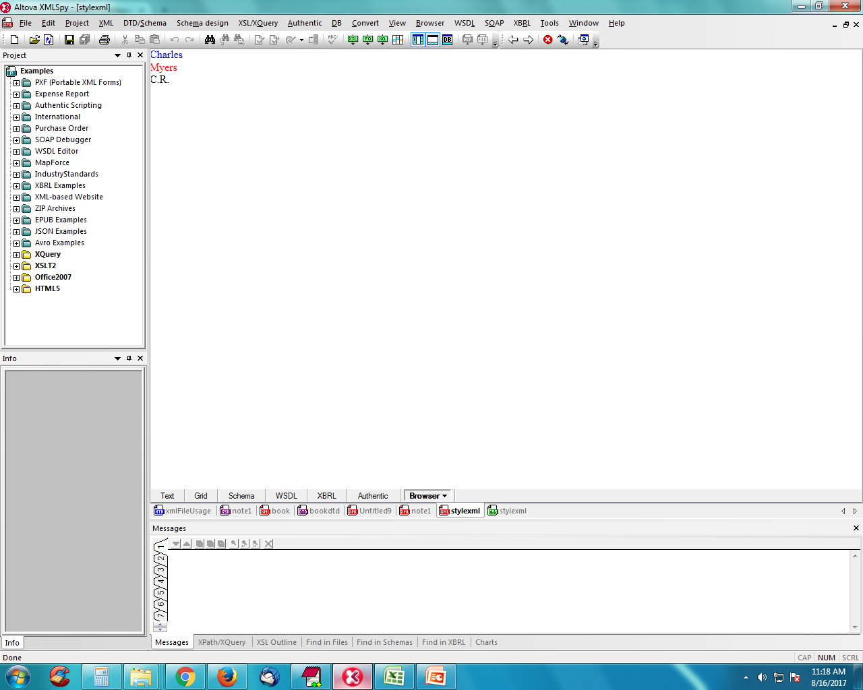
Employee.xml
Style.css
<?xml version="1.0"?>
<?xml-stylesheet type=“text/css”
href="style.css"?>
<person gender=“male”>
<name>
<first>Charles</first>
<last>Myers</last>
<nickname>C.R.</nickname>
</name>
</person>
first {
position:relative;
left:300;
color:blue;
}
last {
display:block;
color:red;
}
Output

Slide 96
XSL
XSL stands for eXtensible Stylesheet Language.
CSS = HTML Style Sheets
XSL = XML Style Sheets
  More Than a Style Sheet Language
  XSL consists of three parts:
    XSLT - a language for transforming XML documents
    XPath - a language for navigating in XML documents
    XSL-FO - a language for formatting XML documents .

Slide 97
Quick Overview of XSL
XSL
XSLT
XPath
XSL-FO
Uses files: .xml and .xsl
Procedural programming Style
Rule-Based programming style
types

Slide 98
XSLT
XSLT stands for Extensible Stylesheet Language Transformations.
XSLT is used to transform XML documents into other kinds of documents--usually, but not necessarily, HTML
XSLT uses two input files:
  The XML document containing the actual data
  The XSL document containing information about how to display the xml elements.

Slide 99
Two programming styles with XSLT
There are two programming styles that can be used with XSLT:
  Procedural programming style
  Rule based programming style
It also possible to mix both programming styles.

Slide 100
Procedural programming style
Procedural operations
  Control structures : XSLT instructions such as xsl:for-each, xsl:if and xsl:choose etc. provide control structures like conditional execution or loops.
  Accessing content : The xsl:value-of instruction writes the content of the current node to the target document.
ex :-

Slide 101
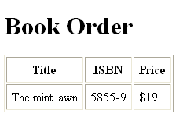
Myxsl.xsl file
xml file
<?xml version="1.0"?>
<HTML xmlns:xsl="http://www.w3.org/1999/XSL/Transform" xsl:version="1.0">
<BODY>
<H1>Book Order</H1>
<TABLE border="1" cellpadding="6">
<TR>
<TH>Title</TH>
<TH>ISBN</TH>
<TH>Price</TH>
</TR>
<xsl:for-each select="bookOrder/orderlist/item">
<TR>
<TD><xsl:value-of select="title"/></TD>
<TD><xsl:value-of select="@ISBN"/></TD>
<TD><xsl:value-of select="price/@currency"/>
<xsl:value-of select="price"/>
</TD>
</TR>
</xsl:for-each>
</TABLE>
</BODY>
</HTML>
<?xml version="1.0"?>
<?xml-stylesheet type="text/xsl“
href="myxsl.xsl"?>
<bookOrder>
<shipTo country="US">
<name>Venus </name>
<street>Chapel Street</street>
<city>papermoon</city>
</shipTo>
<billTO country="UK">
<name>Rick </name>
<street> Marine </street>
</billTO>
<note>Special Valentine wrapping!</note>
<orderlist>
<item ISBN="5855-9">
<title>The mint lawn</title>
<quantity>1</quantity>
<price currency=“$">19</price>
<note>On stock</note>
</item>
</orderlist>
</bookOrder>

Slide 102
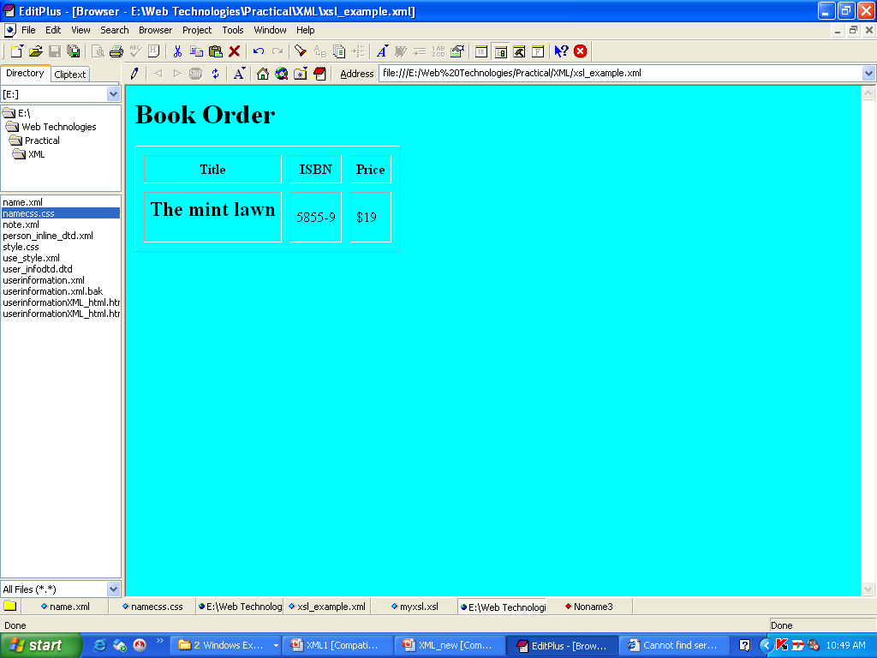
Changes made in xsl file
<BODY bgcolor="cyan">
<H1>Book Order</H1>
<TABLE border="1" cellpadding="6" cellspacing="10">
<TR>
<TH>Title</TH>
<TH>ISBN</TH>
<TH>Price</TH>
</TR>
<xsl:for-each select="bookOrder/orderlist/item">
<TR>
<TD><H2><xsl:value-of select="title"/></H2></TD>
<TD><xsl:value-of select="@ISBN"/></TD>
<TD><xsl:value-of select="price/@currency"/>
<xsl:value-of select="price"/>
</TD>
</TR>
</xsl:for-each>
</TABLE>
</BODY>

Slide 103
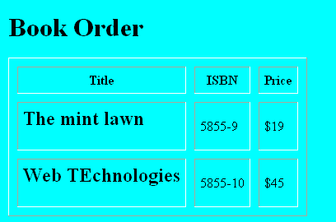
Number of items are increased in xml file
……………………………
<note>Special Valentine wrapping!</note>
<orderlist>
<item ISBN="5855-9">
<title>The mint lawn</title>
<quantity>1</quantity>
<price currency="$">19</price>
<note>On stock</note>
</item>
<item ISBN="5855-10">
<title>Web TEchnologies</title>
<quantity>2</quantity>
<price currency="$">45</price>
<note>On stock</note>
</item>
</orderlist>
</bookOrder>

Slide 104
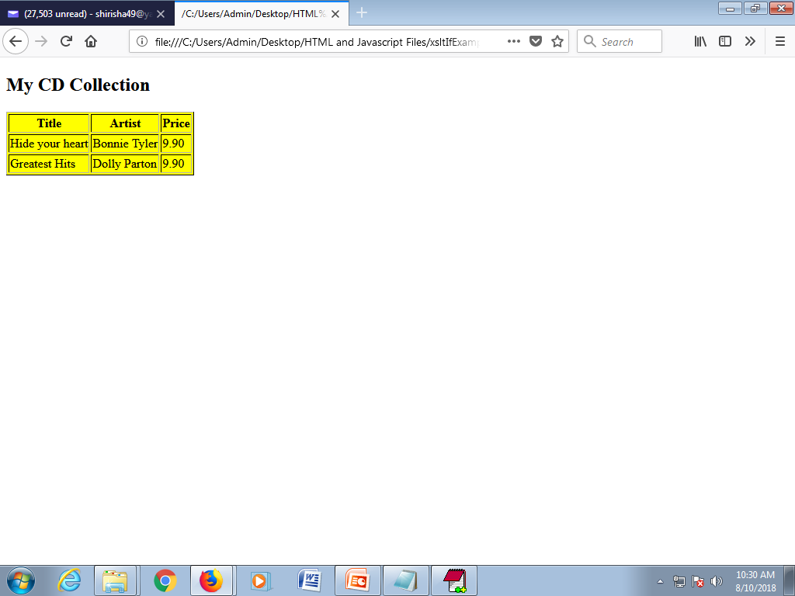
<?xml version="1.0" encoding="UTF-8"?>
<?xml-stylesheet type="text/xsl“ href=“f1.xsl"?>
<catalog> <cd>
<title>Empire Burlesque</title>
<artist>Bob Dylan</artist>
<country>USA</country>
<company>Columbia</company>
<price>10.90</price><year>1985</year>
</cd> <cd>
<title>Hide your heart</title>
<artist>Bonnie Tyler</artist>
<country>UK</country>
<company>CBS Records</company>
<price>9.90</price><year>1988</year>
</cd> <cd>
<title>Greatest Hits</title>
<artist>Dolly Parton</artist>
<country>USA</country>
<company>RCA</company>
<price>9.90</price><year>1982</year>
</cd></catalog>
Example: xsl:if
<?xml version="1.0" encoding="UTF-8"?>
<xsl:stylesheet version="1.0“ xmlns:xsl= "http://www.w3.org/1999/XSL/Transform">
<xsl:template match="/">
<html> <body> <h2>My CD Collection</h2>
<table border="1“> <tr bgcolor=“yellow">
<th>Title</th><th>Artist</th><th>Price</th> </tr>
<xsl:for-each select="catalog/cd">
<xsl:if test="price &lt; 10">
<tr><td><xsl:value-of select="title"/></td>
<td><xsl:value-of select="artist"/></td>
<td><xsl:value-of select="price"/></td></tr>
</xsl:if> </xsl:for-each>
</table>
</body> </html>
</xsl:template>
</xsl:stylesheet>
f1.xml
f1.xsl

Slide 105
xsl:choose, xsl:when test=“..”, xsl:otherwise (if – else)
For multiple conditional test against the XML file, add the <xsl:choose>, <xsl:when>, and <xsl:otherwise> elements to the XSL file. Syntax:
<xsl:choose>
<xsl:when test="expression">
... some output ...
</xsl:when>
<xsl:otherwise>
... some output ....
</xsl:otherwise>
</xsl:choose>

Slide 106
<?xml version="1.0" encoding="UTF-8"?>
<?xml-stylesheet type="text/xsl“ href=“f1.xsl"?>
<catalog> <cd>
<title>Empire Burlesque</title>
<artist>Bob Dylan</artist>
<country>USA</country>
<company>Columbia</company>
<price>10.90</price><year>1985</year>
</cd> <cd>
<title>Hide your heart</title>
<artist>Bonnie Tyler</artist>
<country>UK</country>
<company>CBS Records</company>
<price>9.90</price><year>1988</year>
</cd> <cd>
<title>Greatest Hits</title>
<artist>Dolly Parton</artist>
<country>USA</country>
<company>RCA</company>
<price>9.90</price><year>1982</year>
</cd></catalog>
<?xml version="1.0" encoding="UTF-8"?>
<xsl:stylesheet version="1.0"
xmlns:xsl="http://www.w3.org/1999/XSL/Transform">
<xsl:template match="/">
<html><body>
<h2>My CD Collection</h2>
<table border="1“> <tr bgcolor="#9acd32">
<th>Title</th> <th>Artist</th> </tr>
<xsl:for-each select="catalog/cd">
<tr> <td><xsl:value-of select="title"/></td>
<xsl:choose>
<xsl:when test="price > 10">
<td bgcolor="#ff00ff">
<xsl:value-of select="artist"/>
</td>
</xsl:when>
<xsl:otherwise>
<td><xsl:value-of select="artist"/></td>
</xsl:otherwise>
</xsl:choose>
</tr> </xsl:for-each>
</table></body></html>
</xsl:template></xsl:stylesheet>

Slide 107
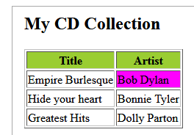
Output: choose-when-otherwise

Slide 108
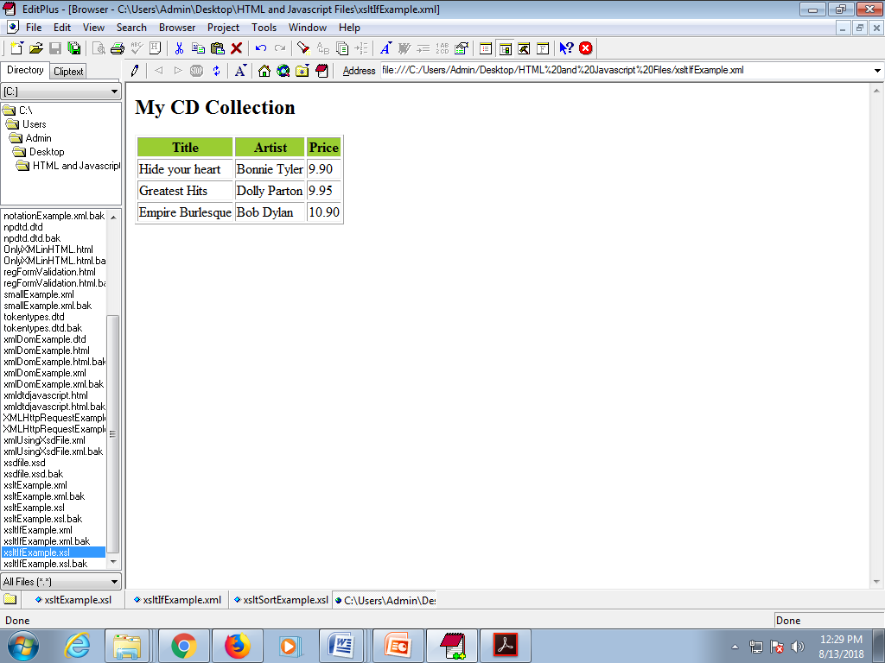
<xsl:sort select=“….”/>
    Syntax: <xsl:sort
    select = string-expression
    lang = { nmtoken }
    data-type = { "text" | "number" | QName }
    order = { "ascending" | "descending" }
    case-order = { "upper-first" | "lower-first" } >
    </xsl:sort>
Example:
<xsl:for-each select="catalog/cd">
<xsl:sort select="price" data-type="number"/>
<tr> <td><xsl:value-of select="title"/></td>
<td><xsl:value-of select="artist"/></td>
<td><xsl:value-of select="price"/></td></tr>
</xsl:for-each>

Slide 109
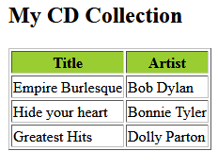
<?xml version="1.0" encoding="UTF-8"?>
<?xml-stylesheet type="text/xsl“ href=“f1.xsl"?>
<catalog> <cd>
<title>Empire Burlesque</title>
<artist>Bob Dylan</artist>
<country>USA</country>
<company>Columbia</company>
<price>10.90</price><year>1985</year>
</cd> <cd>
<title>Hide your heart</title>
<artist>Bonnie Tyler</artist>
<country>UK</country>
<company>CBS Records</company>
<price>9.90</price><year>1988</year>
</cd> <cd>
<title>Greatest Hits</title>
<artist>Dolly Parton</artist>
<country>USA</country>
<company>RCA</company>
<price>9.90</price><year>1982</year>
</cd></catalog>
Example: xsl:sort
<?xml version="1.0" encoding="UTF-8"?>
<xsl:stylesheet version="1.0” xmlns:xsl="http://www.w3.org/1999/XSL/Transform">
<xsl:template match="/">
<html> <body>
<h2>My CD Collection</h2>
<table border="1“><tr bgcolor="#9acd32">
<th>Title</th><th>Artist</th></tr>
<xsl:for-each select="catalog/cd">
<xsl:sort select="artist"/>
<tr> <td><xsl:value-of select="title"/></td>
<td><xsl:value-of select="artist"/></td> </tr>
</xsl:for-each>
</table> </body>
</html>
</xsl:template>
</xsl:stylesheet>

Slide 110
Rule based programming style
  An XSL style sheet consists of one or more set of rules called templates.
  A template contains rules to apply when a specified node is matched.
  xsl:template -defines a set of rules for transforming elements .
  The match attribute is used to associate a template with an XML element.
  Syntax:- <xsl:template match=element_name >
  Rules for transforming element
  </xsl:template>
  match="/" defines the template for root element.

Slide 111
xsl:apply-templates –applies all the templates defined in the document recursively.
select attribute --to specify the child nodes which you want to use inside a parent.

Slide 112
…<xsl:stylesheet version="1.0“
xmlns:xsl="http://www.w3.org/1999/XSL/Transform">
<xsl:template match="/">
<html><body>
<h2>My CD Collection</h2>
<xsl:apply-templates />
</body></html>
</xsl:template>
<xsl:template match="cd">
<p> <xsl:apply-templates select="title"/>
<xsl:apply-templates select="artist"/>
</p>
</xsl:template>
<xsl:template match="title">
Title: <span style="color:#ff0000">
<xsl:value-of select="."/></span>
<br />
</xsl:template>
<xsl:template match="artist">
Artist: <span style="color:#00ff00">
<xsl:value-of select="."/></span>
<br />
</xsl:template>
</xsl:stylesheet>
<?xml version="1.0"
encoding="ISO-8859-1"?>
<?xml:stylesheet type="text/xsl"
href="mycd.xsl"?>
<catalog>
<cd>
<title>Empire Burlesque</title>
<artist>Bob Dylan</artist>
<country>USA</country>
<company>Columbia</company>
<price>10.90</price>
<year>1985</year>
</cd>
</catalog>
mycd.xsl file

Slide 113
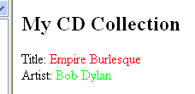
Output

Slide 114
<?xml version = "1.0"?>
<?xml-stylesheet type = "text/xsl"
href = "employee.xsl"?>
<class>
<employee id = "001">
<firstname>Aryan</firstname>
<lastname>Gupta</lastname>
<nickname>Raju</nickname>
<salary>30000</salary>
</employee>
<employee id = "024">
<firstname>Sara</firstname>
<lastname>Khan</lastname>
<nickname>Zoya</nickname>
<salary>25000</salary>
</employee>
<employee id = "024">
<firstname>Sara</firstname>
<lastname>Khan</lastname>
<nickname>Zoya</nickname>
<salary>25000</salary>
</employee> </class>
<?xml version = "1.0" encoding = "UTF-8"?>
<xsl:stylesheet version = "1.0"
xmlns:xsl = "http://www.w3.org/1999/XSL/Transform"> <xsl:template match = "/">
<html> <body> <h2>Employees</h2>
<xsl:apply-templates select = "class/employee" />
</body> </html>
</xsl:template>
<xsl:template match = "class/employee">
<xsl:apply-templates select = "@id" />
<xsl:apply-templates select = "firstname" />
<xsl:apply-templates select = "lastname" />
<xsl:apply-templates select = "nickname" />
<xsl:apply-templates select = "salary" /> <br />
</xsl:template>
<xsl:template match = "@id">
<span style = "font-size = 25px;">
<xsl:value-of select = "." />
</span> <br />
</xsl:template>

Slide 115
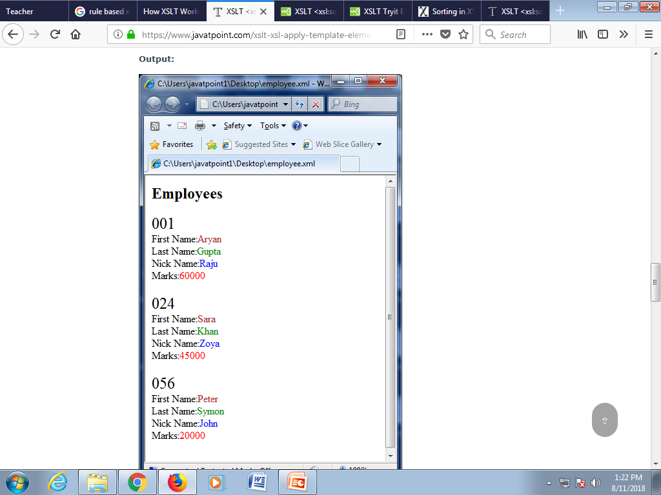
Contd..→
<xsl:template match = "firstname">
First Name:<span style = "color:brown;">
<xsl:value-of select = "." />
</span> <br />
</xsl:template>
<xsl:template match = "lastname">
Last Name:<span style = "color:green;">
<xsl:value-of select = "." />
</span> <br />
</xsl:template>
<xsl:template match = "nickname">
Nick Name:<span style = "color:blue;">
<xsl:value-of select = "." />
</span> <br />
</xsl:template>
<xsl:template match = "salary">
Marks:<span style = "color:red;">
<xsl:value-of select = "." />
</span> <br />
</xsl:template>
</xsl:stylesheet>
Output

Slide 116
XML Advantages/Goals
1. XML is used to Exchange Data
  With XML, data can be exchanged between incompatible systems
2. XML and B2B
  With XML, financial information can be exchanged over the Internet.
3. XML can be used to Share Data
  With XML, plain text files can be used to share data.

Slide 117
4. XML is free and extensible
  XML tags are not predefined. we must "invent" your own tags.
5. XML can be used to Store Data
  With XML, plain text files can be used to store data.
6. XML can be used to Create new Languages
  XML is the mother of WAP and WML.
7. HTML focuses on "look and feel”
  XML focuses on the structure of the data.

Slide 118
XML Can be Used to Create New Languages.
Ex:- The mathematics markup language
( MathML)encodes equations.
Representation of Newton’s Law of
Gravitation F=GMm / r² by using MathML.

Slide 119
EX:- ( MathML )
<?xml version=“1.0”>
<math>
<mi>F</mi>
<mo>=</mo>
<mi>G</mi>
<mfrac>
<mnum>
<mi>M</mi>
<mi>m</mi>
</mnum>
<apply>
<power>
<mi>r</mi>
<mn>2</mn>
</power>
</apply>
</mfrac>
</math>

Slide 120
One application might use this input to display the equation.
Another application might use it to solve the equation with a series of values.
This is a sign of XML’s power.

Slide 121
Ex:-2
The Wireless Markup Language (WML), used to markup Internet applications for handheld devices like mobile phones, is written in XML.

Slide 122
END

