Slide 1
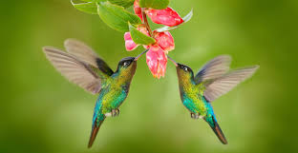


Slide 2






1
Introduction
4
Literature Review
2
Aims and Objectives
5
Requirements
3
Goals and Scope
6
System Architecture

Slide 3
1
Introduction
Though the world has changed towards the era of technology and automation, in many bird habitation centers in Bhutan the data that they collect are kept private and it is not centralized and organized. Bhutan today is of harboring about 5,369 plant species and 5,114 species of animals of which about 774 species are birds.
E-bird Bhutan aims to address the lack of comprehensive and up-to-date information on the bird species, abundance and distribution in and around Bhutan.

Slide 4
2
Aim and Objectives
To develop an application to create an organized and centralized platform for gathering and sharing information about bird observations across the country
Collecting high-quality data
Providing a platform for birdwatchers
To revolutionize the way bird observation data is collected, analyzed and shared.
To create a centralized platform for bird observation in and around Bhutan

Slide 5
3
Literature Reviews
ebird mobile application.
White-bellied heron conservation. Royal Society For Protection of Nature.
Analytical guidelines to increase the value of community science data: An example using eBird data to estimate species distributions
A citizen-based bird observation network in the biological sciences.

Slide 6
4
Requirements
Functional Requirements
Registration
Login
Start Birding
Stop Birding
My Checklist
Search
Dashboard
Non-Functional Requirements
Performance
Reliability
Usability
Security
Compatibility
Technology Requiremnts
React Native
Node Js
My SQL
Gitlab
Figma
Asana

Slide 7
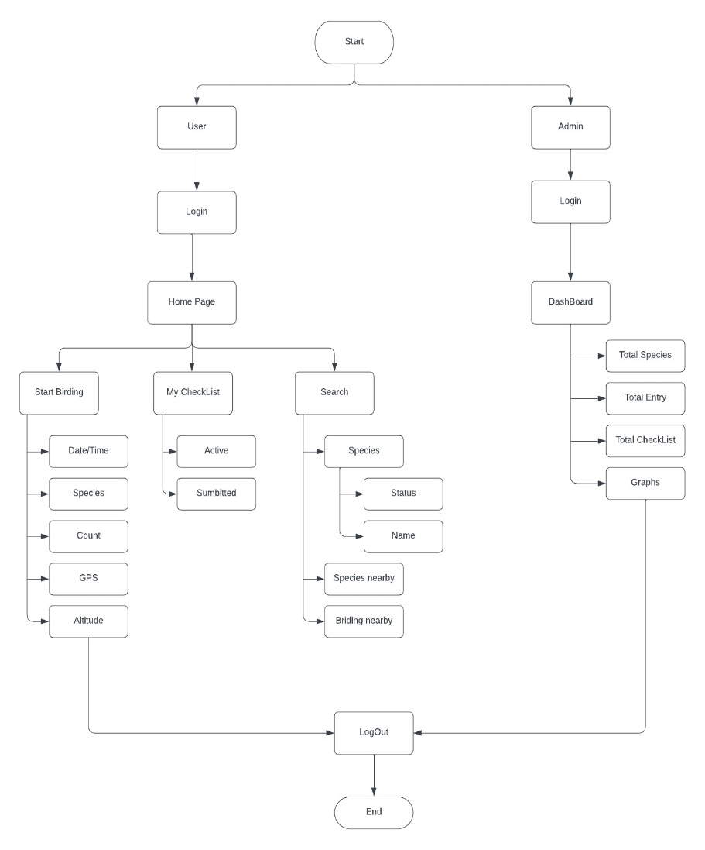
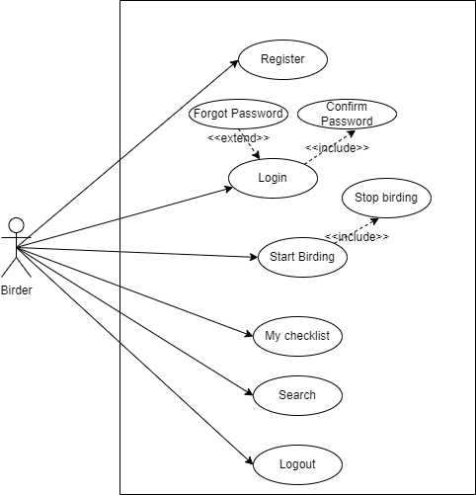
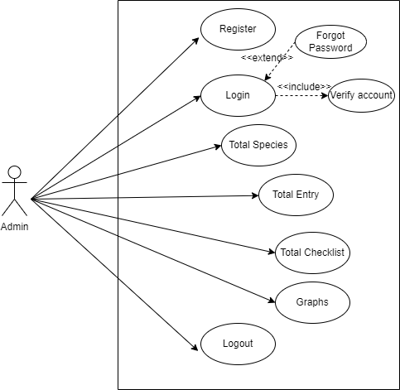
5
System Architecture
5

