Slide 1
GWAS/GS exercise using GAPIT
EEE338
Narcis Yousefi
26 Sep. 2025

Slide 2
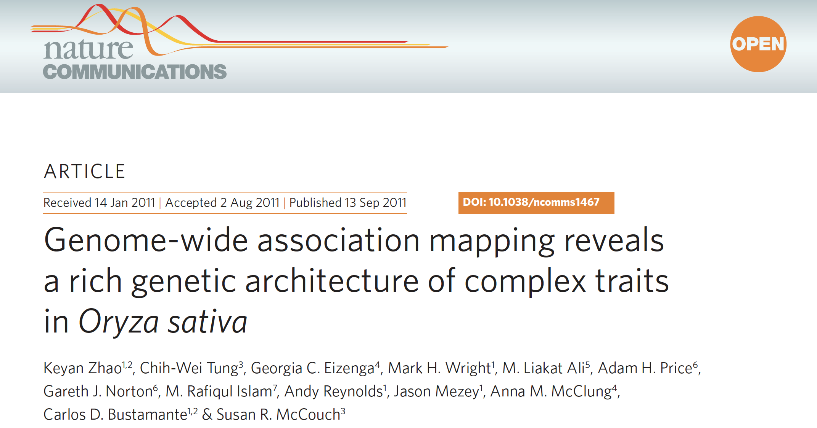
Dataset: Rice 44k genomes
Data from Zhao et al. (2011) Nature Communications 2:467
Data available at http://www.ricediversity.org/data/
34 agronomic traits were examined for 413 rice accessions

Slide 3
What to do in this exercise
GWAS example: Find genomic region associated with the seed length
GS example: Predict flowering time between different study years
Finally, you will be able to try GWAS/GS for traits of your interest!

Slide 4
Source codes and input data
RiceDiversity_44K_Genotypes_PLINK_imputed.txt.gz
RiceDiversity_44K_Genotypes_PLINK_info.txt
This instruction PDF
All available at:
https://github.com/naryou/EEE338_HS2025

Slide 5
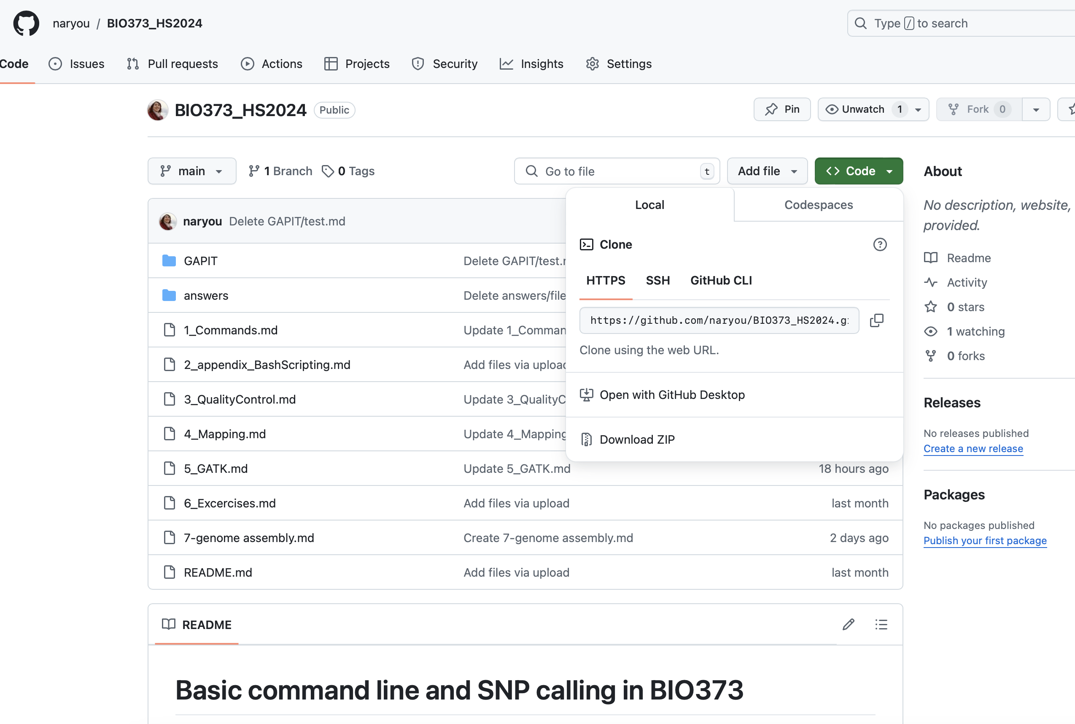
Download materials
Download .zip from:
https://github.com/naryou/EEE338_HS2025

Slide 6
Set up the working directory
1. Access to RStudio server (https://fgcz-genomics.uzh.ch) via terminal and log-in with your B-fabric username and Password
2. Make and change your working directory with mkdir GAPIT from Terminal; and then setwd("./GAPIT") from R Console
3. Upload RiceDiversity_44K_Genotypes_PLINK_imputed.txt.gz and RiceDiversity_44K_Genotypes_PLINK_info.txt to the directory you made

Slide 7
First of all, load Genomic Association and Prediction Integrated Tool (GAPIT)
Now access to RStudio server (https://fgcz-genomics.uzh.ch) in a browser
Install GAPIT source code and its dependency
Wait ca. 15 min. to install everything
Some packages are not installed but they are negligible
Try twice when it fails
# clean up your workplace
rm(list=ls())
# select "1:All" if this asks something about dependent packages
install.packages("devtools")
# BiocManager::install("snpStats") # You don’t need to install this one
devtools::install_github("SFUStatgen/LDheatmap")
devtools::install_github("jiabowang/GAPIT3@078fe28",force=TRUE)
library(GAPIT3) # load GAPIT3 package

Slide 8
Load and see phenotype data
url <- "http://www.ricediversity.org/data/sets/44kgwas/RiceDiversity_44K_Phenotypes_34traits_PLINK.txt"
p <- read.table(url, sep="\t", header=TRUE)
nrow(p) # no. of plants
## [1] 413
head(p)
## HybID NSFTVID Flowering.time.at.Arkansas Flowering.time.at.Faridpur
## 1 081215-A05 1 75.08333 64
## 2 081215-A06 3 89.50000 66
## 3 081215-A07 4 94.50000 67
## 4 081215-A08 5 87.50000 70
## 5 090414-A09 6 89.08333 73
## 6 090414-A10 7 105.00000 NA
## Flowering.time.at.Aberdeen FT.ratio.of.Arkansas.Aberdeen
## 1 81 0.9269547
## 2 83 1.0783133
## 3 93 1.0161290
## 4 108 0.8101852
## 5 101 0.8820132
## 6 158 0.6645570
## FT.ratio.of.Faridpur.Aberdeen Culm.habit Leaf.pubescence Flag.leaf.length
## 1 0.7901235 4.0 1 28.37500
## 2 0.7951807 7.5 0 39.00833
## 3 0.7204301 6.0 1 27.68333
## 4 0.6481481 3.5 1 30.41667
## 5 0.7227723 6.0 1 36.90833
## 6 NA 3.0 1 36.99000
## Flag.leaf.width Awn.presence Panicle.number.per.plant Plant.height
## 1 1.2833333 0 3.068053 110.9167
## 2 1.0000000 0 4.051785 143.5000
## 3 1.5166667 0 3.124565 128.0833
## 4 0.8916667 0 3.697178 153.7500
## 5

Slide 9
Read genotype data and marker information
g <- read.table("RiceDiversity_44K_Genotypes_PLINK_imputed.txt.gz",
header=TRUE, sep="\t")
gm <- read.table("RiceDiversity_44K_Genotypes_PLINK_info.txt.gz",
header=TRUE, sep="\t")
nrow(g) # no. of plants
## [1] 413
ncol(g[,-1]) # no. of SNPs
## [1] 36901
head(gm) # marker info
## ID CHROM POS
## 1 id1000001 1 13147
## 2 id1000003 1 73192
## 3 id1000005 1 74969
## 4 id1000007 1 75852
## 5 id1000008 1 75953
## 6 id1000011 1 91016

Slide 10
(1) Genome-wide association study (GWAS)

Slide 11
Aim: Looking for genomic region underlying the length of rice grains
Indica cultivars have long grains, while Japonica have round-shaped grains
Grain Size 3 (GS3) is known to regulate the seed length in rice (Wang et al. 2011)
Can we detect the known loci with GWAS?

Slide 12
Run GWAS with a general linear model (GLM) or mixed linear model (MLM)
It takes several minutes. Wait.
When finished, output files appear in the current directory
Warning messages occur but the program still works
Note: When you run GAPIT twice, the second run may not work. In such a case, log-out once and retry from data loading.
myGAPIT <- GAPIT( # warnings occur but it still works
Y=p[,c("HybID","Seed.length")],
GD=g,
GM=gm,
SNP.MAF=0.05, # cut-off minor alleles at 0.05
Inter.Plot=TRUE, # option to make interactive plots
model=c("GLM", "MLM"),
kinship.algorithm="VanRaden",
Multiple_analysis=TRUE)

Slide 13
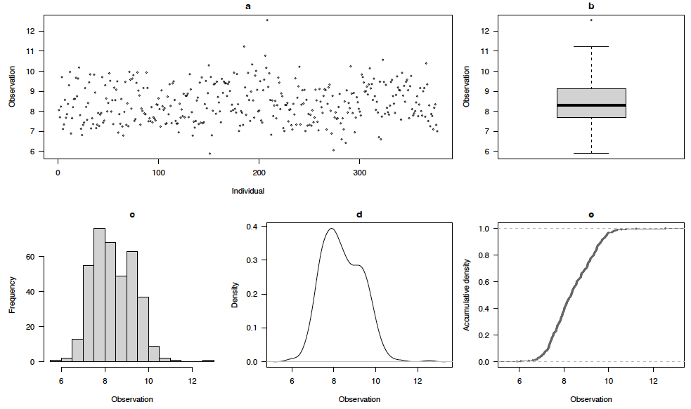
GWAS is done. Let us see a trait diagnosis first
Figure 1: “GAPIT.Phenotype.View.Seed.length.pdf”
The seed length looks normally distributed

Slide 14
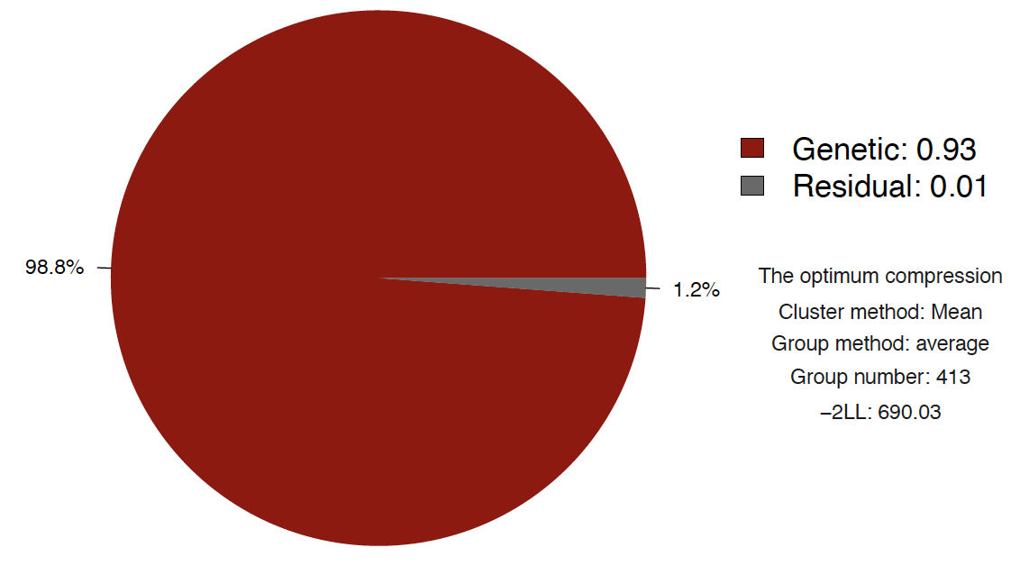
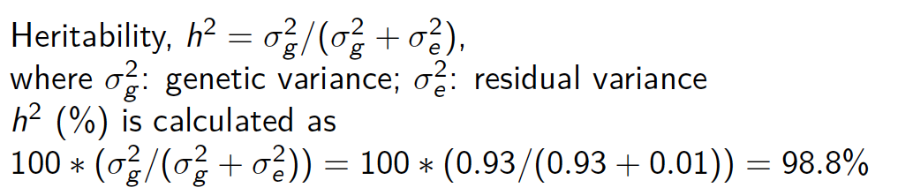
. . . and also check heritability in the seed length
Figure 2: “GAPIT.Association.Optimum.MLM.Seed.length.pdf”

Slide 15
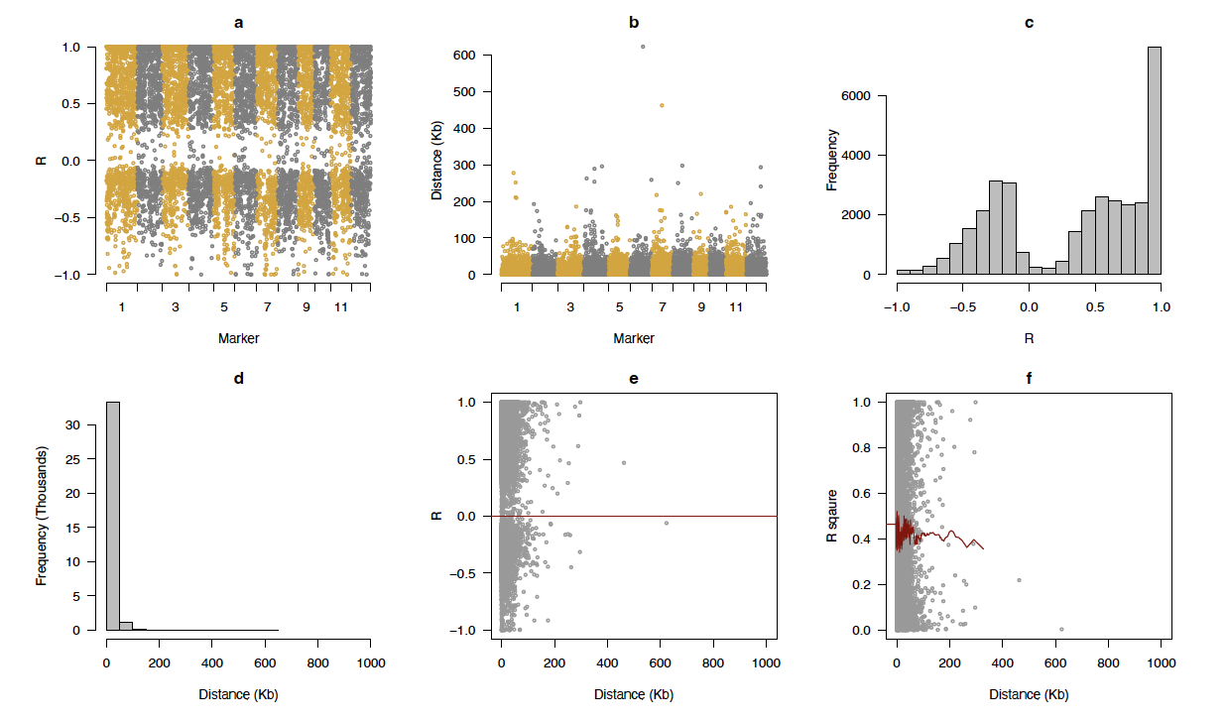
Check LD to see what kbp we should refer around the SNPs.
Figure 3: “GAPIT.Genotype.Density_R_sqaure.pdf”
(b) The length of linkage disequilibrium is at most 600 kbp.

Slide 16
Compare the marker density with the LD length
Figure 4: “GAPIT.Genotype.Density_R_sqaure.pdf”
(d) The marker intervals are much shorter than the length of LD,
indicating that marker density was enough

Slide 17
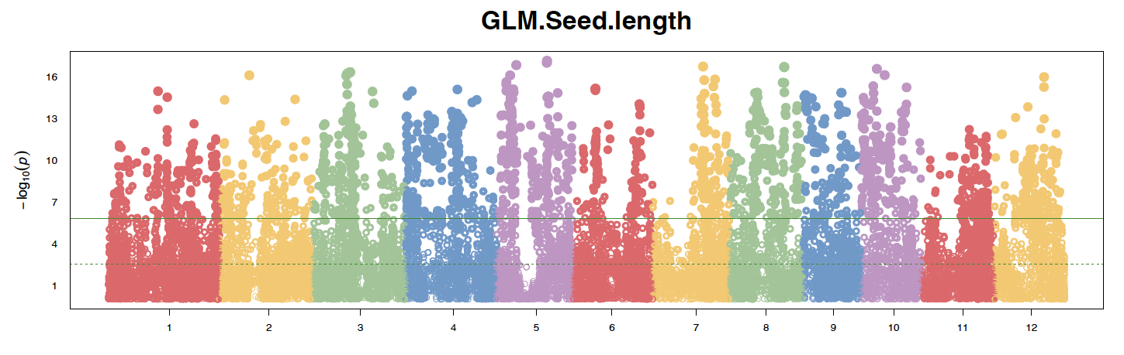
Manhattan plot of the general linear model (GLM)
Figure 5: “GAPIT.Association.Manhattan_Geno.GLM.Seed.length.pdf”
Is everything significant?? Very difficult to find key variants. . .

Slide 18
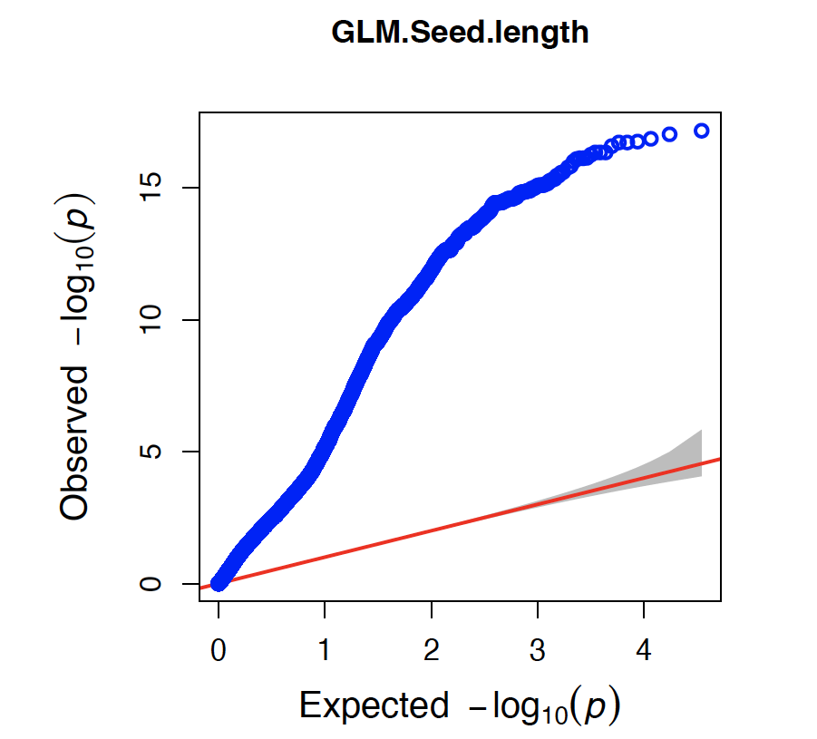
Quantile-quantile (QQ) plot also shows inflated p-values
Figure 6: “GAPIT.Association.QQ.GLM.Seed.length.pdf”
Blue dots: Observed -log10(p-values)
Red line: Expected -log10(p-values) when they are random

Slide 19
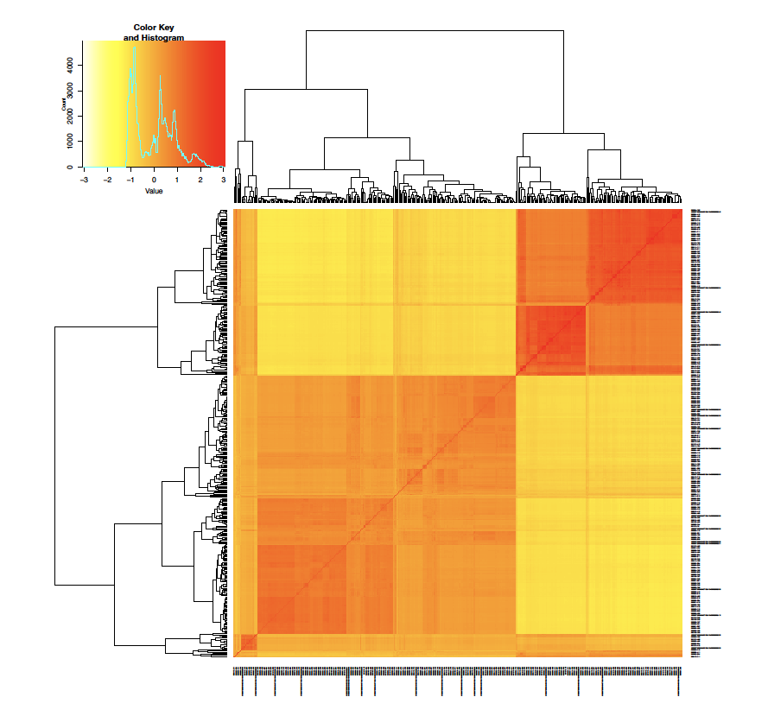
Heatmap of the kinship matrix shows two clusters
Figure 7: “GAPIT.Genotype.Kin_VanRaden.pdf”
Here we see a complex kinship structure
A mixed linear model is worth trying to correct it

Slide 20
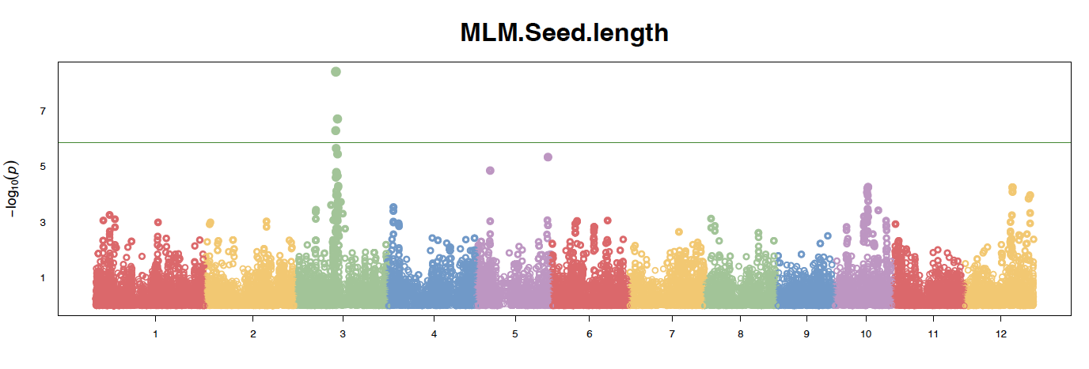
Manhattan plot of the mixed linear model (MLM)
Figure 8: “GAPIT.Association.Manhattan_Geno.MLM.Seed.length.pdf”
We can find a peak on the chromosome 3!

Slide 21
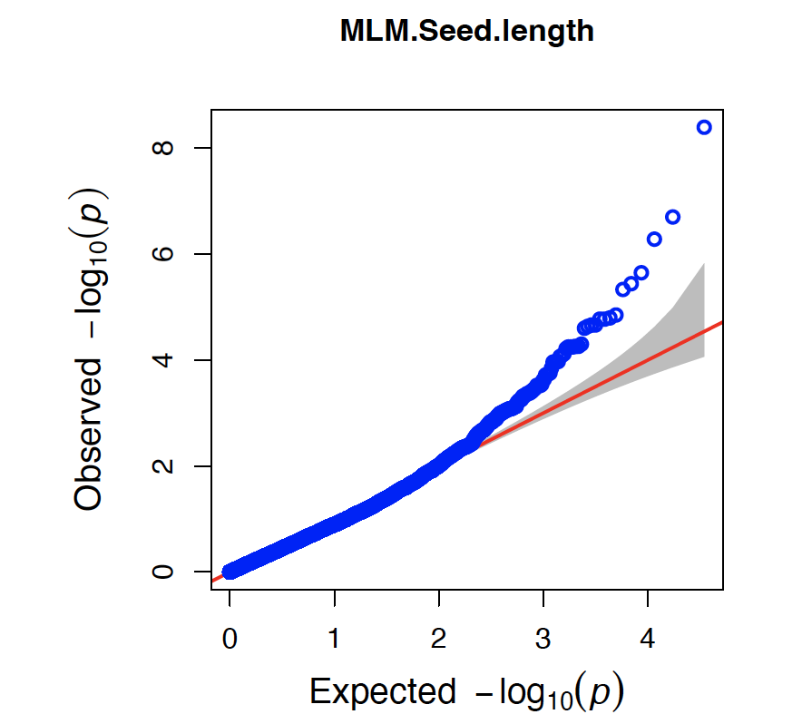
QQ plot of the mixed linear model
Figure 9: “GAPIT.Association.QQ.MLM.Seed.length.pdf”
Only for top-scoring SNPs, -log10(p-values) are higher than expected

Slide 22
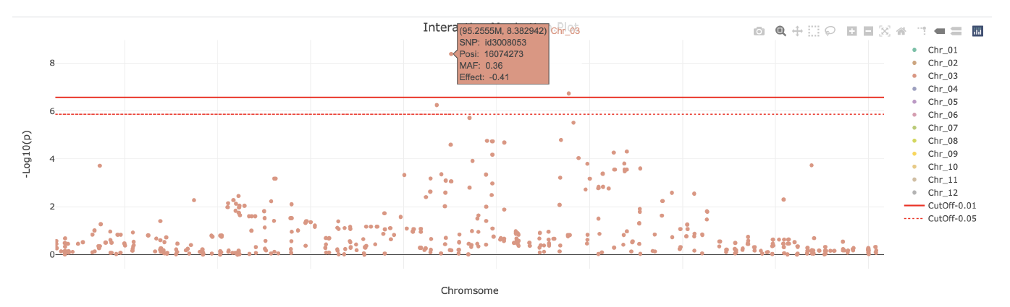
GWAS works well. Check the position of top-scoring SNPs
Figure 10: “GAPIT.Association.Interactive_Manhattan.MLM.Seed.length.html”
Open “Interactive.Manhattan.MLM.Seed.length.html”
You can find 2 significant SNPs on the chromosome 3
The position info appears when you put your cursor on a SNP

Slide 23
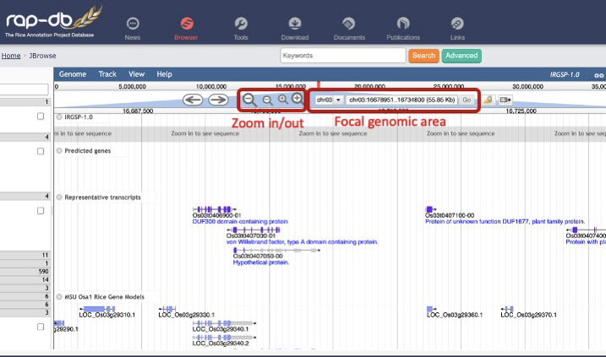
What genes are located nearby? Check the database
Access RAP-DB website at https://rapdb.dna.affrc.go.jp/
Look for and click “JBrowse”

Slide 24
Short exercise: Let’s find the GS3 locus.
By using RAP-DB,
1. Input significant SNP positions ± 3 bp as a focal genomic area and “Go”
e.g., chr03:16706777..16706779
2. Zoom in/out ± the average LD length near the SNP
3. Find the locus ID “Os03t0407400-01” (= GS3) and click!
Point of (biological) interpretation
Which SNPs can you find GS3 locus nearby?
How far is the GS3 from the significant SNP?
What family of proteins does the GS3 encode?

Slide 25
(2) Genomic selection (GS)

Slide 26
Aim: Prediction of the flowering time in rice cultivars
Flowering time, or heading date in rice, was recorded at Arkansas on 2006 and 2007 (Zhao et al. 2011)
Genotypes were same but environment should be different between years
The flowering time of some accessions were unavailable
Can we predict the flowering time only on the basis of genotypes?

Slide 27
Estimate a trait value of each plant with gBLUP
When finished, results are stored in “myGAPIT_BLUP” object.
# gBLUP for the flowering time 2006 at Arkansas
myGAPIT_BLUP <- GAPIT( # warnings occur but it still works
Y=p[,c("HybID","Year06Flowering.time.at.Arkansas")],
GD=g,
GM=gm,
SNP.MAF=0.05,
model="gBLUP",
kinship.algorithm="VanRaden",
file.output=FALSE)
## [1] "--------------------- Welcome to GAPIT ----------------------------"
## [1] "gBLUP"
## [1] "--------------------Processing traits----------------------------------"
## [1] "Phenotype provided!"
## [1] "The 1 model in all."
## [1] "MLM"
## [1] "GAPIT.DP in process..."
## [1] "GAPIT will filter marker with MAF setting !!"
## [1] "The markers will be filtered by SNP.MAF: 0.05"
## maf_index
## FALSE TRUE
## 2150 34751
## [1] "Calculating kinship..."
## [1] "Number of individuals and SNPs are 413 and 34751"
## [1] "Calculating kinship with VanRaden method..."
## [1] "substracting P..."
## [1] "Getting X’X..."
## [1] "Adjusting..."
## [1] "Calculating kinship with VanRaden method: done"

Slide 28
We get BLUP, PEV, BLUE, and predicted trait values
BLUP: Best Linear Unbiased Predictor shows trait variance around mean
PEV: prediction error variance of BLUP
BLUE: Best Linear Unbiased Estimator shows mean differences of traits
BLUP + BLUE = Prediction
# load results of genomic prediction
pred <- myGAPIT_BLUP$Pred
head(pred)
## Taxa Group RefInf ID BLUP PEV BLUE Prediction
## 1 081215-A05 1 1 1 -10.3304078 11.01517 89.3738566605352 79.04345
## 2 081215-A06 2 1 2 0.7679973 21.42044 89.3738566605352 90.14185
## 3 081215-A07 3 1 3 -1.9286126 20.80244 89.3738566605352 87.44524
## 4 081215-A08 4 1 4 0.4137206 15.23512 89.3738566605352 89.78758
## 5 090414-A09 5 1 5 1.8817708 18.49218 89.3738566605352 91.25563
## 6 090105-A02 7 1 6 8.8639442 20.66431 89.3738566605352 98.23780

Slide 29
Of course, predicted flowering time is well correlated with observed values
# align predicted and observed traits following the taxa name
pred <- pred[order(pred$Taxa),]
y <- p[order(p$HybID),]
# calculate Pearson s correlation between predicted and observed flowering
cor.test(pred$Prediction, y$Year06Flowering.time.at.Arkansas , method = 'pearson')
##
## Pearson’s product-moment correlation
##
## data: pred$Prediction and y$Year06Flowering.time.at.Arkansas
## t = 49.431, df = 335, p-value < 2.2e-16
## alternative hypothesis: true correlation is not equal to 0
## 95 percent confidence interval:
## 0.9234637 0.9494873
## sample estimates:
## cor
## 0.9377791

Slide 30
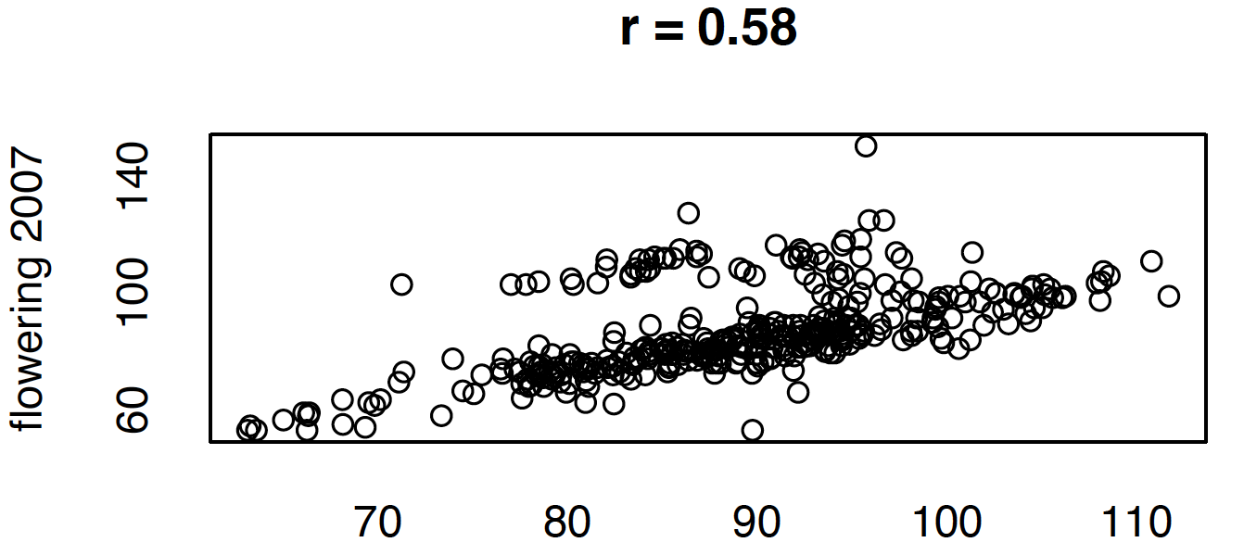
Predicted flowering time is correlated with those observed on 2007
# perform a linear regression to estimate the slope and intercept
res <- lm(y$Year07Flowering.time.at.Arkansas~pred$Prediction)
# plot the results
plot(pred$Prediction,
y$Year07Flowering.time.at.Arkansas,
ylab="flowering 2007", xlab="predicted",
main=paste("r =",round(sqrt(summary(res)$r.squared),2)))
abline(res)

Slide 31
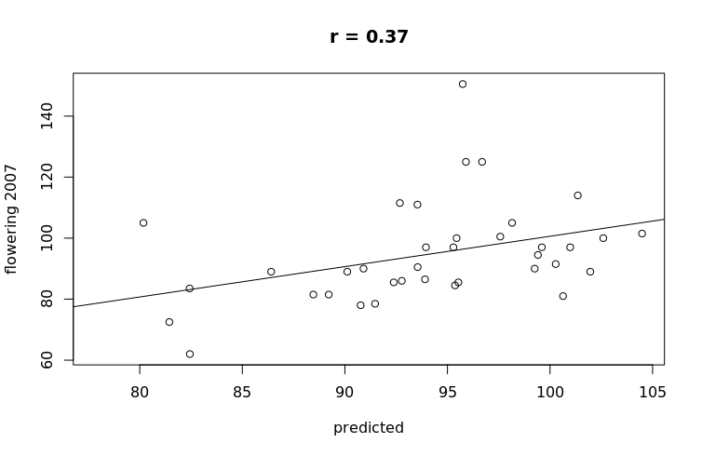
Predicted flowering time is correlated with those of missing accessions
NA06 <- is.na(y$Year06Flowering.time.at.Arkansas)
# perform a linear regression to estimate the slope and intercept
res <- lm(y$Year07Flowering.time.at.Arkansas[NA06]~pred$Prediction[NA06])
# plot the results
plot(pred$Prediction[NA06],
y$Year07Flowering.time.at.Arkansas[NA06],
ylab="flowering 2007", xlab="predicted",
main=paste("r =",round(sqrt(summary(res)$r.squared),2)))
abline(res)

Slide 32
(3) Exercise
Q1. Try GWAS of the flowering time at Aberdeen. How high is the heritability of this trait? At which chromosome can you find a peak?
Q2. Find HEADING DATE1 (Hd1: locus ID “Os06g0275000”). How distant is this gene from the top-scoring SNP? What is the ortholog of Hd1 in Arabidopsis thaliana?
Q3. Try gBLUP of the flowering time at Aberdeen. How large is the correlation between the predicted flowering time and observed one at Arkansas?
Q4. More? You can test any traits of your interests!

Slide 33
(4) Optional: GWAS group work (30 min. incl. a break)
Select 1 interesting trait for 1 group
1. Report its heritability,
2. perform MLM, and report –log10(p) of the most significant SNP,
3. and list up 2 interesting candidate genes (specified by the code like Os03txxxxx) <200 kb near the most significant SNP.
Send the results to me (narjes.yousefi2@uzh.ch).
One email from a representative is ok. Please add your group no. to the email title.

Slide 34
References
Lipka, A. E., Tian, F., Wang, Q., Pei er, J., Li, M., Bradbury, P. J. et al. (2012). GAPIT: genome association and prediction integrated tool. Bioinformatics, 28(18):2397-2399. https://zzlab.net/GAPIT/Rice Diversity website: http://www.ricediversity.org/
Sakai, Hiroaki, Sung Shin Lee, Tsuyoshi Tanaka, Hisataka Numa, Jungsok Kim, Yoshihiro Kawahara, Hironobu Wakimoto, et al. (2013). Rice Annotation Project Database (RAP-DB): An Integrative and Interactive Database for Rice Genomics. Plant and Cell Physiology 54(2):e6. https://rapdb.dna.a rc.go.jp/
Wang, Chongrong, Sheng Chen, and Sibin Yu. (2011). Functional Markers Developed from Multiple Loci in GS3 for Fine Marker-Assisted Selection of Grain Length in Rice. Theoretical and Applied Genetics 122(5):905–13. https://doi.org/10.1007/s00122-010-1497-0.
Wang, Jiabo, and Zhiwu Zhang. (2021) GAPIT version 3: boosting power and accuracy for genomic association and prediction. Genomics, Proteomics & Bioinformatics 19(4):629-640. https://doi.org/10.1016/j.gpb.2021.08.005
Zhao, Keyan, Chih-Wei Tung, Georgia C. Eizenga, Mark H. Wright, M. Liakat Ali, Adam H. Price, Gareth J. Norton, et al. (2011). Genome-Wide Association Mapping Reveals a Rich Genetic Architecture of Complex Traits in Oryza sativa. Nature Communications 2(1):467. https://doi.org/10.1038/ncomms1467.

