Slide 1
Fetch
Niloofar Arazkhani
Bahman 99

Slide 2
A simple fetch example
  The simplest use of fetch() takes one argument — the path to the resource you want to fetch — and returns a promise containing the response (a Response object).
  https://jsonplaceholder.typicode.com/
https://jsonplaceholder.typicode.com/users

Slide 3
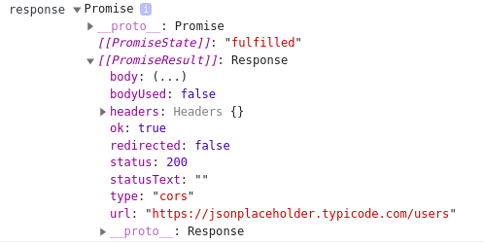
Response object
Readonly properties

Slide 4
Extract JSON body content from the eresponse
This is just an HTTP response, not the actual JSON.
To extract the JSON body content from the response, we use the json() method
.then when it is success
.catch when it is in error

Slide 5
Async Function

Slide 6
Get data from a file
Data set: .csv
https://people.sc.fsu.edu/~jburkardt/data/csv/csv.html

Slide 7
Show the data with canvas
Chart.js

Slide 8
THANKS

