Slide 1
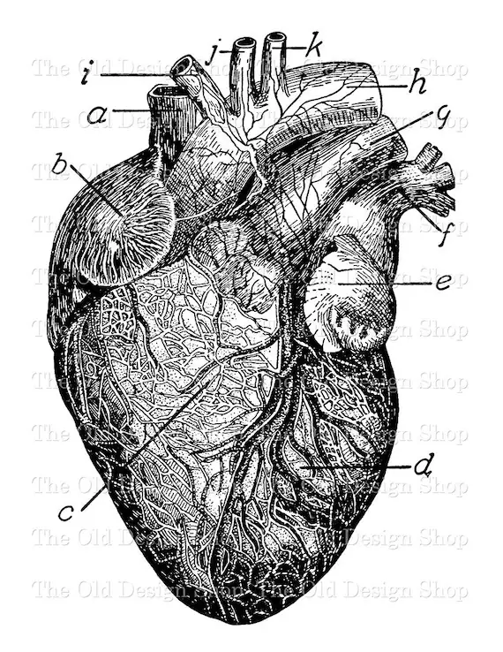
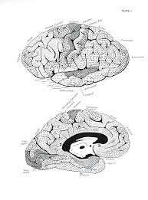
Causes of Death Our World In Data Data Visualization with Tableau (Option 2)
2024-01-16

Slide 2
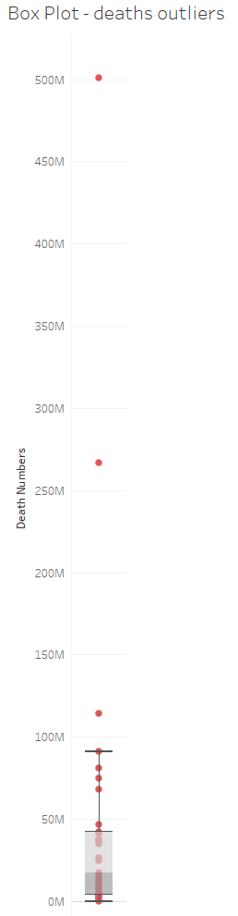
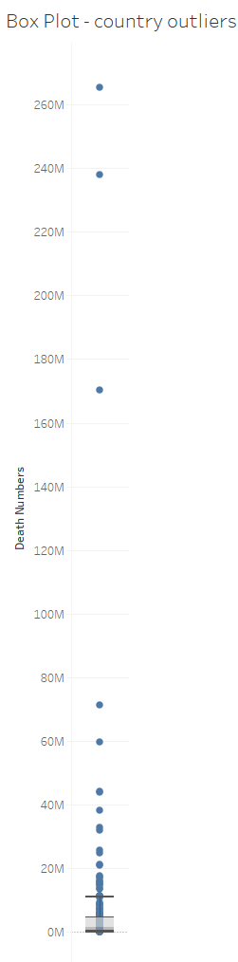
Project Flow Structure
Data connection
Data validation
Exploration through visualization
Pulled in population data from other source
More data viz/exploration to formulate questions
Dashboard creation!

Slide 3
Questions
Main dashboard question: Around the world, what are the top causes for death? And how have they changed over time?
Forecast: what could this look like in the coming years ahead?
Are there any countries with disproportionately large deaths per capita?

Slide 4
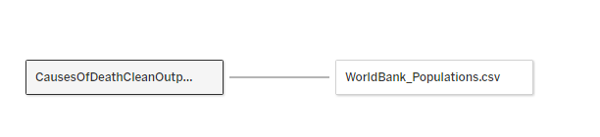
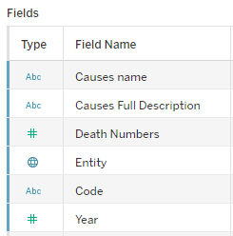
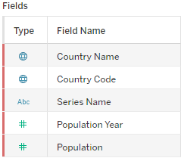
Features of the dataset

Slide 5
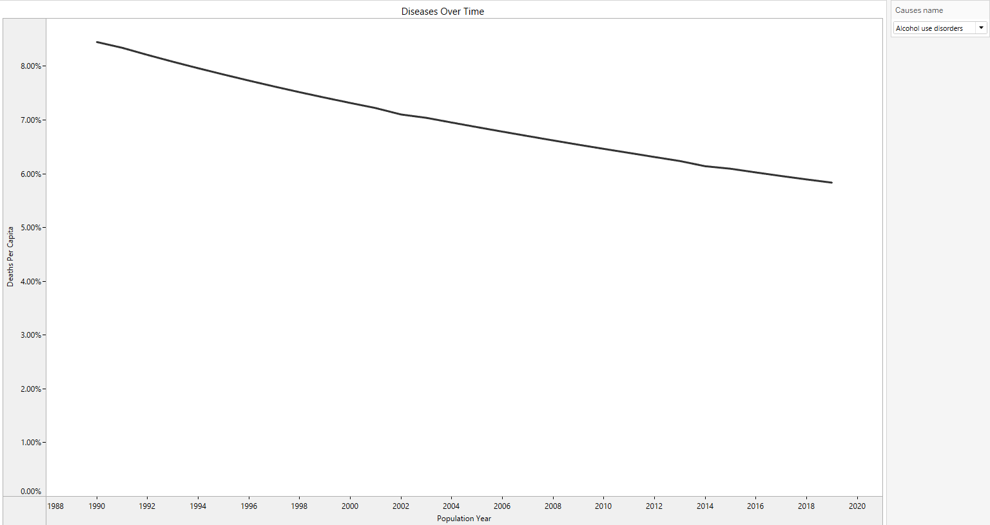

Slide 6
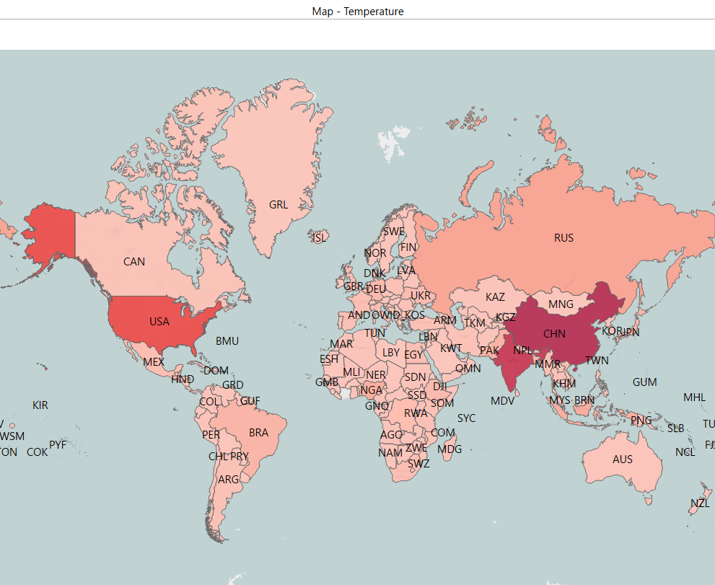

Temperature Map

Slide 7
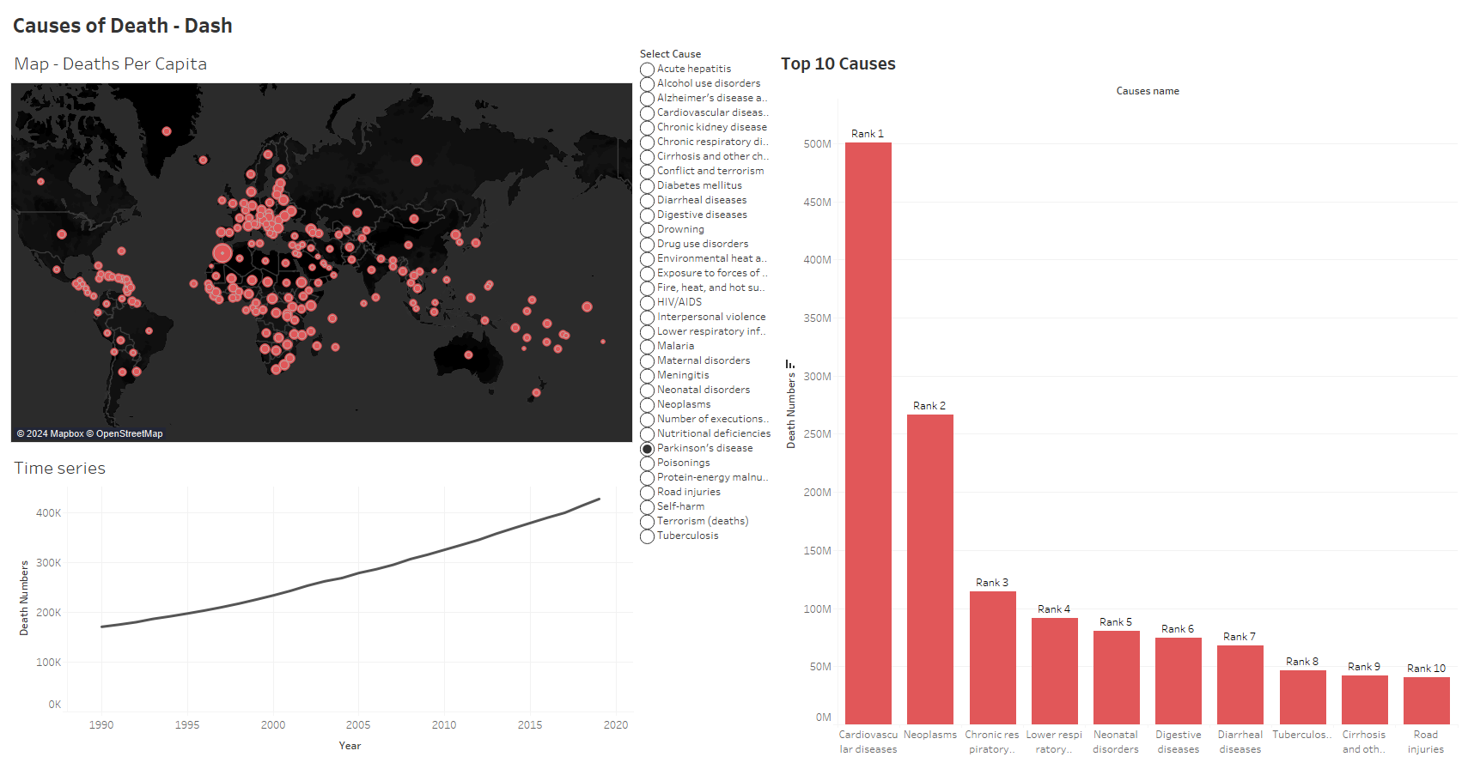

Slide 8
Challenges
Future Goals
Indecision about direction
Time constraints
Skewed data
Data Cleaning
Data Wrangling
Interpreting journal specific data
Clean raw data file from Kaggle instead of taking already cleaned output Group countries by region/continent Bring in other series’ (i.e. education, poverty, nutrition stats etc.) Optimize Tableau for different views (i.e. PowerPoint, Pdf, different styles, formats etc.) and consistent design

Slide 9
Thank you

