Slide 1
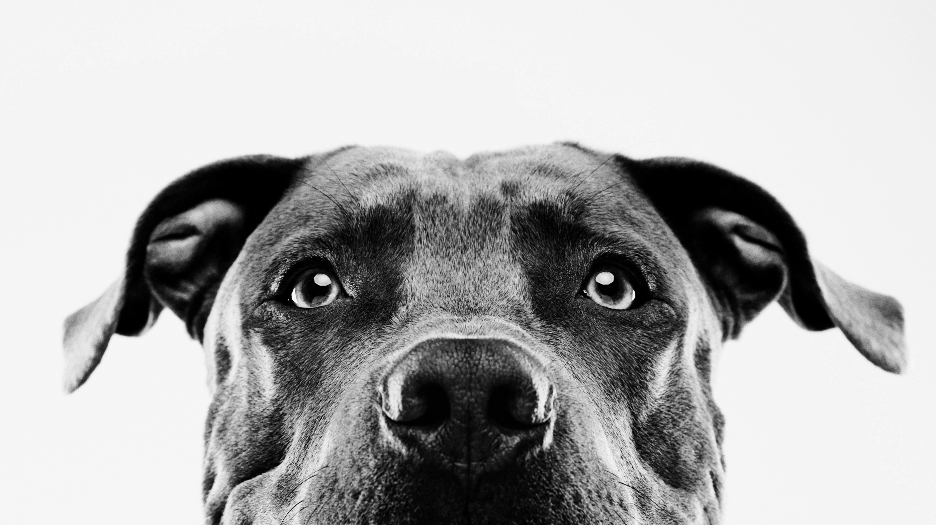
Doggo Data
Dog breed data analysis

Slide 2
introduction
Collection
&
analysis
Diagnosing insights
Polishing
&
Presenting

Slide 3
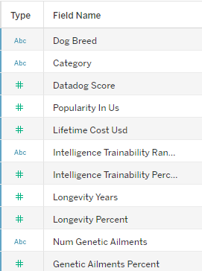

Exploratory data analysis
Gathered data from Kaggle, Google research, API
Exploratory techniques
Tech stack – Excel, Jupyter lab- python + various libraries Pandas, Numpy, MatplotLib/Seaborn
Data Cleaning & Wrangling

Slide 4
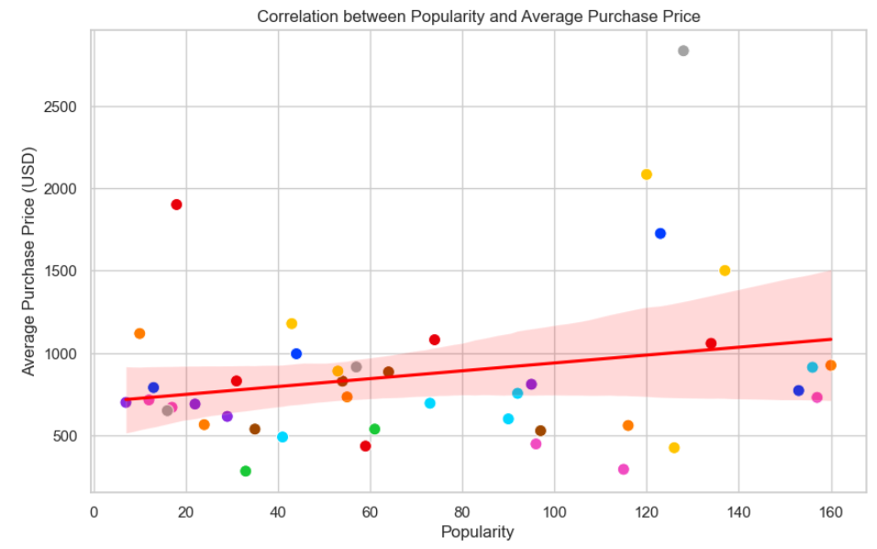
EDA Continued…

Slide 5

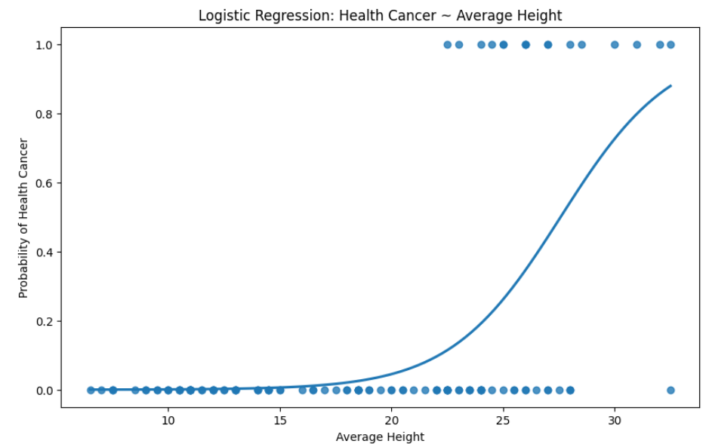
Statistical model
Does the size of a dog affect their predisposition to get cancer?

Slide 6
User experience - tableau
Dashboard 1 – Cost Breakdown
prospective buyers shortlisting breeds can see associated costs
Dashboard 2 – Character traits & ailments in breed selection
prospective buyers can view and filter traits/health risks

Slide 7
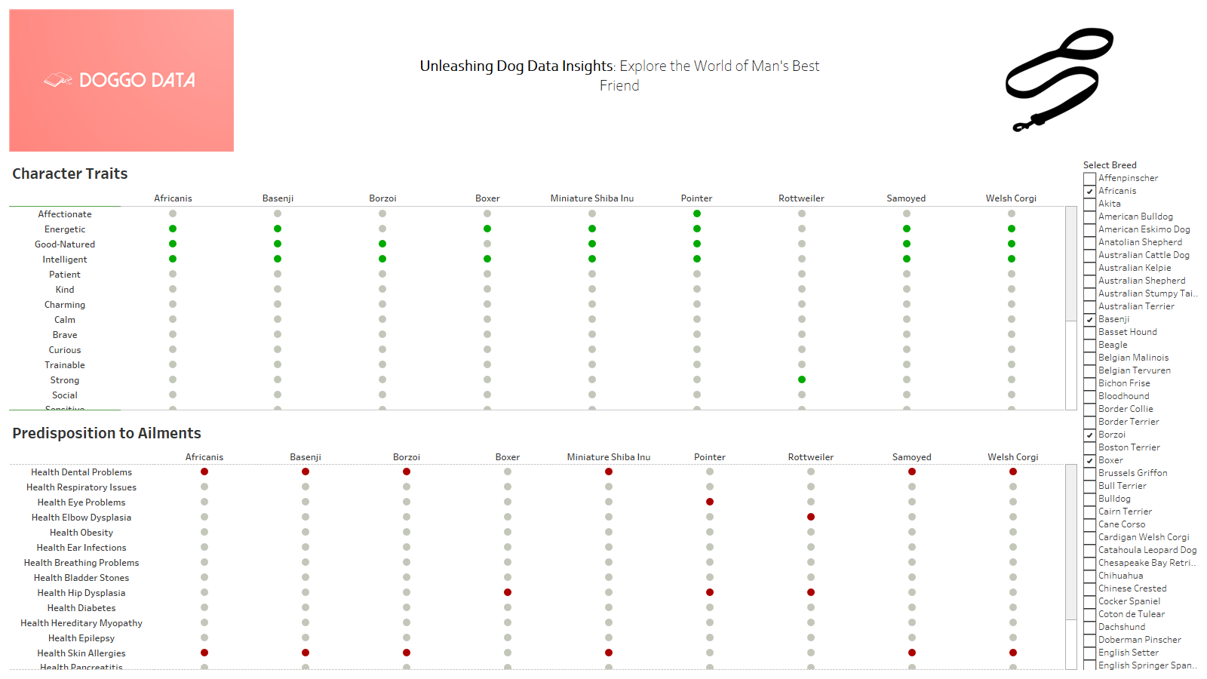

Slide 8
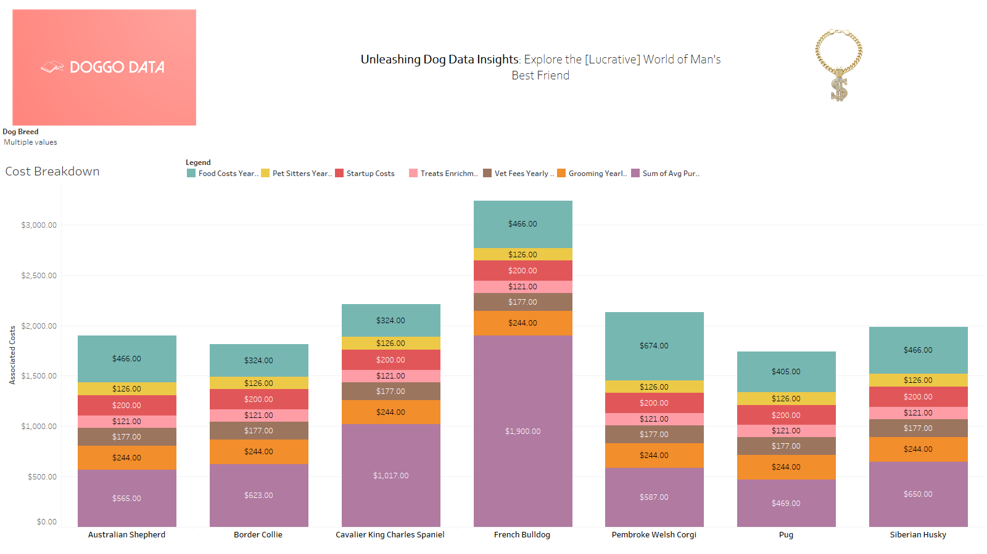

Slide 9
Future goals
improve and enhance
More robust data gathering/clean i.e. standardization via breed code
More statistical modelling
Code quality – modular
API integration – request pull in images

Slide 10

Thank you

