Slide 1
GCN circular viewer
Donggeun

Slide 2
Structure
Notice
Circular
GCN Viewer
Flask
React

Slide 3
workflow
Notice
Processing
(Tom)
Circular
Divide sections
(e.g., subject, body, …)
Parse Trigger time, RA, DEC, …
Search for the event name & the observatory from subject
Select the best event information
Event association
(Eric)
New GCN viewer

Slide 4
workflow I
Notice
Processing
(Tom)
Currently, I used only Swfit and Fermi notices.
Swift:
1. Check comment fields
2. If “This is a GRB.” exists. parse trigger time, RA, DEC, error, and Swift trigger number
Fermi:
1. check comment fields
2. If “This is likely a Long GRB” or “This is likely a Short GRB”, parse trigger time, RA, DEC, error, and Fermi trigger number
Is there a better way to determine that a notice is related to a real GRB?
Circular
Divide sections
(e.g., subject, body, …)
Parse Trigger time, RA, DEC, …
Search for the event name & the observatory from subject
Select the best event information
Event association
(Eric)
New GCN viewer

Slide 5
workflow II
Notice
Processing
(Tom)
Circular
Trigger time: the earliest trigger time
Localization: if both Swift and Fermi notices exist, I adopt Swift one. Later, I will compare the error size and adopt the better localization.
Divide sections
(e.g., subject, body, …)
Parse Trigger time, RA, DEC, …
Search for the event name & the observatory from subject
Select the best event information
Event association
(Eric)
New GCN viewer

Slide 6
workflow III
Notice
Processing
(Tom)
Circular
Parse Trigger time, RA, DEC, …
Divide sections
(e.g., subject, body, …)
Event name:
For GRBs, currently I used the list of event names provided by Eric. However, this list will be automatically obtained and updated with notices later (the event association).
For others, I parsed event names from circulars (e.g., SYYMMDDabc).
Observatory:
The list of observatories can be manually updated with the GCN viewer.
Search for the event name & the observatory from subject
Select the best event information
Event association
(Eric)
New GCN viewer

Slide 7
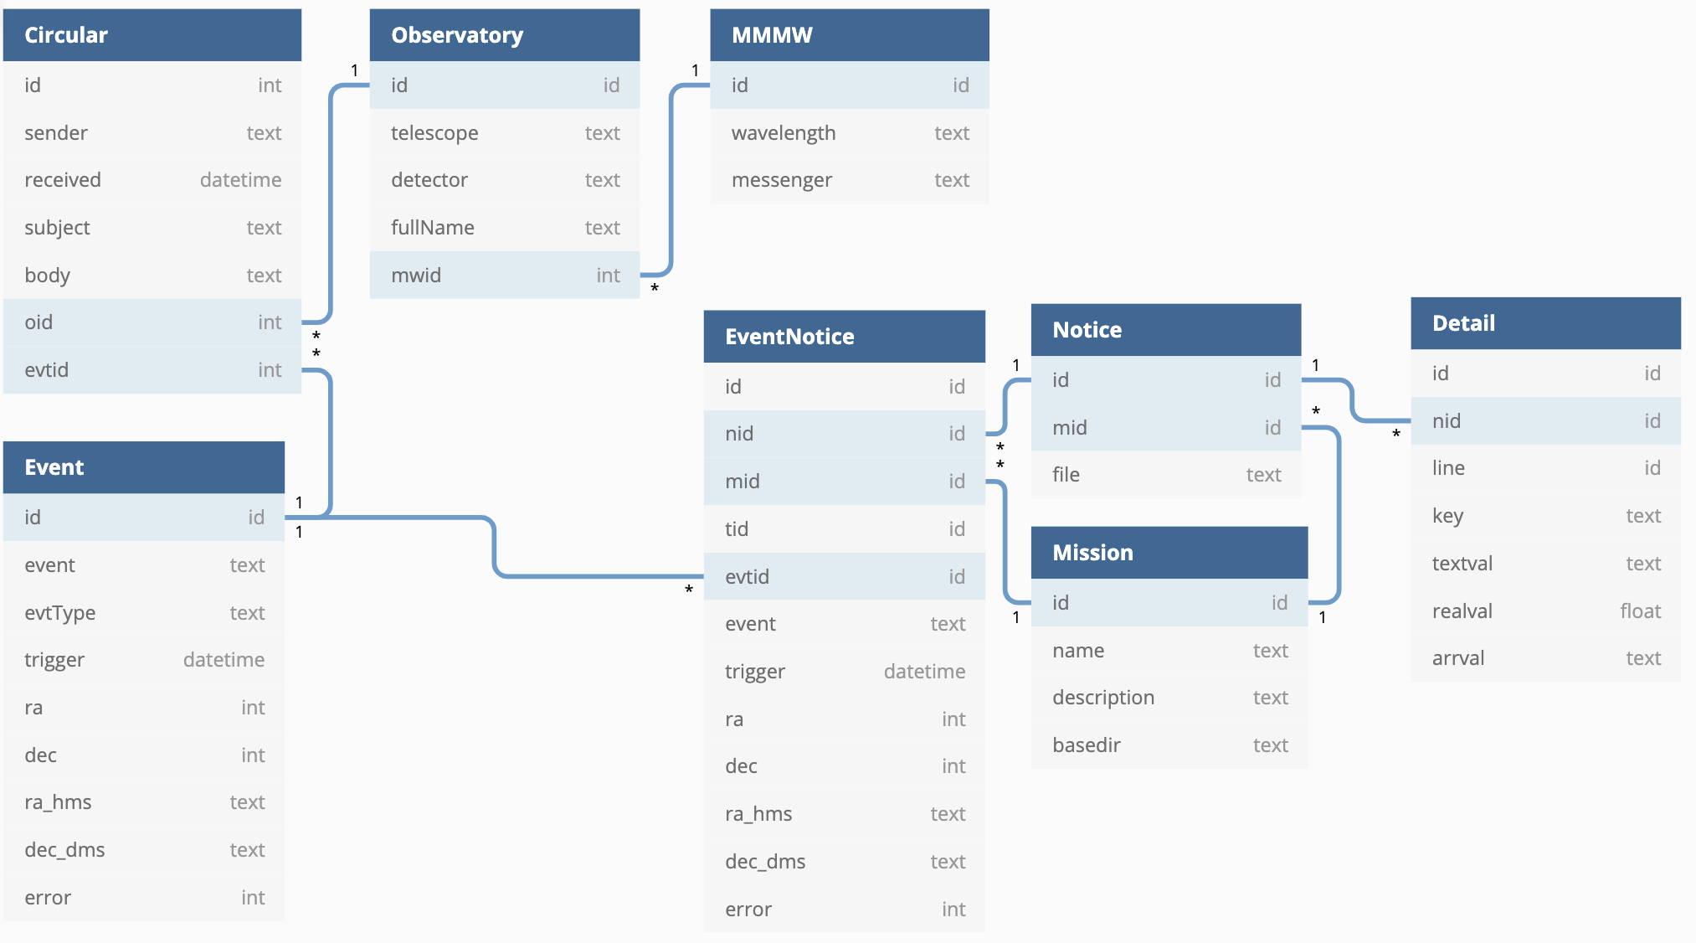
Relational database

Slide 8
Relational database
Workflow III
Workflow I
Workflow II

Slide 9
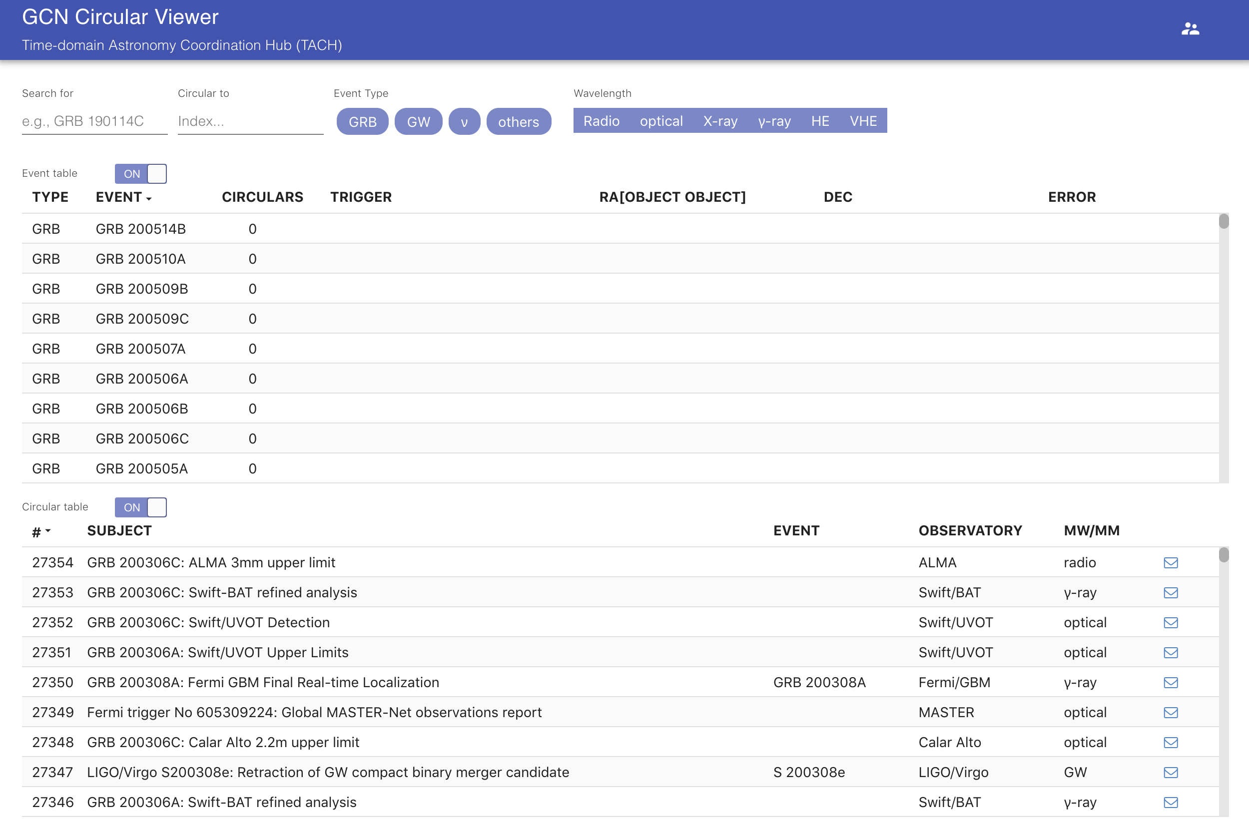
GCN circular viewer
Admin mode
Filter menu
Event table
Circular table

Slide 10
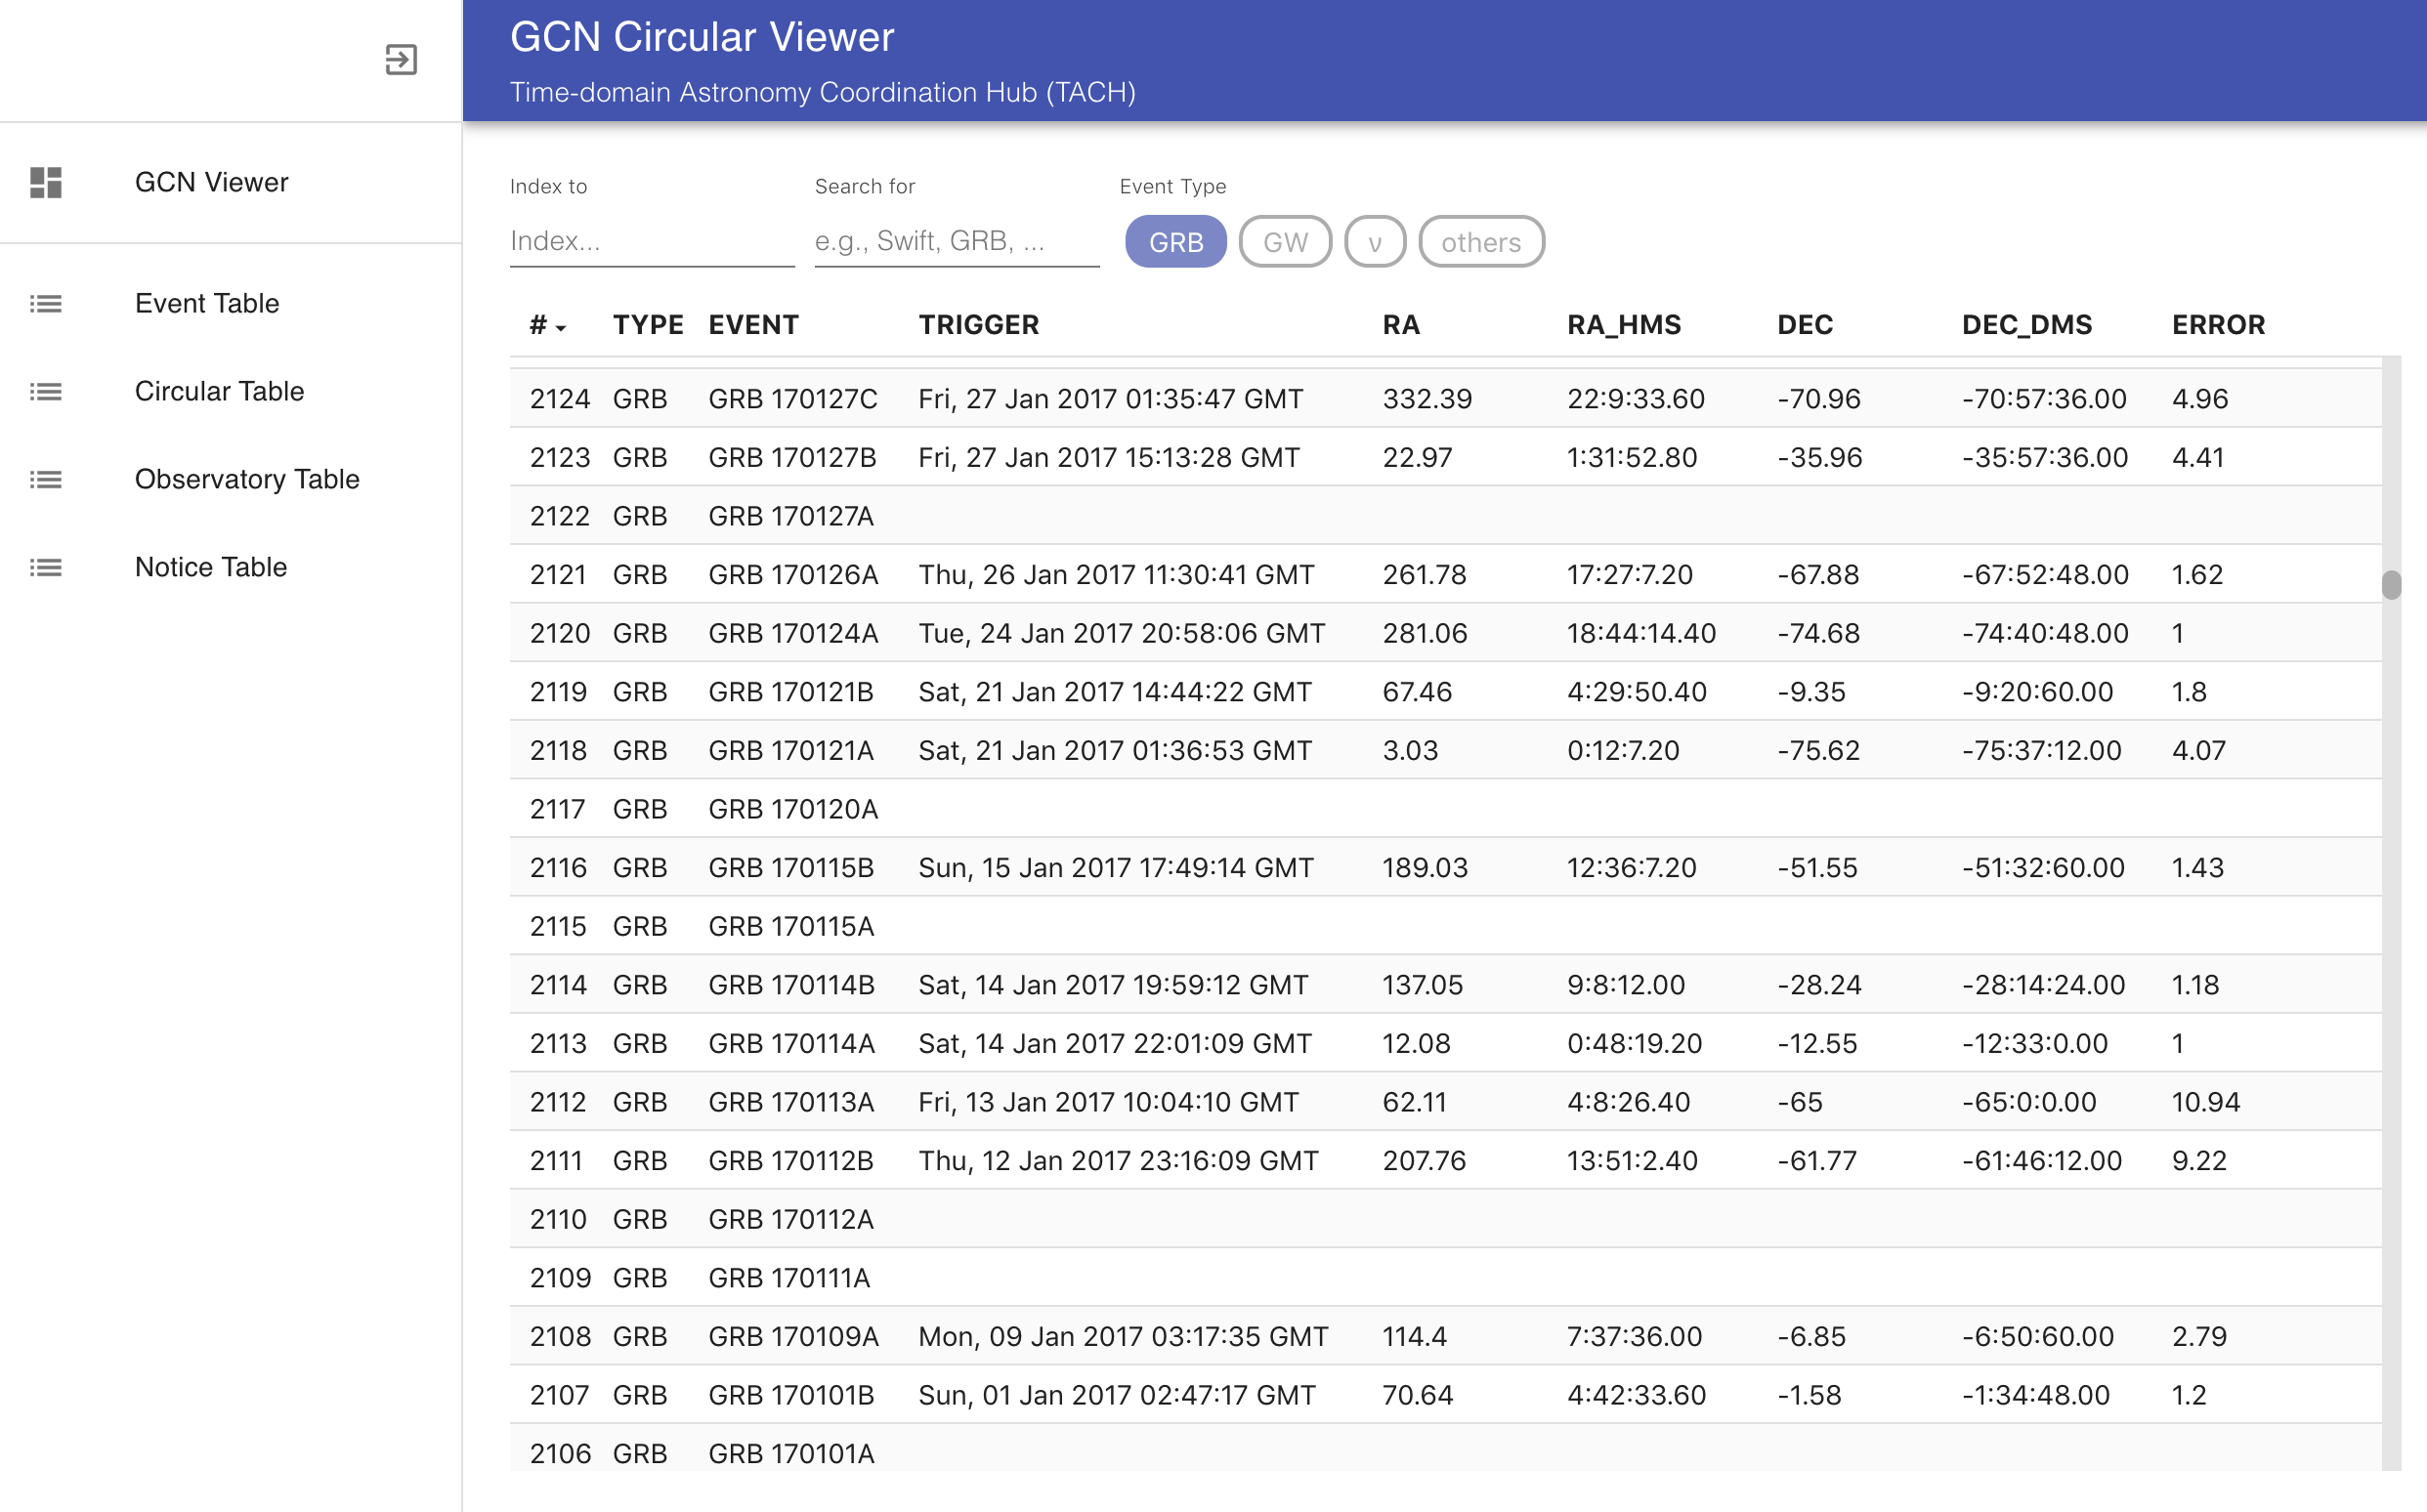
GCN circular viewer – Admin mode
Menu
Event.db
Circular.db
Observatory.db
Notice.db
Database
Event.db: only show
Circular.db: show, modify (event name, observatory)
Observatory.db: show, add, modify
Notice: only show (very slow, I am not sure this is needed)

Slide 11
Next steps
0. Currently, I used the archived circulars and notices (from Tom). However, we need a viewer whose database is updated automatically when a new circular or notice is received (this may be related to Kafka).
1. Automatic event association (use only temporal information).
2. Improve methods for parsing information.
Currently, neutrino events are not correctly parsed.
We need to use notices from other observatories (e.g., Integral)
Other event types should be added.
3. Improve admin mode.
When a new observatory is added, check all circulars
Others ?

