Slide 1
NASA Hunch Presentation
NASA Hunch admins

Slide 2
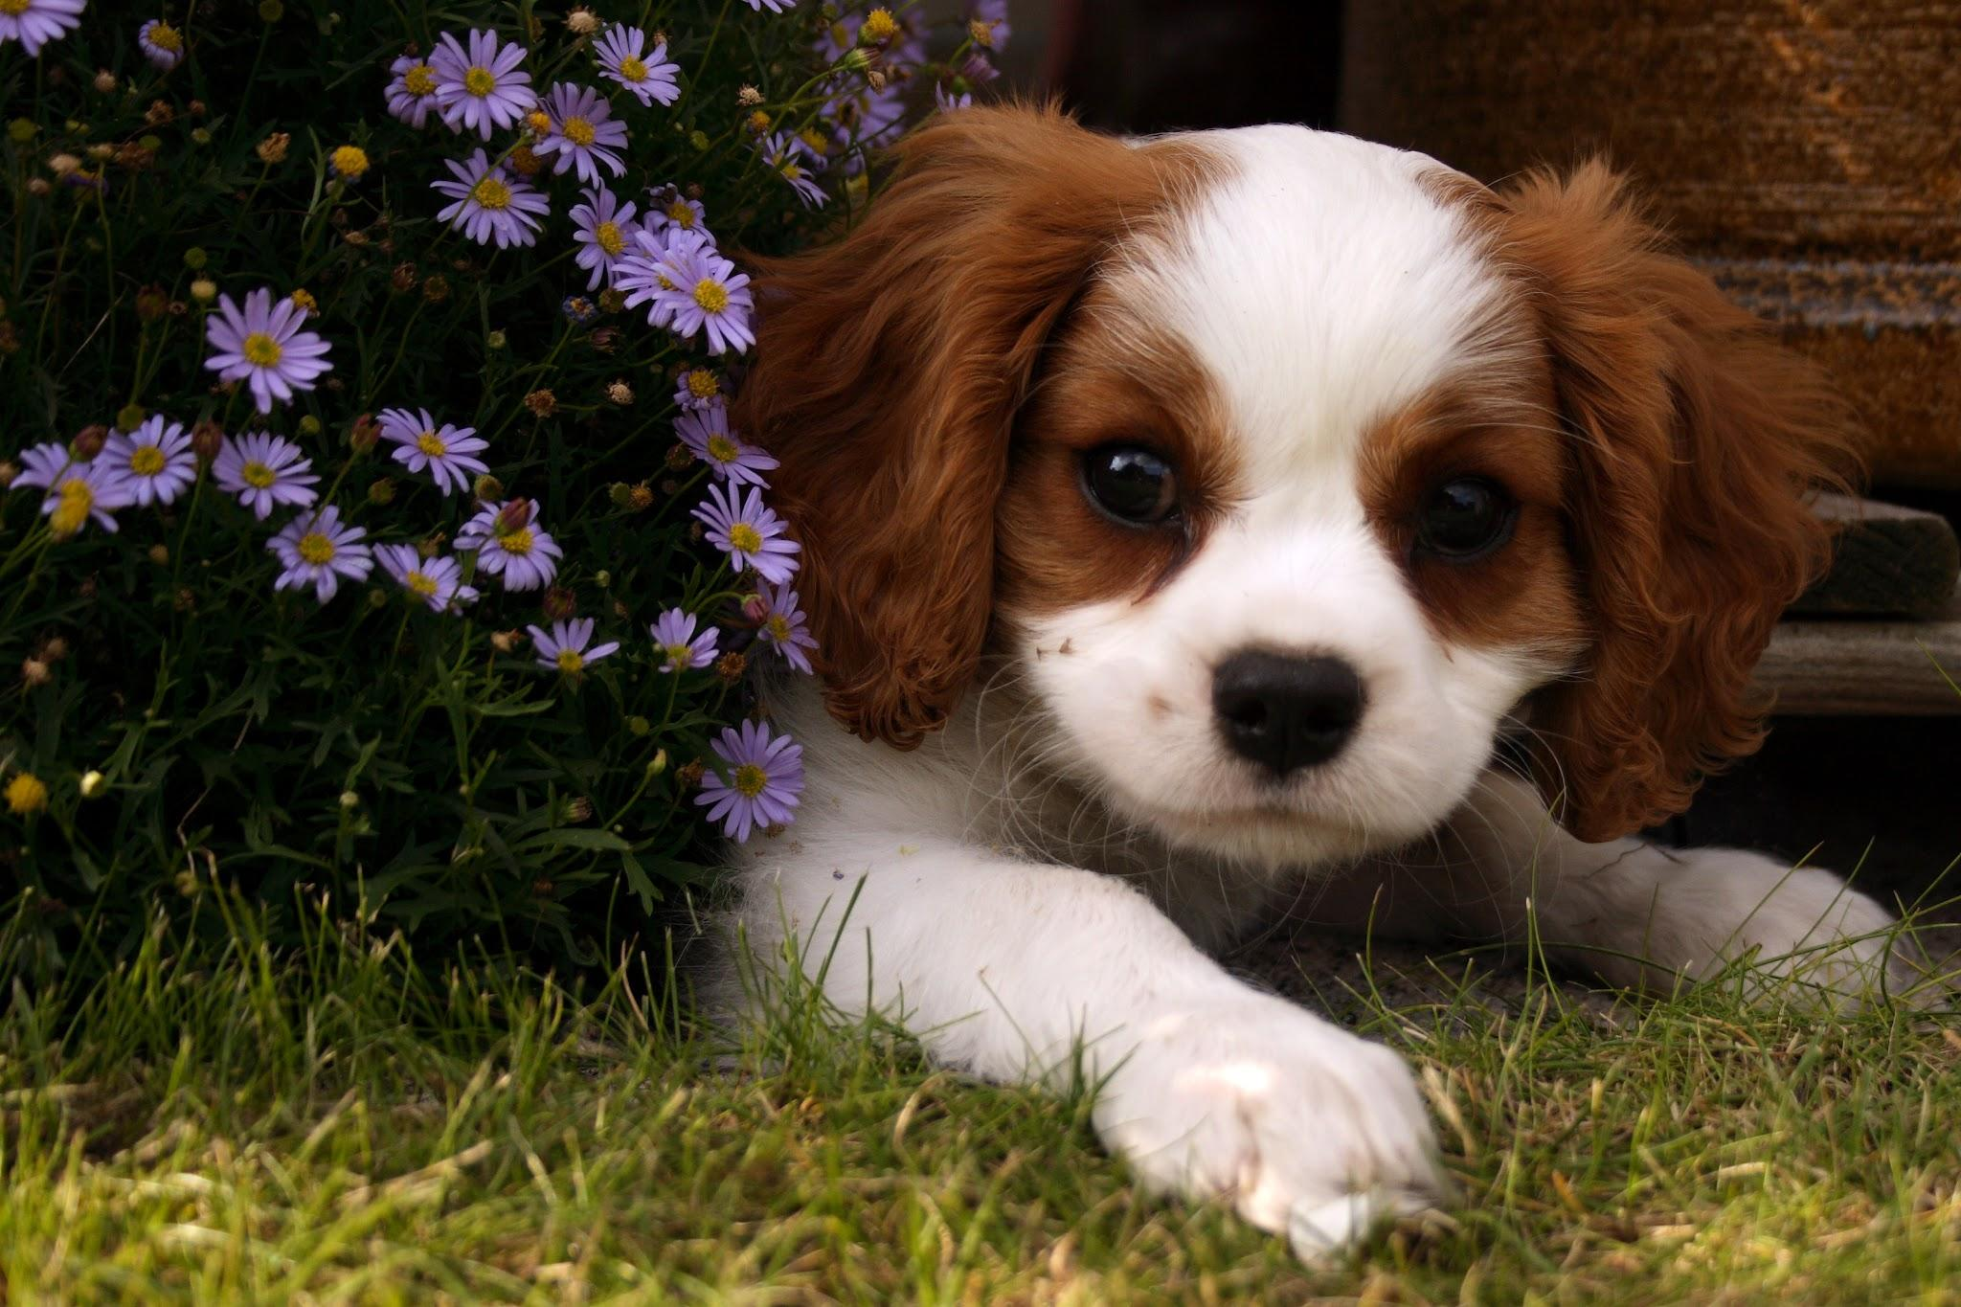
NASA Hunch Mascot
NASA Hunch Dog Mascot

