Slide 1
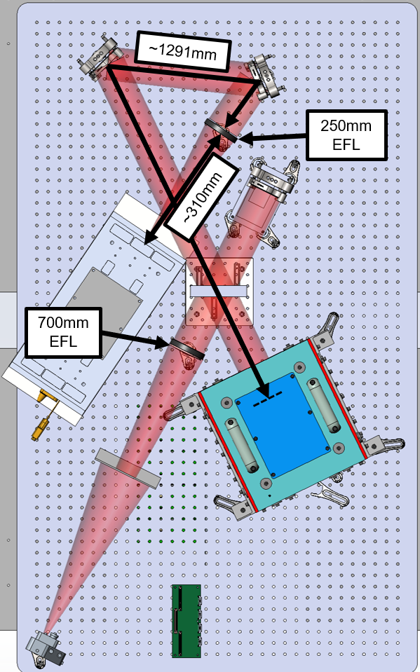
VSG2 Basic Information
VSG2 Optical Layout
Fold 1
~1175 mm
VSG2 is a Twyman-Green interferometer with the camera focused on the DM, which serves as the system pupil.
It will be updated to include Zernike Wavefront Sensor (ZWFS)
Source: frequency stabled He-Ne laser feed into SM fiber
Baffle to block excessive light outside the L1
Collimate lens (L1): Achromatic Doublet Lens, Visible, D=76.2 mm, 750 mm EFL, 430-700 nm.
https://www.newport.com/p/PAC097AR.14
Beam splitter:
Focusing lens (L2): Achromatic Doublet Lens, Visible, D=76.2 mm, 250 mm EFL, 430-700 nm
https://www.newport.com/p/PAC095AR.14
Total length from DM to focusing lens ~1175 mm
Camera: Andor NEO sCMOS
2160x2560 array of 6.5 µm pixels
Camera is focused to DM surface
Distance from focusing lens to camera is ~317 mm
Fold 2
L2
ND
~317 mm
Ref Mirr & PZT Stage
Camera
BS
L1
DM
Baffle
Source

Slide 2
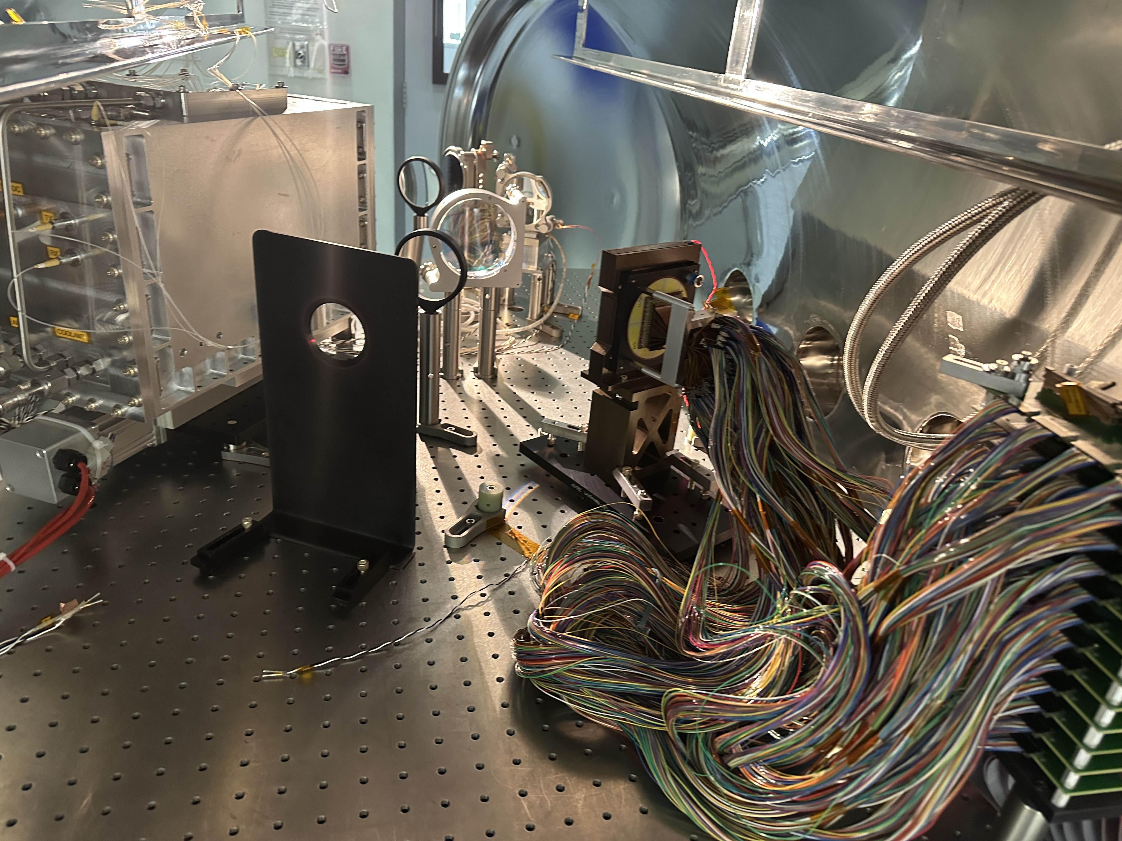
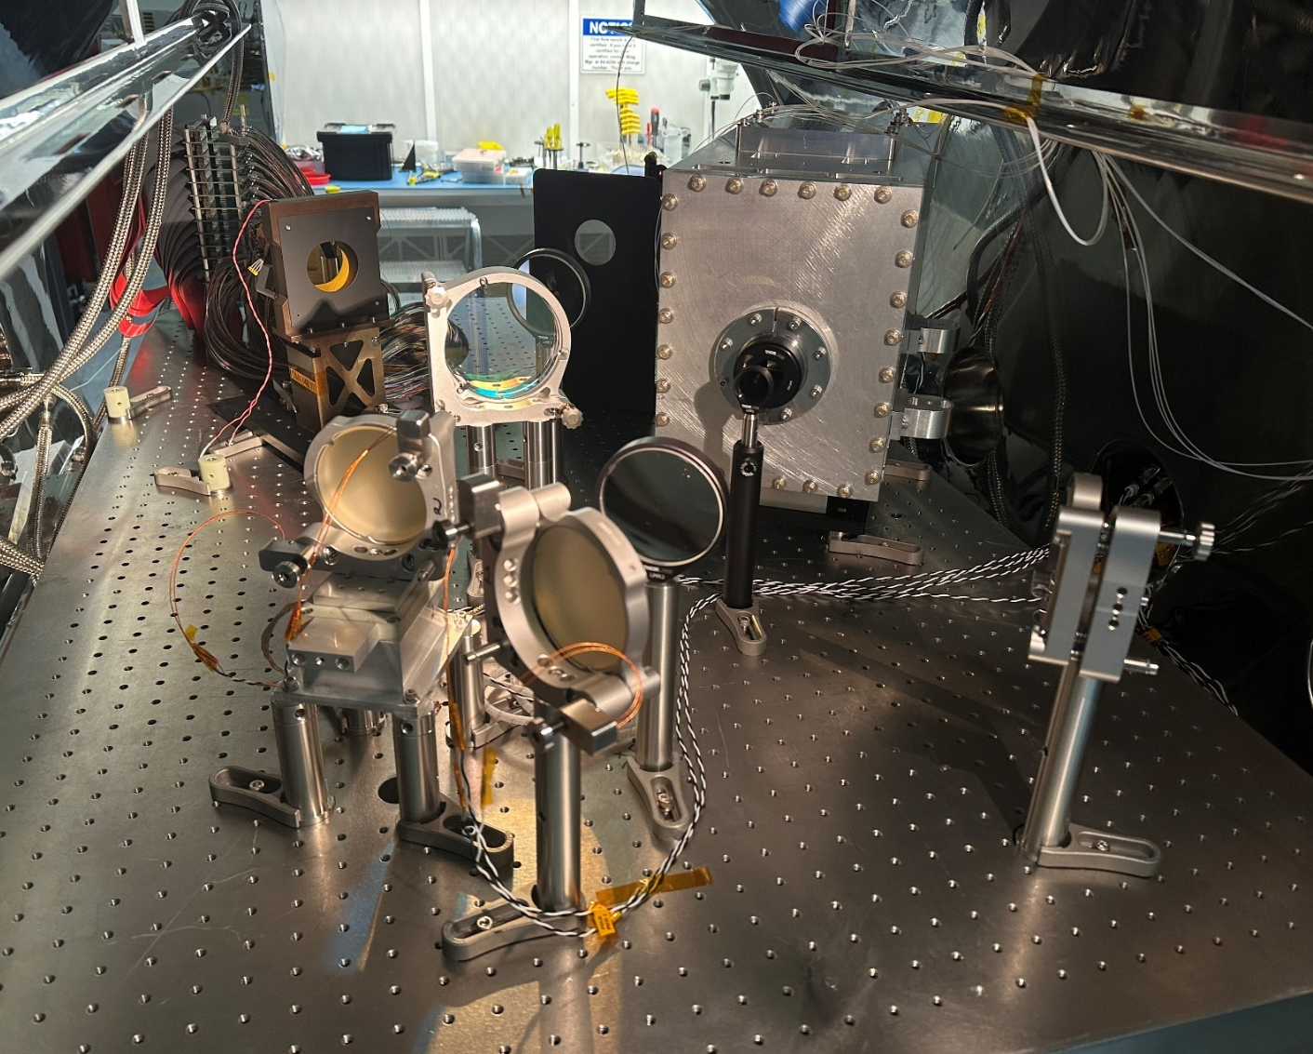
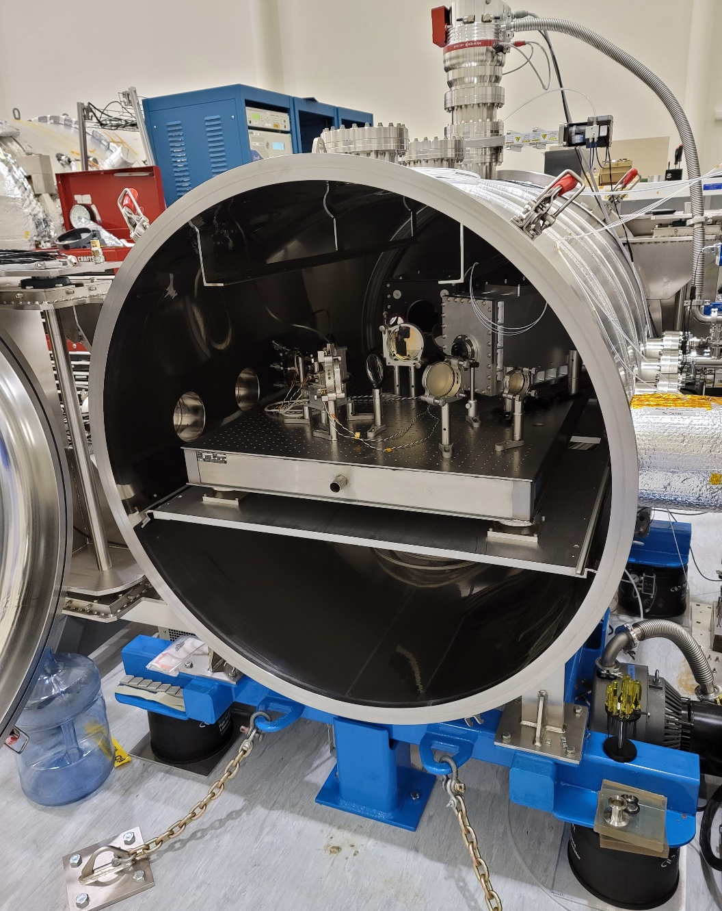
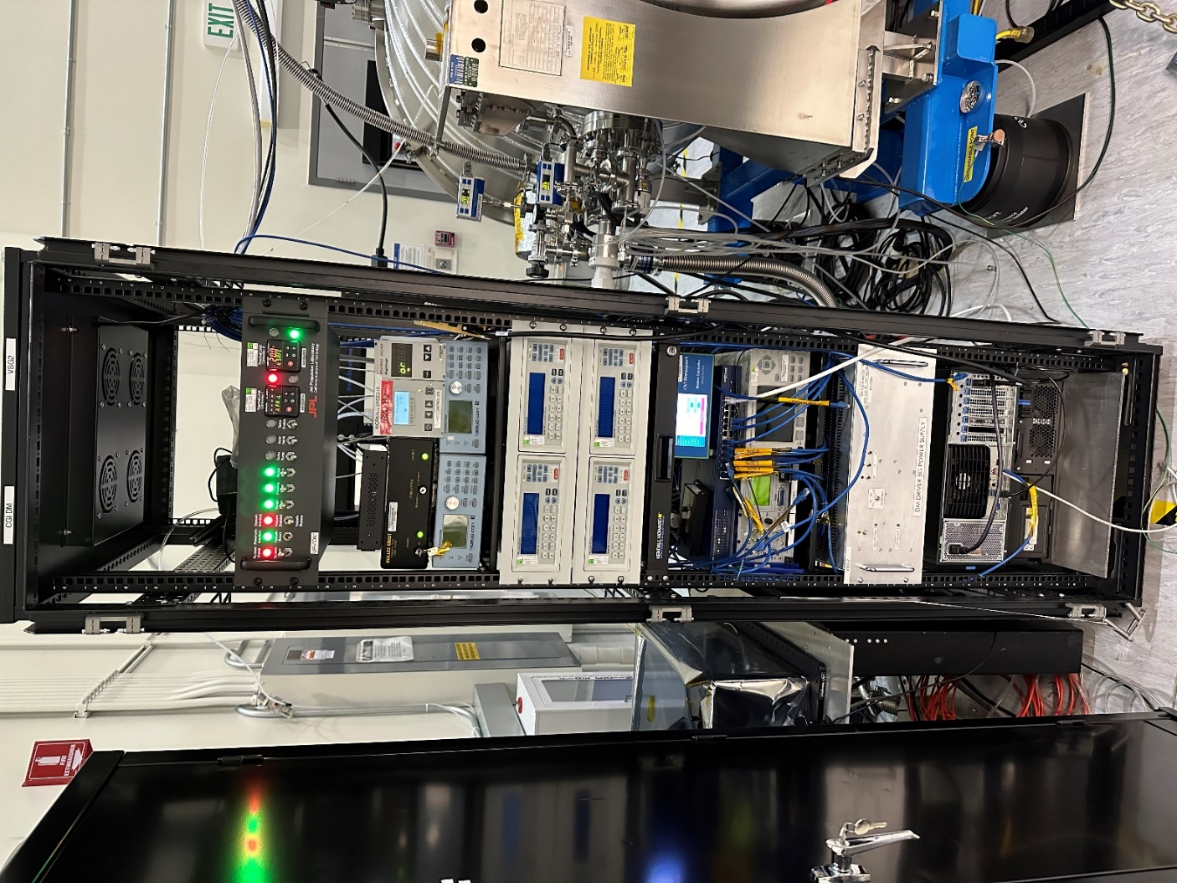
VSG2 In Picture
VSG2 Test Article: Deformable Mirror (DM)
VSG2 Bench Inside Chamber
L1
Baffle
Camera
DM
VSG2 Chamber
VSG2 Rack
BS
ND
Ref Mirr & PZT Stage
L2
Fold 1
Fold 2

