Slide 1
A 6 m unobscured coronagraph, end to end — with the loop closed
An optical design, its segmentation, its instrument with deformable mirrors and metrology, its error budget and its corrected drift — one model, one train
Conventions, stated once. Wavefront error is RMS at 500 nm at the exit pupil of the configuration being quoted — the telescope's own for the telescope-only slides, the coronagraph's once the instrument is attached (and every model-vs-engine check is evaluated at the surface its sensitivity model was harvested at). Contrast is the dark-zone mean over 3–15 λ/D, normalised to the bare on-axis peak of the same train; static scoring at a 1024 grid, the drift series at 512 (its control operator's grid). The diffraction limit is 0.071 waves RMS. Packaging is a deployed, diameter-only fit in an 8 m launch shroud.
Built with MACOS / mmacos. Every number on these slides is parsed from the committed stage reports; no figure was redrawn for the deck.
DRAFT (2026-08-27): the coronagraph-family slides (families / floors / Lyot trade) await Dave's review of the CF1c-CF3a numbers.

Slide 2
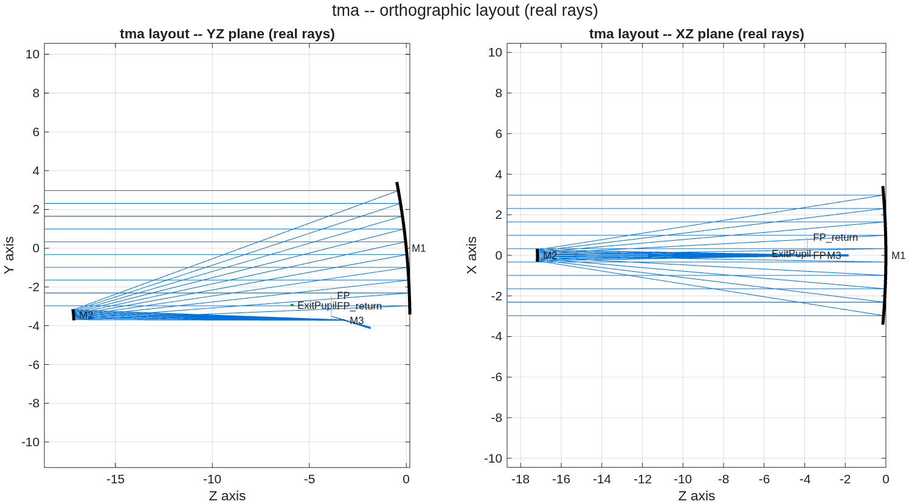
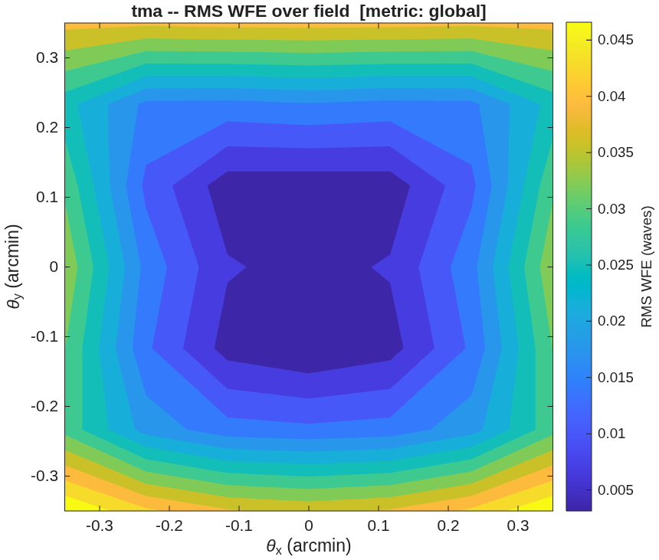
The telescope
0.0473 waves RMS across the field — diffraction-limited at 500 nm
• The design. A 6 m unobscured three-mirror telescope: three base spheres placed for packaging, fold tilts doing the unobscuration, all correction carried by Zernike surface departures. Field ±0.35 arcmin.
• The wavefront. 0.0473 waves RMS worst case over the field, against a 0.071-wave diffraction limit.
• The packaging. 7.450 m diameter against the 8 m shroud; 1185/1185 rays survive a standalone reload of the saved prescription.
• The one miss. Focal ratio f/25.39 against a requested f/12–20; not a tuning failure — see the backup.
The three-mirror train: light enters from the left, folds back to the secondary, returns past the primary to the tertiary and the focus.
Wavefront error over the design field. Worst corner 0.0473 waves.

Slide 3
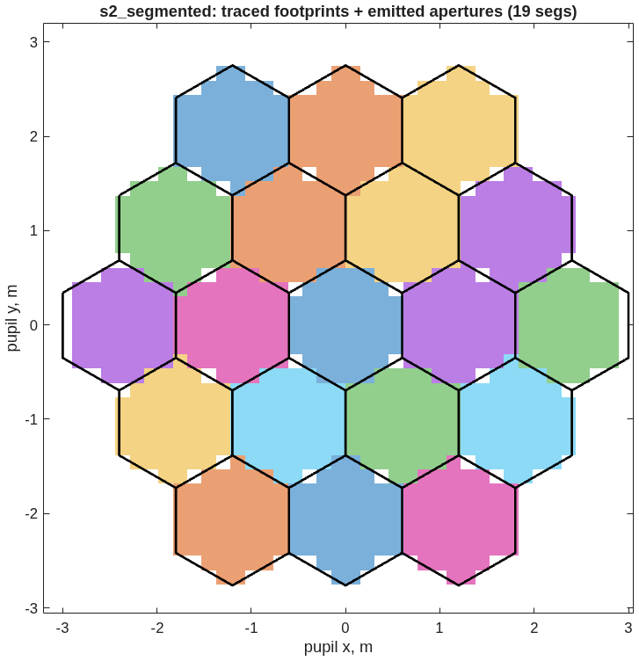
The segmented primary
19 segments, and a poke that stays where it is put
• The segmentation. 19 hexagonal segments, 1.2 m flat to flat, 25 mm gaps, each carrying the parent's solved figure and its own physical polygonal aperture.
• The apertures are real. 983 of 985 traced rays survive the declared polygons, and a standalone reload reproduces the count — the check that catches a wrongly-framed aperture.
• The check that matters. Displace one segment 10 nm along its normal: the wavefront responds 19.91 nm over the 52 rays on that segment and exactly zero over the other 930.
Traced footprints against the emitted aperture polygons. Colour is the segment a ray landed on; black is the declared glass.

Slide 4
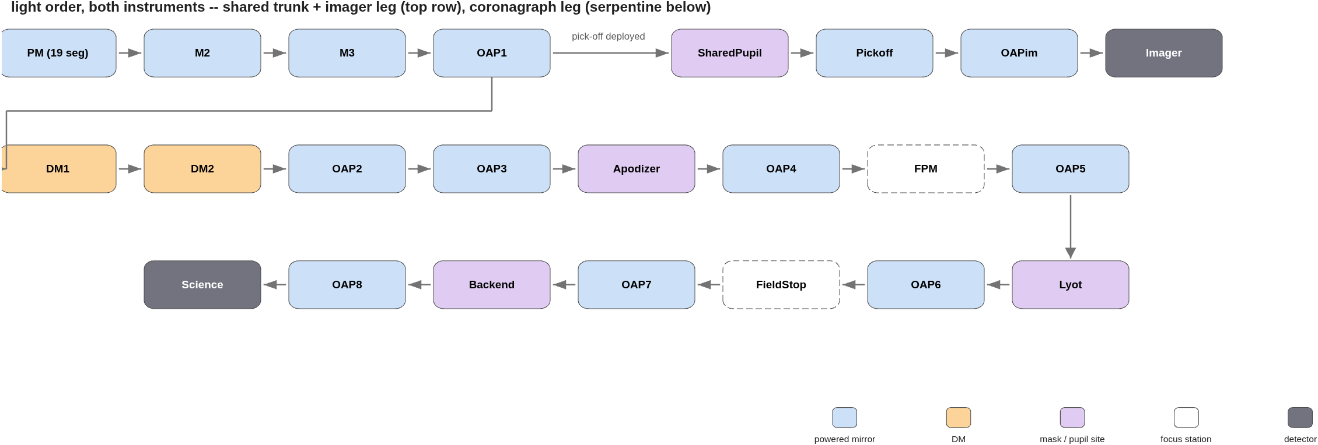
The instrument, in light order
Eight relay mirrors, two deformable mirrors, five mask and pupil stations, two cameras
• One train. From the segmented primary through the fold train to the collimated pupil, then the coronagraph leg — DMs, apodizer, occulter, Lyot, field stop, back-end pupil, detector — with a deployable pick-off feeding the imager. Spliced as 37 elements of one prescription; 983/985 rays, the telescope's own count.
Light order through both instruments, read from the prescriptions. Orange marks the deformable mirrors, purple the mask and pupil sites, dashed the focus stations.

Slide 5
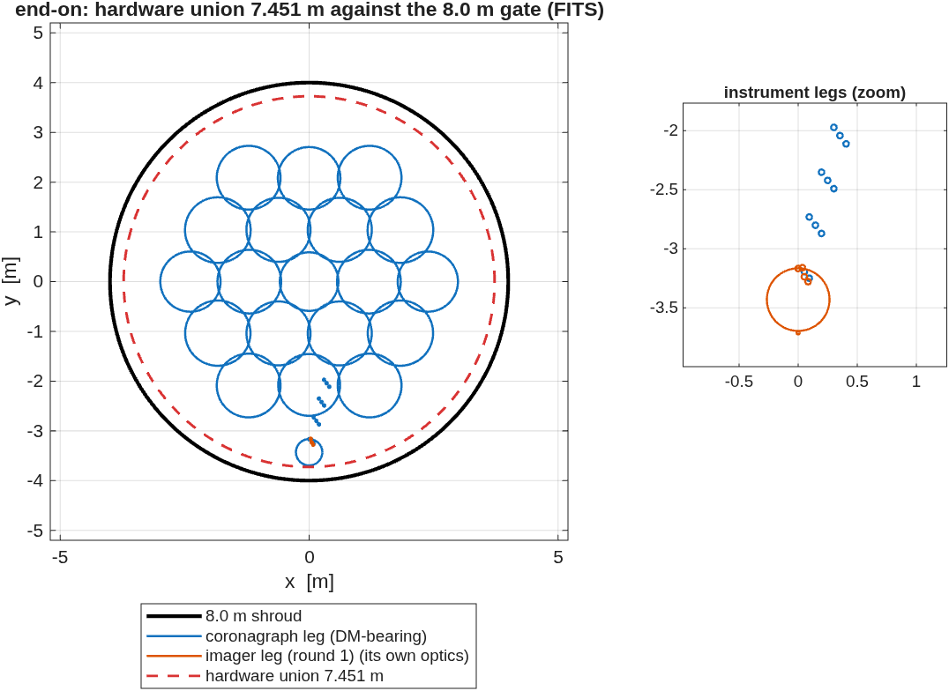
Two instruments, one shroud
A second camera still costs nothing in diameter
• The coronagraph leg carries the science train: 37 elements, chief ray through the diffraction model agreeing with the geometric one to 5e-16.
• The imager leg. A deployable pick-off just after the collimator feeds its own f/19 camera: 0.0042 waves RMS, Strehl 0.9993 — unchanged from the round-1 stage that built it, because the pick-off sits upstream of everything round 2 added.
• Both fit. 7.451 m against the 8 m shroud for either leg and for the union; the 6 m primary sets the envelope.
Both legs down the launch axis, inside the 8 m shroud circle.

Slide 6
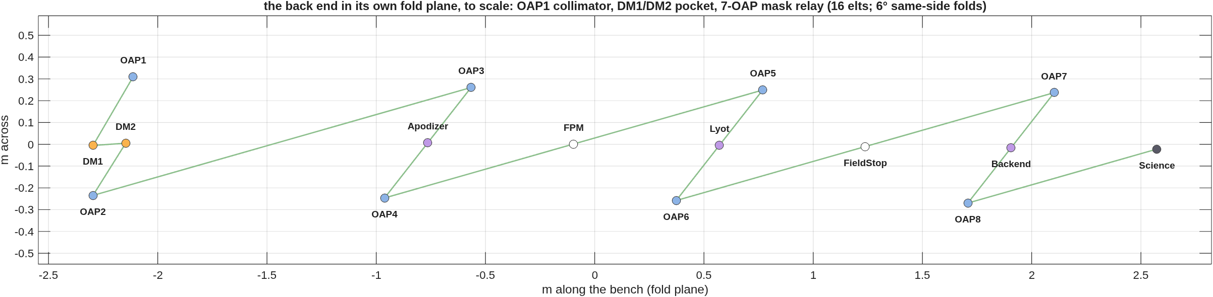
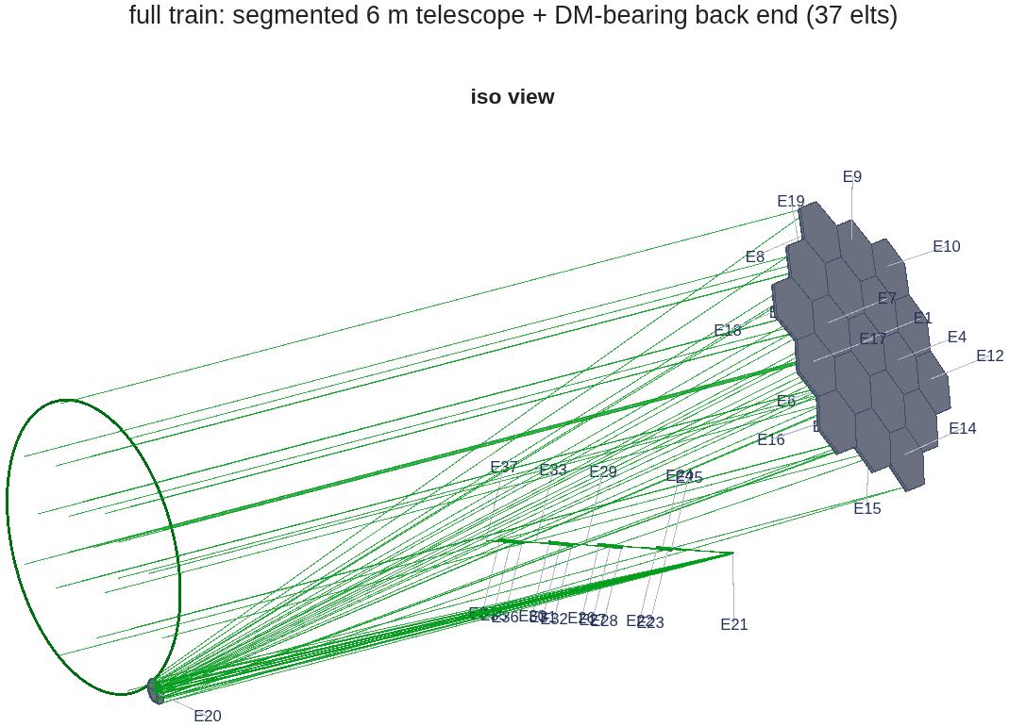
The back end on its bench
Eight relay mirrors and two DMs in a 5.1 × 0.6 m accordion
• The drawing is to scale, in the plane the folds live in: the collimator, the DM pocket, then the mask relay — each mask plane sitting between its focus and pupil mirrors.
• Near-normal folds (6°) keep each off-axis section gentle; folding every mirror to the same side ping-pongs the beam into a bench-sized pocket. The other choice fans the chain 120° and breaks the shroud — measured, in the backup.
• In the full train the back end is centimetre-class against the 6 m primary — the reason it gets its own drawing.
The back end in its fold plane, to scale. Orange: the DMs at the collimated pupil. Purple: apodizer, Lyot and back-end pupil sites. White: the occulter and field-stop foci.
The full train for scale: the 6 m segmented primary and the beam it feeds.

Slide 7
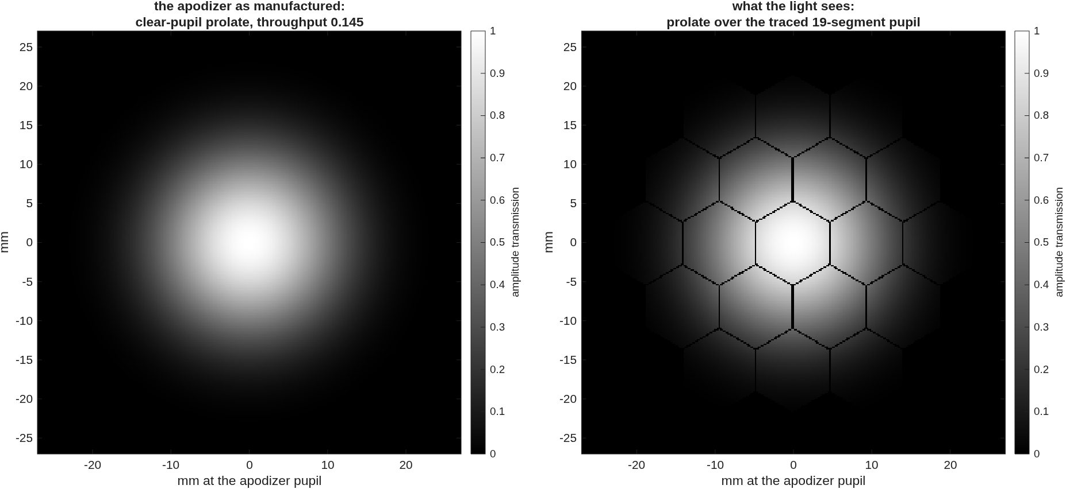
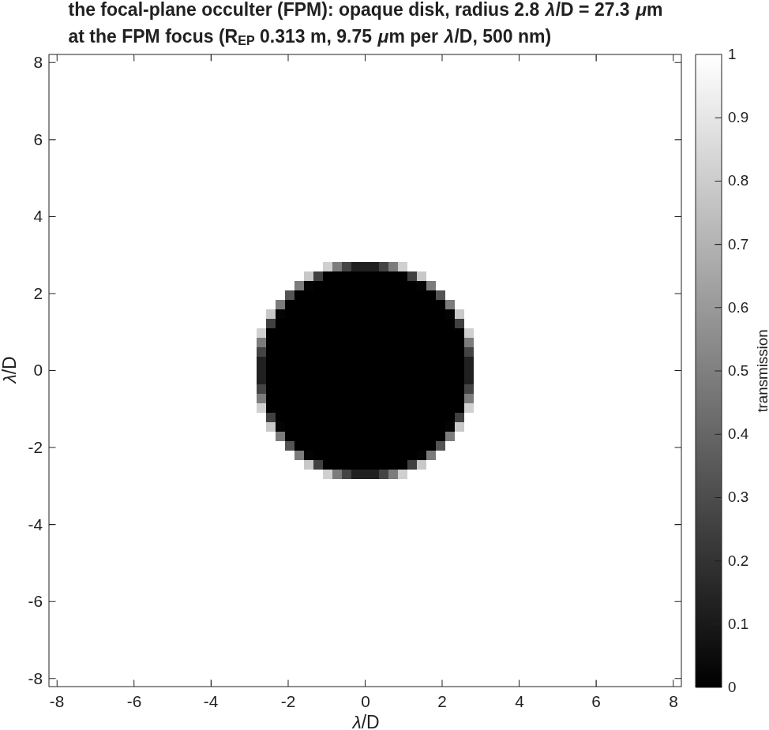
The masks, as physical objects
An occulter 2.8 λ/D across at a 500 nm focus is 27 µm of metal
• The occulter is an opaque disk of radius 2.8 λ/D at the intermediate focus — 27.3 µm physical radius at the measured 9.76 µm-per-λ/D focal scale, drawn from the same engine quantities the scoring chain uses.
• The apodizer is the clear-pupil prolate the coronagraph is scored with, shown as manufactured and as the light sees it — over the traced 19-segment pupil, gaps and all.
• Both figures are the scoring masks rebuilt from the scoring parameters, not illustrations.
The apodizer: the prolate transmission profile (left) and the same profile over the traced segmented pupil (right), mm at the 47 mm pupil.
The focal-plane occulter, transmission against λ/D; the physical radius is stated on the figure.

Slide 8
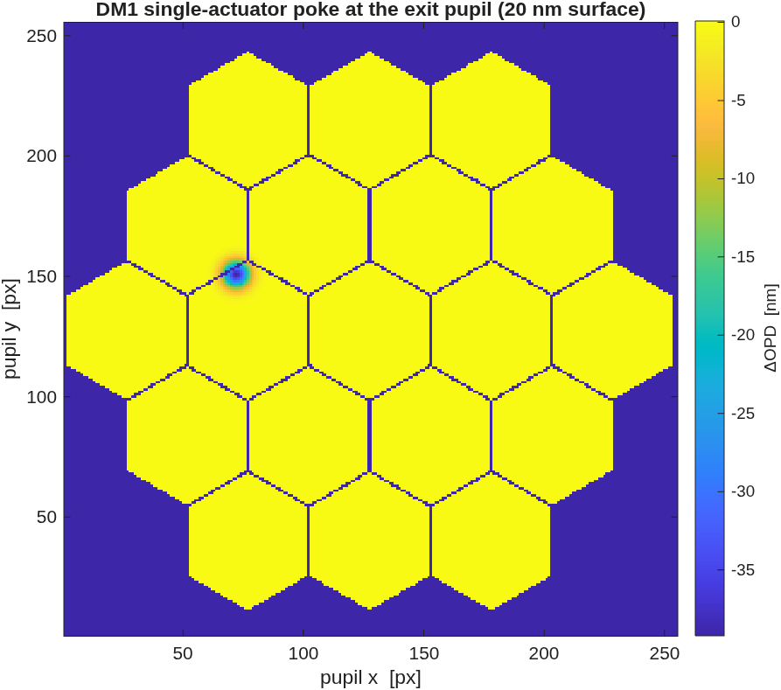
The deformable mirrors are real
A 20 nm actuator poke lands where it is put, at twice the surface
• The model. Two 32×32-actuator DMs as grid-data surfaces in their own frames, 880 actuators each inside the 47 mm beam, influence functions with nearest-neighbour coupling.
• The gate. One actuator poked 20 nm, half a pupil radius off centre: the exit-pupil wavefront answers with 3.92e-08 m peak against 4e-08 expected (twice the surface, for a mirror), 100% of the response energy within 0.15 pupil radii of the peak, peak at 0.53 radii off centre.
• Why it is a gate. The failure mode of a wrongly-framed grid surface is a response painted at the pupil centre — localisation is the proof the actuator geometry is right.
The single-actuator response at the exit pupil: localised, off-centre, 2× the commanded surface.

Slide 9
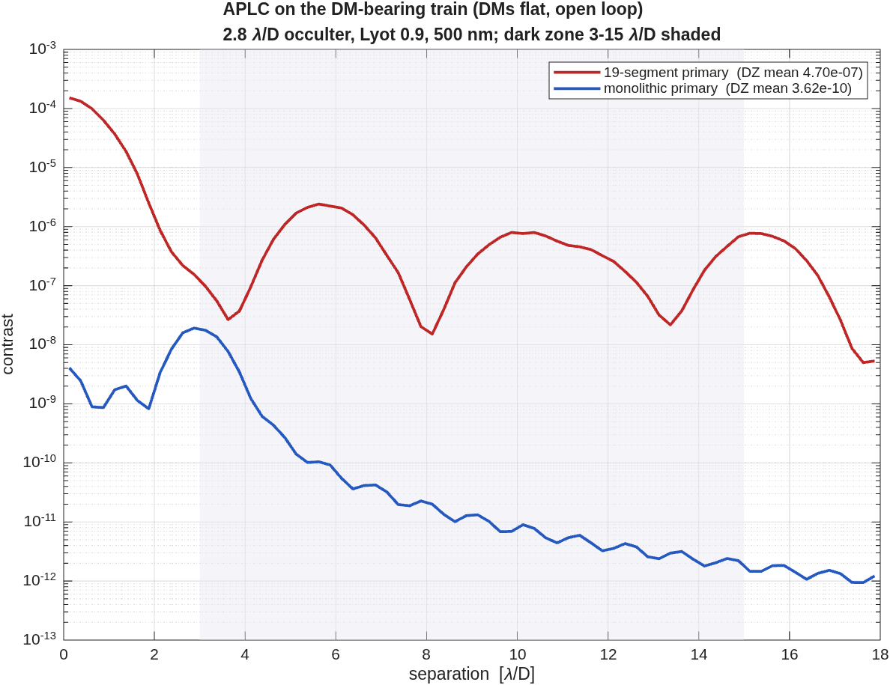
What the segment gaps cost
1298× in dark-zone contrast, same mask on both apertures
• The measurement. The same apodized-pupil Lyot coronagraph on the segmented primary and on a monolithic twin of the identical telescope.
• Segmented: 4.705e-07 mean contrast, 6.18e+03 on-axis suppression.
• Monolithic: 3.624e-10 mean, 2.82e+07 suppression.
• The ratio is the gaps and nothing else — 1298× in the mean, 3809× in the median; both trains share the same wavefront.
• These are open-loop numbers: the DMs are flat here. The loop slide prices what they buy.
Radial contrast, both apertures, dark zone shaded. The segmented curve plateaus where the monolithic one keeps falling — that plateau is gap-scattered light.

Slide 10
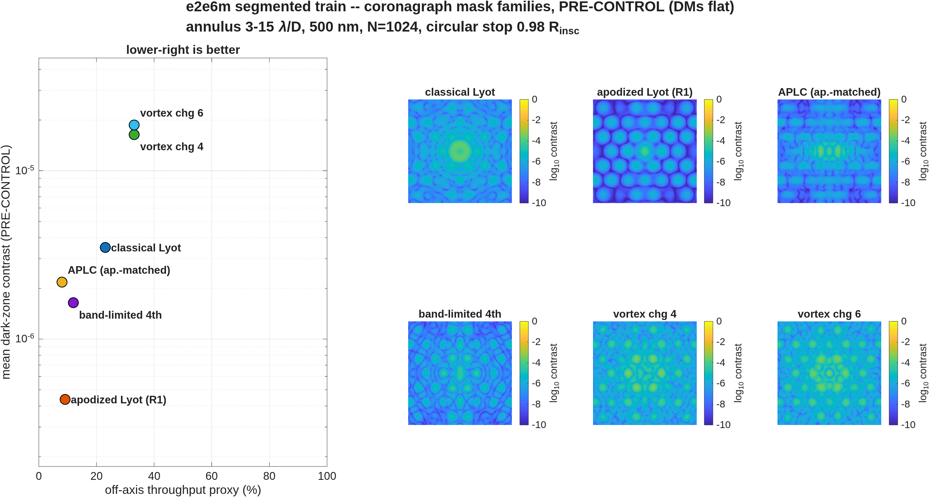
Six coronagraphs, one train
Pre-control: the apodized Lyot leads at 4.4e-07; the vortex pays the gaps ~40x
• The design rule that made them comparable. On a segmented hex aperture the coronagraph's pupil is a CIRCULAR STOP at the apodizer plane — the telescope's hex envelope is upstream optics, not the coronagraph pupil. Every family below sees the same circularized, gapped pupil; contrast normalizes to its bare peak, and the stop's ~8% collecting-area cost sits in the throughput column.
• The families (dark-zone mean, PRE-CONTROL | throughput): classical Lyot 3.50e-06 pre-control, 23% throughput; apodized Lyot 4.37e-07 pre-control, 9% throughput; APLC-as-implemented 2.18e-06 pre-control, 8% throughput (cap-limited prolate, not design-grade on this pupil; family DEFERRED); band-limited 1.64e-06 pre-control, 12% throughput; vortex c4 1.64e-05 pre-control, 33% throughput; c6 1.87e-05 pre-control, 33% throughput — the vortex passes the segment-gap light the occulting families block.
• The stop's 2.16x on the bare occulter, attributed by measurement: entirely the stop edge at fixed masks (the scale re-reference contributes 1.00x); the Babinet split shows the edge enters by coherent INTERFERENCE with the gap field (cross 6.5e-06 vs the rim's own 2.5e-06) — coherent, hence in the loop's reach. The next slide cashes that.
The six families, statics on the circularized segmented train.

Slide 11
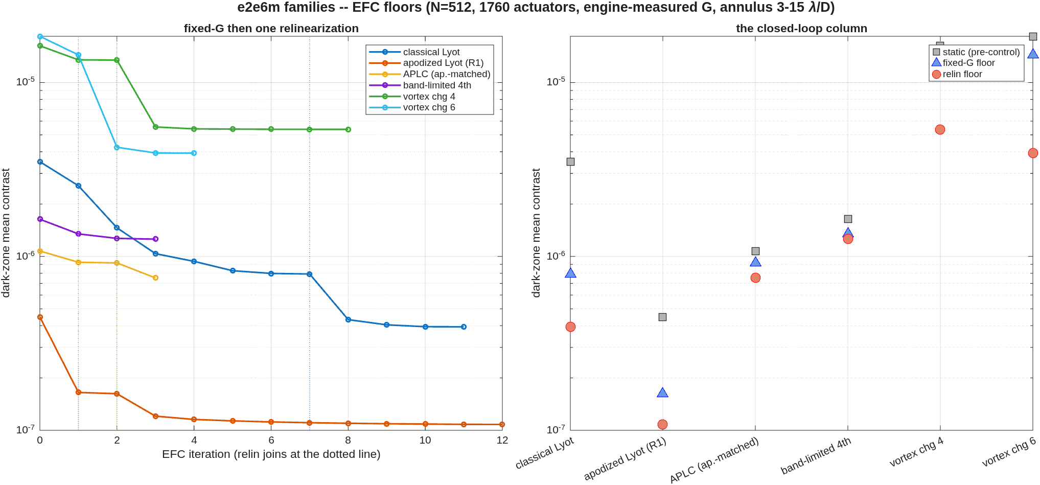
The loop on every family
All six floors sit within 2x of their own Jacobian's linear-achievable: the substrate speaks, not the controller
• static -> relin floor | linear-achievable at the achieved stroke: classical Lyot 3.5e-06 -> 3.9e-07 | 2.1e-07; apodized Lyot 4.5e-07 -> 1.1e-07 | 1.1e-07 (the campaign floor); APLC-as-implemented 1.1e-06 -> 7.5e-07 | 7.5e-07 (implementation verdict, not family); band-limited 1.6e-06 -> 1.3e-06 | 7.2e-07; vortex c4 1.6e-05 -> 5.4e-06 | 5.5e-06; c6 1.8e-05 -> 3.9e-06 | 4.7e-06.
• The stopped occulter digs 8.9x where its no-stop self dug 5.2x — the loop claws back most of the coherent edge term the previous slide measured.
• The vortices are linear-optimal: relinearization pays 2.5-3.7x where the fixed Jacobian paid 1.2x (gap-chasing strokes reach the linearity boundary early), and the residual gap leak is uncontrollable at this amplitude authority.
• The knob is the DM spacing: z/z_T = 3.7e-03 at the outer working angle — Talbot-weak amplitude authority is the common ceiling; the spacing trade prices it.
Convergence per family (relinearization joins at the dotted lines) and the closed-loop column.

Slide 12
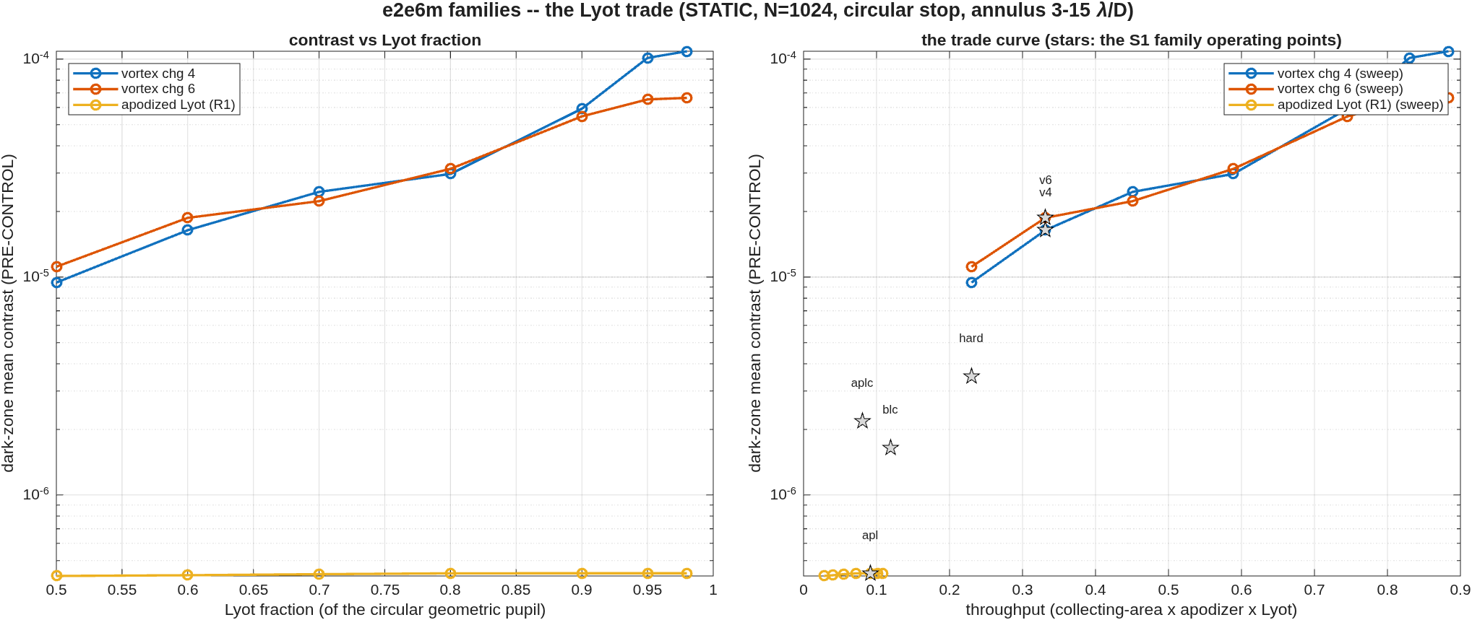
The Lyot trade
Throughput is bought with contrast on every leg; the operating points were chosen, not defaulted
• The sweep. Lyot fraction against contrast AND throughput for the vortex legs and the apodized-Lyot leg, statics under the stop; stars mark the S1 operating points the campaign scored.
Contrast vs Lyot fraction (left) and the contrast-throughput trade with the family operating points (right).

Slide 13
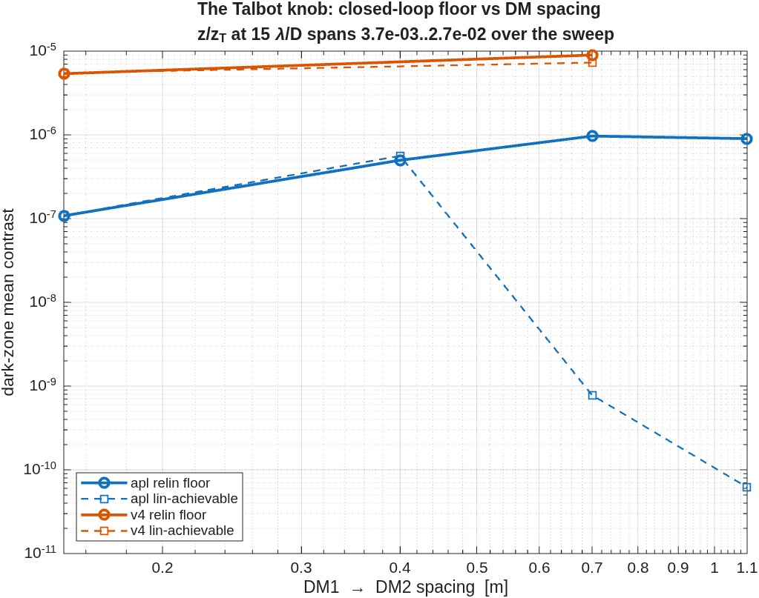
Both dials lose to the operating point
Lyot 0.90 and 0.15 m spacing were confirmed by measurement, not defaulted
• The gate. The campaign's operating point — apodized Lyot, 1.08e-07 floor at 9.5% throughput, spacing 0.15 m — was put to both of its dials before the physics layers ran.
• The Lyot dial stalls closed-loop. The static dial is flat (previous slide), but at L=0.98 the loop stops in two iterations at 1.58e-07 — 1.46x the contrast for 1.19x the throughput, a net loss in a throughput/contrast merit — and the wide-ladder retry does not dig. Static-free is not loop-free.
• The spacing dial's knee IS the baseline. Floors 1.08e-07 / 4.98e-07 / 9.67e-07 / 9.00e-07 at 0.15/0.40/0.70/1.10 m: the Talbot expectation INVERTS — wider spacing raises the linear-achievable bound and the loop cannot take it, because the STATIC degrades faster than the authority grows. Attributed by measurement: the added light is the same amplitude-type gap-Fresnel family (symmetric fraction 0.986 at every spacing), evolved over the longer DM1-to-DM2 leg. Packaging never discriminates (7.451 m shroud at every point, measured).
The Talbot knob measured: closed-loop floor and linear-achievable vs DM spacing — the bound deepens as the floor worsens.

Slide 14
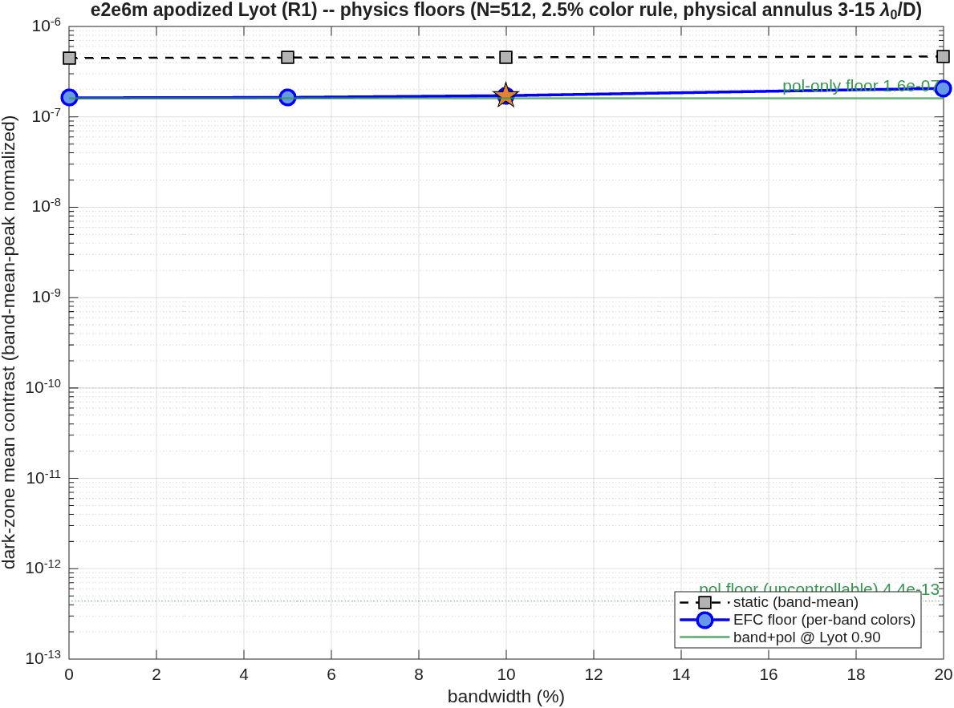
The physics layers at the operating point
Polarization does not set the floor; the chromatic penalty is 1.3x over a 20% band; the layers do not interact
• Polarization. All 31 reflectors coated (protected aluminum), Jones-pupil screens at the exit pupil, complex-mean normalized. The co-polarized imprint is 9.5% — twenty times the CTB's gentle train — yet almost entirely common-mode: the screened floor equals the unscreened one, and the UNCONTROLLABLE polarization floor is 4.4e-13.
• Bandwidth. One 9-color superset Jacobian, per-band block subsets: floors 1.62e-07 / 1.64e-07 / 1.72e-07 / 2.07e-07 at 0/5/10/20% — the floor is gap-speckle-owned, not chromatic (the inverse of the CTB vortex, whose floor was chromaticity).
• Together. 10% band + screens: 1.72e-07 — the band-only floor to three digits. The mask memoization behind the sweep is gated bit-exact (backup).
The physics ladder at the gate point: polarization, the band ladder, and band+pol together.

Slide 15
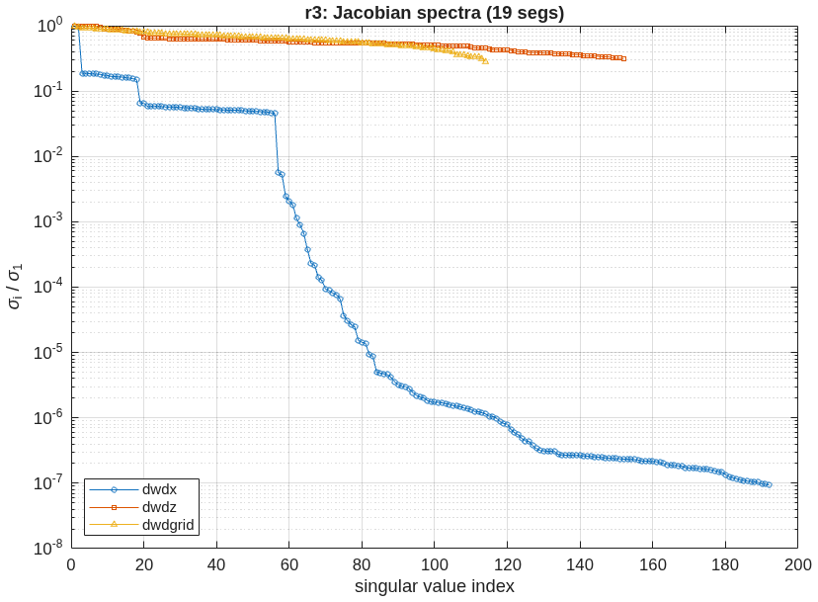
The error budget closes
Engine vs model: worst 0.35% over a segment, a DM and a relay mirror, all six freedoms
• The model. Wavefront sensitivity to every rigid-body freedom of 31 optics — the segments, the fold mirrors, the relay and both DMs — plus segment figure modes and a per-segment influence basis: 192 + 152 + 114 channels over five field points.
• The closure check. Poke a segment, a DM and a relay mirror through the engine and compare with the model, at the surface the model was harvested at: worst relative error 0.0035 over 18 freedom pairs. The matching check in the previous build disagreed by factors up to 55; the resolution is in the backup, and it was not the model.
• The assembly exhibit. The 19 segments perturbed as one body against one segment alone: tilt adds up (ratio 16.9), piston cancels (ratio 0.028), clocking is invisible per segment and real for the assembly.
freedom | assembly response | assembly / one segment
Rx | 2.619 | 16.88
Ry | 2.506 | 16.12
Rz | 0.2475 | 9.324e+04
Tx | 0.06566 | 16.2
Ty | 0.06706 | 16.6
Tz | 0.0136 | 0.0282
Column RMS of wavefront change per unit motion; rotations per radian, translations per metre.
Singular values of the three Jacobians, largest normalised to one.

Slide 16
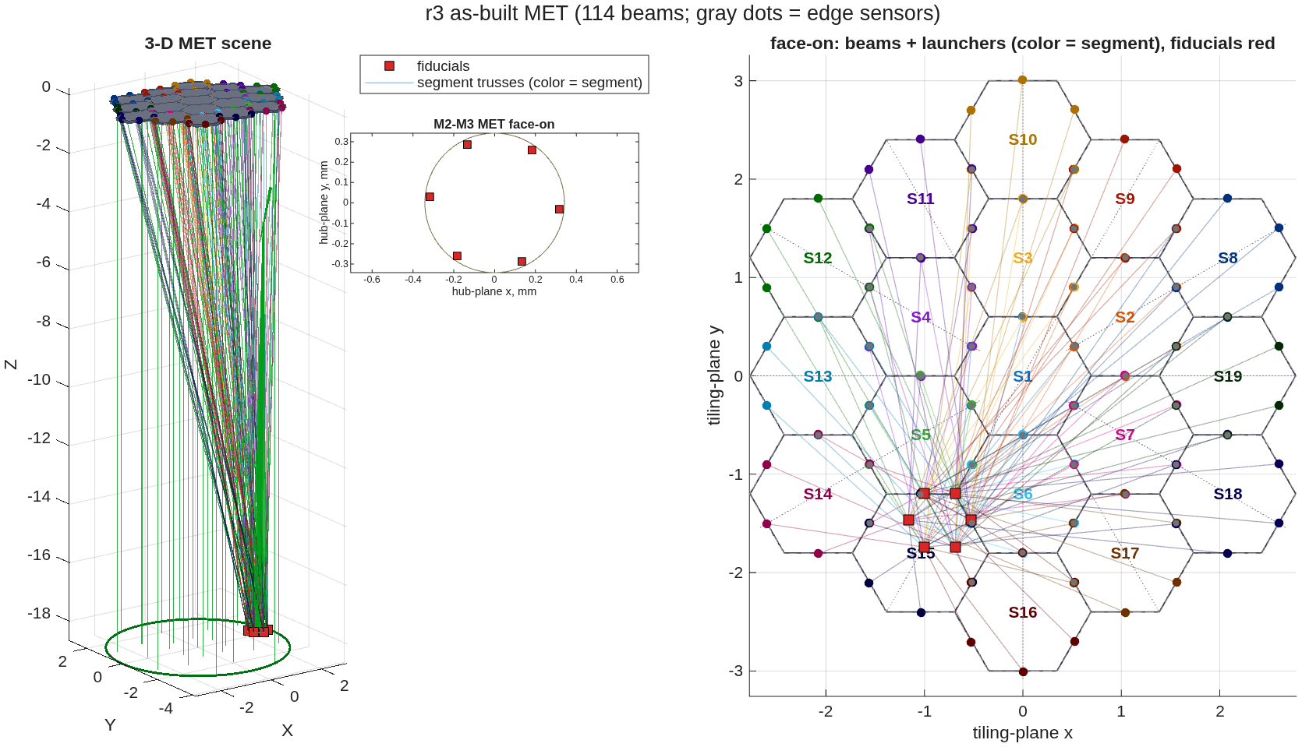
The metrology truss
114 laser gauges + 252 edge sensors, validated against the engine to 0%
• The layout. Six launchers per segment on its true boundary, fiducials on the secondary's rim, plus inter-segment edge sensors — the committed metrology stage run on this telescope with this train's sensitivity model.
• What it buys. Post-control wavefront residual 0.86 nm per nm of gauge noise with edges and gauges together, against 0 for gauges alone — the edge sensors carry the segment-to-segment state.
• Validated. The layout merit's finite-difference check closes at 0%, and a 200-draw Monte-Carlo estimate/control loop lands within 2.6% of the analytic residual.
The as-built truss: beams from the 19 segments to the hub fiducials; edge sensors on the segment boundaries.

Slide 17
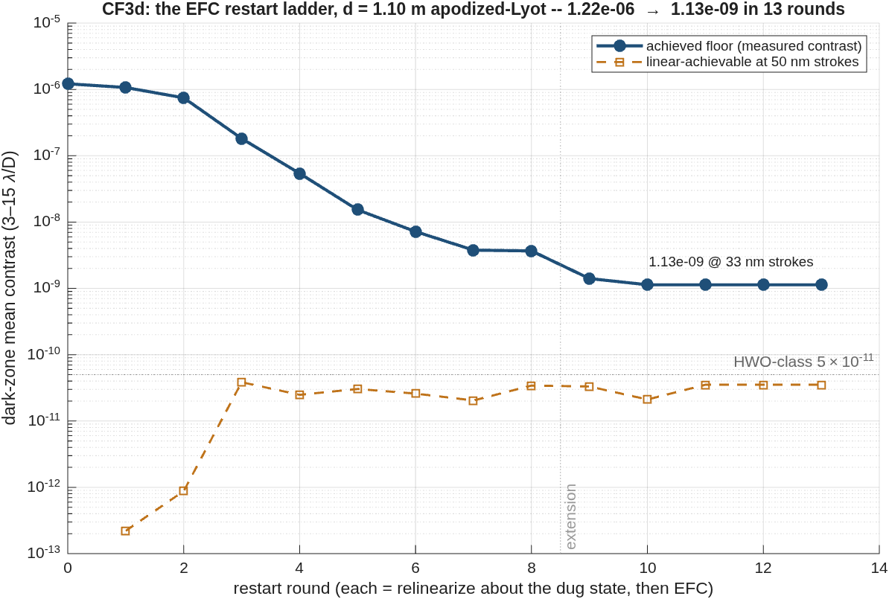
The restart ladder
The controller was the bottleneck: 1.2e-06 → 1.13e-09 at d = 1.10 m, with the substrate still pricing 3.5e-11
• The recipe (rinse and repeat): EFC to a floor, relinearize about the dug state, restart at that floor. 10 digging rounds over 4.6 h unattended; 3 stall rounds then prove the plateau — no accepted step at any Tikhonov α down to 1e-10, and two independent G measurements at the unchanged state agree to four digits.
• What it removed: the single-linearization stall at 9.0e-07 (the spacing sweep's d = 1.10 m entry) — four decades above the linear bound at this spacing.
• What remains, priced: la(G) holds 2.0e-11–3.8e-11 at every dug state; the plateau at 1.13e-09 is the monotone full-Tikhonov step rule — the measured case for FALCO-grade step machinery. Strokes end at 33 nm rms of the 50 nm bound.
The ladder: achieved floor by restart round against the linear-achievable substrate re-measured at every dug state. The early linear claims (rounds 1–2) are flat-state optimism; they settle once the linearization is honest.

Slide 18
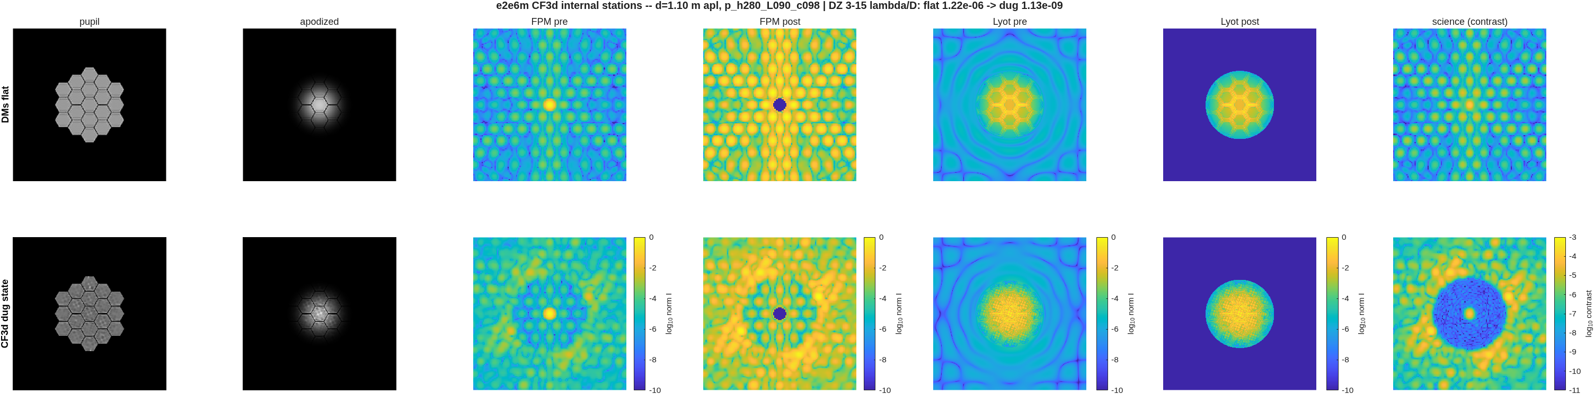
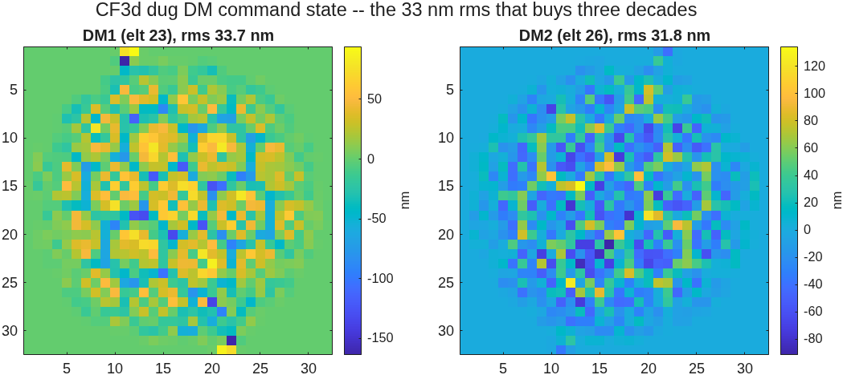
Inside the dig, station by station
The controller does the gap work: the DM commands imprint the hex-gap lattice
Seven planes, DMs flat against the dug state: pupil, apodizer, FPM before/after the occulter, Lyot before/after the stop, science-plane contrast. The in-walk dark-zone means reproduce the scored record exactly (1.22e-06 / 1.13e-09).
• Reading the strip: the flat row's segment-lattice speckle becomes the dug row's sculpted field; the science panel shows the full 3–15 λ/D annular dark hole carved to the 1e-9 floor.
• Two measured readables: DM1's command map carries the hex-gap lattice — the DMs are doing the gap work themselves (the no-apodizer A/B is the scoped follow-on); and the 0.90 Lyot stop removes only ~0.1% of the post-FPM energy — this train's rejected light is interior gap structure, not edge rings.
The dug command state: DM1 imprints the gap lattice; strokes ~33 nm rms, peaks ~160 nm.

Slide 19
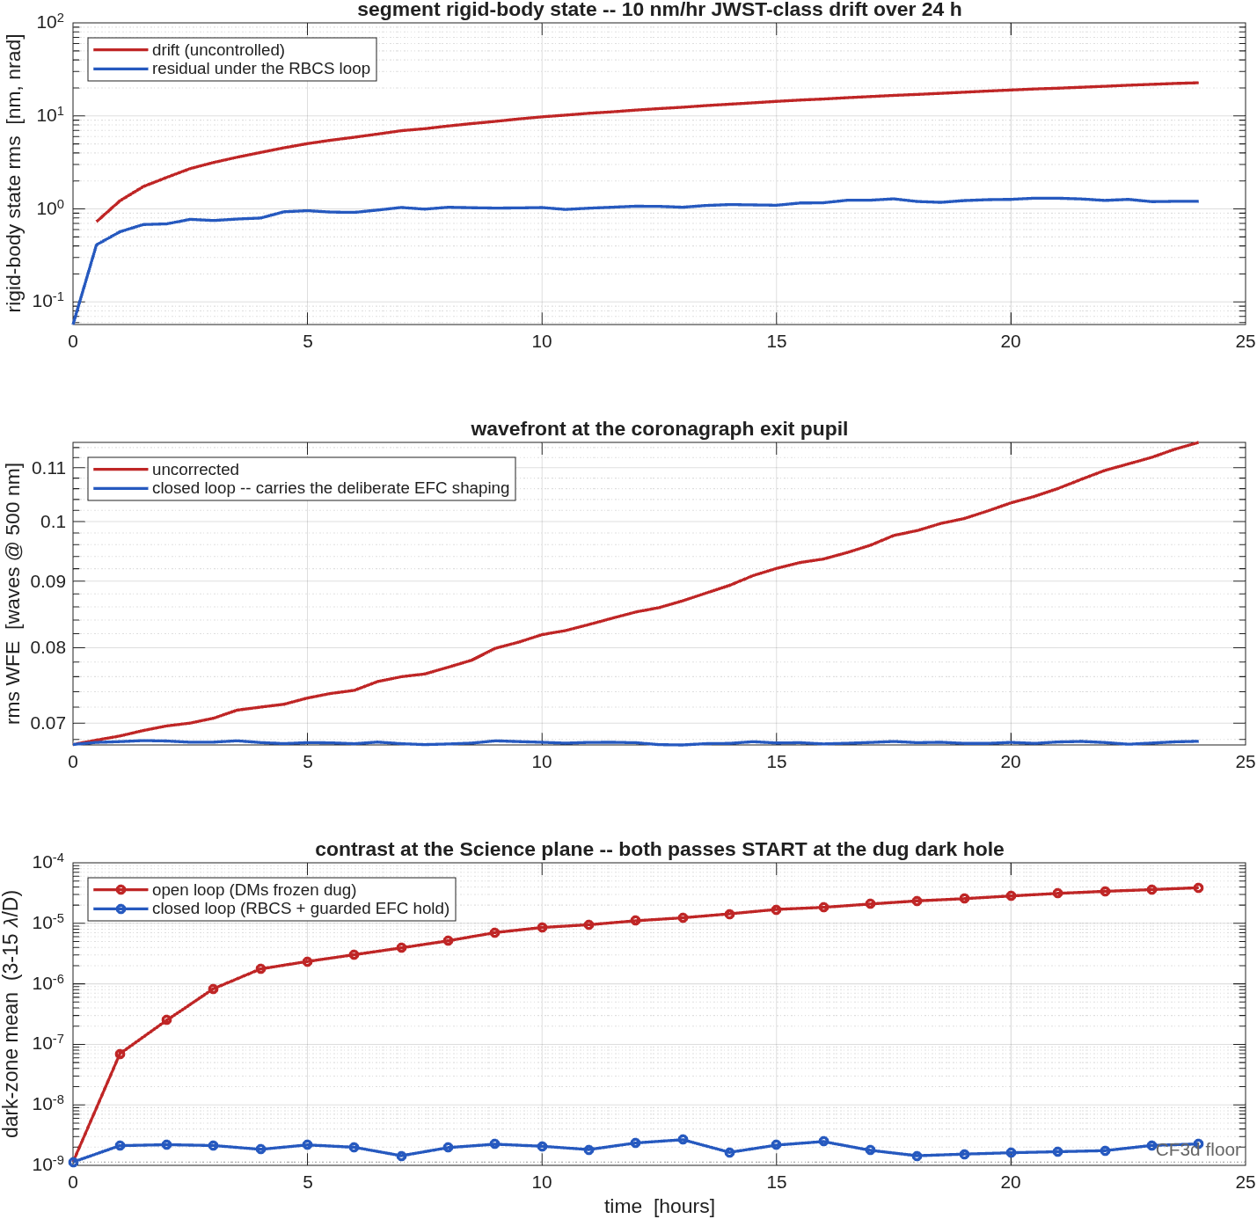
The loop closes
JWST-class drift on the dug dark hole: open loop decays 4.5 decades in a day; the loop holds 2.0e-09
• The series starts at the new solution — frame one reproduces the CF3d floor to 1.001× (a built-in gate) — and runs a JWST-experience disturbance: a 10 nm/hr correlated drift ramp plus a 0.5 nm/step walk, 24 hours at 30-minute frames, on the d = 1.10 m train.
• Open loop (DMs frozen dug): 1.1e-09 → 3.9e-05. The first decade is lost to the first nanometre of drift — at 1e-9, continuous control is not optional.
• Closed loop: the RBCS loop (BLUE + ridge, gain 0.5, six DOFs) holds the segment state at 1.2 nm against 23 nm of drift; a guarded EFC hold (one damped step per hour about the dug-state G; 25 steps taken, 0 reverted) keeps the dark zone at 2.0e-09 for the full day.
• Mechanization pedigree (the 3 nm series, kept in the record): the held one-shot and the sliced-MMSE gain both fail measured (noise injection; spectral radius 1.154); BLUE + ridge + integrator is the loop that survives — and at 0.3 nm-class drift the ~2.5e-07 hold on the d = 0.15 train was the loop's own noise floor, which is why this series holds 100× deeper: it starts deeper, drifts slower, and the EFC hold is guarded.
Twenty-four hours under JWST-class drift, both passes starting at the dug dark hole: segment state, exit-pupil wavefront, science-plane contrast.

Slide 20
What this demonstrates
One model, from surface figure to a held dark zone
• A design becomes an instrument becomes an error budget becomes a controlled observatory, without leaving the model or re-entering the geometry anywhere.
• The gap penalty is measured, not assumed — 1298× open loop — and the control loop that answers it is measured too: under JWST-class drift the open loop decays to 3.9e-05 in a day while the closed loop holds 2.0e-09 — starting from, and keeping, the dug dark hole.
• Every model-vs-engine comparison closes — worst 0.0035 across segments, DMs and relay optics — because the comparison is made at the surface the model lives on. Where a build disagreed, the deck says why and what fixed it.
• All of it is committed: prescriptions, runners, reports, and this deck's numbers are one git clone away.

Slide 21
Backup Slides

Slide 22
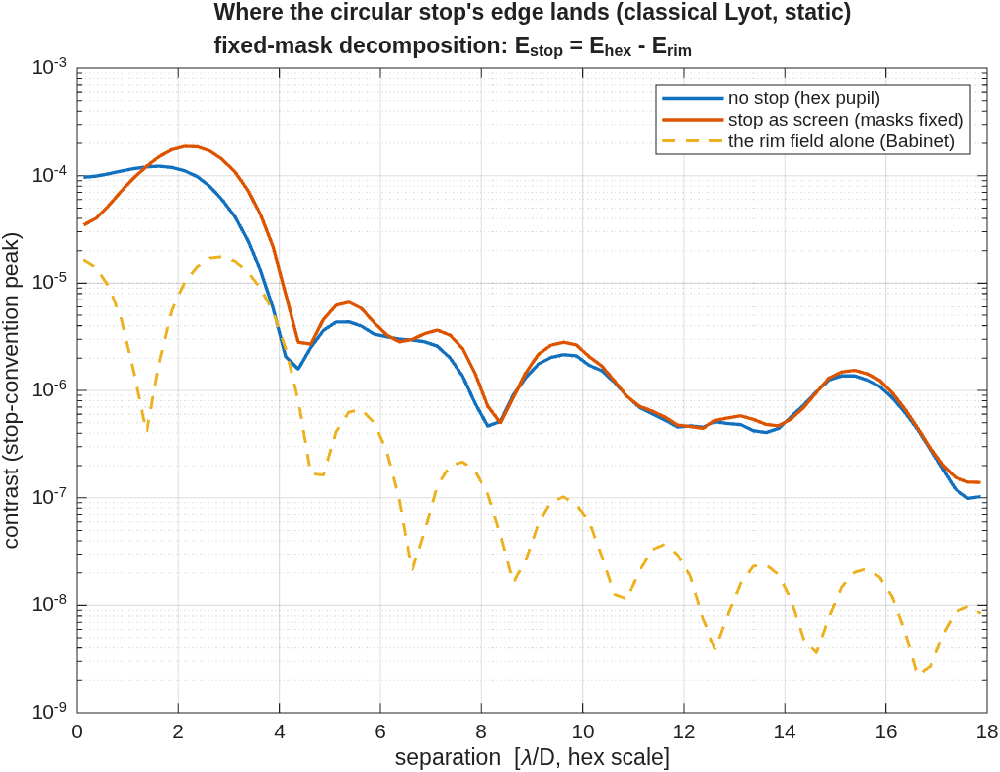
The stop's edge, measured
A Babinet split with 1e-15 closure: the edge interferes, it does not merely add
• Method. The circular stop applied as a SCREEN on the no-stop chain holds every mask and scale fixed, so E_rim = E_hex - E_screened is exactly the blocked rim's field. Pins: screened bare peak == stopped bare peak to 0.0e0; both S1 records reproduced under 1%.
• The split (dark-zone mean energy): I_ns 1.09e-05 + rim 2.53e-06 + cross 6.54e-06 — the rim's own ring is ~28% of the increase; the cross term (coherent interference with the pre-existing gap speckle) is 2.6x larger. Peak renormalization 1.178x; dark-zone energy up 1.83x at fixed masks; the lambda/D re-reference contributes 1.00x.
• The APLC flag, restated: the stopped aperture-matched prolate hit its iteration cap unconverged (the answer moves with the cap — not an eigenfunction, not a design); its apodizer also moves 2x with grid size (1.07e-6 at N=512 vs 2.18e-6 at 1024) — an implementation verdict, not a family verdict; the family is DEFERRED and the block/Lanczos eigensolver or the N'Diaye LP co-design are the named machines. Bound reading (all rows): lin-ach is the relin G's rank-curve at the achieved stroke — a scale, not a strict inequality; Tikhonov solutions can undercut it by O(20%) (vortex c6 does).
Where the stop's edge lands: no-stop, stop-as-screen, and the rim field alone.

Slide 23
The round-1 disagreement, resolved
The same basis includes the evaluation surface
• The symptom. Engine and linear model disagreed by 1–55× on every segment freedom but piston, which agreed to 0.6%.
• The cause, measured. The check traced to the Science focal plane; the model lives at the coronagraph exit pupil. At a focal plane a segment tilt is a footprint piston with lever = the segment's pupil radius — at that segment, 6.5× the tilt response, which is exactly the "mystery factor" the fingerprint carried. Piston agreed because a normal displacement adds path uniformly at any surface.
• Same element, same pokes, one changed trace target — the table.
• The fix is structural. The closure check is now a shared function that takes the evaluation surface from the harvest artifact, with a regression test that fails if a rotation ever closes at the wrong surface.
freedom | rel. error at the focal plane | at the model's surface
Rx | 56.9 | 3.34e-05
Ry | 1.01 | 3.48e-05
Rz | 1.04 | NaN
Tx | 1.01 | 0.00131
Ty | 54.8 | 0.00131
Tz | 0.00614 | 1.06e-05
Segment 19, 1 nm / 1 nrad pokes against the stored sensitivity columns. "NaN" rows are the segment-clocking null (response below the 1 pm floor).

Slide 24
Choosing a stable control law
Two mechanizations rejected by measurement
• A held one-shot correction (the round-1 idiom, with real sensor noise): at the solve frame the drift sits below the 1 nm edge noise, the estimate residual exceeds the state, and the corrected leg ends worse than the uncorrected one.
• A per-frame loop on the estimator's segment slice: the full-body minimum-variance gain is contractive, its segment slice is not (spectral radius 1.154) — the engine loop diverged to 19 nm on a 3 nm drift, and a pure-linear simulation predicts the divergence to three digits.
• Shipped: weighted least squares with ridge on the segment state (radius 0.9998, gain 0.5): converges to the 0.36 nm sensor-noise floor.
• The DM re-solve needed the same care. Undamped solves against gap speckle — amplitude-dominated, weakly controllable at this DM spacing — push stroke along near-null directions and diverge; damping (0.7) plus a small leak (0.02) makes the dig monotone and held. DM spacing as an amplitude-authority knob is a stated design trade, not exercised here.

Slide 25
Packaging the longer relay
Fold side is a stability choice, not a taste choice
• A near-normal fold turns the chief by 180° − 2·AOI, and the beam direction reverses at each mirror.
• Alternating the fold side — fine for the five folds of the shorter round-1 relay — adds −2·AOI of net rotation per fold: over this chain's ten folds the accordion fans ~120° and walks to a 10.33 m shroud diameter. Measured, with the element positions in the record.
• Keeping the same side every fold ping-pongs the beam between two fixed directions and packs the chain into a leg-sized pocket: 7.451 m, identical to the primary-set envelope. The DM-bearing back end costs nothing in shroud diameter.

Slide 26
Focal ratio: why f/25.4 and not f/12–20
The corrected focal ratio is not a continuous function of the layout
• The surface-figure solve spends optical power, so the focal ratio must be read on the corrected system; a search on the tertiary radius lands in different solve basins and refuses to steer continuously (f/15.5 and f/25.7 at layouts 0.36% apart).
• The design point was chosen on wavefront, which it meets; the slower focal ratio also puts more λ/D on the focal-plane mask, easing its fabrication.

Slide 27
What an apodizer alone does not buy back
The round-1 negative result stands
• Redesigning the apodizer for the segmented pupil — a linear-program optimum and an aperture-specific eigenfunction — recovered essentially nothing: the gaps scatter light no transmission profile removes.
• The optimizer's design model (a single Fourier transform) floors five times above what the engine already reaches, and the disagreement grows the harder the optimizer is pushed — the signature of an optimizer mining its model, worth reusing as a diagnostic anywhere a design model is cheaper than the simulator it feeds.
• The round-2 answer is the deformable mirrors: measured against the engine, they dig the segmented floor 4.6e-07 → 1.9e-07 and hold it under drift.

Slide 28
What is not in this model
Stated, not omitted
• The coronagraph masks are clear-pupil designs. Co-optimising apodizer, occulter and Lyot for the segmented aperture is known, separate work; the open-loop 1298× is the size of that prize.
• Monochromatic, at 500 nm. The bandwidth and polarization layers exist on the testbed substrate and are configuration away, not new machinery.
• The metrology measurement is simulated from its validated linear model plus noise, not a second engine trace of the truss; the engine holds the truss points rigid, so the model is the only figure source either way.
• DM spacing (47 mm pupil, 0.15 m apart) limits amplitude-speckle authority; the testbed's wider spacing is the knob, and re-running the chain at another spacing is parameter work.

Slide 29
How to reproduce
Every number on these slides comes from these runs
• Round 1 (frozen): s1_layout_search, s1_telescope, s2_segmentation — the telescope and the segmented primary.
• r1_backend, r1_coro, r1_dm, r1_shroud_union — the DM-bearing train, the coronagraph on both apertures, the DM surfaces, the two-leg shroud.
• r2_sequence_fig, r2_bench_fig, r2_masks_fig — the four exhibit graphics.
• r3_sensitivities, r3_dm_jacobian, r3_met — the error budget, the actuator Jacobian, the metrology stage.
• r4_timeseries — the closed-loop drift series.
• cf_chain + cf1_families..cf4_physics — the coronagraph-family campaign; cf3d_deepdig + cf3d_stations — the restart ladder and its station graphics; cf5b_jwst_series — the JWST-class drift series on the dug state.
• python3 deck_e2e6m_r2.py — this deck, from the reports those runs wrote.
All knobs live in one parameter file. The narrative record — every question, decision and gate — is the campaign log beside the runners.

