Slide 1
A 6 m unobscured coronagraph, end to end
An optical design, its segmentation, its instrument, its error budget and its drift — one model, one train
Conventions, stated once. Wavefront error is RMS at 500 nm, referenced to the exit pupil of the configuration being quoted — the telescope's own for the telescope-only slides, the coronagraph's once the instrument is attached. Contrast is the dark-zone mean over 3–15 λ/D, normalised to the bare on-axis peak of the same train. The diffraction limit is 0.071 waves RMS. Packaging is a deployed, diameter-only fit in an 8 m launch shroud; length is free.
Built with MACOS / mmacos. Every number on these slides is parsed from the committed stage reports; no figure was redrawn for the deck.

Slide 2
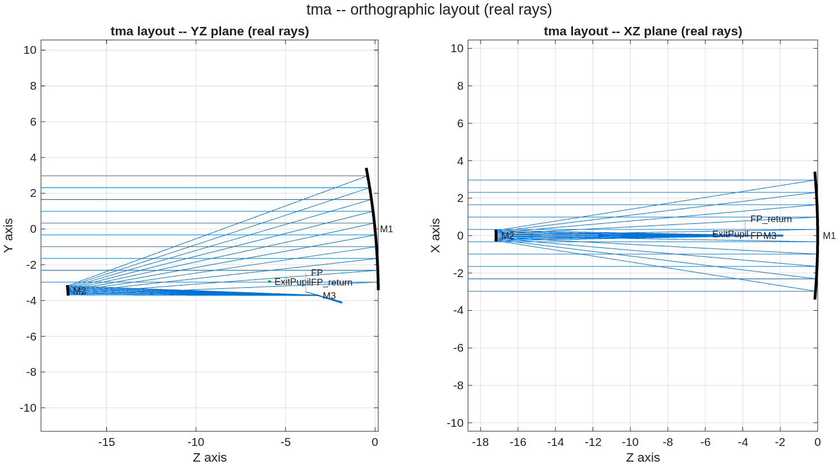
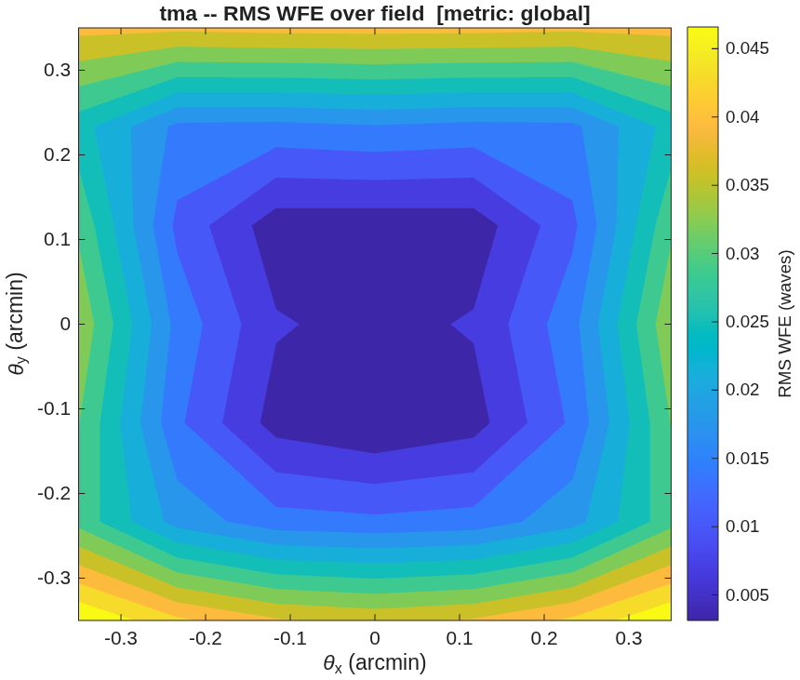
The telescope
0.0473 waves RMS across the field — diffraction-limited at 500 nm
• The design. A 6 m unobscured three-mirror telescope: three base spheres placed for packaging, fold tilts doing the unobscuration, all correction carried by Zernike surface departures. Field ±0.35 arcmin.
• The wavefront. 0.0473 waves RMS worst case over the field, against a 0.071-wave diffraction limit.
• The packaging. 7.450 m diameter against the 8 m shroud, over a 17.37 m train; 4/4 bodies clear of every beam; 1185/1185 rays survive a standalone reload of the saved prescription.
• The one miss. Focal ratio f/25.39 against a requested f/12–20. It is not a tuning failure — see the backup.
The three-mirror train: light enters from the left, folds back to the secondary, returns past the primary to the tertiary and the focus.
Wavefront error over the design field. Worst corner 0.0473 waves.

Slide 3
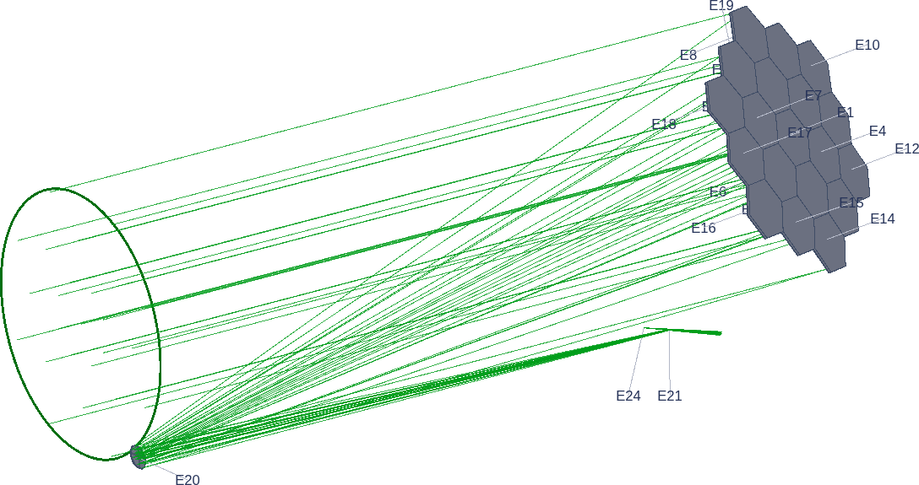
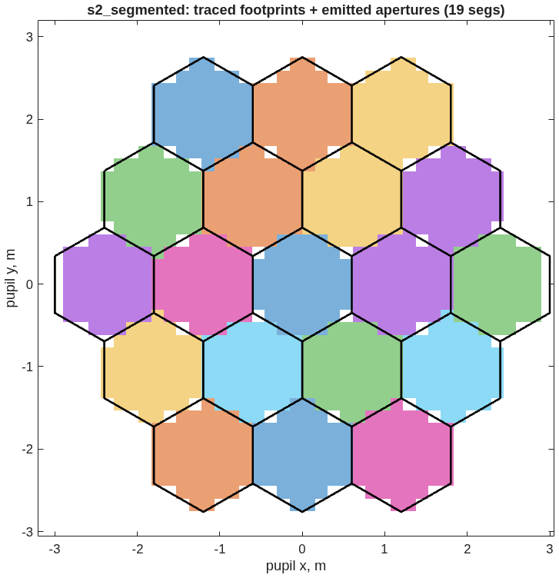
The segmented primary
19 segments, and a poke that stays where it is put
• The segmentation. 19 hexagonal segments, 1.2 m flat to flat, 25 mm gaps, each carrying the parent's solved figure and its own physical polygonal aperture.
• The apertures are real. Each segment declares its polygon, and 983 of 985 traced rays survive them; the two that clip land on a gap edge. Reloading the saved prescription standalone reproduces 983/985 — the check that catches a wrongly-framed aperture, which otherwise fails silently on disk.
• The check that matters. Displace one segment by 10 nm along its normal: the wavefront responds 19.91 nm over the 52 rays that land on it and exactly zero over the other 930. The response stays on the segment that moved — which is what makes a per-segment error budget mean anything.
The segmented telescope: 19 hexagons on the primary, feeding the same fold train.
Traced footprints against the emitted aperture polygons. Colour is the segment a ray landed on; black is the declared glass.

Slide 4
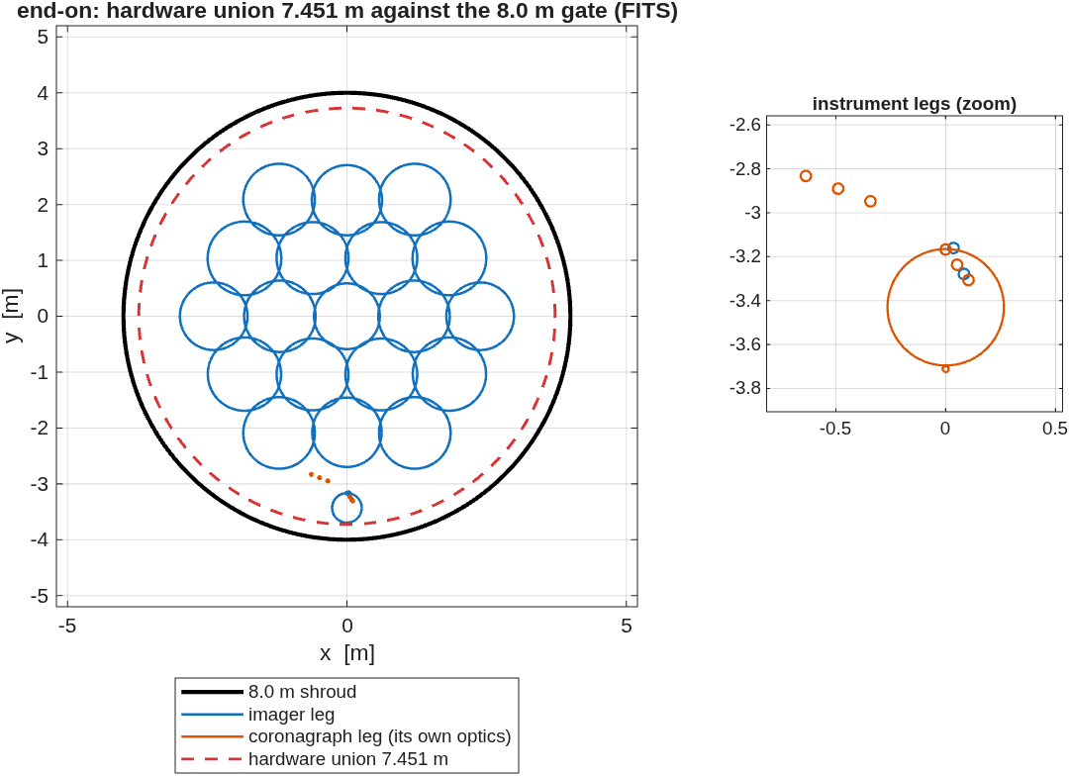
Two instruments
A second camera costs nothing in shroud diameter
• The coronagraph. A four-mirror relay off the telescope focus: collimate to an accessible pupil, focus to the mask, re-collimate to the Lyot stop, focus to the detector. Spliced onto the segmented telescope as 29 elements of one prescription — not a second model. Only a single model carries a telescope perturbation through to a contrast number, which is what stages four and five need.
• The imager. A deployable pick-off at the shared pupil feeds its own f/19 camera: 0.0042 waves RMS, Strehl 0.9993, and a 0.87 µm geometric spot against a 9.5 µm diffraction core — the image is limited by diffraction, not by the optics.
• Both fit. 7.451 m against the 8 m shroud, for either leg and for the two together. The 6 m primary sets the envelope; the instruments are centimetre-class.
• The models are faithful. The chief ray through the diffraction model agrees with the geometric one to 1.2e-15 m, and the imager leg loses no rays the telescope did not already lose (983/985).
Both legs down the launch axis, inside the 8 m shroud circle. The instrument optics are the inset — at this scale they are a few pixels.

Slide 5
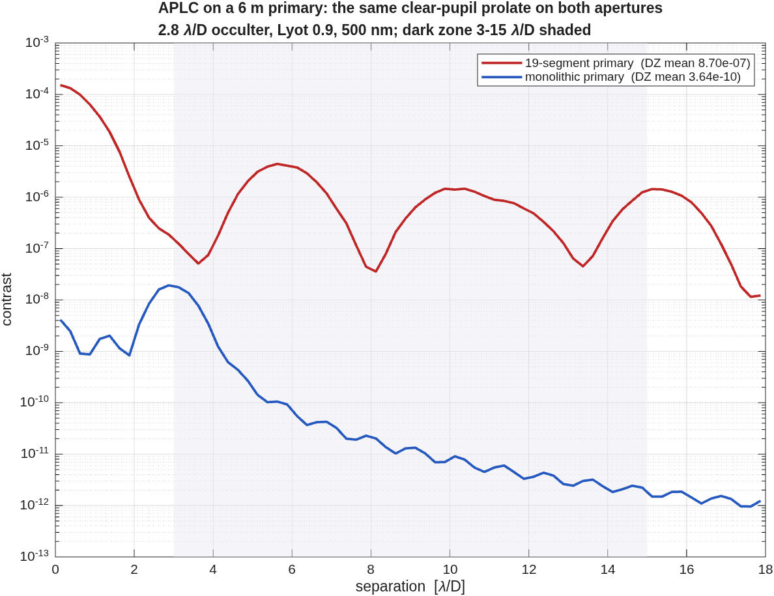
What the segment gaps cost the coronagraph
2390× in dark-zone contrast, same mask on both apertures
• The measurement. The same apodized pupil Lyot coronagraph — same apodizer, same 2.8 λ/D occulter, same Lyot stop — run on the segmented primary and on a monolithic version of the identical telescope.
• Segmented: 8.700e-07 mean contrast, 6.17e+03 on-axis suppression.
• Monolithic: 3.640e-10 mean, 2.82e+07 suppression.
• The ratio is the gaps and nothing else — 2390× in the mean, 8573× in the median. Both trains share the same wavefront; only the pupil's structure differs.
• The monolithic result independently reproduces the reference testbed's clear-pupil number, with nothing tuned to match it.
Radial contrast, both apertures, dark zone shaded. The segmented curve plateaus where the monolithic one keeps falling — that plateau is light scattered by the gaps.

Slide 6
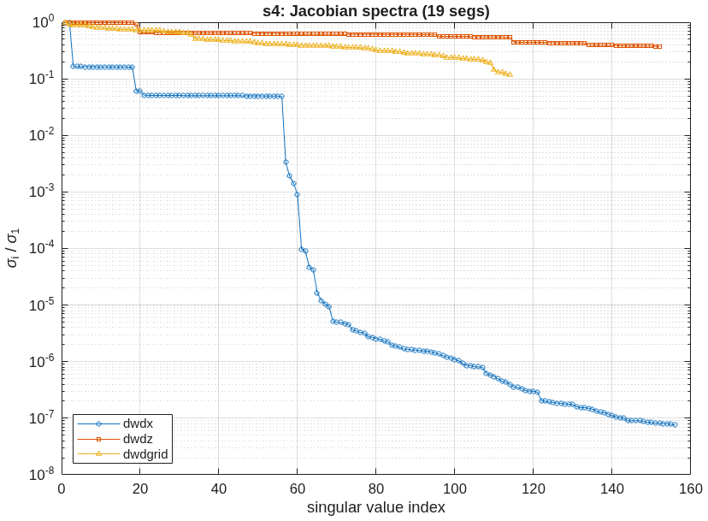
The error budget
Moving 19 segments as one body is not 19 times moving one
• The model. Wavefront sensitivity to every rigid-body freedom of 25 optics, to each segment's figure modes, and to a per-segment influence basis: 156 + 152 + 114 channels over five field points.
• The exhibit. The 19 segments were also perturbed as a single rigid body. Comparing that with a single segment's response separates three different behaviours — in one table.
• Tilt adds up: ratio 19.3, the member count. A per-segment budget is right.
• Piston cancels: ratio 0.032. Moving all 19 together is nearly a global piston, which the reference removes — a per-segment budget overstates the assembly by about 31×.
• Clocking is invisible per segment and real for the assembly: ratio 111004.
• Not every freedom is observable. The 114 segment rigid-body channels span a range of 2.16e+06 in singular value: a wavefront measurement constrains far fewer directions than there are freedoms, which is what makes the correction in the next slide a solved problem rather than an inversion.
freedom | assembly response | assembly / one segment
Rx | 2.756 | 19.32
Ry | 2.74 | 19.17
Rz | 0.2706 | 1.11e+05
Tx | 0.07168 | 19.24
Ty | 0.07054 | 19
Tz | 0.01437 | 0.0322
Column RMS of wavefront change per unit motion; rotations per radian, translations per metre, the same convention on both sides.
Singular values of the three Jacobians, largest normalised to one. Rigid-body motion (blue) collapses by seven decades; the figure and influence bases stay within one.

Slide 7
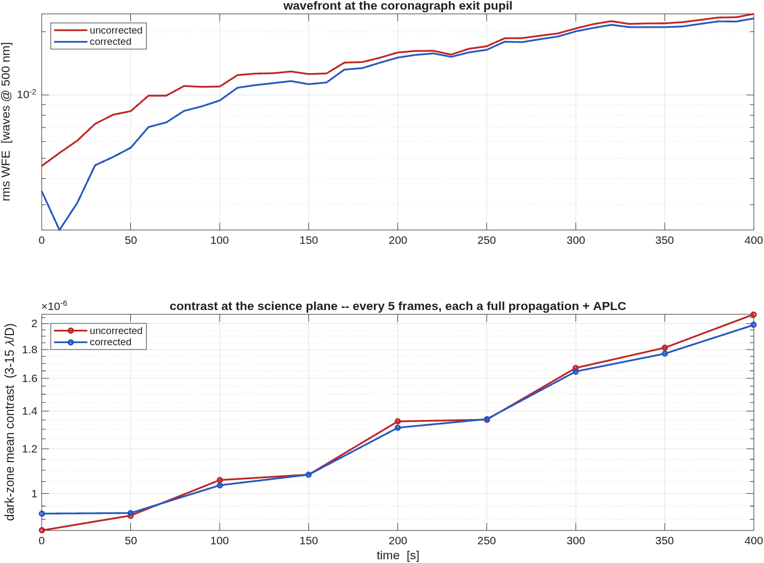
The observatory drifts
Contrast tracks the wavefront, 8.60e-07 to 2.08e-06
• The history. 41 frames at 10 s — a 7-minute soak — with a random walk plus a correlated drift on every freedom of all 19 segments, played through the engine.
• Uncorrected: wavefront 0.0046 to 0.0243 waves; contrast 8.601e-07 to 2.078e-06.
• Corrected: 0.0035 to 0.0231 waves; contrast 9.213e-07 to 1.990e-06. One image-based correction, solved early and held.
• Why the benefit fades. The correction is never updated, so it decays as the state walks away from where it was solved. That is the shape of a held correction, not a modelling artefact.
• Each contrast point is a full diffraction propagation through the mask chain, so the timeline is sampled every 5 frames (9 of 41).
Wavefront and contrast against time, corrected and uncorrected.

Slide 8
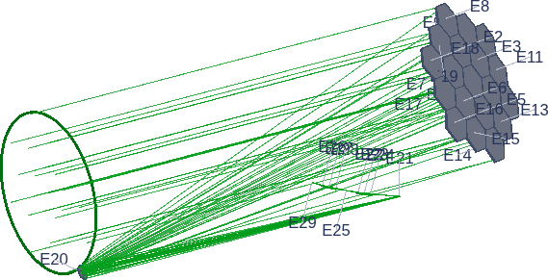
What this demonstrates
One model, from surface figure to science contrast
• A design becomes an instrument becomes an error budget becomes a time series, without leaving the model or re-entering the geometry anywhere.
• The gap penalty is measured, not assumed: 2390×, from two runs that differ in one thing.
• Assembly-level freedoms behave differently from their members — by a factor 31 in one direction and 111004 in another — and the model shows which.
• Every gate is in the record. Where something did not close, the deck says so and prices it.
The modelled observatory: the 19-segment primary and the beam it feeds, in one prescription. The secondaries and the instrument optics are decimetre- and centimetre-class and do not resolve at 6 m scale.

Slide 9
Backup Slides

Slide 10
Focal ratio: why f/25.4 and not f/12–20
The corrected focal ratio is not a continuous function of the layout
• The surface-figure solve spends optical power, so the focal ratio of the corrected system differs from that of the base spheres. It has to be read on the corrected system.
• A search on the tertiary radius refused after five iterates. Two neighbouring layouts, 0.36% apart in that radius, gave f/15.54 and f/25.74; widening the sweep gave f/20.09, f/8.56, f/26.90, f/25.39 at four nearby values.
• The solve lands in different basins depending on the starting geometry, and each spends a different amount of power. No continuous search steers it.
• Narrowing the design field does not help either: at fixed geometry, halving the field made the residual worse.
• The design point was therefore chosen on wavefront, which it meets. A slower focal ratio also puts more λ/D on the focal-plane mask, which eases the hardest fabrication in the instrument.

Slide 11
Linear model against the engine
Only piston reproduces; control was restricted to it
• Poking each freedom and comparing the engine's wavefront change with the sensitivity model:
• Piston agrees to better than 1%. Every other freedom disagrees, by factors of 1–57.
• A ladder over three decades of poke size separates two behaviours: the centre segment's tilt response is purely second-order, while an outer segment's is linear but 3.8× the model. Neither is a noise floor.
• Ruled out by measurement: the wavefront reference. Repeating the ladder with the other reference reproduces every number to five digits.
• Consequence. With all six freedoms in the control basis the corrected leg came out worse than the uncorrected one. Control was restricted to the freedom that reproduces; the drift still moves all six.
freedom | engine | model | relative error
Rx | 2.482e-12 | 1.419e-10 | 56.9
Ry | 9.257e-10 | 1.426e-10 | 1.01
Rz | 7.950e-14 | 9.395e-15 | 1.04
Tx | 2.389e-11 | 3.682e-12 | 1.01
Ty | 6.640e-14 | 3.679e-12 | 54.8
Tz | 4.466e-10 | 4.440e-10 | 0.00614
RMS wavefront change, in metres, for a 1 nm / 1 nrad poke of a single segment. Open item: two untested candidates remain — the focal-plane tracking used when the sensitivities were harvested, and the real-ray stop aiming, which would explain why the centre segment — the one the chief ray lands on — is the anomalous case.

Slide 12
What the segment gaps cost, and what does not buy it back
The redesign recovers 1.10×
• The attempt. Redesign the apodizer for the segmented pupil two ways: the globally optimal transmission mask from a linear program, and the aperture-specific version of the same eigenfunction the incumbent uses.
• Neither beats the incumbent. The aperture-specific mask recovers 1.10× in dark-zone mean and 0.57× in median, at 0.73× the throughput. No rung of the linear program beat it either.
• Why, measured. The design model is a single Fourier transform; the real back end is a multi-leg chain. It reproduces the bare image to 1.2% but floors near 4e-06 against the engine — five times above the contrast the incumbent already reaches.
• A negative result, priced. The gap penalty is real and an apodizer alone does not remove it. What would fix it is a design operator matching the propagation it is scored against — queued, not attempted here.
configuration | dark-zone mean | throughput
bare segmented (baseline) | 8.700e-07 | 0.100
aperture-specific mask | 7.909e-07 | 0.073
linear-program mask | 1.505e-06 | 0.175
clear-pupil reference | 3.640e-10 | 0.100
Same plane, same mask geometry, same 3–15 λ/D annulus as the main-path number.

Slide 13
How to tell an optimizer is mining its model
The disagreement grows 4.8× → 40.0× as you push it
• The design model and the engine are not the same code. One is a single Fourier transform, the other propagates the real multi-leg chain. Ask the optimizer for a deeper dark zone and it spends the difference.
• The pattern is the diagnosis. A fixed offset would be a calibration error. An offset that grows monotonically with the demand is the optimizer finding more of the model's error the harder it is pushed — and it shows up without knowing the true answer.
• Isolated in six experiments. The bare image agrees to 1.2%; the engine applies the mask with residual exactly zero; every diffraction ring lands at the right radius; and feeding the engine's own post-mask field back through the model still lands on the model's floor.
• Worth reusing. Any time a design model is cheaper than the simulator it feeds, run the ladder and watch the trend rather than a single agreement number.
LP target | model says | engine says | apart by
1e-05 | 1.13e-06 | 5.37e-06 | 4.8×
3e-06 | 1.92e-07 | 2.61e-06 | 13.6×
1e-06 | 3.77e-08 | 1.50e-06 | 40.0×
Dark-zone mean, bare-peak normalised. The model's floor near 4e-06 sits five times above the 8.70e-07 the incumbent already reaches.

Slide 14
What is not in this model
Stated, not omitted
• No deformable mirrors and no field stop. The reference testbed model carries both. Without them the contrast here is an open-loop number — what the optics deliver, not what a wavefront-control loop would hold — and the dark zone is not the annulus two deformable mirrors would give.
• No metrology loop. The correction in the drift series is image-based: it sees the wavefront directly rather than estimating it from a truss. The corrected leg is therefore an optimistic bound.
• The coronagraph mask is a clear-pupil design. Re-optimising it for a segmented aperture is a known and separate piece of work; the 2390× above is the size of the prize.
• Both additions are existing primitives in the toolkit, so the extension is configuration rather than new machinery.

Slide 15
How to reproduce
Every number on these slides comes from these runs
• s1_layout_search then s1_telescope — the layout pick and the telescope.
• s2_segmentation — the segmented primary and its edge-sensor sidecar.
• s3_backend, s3_train_fig, s3_coro, s3_imager then s3b_pupil + s3b_apodizer — the two instruments, the coronagraph on both apertures, and the apodizer redesign.
• s4_sensitivities — the error budget, roughly half an hour.
• s5_timeseries — the drift series.
• python3 deck_e2e6m.py — this deck, from the reports those runs wrote.
All knobs live in one parameter file. The narrative record — every question raised, every decision and its result, every gate outcome — is in the campaign log beside the runners.

