Slide 1
Re-Walking the Offset-Field Imager
A workbook: from the committed truth files to the gated ladder
D. C. Redding with Claude Code — 22 August 2026. Companion to the story deck (deck_rodgers3); source study M. Rodgers, 260802-WFOVimager_Offsetfield. Everything quoted here is parsed from the committed records of MACOS_resources mmacos/challenges/rodgers3 + templates/10_telescopes/offset_imager.
THE METRIC CONTRACT, once for the whole deck: strict RMS WFE, centroid reference on the stage's frozen focal plane, exit-pupil anchor, piston-only removal; quoted statistic = dense 11x11 map MAXIMUM over the field box. Every WFE number on every slide inherits it. Workbook genre: 18 content slides in six sections (budget deviation declared, DECK2_PLAN.md). DRAFT — pending sign-off.

Slide 2
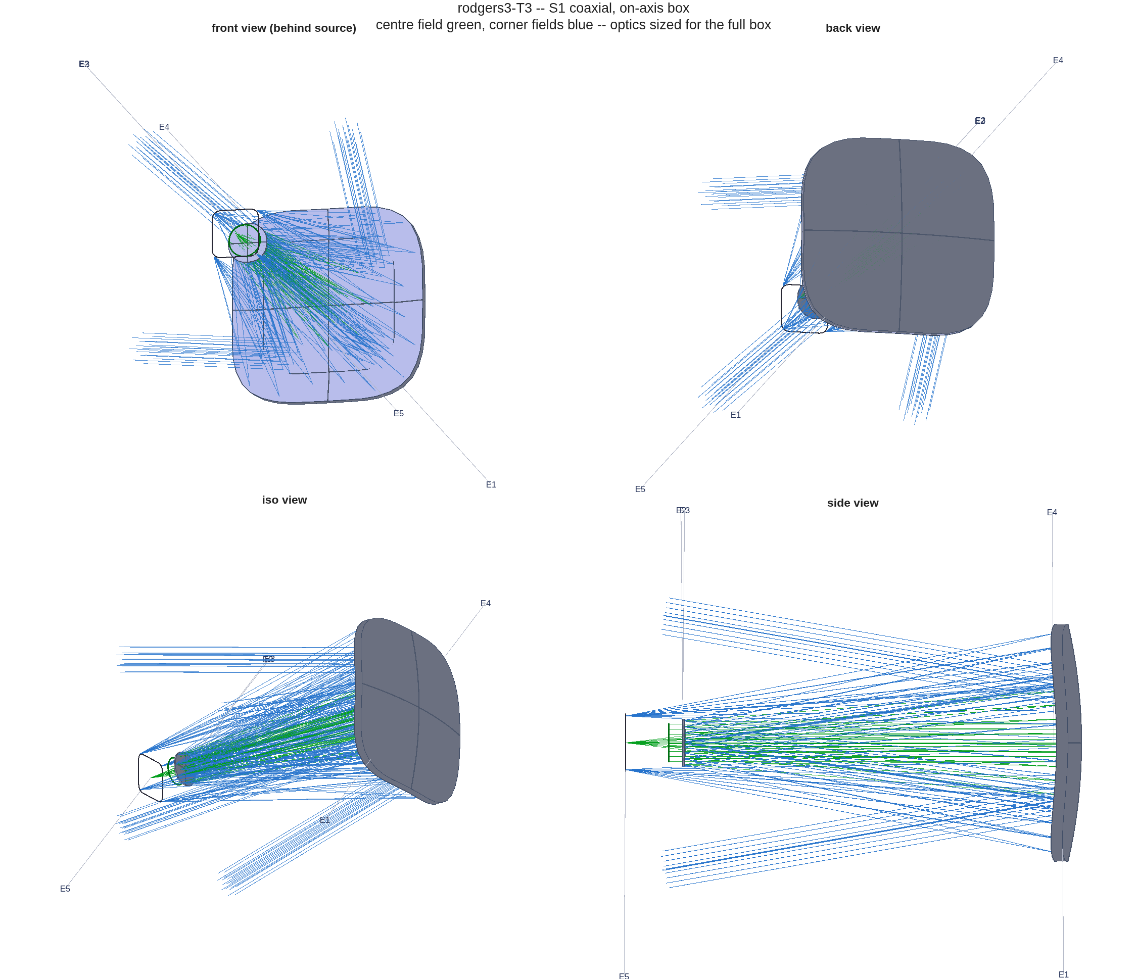
A1 — The problem, and everything needed is committed
Three mirrors, a 20°x20° box at 22°, an exit pin, hard clearances — and five reported rungs to meet
• The system: EPD 75 mm, F/4 (EFL 300 mm), λ = 1 µm, field box 20°x20° full width at YAN +22°; exit beam horizontal (rung 2 on); clearances > 50 / > 35 mm (rung 4 on); 9-point optimization field, XAN ±10°.
• The reproduction inputs are IN the repo: five CODE V lens sequences (the truth), the machine-generated reader (rodgers3_seq), the template, the tests, and the packet. The source presentation is referenced, not committed — nothing below depends on it.
rung | design state | reported nm
r1 | coaxial, on-axis box, aspheres | 159
r2 | same mirrors, offset box, FPA refit | 8810
r3 | re-asphered at the offset | 168
r4 | + tilt/decenter + radii | 117
r5 | + 8th-order Zernike + radii | 53
The instrument class, traced: the coaxial stage of the reproduction.
Repo map: challenges/rodgers3/ (decks *.seq -> rodgers3_seq.m, rodgers3.m, run_t3.m, run_s5_budget.m, run_s5_signed.m, PACKET.md) + templates/10_telescopes/offset_imager/ (the template) + design/src (oi_score, oi_clear) + tests (tRodgers3, tOffsetImager).

Slide 3
A2 — Read the truth, decode the conventions, gate the decode
Five conventions had to be established — each carries its own falsifier
convention | decode | its gate
focal ratio | thicknesses, NOT stations: th4 −722.9 / th6 +740.8 mm -> F/4.00004 | stations misread gives F/4.95 — retracted in place; runner reads the .seq at runtime
the reported statistic | MAX of the dense RMS-vs-field map (from the slides' own embedded plot metadata) | five rungs reproduce in [0.8, 1.25]x
Zernike basis | BornWolf, mode = C-index MINUS ONE | dropping the offset misses rung 5 by 2989x
tilt/decenter | decenters verbatim, tilt sense flipped | origin discriminant + map-shape check
stop aiming | native ChiefRayAiming at the stop Reference | A/B vs Newton aiming: ≤ 0.04 nm
rung | reported nm | reproduced | ratio | verdict
r1 | 159 | 157.74 | 0.992 | PASS
r2 | 8810 | 9664.11 | 1.097 | PASS
r3 | 168 | 166.32 | 0.990 | PASS
r4 | 117 | 124.29 | 1.062 | PASS
r5 | 53 | 54.66 | 1.031 | PASS
• The reproduction is the licence for every comparison after it: same metric, same statistic, same sampling, both sides. Nothing was tuned toward the reported values — the band IS the measurement.
Claim of this slide: decode conventions, then GATE the decode with a falsifier that has teeth. A convention without its negative control is a guess (r3_s0_report.txt carries the full caveat list).

Slide 4
B3 — The template
Five stages; first-order identities are re-derived every iterate, never penalized
S1 · coaxial solve
first-order seed (EFL = EPD x F#, Petzval = 0), then conics + aspheres at the on-axis box
• Identities enforced by construction: EFL exact at every iterate; Petzval zero in the symmetric stages; the stop pose re-derived (and BOUNDED — a degenerate pupil construction falls back to the pose that traced); the focal plane re-posed per stage.
• Pinning doctrine: power belongs to the radii, tilt to the pointing — freeing them into the figure basis makes the solve fight its own pins (slide D12, counter b).
• One call runs the whole story: oi_story(params) = ladder + counters + report. The challenge instance is run_t3.m — a thin wrapper that reads the .seq truth at runtime.
S2 · the move
the same mirrors at the offset box; only the focal plane follows
S3 · re-solve at the used field
symmetric surfaces re-solved at the offset, from the better of two starts
S4 · tilt/decenter under constraints
exit direction + clearances enter the solve as residual rows
Template: templates/10_telescopes/offset_imager. Every stage emits its deck (.in), figures, and a REPORT section — the records this deck is parsed from.
S5 · Zernike departures
aspheres replaced; power pinned to the radii, tilt to the pointing

Slide 5
B4 — The solver
Per-ray residuals with vertex-radial scales; the solve set must be sized to the variables
• Residuals are PER-RAY wavefront errors stacked over the solve fields — per-field RMS residuals stall: the scalar hides the gradient direction, and the table's S1 row is what per-ray recovers.
• Natural scales are VERTEX-RADIAL: aspheres and Zernike-lMon terms are r^n about the vertex, so an offset beam's lever arm is |footprint centre| + its radius. Footprint-centred radii under-scale r^8 by orders of magnitude and finite-difference steps then destroy the surface.
• Damped Gauss–Newton with a chord (one Jacobian reused up to 3 accepted steps), trust-radius damping, and a plateau stop (< 0.1%/iteration after warm-up).
• SIZE THE SOLVE SET TO THE VARIABLES: 9 fields against 82 Zernike variables under-determines the solve — the solve set converges while the dense map stalls (measured on slide C11; 25 fields resolve it). The dense map is always the score; the solve set is only what the optimizer sees.
stage | vars | fields | start -> qmean (nm) | iters
S1 | 15 | 9 | 13462 -> 23.7 | 7
S3 | 16 | 9 | 25619 -> 140.4 | 30
S4 | 23 | 9 | 140 -> 70.7 | 30
S5 | 83 | 9 | 2150 -> 35.0 | 30
• Reading the table: S5's 83 variables against 9 fields is the under-determined row — its dense-map stall and the fix are slide C11.
Solver: oi_solve (template dir). The qmean column is over the SOLVE set; headline numbers are always the dense map.

Slide 6
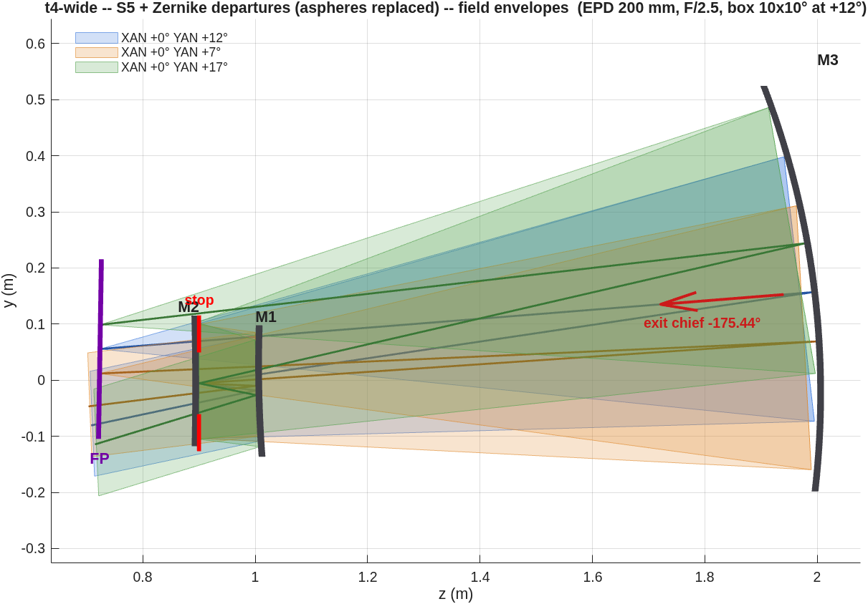
B5 — Constraints are rows, and drawings are gates
A wall freezes; a hinge pays; a pierced hinge must go NEGATIVE
• The exit-beam pin is an EQUALITY row (weighted residual), not a wall: a boolean wall freezes any stage that STARTS outside tolerance — the base Jacobian becomes all wall rows and no step can be evaluated.
• Clearances: nine ordered beam-leg/obstacle pairs, per-field glass patches (footprint disks x1.15, or 1.15-scaled convex hulls), the FP counted as an obstacle, evaluated over the field box — the centre field alone misses edge-field blockage. The SAME model is the solve's hinge rows and the report's gate.
• The measure must test PIERCING exactly and return MINUS the penetration depth inside the glass. Both halves were learned the hard way: a 25-sample walk reported millimetres of clearance for beams THROUGH a mirror, and a zero-at-contact measure gives the optimizer no slope to climb out — the solve re-converges on the blocked design.
• The defect was caught by READING THE LAYOUT FIGURE against the gate, not by any number. Hardware drawings are gates, not illustrations.
The exhibit: a second instance's beams thread M1 and M2 while the sampled gate reported PASS. The instance is retired; the measure is fixed and gated.
Measure: design/src/oi_clear (signed, piercing-exact, ray-paired; reference floors gated). Full defect record: PACKET.md, 2026-08-21 addendum SSA.

Slide 7
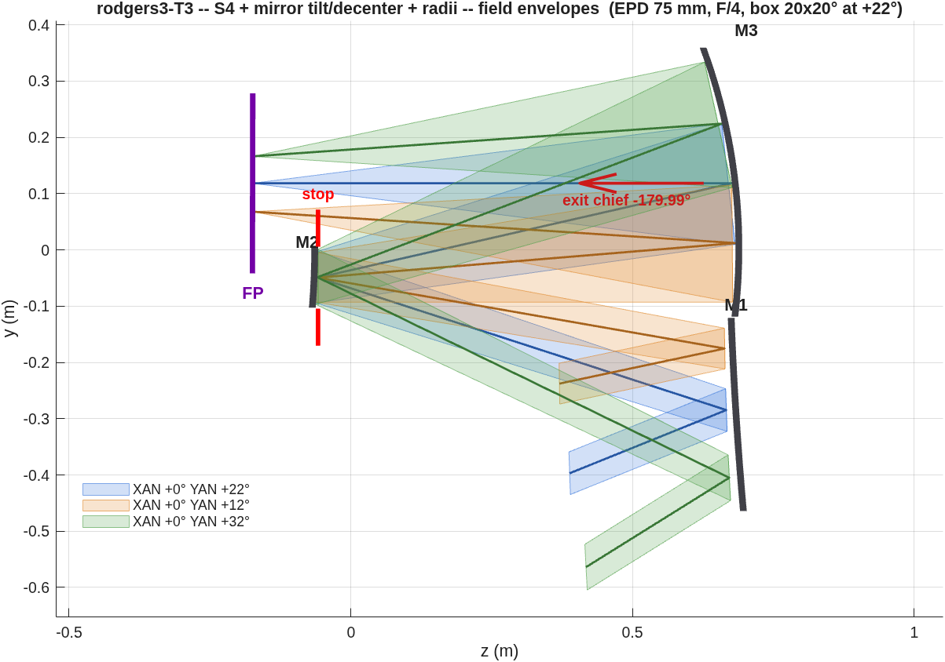
B6 — Scoring and gates
Solve set != scoring set; gates carry a knee; two glass models
• Every reported number is the dense 11x11 map MAXIMUM under the cover's metric contract — the statistic the source study's own slides quote (decoded and gated on A2).
• oi_gates: exit pin PASS at ≤ tolerance; clearance PASS at ≥ min(spec) − 1.5 mm (the hinge knee); WARN below the larger spec value.
• Two glass models, one knob (P.clear_footprint): 'disk' (footprint centre + 1.15x radius — the model of record) and 'hull' (1.15-scaled convex hull — tighter on elongated off-axis patches). The S4 design of record reads 34.1 mm under disk (confirmed at fine sampling) and 42.0 mm under hull.
• The solve must pay what the gate measures: hinge rows and report gates share the model and the knob.
S4 field envelopes: the gate's geometry — every leg vs every mirror edge, over the field box.
strict RMS WFE, centroid reference on the stage's frozen focal plane, exit-pupil anchor, piston-only removal; quoted statistic = dense 11x11 map MAXIMUM over the field box.

Slide 8
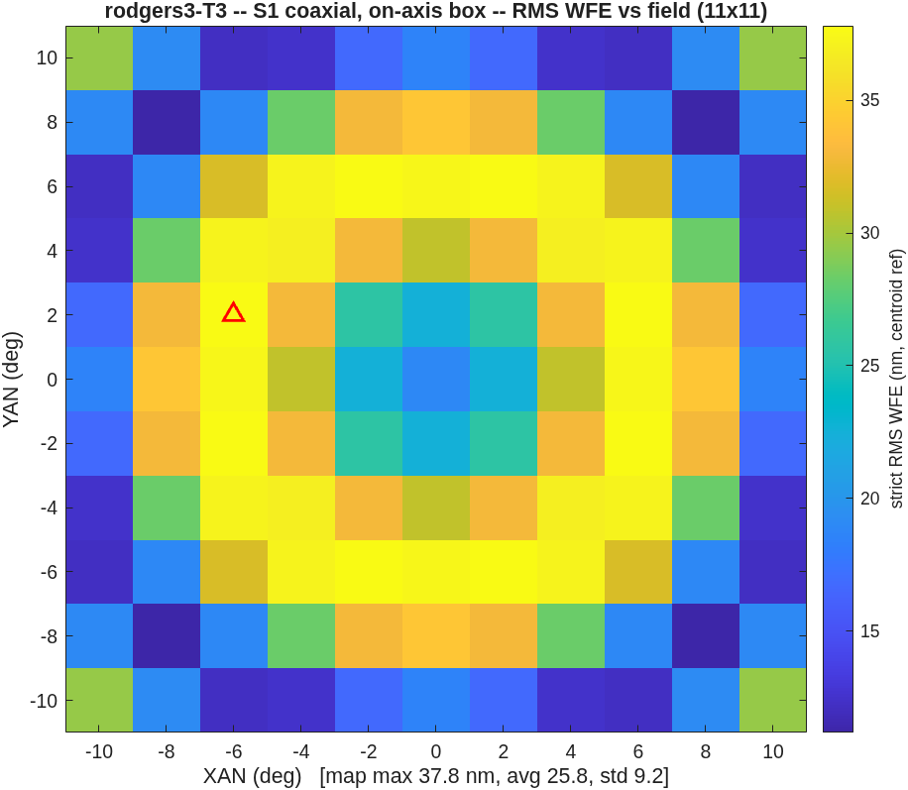
C7 — S1, the on-axis anchor
37.8 nm over the on-axis box (reported rung 1: 159)
• What is varied: conics + aspheres (radii through the EFL/Petzval closure). What is held: packaging (from the .seq truth), the on-axis box.
• The solve runs 4x deeper than the source rung — depth that S2 will tax (next slide).
• Walk: oi_story(...) stage 1, or run_t3() for the challenge instance verbatim.
S1 map: 37.8 nm max; avg 25.8.
strict RMS WFE, centroid reference on the stage's frozen focal plane, exit-pupil anchor, piston-only removal; quoted statistic = dense 11x11 map MAXIMUM over the field box. S1–S3 are unconstrained; clearance floors are reported for context only.

Slide 9
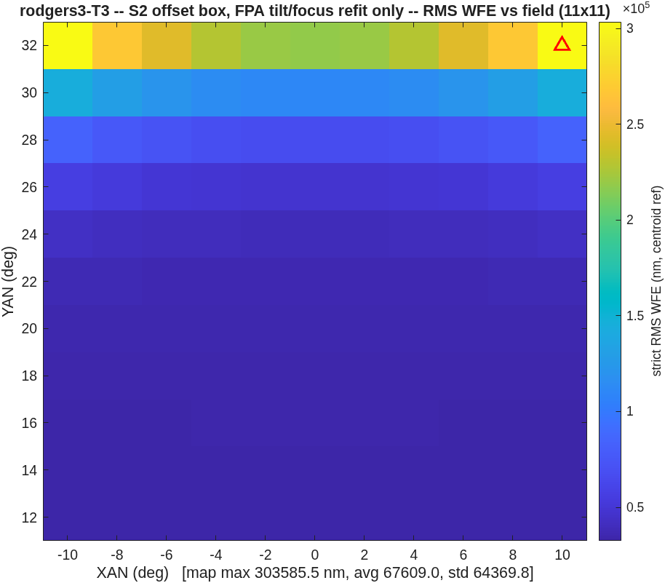
C8 — S2, the disaster is the pedagogy
303,586 nm when the box moves 22° with the design frozen
• Only the focal plane may follow (tilt/focus refit). The cost: 37.8 -> 303,586 nm — 34x the reported 8810, because the deeper on-axis optimum pays proportionally more off axis.
• The rung measures the S1 DESIGN as much as the offset: harder-tuned aspheres fall harder. Expect your own S2 to scale with your S1 depth, not with the reported value.
S2 map: the price of moving the box with the design frozen.
strict RMS WFE, centroid reference on the stage's frozen focal plane, exit-pupil anchor, piston-only removal; quoted statistic = dense 11x11 map MAXIMUM over the field box.

Slide 10
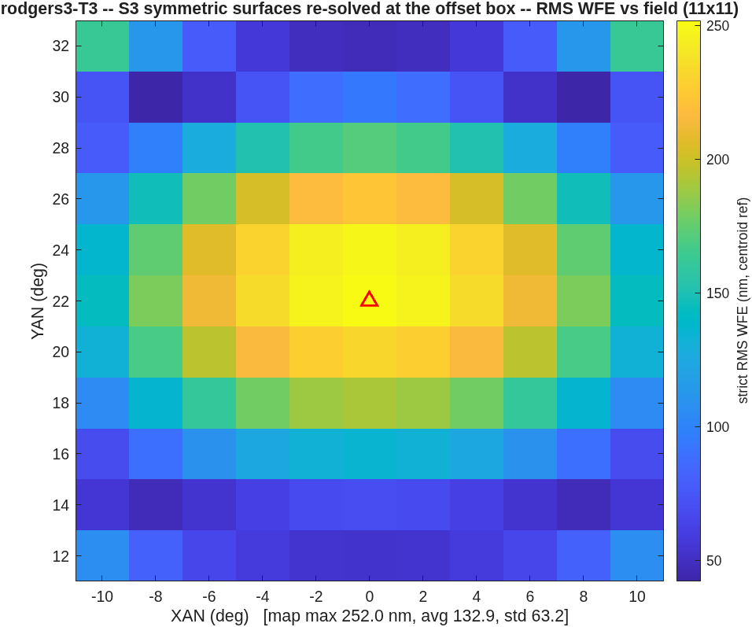
C9 — S3, re-solve at the used field
252.0 nm (reported: 168) — from the better of TWO starts
• The two-candidate start is load-bearing: at a large offset the on-axis-optimized aspheres are poison (25.6 µm for the fresh Petzval-flat spheres vs far worse for the carry), but at a MILD offset the carry wins — score both at the used field, start from the winner.
• Conic migration under the bias doctrine (solve at the used field): K1 -2.42 -> 1.44 (oblate class). Expect sign flips; they are the doctrine working, not an error.
• The stop pose is constructed ONCE at stage entry and frozen; from here the stop decenter is a solve variable driven by the exit row.
S3 map: re-solved at the offset box.
strict RMS WFE, centroid reference on the stage's frozen focal plane, exit-pupil anchor, piston-only removal; quoted statistic = dense 11x11 map MAXIMUM over the field box.

Slide 11
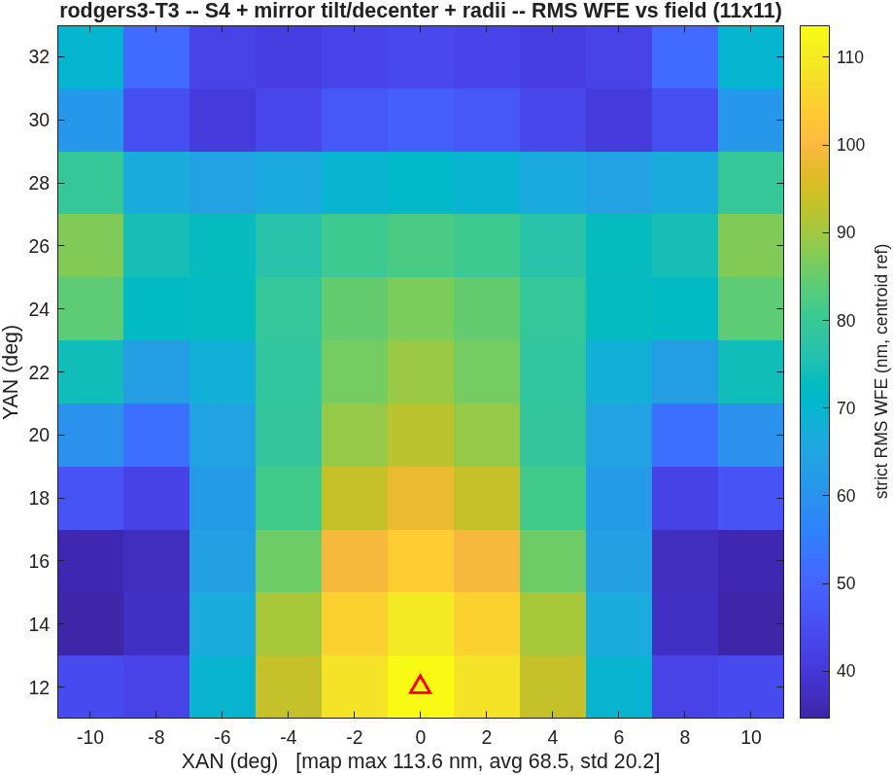
C10 — S4, buildability
113.6 nm at a 34.1 mm floor (confirmed) vs the reported 117 at ≥ 35 — 0.97x
• Unconstrained, tilt/decenter reach 58.3 nm — with the M3-to-FP beam through M2's patch. Not buildable; the map alone cannot tell you.
• With the clearance rows paying the nine-pair model: 113.6 nm at 34.1 mm (42.0 mm under the hull model). Two toolchains, same constraint, same answer to 3% — and the constraint's measured price is 1.9x in WFE.
• Exit chief within 0.03° of horizontal at every stage (the equality row, not a wall).
S4 map: 113.6 nm max over the box.
strict RMS WFE, centroid reference on the stage's frozen focal plane, exit-pupil anchor, piston-only removal; quoted statistic = dense 11x11 map MAXIMUM over the field box. The floor is fine-sampling-CONFIRMED under the fixed measure (addendum SSA).

Slide 12
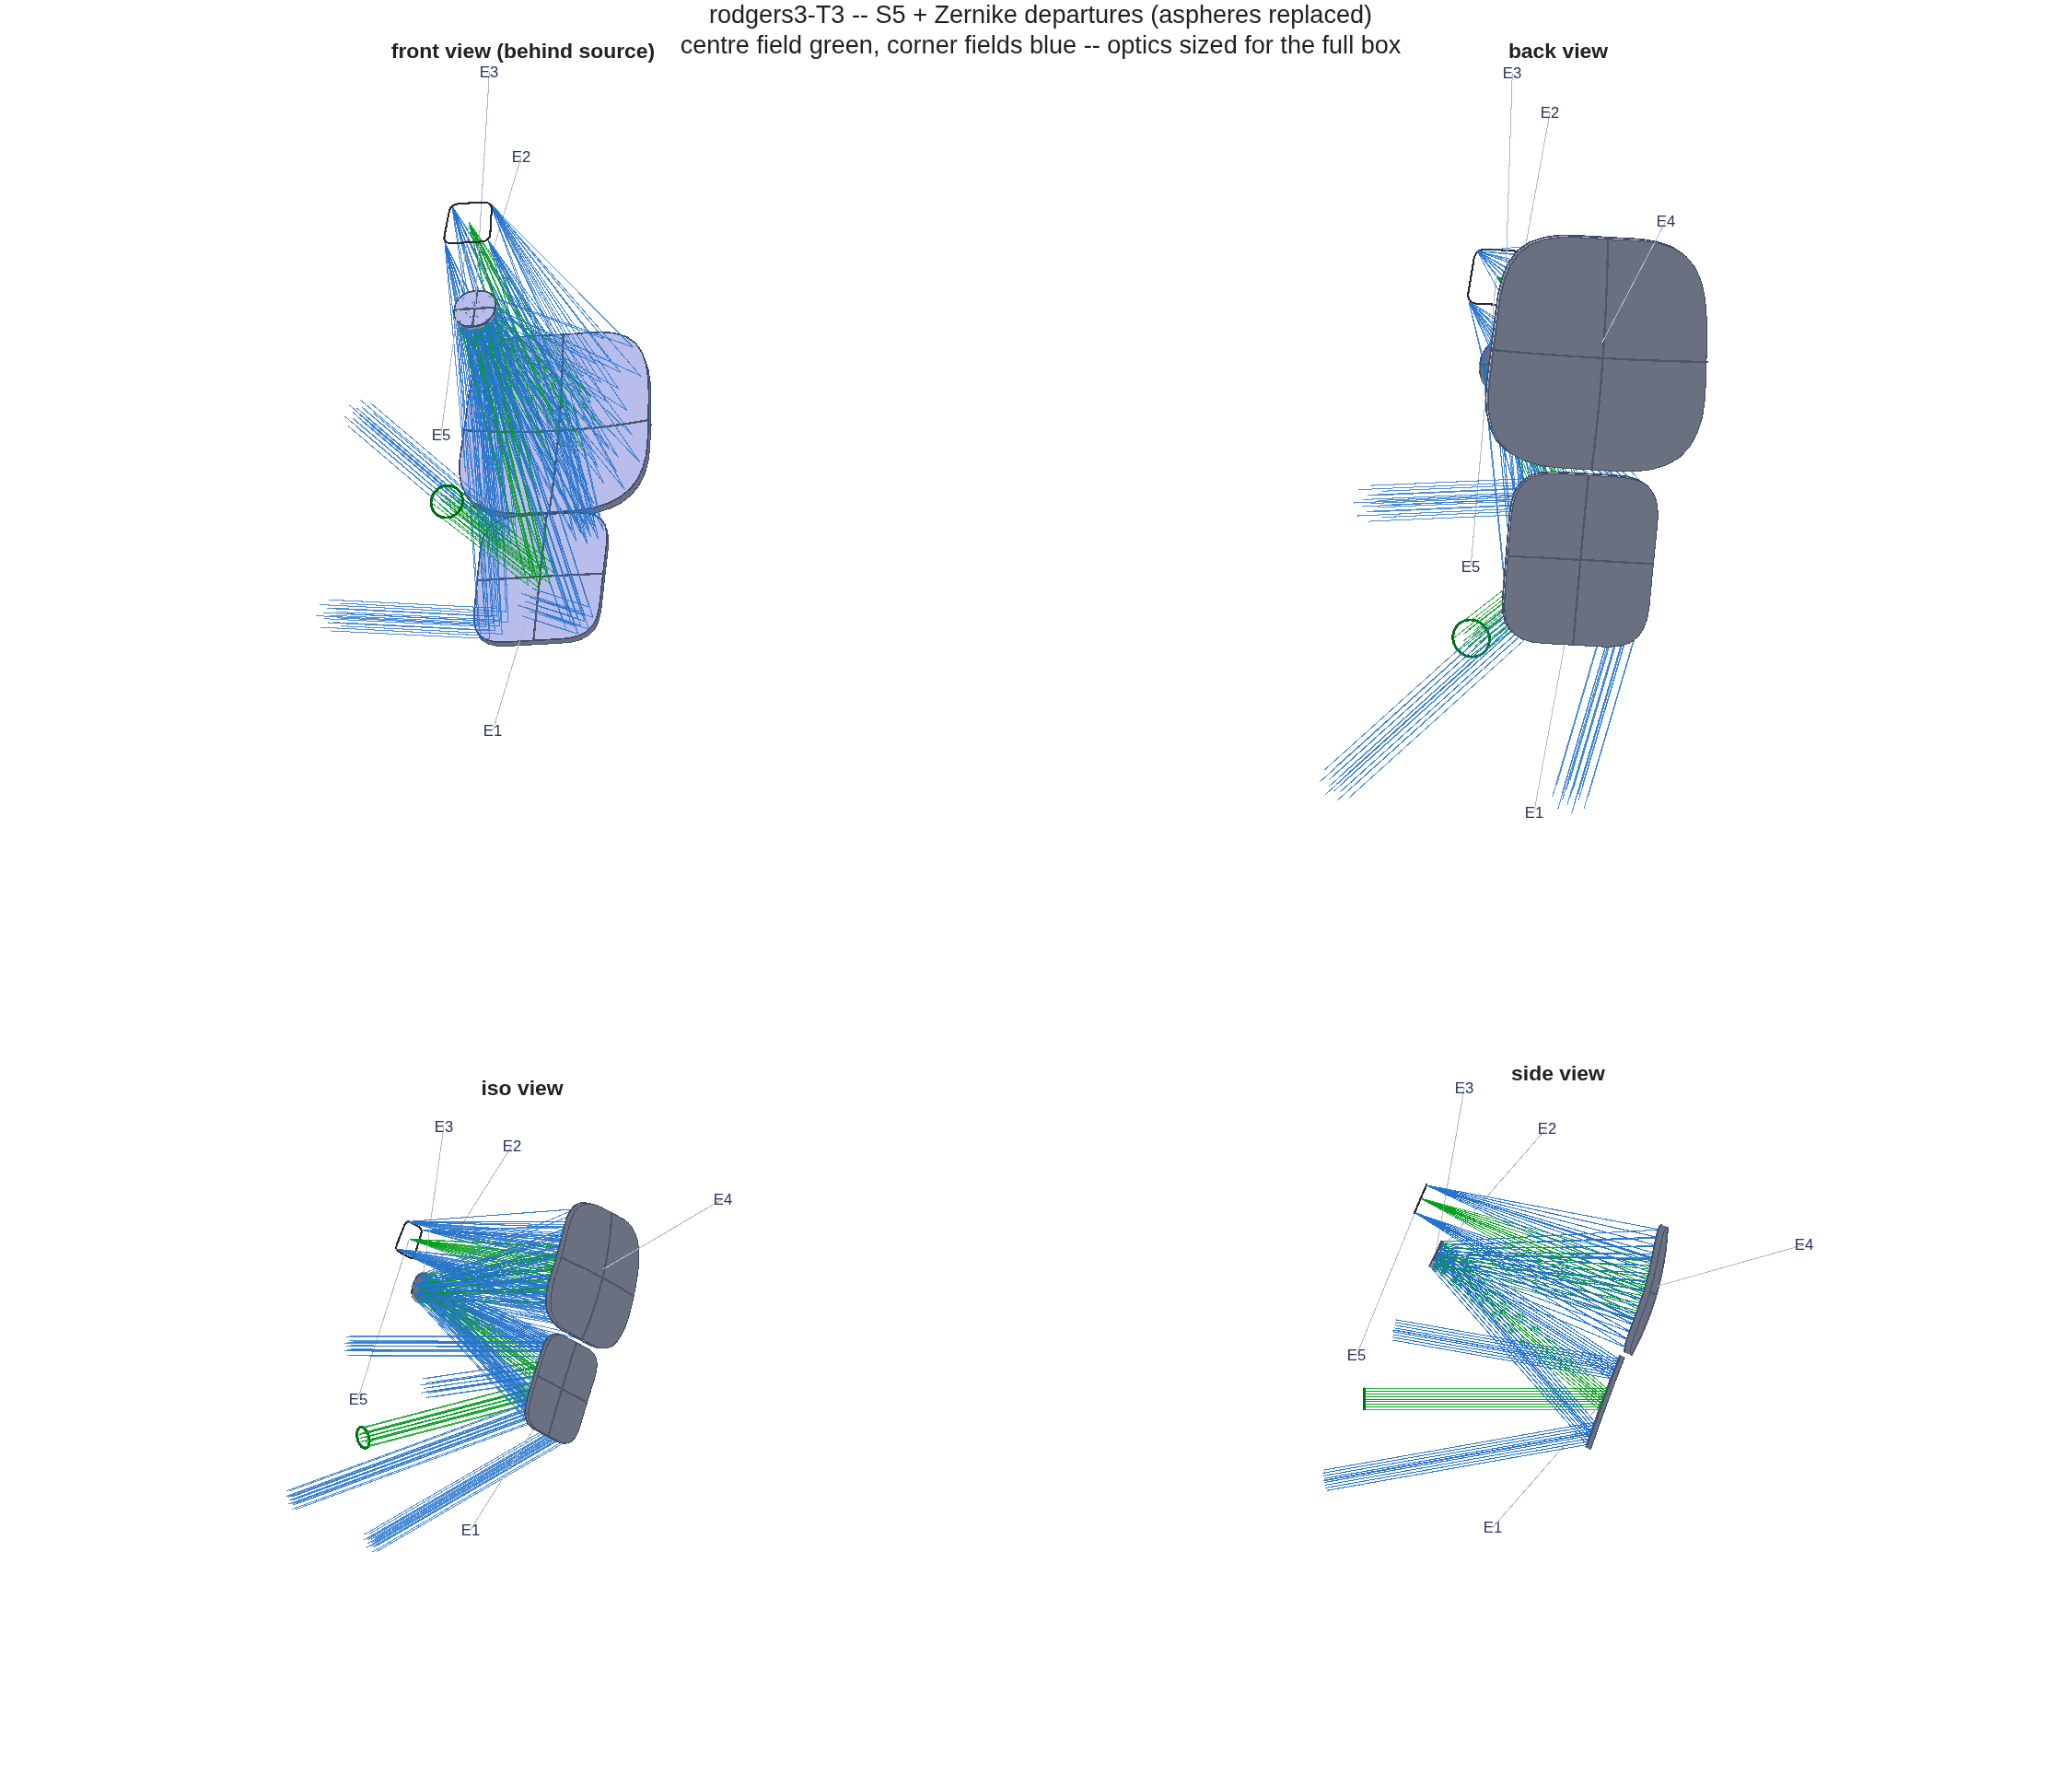
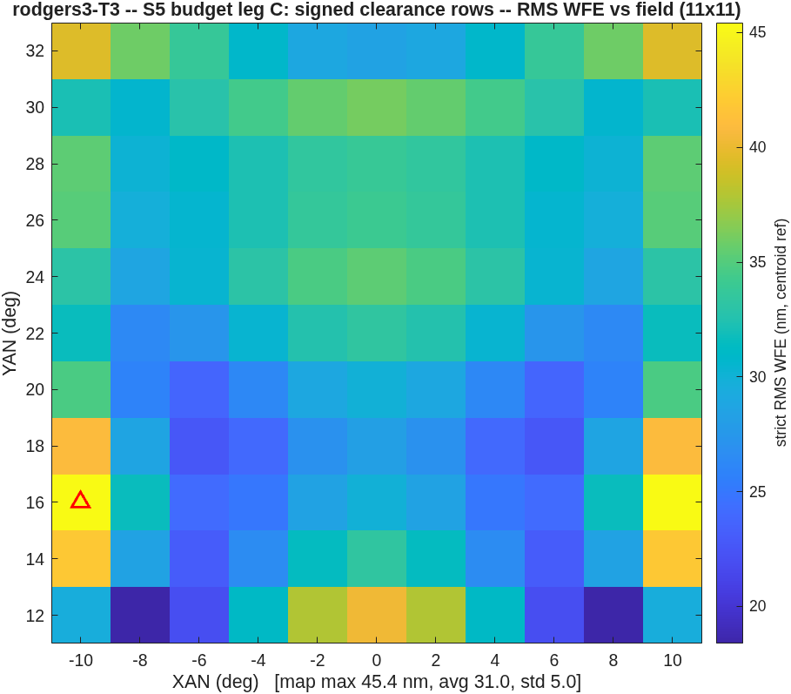
C11 — S5, diagnosed then beaten
The gap to the reported 53 was the solve-field count; matching it lands 45.4 nm
• The five-stage run closes at 118.2 nm — stalled at its S4 level, 83 variables against 9 solve fields.
• The controlled probes, all from the identical S4 seed (the printed start reproduces the record's 2150.1 nm — your re-walk should too):
probe | fields | iters | map max | true floor
S5 of record | 9 | 30 (cap) | 118.2 | 30.0 mm
A | 9 | 150 | 110.7 | 28.9 mm
B | 25 | 60 | 54.1 | 28.2 mm
C (honest rows) | 25 | 49 (plateau) | 45.4 | 33.4 mm
The S5-of-record design, drawn: the layout every map on this slide belongs to.
• Iterations are not the gap (A); fields are (B); with the fixed clearance rows the template lands 45.4 nm — 0.86x the reported 53 — at a floor 1.6 mm shy of the stated 35 (the rows bought back what the blind measure had conceded).
The honest re-solve (probe C): 45.4 nm max, true floor 33.4 mm.
strict RMS WFE, centroid reference on the stage's frozen focal plane, exit-pupil anchor, piston-only removal; quoted statistic = dense 11x11 map MAXIMUM over the field box. The of-record S5 clearance (34.6 mm recorded) retracts to 30.0 mm under the fixed measure — addendum SSB carries the whole table.

Slide 13
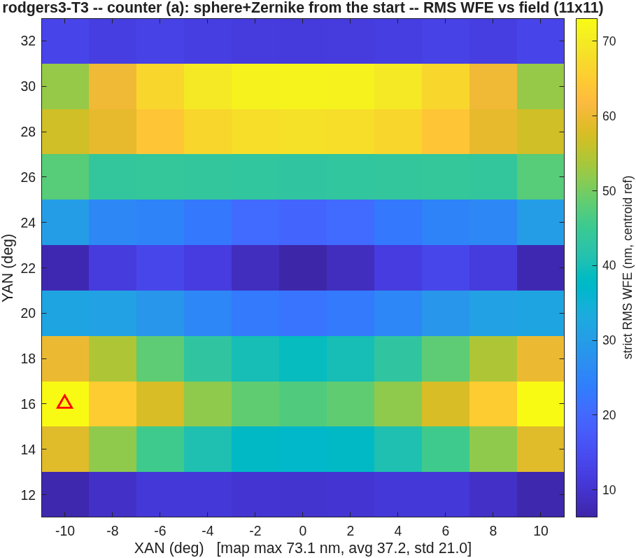
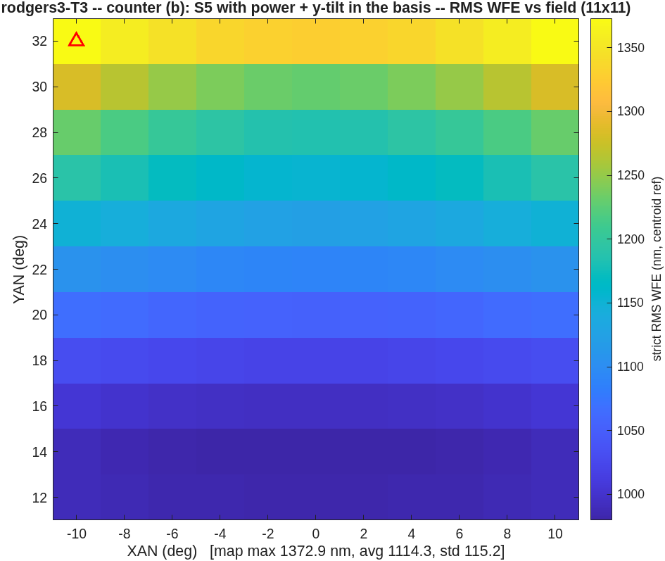
D12 — Counter-designs bound the space
Same constraints, same budget: the sphere+Zernike start wins; releasing the pins chokes
• (a) Sphere + Zernike from the start (no asphere heritage): 73.1 nm vs the heritage path's 118.2 — the heritage is a burden, not a head start. The unconstrained variant (27.9 nm) did NOT survive buildability: always re-check a counter under the full constraint set.
• (b) Power + y-tilt released into the Zernike basis: 1372.9 nm — the freed modes fight the jobs the pins already do. No evidence the reported 53 is term-set-limited; affirmative evidence for the pinning doctrine.
Counter (a): 73.1 nm under the full constraint set.
Counter (b): 1373 nm — the solve chokes.
strict RMS WFE, centroid reference on the stage's frozen focal plane, exit-pupil anchor, piston-only removal; quoted statistic = dense 11x11 map MAXIMUM over the field box.

Slide 14
D13 — The gate map
Every claim in this deck lives in a committed test
claim | where it is gated | the gate
the five-rung reproduction | tests/tRodgers3.m | per-rung bands around [0.8, 1.25]x (coarsened 5x5 maps)
the Zernike-basis decode | tRodgers3 negative control | C-offset dropped must miss by > 100x (measured 2989x)
the clearance measure | oi_clear reference floors | S4 34.11 / S5 29.97 mm reproduce exactly post-change
the template flow | tests/tOffsetImager.m | structural smoke: S1-S3 run and recover at reduced knobs
the promotion/graphics layer | freeform suite group | 128 pass / 0 fail on the merged tree (2026-08-21)
• The suite is the arbiter of "reproduced": if your re-walk passes the freeform group, you have the solution. If a number drifts outside a band, the gate names the rung and the convention to re-check.
Run: ./run_mmacos_tests.sh freeform (mmacos root).

Slide 15
E14 — The re-walk, verbatim
Four commands, their runtimes, and what "reproduced" means
run mmacos_setup.m
rodgers3(); % Stage-0 gate ladder (~40 min)
run_t3(); % template at the challenge
% + counters (~4 h)
run_s5_budget(); % probes A + B (~8 h)
run_s5_signed(); % probe C, honest rows (~4 h)
./run_mmacos_tests.sh freeform % the arbiter (~1 h)
• Artifacts land beside the runners: challenges/rodgers3/t3/ (decks, figures, REPORT), s5_budget/ (probe maps + .mat), and the packet quotes all of it.
• "Reproduced" means: the five rungs inside their tRodgers3 bands; the probe-C start printing ~2150.1 nm (the seed self-check); the clearance reference floors to 0.01 mm; the suite green. Map maxima are digit-stable on one engine build; across compilers expect round-off-level drift only.
• Every figure in this deck regenerates from the committed .mats without re-solving (the deck generators parse the records — nothing is hand-typed).
strict RMS WFE, centroid reference on the stage's frozen focal plane, exit-pupil anchor, piston-only removal; quoted statistic = dense 11x11 map MAXIMUM over the field box.

Slide 16
F15 — Can a new user re-instance it without an agent?
Measured: FAIL — three attempts, three crashes, none past stage 2 of 5
• The protocol: an agent restricted to the COMMITTED docs (README, packet + addendum, function help) — no lore, no memory, no fixes — plays the new-user proxy at a fresh instance (EPD 150 mm, F/3.3, 15°x15° at 22.5°, clearances > 40 / > 25 mm, exit horizontal), envelope and seed left to the docs.
• The frictions to act on first (of 15, all in the committed report):
• F7 — a dense-map headline can be computed from ONE surviving field point, with no warning: attempt 2's S2 printed [max 768194.5, avg 768194.5, std 0.0] — one finite point of 121; the failed fraction is never reported.
• F8 — the flow proceeds from a design it has already scored as unusable: one check there converts three opaque crashes into one accurate sentence.
• F1/F2 — the README's own run recipe errors on the path, and oi_story is undocumented outside its help.
• F3/F4 — no documented way to choose the envelope, and seed_R1_m is load-bearing with nothing saying so.
• F13 — the addendum's 25-solve-field lesson never reached the nsolve default or its help.
• What WORKED: the constraint conventions were guessable and the gates confirmed the guesses; the packet's t4 retraction kept the user out of the retired trap without opening it.
attempt | envelope | reached | died in
1 | 2× rodgers3 (EPD ratio) | S1 (20.9 nm) | oi_map_fig:43
2 | 1.65× rodgers3 (EFL ratio, the rescale the docs name) | S1 (30.6 nm) | oi_layout_fig:140
3 | as attempt 2, stages=[1 3 4 5] (documented S2 skip) | S1 (30.6 nm) | oi_map_fig:43
• One optical root cause, in the packet's own words: the S1 solve runs far deeper than the source rung (20.9 / 30.6 nm vs the reported 159), and "the S2 rung measures the S1 design as much as the offset" — taken past the point where the offset box traces at all. The docs NAME the mechanism and offer no guard, cap, or knob.
Instrument: BRIEF_oi_unguided; deliverable: challenges/rodgers3/t5_unguided_REPORT.md (verbatim, committed). A negative result is a valid result — this one prices the gap between "documented" and "actionable". Acts 2 and 3 — the fixes, the walk, the close — next two slides.

Slide 17
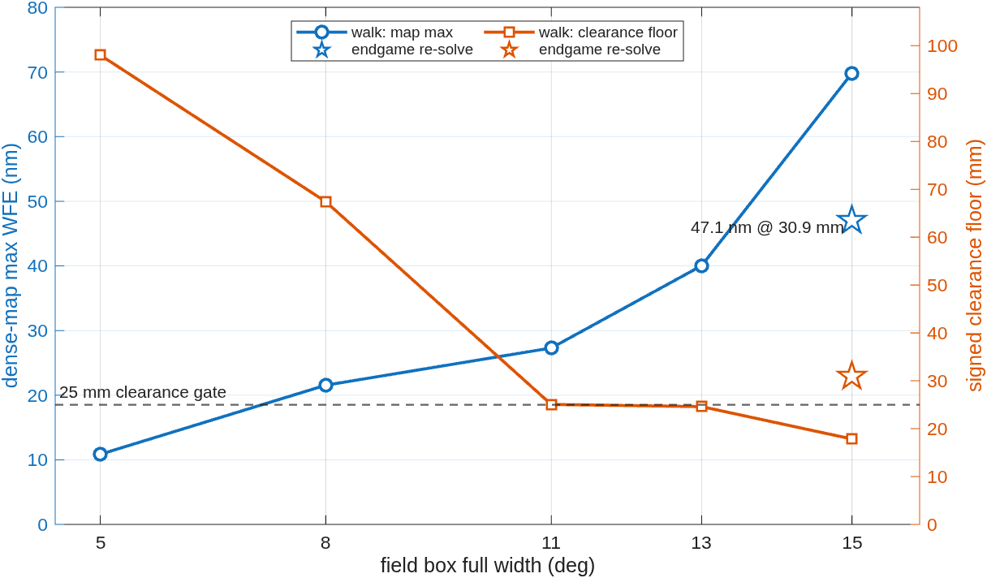
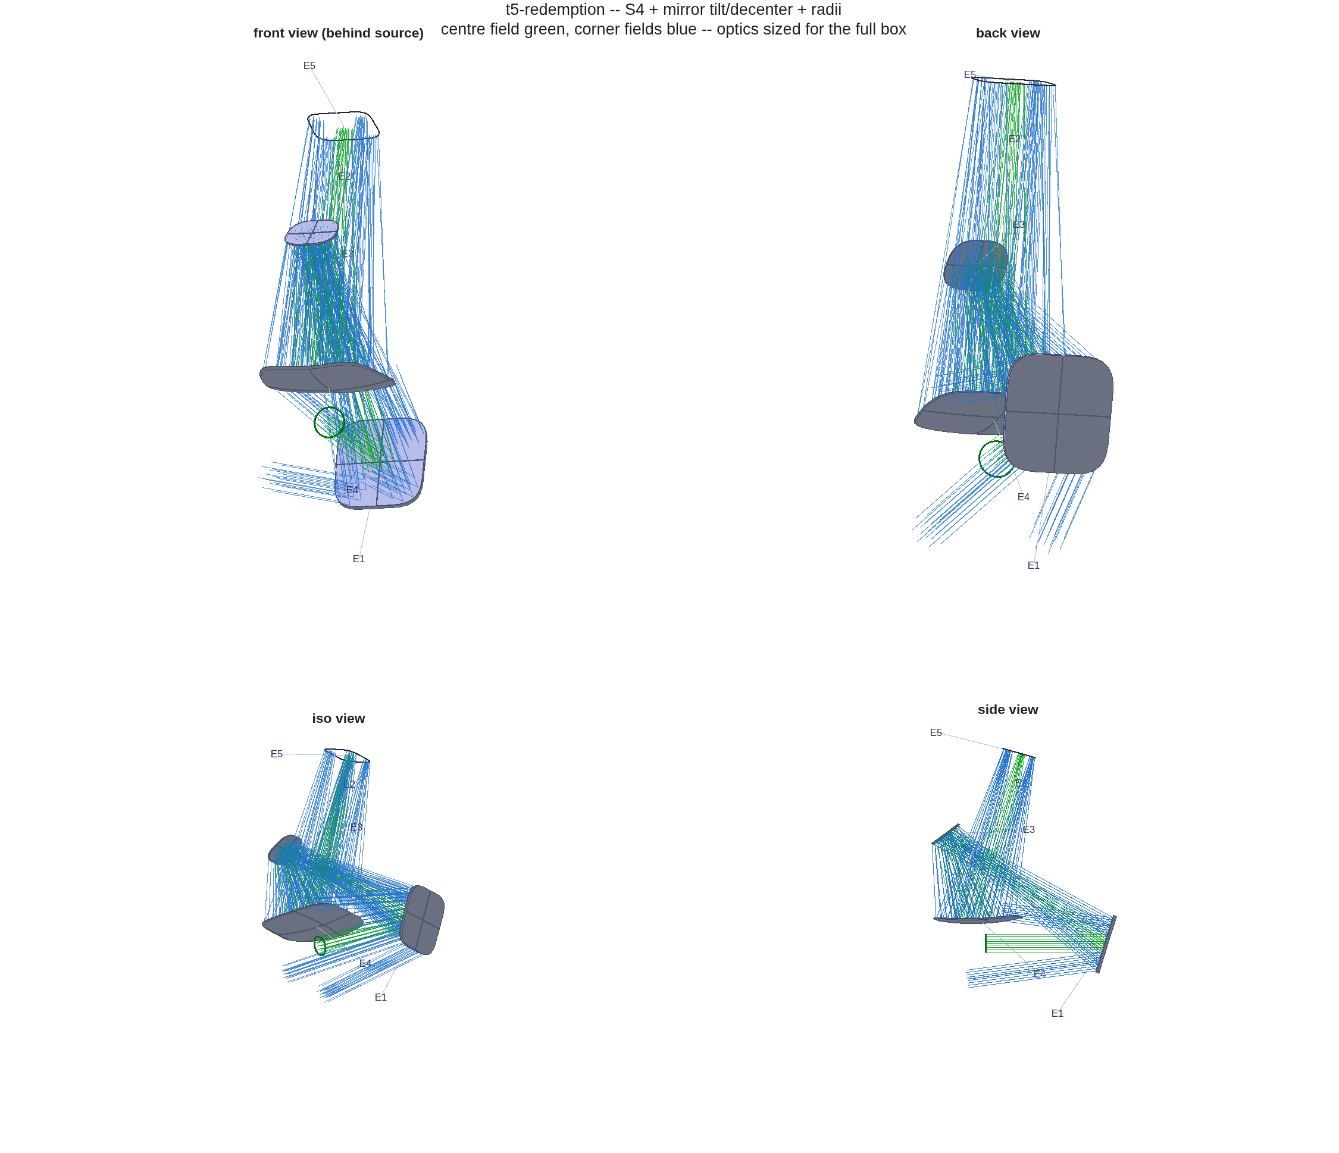
F16 — The sequel: fix the frictions, then walk the box
The cold start dies 205 mm inside the glass; the walk lands 69.8 nm — 8531x better
• The instance against the source challenge (a fresh, HARDER system — bigger beam, faster, tighter clearances):
• Act 3 — the WALK (oi_walk): solve an easy 5° box, then open the box toward the target carrying each solved design as the next warm start — full freedom + all constraint rows at every step; every carried design traced the widened box first try.
 | rodgers3 challenge | t5 walk instance
EPD / F# | 75 mm / F4.0 | 150 mm / F3.3
field box | 20x20° at YAN +22° | 15x15° at YAN +22.5°
clearances | ≥ 50 / 35 mm | ≥ 40 / 25 mm
envelope | native .seq spacings | rodgers3 W-fold x1.65
exit pin | horizontal | horizontal
step | box | map max (nm) | floor (mm) | gates
1 | 5x5° | 10.9 | 98.0 | exit PASS / clear PASS
2 | 8x8° | 21.5 | 67.4 | exit PASS / clear PASS
3 | 11x11° | 27.3 | 25.1 | exit PASS / clear PASS
4 | 13x13° | 40.0 | 24.6 | exit PASS / clear PASS
5 | 15x15° | 69.8 | 17.8 | exit PASS / clear FAIL
• Act 2 — the REDEMPTION rerun (run_t5r): ZERO crashes, every failure self-diagnosed (capped S1 74.9 nm; "INVALID — 104/121 fields lost"; exit "unmeasurable") — but S3–S5 stall at ~596 µm with the beam 205 mm INSIDE the glass (figure): the cold start is outside the convergent basin, and both counter-designs stall with it.
The two trends the table hides: WFE climbs as the box opens, the floor falls through the 25 mm gate — and the endgame re-solve (stars, next slide) closes both.
The stall, drawn: the corner-field fans thread the mirrors — the layout no number can excuse.
Records: t5_redemption/t5r_REPORT.md + t5_walk/t5_walk_REPORT.md; runner oi_walk.m. Trend figure: fig_walk_trend.m from the committed .mat records. Every number: the cover contract.

Slide 18
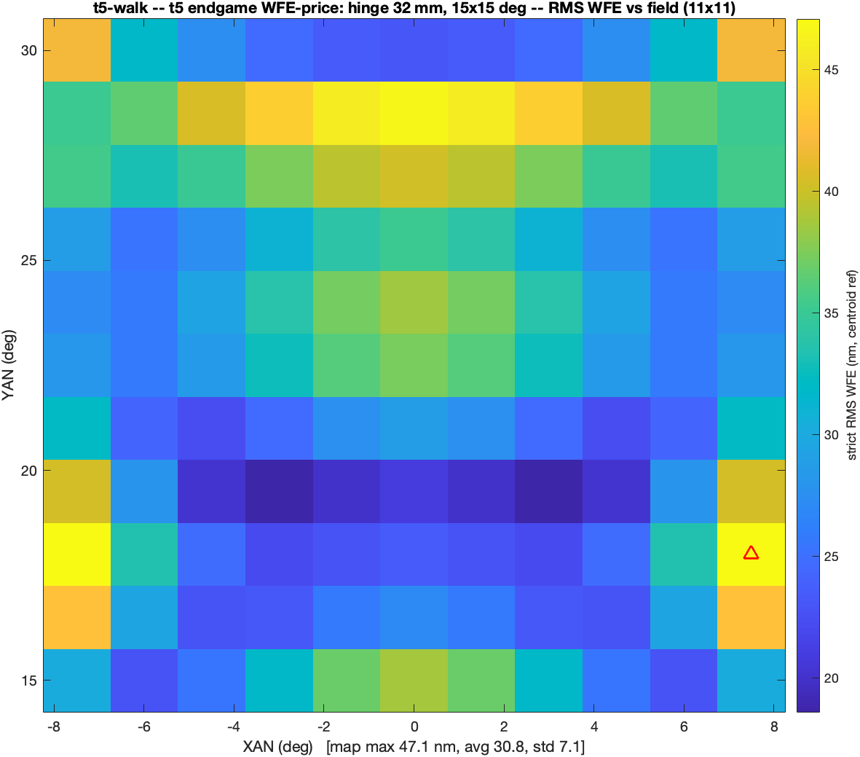
F17 — The endgame: the last gate closes at negative cost
Hull reads the walk endpoint at 28.7 mm (clears as-is); the re-solve lands 47.1 nm at 30.9 mm — better than the walk on BOTH axes
• WHY the walk left 7.2 mm on the table: oi_solve's plateau break watches WFE only, so the final step stopped at 6 iterations — the moment WFE flattened, with the clearance hinge still pulling. Under-solved, not blocked.
• The re-solve: warm from the 13° step, a restart loop past the break, and the clearance hinge asked for MORE than the gate — at-spec undershoots, because the hinge gradient dies at its own target:
hinge (mm) | map max (nm) | floor (mm) | iters / restarts | ≥ 25 mm
25 (spec) | 51.7 | 24.2 | 46 / 3 | short
32 | 47.1 | 30.9 | 82 / 5 | yes
40 | 47.3 | 39.0 | 92 / 6 | yes
• Envelope stretch is the WRONG lever: x1.75–x1.9 buys WFE (34.9 -> 31.3 nm) while the at-spec floor asymptotes just under 25 mm — and the x1.65 envelope already reaches 30.9. Keep the envelope; raise the hinge.
The closing map, ladder-style: 47.1 nm max over the 15° box at a 30.9 mm floor (deck t5_endgame_wfe.in, committed).
• Every frontier box is now spec-compliant: the deficit was part model conservatism (hull 28.7 mm), part under-solve — and zero physics.
Record: t5_endgame/t5_endgame_REPORT.md (verdict CLOSED); harness run_t5_endgame.m — CCMac's runs, cross-checked on Linux to 4.6e-13 mm. Every number: the cover contract.

Slide 19
F18 — Should mmacos embed an agent helper?
The F15–F17 arc feeds both camps — that is the question
• FOR, from this arc: every defect found was a CONCEPTUAL coupling — a frame convention, a metric reference, a constraint model — that documentation had not prevented; agent-in-the-loop found and fixed each in hours. And F15's one conceptual failure (S1 depth poisoning offset traceability) was DOCUMENTED and still not actionable — the case for advice AT CALL TIME ("your S1 is 8x deeper than the reference; expect the offset box to lose rays").
• AGAINST, from the same arc: every fix COMPILED into a check — the prescription validator, the pose bound, the signed piercing measure, the gate map — and 13 of F15's 15 frictions compile the same way (guards, caps, doc lines; F8 is literally "one check converts three crashes into one sentence"). Compiled knowledge is inspectable, testable, maintenance-stable; a runtime assistant is none of those by default.
• The F16–F17 sequel is itself an AGAINST exhibit: the continuation STRATEGY — agreed in one discussion — compiled into a runner (oi_walk.m), the compiled walk solved unattended the instance the cold start could not, and the endgame close came from the same loop (run_t5_endgame.m). The walk itself is compiled knowledge.
• Where is the line between knowledge compiled into checks and knowledge served by an assistant?
• What should a helper catch AT CALL TIME that a validator cannot?
• Who maintains the helper's knowledge when the engine moves — and how is IT gated?
• Would you trust a design whose constraint model was chosen by the assistant?
Discussion slide: questions are the deliverable. The measured input: docs + gates did NOT carry an unassisted user through a COLD re-instance (F15); the compiled walk then did (F16–F17) — most of the gap was compilable, and was compiled.

