Slide 1

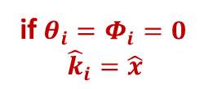


z
if $θ_{i}=Φ_{i}=0$
$${\hat{k}}_{i}=\hat{x}$$
$${\hat{k}}_{i}$$
$$Φ_{i}$$
$$θ_{i}$$
x
y

