Slide 1
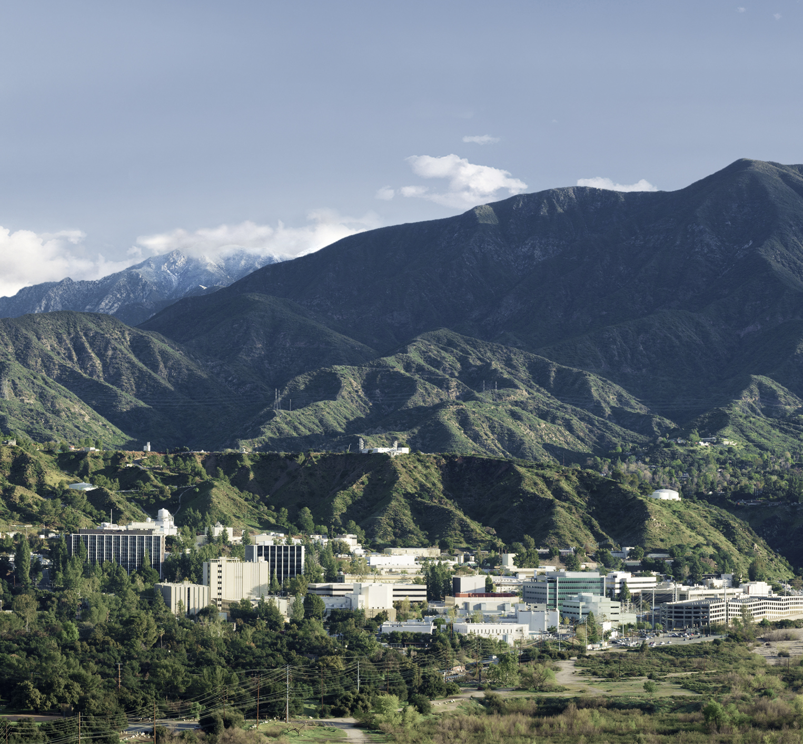
PolSARproSim+
PolSARproSim Code Walkthrough
Razi Ahmed
Jet Propulsion Laboratory, California Institute of Technology

Slide 2
Basic Structure
PolSARproSim
Clean up and Initialize SAR images
For each Track
Inputs and Initialization
Create Stem Map
Create Forest Image
(for visualization)
Calculate Effective Permittivities
Calculate Attenuation Map
(ALUT)
Create DEM
Calculate Direct Ground Scattering
Calculate Direct Short Vegetation Scattering
Calculate Direct Forest Scattering
Write Images and Clean up
For each tree
Primary Branch Scattering
Secondary Branch Scattering
For each Branch or Stem
Simulate scattering from cylinder (use the ALUT)
Accumulate Scattered field into SAR image for HH, HV, VV polarization
Calculate Indirect (bounce) Forest Scattering
Calculate Indirect (bounce) Short Vegetation Scattering
Tertiary Branch Scattering
Foliage Scattering
Stem Scattering
Realize a branch as a cylinder
N x M
Monte Carlo Simulations
N
1

Slide 3
Data Structures
One Master Record with
Various scalar parameters, filenames, file handles etc.
Pointers to HH, HV and VV images
Pointers to attenuation map, DEM
A Record (structure) of Tree parameters such as location, height, dbh etc
Record (structure) of Allometric parameters
A structure for each tree with
Scalar parameters (height, dbh etc)
Link lists for
Crowns (of type crown)
Stems (of type branch)
Primary branches (of type branch)
Dry primary branches (of type branch)
Secondary branches (of type branch)
Tertiary branches (of type branch)
Foliage (of type leaves)

Slide 4
Effective_Permittivities(&Master_Record); in PolSARproSim_Procedures.c
Effective_Permittivities
(functions called)
Initialise_Standard_Jnlookup
Initialise_Standard_Ynlookup
Realise_Tree
(see backup slide)
Cylinder_from_Branch
CylinderPolarisability
Leaf_Moisture
vegetation_permittivity
Leaf_Depolarization_Factors
Tertiary_Branch_Moisture
Computes the effective wave vectors that are later used to calculate attenuation from a tree crown.
Loops through each tree and its respective stem, primary, secondary, tertiary branches and leaves and sums the polarizability tensor ‘Alpha’ for each.
The effective permittivity tensor of each component is estimated by normalizing the cumulative polarizability tensor by the total crown volume. Effective permittivity of each component is then added up to estimate the effective permittivity of material inside the crown.
The effective wave vectors are then estimated using effective permittivities.
Similar process for short vegetation.

Slide 5
Attenuation_Map (&Master_Record) in PolSARproSim_Procedures.c
Attenuation_Map
(functions called)
RayCrownIntersection
Realise_Tree_Crown_Only
Create_SIM_Record
Initialize_SIM_Record
PutSIMPixel
Write_SIM_Record
Rename_SIM_Record
Destroy_SIM_Record
Populates the Attenuation Map structure in the Master Record.
This structure contains six lookup tables for wave attenuation
Direct H and V
Bounce H and V
Direct Short Vegetation H and V
Loops through each voxel, finds the path length of a ray originating at that voxel and traveling towards the radar (for bounce) or towards the ground (for direct) through all intersecting canopies.
Attenuation is computed using path lengths and wave vectors computed in Effective_Permittivity() as

Slide 6
Direct Ground Scattering
PolSARproSim_Direct_Ground
(functions called)
Facet_init_list
monostatic_soil_sigma0HH
nonostatic_soil_sigma0VV
facet_area
Lookup_Direct_Attenuation
Accumulate_SAR_Contribution
getSIMpixel
Rescale_SIM_Record
Estimates Radar scattering from ground surface.
Each resolution element is divided into many triangular facets that can have arbitrary slopes.
For each triangular facet
If the facet is visible, then
Calculate the scattered matrix using the SPM model and add noise to its amplitude and phase
Scale with facet area, rotate about LOS using Lee et al. and incorporate attenuation using the lookup table
Locate the pixel to which this facet belongs and accumulate the scattered field to that particular pixel of the SAR image
Normalize and rescale entire image using PSF

Slide 7
Bounce Scattering from Forest
Stems
PolSARproSim_Forest_Bounce
(functions called)
Initialize_SAR_Geometry
Realise_Tree
Image_Tree_Bounce
Cylinder_from_Branch
Image_Cylinder_Bounce
Estimate_SAR_Tertiaries
Tertiary_Branch_Moisture
vegetation_permittivity
Realise_Tertiary_Branch
Image_Foliage_Bounce
Accumulate_SAR_Contribution
Estimate_SAR_Foliage
Cylinder_from_Branch
Image_Cylinder_Bounce
Accumulate_SAR_Contribution
Cylinder_from_Branch
Image_Cylinder_Bounce
Accumulate_SAR_Contribution
Cylinder_from_Branch
Image_Cylinder_Bounce
Accumulate_SAR_Contribution
Realise_Foliage_Element
Accumulate_SAR_Conribution
Primaries
Estimates the bounce scattering from Forest
Deterministic/Monte-Carlo approach
For each tree
Realize the tree
Image the tree
For each stem, Divide the stem into Ns sections, image each section as a finite cylinder, incorporate attenuation, accumulate field
For each primary and secondary branch (separately), divide branch into Nb sections, image each section as a finite cylinder, incorporate attenuation, accumulate field
For a sample of tertiary branches, divide the cylinders into Nt sections, image each section as a finite cylinder, scale by sample fraction, attenuate using ALUT and accumulate field.
For a sample of leaves, image the leaves/needles based on random orientation and location of leaves within the canopy, incorporate attenuation and accumulate field
Secondaries
Tertiaries
Foliage

Slide 8
Direct Scattering from Forest
PolSARproSim_Forest_Direct
(functions called)
Initialize_SAR_Geometry
Realise_Tree
Image_Tree_Direct
Cylinder_from_Branch
Image_Cylinder_Direct
Accumulate_SAR_Contribution
Estimate_SAR_Tertiaries
Tertiary_Branch_Moisture
vegetation_permittivity
Realise_Tertiary_Branch
Estimate_SAR_Foliage
Image_Foliage_Direct
Realize_Foliage_Element
Estimates the direct scattering from Forest
Deterministic/Monte-Carlo approach
For each tree
Realize the tree
Image the tree
For each stem, Divide the stem into Ns sections, image each section as a finite cylinder, incorporate attenuation, accumulate field
For each primary and secondary branch (separately), divide branch into Nb sections, image each section as a finite cylinder, incorporate attenuation, accumulate field
For a sample of tertiary branches, divide the cylinders into Nt sections, image each section as a finite cylinder, scale by sample fraction, attenuate using ALUT and accumulate field.
For a sample of leaves, image the leaves/needles based on random orientation and location of leaves within the canopy, incorporate attenuation and accumulate field

Slide 9
Direct Scattering from Short Vegetation
PolSARproSim_Short_Vegetation_Direct
(functions called)
vegi_polar_angle
leaf_moisture
vegetation_permittivity
Leaf_Scattering_Matrix
Lookup_Direct_Attenuation
Accumulate_SAR_Contribution
Estimates the direct scattering from understory (short vegetation)
For each pixel in the image
For each Monte-Carlo iteration (number based on stem volume fraction)
Generate stem of some mean height, and estimate the scattering matrix parameterized by global stem depolarizations and permittivities
Scale the scattered field and accumulate in the image
For each Monte-Carlo iteration (number based on leaf volume fraction)
Generate leaves of some mean extent, and estimate the scattering matrix parameterized by global leaf depolarizations and permittivities
Scale the scattered field and accumulate in the image

Slide 10
Indirect Scattering from Short Vegetation
PolSARproSim_Short_Vegetation_Bounce
(functions called)
vegi_polar_angle
leaf_moisture
vegetation_permittivity
Leaf_Scattering_Matrix
Lookup_Bounce_Attenuation
Accumulate_SAR_Contribution
RayPlaneIntersection
Lookup_Direct_Attenuation
Estimates the indirect (bounce) scattering from understory (short vegetation)
Same programming structure as PolSARproSim_Vegetation_Direct, the calculations for scattered field are however different

Slide 11
Direct Ground Scattering, the math
Facet surface normal and unit look vector

Slide 12
Vegetation Permittivity from Moisture, [Ulaby, El-Reyes, 1987]

Slide 13
Realise_Tree : populates the tree structure
Realise_Tree
Crown_Init_List
Realise_Global_Crown
{Create/Assign}_Leaf
Realise_Stem
Realise_Primaries
Realise_Tertiaries
Realise_Foliage
Create_HEDGE_Global_Crown
Create_PINE00n_Global_Crown
(n = 1,2,3)
Create_DECIDUOUS001_Global_Crown
Create_Crown
Stem_Direction
Assign_Crown
Crown_head_add
Create_Crown
Assign_Crown
Crown_Fractional_Dry_Depth
Assign_Crown
Crown_tail_add
Crown_head_add
Stem_Start_Radius
Stem_End_Radius
Stem_Tropism_{Factor/Direction}
Stem_{Lamdacx/Lamdacy/Gamma/Moisture}
Vegetation_permittivity
Realise_living_crown_depth
Stem_direction
{Create/Assign}_Crown
RayCrownIntersection
Assign_Branch
Branch_{Crookedness/Centre/head_add}
Realise_PINE001_Primaries
Realise_DECIDUOUS001_Primaries
Primary_Maximum_Polar_Angle
Branch_Center
Primary_Radius
Primary_Tropism_{Factor/Direction}
Primary_{Lamdacx/Lamdacy/Gamma/Dry_Moisture}
Vegetation_permittivity
RayCrownIntersection
Assign_Branch
Branch_{Crookedness/Centre/head_add}
Branch_{Centre/Radius}
Primary_Tropism_{Factor/Direction}
Primary_{Lambdacx/Lambdacy/Gamma/Moisture}
Vegetation_permittivity
RayCrownIntersection
Create_{Branch/Ray/Spheroid}
Assign_Branch
Branch_{Crookedness/Centre/head_add}
Realise_PINE001_Secondaries
Realise_DECIDUOUS001_Secondaries
Create_Crown
Branch_Centre
Number_of_Secondaries
Pine_Secondary_Length
Secondary_{Tropism_{Factor/Direction}/Lamdacx/Lamdacy/Gamma}
RayCrownIntersection
Assign_Branch
Branch_{Crookedness/Centre/head_add}
Realise_Secondaries
(for each primary)
Create_{Branch/Ray/Spheroid}
Assign_Spheroid
Secondary_{Tropism_{Factor/Direction}/Lamdacx/Lamdacy/Gamma}
RaySpheroidIntersection
Assign_Branch
Branch_{Crookedness/Centre/head_add}
Create_Branch
Tertiary_Branch_Moisture
Random_Crown_Location
Assign_Branch
Branch_{Crookedness/Centre/head_add}
Random_Crown_Location
Vegetation_permittivity
Leaf_Moisture
Assign_Leaf
Leaf_head_add

Slide 14
Scattering from a cylinder
Each branch is simulated as either an infinite or a finite cylinder based on a flag (by default set to simulate an infinite cylinder)
In case the cylinder is finite
Karam, Fung and Antar, “Electromagnetic Wave Scattering from Some Vegetation Samples”, TGRS 1988
Uses generalized Rayleigh-Gans (GRG) Approximation:

