Slide 1


ION Configuration Tools
September 2022
Summer DTN F2F Meeting
Rick Borgen
Richard.L.Borgen@jpl.nasa.gov
LRR0xxxxxx - NASA DTN Readiness Program only –
The technical data in this document is controlled under the U.S. Export Regulations, release to foreign persons may require an export authorization.

Slide 2
ION Configuration Tools
Introduction
Progress Summary
The Two Models Approach
New Command-line IonConfig Tools
Network Model Tool (Browser)
IonConfig Editor (Browser)
Notes:
*Specifically, the ION implementation of AMS

Slide 3
ION Configuration and Infusion Tools
DTN Network Model and ION Configuration Tool
(Public availability: http://downloads.jpl.nasa.gov, request ION Configuration Tools-NPO51921)
Progress in last year:
New release of IonConfig tools, latest: IonConfig 4.7
Supports ION 4.1.1, uses bpv7rc as default
Includes new command-line tools, sync’ed with browser tool
More testing, bug fixes
DTN Model tool, latest DtnModel 1.2
Improved long-term maintainability
Consolidated code, docs, tests in single github repo
Updated all React, Babel and other Javascript packages
Updated developer-oriented documentation
Developed/improved build and release automation scripts
Coming work:
Command-line tool refinement, improvements, regression tests
Develop command-line tool for network survey reports

Slide 4
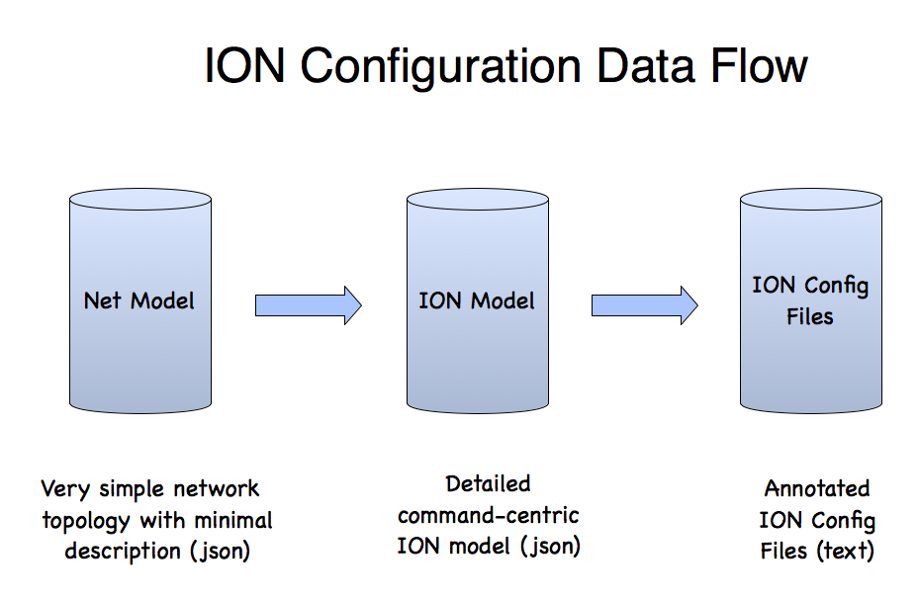
Two Modeling Tools Work Together
DTN Model Visualization Tool
Displays 3D image of network nodes and hops
Provides editing features of general network parameters
Is provider-agnostic (e.g. , no ION specific details)
Captures parameters and visualization details in json network model
IonConfig Editor
Specialized for configuring ION networks
Provides structured editing of ION commands
Generates complete annotated ION config files
Captures ION command details in json ion model
Can ingest/edit network model & auto-generate basic ION configuration

Slide 5
New Command-line IonConfig Tools
checkdtn
dtn2ion
ionconfig
Network
Model
(json)
ION
Model
(json)
ION Config Files
(text)

Slide 6
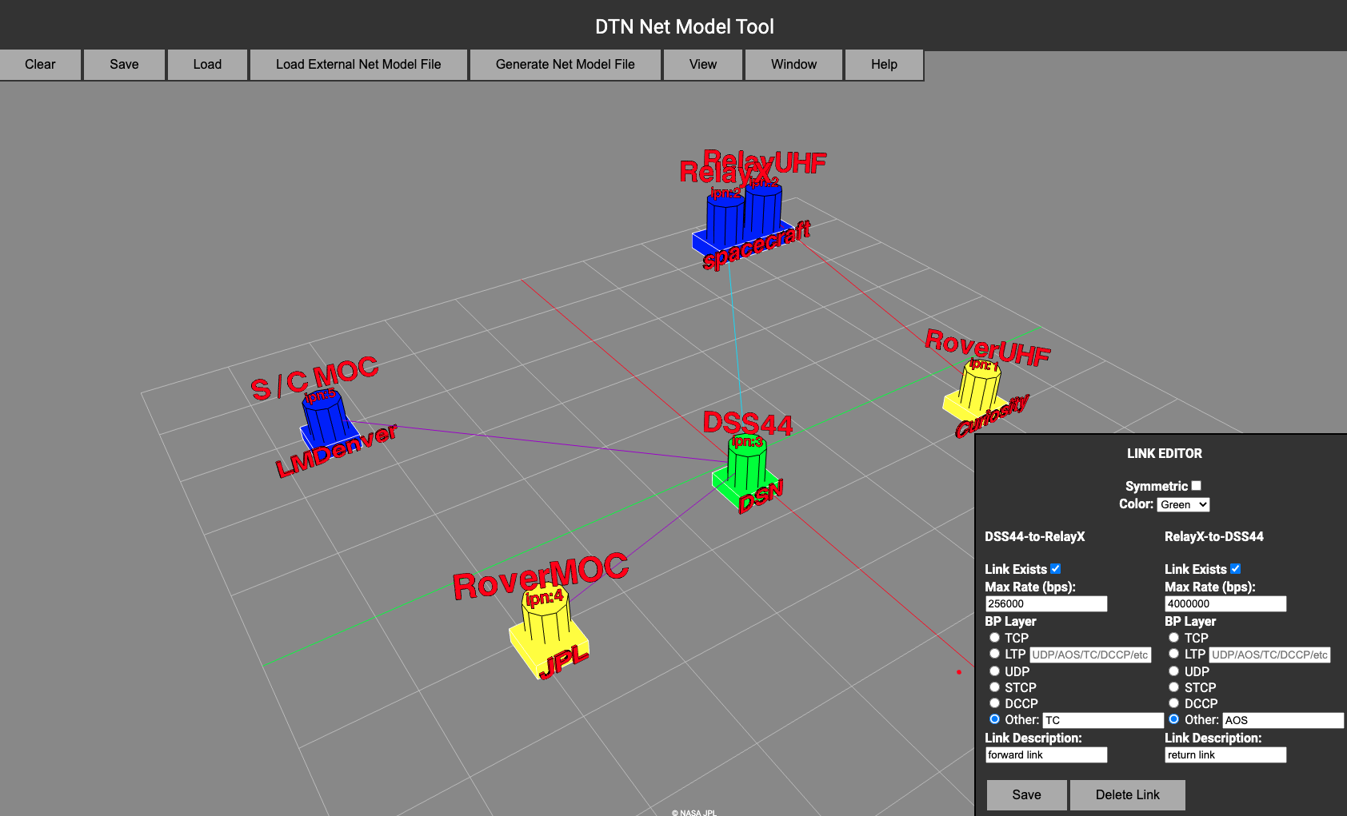
Network Model Tool

Slide 7
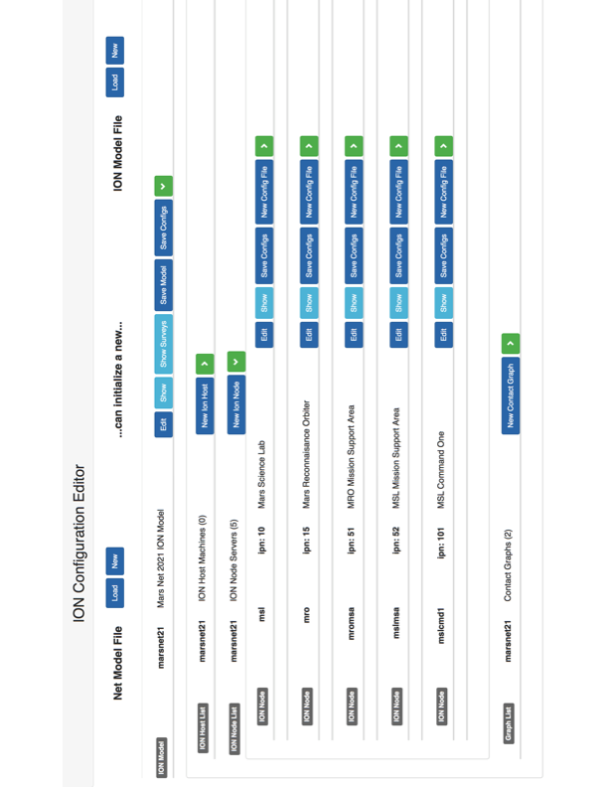
IonConfig Editor
Backup Material

