Slide 1
IonConfig Tool
Rick Borgen
21 Feb 2019

Slide 2
General Status/Forecast
Significant hiatus in 2018…funds exhausted post-July-F2F, work not restarted until Dec ’18…but progress has resumed
Now – Net Model feature accelerates config development
Hosts feature enables port de-confliction
Mid 2019 – Substantially complete (add support for latest ION versions)
Late 2019 – Work bugs, refinements, regression tests, performance

Slide 3
Recent Progress
Visual editor for the Net Model (intern effort last summer)
Full React editor/loader for the Net Model (simple topology)
Can initialize a working ION Model from a Net Model
Defining Hosts enables automatic port analysis
Bug fixes
Documentation (html) updates
User’s Manual
Command Dictionaries
Version Deltas

Slide 4
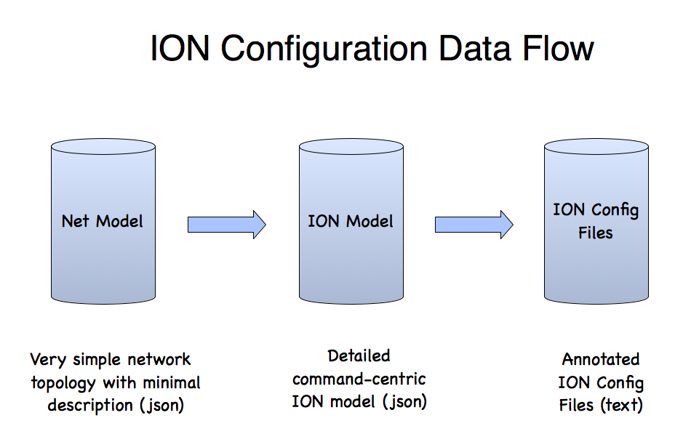

Slide 5
Significant Bug Fixes
Eliminated Byte-Order-Marker (BOM) [reported by Keith Scott]
(a BOM in a text file breaks most editors)
Use host-dependent linefeeds [reported by Marc Sanchez-Net]
(Windows machines can’t handle unix linefeeds in text files)
Handle multi-file outputs as a zip file
(some browsers could not handle multi-file downloads)
Got rid of spellcheck (default) for text field inputs
(most text fields are for names, so spellcheck was just annoying)

Slide 6
Work In-Progress/Coming
Extend model-checking rules
Implement versioning solution (node-specific versions)
Catch up with latest ION releases
Tool based on ION 3.5.0
Newer versions: 3.6.0, 3.6.0b, 3.6.1, 3.6.2

Slide 7
The Version Problem
Issues
How to support multiple ION versions?
How to deal with network nodes at different versions?
Approach
Leverage command-centric design
Restructure dictionary
Normalize versions
Map commands with version effectivity

Slide 8
ION version JSON
Command JSON
"10" : {
"seqNum": 10,
"ionVersion": "3.5.0",
"desc": "ION 3.5.0 release",
"released": "2016-09-08"
},
"11" : {
"seqNum": 11,
"ionVersion": "3.6.0",
"desc": "ION 3.6.0 release",
"released": "2017-04-21"
},
"12" : {
"seqNum": 12,
"ionVersion": "3.6.0b",
"desc": "ION 3.6.0b release",
"released": "2017-08-16"
},
"13" : {
"seqNum": 13,
"ionVersion": "3.6.1",
"desc": "ION 3.6.1 release",
"released": "2018-01-31"
}
"acsrc_mincustodyid": {
"configType": "acsrc",
"name": "mincustodyid",
"paramCnt": 1,
"verFrom": 10,
"verThru": 999
},
"bprc_add_plan": {
"configType": "bprc",
"multiple": true,
"name": "add_plan",
"paramCnt": 2,
"verFrom": 11,
"verThru": 999
},
"ipnrc_plan_udp": {
"configType": "ipnrc",
"name": "plan_udp",
"paramCnt": 2,
"pickClone": true,
"verFrom": 10,
"verThru": 10
},

