Slide 1
DtnModel/IonConfig Tools
Rick Borgen
13 Jan 2021

Slide 2
Previous Status
Believed substantially complete with significant new features
Simple net model feature accelerates config development
Supports multiple ION versions concurrently, per node
Current with ION 3.7.1 and all versions back to ION 3.5.0
Shifting to a maintenance/small feature mode

Slide 3
Current Status
Release of ION 4.0.0 was the major impact on IonConfig this past year
Chose to echo ION approach by forking the IonConfig tool
Re-baselined with a new 4x series tool beginning with ION 4.0.0
Branched a 3x series tool for all prior versions 3.5.0 to 3.7.x
Other work…
Revived the Network Model visualization tool (DtnModel)
Aligned the JSON model exchange between the two tools
(DtnModel vs. IonConfig)
Added bssp support
Misc bug fixes and alert improvements

Slide 4
Two Modeling Tools Work Together
DtnModel Visualization Tool
Displays 3D image of network nodes and hops
Provides editing features of general network parameters
Is provider-agnostic (e.g. , no ION specific details)
Captures parameters and visualization details in json network model
IonConfig Editor
Specialized for configuring ION networks
Provides structured editing of ION commands
Generates complete annotated ION config files
Captures ION command details in json ion model
Can ingest/edit network model & auto-generate basic ION configuration

Slide 5
DtnModel & IonConfig Tools (Browser-based)
DtnModel
Visual Editor
IonConfig
GUI Editor
Ion Config
Files
(text)
User Input
User Input
Network
Model
(json)
Network
Model
(json)
ION
Model
(json)

Slide 6
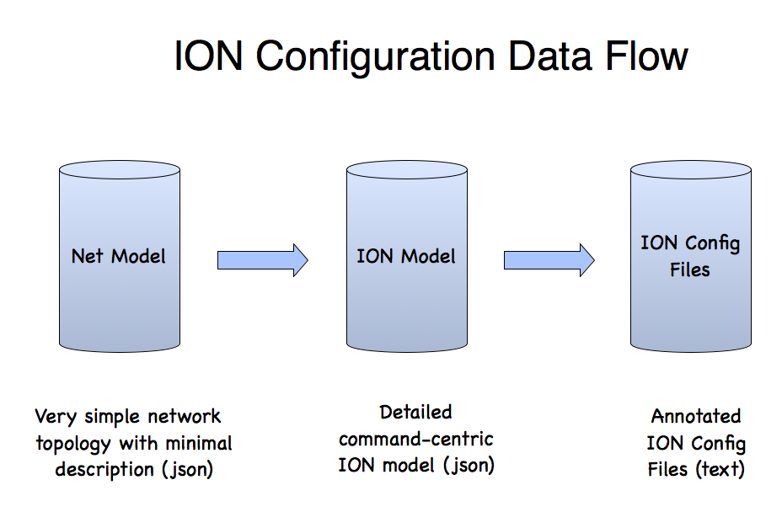

Slide 7
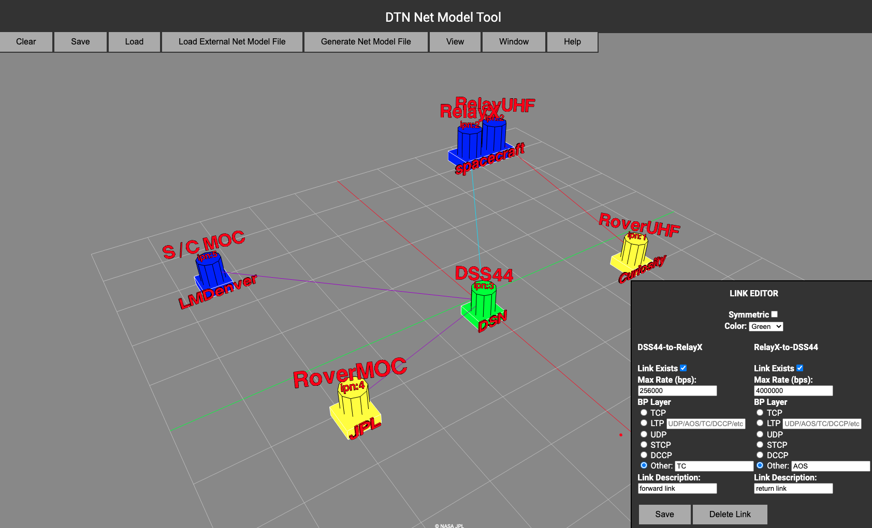
Net Model Tool
Rapid graphical sketch of network
Designed for SCT or Mission Ops without need for having detailed ION Configuration knowledge

Slide 8
ION Model - IonConfig Overview
Runs on modern web browsers (HTML5)
Built with JavaScript, React & others
Single-page Application
Load program file & run locally
Easy to distribute & install
No dependence on a web server
ION 4.0.0 (and easy to adapt new versions)
Supports most ION config file types:
ionconfig, ionrc, bpv6rc, bpv7rc, ipnrc, ltprc,
cfdprc, acsrc, biberc, bssprc, imcrc, dtprc,
bpsecv6rc, bpsecr7rc, ionsecrc, ltpsecrc & contact graphs

Slide 9
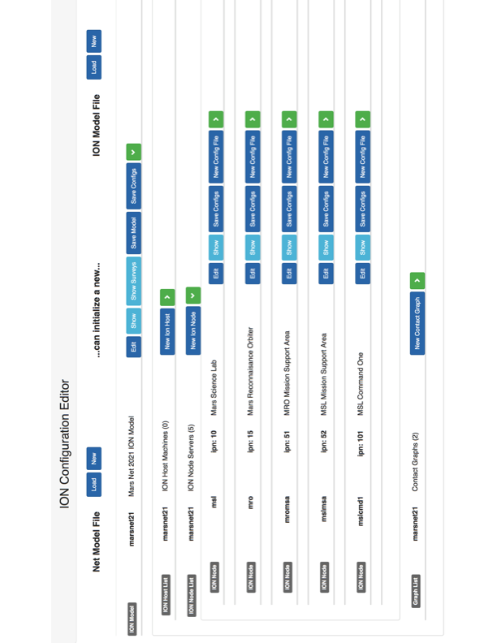

Slide 10
Summary
Largely recovered from ION 4.0 shock
(now a 3.x series and 4.x series for IonConfig)
DtnModel & IonConfig Tools working together
Coming…
Shifting closer to maintenance mode
Should distribute model tools (with ION?)
Investigating command-line variants of model tools
(better for regression testing and scripting)

