Slide 1


ION Testing, Hardening and Infusion and Project Support
1/26/2022
Winter DTN F2F Meeting
Leigh Torgerson
ltorgerson@jpl.nasa.gov
and the PTL team
Notes:
~/Documents/Working Data/CurrentWork-LaptopSynch/ActiveProjects/AMMOS/DTN Network Operations/DeepSpace DTN NetOps Drawings.curio

Slide 2
ION Configuration and Infusion Tools, cont.
DTN Network Model and ION Configuration Tool
(Public availability: http://downloads.jpl.nasa.gov, request ION Configuration Tools-NPO51921)
Progress in last year:
Three releases of IonConfig tool, latest: IonConfig 4.6
Two releases of DTN Model tool, latest DtnModel 1.2
Supports ION 4.1.0, though modest changes since 4.0.0
More testing, bug fixes, improved documentation
Submitted New Technology Report, obtained licensing
Developed command-line tools as alternative/supplement to browser tools
More suitable for scripting, automation and regression testing
Coming work…
Browser tool maintenance
Command-line tool refinement, improvements, regression tests
Credit: Rick Borgen

Slide 3
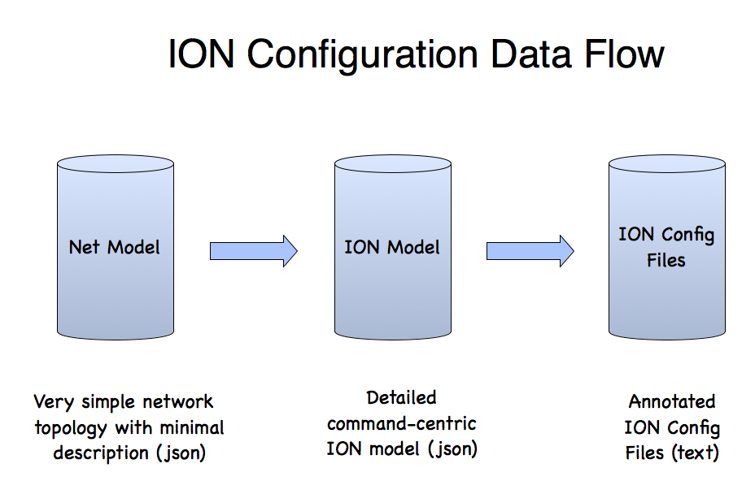
Two Modeling Tools Work Together
DTN Model Visualization Tool
Displays 3D image of network nodes and hops
Provides editing features of general network parameters
Is provider-agnostic (e.g. , no ION specific details)
Captures parameters and visualization details in json network model
IonConfig Editor
Specialized for configuring ION networks
Provides structured editing of ION commands
Generates complete annotated ION config files
Captures ION command details in json ion model
Can ingest/edit network model & auto-generate basic ION configuration
Credit: Rick Borgen

Slide 5
New Command-line IonConfig Tools
checkdtn
dtn2ion
ionconfig
Network
Model
(json)
ION
Model
(json)
ION Config Files
(text)

Slide 6
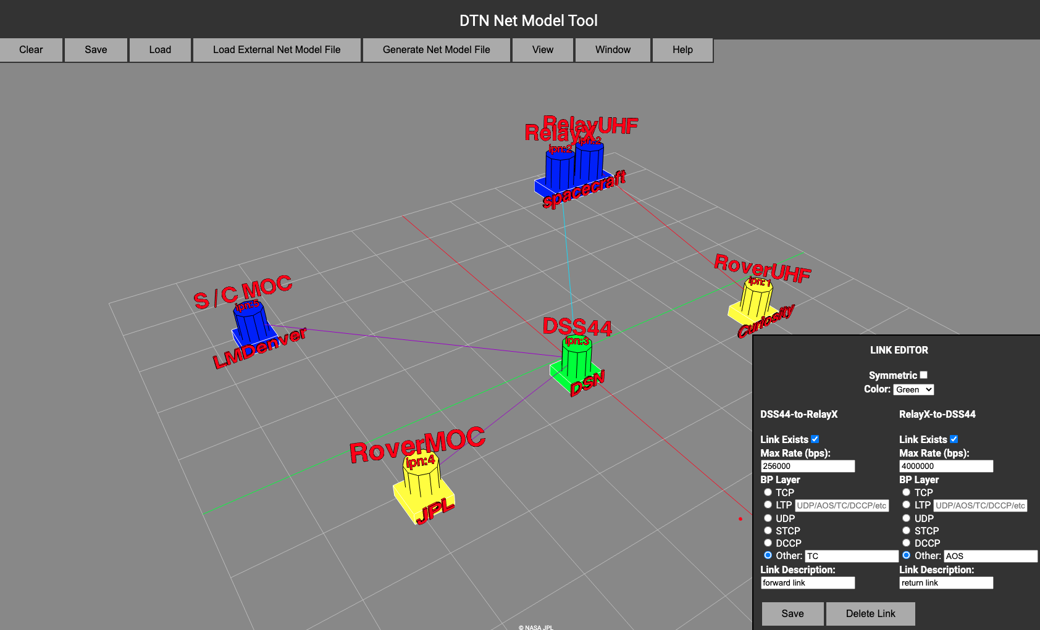
Net Model Tool
Rapid graphical sketch of network
Designed for SCT or Mission Ops without need for having detailed ION Configuration knowledge
Credit: Rick Borgen

Slide 7
ION Model - IonConfig Overview
Runs on modern web browsers (HTML5)
Built with JavaScript, React & others
Single-page Application
Load program file & run locally
Easy to distribute & install
No dependence on a web server
ION 4.1.0 (and all prior versions back to 3.5.0)
Supports most ION config file types:
ionconfig, ionrc, bpv6rc, bpv7rc, ipnrc, ltprc, cfdprc, acsrc,
biberc, bssprc, imcrc, dtprc, imcrc, dtkrc, tcarc, tccrc,
bpsecv6rc, bpsecr7rc, ionsecrc, ltpsecrc & contact graphs
Credit: Rick Borgen

Slide 8
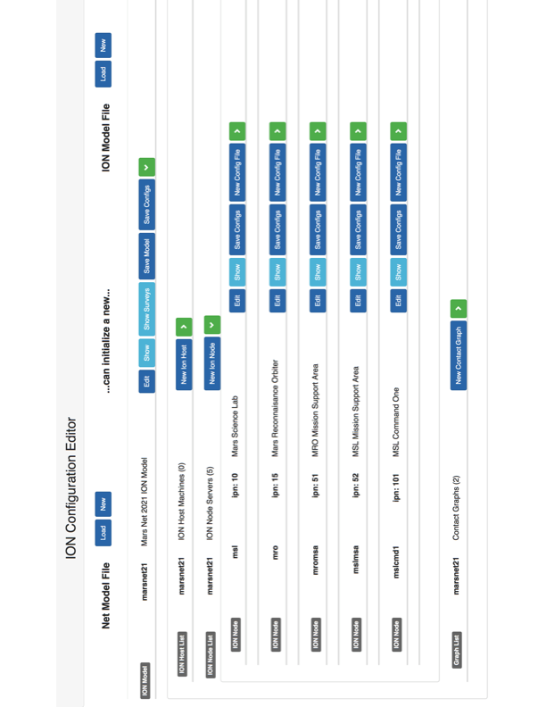
Credit: Rick Borgen

