Slide 1
DtnModel/IonConfig Tools
Rick Borgen
14 July 2021

Slide 2
Prior Status
Release of ION 4.0.0 was the major impact on IonConfig in 2020
Chose to echo ION approach by forking the IonConfig tool
Re-baselined with a new 4x series tool beginning with ION 4.0.0
Branched a 3x series tool for all prior versions 3.5.0 to 3.7.x
Other work…
Revived the Network Model visualization tool (DtnModel)
Aligned the JSON model exchange between the two tools
(DtnModel vs. IonConfig)
Added bssp support
Misc bug fixes and alert improvements

Slide 3
Current Status
Substantially complete with improvements, latest ION changes
Simple net model (DtnModel) accelerates config development
DtnModel refined and simplified
IonConfig supports multiple ION versions concurrently, per node
IonConfig 3.x series current with ION 3.7.1 and all versions back to ION 3.5.0
IonConfig 4.x series current with ION 4.1.0 and all versions back to ION 4.0.0
Shifted to a maintenance/small feature mode
Ducked new bpsecrc event command (json style clashes with ion style)
Established CalTech license to support wide distribution

Slide 4
Two Modeling Tools Work Together
DtnModel Visualization Tool
Displays 3D image of network nodes and hops
Provides editing features of general network parameters
Is provider-agnostic (e.g. , no ION specific details)
Captures parameters and visualization details in json network model
IonConfig Editor
Specialized for configuring ION networks
Provides structured editing of ION commands
Generates complete annotated ION config files
Captures ION command details in json ion model
Can ingest/edit network model & auto-generate basic ION configuration

Slide 5
DtnModel & IonConfig Tools (Browser-based)
DtnModel
Visual Editor
IonConfig
GUI Editor
Ion Config
Files
(text)
User Input
User Input
Network
Model
(json)
Network
Model
(json)
ION
Model
(json)

Slide 6
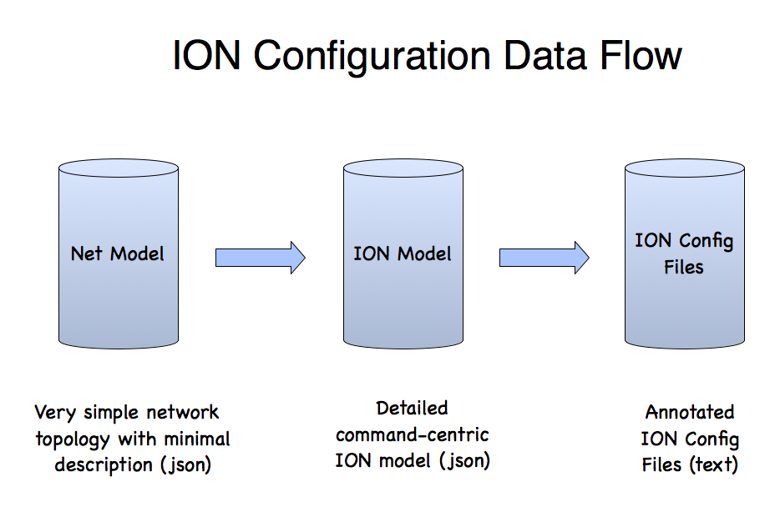

Slide 7
Comparing Models
DtnModel (json)
Hosts
Nodes
Hops
+ visualization info
Few parameters,
easy to understand
IonModel (json)
Hosts
Nodes
Contact Graphs
Config Files
Commands
Numerous parameters,
many tricky to understand

Slide 8
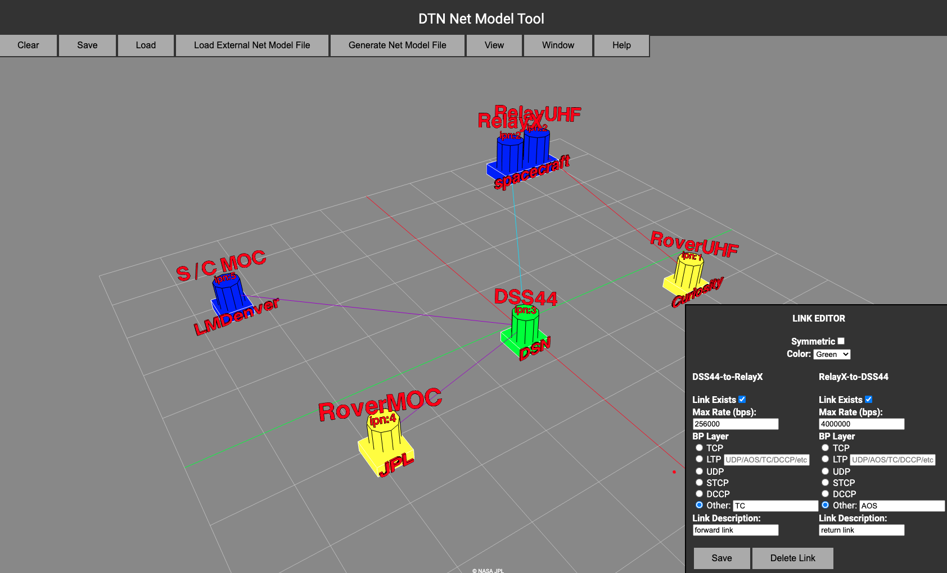
Net Model Tool
Rapid graphical sketch of network
Designed for SCT or Mission Ops without need for having detailed ION Configuration knowledge

Slide 9
ION Model - IonConfig Overview
Runs on modern web browsers (HTML5)
Built with JavaScript, React & others
Single-page Application
Load program file & run locally
Easy to distribute & install
No dependence on a web server
ION 4.1.0 (and all prior versions back to 3.5.0)
Supports most ION config file types:
ionconfig, ionrc, bpv6rc, bpv7rc, ipnrc, ltprc, cfdprc, acsrc,
biberc, bssprc, imcrc, dtprc, imcrc, dtkrc, tcarc, tccrc,
bpsecv6rc, bpsecr7rc, ionsecrc, ltpsecrc & contact graphs

Slide 10
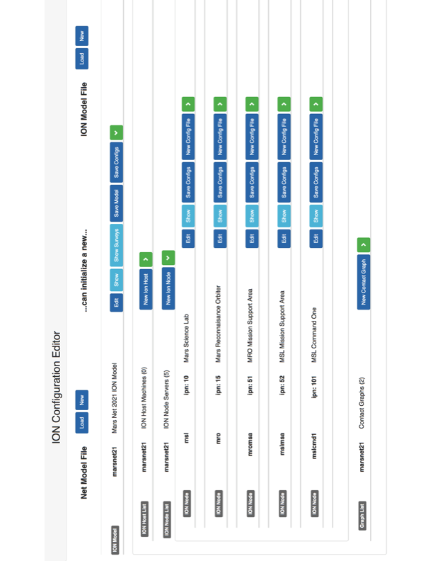

Slide 11
Summary
Recovered from ION 4.0 shock, model tools stable
(now a 3.x series and 4.x series for IonConfig)
DtnModel & IonConfig Tools working together better
Ready for wider distribution
Coming…
Shifted to maintenance mode, fewer ION changes expected
Investigating command-line variants of model tools
(better for regression testing and scripting)

