Slide 1
IonConfig Tool
Rick Borgen
24 June 2019

Slide 2
General Status/Forecast
Previously
simple net model feature accelerates config development
hosts feature enables port de-confliction
Now – Substantially complete
supports multiple ION versions concurrently, per node
is current with latest ION version (3.5.0, 3.6.0, 3.6.0b, 3.6.1, 3.6.2)
relatively easy to extend to new ION versions
Coming
recommend incorporation of ionconfig into standard ION distribution
pivot to bug fixes, refinements, regression tests, performance, …
revive visualization tool for network model

Slide 3
IonConfig Tool (Browser-based)
IonConfig
GUI Editor
Ion Config
Files
(text)
User Input
Network
Model
(json)
ION
Model
(json)

Slide 4
Browser-based IonConfig
Runs on modern web browsers (HTML5)
Built with JavaScript, React & others
Single-page Application
Load program file & run locally
Easy to distribute & install
No dependence on a web server
ION 3.6.2 (and easy to adapt new versions)
Supports ionconfig, ionrc, bprc, ipnrc, ltprc, cfdprc,
acsrc, imcrc, dtprc, ionsecrc & contact graphs

Slide 5
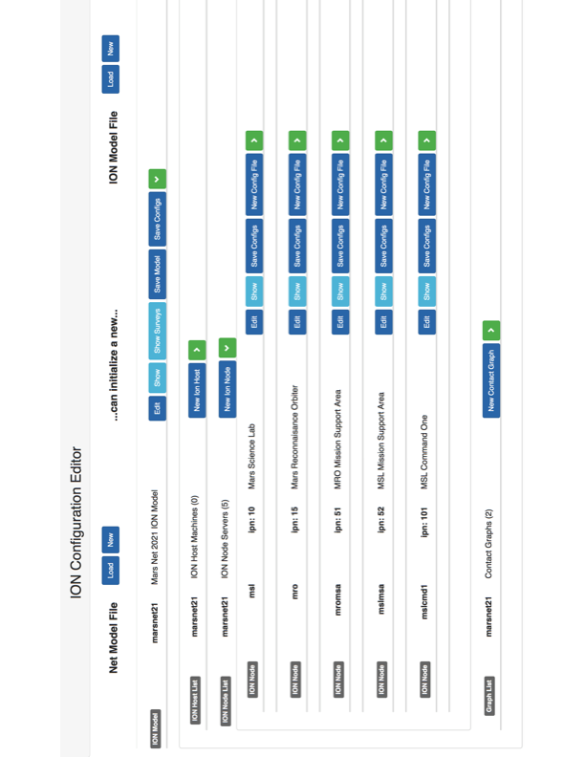

Slide 6
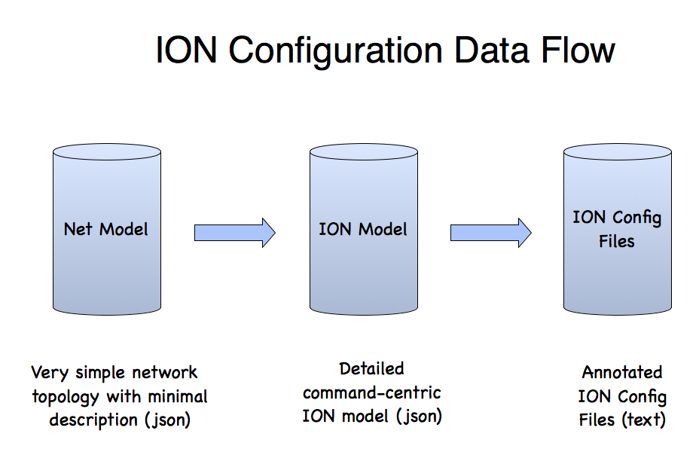

Slide 7



