Slide 1
JPL’s Earth Modeling &
Observation Dashboard
Tracking Scientific Impact, Cross-Model Connections, and Capability Assessment
Technical Seminar • March 2026
JEME • JEOE • JESP • Model Capability Levels
Notes:
Welcome everyone — thank you for joining. Today I'll walk you through what we've built: a unified platform that tracks the scientific impact, cross-model connections, and capability maturity of JPL's Earth science models and missions. By the end, you'll see how citation data, AI classification, and network analysis come together — plus a surprise at the end.

Slide 2
Agenda
Context & Scope
Analytics & Quality
Interconnections
Synthesis & Surprise
• Motivation & objectives
• JEME: 8 Earth system models
• JEOE: NASA observation missions
• Citation analytics pipeline
• Multi-agent data verification
• Uncertainty quantification
• Cross-model network analysis
• Earth system spheres
• Model Capability Levels
• Gap analysis & priorities
• Dashboard architecture
• JESP: scientist profiles
• Path forward
20 minutes
Notes:
Four themes in about 20 minutes. First, the "why" — motivation and scope of what JEME and JEOE cover. Then the analytics engine — how we collect, classify, and quality-check thousands of citations. Next, the insights — what the data tells us about model interconnections, Earth system coverage, and capability maturity. And finally, a synthesis section with a surprise addition you haven't seen before. Let's dive in.

Slide 3
Motivation & Objectives
NASA’s Earth Science to Action Strategy and JPL’s Strategic R&TD investment in the Earth Science domain require objective, quantitative assessment of observation-informed models to advance science, build decision-support tools, and formulate new satellite missions.
Scientific Impact
Cross-Model Connections
Capability Assessment
• How widely are JPL models cited?
• Which research domains adopt them?
• What is the geographic reach?
• Track growth and influence over time
• Which models share citing papers?
• How do Earth system spheres interconnect?
• Where are collaboration opportunities?
• Identify bridge papers linking domains
• Are models fit for intended applications?
• Where are common development gaps?
• How to prioritize limited resources?
• Systematic, evidence-based evaluation
This dashboard provides the quantitative evidence base for JPL’s Strategic R&TD planning in Earth Science.
Notes:
Why are we doing this? NASA's Earth Science to Action strategy — and JPL's own Strategic R&TD investment — call for objective, evidence-based assessments of our models. Three questions drive the dashboard: - Scientific impact: are our models being used? by whom? where? - Cross-model connections: which models share research communities? - Capability assessment: are models ready for the applications we need them for? This dashboard gives us the quantitative evidence to answer those questions — not opinions, data.

Slide 4
JEME: JPL’s Earth Modeling Enterprise
8 observation-informed modeling frameworks spanning the full Earth system
Model
Domain
Data Assimilation
Key Partners
ECCO
Oceanography
4D-Var adjoint
MIT, UT Austin, Scripps
ISSM
Cryosphere / Sea Level
4D-Var adjoint
UC Irvine
CMS-Flux
Carbon Flux Monitoring
4D-Var adjoint
NASA GSFC, Ames
RAPID
Hydrology
Kalman Filter
UT Austin, NOAA NWS
CARDAMOM
Terrestrial Ecosystems
Bayesian MCMC
Stanford, Edinburgh
MOMO-CHEM
Atmospheric Chemistry
Ensemble Kalman Filter
JAMSTEC
LES
Cloud / Turbulence
Process model
UConn
EDMF
Atmospheric Physics
Bayesian Inference
GFDL, NCAR
All models are mission-essential JPL assets for: (1) addressing Decadal Survey questions, (2) developing decision-support applications, and (3) new satellite mission formulation.
Notes:
JEME covers eight observation-informed models spanning the full Earth system. You can see the range — from ECCO's ocean state estimation to EDMF's atmospheric physics, from ISSM's ice sheets to CARDAMOM's terrestrial ecosystems. Note the variety of data assimilation methods — 4D-Var, Kalman filtering, Bayesian MCMC — and the strong university partnerships. All eight are mission-essential JPL assets. They support Decadal Survey science, decision-support tools, and new mission formulation.

Slide 5
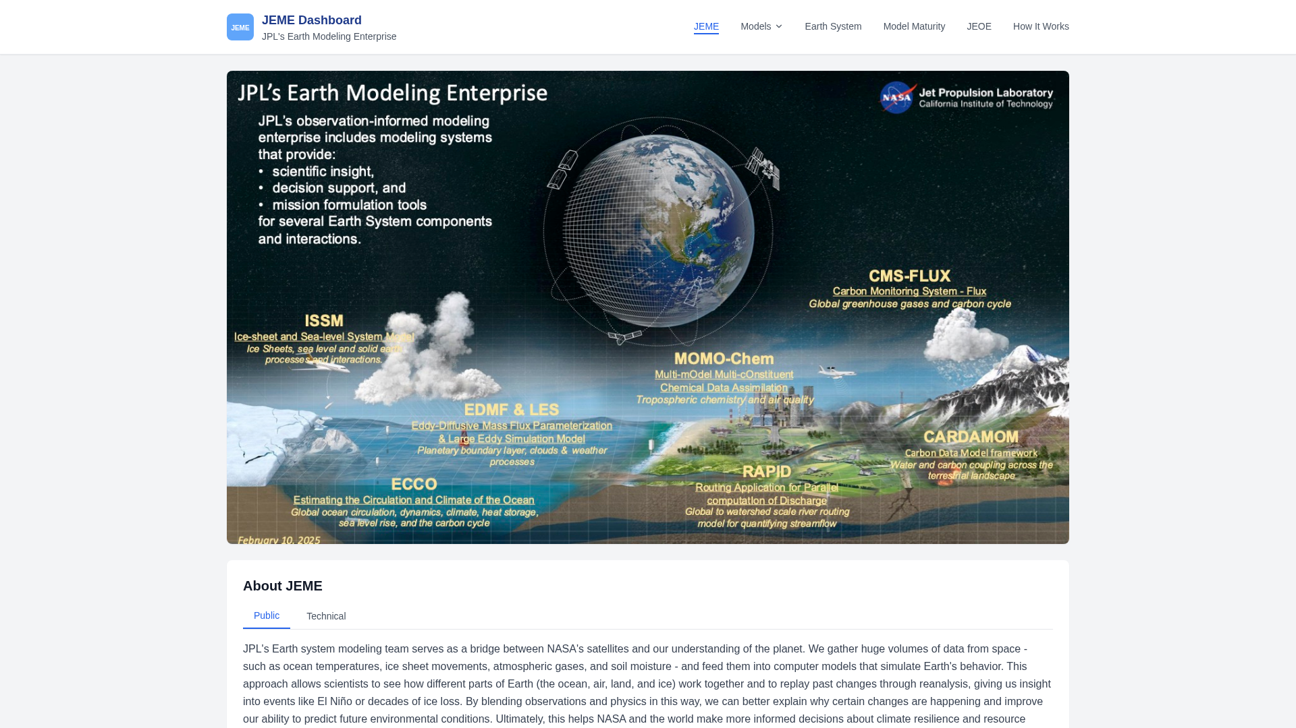
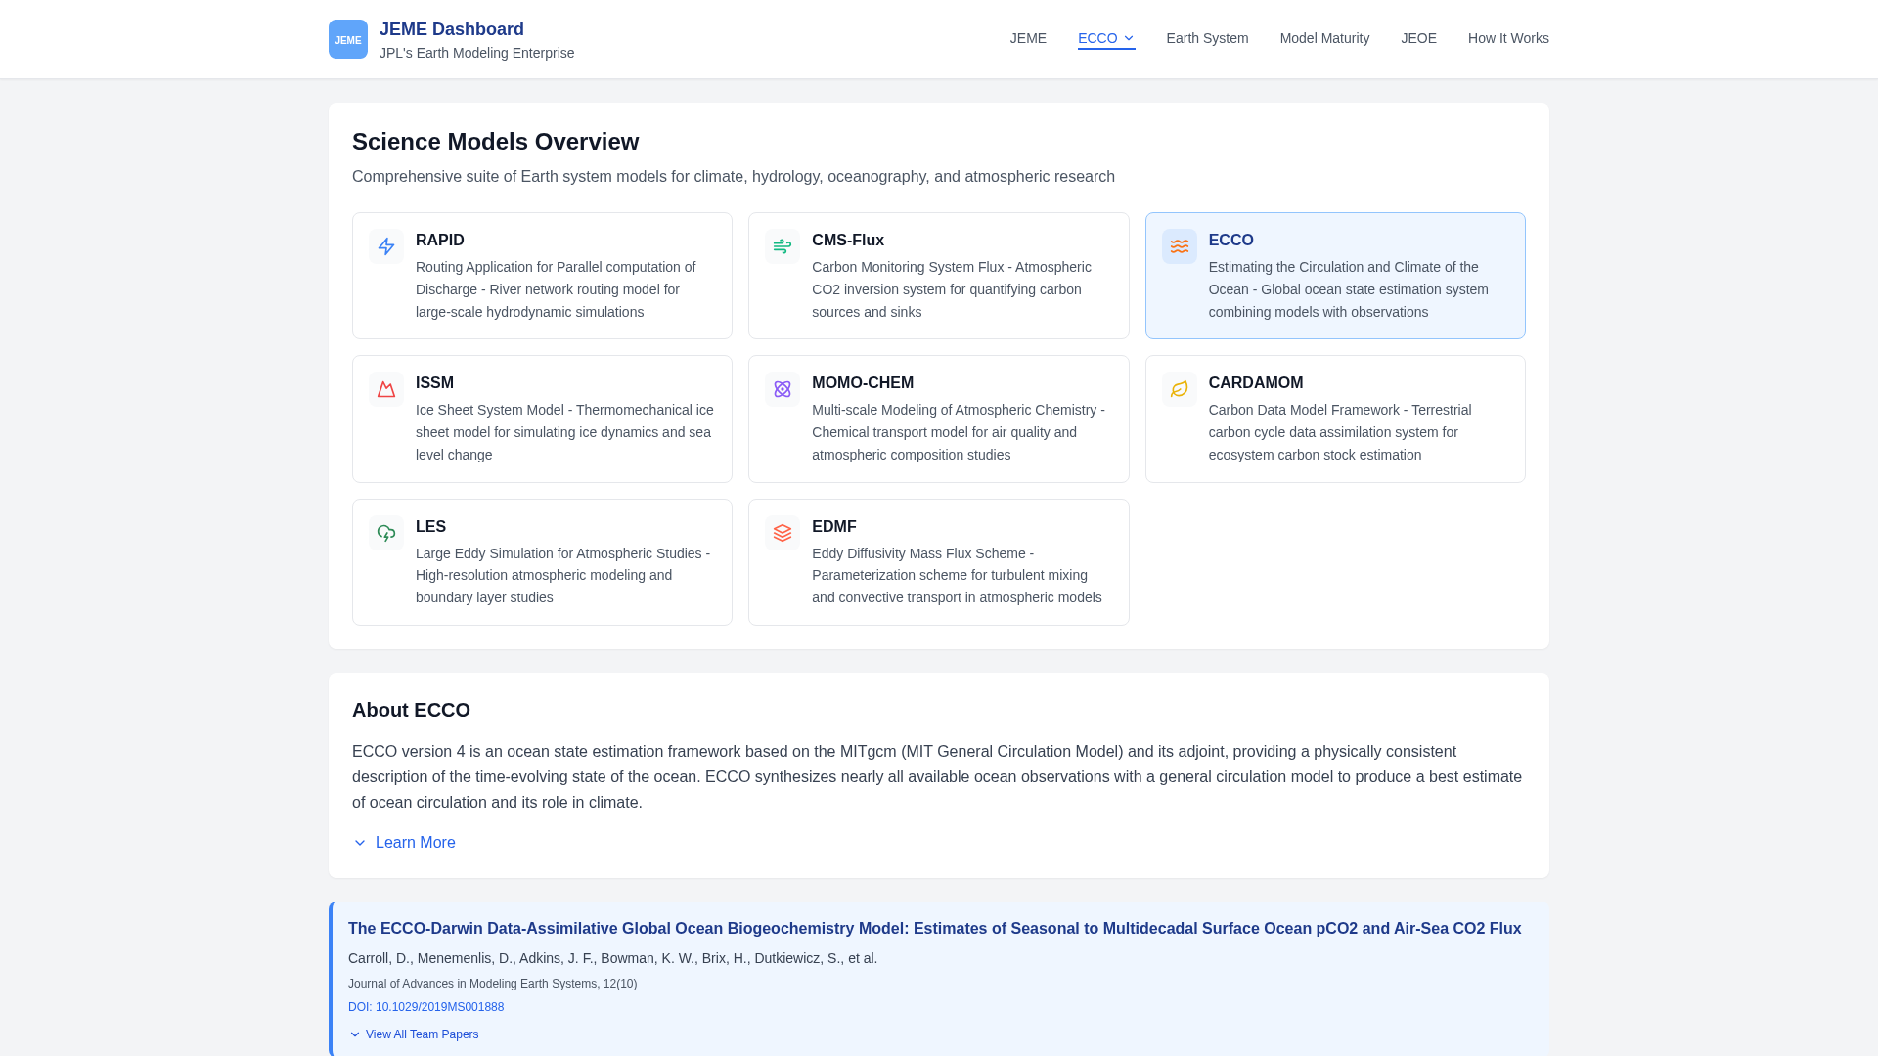
JEME Dashboard: Live Demonstrations
JEME Main Dashboard — 8 models with interactive Earth visualization
Model-Specific View — ECCO citation analytics & metrics
http://34.31.165.25:3000/science-model-dashboard/
Notes:
Here's what the dashboard actually looks like. On the left — the main JEME page. That's an interactive 3D Earth with all eight models positioned around it. You can click into any model. On the right — the ECCO model-specific view. Citation trends, engagement levels, geographic reach, research domains — all generated automatically from the data pipeline. Feel free to explore it live at the URL shown — it's fully interactive.

Slide 6
JEOE: JPL Earth Observation Enterprise
GRACE / GRACE Follow-On
SWOT
Gravity Recovery and Climate Experiment • Geophysics & Geodesy
Surface Water and Ocean Topography • Ocean & Inland Water
• Tracks Earth’s gravity field changes
• Water storage, ice mass balance, sea level
• Observational constraint for ECCO, ISSM, RAPID
• Ka-band radar interferometry
• Unprecedented water surface elevation measurements
• Key future data source for RAPID, ECCO
JEOE and JEME share a unified dashboard with context-aware navigation, cross-referencing mission observations with the models that assimilate their data.
Notes:
JEOE is the observation side of the house — NASA missions that provide the data our models assimilate. GRACE measures gravity field changes — essential for tracking water storage, ice mass, and sea level. It feeds directly into ECCO, ISSM, and RAPID. SWOT measures water surface elevation with unprecedented precision — a key future data source. The dashboard links missions to models so you can see the observation-to-model pipeline in one place.

Slide 7
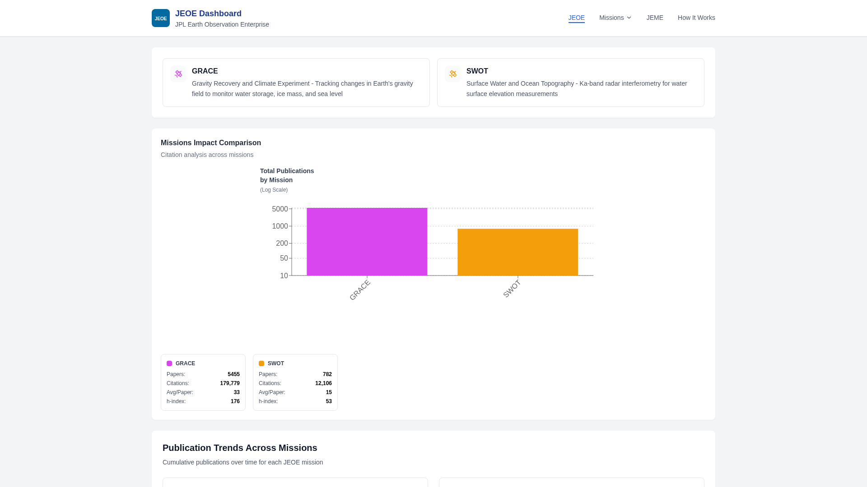
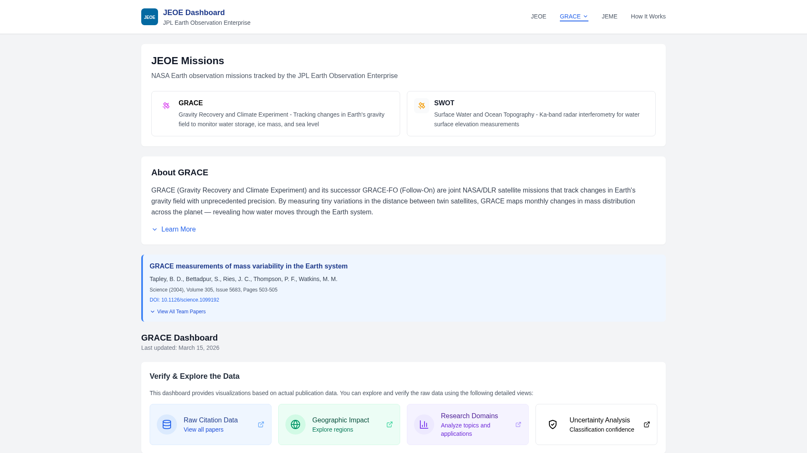
JEOE Dashboard: Live Demonstrations
JEOE Main Dashboard — GRACE & SWOT mission comparison
Mission-Specific View — GRACE citation analytics & metrics
http://34.31.165.25:3000/science-model-dashboard/JEOE
Notes:
The JEOE dashboard mirrors JEME's design but focuses on missions. Left: the main comparison page — GRACE has over 5,400 papers and 179,000 citations. SWOT, being newer, has 782 papers but is growing rapidly. Right: GRACE's detailed view with the same analytics — citation trends, research domains, geographic impact. Notice the navigation bar switches context automatically — JEME shows "Models," JEOE shows "Missions," and they cross-link to each other.

Slide 8
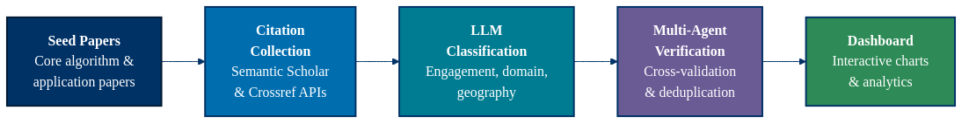
Citation Analytics Pipeline
Key Metrics per Model
• Total papers & citations with year-over-year growth trends
• Engagement levels: Level 1 (background citation) → Level 4 (foundational usage)
• Research domain distribution & geographic reach across 50+ countries
• Cross-model bridge papers & co-authorship networks
Notes:
This is the engine behind everything. Five steps: we start with seed papers — the core algorithm and application papers for each model. Then we pull all citing papers from Semantic Scholar and Crossref. Next, a local LLM — Gemma3 running on Ollama — classifies every paper by engagement level, research domain, and geography. Then multi-agent verification cross-checks the results. And finally, everything flows into the React dashboard. Key point: this entire pipeline is automated and reproducible. Add a new model, run the pipeline, and you have a full analytics page.

Slide 9
Value Over Commercial Counterparts
The advantage is granularity — going beyond aggregate citation counts
Google Scholar / Semantic Scholar
Our Platform (JEME / JEOE)
• Aggregate citation counts only
• No engagement-level distinction
• No research domain classification
• No geographic impact analysis
• No cross-model network analysis
• No capability maturity assessment
• Manual curation required for quality
• 4-tier engagement level classification
L1: background → L4: foundational usage
• 10 research domain categories
with AI-powered classification
• Geographic impact across 50+ countries
• Cross-model bridge paper & co-authorship networks
• Model Capability Level (MCL) framework
• 3-phase uncertainty quantification
Unique Granular Capabilities
• Research Domain Classification — Automatically categorizes each citing paper into 10 Earth science domains
(Hydrology, Ocean & Marine, Climate, Atmospheric, Cryosphere, Remote Sensing, Ecosystem, ML, Modeling, Geophysics)
• Engagement Level — Distinguishes how deeply each paper uses the model (background mention vs. foundational method)
• Geographic Impact — Maps research adoption across countries and continents from abstract/title keyword extraction
• Research Direction Suggestion — Identifies emerging domains and underserved research areas from citation trends
• Earth System Sphere Interconnections — Maps publications to atmosphere, hydrosphere, cryosphere, biosphere, geosphere

Slide 10
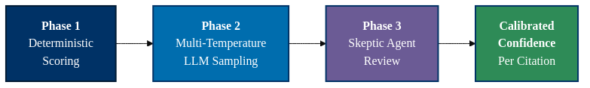
Data Quality & Uncertainty Quantification
Multi-Agent Verification
3-Phase Uncertainty Pipeline
• Team Paper Categorizer: relevance tier classification
• Crossref Agent: DOI validation & venue metadata
• Semantic Scholar Agent: title recovery & enrichment
• Keyword Classifier: domain-specific relevance scoring
• Deduplication Agent: DOI-first, title-fallback detection
• Phase 1: Metadata completeness, keyword agreement, composite confidence
• Phase 2: Gemini 3× at temperatures [0.1, 0.5, 1.0], stochastic variance
• Phase 3: Challenges high-risk entries, override flags for disagreement ≤ 2/5
• False removal ~8-12%; false retention ~3-5%
ECCO: removed ~3,900 off-topic entries; enriched 7,600+ venues
ISSM: repaired 1,904 broken team paper titles
Notes:
Data quality is something we take seriously. On the left — five specialized agents work together. The team paper categorizer, Crossref and Semantic Scholar agents, a keyword classifier, and a deduplication agent. Each catches different types of errors. Real impact: for ECCO, we removed 3,900 off-topic entries and enriched 7,600 venue records. For ISSM, we repaired over 1,900 broken paper titles. On the right — a 3-phase uncertainty pipeline gives every citation a calibrated confidence score. Phase 1 is deterministic, Phase 2 uses multi-temperature LLM sampling, and Phase 3 has a skeptic agent that challenges the results. Bottom line: we know how confident we are in every data point.

Slide 11
Formal Methods for LLM Uncertainty Evaluation
State of the art in quantifying confidence and calibration of large language model outputs
Established Methods
Our 3-Phase Approach
• Calibration & Expected Calibration Error (ECE)
Measures alignment between predicted confidence
and actual accuracy (Guo et al., 2017)
• Selective Prediction / Abstention
Model refuses to answer when uncertainty is high
(Geifman & El-Yaniv, 2017)
• Conformal Prediction
Distribution-free prediction sets with guaranteed
coverage (Angelopoulos & Bates, 2023; Kumar et al., 2023)
• Ensemble / Multi-Sample Methods
Multiple forward passes with temperature variation
to estimate output variance (Lakshminarayanan et al., 2017)
• Verbalized Confidence
Prompting LLMs to self-report confidence scores
(Xiong et al., 2024; Tian et al., 2023)
Phase 1: Deterministic Scoring
• Evidence confidence from metadata completeness
• Pipeline variance: keyword vs. LLM disagreement
• C = 0.45E + 0.45R - 0.10V
Phase 2: Multi-Temperature LLM Sampling
• 3 passes at T = {0.1, 0.5, 1.0} (ensemble method)
• Stochastic variance from label disagreement
• Verbalized confidence (LLM self-assessment)
• C = 0.35E + 0.35R + 0.20(1-S) - 0.10V
Phase 3: Adversarial Skeptic Agent
• Targets high-risk entries for challenge
• Related to red-teaming & selective prediction
• Override flag when agreement <= 2/5
Key References (State of the Art)
• Guo et al. (2017) — On Calibration of Modern Neural Networks (ECE, temperature scaling)
• Angelopoulos & Bates (2023) — Conformal Prediction: A Gentle Introduction (distribution-free UQ)
• Kumar et al. (2023) — Conformal Prediction with LLMs (prediction sets for NLP)
• Xiong et al. (2024) — Can LLMs Express Their Uncertainty? (verbalized confidence survey)
• Kadavath et al. (2022) — Language Models (Mostly) Know What They Know (self-evaluation, Anthropic)
• Lin et al. (2023) — Generating with Confidence: UQ for Black-Box LLMs (semantic entropy)

Slide 12
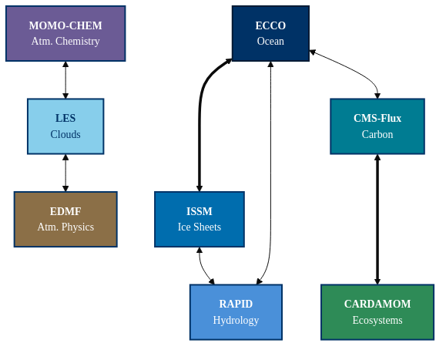
Cross-Model Network Analysis
What We Compute
• Bridge papers: shared citations across multiple models
• Connection matrix: pairwise model overlap counts
• Cross-model co-authorship: researchers spanning teams
• Domain overlap: shared research domain classifications
• Network graph: force-directed visualization
Key Insights
• Strongest links: ECCO ↔ ISSM (ocean-ice), CMS-Flux ↔ CARDAMOM (carbon)
• Bridge papers reveal interdisciplinary opportunities
• Identifies collaboration gaps between modeling teams
Notes:
This is one of my favorite parts — the cross-model network analysis. We look for bridge papers — citations that appear in multiple models' datasets. That tells us which research communities overlap. The diagram on the right shows the connectivity. Thick lines mean strong connections. ECCO and ISSM are tightly linked through ocean-ice research. CMS-Flux and CARDAMOM connect through carbon cycle work. This isn't just interesting — it identifies concrete collaboration opportunities between modeling teams.

Slide 13
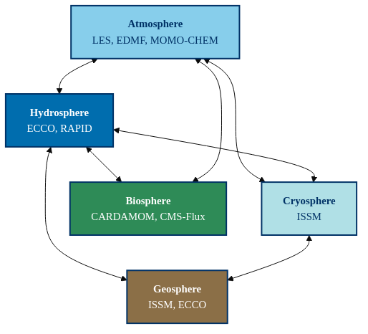
Earth System Interconnections
Classifying all JEME publications into Earth’s five interconnected spheres
Analysis Features
• Keyword-based classification into spheres (multi-sphere papers counted for each)
• Inter-sphere connection matrix showing papers that bridge multiple components
• Interactive D3 force-directed graph with drag, zoom, and hover highlighting
• Model-to-sphere mapping: which JEME models contribute to which spheres
• Cross-sphere bridge papers table: highest-impact interdisciplinary research
Notes:
Every JEME publication is classified into one or more of Earth's five spheres — atmosphere, hydrosphere, cryosphere, biosphere, and geosphere. The diagram shows which models contribute to which spheres — and how those spheres are interconnected through shared research. On the dashboard, this is an interactive D3 force-directed graph. You can drag nodes, zoom in, and hover to see which papers bridge multiple spheres. This gives us a systems-level view of how JEME's research covers the Earth system.

Slide 14
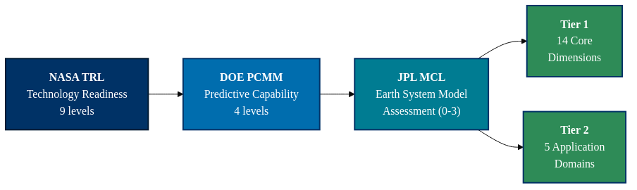
Model Capability Level (MCL) Framework
Tier 1: Core Capabilities (14 dimensions)
Tier 2: Application Domains (5 × 4 sub-dims)
• Process Representation, Spatial & Temporal Resolution
• Process Coupling, Predictive Skill, Computational Performance
• Observational Constraint, Retrospective Analysis
• UQ & Attribution, V&V Framework, ML/AI Integration
• Mission Support, Interoperability, Stakeholder Adoption
• Research: process fidelity, coupling, community impact
• Data Assimilation: observational coverage, operational use
• VVUQ/ML: verification, AI integration, emulator validation
• Mission Support: OSSEs, DA readiness, Decadal Survey alignment
• Decision Support: usability, regulatory relevance, UQ communication
Scoring Scale:
Level 0 — None
Level 1 — Low
Level 2 — Medium
Level 3 — High
Notes:
Now we move from impact to capability. The Model Capability Level framework. The heritage is clear: NASA's Technology Readiness Levels inspired DOE's Predictive Capability Maturity Model, and we adapted that for Earth science models on a 0-to-3 scale. Tier 1 has 14 core dimensions — from process representation to mission support. Tier 2 adds application-specific assessment across five domains. This gives us a systematic, repeatable way to evaluate model maturity — not just "is it published," but "is it ready for the job we need it to do?"

Slide 15
MCL Results: Tier 1 Capability Heatmap
Model
Proc Repr
Spatial Res
Temp Res
Proc Coup
Pred Skill
Comp Perf
Obs Const
Retro Anal
UQ& Attr
V&V
ML/AI
Mission Supp
Inter- op
Stake Adopt
Avg
ECCO
3
2
3
2
3
2
3
3
2
3
1
3
3
2
2.5
ISSM
3
3
2
3
2
2
2
2
2
3
1
2
3
2
2.3
CMS-Flux
2
2
2
1
2
1
3
2
2
2
1
2
2
2
1.9
RAPID
2
2
2
2
2
2
2
2
1
2
1
2
3
2
1.9
CARDAMOM
2
1
2
1
2
1
2
2
3
2
1
1
2
1
1.6
MOMO-CHEM
2
2
2
2
2
1
2
2
2
2
0
1
1
1
1.6
LES
3
3
2
1
1
2
1
0
1
2
2
1
1
0
1.4
EDMF
2
1
2
2
1
2
1
0
2
2
2
0
2
0
1.4
Legend:
0 = None
1 = Low
2 = Medium
3 = High
ECCO and ISSM lead overall. Common gaps: ML/AI integration, stakeholder adoption, and computational performance.
Notes:
Here's the full Tier 1 heatmap across all eight models. Green is good — Level 3. Red is Level 0, meaning that capability doesn't exist yet. Two things jump out immediately: First, ECCO and ISSM lead overall — they're the most mature models. Second, look at the ML/AI column — almost entirely orange and red. That's our biggest cross-cutting gap. Stakeholder adoption is another common weakness. Most models are still research tools, not operational products. This one slide tells a strategic story about where to invest.

Slide 16
Model Deep Dives: ECCO & ISSM
ECCO — Tier 1 Average: 2.5/3.0
ISSM — Tier 1 Average: 2.3/3.0
Strengths (Level 3)
Strengths (Level 3)
• Process Representation: State-of-the-art ocean GCM
• Observational Constraint: 14+ observation types
• Retrospective Analysis: v4r4 reanalysis 1992–2017
• V&V Framework: Extensive intercomparison
• Mission Support: OSSEs for GRACE-FO, SWOT, Sentinel-6
• Temporal Resolution (3): Sub-daily to decadal, monthly output products
• Predictive Skill (3): Validated against 14+ independent observation types
• Interoperability (3): Open data, standardized outputs, community tools
• Process Representation: Full ice-sheet + solid Earth
• Spatial Resolution: Adaptive mesh, sub-km at margins
• Process Coupling: 3-way ice-solid Earth-sea level
• V&V Framework: ISMIP6/CMIP6, initMIP
• Interoperability: Open source, active community
Improvement Areas
Improvement Areas
• ML/AI Integration (1): Research-stage only
• Stakeholder Adoption (2): Not yet operational
• ML/AI Integration (1): Exploratory only
• Retrospective Analysis (2): Not continuous reanalysis
• Stakeholder Adoption (2): Expert interpretation required
Notes:
Let's zoom into the top two models. ECCO scores 2.5 out of 3 — the highest in JEME. It has eight dimensions at Level 3, which is remarkable. Process representation, temporal resolution, predictive skill, observational constraint with 14+ data types, retrospective analysis spanning 1992 to 2017, a strong V&V framework, active mission support through OSSEs, and full interoperability with open data and community tools. ISSM scores 2.3 with five Level-3 dimensions. Spatial resolution with adaptive meshing down to sub-kilometer, three-way process coupling, and full interoperability as open source. Both share the same improvement areas: ML/AI is still exploratory, and stakeholder adoption needs work. The pattern is clear — technically excellent models that need investment in AI integration and operational pathways.

Slide 17
Gap Analysis: Common Development Needs
Dimension
Models < Level 2
Mean Score
Priority
ML/AI Integration
6/8
1.1
HIGH
Mission Support
4/8
1.5
MEDIUM
Stakeholder Adoption
4/8
1.3
MEDIUM
Process Coupling
3/8
1.8
MEDIUM
Computational Performance
3/8
1.6
MEDIUM
Spatial Resolution
2/8
2.0
LOW
Predictive Skill
2/8
1.9
LOW
Observational Constraint
2/8
2.0
LOW
Retrospective Analysis
2/8
1.6
LOW
UQ & Attribution
2/8
1.9
LOW
Strategic Recommendations
ML/AI Integration: Cross-model ML investment would benefit all 8 teams.
Stakeholder Adoption: Bridge from research to operational use via dedicated engagement.
Computational Performance: GPU/cloud portability is a common barrier — shared infrastructure.
Retrospective Analysis: Opportunity for coupled, long-term reanalysis products.
Notes:
The gap analysis makes the strategic priorities concrete. ML/AI integration is the standout — six out of eight models score below Level 2, with a mean of just 1.1. This is the single highest-impact investment opportunity. Mission support and stakeholder adoption are medium priority. Process coupling and computational performance round out the list. The recommendations at the bottom are actionable: a cross-model ML initiative would benefit all eight teams. Shared GPU/cloud infrastructure addresses computational barriers. This is exactly the kind of evidence base that Strategic R&TD planning needs.

Slide 18
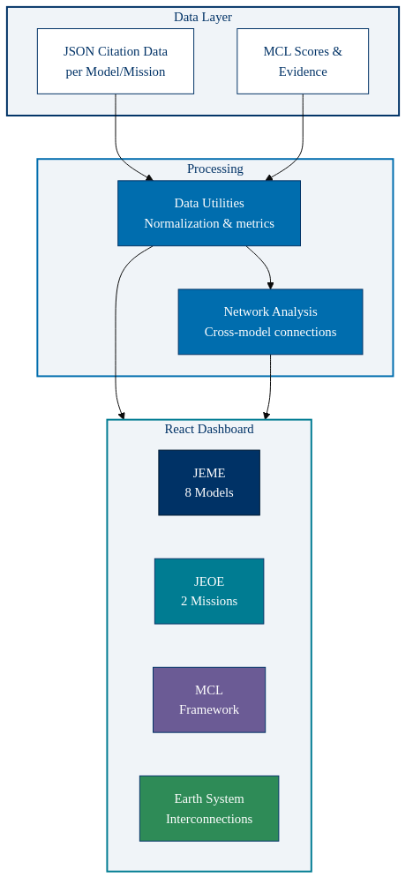
Dashboard Architecture
Key Features
• React (CRA) + React Router SPA with Tailwind CSS
• Recharts for interactive data visualizations
• D3.js + TopoJSON for maps & force-directed graphs
• Context-aware navigation: JEME ↔ JEOE with dynamic branding
• Generic + model-specific page architecture
• Evidence-linked scoring: click any MCL cell for justification
Route Structure
• /science-model-dashboard — JEME (8 models)
• /science-model-dashboard/JEOE — JEOE (missions)
• /{model}/citations | geographic-impact | research-domains
• /{model}/uncertainty | maturity
• /earth-system | /model-maturity
Notes:
Quick architecture overview for the technically curious. It's a React single-page application — Create React App with React Router. Tailwind CSS for styling. Recharts and D3 for visualizations. The key design decision: generic components that work with any model via route parameters. Add a new model's JSON data, and the entire dashboard — citations, geography, domains, uncertainty — generates automatically. JEME and JEOE share one codebase with context-aware navigation. The nav bar, logo, favicon, and even the browser tab title all switch dynamically.

Slide 19
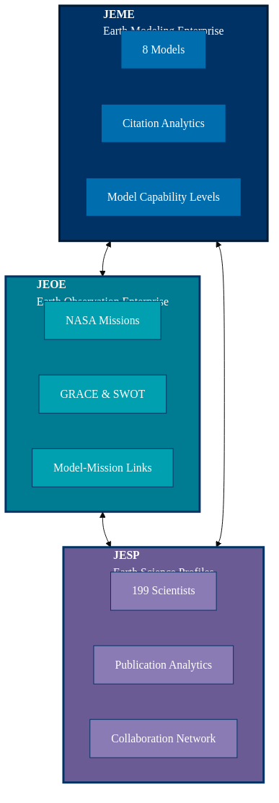
Surprise: Introducing JESP
The same technology behind JEME & JEOE was rapidly applied to build a third dashboard:
JESP — JPL Earth Science Profiles
199 scientists • 12,700+ publications • 1M+ citations • Collaboration network
Notes:
Now for the surprise. Everything I've shown you — the citation pipeline, LLM classification, uncertainty quantification, network analysis — is a technology platform, not just a dashboard. To prove that, we took the same technology and applied it to a completely different problem: profiling the scientists themselves. JESP — JPL Earth Science Profiles — is the third piece of the trilogy. It connects the models, the missions, and the people.

Slide 20
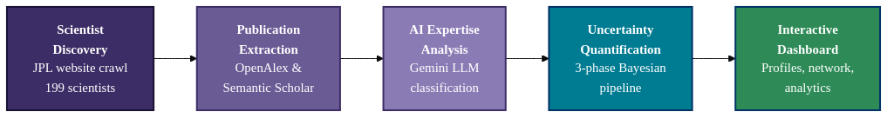
JESP: JPL Earth Science Profiles
What It Does
Key Metrics
• Crawls JPL Earth Science Section website for all scientists
• Extracts publications via OpenAlex & Semantic Scholar APIs
• AI expertise classification using Gemini LLM
• 3-phase Bayesian uncertainty quantification
• Interactive network graph of co-publication relationships
• 199 scientists across 11 research groups
• 12,768 total publications extracted
• 1,022,329 total citations
• Per-scientist: H-index, domain classification, expertise tags
• Collaboration network: 1,281 co-publication connections
Built in days by reusing the citation analytics, LLM classification, and UQ pipeline from JEME/JEOE.
Notes:
JESP profiles every scientist in JPL's Earth Science Section. The pipeline should look familiar — it's the same pattern. Discover scientists from JPL's website, extract publications from OpenAlex and Semantic Scholar, classify expertise using Gemini, and quantify uncertainty with the same 3-phase Bayesian pipeline. 199 scientists. Over 12,700 publications. More than a million citations. And a collaboration network showing 1,281 co-publication connections. The key takeaway: this took days to build, not months, because the platform was already there. That's the power of reusable technology.

Slide 21
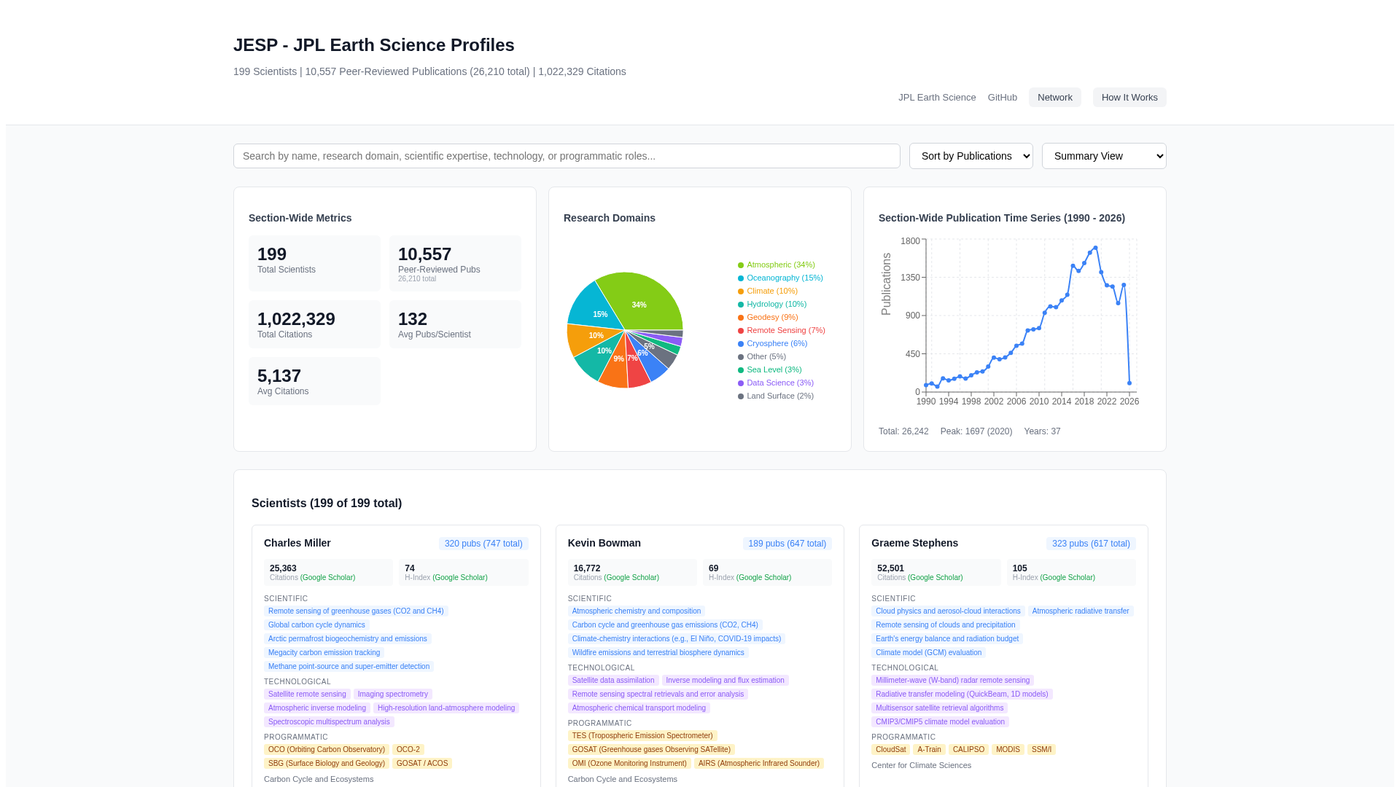
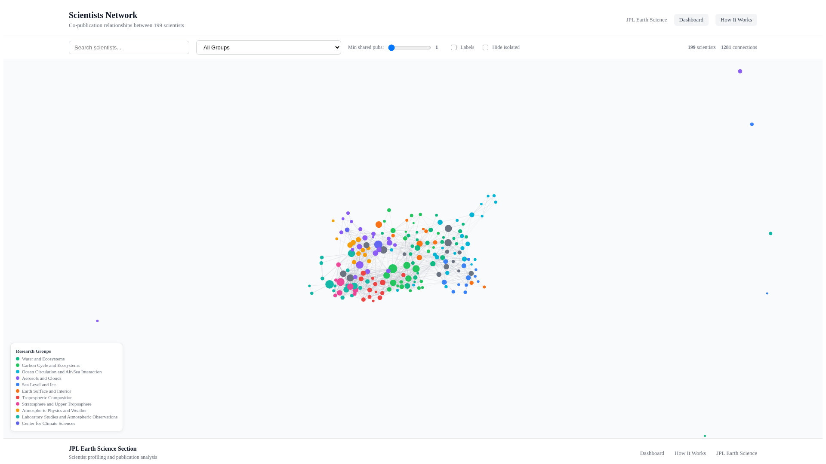
JESP Dashboard: Live Demonstrations
Scientist Profiles — search, filter, domain distribution, publication trends
Collaboration Network — 199 scientists, 1,281 co-publication links
http://34.31.165.25:3002/sci-profile/
Notes:
Here's JESP in action. Left: the main dashboard. Search and filter scientists, see the research domain distribution as a pie chart, publication trends over time, and individual scientist cards with expertise tags. Right: the collaboration network. Every dot is a scientist, colored by research group. Lines connect scientists who share publications. You can filter by group, adjust the minimum co-publication threshold, and search for specific people. This is live right now at the URL shown. Try searching for your colleagues.

Slide 22
Path Forward & Summary
Next Steps
Key Takeaways
• LLM-enhanced MCL scoring: auto-classify papers, generate evidence summaries
• Periodic reassessment: annual MCL review cycle with model teams
• Community adoption: external evaluators for independent scoring
• JESP integration: link scientist expertise to model capabilities
• Extend JEOE: add more NASA missions as data becomes available
• Cross-dashboard analytics: unified JEME + JEOE + JESP insights
• Three dashboards — JEME, JEOE, JESP — from one shared technology platform
• Multi-agent pipeline ensures data quality with calibrated uncertainty
• MCL framework: systematic, evidence-based capability assessment
• JESP: rapid reuse proves platform extensibility (199 scientists in days)
• Common gaps: ML/AI integration and stakeholder adoption across JEME
• Framework is living and extensible — designed for periodic reassessment
JEME: http://34.31.165.25:3000/science-model-dashboard/ JESP: http://34.31.165.25:3002/sci-profile/
Thank you — Questions?
Notes:
Looking ahead — and wrapping up. Next steps include LLM-enhanced MCL scoring, linking JESP scientist expertise to model capabilities, and cross-dashboard analytics that unify all three platforms. The key takeaways: - Three dashboards — JEME, JEOE, JESP — built on one shared technology platform. - Multi-agent verification with calibrated uncertainty on every data point. - MCL framework for systematic capability assessment. - JESP proves the platform is extensible — 199 scientists profiled in days. - Clear strategic gaps identified: ML/AI integration is the top priority. Thank you. I'm happy to take questions — or feel free to pull up any of the dashboards live.

