Slide 1
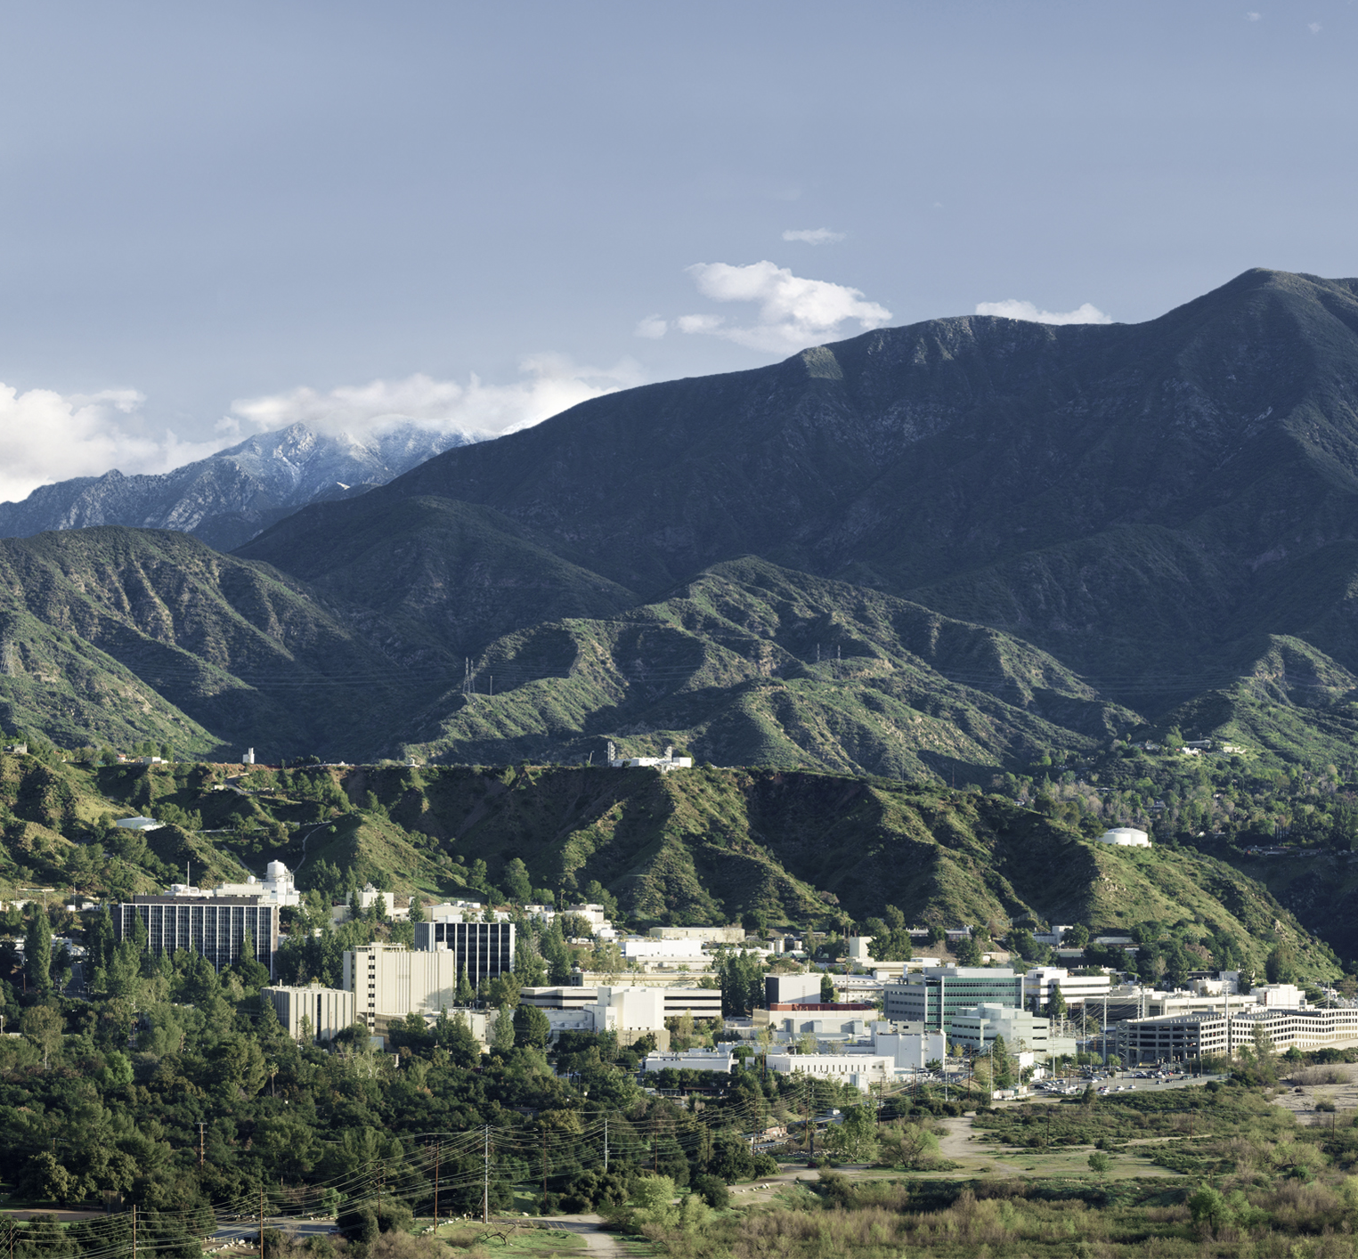
Science Model Dashboard
Kyongsik Yun

Slide 3
To access additional layout options, on the Home tab, click the down arrow next to New Slide on the menu bar.
To obtain the appropriate marking and handling instructions for your information, visit the Marking and Handling Wizard at https://mh.jpl.nasa.gov and answer a few questions about the information's content. The Wizard complies with JPL’s Prime Contract requirements, and by implementing the marking and handling instructions provided by the Wizard, the document will be in compliance with JPL’s Marking and Handling requirements.
When you find your correct marking, copy it to your clipboard; then on the Insert tab, click Header & Footer, and paste it in the Footer box.

Slide 5
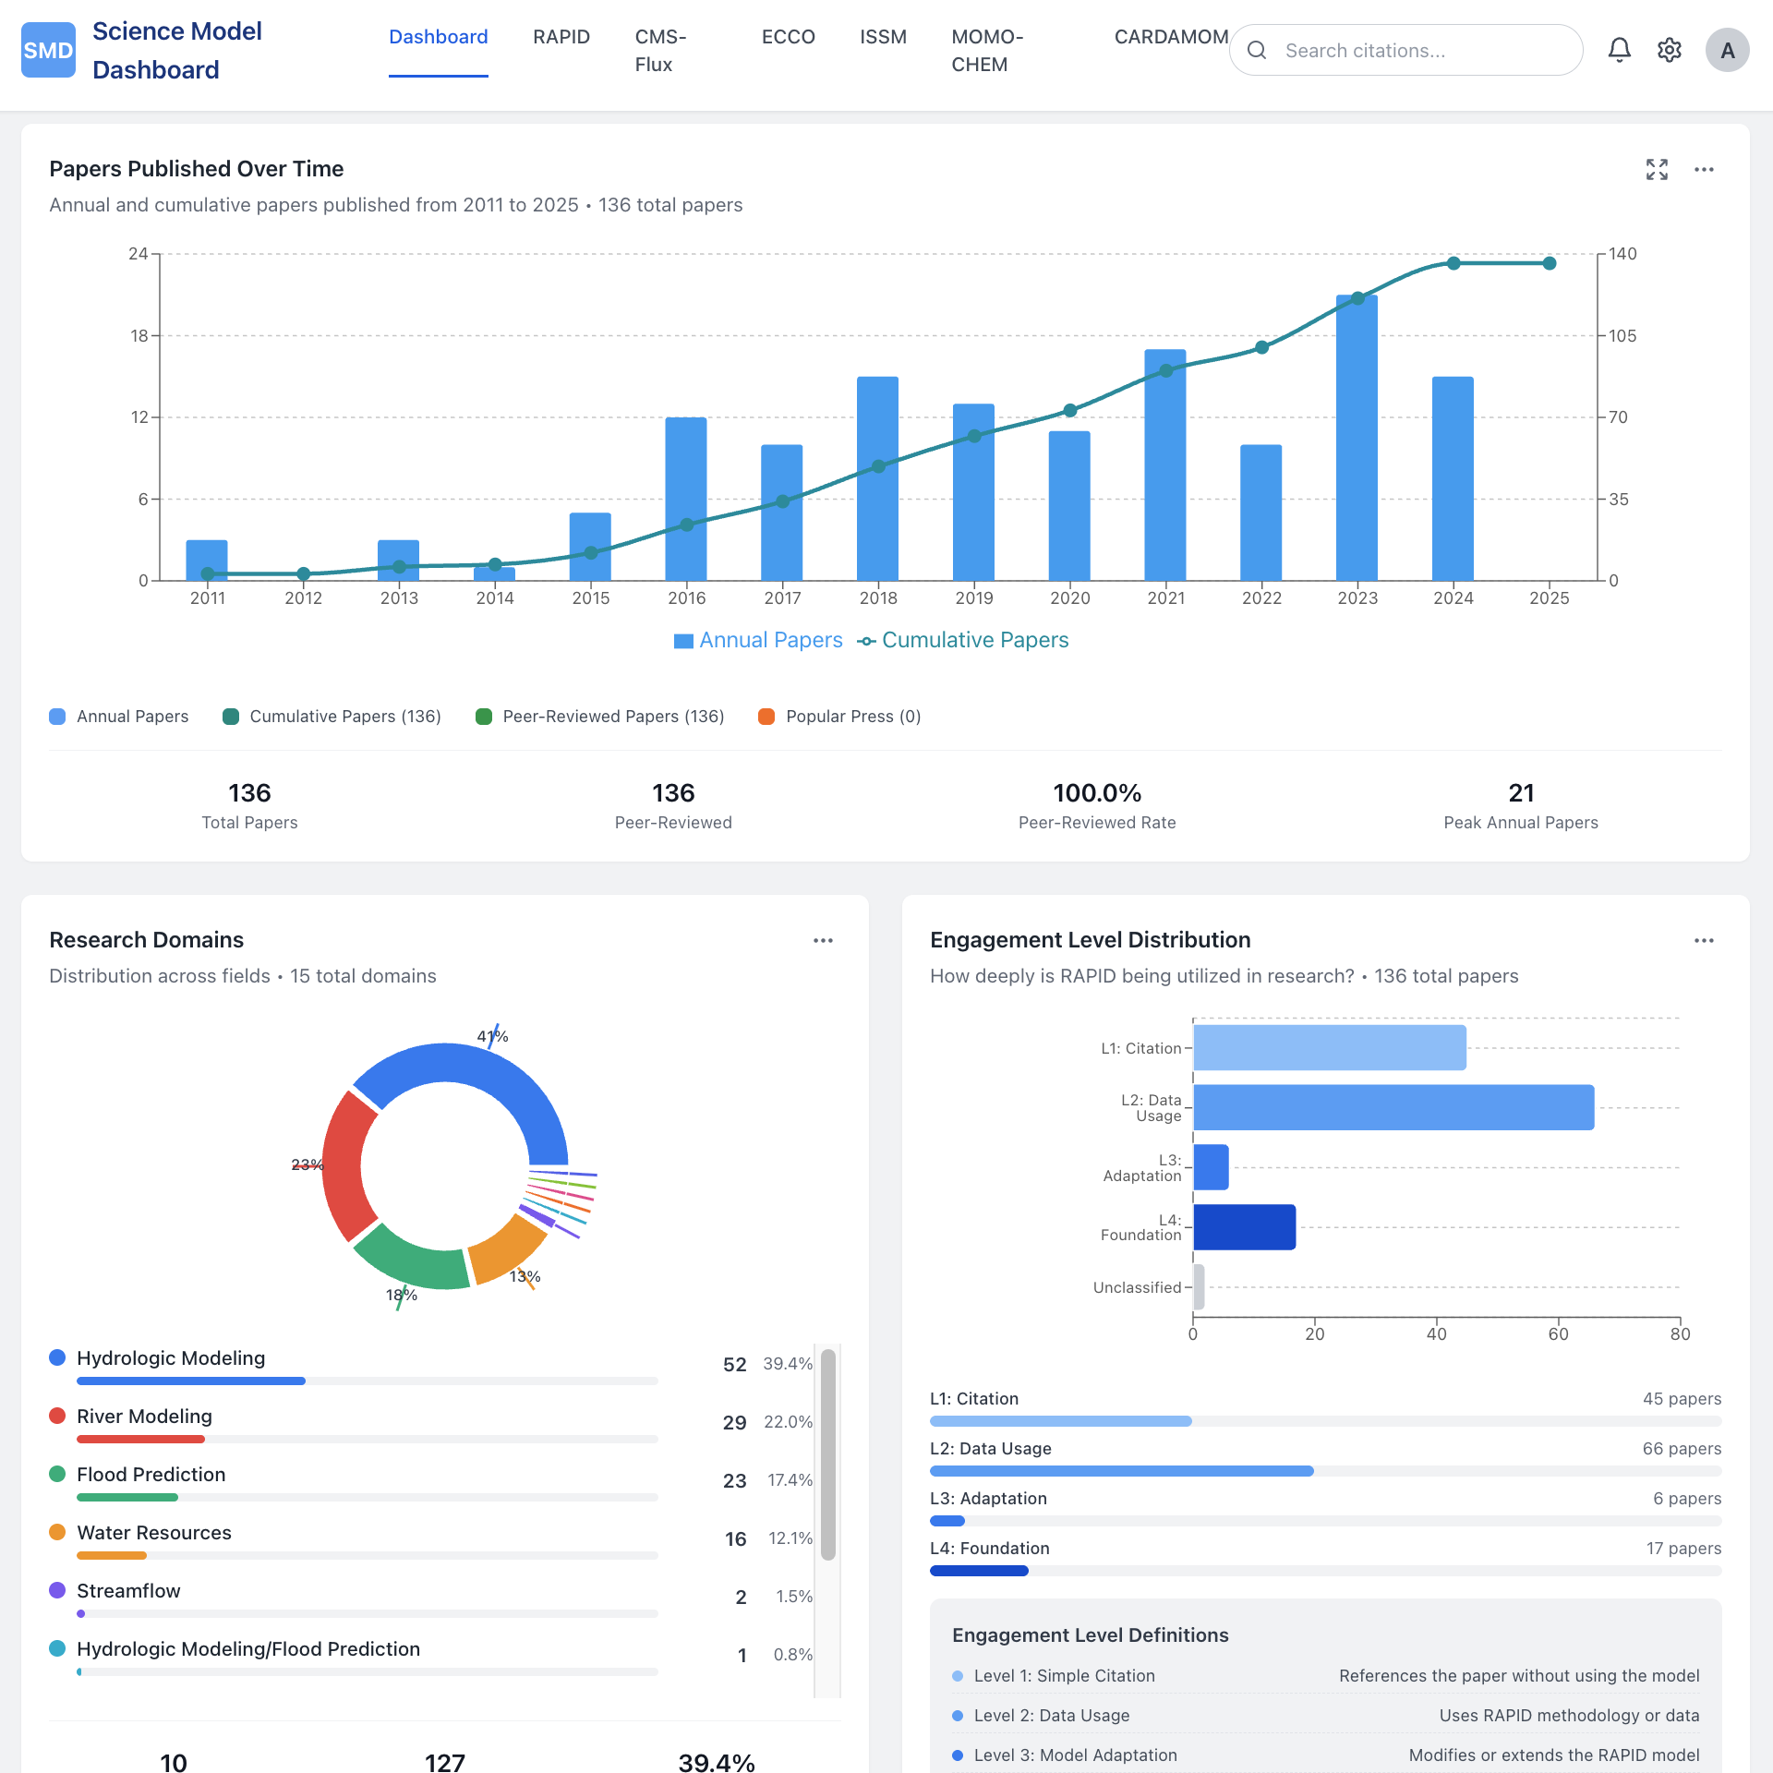
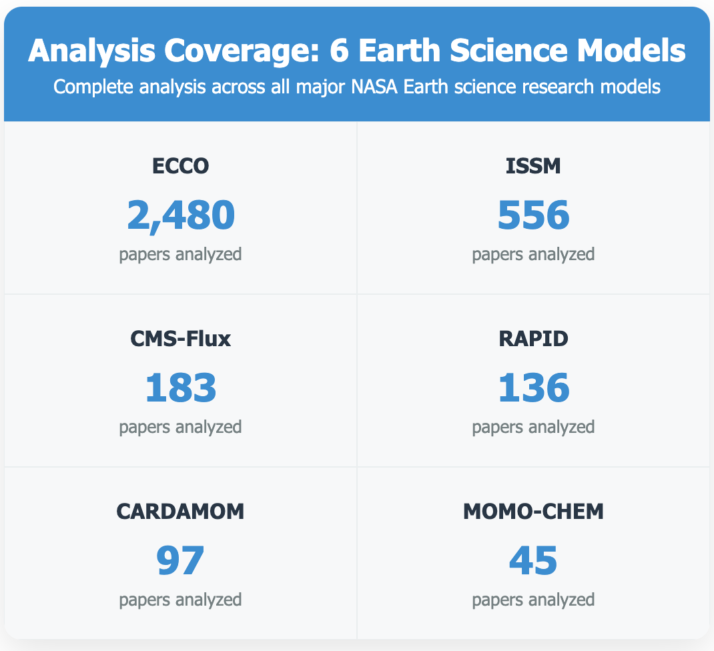
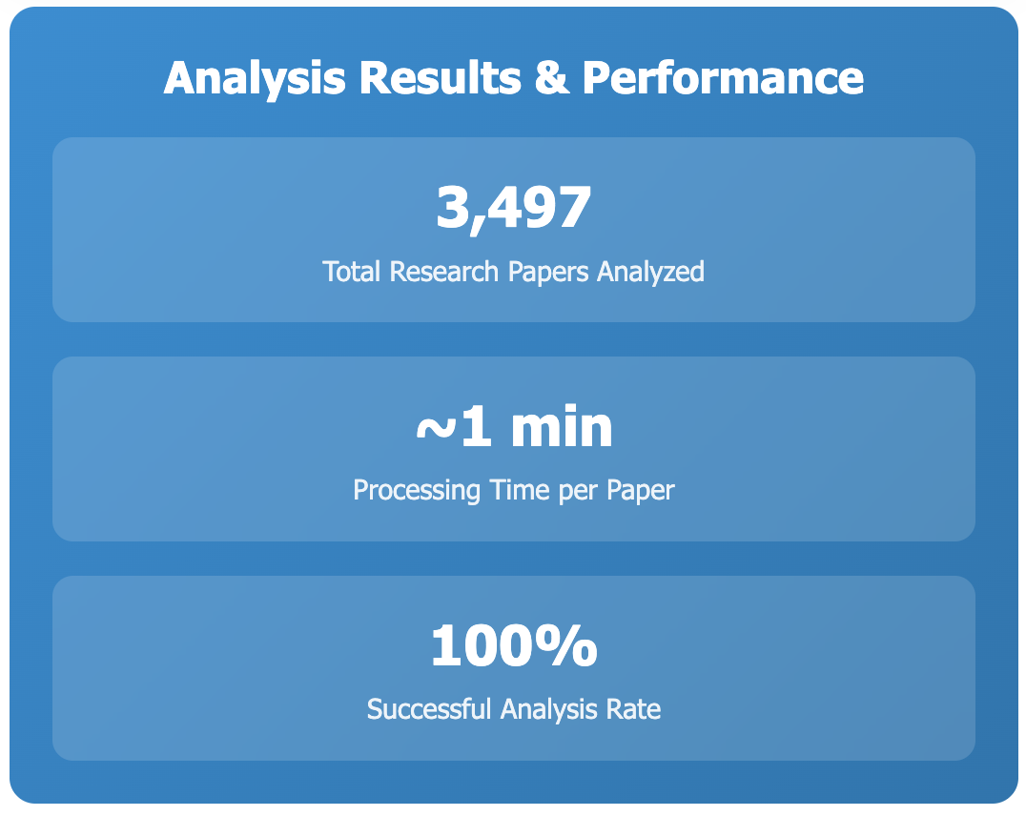
Science Model Dashboard Comprehensive Research Impact Assessment Across Earth Science Models
Project Goal
Analyze and visualize the real-world impact of JPL Earth science models across research domains and geographic regions.
Key Capabilities
Fully automated/customized analysis using local large language model (llama3.3:70b)
Automated engagement level categorization (i.e., citation, data usage, adaptation, foundational usage)
Research domain classification across disciplines
Global geographic impact analysis
Interactive dashboard for trend exploration
https://yunks128.github.io/science-model-dashboard/

Slide 6
Science Model Dashboard
Features
LLM-powered analysis via Ollama integration for automated categorization of research papers
Flexible JSON input handling with automatic field detection across various data formats
React-based interactive dashboard
Analysis Workflow
Data Input: JSON files with papers, titles, abstracts, and metadata
LLM Analysis: Categorize engagement levels, domains, and regions
Data Processing: Extract metrics, trends, and geographic patterns
Visualization: Interactive charts and dashboard components
Supported Science Models
RAPID, CARDAMOM, CMS-Flux, ECCO, ISSM, MOMO-CHEM
https://yunks128.github.io/science-model-dashboard/

Slide 7
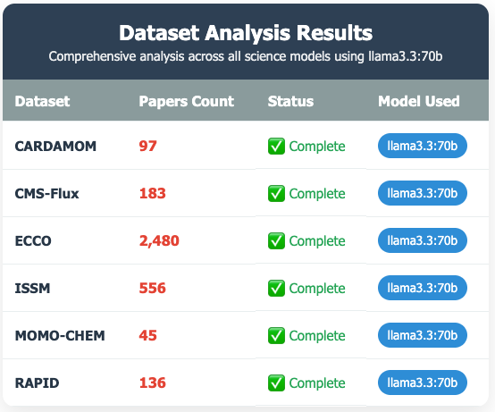
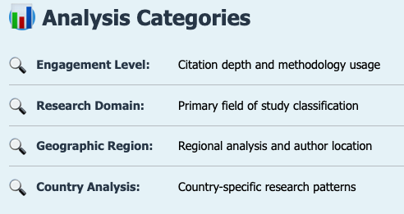
LLM-Powered Citation Analysis
All using the same LLM model (llama3.3:70b) for consistency
3,497 total papers analyzed across all datasets
~1 minute per paper processing time

