Slide 1
Figure 1. Citation dataset overview
Papers and citations per JEME model and JEOE mission (post peer-review filter and multi-agent cleanup, 2026-04). Switch the value axis to logarithmic in PowerPoint to see small models clearly.

Slide 2
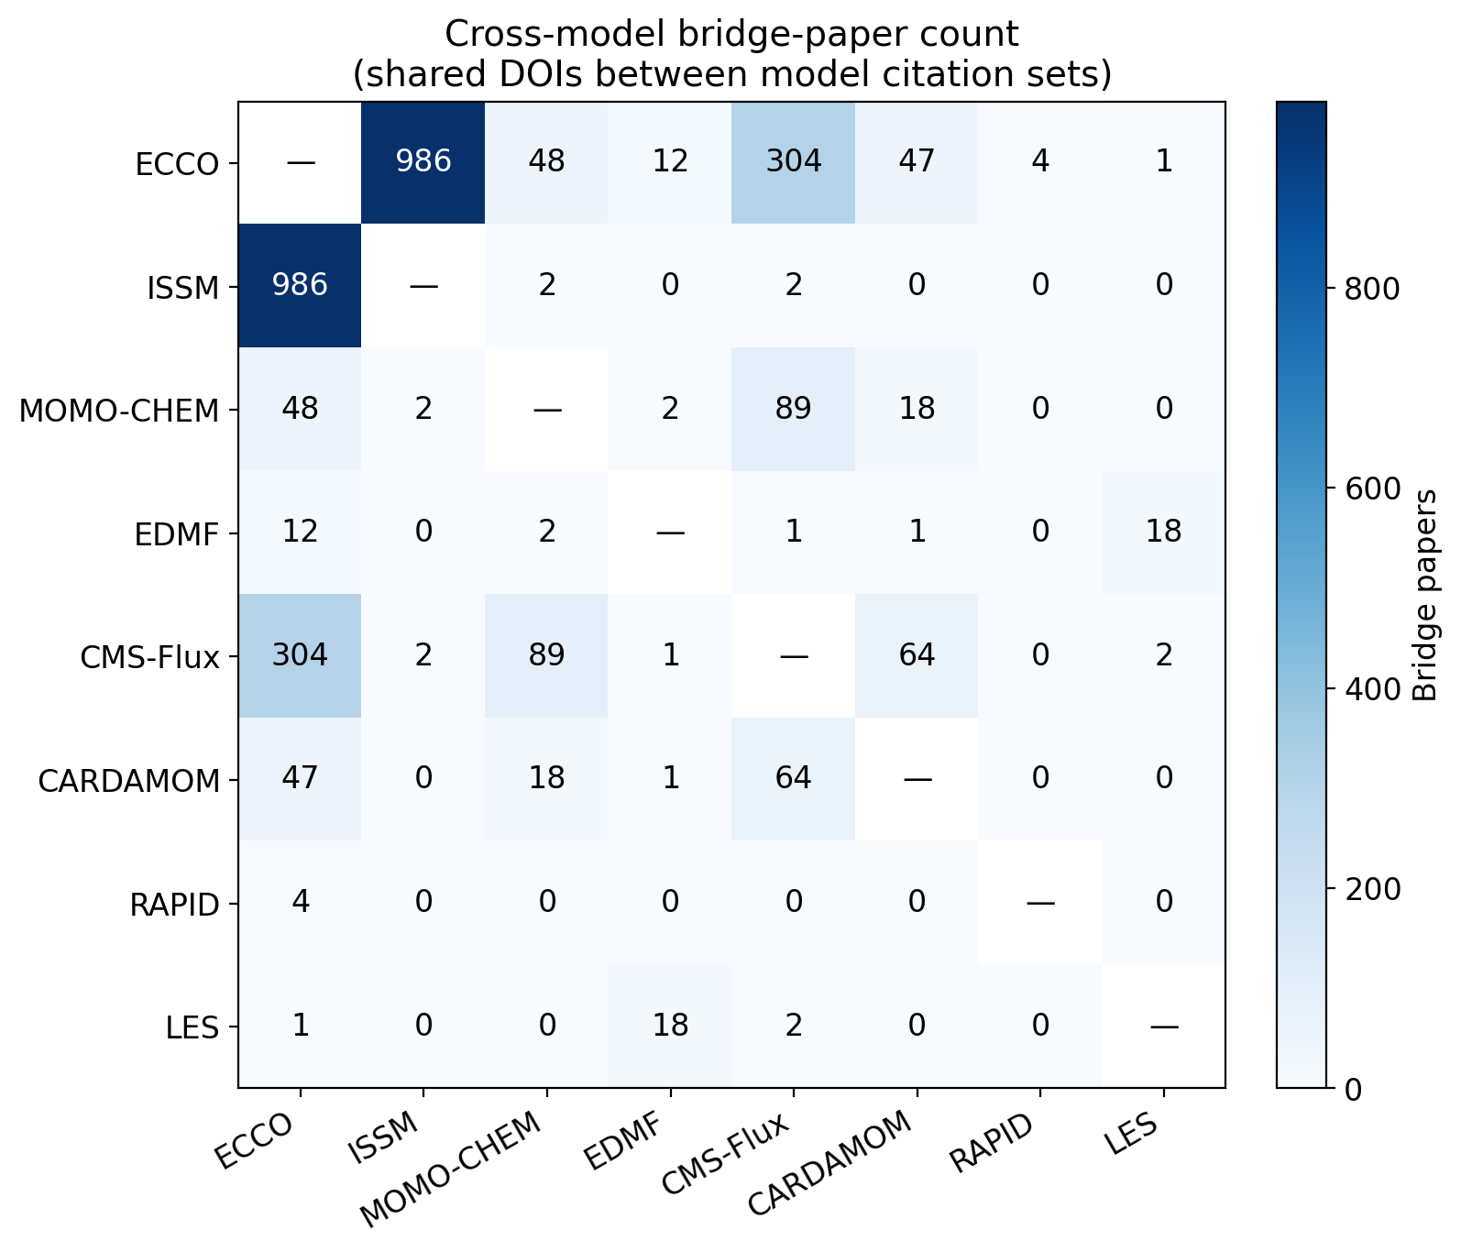
Figure 5. Cross-model bridge-paper matrix
Bridge papers — the count of DOIs cited by both models in each pair. Diagonal omitted; matrix is symmetric.

Slide 3
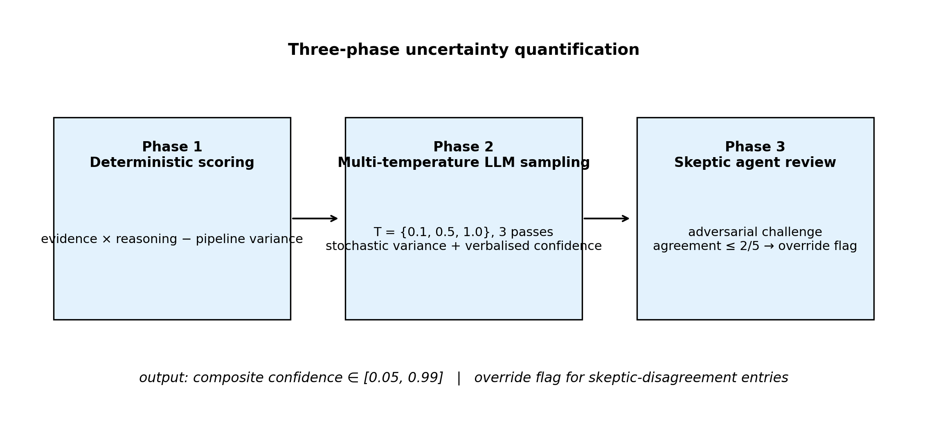
Figure 7. Three-phase uncertainty quantification
Composite confidence is computed in three stages: deterministic scoring on metadata, multi-temperature LLM sampling, and adversarial skeptic review.

Slide 4
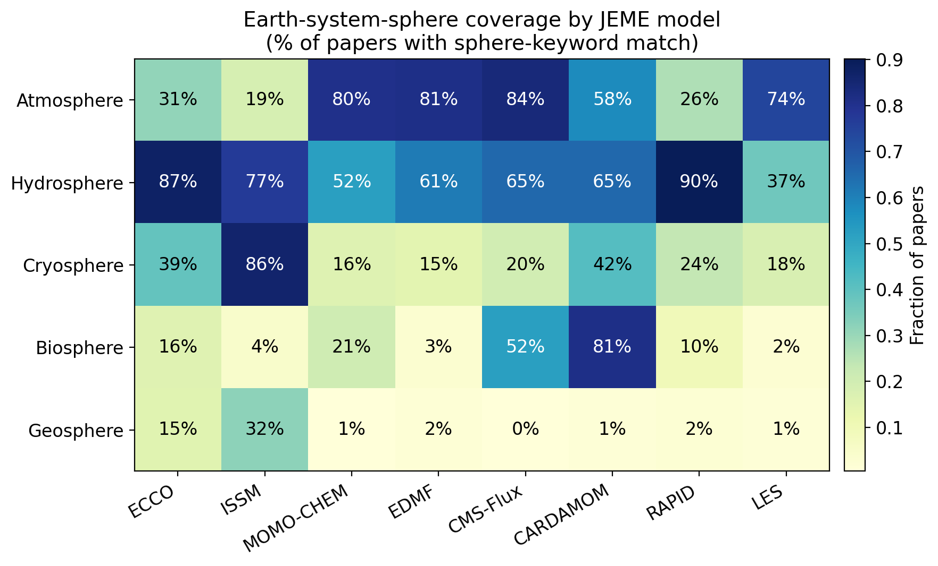
Figure 8. Earth-system-sphere coverage
Fraction of each model's papers that match keywords for each Earth-system sphere. Multi-sphere papers count toward every matching sphere.

Slide 5
Figure 9. Multi-source full-text retrieval pipeline
Copernicus (10.5194)
Wiley TDM (10.1002/29/111)
Elsevier TDM (10.1016)
Unpaywall PDF + HTML
OpenAlex institutional repos
Semantic Scholar openAccessPdf
DOI redirect (last resort)
Extract DAS + Methods + marker contexts
Re-classify with Gemini
Tiered DOI lookup. Each box is a fetch route; success at any tier short-circuits subsequent attempts. ~1,300 previously-failed fetches were recovered when OpenAlex was added.

Slide 6
Figure 10. System architecture
Data sources
Semantic Scholar Crossref Unpaywall OpenAlex Wiley TDM Elsevier TDM Copernicus
Citation analytics pipeline
Seed identification ↓ Citation collection ↓ Multi-agent verification ↓ Peer-review filtering ↓ Full-text enrichment ↓ Gemini classification ↓ Three-phase UQ
Storage
{model}_ analyzed.json
React dashboard
JEME (8 models) JEOE (3 missions) JESP (199 scientists) Network analysis Sphere coverage
End-to-end data flow from external scholarly APIs through the citation analytics pipeline into per-model JSON storage and the React dashboard.

