Slide 1
A deformable-mirror surface gauge, modeled end to end
A polarization phase-shifting Twyman–Green in MACOS: three splitter options priced, the idealized gauge closed at 0.18 nm, calibration taken to the actuator scale, the shallow-plate option measured at full 96×96 scale — and a Zernike-sensor head-to-head on the same DM truth, priced to the 1 pm ambition
D. C. Redding, with Claude Code.
September 2026. Prepared for Fang Shi.
DRAFT — pending review.

Slide 2
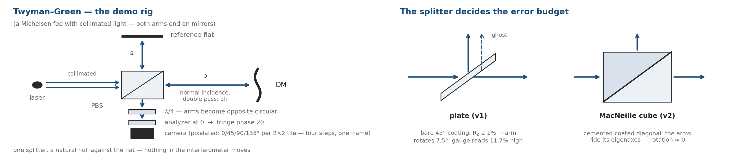
The instrument: a Twyman–Green, phase-stepped by polarization
The test optic is a mirror, so the Michelson topology gives it a whole arm at normal incidence
• Why a Twyman–Green for a DM: both arms end on mirrors, so the DM takes one arm whole, at normal incidence, double pass — height counts twice — with a natural null against the reference flat. A Mach–Zehnder has no natural seat for a mirror: its isolated arms and two ports serve dynamics and transmission, not figure.
• Phase shifting with nothing moving in the interferometer: the arms carry orthogonal polarizations (polarizer and quarter-wave plates in the collimated legs); the analyzer angle θ writes fringe phase 2θ. The analyzer sits in the recombined beam — or is a pixelated camera (0/45/90/135° per 2×2 tile): all four steps in one snapshot.
• The one design decision left is the splitter. Three options follow, priced on the same model.
The rig, and the splitter that decides its error budget.
Test optic: a 16×16-actuator deformable mirror, influence-function surface model, HeNe 632.8 nm. In every option the polarizing elements sit in the arms; the splitter differs.

Slide 3
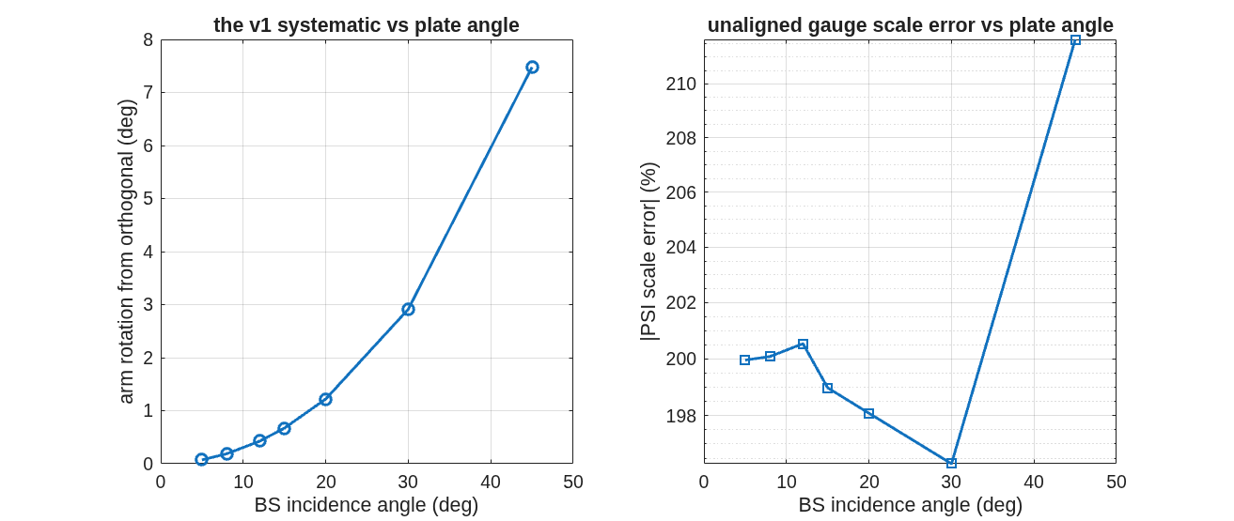
The three splitter options
One architecture, three splitters — the plate's incidence angle and the cube are the levers
• Option 1 — plate at 45°: the compact classic. The plate's unequal s/p transmission rotates one arm's polarization 7.48° from orthogonal; the gauge reads 11.7% high until a one-waveplate alignment (+3.77°, solved in 5 traces) restores it.
• Option 2 — MacNeille cube: a real cemented polarizing cube. Each arm rides a coating eigenaxis, so the rotation is structurally absent (5×10⁻⁶ °); no alignment, 2.27× the light — at a glass cost that grows steeply with aperture.
• Option 3 — plate at a shallow angle (the VSG2 layout's ~10–15°): the same plate architecture with the diattenuation attacked at its source — s/p asymmetry vanishes toward normal incidence. Measured on the model: rotation 7.48° → 0.43° and scale error 11.7% → ~0.5% at 12°, with no alignment step. The price is geometry: the arms separate at twice the incidence angle, so the bench stretches.
The v1 systematic against plate angle: rotation collapses toward normal incidence; scale error falls from 11.7% to under 1% below ~15°.
Ladder measured at 45/30/20/15/12/8/5°, design azimuths, unaligned; the 45° rung reproduces the committed v1 numbers exactly. Sub-1% residuals at shallow angles carry rig-geometry effects at this fidelity — noted, not yet decomposed.

Slide 4
The decision table
The cube buys its error budget with glass; the shallow plate buys most of it with bench length
 | plate 45° (v1) | plate ~12° (option 3) | MacNeille cube (v2)
arm rotation, unaligned | 7.479° | 0.426° | 5×10⁻⁶ °
scale error, unaligned | 11.7% | ~0.5% | 1×10⁻⁴ %
alignment required | one waveplate, +3.768° | none at the 1% level | none
waveplate-error character | invisible scale | invisible scale, 18× attenuated | visible contrast, scale pinned
delivered power (fraction) | 0.169 | plate-class | 0.384 (2.27×)
hardware | plate + compensator | plate + compensator + ~2×CA of separation length per fold | cemented cube, CA³ glass
aperture cost scaling | CA² area | CA² area | CA³ mass + 1/CA homogeneity spec
full 16×16 closure measured | 0.304 nm rms | not yet run | 0.183 nm rms
• Reading: option 1 needs the alignment solve or carries an invisible 11.7% systematic. Option 3 removes ~95% of the systematic with geometry alone and keeps plate-class cost — the natural choice at large aperture. Option 2 removes it structurally and converts residual waveplate errors from invisible scale to visible contrast — the best instrument, at a cost that grows as the cube of aperture.
All entries from committed runs (v1 example, v2 example, tg_aoi_ladder); "plate-class" and the closure gap are marked where not yet measured. Option 3 has since been laid out and measured at full 96×96 scale — the closing slides.

Slide 5
First-order cost with clear aperture
The cube's glass grows as CA³ and its homogeneity spec tightens as 1/CA; plates grow as CA²
clear aperture | 50 mm | 75 mm | 100 mm
cube: glass volume / mass (flint, ~3.5 g/cc) | 125 cm³ / ~0.4 kg | 420 cm³ / ~1.5 kg | 1000 cm³ / ~3.5 kg
cube: transmitted glass path | 50 mm | 75 mm | 100 mm
cube: index homogeneity for λ/20 transmitted WFE | Δn ≤ 6×10⁻⁷ | Δn ≤ 4×10⁻⁷ | Δn ≤ 3×10⁻⁷
cube: coated + cemented hypotenuse area | 35 cm² | 80 cm² | 141 cm²
cube: availability class | top of catalog (2-inch) | custom | custom
plate + compensator: glass volume / mass (silica) | ~50 cm³ / ~0.11 kg | ~140 cm³ / ~0.3 kg | ~340 cm³ / ~0.75 kg
plate: transmitted glass path (2 substrates) | ~17 mm | ~25 mm | ~34 mm
plate: availability class | catalog | catalog | semi-custom flat
• The crossover argument: below ~50 mm the cube is a catalog part and its error budget comes nearly free. Above it, the cube is custom glass whose mass grows as CA³ and whose transmitted-wavefront homogeneity requirement passes beyond standard melt grades near 100 mm — while the shallow plate holds catalog-class cost and, from the ladder, gives up only ~0.4° of arm rotation.
Scaling estimates for planning: masses from geometry and nominal densities; homogeneity from Δn·L ≤ λ/20 at 633 nm; availability classes from current catalog size limits. Vendor quotes are the real numbers — none are quoted here.

Slide 6
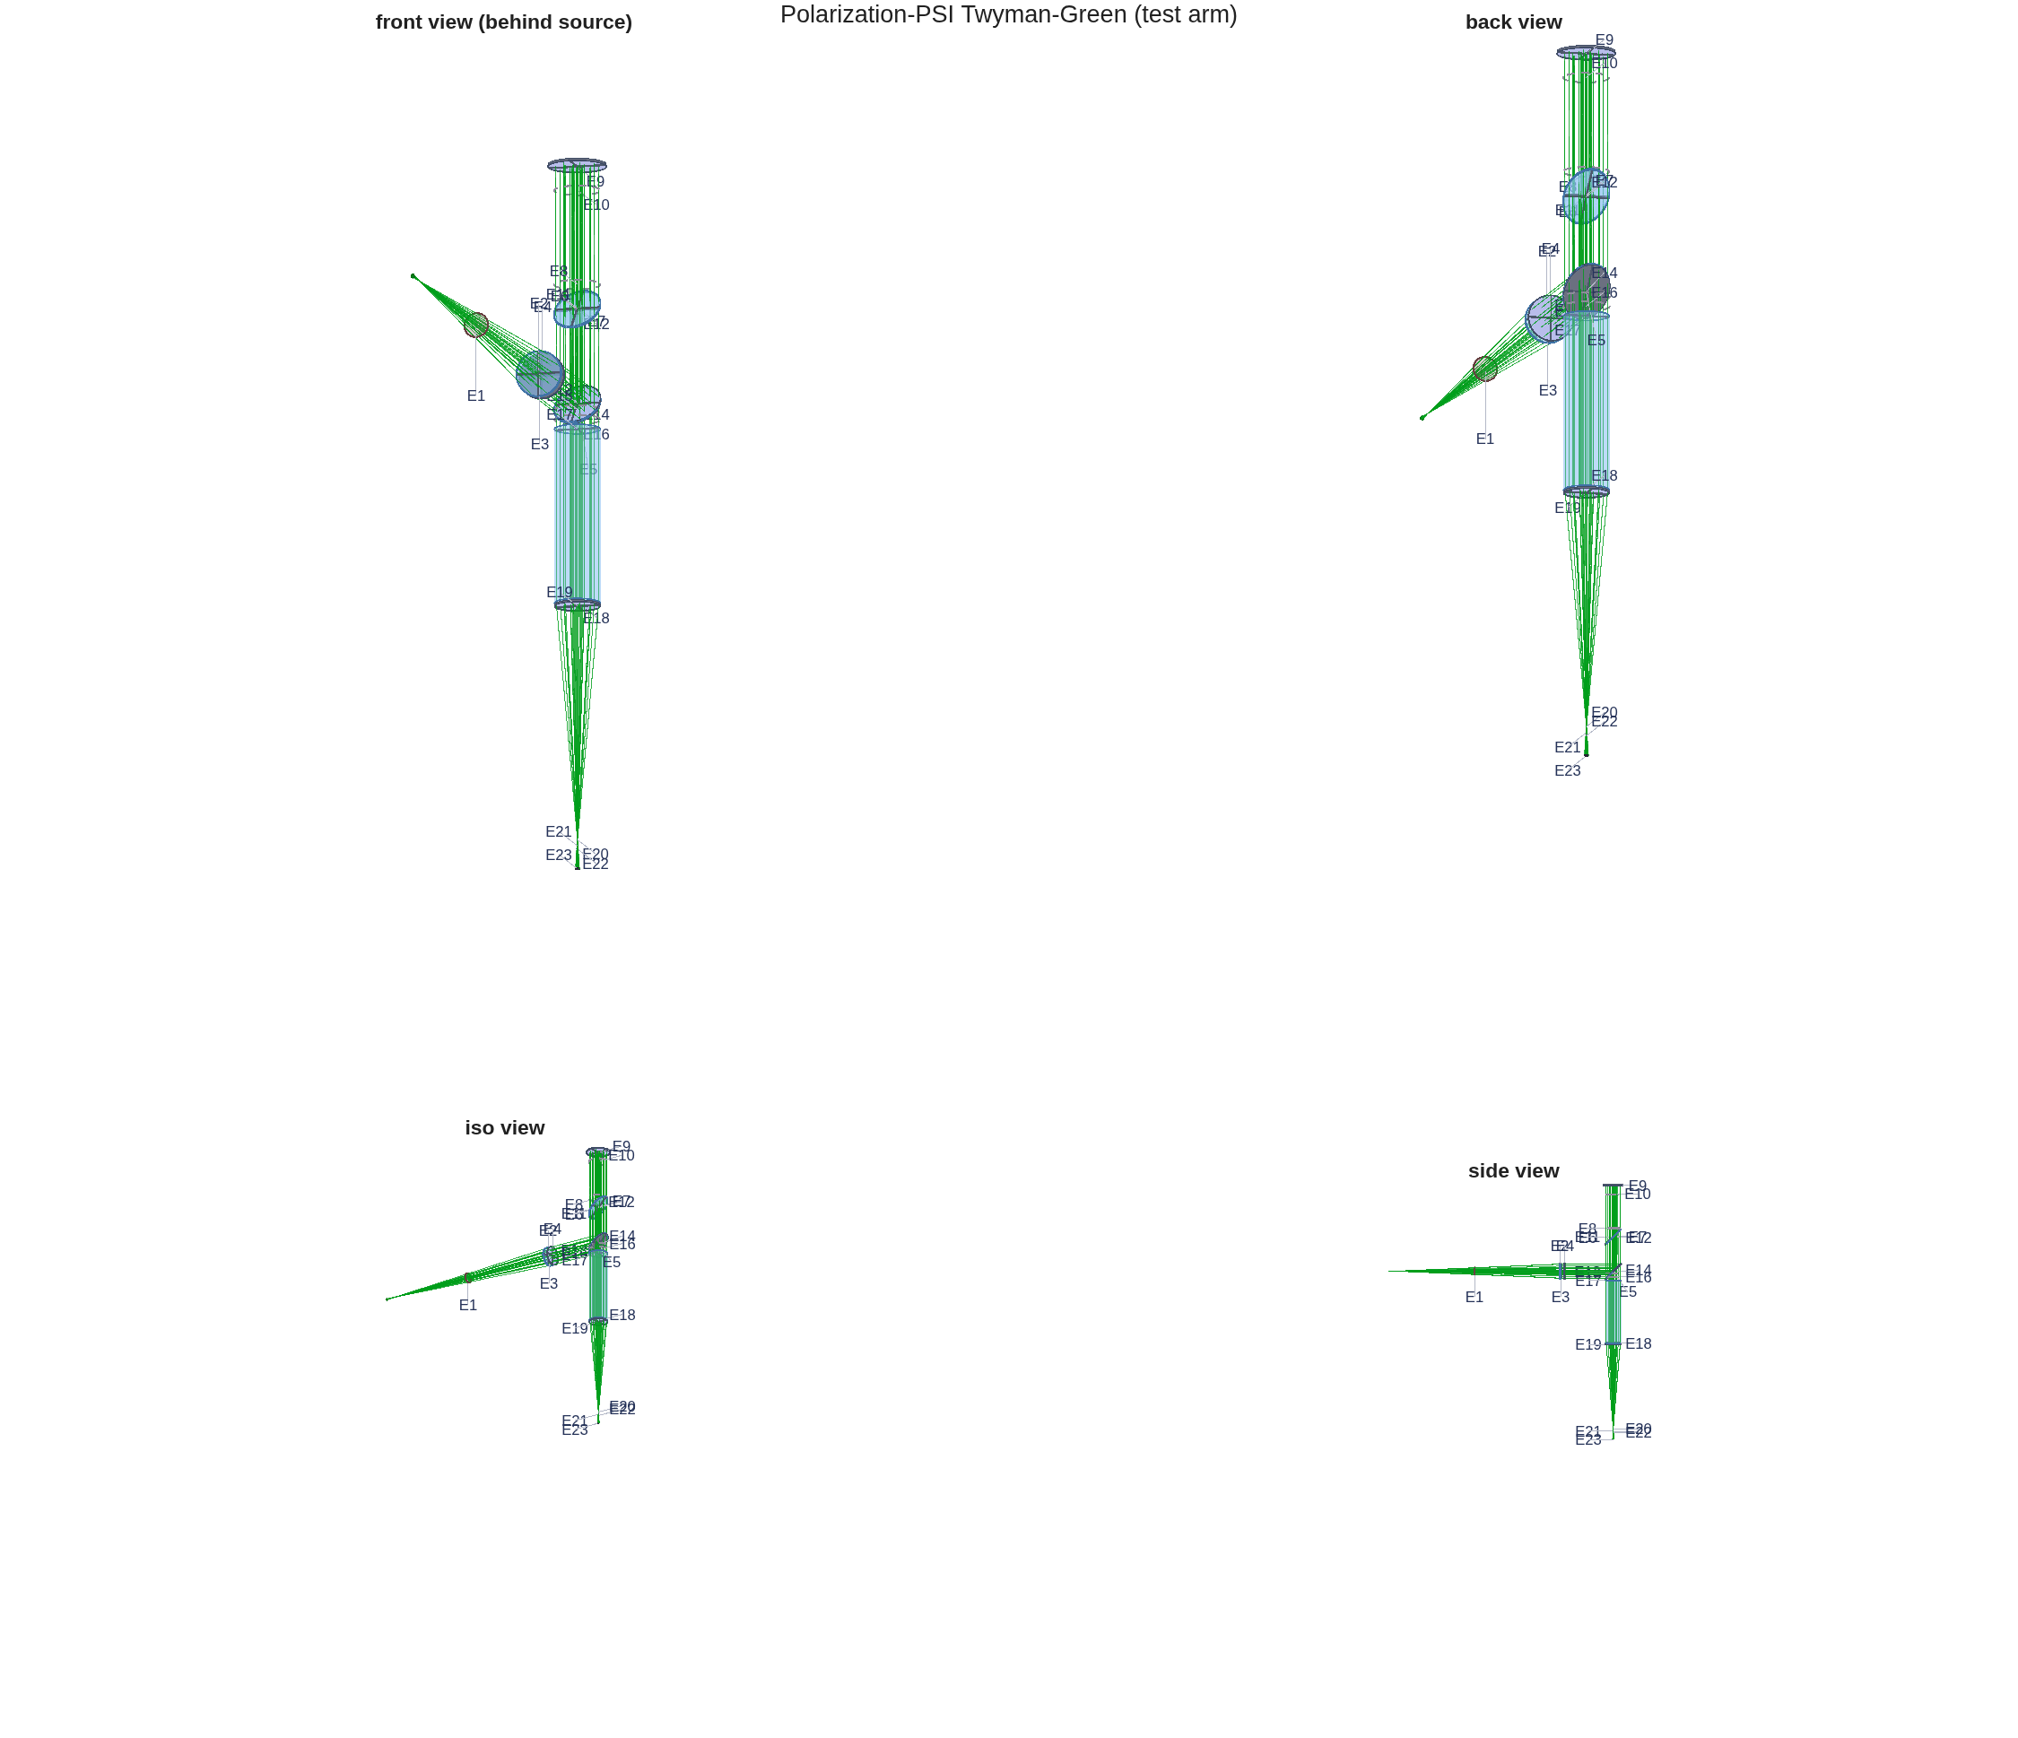
Why the plate needs its alignment: the invisible error, caught in the model
Splitter diattenuation reads as 11.7% of scale while fringe contrast moves 0.17%
• The finding (option 1, as designed): the waveplate azimuths should leave the arms orthogonal at ∓45°. Measured: reference exactly +45.0000°, test −37.52°. The gauge's scale reads 11.7% high.
• The mechanism: every non-normal surface between polarizer and recombination transmits s and p unequally, and unequal transmission rotates a linear state. The reference arm's waveplate cancels the rotation before it against the one after; the test arm's adds them. Nothing downstream repairs it — a waveplate is lossless and cannot restore orthogonality.
• Why it is dangerous on a bench: contrast moves 0.17% while scale moves 11.7% — a 69× blind spot. Every field phase in the model was exact throughout; the error lived entirely in the measurement. On hardware this calibrates out only if you know to look for it.
The plate-rig layout as traced.
The same mechanism, attenuated 18×, is what remains of option 3 at 12°; the cube removes it structurally.

Slide 7
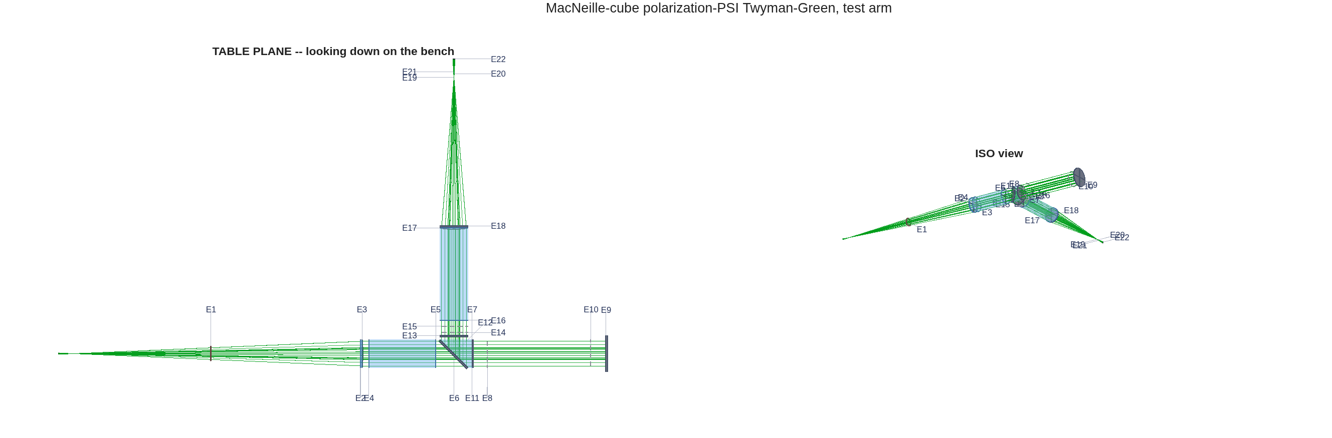
The cube in detail: real MacNeille physics, engine against textbook
One coated 45° interface; the design condition hands back a dense flint
• A real cube, not bookkeeping: a ZnS/cryolite quarter-wave stack on the cemented diagonal. The MacNeille condition fixes the prism glass: n = 1.6555 — the model reproduces why real polarizing cubes are not BK7.
• Engine against textbook: coating reflectances match the thin-film reference calculation at the 10⁻¹⁰ level; R+T = 1.000000000000 measured across the two arm models; polarization extinction 2382:1.
• A design subtlety the model caught: satisfying the MacNeille (Brewster) condition at the layer interfaces is not enough. For p-light the stack is one homogeneous slab, and only its total thickness matters: a 9-quarter-wave stack leaves R_p = 2.1%; the 8-quarter-wave form nulls it. Both are textbook designs; one is a polarizer.
The cube rig as traced: both returns leave by the same port.

Slide 8
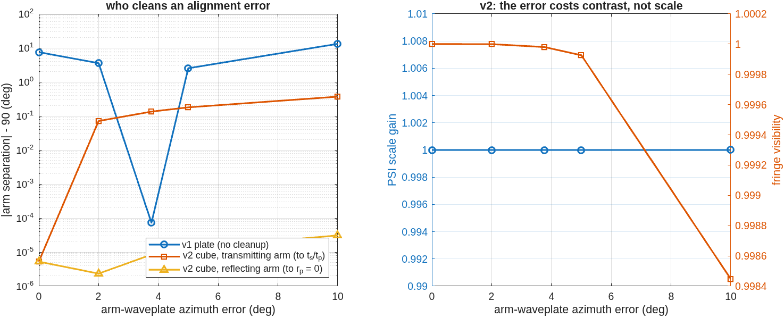
The cube's real purchase: the error budget inverts
A waveplate error becomes visible contrast instead of invisible scale
• On the plate, a waveplate azimuth error appears as measurement scale — nothing in the fringes warns you. On the cube, the same error is cleaned on the return leg (to coefficients the coating pins) and appears as fringe contrast — visible immediately, while the scale stays put.
• Measured: 10° of deliberate waveplate error moves the plate's arm rotation 13.15°; the cube's arms move 3×10⁻⁵ ° (reflecting arm) and 0.37° (transmitting arm), with the error emerging as contrast.
• The instrument lesson: a polarizing cube is worth buying for its error budget before its throughput — where the aperture makes it affordable.
Who cleans an alignment error: the plate's arm rotation walks with waveplate error; the cube's arms stay put.
v2 closure is also the best of the three: 0.183 nm rms against 0.304 for the aligned plate.

Slide 9
The model behind the numbers
Engine surfaces, not appended matrices; the DM surface is data
• Every element is physical and in the trace: polarizers, waveplates, the splitter and its thin-film coating are engine surfaces — not a Jones model multiplied on afterward. Applying the analyzer's matrix to the detector field is measurably wrong (the field there is 2.8×10⁻² non-transverse); the model traces through the analyzer instead.
• The DM is a gridded surface: a grid value is the surface height — a uniform 20 nm piston recovers 4π·dz/λ exactly and matches a rigid 20 nm mirror translation to 2.3×10⁻¹⁰ rad; the double pass supplies the factor 2.
• The trust base: 18 regression checks across the two rigs run per commit; every number in this deck is printed by a committed script.
Records: mmacos templates/90_polarization/tg_psi_dm (v1 + option-3 ladder) and tg_psi_dm_v2; checks tTgPol (9) + tTgPol2 (9).

Slide 10
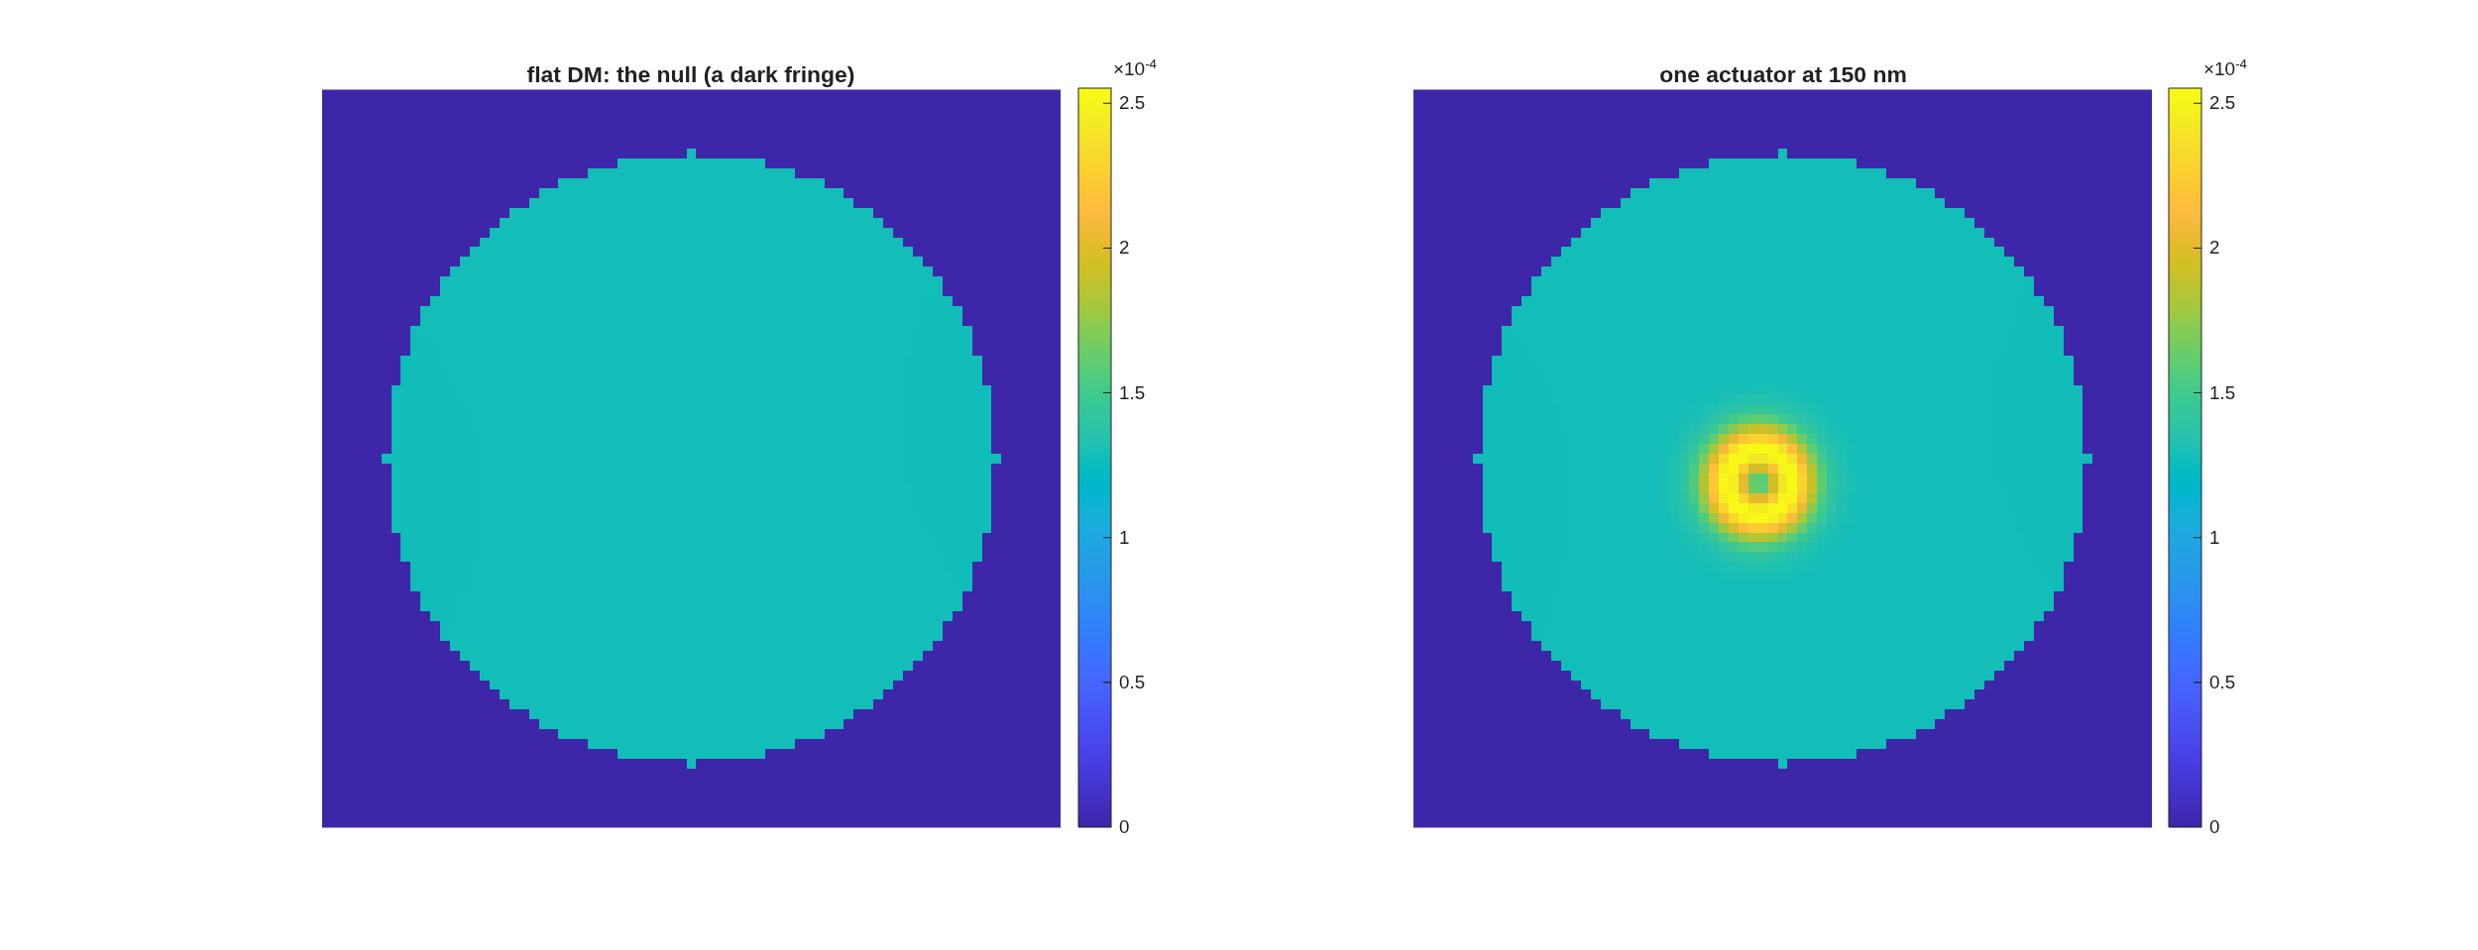
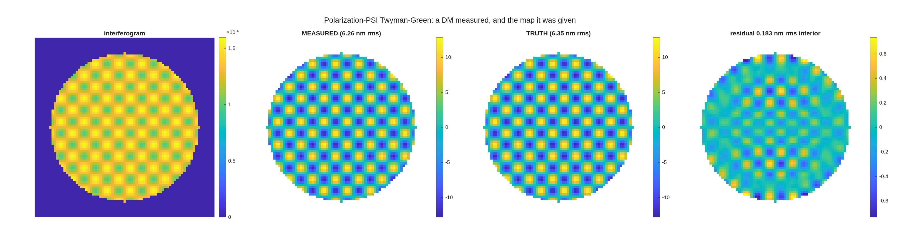
The idealized gauge, closed end to end
Null 73 pm with nothing aligned; the full map recovers to 0.183 nm rms on 6.35 nm of figure
• The null: 73 pm rms with nothing aligned — and the leftover is a smooth saddle, a systematic you could chase, not a noise floor.
• One actuator poked 150 nm: the bullseye does its own arithmetic — half a fringe double-passed is ~158 nm; the gauge recovers 146 nm.
• The analyzer sweep costs no traces: the detector field is bilinear in the analyzer axis, so 3 traces per arm span every analyzer angle exactly (3.5×10⁻¹⁰ against direct traces); 36 sweep frames render in 35 ms with nothing re-traced. The one correction is a clean quadratic in ray angle at the analyzer (0.149·β²), verified over four decades.
• Full closure: a 16×16 checkerboard command at 6.35 nm rms truth recovers 6.26 nm measured — residual 0.183 nm rms, correlation 0.9996.
One actuator poked: the fringes bend over it.
The recovery beside the injected truth map — the panel a bench cannot draw.
These are the numbers from the 2026-09-02 live run (eight beats, ~45 s of compute); every beat writes its figure and its numbers to the record.

Slide 11
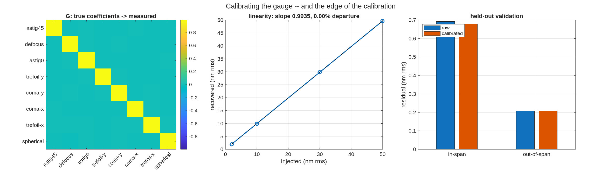
Calibration I: against low-order modes, the gauge is already at its floor
Gain 0.9912 ± 0.0020, linear to 0.00% — almost nothing to calibrate
• The protocol: inject known low-order surface commands, measure, fit gain — the standard bench calibration, run in the model where truth is exact.
• The answer: gain 0.9912 ± 0.0020 across the mode set, linear to 0.00% over the tested range.
• The two correlations say where the leftover lives: the residual correlates with the injected shape, not with the fringe field — a smoothing of the truth, not a phase error. That pointed the follow-up: the gauge error is a spatial-frequency effect, so calibrate against spatial frequency — widen the basis, not the gain.
The low-order calibration: measured against injected, mode by mode.
This beat was built live in answer to a calibration question during the 2026-09-02 demonstration; its conclusion is deliberately not the one it was built expecting.

Slide 12
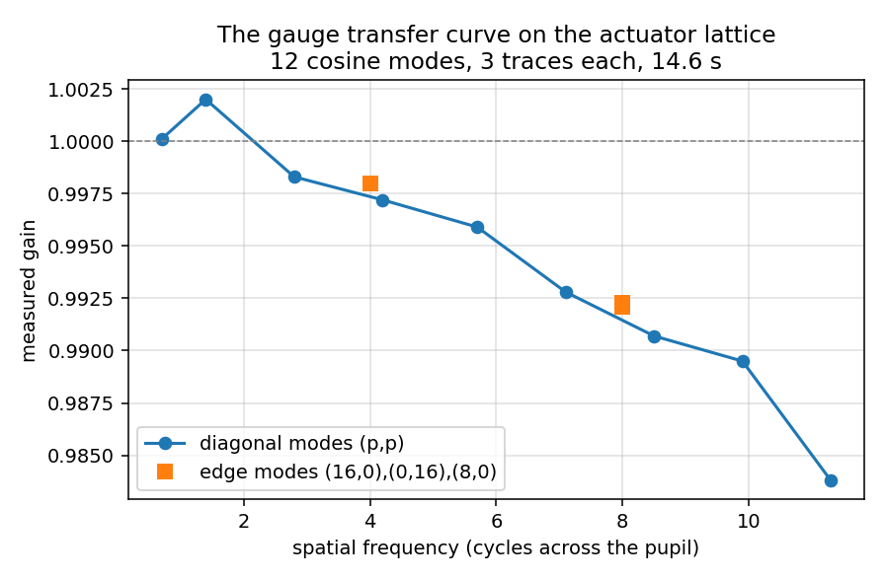
Calibration II: at the DM's own actuator scale
The gauge is a mild low-pass instrument: 1.6% roll-off at Nyquist, and its calibration transfers to a held-out command
• The basis is the actuator lattice, not Zernikes: the detector images the DM through optics that smooth, so the modes that diagonalize the gauge error are the command grid's own spatial frequencies — separable cosines on the 16×16 lattice, from near-piston to the checkerboard at Nyquist.
• The measurement: 12 cosine modes injected at 50 nm, three traces each; per-mode gain and cross-talk from a single least-squares fit. Gain falls monotonically from 1.0001 at 0.7 cycles/pupil to 0.9838 at the checkerboard's 11.3 — a 1.6% roll-off at Nyquist, cross-talk below 1.1%.
• Held-out validation: the calibration matrix, built on the cosine set, is applied to a random command pattern it never saw: 0.300 → 0.296 nm rms on a 29.4 nm input (1.01%), and the residual's correlation with the command falls to −0.20 — what remains is the gauge floor, not a calibratable shape. The in-span checkerboard checks the fit itself: 0.208 → 0.178 nm rms (2.80% of 6.35 nm).
Per-mode gain against spatial frequency: the gauge's transfer curve, measured on the actuator lattice.
12 modes × 3 traces in 14.6 s. The checkerboard is the Nyquist member of the cosine set — in the calibrated span by construction — so the random pattern is the honest test.

Slide 13
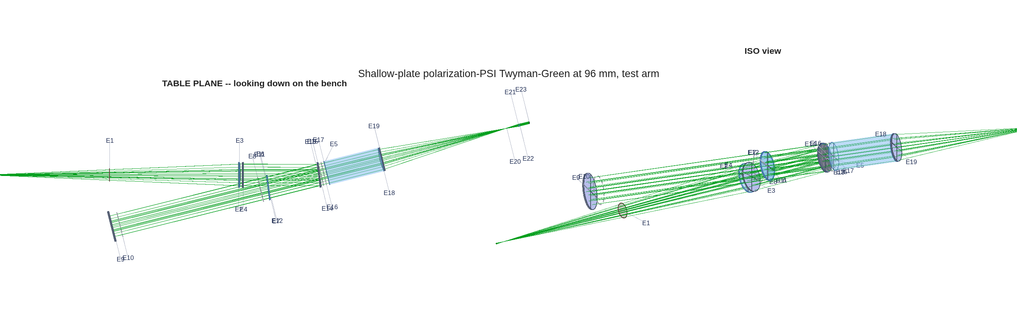
The shallow plate at full scale: a 96×96, 1 mm-pitch Xinetics DM
The layout is solved against clearances — and, after one silent failure, the sampling is solved with it
• The article: a Xinetics 96×96-actuator DM at 1.0 mm pitch — a 96 mm beam, the aperture class where the cube goes custom and the shallow plate is the natural choice. The rig is scaled up 1.71× and re-solved, not just magnified.
• Clearances set the geometry: the arms separate at twice the plate's incidence angle, so beam-edge clearances (25 mm margin around real component bodies) fix the plate at 7° with a 700 mm DM leg. Achieved margins: +28, +58, +68 mm; the binding pair is the DM arm against the reference beam.
• Sampling is part of the design: every sampling interface is now budgeted, in the layout solve itself, against the finest feature to be measured (the actuator spacing, 48 cycles across the pupil): detector 385 px across the pupil (4.0× above the minimum 2×), surface grid 3.6 px per actuator, diffraction grid 1024². The lesson that bought the rule: the geometrically-scaled 63 px detector read a 1 mm actuator at half its true height — with nothing else visibly wrong.
The test arm as traced: plate at 7°, the 96 mm DM on its 700 mm leg, and the detector tail to the pupil-image camera.
Record: templates/40_benches/tg_psi_dm96 (tg96.m; report, clearance-margin layout figure, and all numbers committed).

Slide 14
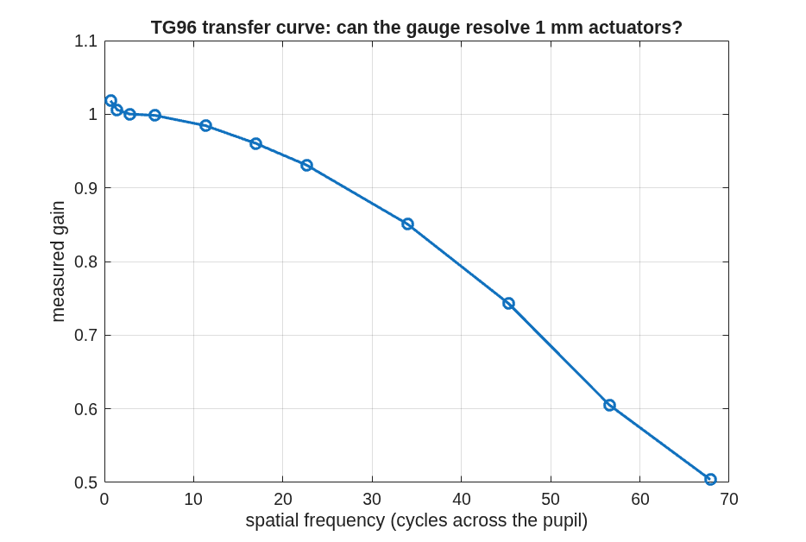
The 96 mm gauge, measured
The ladder's promise holds at full scale: arms 0.14° from orthogonal, null 0.134 nm with nothing aligned, and a smooth measurable response out to the finest actuator pattern
• Polarization at 7°: arm azimuths −44.86° / +45.00° — 0.143° from orthogonal, scale error +0.145%, no alignment step. The 45° plate's 7.5° / 11.7% systematic is removed by geometry alone, as the angle ladder predicted.
• The null: 0.134 nm rms with nothing aligned — after re-optimizing the detector-leg optics at this scale. The geometrically-scaled detector leg read 9.1 nm: lengths scale, diffraction does not. Re-opening its four parameters recovered 68×.
• Camera-to-DM registration needs four separate calibrations, each from its own observable: scale and rotation from traced rays; translation from one center poke; the array's flip/transpose orientation from one off-center poke by direct overlap (0.93 against 0.002 for the runner-up); and the sign of the measurement from that same overlap. Symmetric test patterns fail — a checkerboard cannot see a one-actuator shift or a flip. Measured, not supposed: the failure series is preserved in the record.
• A single 1 mm actuator poked 150 nm reads 146.1 nm.
The measured response against spatial frequency: gain 1.02 at low frequency, 0.85 at 34 cycles/pupil, 0.50 at the finest 96×96 pattern. Positive and monotonic — an instrument response that calibrates.
Tuning the detector leg for the null alone traded away pupil-image sharpness (finest-pattern gain 0.84 → 0.50) and 0.14 mm of mapping warp; the next pass optimizes null, sharpness and distortion jointly. Record: tg96_report.txt.

Slide 15
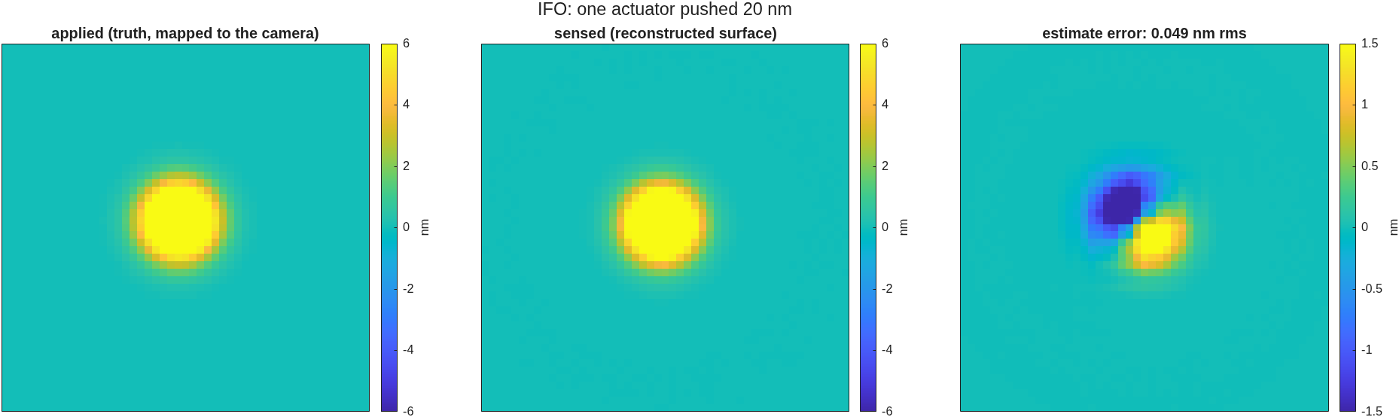
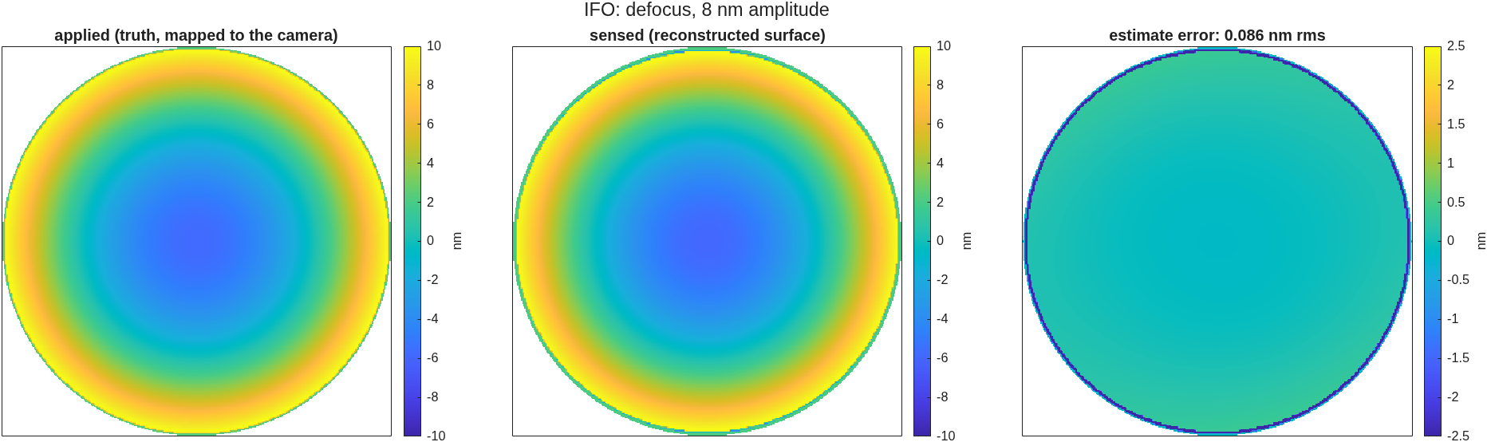
Wavefront estimates through the gauge
One actuator pushed 20 nm recovers at gain 0.98 with 0.05 nm rms error; an 8 nm defocus at 1.02 with 0.09 nm — applied, sensed, and the estimate error
One actuator pushed 20 nm: sensed matches applied; the error is a 0.05 nm rms sub-actuator dipole (residual registration, not gauge phase).
Defocus at 8 nm amplitude: gain 1.024, error flat at 0.086 nm rms — the interferometer owns low order.
• Reading with the transfer curve in hand: the gauge is essentially perfect from low order through the single-actuator scale; its cost concentrates at the finest patterns (0.50 gain at the full 96×96 checkerboard). The same two cases measured on the Zernike sensor (its own deck): poke 0.45 raw — the mask spot selects the band; a sampling sweep refuted the camera as the cause, and kernel calibration recovers 0.90 — defocus 0.99.
Truth mapped to the camera by traced rays; measurement sign −1 and patterns on the illuminated 38 mm radius (the source fills 74% of the aperture — a display-frame lesson recorded in the campaign README). Record: tg96_wf_figs.m.

Slide 16
The differential measurement: how well is a change measured?
A 10 nm actuator deviation reads to 0.021 nm — the same about a 30 nm working surface as about a flat
• The real job of this instrument is measuring deviations — how the surface differs from where it was — not any one surface in isolation. So the closing test measures a base state, applies a known deviation, measures again, and scores the difference of the two measurements against the truth.
base state | deviation applied | fitted gain | residual | correlation
flat | one actuator, 10 nm | 0.965 | 0.021 nm rms | 0.991
flat | random pattern, 10 nm rms | 0.920 | 3.67 nm rms | 0.926
working surface, 30 nm rms | one actuator, 10 nm | 0.977 | 0.024 nm rms | 0.989
working surface, 30 nm rms | random pattern, 10 nm rms | 0.921 | 3.68 nm rms | 0.926
• The common systematic cancels, as designed: the single-actuator rows agree to 0.003 nm across bases — the gauge measures a change the same way about a working surface as about a flat.
• What remains is the response curve, not a hidden coupling: the random-pattern rows (all spatial frequencies at once) read 37% low identically about both bases. The differential error is the instrument response of the previous slide — which calibrates — not a coupling to the working state.
• This benchmark has since been run head-to-head against a Zernike wavefront sensor on the same DM truth, in actuator currency — the next three slides.
Each row: measure the base, apply the deviation, measure again, difference the two measurements, fit one gain against the true deviation; the residual is what is left. Record: tg96_report.txt, differential section.

Slide 17
The head-to-head, in actuator currency
A 10 nm change on a 30 nm working surface reads to 46 pm through the interferometer and 5 pm through the sensor calibrated on that surface; only the interferometer never folds
• Scoring moved to actuator space (the ruling): fit the DM's influence model to the measurement through the ray-traced registration, score recovered actuator commands — one currency for any sensor. Both instruments carry calibrated estimators: a measured (ZWFS) or exact (IFO) response kernel, Tikhonov lattice deconvolution, and a measured modal transfer correction.
single 10 nm actuator change, on a 30 nm working surface | gain | floor
interferometer, four-step differential | 0.92 | 46 pm
Zernike sensor, exact reading with iterated reference and base prior (one frame; calibrated on the flat) | 0.93 | 34 pm
Zernike sensor, phase-stepped retrieval (four frames; response matrix measured on the working surface) | 0.99 | 5 pm
Zernike sensor, linear reading (one frame; response matrix measured on the working surface) | 1.05 | 23 pm
• The break scale separates them: growing the working surface 30 → 480 nm rms costs the interferometer ~5% of gain and 44 → 55 pm of floor — it does not fold. The Zernike sensor's one-frame exact reading holds to 40 nm rms on 1 mm actuators (50 nm on 2 mm) and the four-frame retrieval to 50–60 nm, measured on 47 sites at once; beyond ~120 nm its recoveries alias.
• Verdict as measured, not assumed: the working-state axis belongs to the interferometer; the Zernike sensor, with its response matrix measured on the working surface (64 sparse-grid states, 256 frames once), reads small changes there at a floor ten times below the interferometer's — the calibration a real DM needs anyway, and the same measurement the interferometer's own calibration should adopt.
96×96 rig, both instruments in actuator space through one scoring library (dm_gauge_lib); sensor numbers on the corrected sensor model at its compliant sampling (385 rays across, 2048 grid; its deck), corrected for the measured modal transfer. Records: tg96_s4_report.txt, zwfs_dm96/runs/m2048_lat. Sensor rows: 385 rays; the matrix calibration = every actuator's response measured once from sparse multiplexed grids (the sensor's piston null carried as a rank-one term). The interferometer's S3/S4 fit still uses a single-site response pattern (with a 0.14 mm stencil bias found 2026-09-10); both are to be re-run with the measured matrix in its reflective build.

Slide 18
The Zernike sensor as we model it
Explicit choices, so a different modeling of the same sensor is discoverable in one conversation
• Geometry: the gauge's own test arm, reference arm removed — same source, lenses and DM; the phase dimple sits at the internal focus of the detector leg, and the camera sees the re-imaged pupil. One frame per measurement.
• The mask is a complex transmission applied to the propagated field at focus — not a phase screen on rays: 346.2 nm etch in fused silica (π/2 at 632.8 nm, the VSG2 hardware value), gray-edge supersampled disk, diameter 2.0 λ/D as used (a 3.0 λ/D spot only deepens the sensor's own low-order dip below 2 cycles per aperture; 1.06 λ/D is the hardware default); the mask is fixed glass, so its phase and λ/D diameter scale with wavelength — the multi-color slide.
• Propagation to and from the focus is physical optics — two reference spheres bracketing the mask with one shared radius, so the unmasked round trip is the identity (an asymmetric pair defocused the pupil image by 4.9 m in the first six stages; corrected, checked every run). Sampling asserted: ≥6 pixels across the dimple, ≥2 camera pixels per actuator — the two pull opposite ways in the ray count, so the compliant configuration uses a 2048 grid.
• Three reconstructions, used per their measured strengths: a frozen-reference linear reading (calibrated against model-measured E₀ and E_b on the flat DM); the exact per-pixel inversion with the reference wave re-propagated through the mask model, its branch resolved once per working surface by a phase-stepped retrieval; and the multi-depth phase-stepped retrieval itself (π/2, π, 3π/2 + clear). Worth comparing notes on: for a phase-only dimple |c|² = −2 Re c, so depth stepping yields two observables per pixel, not three — |E_b|² needs a one-time calibration.
• Calibration is noiseless in the model (long-exposure assumption), and scoring is actuator-space through the same estimator code as the interferometer.
Phase 2 in plan: a polarizing metasurface producing two phase images (vector Zernike sensor) once the scalar system is agreed. If Fang's group models the sensor differently — mask representation, propagation, reference handling, reconstruction — this slide is the diff list.

Slide 19
Pricing the 1 pm ambition: photons are not the blocker
The interferometer reaches 1 pm at 10¹⁵ photons per measurement, the Zernike sensor's readings at 10¹⁴ — both trivial, so systematics decide
• Method: the optical fields do not depend on noise, so noiseless frames are captured once per measurement (one DM shape measured once) and photon shot noise is Monte-Carloed numerically; the photon budget per measurement is split across each reading's frames (interferometer 4, linear 1, stepped 4) — equal light and equal time across modalities.
reading | noise on the 10 nm change | photons per measurement for 1 pm
interferometer four-step | 2.8×10⁷/√N pm | 8×10¹⁴
Zernike linear (one frame) | 7.3×10⁶/√N pm | 5.4×10¹³
Zernike exact, iterated reference + base prior (one frame) | 9.4×10⁶/√N pm | 8.8×10¹³
Zernike phase-stepped (four frames) | 1.0×10⁷/√N pm | 1.0×10¹⁴
• The noise follows 1/√N over eight decades, and each instrument's high-photon floor converges to its measured systematic floor — the noiseless campaign and the noise model agree where they must.
• 10¹⁵ photons at 633 nm is ~0.3 mJ — trivial for a bench source. The 1 pm budget is therefore a systematics and gain-stability budget (gain jitter measured at the 0.1% class), not a photon budget. The sensor's tenfold photon advantage over the interferometer is real but does not decide anything at these levels.
Scenario: the head-to-head row (single 10 nm change on the 30 nm working surface, 96×96). Detector read noise, drift and calibration noise are the natural next terms once a use case fixes them. Records: tg96_s5noise_report.txt; zwfs_dm96/runs/rec193full (corrected sensor model).

Slide 20
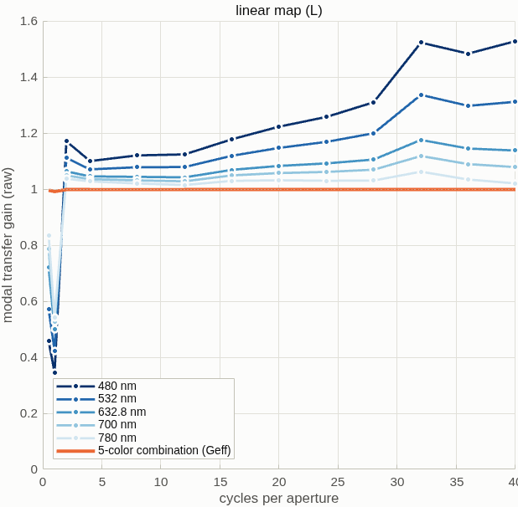
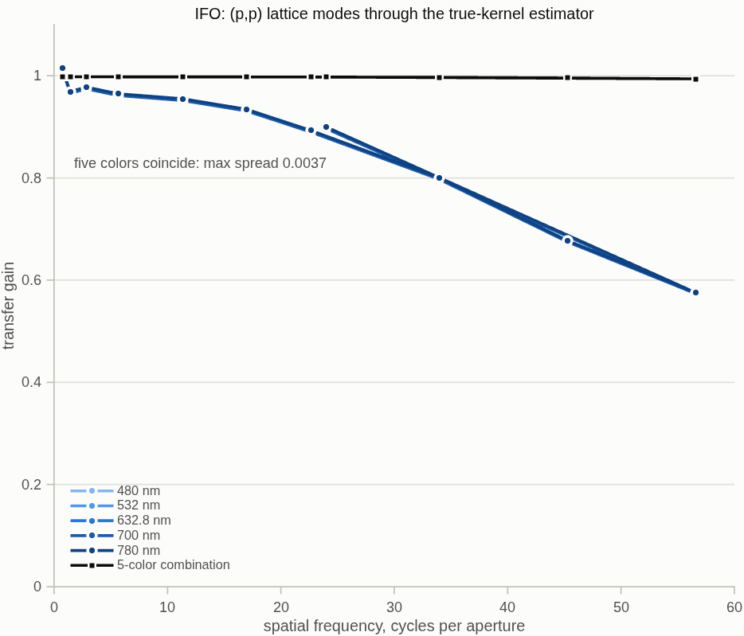
Color is a lever for neither instrument
On the corrected sensor model five colors lift the sensor's transfer by 3% and its rows not at all; every interferometer number holds to three digits
Zernike sensor, linear reading, corrected model: five colors share one smooth transfer with only the dimple's own low-order dip; the five-color combination (orange) sits at 0.99–1.
Interferometer: the five colors coincide (spread 0.004 in gain) — the roll-off is not diffraction.
• Sensor: the blind band that first seemed to migrate with wavelength was the defocused sensor model's Talbot null. On the corrected model the five single-color transfers bottom at 0.92–0.97 after the Wiener step and their combination at 0.991; on the 30 nm working surface the one-frame exact reading's SNR is 269 at 632.8 nm, 183 combined, 255 for the best pair (700 + 780 nm). What stays chromatic is range: the reddest color is the best single color (smaller phase per nanometer, a 1.6 λ/D dimple).
• Interferometer: 92 pm hold-out, 4.17 nm dense random, SNR 210 at every color and after combination. A diffraction roll-off would have moved 1.6× across this band; it moved under 0.3%: the loss is geometric (the null-tuned detector leg's conjugate and 0.14 mm of warp), so the joint leg optimization is the lever, not the source.
One physical mask (346.2 nm etch, dispersion-corrected index), every calibration redone per color; achromatic quarter-wave plates and dispersionless lenses assumed; noiseless — K colors cost K× the frames. Records: zwfs_dm96/runs/rec193full (corrected sensor model), tg96_s6color_report.txt (96×96).

Slide 21
What this offers a bench program
An instrument-error sandbox where truth is exact and every systematic prints
• Catch the invisible class before hardware does: the plate rig's 11.7% scale error moved contrast 0.17% — found on first closure in the model, because the model has the truth panel a bench lacks.
• Price hardware choices in instrument terms: the three-option table is the pattern — splitter angle, cube against plate, waveplate tolerances, coating terminations, analyzer options (rotating or pixelated) all price the same way.
• Rehearse calibration protocols: the low-order and actuator-scale calibrations are scripts; a planned bench protocol can run against the model first, with injected errors of chosen size.
• What the model does not yet carry: source noise, detector noise, vibration and drift — the idealized gauge is the systematic-error floor, not a bench prediction. Adding measured-class realism is the natural next step, sized to a use case.
All records, checks and figures are committed and re-runnable; the full demonstration runs in under a minute of compute.

Slide 22
Backup

Slide 23
Provenance and records
Every number re-derives from a committed script
• v1 rig, finding and fix: templates/90_polarization/tg_psi_dm — example_tg_psi_dm.m (5 gates + closure), demo_tg_psi.m, README with the topology trade; tg_aoi_ladder.m = the option-3 angle ladder (this deck).
• v2 cube: templates/90_polarization/tg_psi_dm_v2 — pbs_macneille.m + thinfilm_rt.m (textbook thin-film reference, general incident medium), example, demo_tg_psi_v2.m (8 beats), tg_widen.m (actuator-scale calibration).
• 96×96 realization: templates/40_benches/tg_psi_dm96 — tg96.m (clearance solve, sampling budget, build, battery, response curve, differential test), tg96_tail.m (detector-leg re-optimization: null 9.11 → 0.134 nm, found at reduced resolution, verified at full), tg96_report.txt (all numbers on the 96×96 slides), plus the preserved registration failure series (six reports).
• Regression: tTgPol (9 checks) + tTgPol2 (9 checks) in the fast suite; the polarizing option's off-state is bit-identical to the plain Twyman–Green.
• Traps recorded so they are not re-derived: a circular state is analyzer-invariant in power (single-arm tripwires pass vacuously on the aligned rig); the four-step protocol's 4θ term is real at the detector (8.9×10⁻⁴ of the fringe) and cancels in the differential protocol (1.7×10⁻¹⁴ nm); diffraction-array row/column parity is calibrated on one actuator and verified on a second, never hard-coded.
• Option-3 open items: joint detector-leg optimization (null + pupil-image sharpness + distortion together — the current leg tuned for null alone gave up finest-pattern gain 0.84 → 0.50; the multi-color run shows that loss is geometric, so the leg, not the source, is the lever), response-curve-corrected scoring of the differential residuals, decomposition of the sub-1% shallow-angle residuals (rig geometry against polarization), and a real splitter-coating design at shallow incidence.
• Head-to-head campaign records (both instruments, one scoring library): templates/40_benches/dm_gauge_lib (registration / actuator fit / modal correction / both measurement factories; the two S3 batteries re-run identically through it as the equivalence gate) + tg_psi_dm96 stage reports S2–S6 and, for the sensor, the parameterized runner's runs (zwfs_dm96/runs: rec193, ng385, ng385s3, m2048, rec193full) on the corrected sensor model. Campaign READMEs carry the findings ledgers, including the corrected attributions (pattern-radius frame bias; the refuted sampling-starvation hypothesis; the defocused mask bracket behind every S1–S6 sensor number).
• Planned configurations on the same DM truth and battery: an all-reflective variant (off-axis paraboloids replace the lenses — removes the transmitted-glass and homogeneity cost rows entirely) and the phase-2 vector Zernike sensor (polarizing metasurface, two phase images).

