Slide 1
The four dW rungs on one segment: rigid body, figure, prescription, grid
jwst_ote_designc.in (the zoom_5x5 fixture), model 512, 63-ray grid, stop at the FSM (element 25), wavefront read at the ExitPupil Return (27); 5 zoom states x 5 field points = 25 blocks, 54 595 rows; segment 7 shown in every rung
DRAFT 2026-09-10. Every figure is a file run_sensitivities wrote, unmodified: templates/50_sensitivities/zoom_5x5/<name>_opdall.png, <name>_svspec_configs.png, <name>_<ch>_channels.png and the per-element pages in <name>_pages/. Display conventions are the plotters': colormap jet, autoscaled per panel, piston removed, exact zeros not drawn. Harvest conventions: orient=raw, sign=opl, opd_ref=mean (the defaults; the report header names them). Units: BaseUnits mm of OPD per unit parameter.

Slide 2
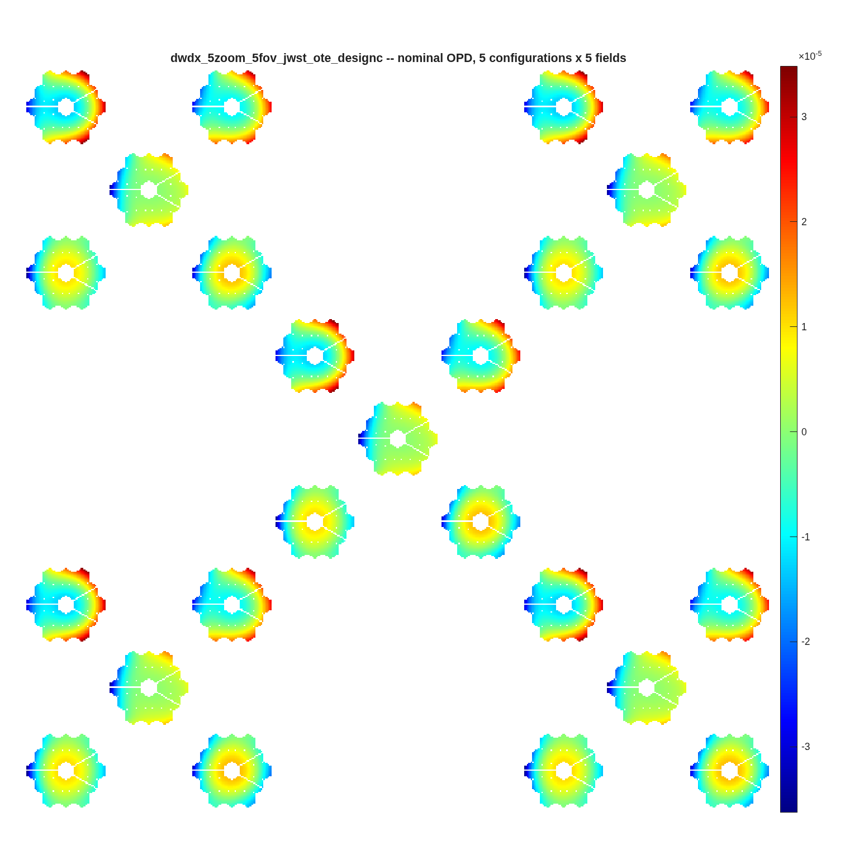
Every column is a difference of two of these maps
the nominal wavefront at all 25 (zoom state, field) blocks -- the canvas each Jacobian column is scattered onto
• One harvest, four rungs: the same field set, the same stop, the same exit-pupil reset -- only the perturbed quantity changes
• 54 595 rows: every valid ray of all 25 blocks (2 183-2 184 per block; ray loss differs slightly between them). All four rungs share these rows
• Per-field exit-pupil reset: reset_xp re-finds the pupil per block, so the gross field tilt is out and the tiles show residual aberration
• Configuration axis: element 25 (a flat FSM at a pupil) points to the four corners of a 0.5 arcmin square; blocks stack as ROWS
dwdx_5zoom_5fov_jwst_ote_designc_opdall.png. The 25-block harvest takes 175-378 s per rung on this box (gfortran mex).
The canvas is a quincunx of quincunxes: each of the 5 zoom states holds its own 5-field canvas, so position on the page means (zoom state, field point). 9 x 9 tiles of 63-ray maps.

Slide 3
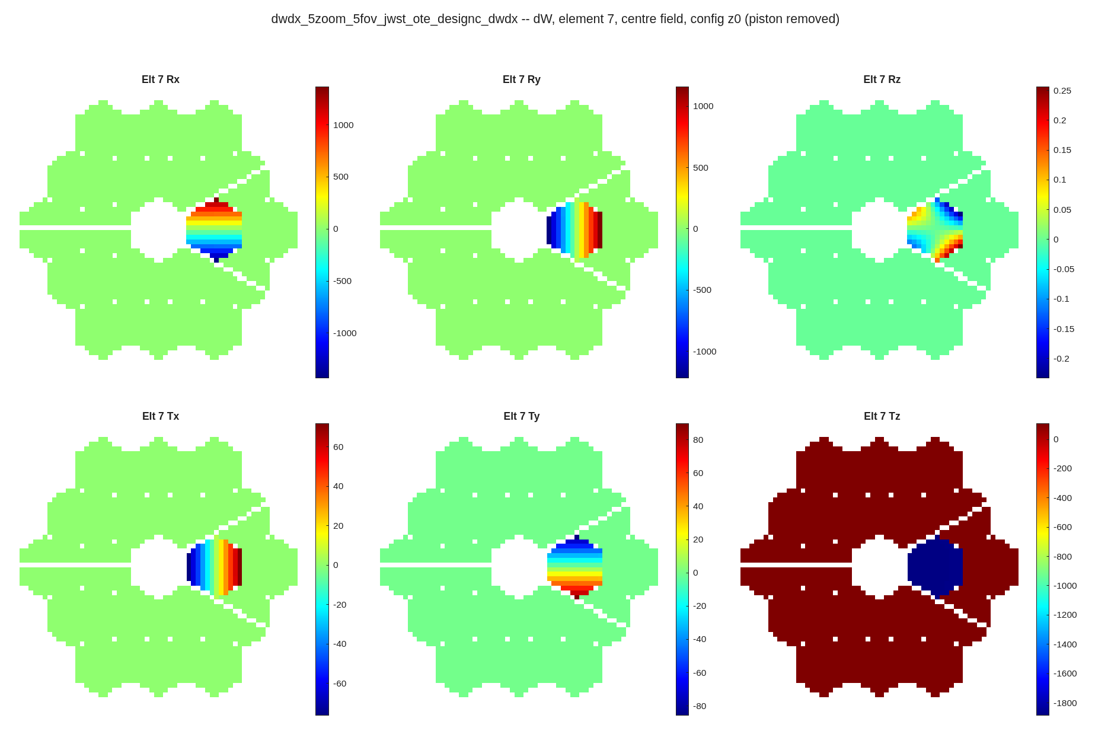
Rigid body: clocking a segment barely moves the wavefront
dW/dx, 138 channels over 22 optics + the PM group, rank 129; Rz is four decades below Rx/Ry, same units
Segment 7's six columns at the centre field. Rx/Ry tilt the segment; Tz pistons it -- and the whole pupil turns dark red because poking one segment moves the aperture-mean OPD reference every other ray is measured against.
<name>_pages/<name>_dwdx_elt7_center.png. Segment 7 column norms (rms, per unit DOF): Rx 1.56e+02, Ry 1.59e+02, Rz 2.09e-02, Tx 9.91e+00, Ty 9.78e+00, Tz 4.54e+02. Rz is four decades below Rx/Ry -- clocking a circular-footprint segment barely moves the wavefront. 22 optics x 6 DOFs + the PM group's 6 = 138 harvested; 132 are saved, because element 4 (the virtual centre segment, column norms 1e-16) is dropped number-free by flag_zero_norm_channels.

Slide 4
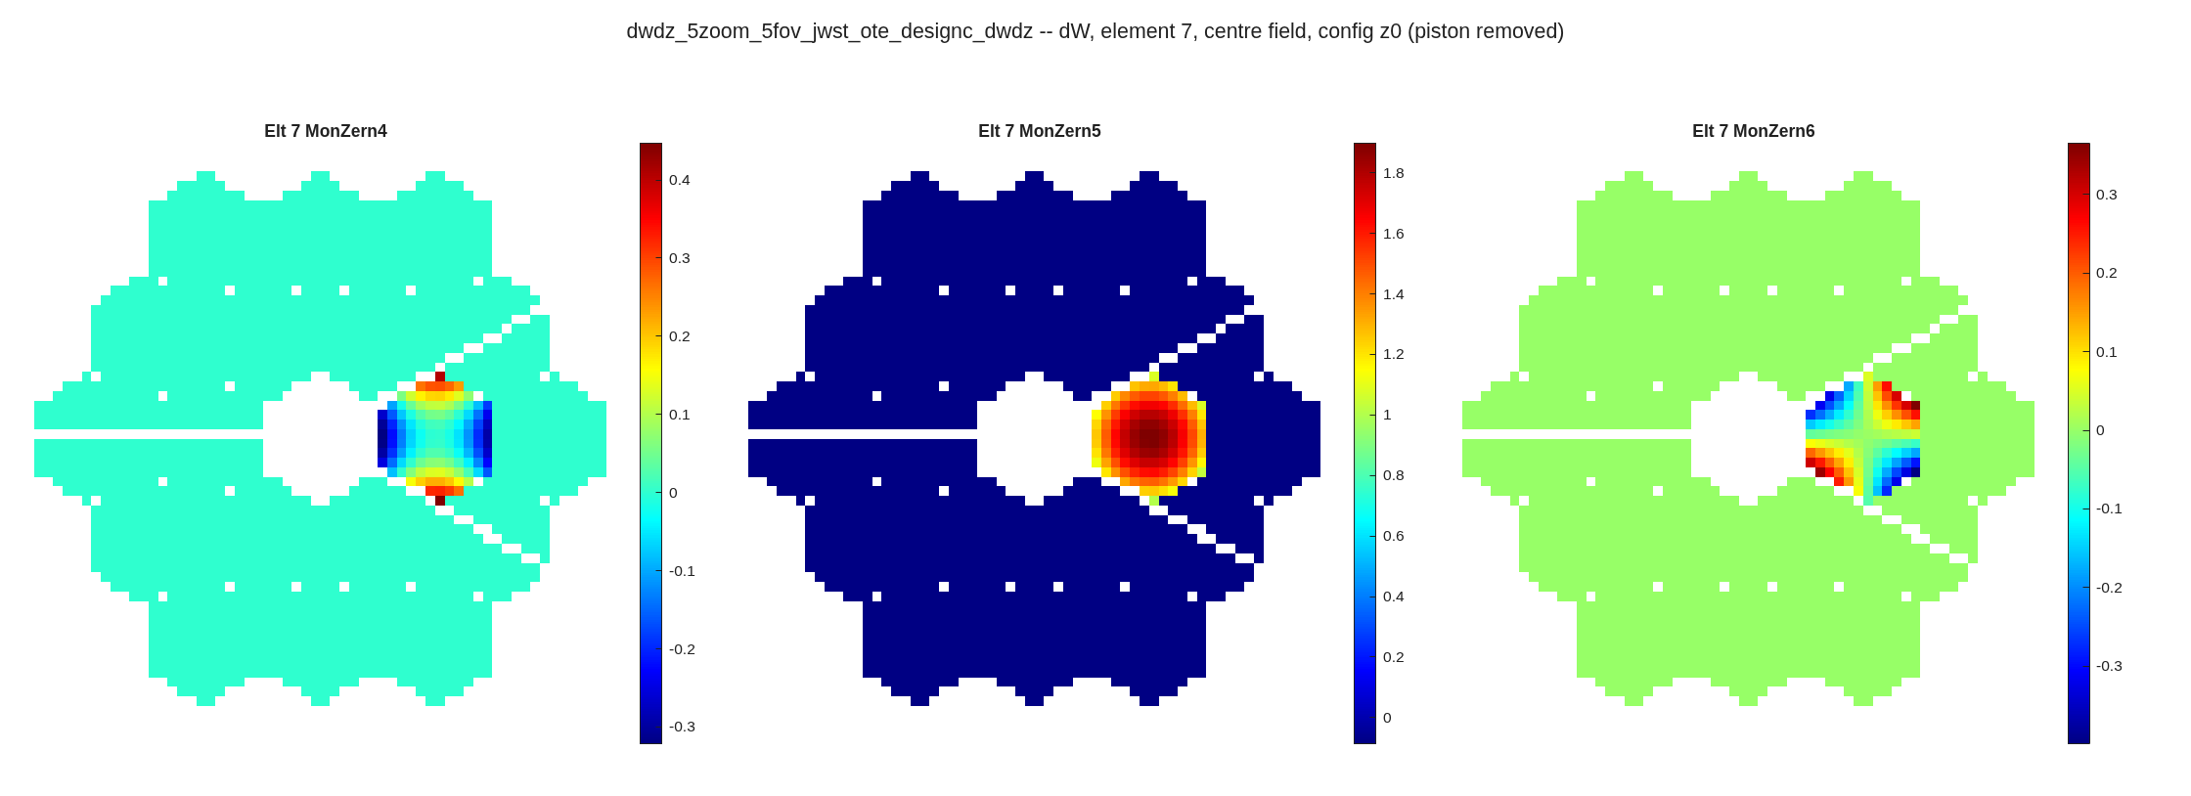
Figure: only a non-zero-mean mode moves the reference
dW/dz, 60 channels (20 optics x 3 modes), rank 60, cond+ 33; three modes of segment 7's own basis
Modes 4 and 6 are the two astigmatism orientations and leave the rest of the pupil at zero; mode 5 is a single-sign defocus blob and paints the whole pupil dark. A mode with a non-zero mean over its footprint moves the aperture-mean OPD reference every other ray is measured against.
<name>_pages/<name>_dwdz_elt7_center.png. Full 54 595 x 60, rank 60, cond+ 3.32e+01; segment-only 54 595 x 45, cond+ 1.06e+01. The rung harvests every lMon-bearing optic, so the SM and TM appear beside the 18 segments. The whole-pupil colour is the opd_ref=mean default; under opd_ref='chief' those pixels read exactly 0 (Luis round 4, 2026-09-09).

Slide 5
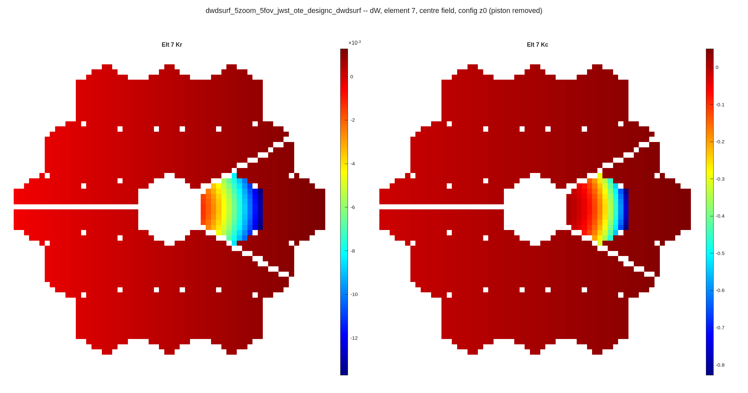
Prescription: Kr and Kc are gradients, not focus blobs
dW/dsurf, 42 channels (21 powered optics x Kr, Kc), rank 40, cond+ 6.5e+05
Kr and Kc for segment 7: a one-sided gradient across the footprint, not a centred blob, because the segment sits off the parent axis. Both have a non-zero footprint mean, so both paint the rest of the pupil.
<name>_pages/<name>_dwdsurf_elt7_center.png. Peak 1.4e-02 mm per mm of radius and 8.5e-01 mm per unit conic -- different units, so the panels are autoscaled independently and the two are not comparable by eye. Full 54 595 x 42, rank 40: two channels are dead (element 4, the virtual centre segment). Segments count as powered since the 2026-09-05 eligibility ruling; before it this rung harvested the SM and TM alone (4 channels).

Slide 6
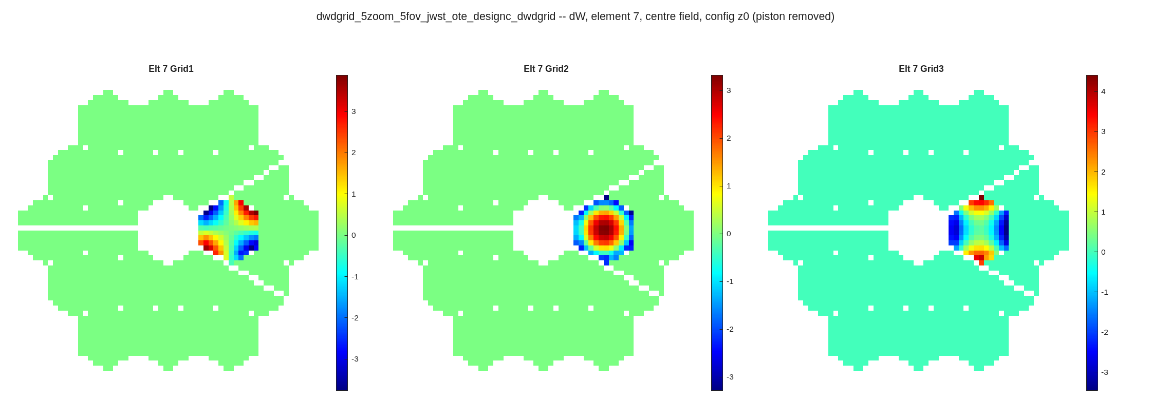
Grid influence: the best-conditioned rung
dW/dgrid, 60 channels on the segment's own clocked grid, rank 60, cond+ 5.7
The three influence modes poked on the segment's CLOCKED Mon-frame grid. Grid2 is defocus-like yet leaves the rest of the pupil at zero -- the basis is Gram-Schmidt orthogonalized with piston out, so no grid mode moves the reference. Contrast the dW/dz defocus page.
<name>_pages/<name>_dwdgrid_elt7_center.png. Full 54 595 x 60, rank 60, cond+ 5.72e+00 -- best of the four. Basis: macos.segment_grid_basis, Zernike modes 4-6 over each segment's true (irregular) footprint, orthogonalize true. The Rx is grid-augmented first (macos.design.grid_augment_rx), which REPLACES the stale parent-frame grid lines SegMirMaker replicates into segment blocks; poking those instead paints a central dot and collapses the rank.

Slide 7
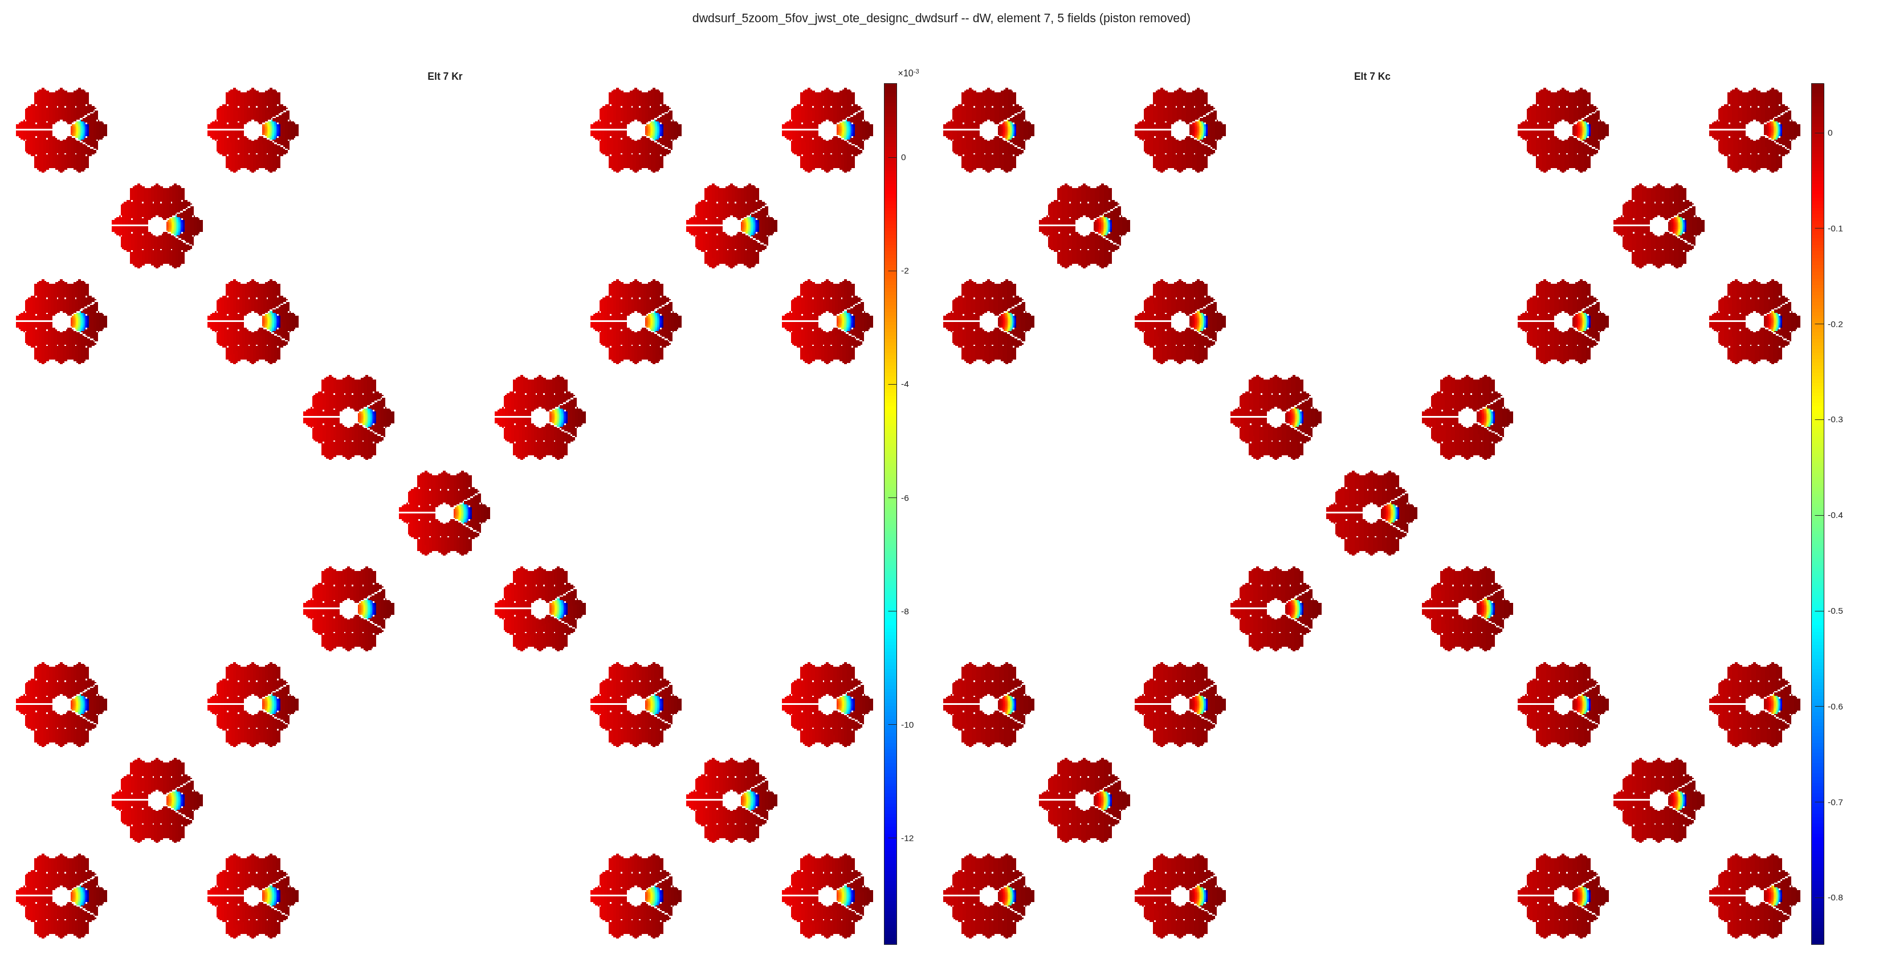
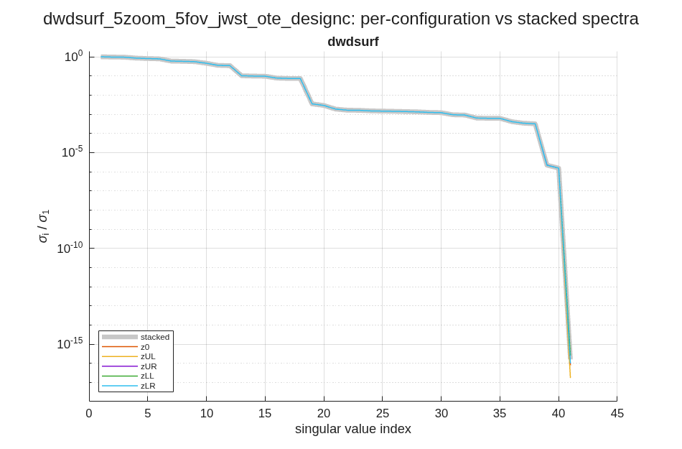
Every column carries the (zoom, field) axis
the multi-field page shows one channel across all 25 blocks; the spectra show what the configuration axis adds
The same rung's per-configuration singular-value spectra against the stacked one (thick grey). The five zoom states separate only in the small-sigma tail -- that tail is the rank the configuration axis buys.
Segment 7's Kr and Kc on the full canvas: the response repeats at every zoom state and field, modulated by the field. This is the same column as the centre-field page, un-collapsed.
<name>_pages/<name>_dwdsurf_elt7_multi.png and dwdsurf_..._svspec_configs.png (both the dW/dsurf rung). A flat mirror at a pupil tilts the wavefront to first order and the per-field pupil reset removes it, so the configuration's effect on the Jacobian is the SECOND-order residual: 5.3e-06 relative against 1.9e-04 with the pupil frozen (measured on the dW/dx rung; run_dwdx_5zoom_5fov.m's header carries the definition of the statistic).

Slide 8
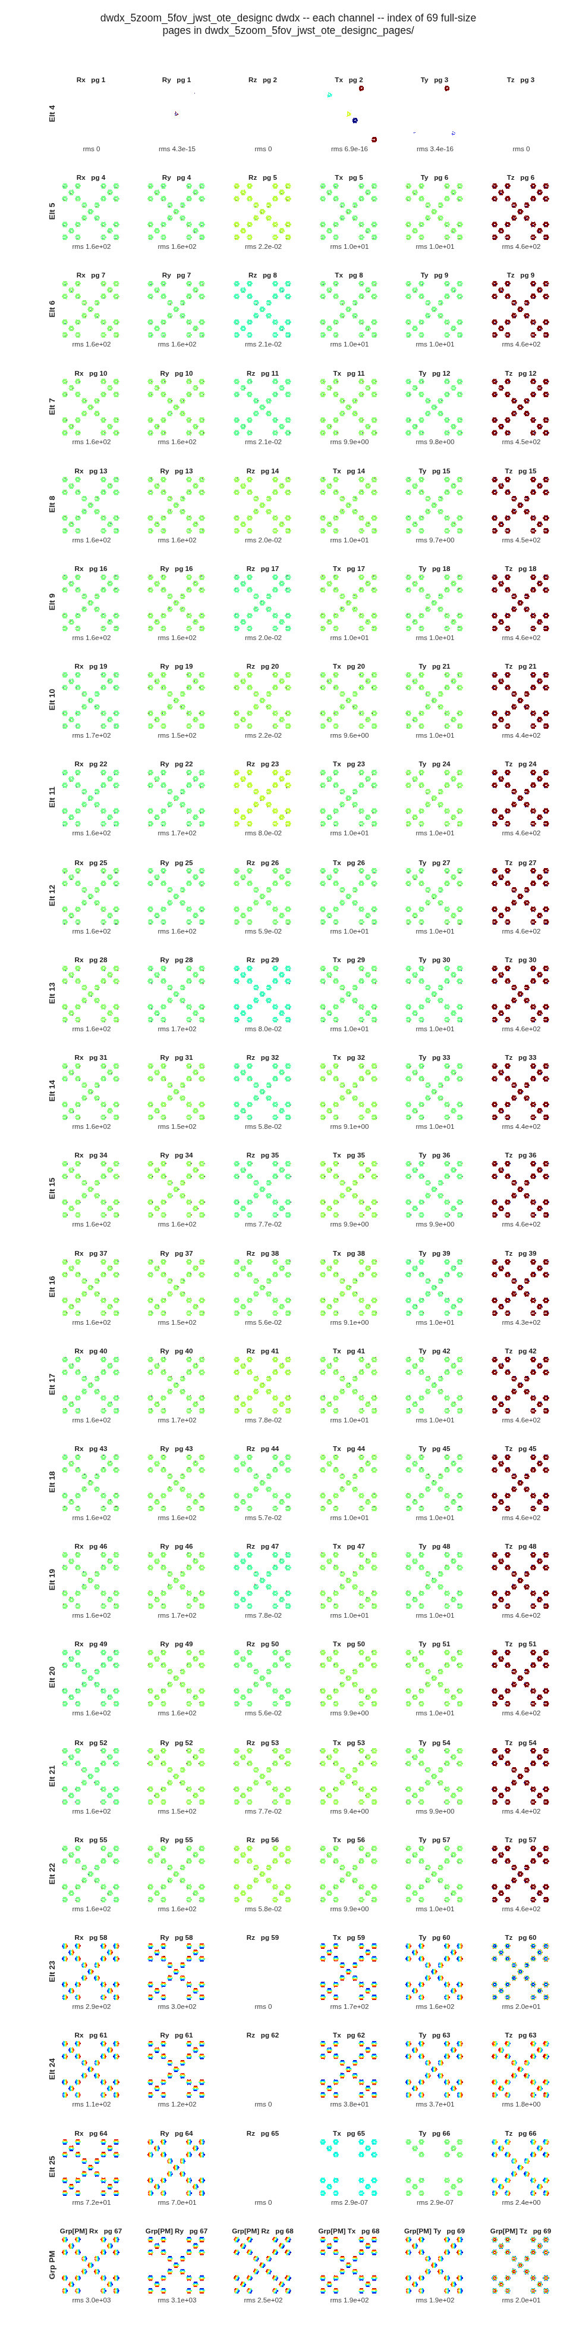
Reading a 275-page harvest
the contact sheet indexes every channel to its page; the text index names the channels on each
rung | channels | rank | cond+ | pages | runtime s
dW/dx | 138 | 129 | 2.0e+10 | 92 | 378
dW/dz | 60 | 60 | 3.3e+01 | 60 | 190
dW/dsurf | 42 | 40 | 6.5e+05 | 63 | 192
dW/dgrid | 60 | 60 | 5.7e+00 | 60 | 175
THE E4 ROW IS ROUND-OFF, AND THE SHEET NOW SAYS SO. Element 4 is the virtual centre segment; its six columns are dead -- Rx, Rz, Tz are EXACTLY zero over all 54 595 rows (nothing drawn, rms 0) and Ry, Tx, Ty carry max 1.06e-14 / 8.47e-16 / 8.47e-16 mm on 612 / 8 641 / 2 491 rows, taking 3-4 distinct values each: the finite-difference floor of a re-trace, 17 decades below element 5 (column max 1.405e+03, rms 1.614e+02). Autoscaled thumbnails with no colorbar painted those few pixels across the full jet range, which reads as structure; the per-panel rms is the scale the colours were missing (rms 4.3e-15 against rms 1.6e+02 one row down). Panel rms is of the map AS DRAWN -- valid pixels, piston removed -- so it differs from the column rms over all rows. flag_zero_norm_channels catches the column and the driver drops it from the saved .mat; the figures are drawn before that drop.
Panels are drawn at a floor of 3.5 in per OPD map / 1.2 in per field tile and the pages follow, so a 19-segment harvest is 275 readable pages (17 MB) instead of one sheet of specks. <name>_<ch>_channels.png is that contact sheet; <name>_pages_index.txt lists every page with its element and channels; the full-size pages are in <name>_pages/ (gitignored -- regenerate with the four run_dwd*_5zoom_5fov.m drivers).
The dW/dx contact sheet: 23 rows (one per element, group, source) x 6 DOFs. Each row is named once on the left, each thumbnail carries its channel and page ("Rx pg 4") and its own rms underneath -- so a dead channel announces itself instead of being painted at full colour scale.

