Slide 1
A VSWIR Dyson Imaging Spectrometer, Designed From the Spec
An EMIT-class push-broom spectrometer (F/1.8, 3000 × 500 pixels at 18 µm, 380–2500 nm) designed with MACOS from the public specification alone, scored on smile, keystone and the response functions, and checked by physical-optics propagation.
D. C. Redding, with Claude Code.
October 2026. Working record; no proprietary prescription is used.
DRAFT — in progress. Every number is from a committed, parameterized runner (mmacos, dyson5_run); records and figures are the runner's own output. Design of record: the compact variant (step R4): keystone 0.0026 px, smile 0.005 px, CRF 1.33 px, 76 % of the energy in one pixel, at a 220 mm block.

Slide 2
Contents
The target, the forms, the design ladder, the evidence
• 3 The target and how it is scored
• 4 The Dyson as traced by the engine
• 5 The Offner as traced by the engine
• 6 The concentric Dyson and its scaling law
• 7 The exact chain and the engine agree
• 8 The seed, scored
• 9 The departure ladder
• 10 The departure ladder, by the numbers
• 11 What each departure buys
• 12 The compact variant, as traced by the engine
• 13 The compact variant in section
• 14 The compact variant, scored
• 15 The trade at a glance
• 16 The propagation twin
• 17 Slit diffraction loss
• 18 Next steps
• 19 Run it yourself
• 20 Backup

Slide 3
The target and how it is scored
Joe's specification, EMIT-class; the metrics stated once, here
item | value
F-number (air-equivalent, image space) | 1.8
focal plane | 3000 spatial × 500 spectral pixels, 18 µm
slit | 54 mm; spectral height 9 mm
band | 380–2500 nm, 4.24 nm per pixel
smile, keystone | < 0.1 pixel
SRF FWHM | < 1.5–2.0 pixels
CRF FWHM | < 1.5 pixels
radiometric chain | throughput, grating efficiency, QE, slit loss vs wavelength
• Smile: centroid drift along the slit at fixed wavelength; keystone: drift across wavelength at fixed slit position; both in pixels from ray centroids.
• SRF, CRF: slit ⊗ line-spread function ⊗ pixel ⊗ Airy, FWHM in pixels (Mouroulis & Green 2018 definitions); the Airy diameter at 2500 nm is 11 µm, under the 18 µm pixel, so the incoherent chain is valid.
• Design rules adopted from the literature: distortion to ~1 % of a pixel at design, > 75 % of the energy in one pixel, degraded spots accepted for uniformity, the grating is the stop.
• Realism (Jim): as-built SRF is 2.5–3 pixels, slits are 2 pixels wide, the systems are photon-limited; smile and keystone drive the design.
The 54 mm slit is 2.3× EMIT's; Table 3 of the review places this spec in the ALIS class (3200 spatial pixels, 380–2500 nm). Public comparison point: Carbon-I (arXiv:2505.22545), F/2.2, 2040–2380 nm.

Slide 4
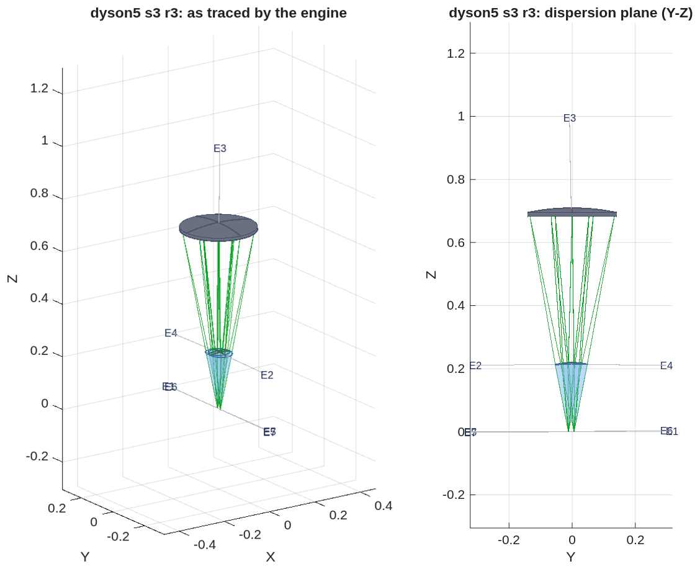
The Dyson as traced by the engine
Step R3 of the ladder, before apertures: the beams clear every body, but the grating is 270 mm wide on a 0.70 m radius and the slit sits 18 mm from the band
• The prescription: challenges/dyson5/dyson5_s3_r3.in, seven elements; the block's spherical face (E2), the grating (E3, radius 0.71 m at the Dyson condition for a 220 mm block), and the focal plane on the flat face. Bodies, rays and labels are read back from the engine.
• Sizes from the traced footprints: block face 85 mm across at the sphere (220 mm radius, 217 mm thick), grating 270 mm across (0.70 m radius) at 0.69 m from the face; slit at +6 mm, this wavelength lands at −12 mm on the same face.
• No element declares an aperture yet, so the block draws as the beam's hull and nothing can vignette; apertures, a clearance check and the slit-to-detector package split are the next revision of this layout.
Left: the traced bundle and the solid bodies in 3-D. Right: the dispersion plane (Y-Z). Positions in metres, global frame.

Slide 5
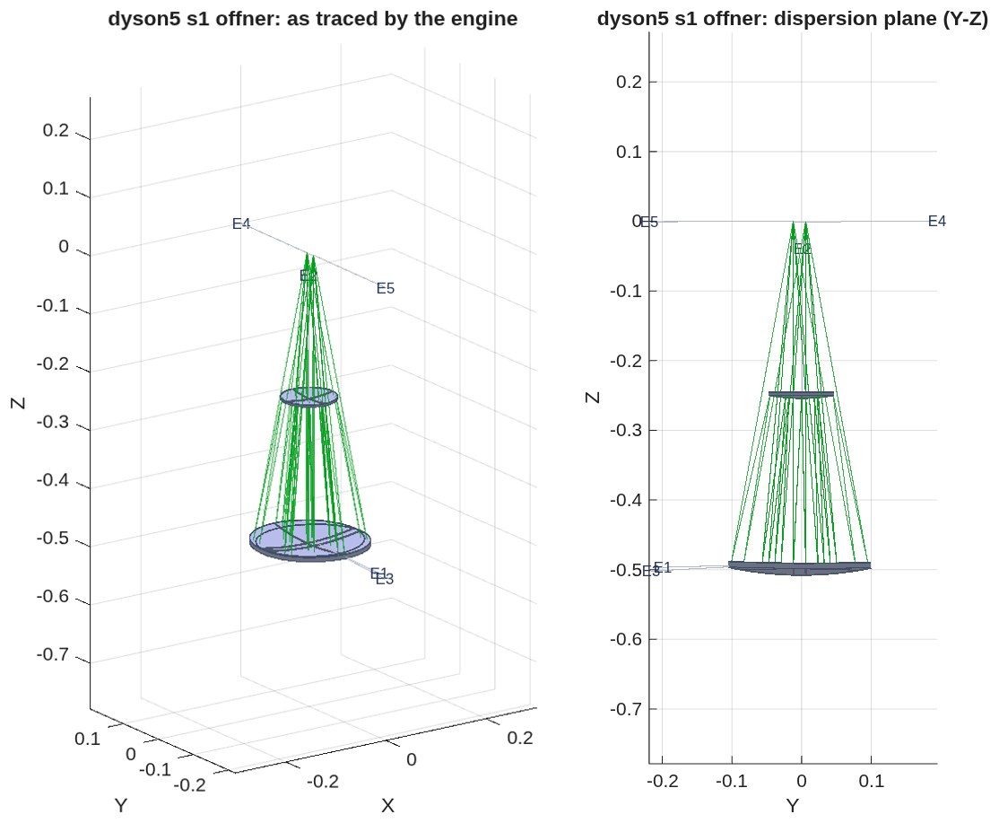
The Offner as traced by the engine
The all-reflective twin at F/2.8, before apertures: the grating sits inside the slit-to-mirror beam, so the slit must move out to about 0.2 R
• The prescription: challenges/dyson5/dyson5_s1_offner.in, five elements; the concave mirror (E1, used twice), the convex grating (E2) at the stop, the focal plane at the slit's conjugate.
• Obstruction, measured from the ray history: the slit-to-M1 beam crosses the grating's plane over y = −39 to +51 mm while the grating's footprint spans ±45 mm; the return beam crosses it over −58 to +33 mm. With no apertures declared the trace cannot see this; the slit offset of 6 mm must become about 100 mm (0.2 R, the classical Offner geometry) and the layout re-scored.
• Why it stays in the deck: it is where the physical-optics twin is validated (order 0: pupil OPD 8e-11 m, 94 % of the energy in one pixel) and the trade's reference form.
Left: the traced bundle and the solid bodies in 3-D. Right: the dispersion plane (Y-Z). Positions in metres, global frame.

Slide 6
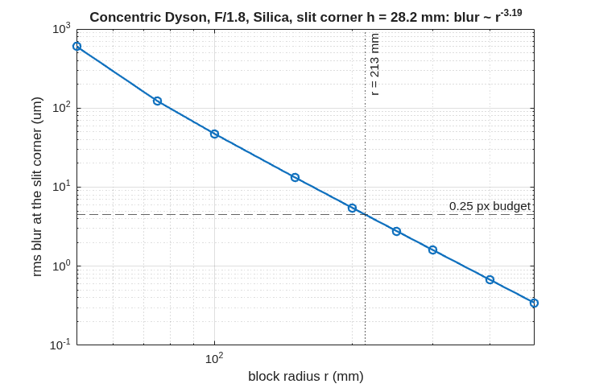
The concentric Dyson and its scaling law
The classical condition verified by exact trace; at this slit the concentric block needs r ≥ 213 mm
• The Dyson condition R_g = n·r / (n − 1) is the blur minimum by exact 3-D trace: 0.67 µm at the condition against 4–5 µm at ±5 %, image at −h, residual fifth order (h⁴·¹⁷, r⁻³·¹⁹).
• The scaling answer, before any element was added: a single concentric block meets a quarter-pixel corner blur only at r ≥ 213 mm, about twice flight scale, which is why the flight forms add an asphere, a meniscus or an air gap.
Rms blur at the slit corner (h = 28.2 mm) of a concentric silica Dyson at F/1.8 versus block radius, exact trace at order 0: blur ∝ r⁻³·¹⁹; the quarter-pixel budget is met at r = 213 mm (grating radius 687 mm).

Slide 7
The exact chain and the engine agree
Every engine ray re-traced by the chain from the engine's own launch directions lands within 1e-9 m
• The check: the engine's chief ray and every ray of its grid are re-traced through the chain's surfaces from the engine's launch directions; agreement is per ray, every surface, 1e-9 m; the dispersed band spans the focal plane to 1 %.
• With the aspheric block face (ladder step R2): agreement 1e-12 m per ray; a sphere-only chain misses by 0.26 mm, so the check is not vacuous.
• The physical-optics twin: a far-field terminal on a reference sphere upstream of the focal plane, re-posed per slit position and wavelength; on the Offner at order 0 the pupil OPD is 8e-11 m and the Airy spot puts 94 % of its energy in one 18 µm pixel.
• What the checks found in the engine, now fixed (details in Backup): glass names were ignored at load; propagation inside glass used the vacuum wavelength; the grating groove period was held constant along the curved surface instead of along the chord; the grating's path-length jump had the matching defect. Each has a regression test written from the physics, not from the engine.
Regression tests: tSpectrometerRx (3), tGratingOpl (2), tGratingImmersed (4), tGlassDispersion (3), tPropMedium (3); mmacos fast suite 501 pass, 0 fail (2026-10-01).

Slide 8
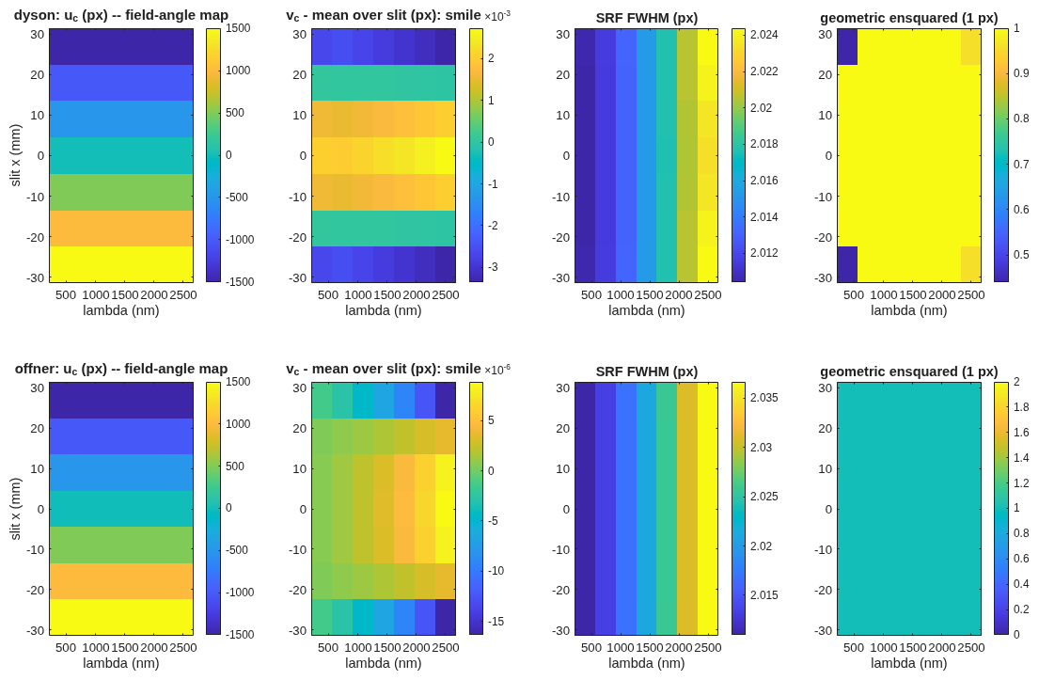
The seed, scored
The concentric seed at a 220 mm block meets smile; keystone and the corner blur are the work
• Smile is met at the seed (below 0.01 pixel on both forms); the field-angle map is linear along the slit as designed.
• SRF sits at 2.02 pixels on both forms, the floor set by the 2-pixel slit; re-scored on the engine after the grating fixes (the earlier ramp with wavelength was the groove-period defect, not the design).
Scorer maps for the two seeds at 220 mm (rows: Dyson, Offner): field-angle map, smile (pixels), SRF FWHM (pixels), ensquared energy in one pixel, versus slit position and wavelength.

Slide 9
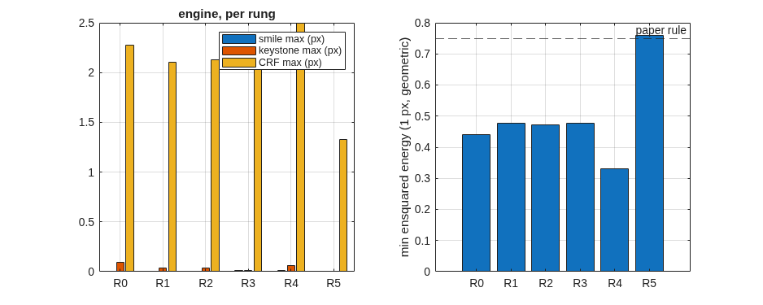
The departure ladder
Each step solved on the exact chain with pixel-unit smile and keystone in the merit from the first pass, then emitted and scored in the engine
Engine-scored maxima per ladder step at the seed's 220 mm block (left: smile, keystone, CRF FWHM in pixels; right: minimum ensquared energy in one pixel against the 0.75 design rule).

Slide 10
The departure ladder, by the numbers
Keystone falls 37-fold at fixed scale; the meniscus pays only with the block offset and grating radius moving with it
step | what moves | keystone (px) | smile (px) | CRF FWHM (px) | ensquared, 1 px | length (mm) | grating footprint (mm) | glass (L)
R0 | concentric seed | 0.095 | 0.006 | 2.28 | 0.44 | 708 | 275 | 22.2
R1 | grating-radius factor, face offset | 0.038 | 0.003 | 2.10 | 0.48 | 704 | 274 | 22.3
R2 | + conic and h⁴, h⁶ terms on the block face | 0.037 | 0.004 | 2.13 | 0.47 | 704 | 274 | 22.3
R3 | + block centre off the grating's, along the dispersion | 0.011 | 0.008 | 2.10 | 0.48 | 698 | 272 | 22.1
R4a | meniscus corrector alone | 0.063 | 0.012 | 2.49 | 0.33 | 698 | 270 | 22.3
R4 | meniscus with all variables (the compact variant) | 0.0026 | 0.005 | 1.33 | 0.76 | 694 | 269 | 22.7
size alone | block radius free (341 mm) | 0.024 | 0.001 | 1.34 | 0.74 | 1099 | 427 | 82.8
SRF FWHM is 2.02–2.05 px on every step: the 2-pixel-slit floor. Length = slit plane to grating vertex; footprint = diameter of the grating hits over slit centre and ends × band edges; glass = block cap + meniscus. Record dyson5_s3_trade.txt.

Slide 11
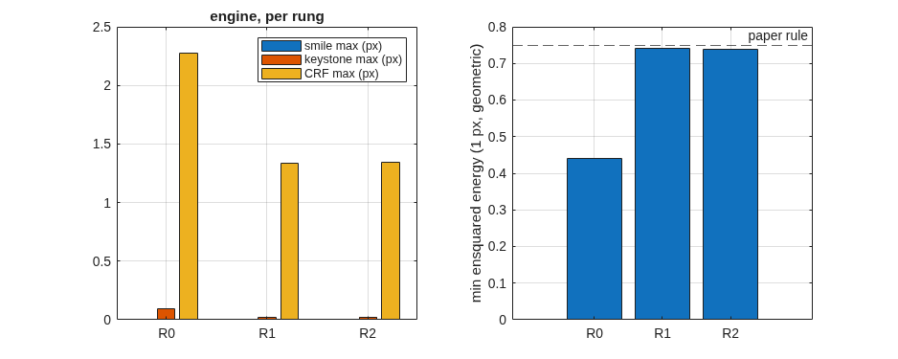
What each departure buys
De-concentring the block solves the distortion; the face asphere is inert; the blur is bought only by size or by the compact form
• Keystone: 0.095 → 0.011 pixels at fixed scale, nine times inside the 0.1-pixel specification and at the literature's 1 % design rule; smile stays below 0.01 pixel throughout.
• The block-face asphere does nothing here: step R2 converges to 10 nm sags, and a one-dimensional scan about R1 is a steep bowl centred at zero. An axisymmetric figure acts on every field point alike and cannot cancel a residual that grows as h⁴ along the slit.
• The blur does not move on any step, and the reason is on record: the dispersed image sits 12 mm from the order-0 image, so the slit corner's effective field height is about 32 mm, and the h⁴/r³ law predicts the measured 0.4 px rms.
• Two routes buy it: size alone (0.74 ensquared at a 341 mm block, 1.1 m long, 83 L of glass) or the compact variant: a meniscus corrector in the air gap, solved together with the block offset and the grating radius, reaches the same at the 220 mm block — 63 % of the length, 27 % of the glass.
The free-radius ladder: ensquared energy reaches the 0.75 rule only as the block grows to 341 mm.

Slide 12
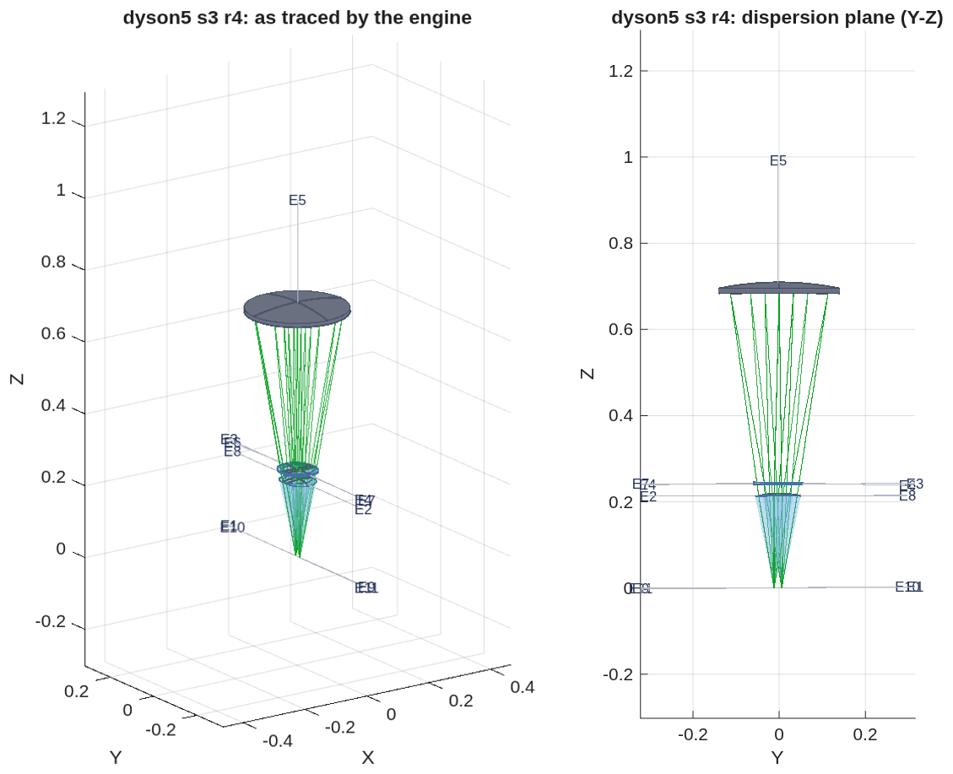
The compact variant, as traced by the engine
Step R4: the meniscus corrector in the air gap between the block and the grating; the design of record at a 220 mm block
• The prescription: challenges/dyson5/dyson5_s3_r4.in, nine elements: the block's flat face, its spherical face, the meniscus (two surfaces), the grating, and the return through the meniscus and block to the focal plane.
• Bodies, rays and labels read back from the engine; apertures are not yet declared (the block draws as the beam's hull), which the clearance pass adds next.
Left: the traced bundle and the solid bodies in 3-D. Right: the dispersion plane (Y-Z). Positions in metres, global frame.

Slide 13
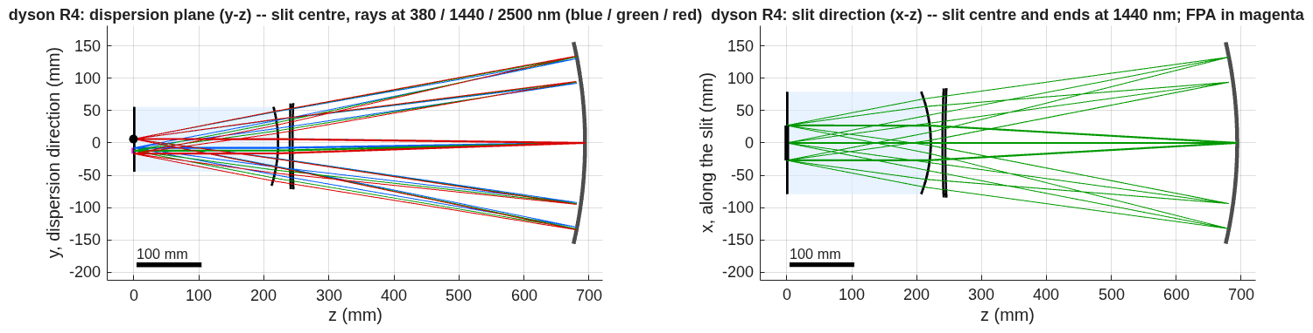
The compact variant in section
Dispersion plane and slit direction, to scale: block, meniscus, grating; slit and focal plane on the block's face
Left: the dispersion plane, slit centre, rays at 380 / 1440 / 2500 nm (blue / green / red). Right: the slit direction, slit centre and ends at 1440 nm; the focal plane in magenta. Block shaded; 100 mm scale bar.
• Sizes: block radius 220 mm (217 mm thick, 85 mm face), meniscus 4 mm thick at radii near 2 m, grating 269 mm across on a 0.69 m radius; slit plane to grating vertex 694 mm.
• The solve ends on its bounds (plate thickness and radii), and three solves from the same seed found a multimodal landscape; the global search over the meniscus is the next step.

Slide 14
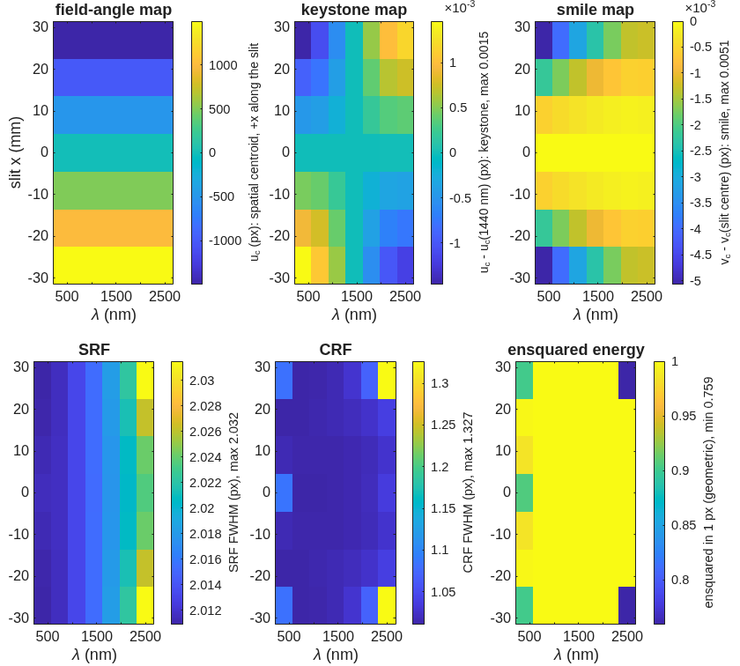
The compact variant, scored
Keystone 0.0026 px, smile 0.005 px, CRF 1.33 px, SRF 2.03 px, 76 % of the energy in one pixel, over the slit and the band
Engine-scored maps for R4 on 18 µm pixels, per slit position and wavelength: field-angle map, keystone, smile, SRF FWHM, CRF FWHM, ensquared energy; each convention on its colorbar, maxima in the labels.

Slide 15
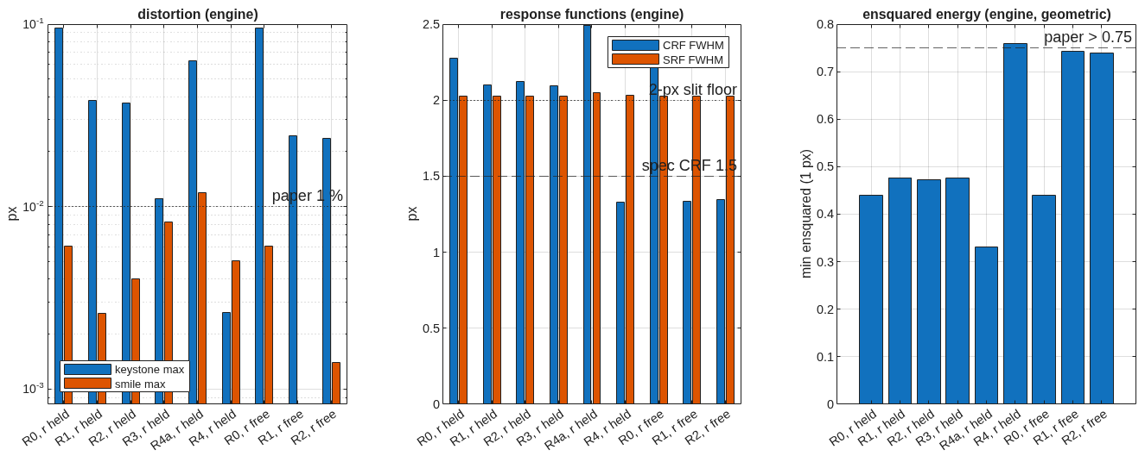
The trade at a glance
Distortion, response functions and ensquared energy per step, both records; the specification and the literature rules as lines
Left: keystone and smile maxima (log scale) against the 1 % rule. Middle: CRF and SRF FWHM against the 1.5 px specification and the 2-px-slit floor. Right: minimum ensquared energy in one pixel against the 0.75 rule.

Slide 16
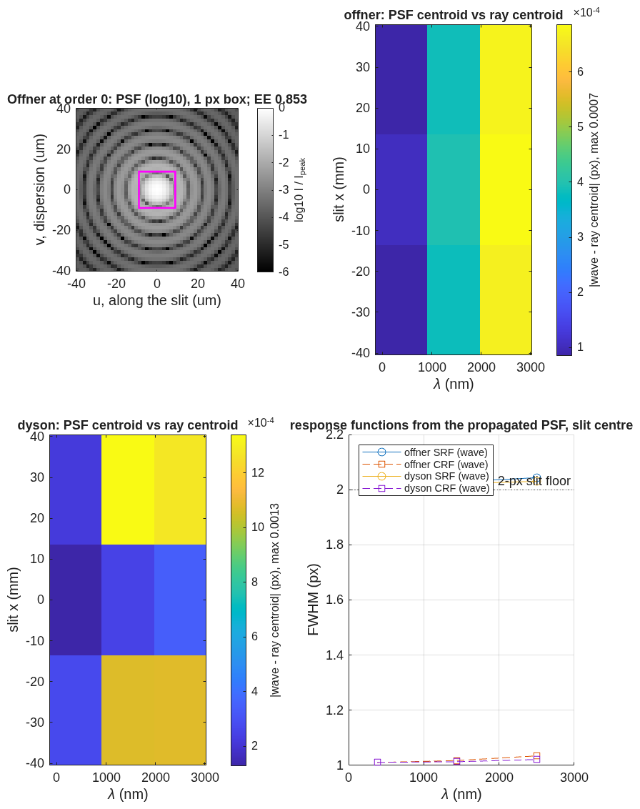
The propagation twin
A far-field terminal on a reference sphere, re-posed per slit position and wavelength, agrees with the ray centroids to 0.0013 px
• What it checks: the ray-side scorer's centroids and response functions against physical-optics propagation through the same decks; across a grating the comparison is made in phase (modulo λ), never as unwrapped lengths.
Left: the Offner at order 0, PSF (log scale) with the 18 µm pixel box, 85 % ensquared. Middle: wave-minus-ray centroid over the slit and band, Offner and Dyson seeds. Right: SRF and CRF from the propagated PSF at the slit centre.

Slide 17
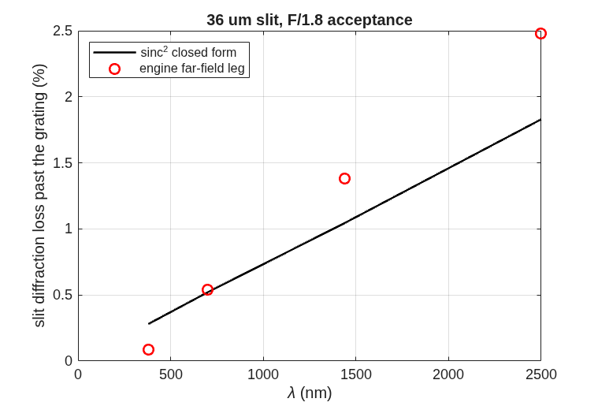
Slit diffraction loss
A 36 µm slit at F/1.8: the engine's far-field leg against the sinc² closed form
Loss past the grating versus wavelength: engine far-field leg (points) against the sinc² form (line).
• Under 2.5 % over the band by both; the engine runs above the closed form at the long end (2.48 % against 1.83 % at 2500 nm) and below it at the short end, and that factor is an open item in the record.

Slide 18
Next steps
Clearance on the design of record, the global meniscus search, and the telescope that feeds the slit
• Apertures and clearance on R4: declare every element's aperture from the footprint hulls, compute the minimum clearance of every beam leg against every body it does not traverse, model the slit-to-detector package on the block's face (a fold prism if it fails), and re-pose the Offner reference at a 0.2 R slit offset.
• Beat 4: a global search over the meniscus (the R4 solve ends on its bounds) and the native multi-wavelength optimizer with the same smile and keystone operands.
• Beat 5, the telescope: EMIT parameters — 420 km, 60 m ground sample, 0.143 mrad IFOV, focal length 126 mm, 70 mm aperture at F/1.8, 24.6° cross-track field onto the 54 mm slit, telecentric and flat; the telescope's exit pupil on the grating. Then spectrometer and telescope traced end to end as one deck.
• Then the physical-optics twin on R4 and the radiometric chain against the band.

Slide 19
Run it yourself
One parameter file, one runner, every stage through it
run('<path>/mmacos/mmacos_setup.m');
addpath('<path>/mmacos/challenges/dyson5');
OUT = dyson5_run(); % stage s0: the scaling law (engine-free)
OUT = dyson5_run(struct('stages', {{'s1','s2','s3'}})); % emit, score, ladder
• Knobs live in dyson5_params.m (F-number, pixel, band, slit, block radius, ladder options); every record in this deck is a stage output under challenges/dyson5/.
• Engine checks: ./run_mmacos_tests.sh tSpectrometerRx and the four grating / glass / propagation classes, all in the fast suite.

Slide 20
Backup
Diagnostics, the engine findings, and the conventions behind the main path.

Slide 21
Backup: four engine findings, each with a regression test
Found by the challenge's checks on 2026-09-30 and 10-01, fixed in the engine the same day
finding | symptom | fix | test
glass names ignored at load | a GlassElt= Silica element traced as air in every binding | the glass catalog is blanked once at allocation, not on every load | tGlassDispersion (3)
vacuum wavelength inside glass | a propagation leg in a medium ran at the wrong Fresnel number by n | every kernel takes λ/n of the leg's medium | tPropMedium (3): z in n ≡ z/n in vacuum
groove period along the surface | 2.8 / 3.3 px rms spectral blur at 2500 nm (Offner / Dyson) | the local grating vector is the un-normalised projection of the ruling direction (chord-ruled) | tGratingImmersed (4), test_grating_chord
grating path-length jump | 4 waves rms of pupil OPD where the rays converged to 0.05 µm | the jump is the groove count from the vertex along the ruling direction | tGratingOpl (2)
Flat gratings are unchanged by the last two. A fifth item, a short AsphCoef= line killing the host process, now pads with zero and warns (tRxShortAsph).

Slide 22
Backup: records and tools behind each slide
Every number traces to a runner stage and its record file
slide | runner stage | record | tool
scaling law | s0 (engine-free) | dyson5_s0_scaling.txt | design/src/dyson_layout.m, dyson_scaling.m
as traced (both forms) | dyson5_view_figs.m | _view3d.png, _viewyz.png | macos.view_rx on the deck
seed scored | s1 emit, s2 score | dyson5_s1.txt, dyson5_s2.txt, dyson5_s2_maps.png | spectrometer_geom.m, spectrometer_rx.m, spectrometer_score.m
chain vs engine | gate | tests/tSpectrometerRx.m | per-ray re-trace, 1e-9 m
propagation twin | s2w (opt-in, model 512) | dyson5_s2w.txt | spectrometer_wave.m
departure ladder, R4, trade | s3, s3free, s3b | dyson5_s3.txt, dyson5_s3free.txt, dyson5_s3_trade.txt, dyson5_s3_layout_r.png, dyson5_s3_maps_r.png | dyson_ladder.m, dyson5_trade.m
slit loss | s2l | dyson5_s2l.txt, dyson5_s2l_slitloss.png | far-field leg vs sinc²
Conventions behind the scaling law: block index n(silica, 1 µm) = 1.450417; in-glass marginal half-angle u = asin(1 / 2nF); field height h from the Dyson axis on the flat face; the slit corner is h = hypot(27 mm, 8 mm).

Slide 23
Backup: conventions pinned on the way
Engine facts the chain depends on, stated once
• ChfRayPos is where rays start and must lie before the first surface; at load the engine folds zSource in once, after which it is the physical source.
• macos.stop aims immediately and its first pass is one step short on this deck (3.6 mrad): declare the stop first, then write the exact chief ray.
• A Return coincident with the focal plane drops the rays; use a Reference upstream.
• An immersed grating carries its glass on its own element: the grating branch takes the exit index from the element as written.
• ray_info_get returns the outgoing direction at the traced element.
• Centre of curvature is the vertex plus |Kr| along psiElt; KrElt is stored as −|R|.
Reference document: optical_design/SPECTROMETER_DESIGN_REFERENCE.md (forms, conditions, metrics, references).

