Slide 1
dw/dsurf on the JWST OTE deck: what each option does to one segment's column
jwst_ote_designc.in (Luis's zoom deck), model 512, 63-ray grid, stop at the FSM (element 25), wavefront read at the ExitPupil Return (27); Seg2 (element 5) poked alone in radius (Kr) and conic (Kc) through run_sensitivities, centre field
DRAFT 2026-09-10. Every figure is the runner's own centre-field page (<name>_pages/*_elt5_center.png), unmodified: colormap jet, autoscaled, piston removed by the page plotter, zeros not drawn. Every option shown is a run_sensitivities option since 2026-09-09 ('orient', 'sign', 'opd_ref', and 'elts' now reach the dwdsurf channel). Numbers: dW/dp per unit parameter, mm of OPD per mm (Kr) / per unit (Kc), centre field, single configuration.

Slide 2
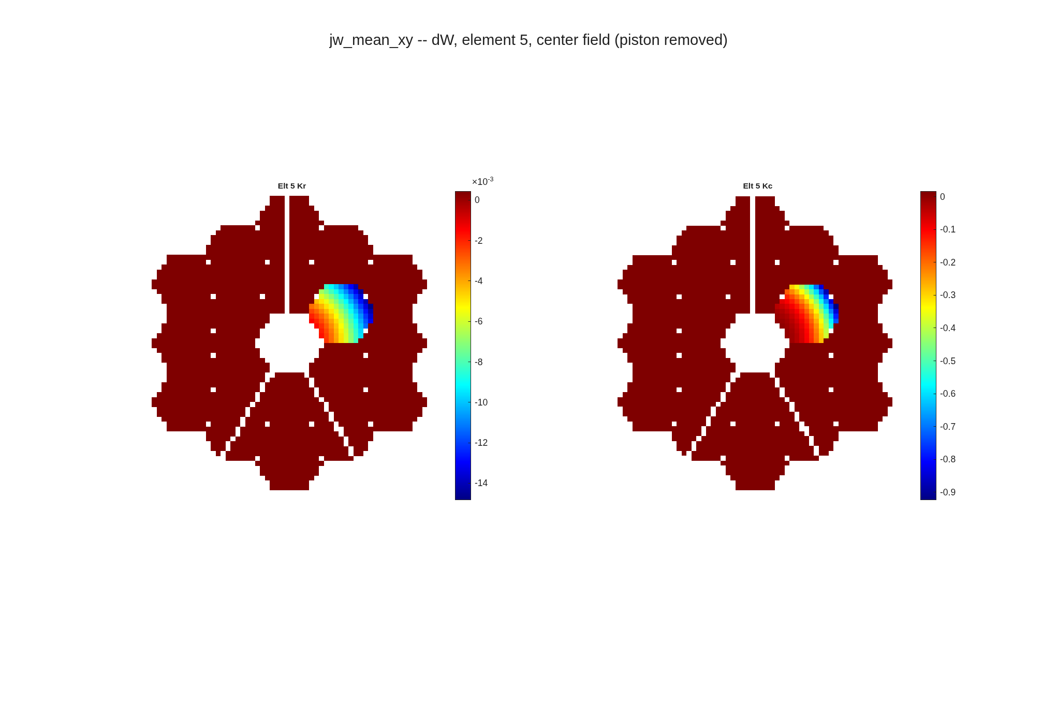
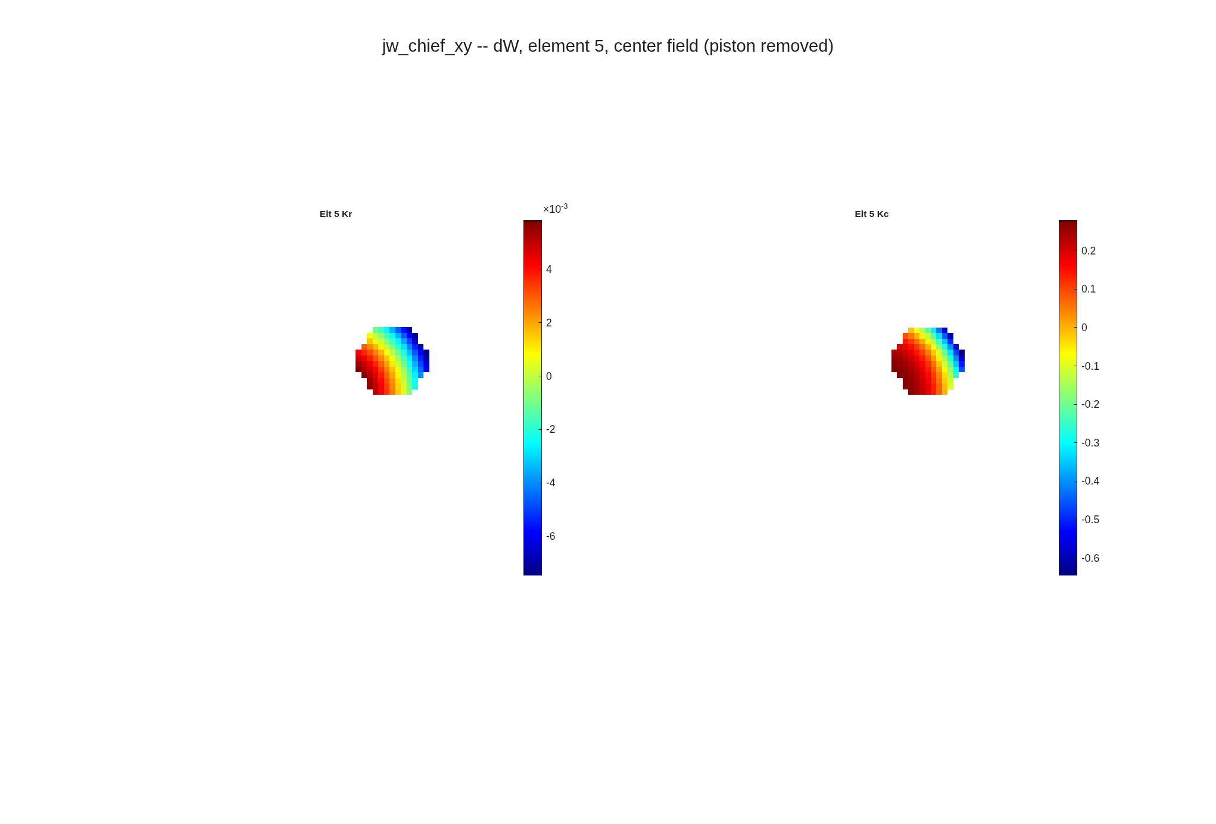
The OPD reference decides what the unpoked segments read
the same correct data under two references: mean paints the other 17 segments one flat colour, chief shows only the poked one
opd_ref = mean: the 17 unpoked segments appear as one flat colour (the piston-removed constant), the poked Seg2 as the hexagon.
opd_ref = chief: the unpoked segments read exactly zero and are not drawn; only Seg2 remains.
run_sensitivities pages (<name>_pages/*_elt5_center.png), orient xy, sign opl, surf_remove_ptt off, piston removed by the page plotter, jet, autoscaled. The two columns differ by one constant everywhere (neither is wrong); under mean the constant the unpoked segments carry is -(N_k/N) x mean(poked response): Kr 4.40e-4, Kc 1.66e-2 per unit parameter (5.4% / 4.5% of the poked segment's rms), equal on all 17 to 6e-16.

Slide 3
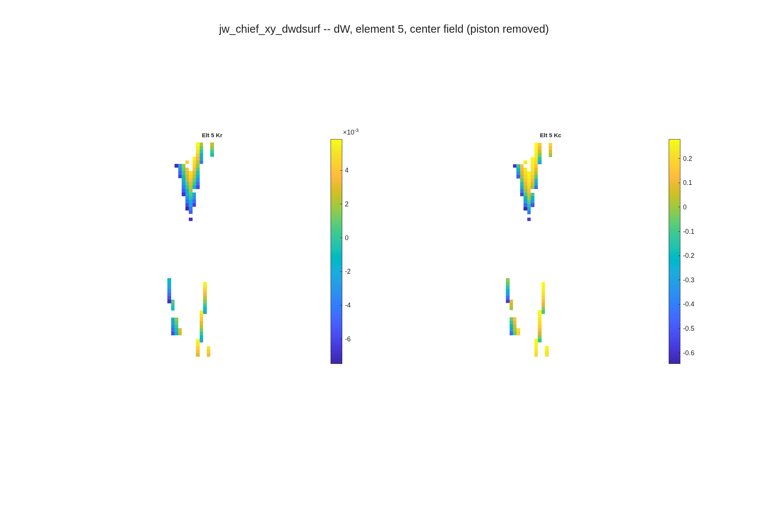
Under orient xy the page itself was scrambled
the same chief-reference page before and after the plotter fix; the raw-orientation page was always clean
Before: the centre-field page rebuilt its pixel index from the transposed nominal map, so the rows landed on the wrong pixels and the hexagon smeared into streaks.
After: the index is built on the raw-orientation map and remapped with the same rule as the harvest; the xy page is the raw page transposed, exactly.
sensitivities/per_field_indx.m; gate tRunSensitivities/test_per_element_page_index_follows_orient_xy (xy page == raw page transposed to 0; the old recipe differs by more than 10% of the map). This is the picture Luis was reading as a residual.

Slide 4
Why: a column is a difference of two referenced maps
poking one segment moves the aperture-mean reference; the chief ray's does not move unless its own segment is poked -- a convention, not an error
Engine OPD
path length minus a reference: whole-aperture mean (default) or the chief ray's own path (macos.opd_ref)
Under mean
the poked segment shifts the mean by (N_k/N) x its mean response; every ray inherits the shift as a piston
Under chief
the reference is one ray; on this deck it passes through the virtual centre segment (element 4), so every REAL segment's poke leaves it alone and the other segments read 0
The one gap
a deck whose chief ray sits on a real segment (e5hex1: the centre one) moves the reference when that segment is poked; the others then read -m(chief), 5% of that segment's rms for Kr. A fixed nominal reference length (engine OPDRefRayLen branch, one api wrapper) localises every column
Gates: tOpdRef/test_driver_single_segment_poke_is_local_under_chief (e5hex1, driver path; fails on the previous code) and tRunSensitivities/test_dwdsurf_channel_honours_elts_orient_and_opd_ref. The default stays 'mean' until the fixed-length reference lands: no committed baseline moves.

Slide 5
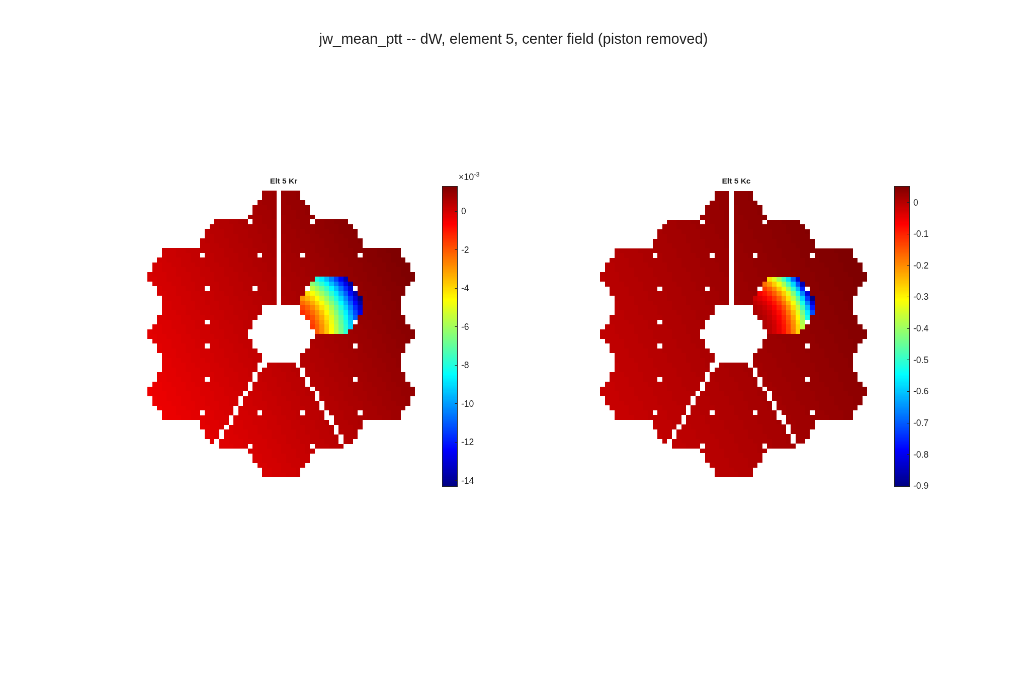

PTT removal is a third convention on the same data
with surf_remove_ptt on, the mean and chief pages become identical and the unpoked segments show a tilt instead of a flat offset
surf_remove_ptt = true, opd_ref = mean: the 17 unpoked segments show a tilt instead of a flat offset.
surf_remove_ptt = true, opd_ref = chief: identical to the mean page, the global piston/tip/tilt fit has absorbed the reference difference.
Runner pages, unmodified. The fit is global, so the poked segment sets it: the unpoked segments' rms is 7.0e-4 (a tilt) against 4.4e-4 (the flat offset under mean), the same under either reference. Pick the convention the consumer expects; none of the three is an error.

Slide 6
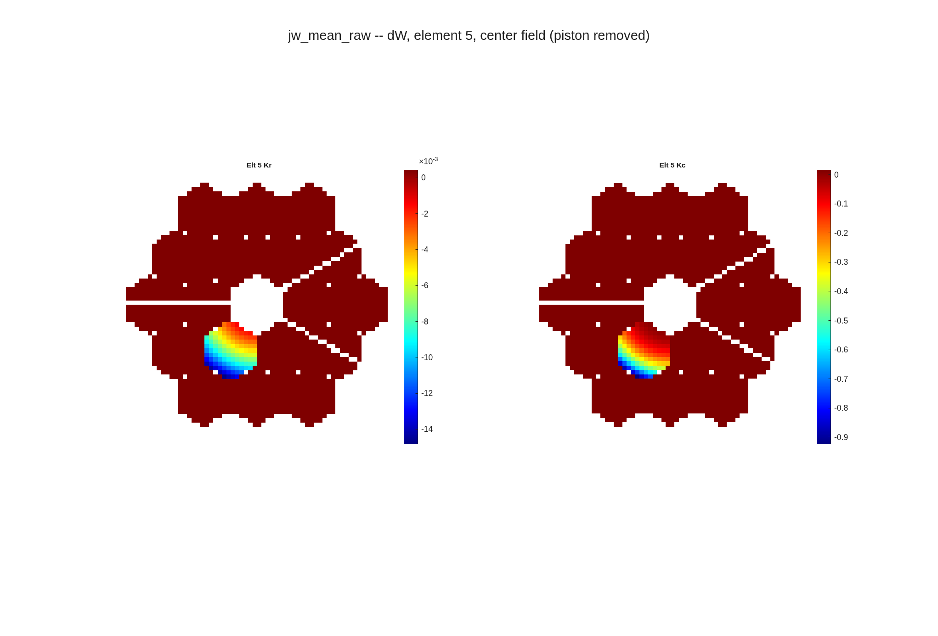
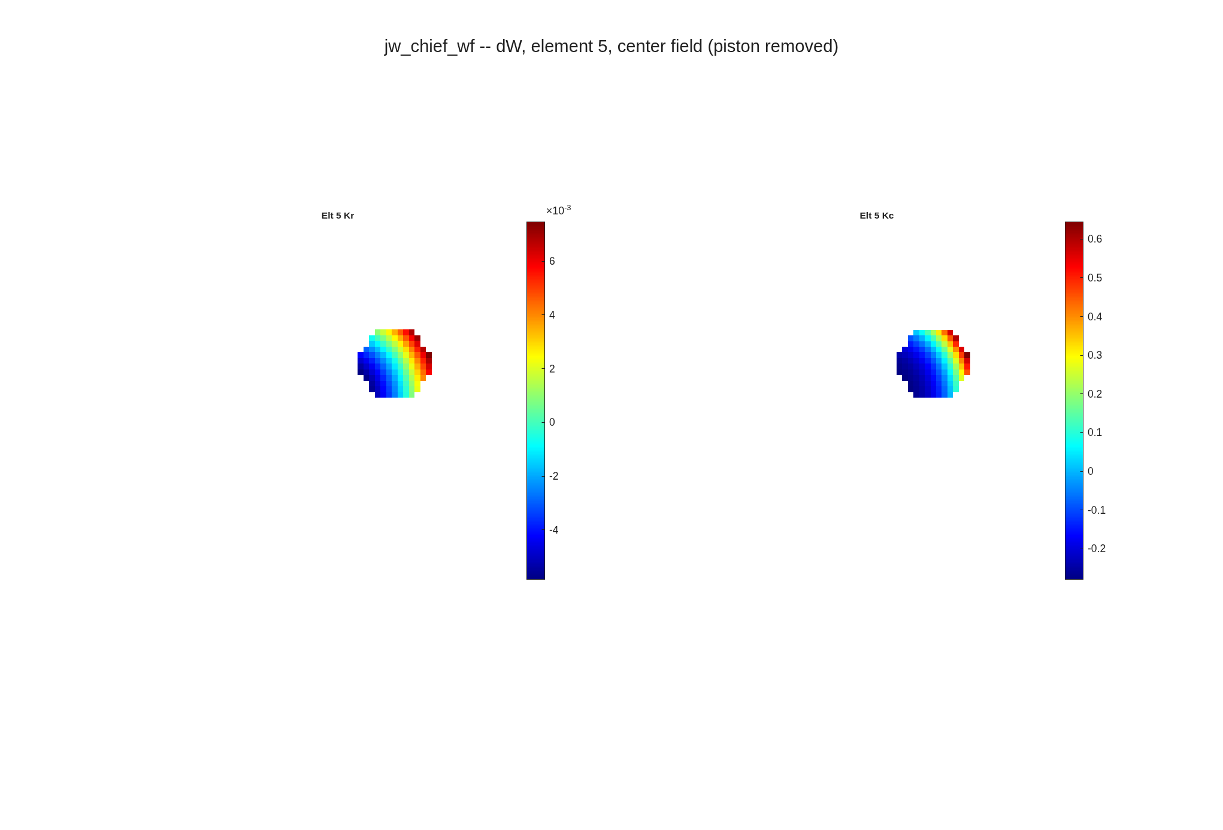
Orientation transposes the array; sign negates it
raw is the engine array (index 1 along global X), xy is its transpose; wavefront is opl negated
orient = raw, opd_ref = mean: the same rays as the xy page, transposed (the spider arms rotate); the unpoked segments carry the same flat offset.
sign = wavefront, opd_ref = chief, orient xy: the poked segment's response negated, nothing else drawn.
Runner pages, unmodified. Orientation anchor: Seg2 sits at (X, Y) = (-1137, +657) mm; in the xy page its footprint is at (+10, -6.5) px from the pupil centre, i.e. columns run along xGrid = -X and rows along yGrid = -Y (the deck's source frame). 'xy' fixes the transpose, not the sign of each axis.

Slide 7
What to run
the options, where they live, and the recommended call on a segmented deck
option | values | now taken by | recommended (segmented)
opd_ref | mean (default), chief | all 8 dw_d* drivers, the core, run_sensitivities | chief, if unpoked segments should read 0
orient | raw (default), xy | same | xy for display
sign | opl (default), wavefront | same | as the consumer needs
elts | [] (all eligible), ids | run_sensitivities -> all four channels (dwdsurf was dropped) | the segments of interest
surf_remove_ptt / remove_ptt | false (default), true | dwdsurf driver + runner | as the consumer expects
run_sensitivities(RX, ..., 'channels', "dwdsurf", 'elts', 5, 'orient', 'xy', 'opd_ref', 'chief'). The reference is re-applied after every Rx reload (a load resets it). Open for Dave: the fixed nominal reference and the default flip (PLAN 0.x).

