Slide 1
MACOS — Optical Modeling, Analysis and Design, with an AI in the Loop
One ray-trace and physical-optics engine, four language surfaces, an AI-driven design layer — with two elements run live
D. C. Redding, with Claude Code.
2 September 2026.
The code is public: github.com/nasa-jpl/macos and github.com/nasa-jpl/MACOS_resources
This document has been reviewed and determined not to contain export-controlled information

Slide 2
Four decades of NASA optical modeling
Technology development to flight: Hubble, JWST, TMT
• Late 1980s: the engine originates in NASA telescope technology development
– Based on a coordinate-free ray-trace theory
– Used for Star Wars control-system development and NASA SubMM telescope analysis.
• 1991: Hubble — prescription recovery correctly diagnosed the aberration from flight imagery
– Prescription retrieval from image data has served other missions as well.
• JWST: integrated observatory modeling and wavefront sensing and control development
– Testbeds validated the models, and the validated models proved the space system.
• TMT, Keck and other space missions: Observatory modeling, including segmented-aperture systems, testbeds, instrument studies.
– Validated against testbed and operational data across those programs.
• We are now modernizing and extending our modeling tools and practices to meet new challenges.
– New elements: Freeforms with aberrations, polarizers, complex masks and apodizers, completely general surfaces added through the API
– The same functionality, streamlined: linear model generation, simulation, multi-path, metrology and edge sensors
– New capabilities: design layer
– Code cleanup: improved robustness, automated testing, updating documentation
This document has been reviewed and determined not to contain export-controlled information

Slide 3
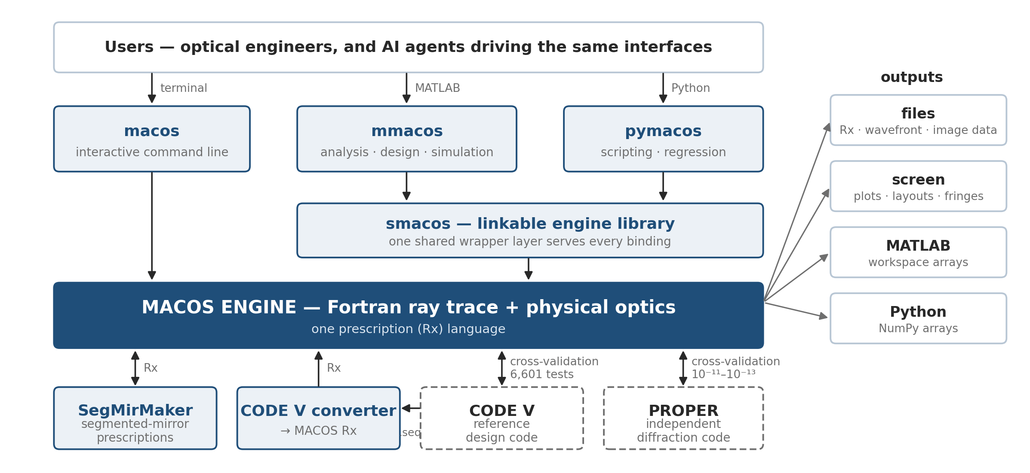
One engine, four surfaces
The same Fortran core answers a terminal, a library call, MATLAB, and Python
• Physics lives in the engine: a capability added there is everywhere at once
• One shared library layer serves the MATLAB and Python toolboxes.
• The prescription generators and the CODE V converter feed the same Rx language.
• CODE V and PROPER provide independent cross-checks.
• One source tree: github nasa-jpl/macos and /MACOS_resources contain it all.

Slide 4
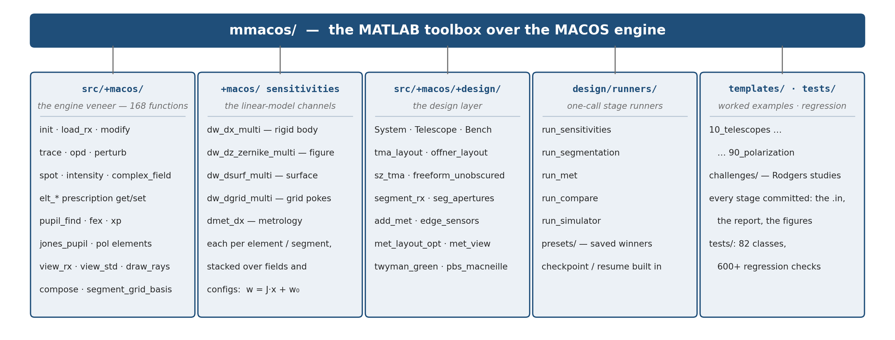
Inside the mmacos toolbox
Five areas, organized the way the work flows — veneer, sensitivities, design, runners, worked examples
Counts as of 2026-08. Every area is exercised by the committed test suites and by the worked examples beside it — the same templates this talk's studies live in.

Slide 5
Three design challenges, one method
CODE V benchmark studies reproduced first, then extended
 | challenge 1 (July) | challenge 2 (August) | challenge 3 (August)
the task, as posed | a three-mirror telescope, f/20, 5 m aperture: a 0.2°×0.2° field box offset 0.5° off axis | a three-mirror afocal telescope, 30×, 1 m aperture: a 0.5°×0.5° field offset 0.6°, a tilted cold stop the interface to the instrument | a three-mirror imager, f/4, 75 mm aperture: a 20°×20° field box centered 22° off axis, exit beam horizontal, hard beam–mirror clearances
the ladder, in steps | on-axis → offset, frozen → re-solved → tilt/decenter | on-axis → offset, frozen → re-solved → tilt/decenter | on-axis → offset, frozen → re-solved → + clearance constraints → + Zernike freedom
reported ladder (max RMS WFE) | 2 → 375 → 92 → 40 nm | 15 → 430 → 160 → 119 nm | 159 → 8810 → 168 → 117 → 53 nm
reproduction | 0.991–1.003× | 0.95–1.02× | 0.8–1.25× (all five steps)
the feature it proved | the field widened without freeforms — joint optics + focal-plane solves | pupil image quality, measured: metrics + the fourth-mirror trade | a super-wide-field imager family: the continuation walk + its frontier
• Objective: meet the challenge, and use the solution to establish a design family.
– Build a solution code for each particular problem, using AI assistance.
– Build another code to rapidly generate adjacent solutions, without AI assistance.
• Each challenge left a reusable template behind — the whole study re-runs at new parameters in one call.
• MACOS solves each problem with its own optimizer and the same degrees of freedom.
• MACOS separately re-traces the delivered prescriptions to compare design against design under one decoded metric.
• Challenges and solution prompts provided by Mike Rodgers (thanks Mike!).
This document has been reviewed and determined not to contain export-controlled information

Slide 6
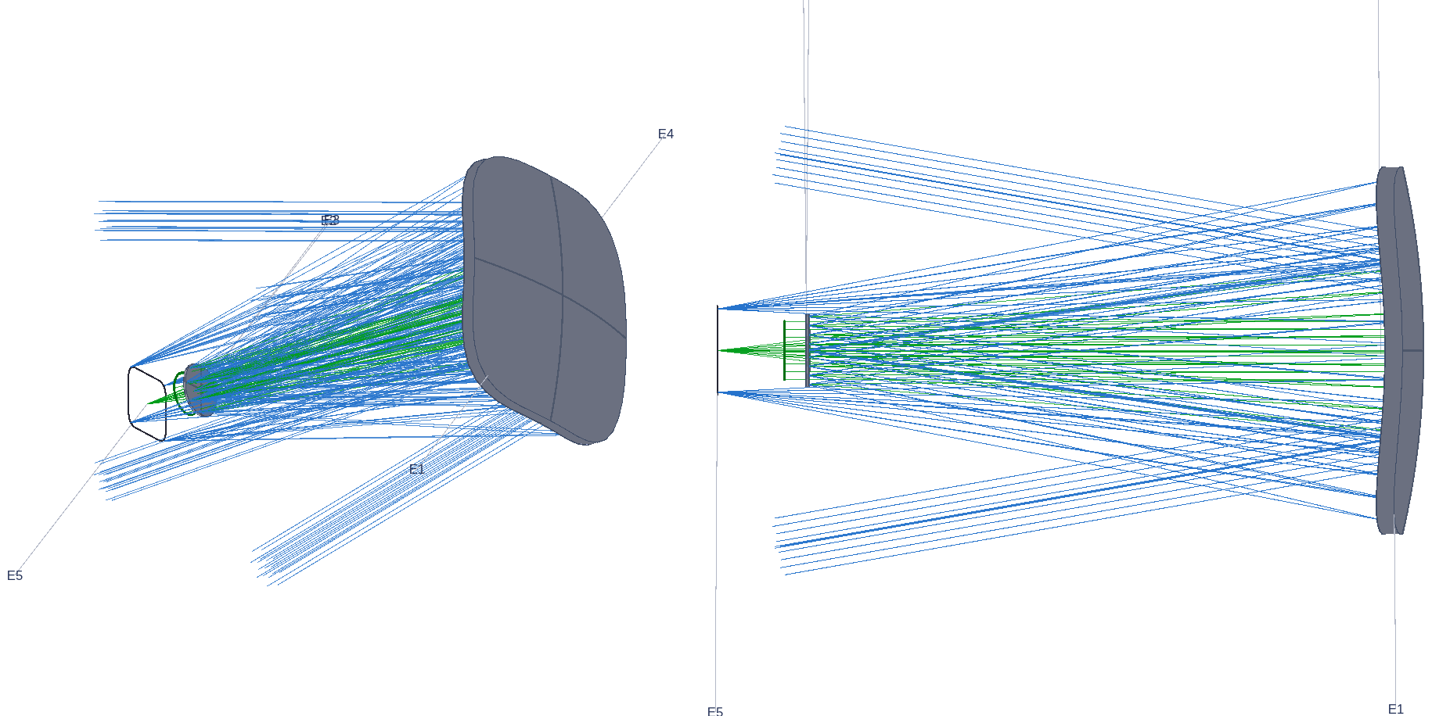
Challenge 3: moving a 20°×20° field 22° off axis
All five reported steps reproduce from the lens sequences before any extension is claimed
• The hardest of the three: a wide field box far off axis, an exit-beam pointing constraint, and hard clearance requirements between beam and mirrors.
• Reproduction first: all five reported design steps rebuild from the delivered lens sequences inside 0.8–1.25× — nothing tuned toward the reported numbers.
• The study became a template: one parameterized five-stage flow (solve on axis, map the offset, re-solve at the used field, add buildability constraints, add surface freedom) — re-running the whole study at new parameters is one call.
• Every design passes the same gate sequence:
– 1 · traceability — every solve field reaches the detector (screened before solving)
– 2 · map validity — all 121 dense-map fields present, none lost
– 3 · exit-beam direction — the chief within tolerance of the horizontal pin
– 4 · clearance — the signed beam–mirror floor at or above spec
– 5 · score — strict RMS WFE against the reported ladder
– pinned by regression checks with negative controls (the control reads 2989× the gate)
The offset imager as traced in MACOS at the stage-1 configuration (iso + side views).
Record: challenges/rodgers3 — packet, per-step prescriptions, regression checks with negative controls.

Slide 7
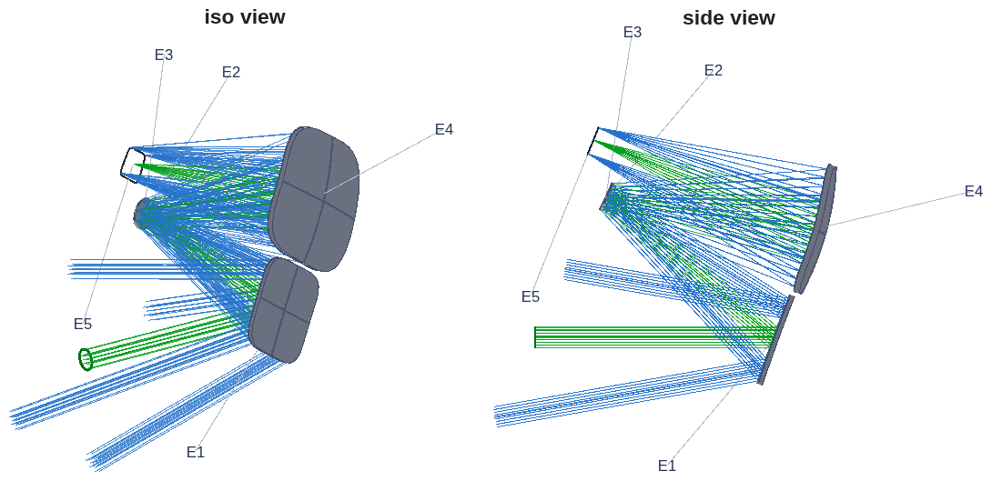
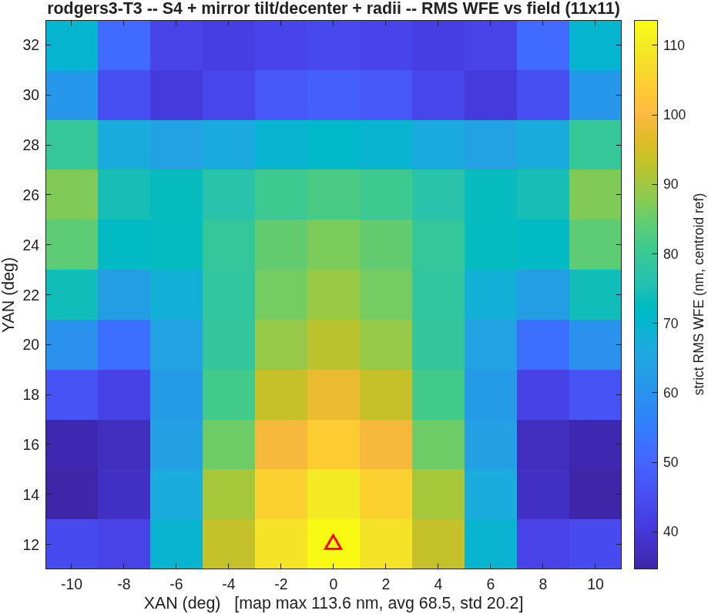
Challenge 3: the numbers
Paying the same constraints lands the same design space — then a diagnosis beats the reported result
• The buildability step: enforcing the reported ≥35 mm clearance lands 113.6 nm at a 34.1 mm floor, against the reported 117 nm — 0.97×, same design space. The final step, diagnosed then beaten: the barrier to achieving the reported 53 nm was the solve-field count, not physics; matching it lands 45.4 nm — 0.86× — at a floor 1.6 mm shy of the stated 35 mm.
• An unconstrained solve reads 58.3 nm — with the beam passing through the secondary. The layout figure caught it; clearance constraints are part of the problem statement.
Its field map: 113.6 nm max over the 20° box.
The buildability-constrained design: a 34.1 mm clearance floor, traced (iso + side views).
Metric, stated once for this study: strict RMS WFE, reference sphere on the spot centroid on the frozen focal plane, anchored at the exit pupil, piston-only removal; headline = maximum of a dense 11×11 field map.

Slide 8
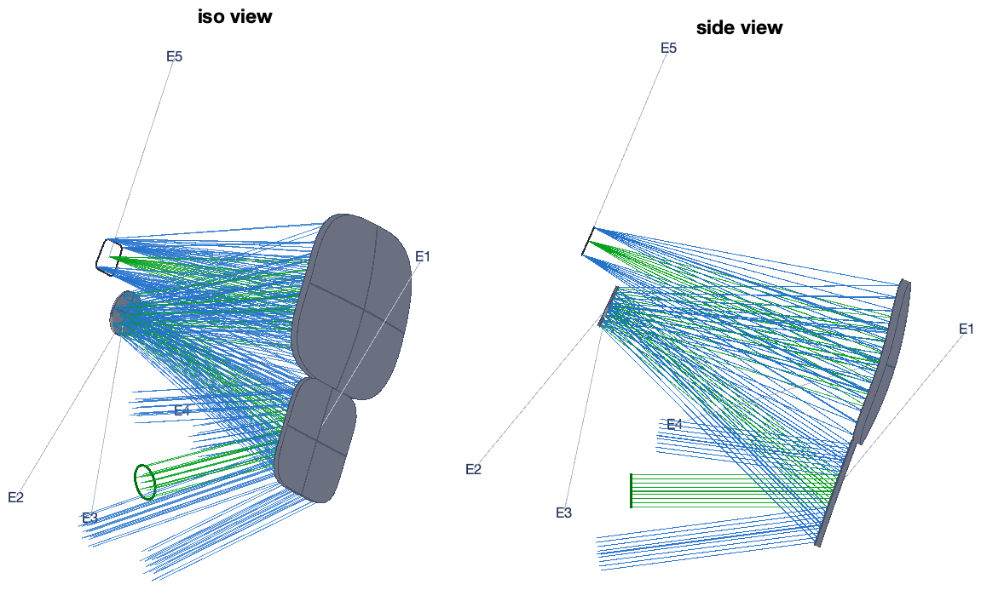
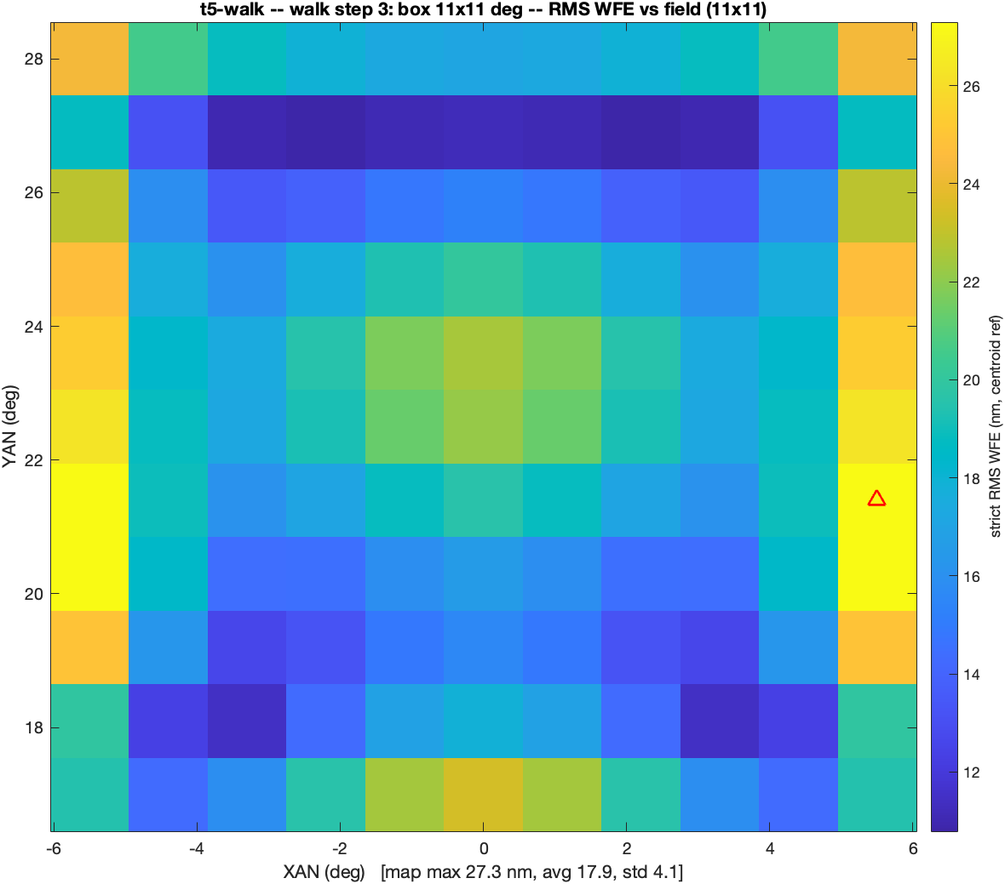
From one design to a design family
Warm-started continuation solves what a cold start cannot
• The cold start fails (596 µm, most field points lose every ray); the walk succeeds: solve an easy 5° box, widen in steps, each warm-started from the last — 10.9 → 21.5 → 27.3 → 40.0 → 69.8 nm at 5/8/11/13/15°, 8531× better than the cold start.
• The step table is the instrument's field-vs-packaging frontier: every row a finished, checked design; the largest spec-compliant box is 11°×11° at 27.3 nm with a 25.1 mm clearance floor.
The 11° step's field map: 27.3 nm max — the largest spec-compliant row.
This frontier is the basis of the live demonstration — next slide.
The 15° endpoint of the continuation walk, traced with clearances (iso + side views).

Slide 9
The agent asks: when do you change basins?
A question to this room, from the AI that ran these studies
• Our solvers never left the basin they were seeded in. The warm-started walk beat the cold start 8500×; offered ±15° of rigid-body freedom, a converged solve used 0.9° — the off-axis family had to be seeded, never perturbed into. When does your practice reach for a genuinely new starting geometry rather than a better step — and do you trust automated global search to make that call?
• And how do you scale one merit across requirement classes decades apart? A term 120× from feasible owned our sum of squares and the rest cast no vote; we ended in log-domain residuals and constraint walls applied to iterates, never to reports. What is your practice?
Genuine, not rhetorical: the agent is live during this talk — Dave can relay your answers, or your questions, and it will respond in real time.
This document has been reviewed and determined not to contain export-controlled information

Slide 10
The live demonstration: an adjacent instrument, designed during this talk
Kicked off now, in MATLAB; predicted first, revealed before the closing discussion
• The ask: name a field-box full width, anywhere in 5–15°, for the same instrument class — 150 mm f/3.3 at the +22.5° offset, same envelope, same clearance rules.
• What happens: the frontier states the prediction first; one MATLAB call launches a full-freedom solve, warm-started from the nearest committed design below the ask, and it runs while the talk continues (~15 min).
• The AI is not driving: the design knowledge is compiled into the driver — this is the "adjacent solutions, without AI assistance" half of the objective, running live.
• The AI is available for questions.
• What the reveal shows: the field map, the clearance floor and the exit-direction check, beside the stated prediction. Every ask is a genuine continuation step, never a re-score of a stored design; a repeat run reproduces every printed digit.
$ matlab & % a fresh MATLAB, just for this solve
>> cd ~/dev/MACOS_resources/mmacos/templates/10_telescopes/offset_imager
>> OUT = oi_demo_step(12) % <-- the room's width goes here (5-15 deg)
warm start : committed walk step 3 (11 x 11 deg)
predicted : ~33.7 nm, ~24.8 mm floor (frontier rows 11/13 deg)
solving : one full-freedom step ... ~15 min
... at the reveal, the windows are already up; if needed:
>> oi_demo_show(OUT) % live layout + WF map + fields
>> type(OUT.files.verdict) % the verdict block
The literal demo-day sequence ($ = shell, >> = MATLAB); the rehearsal at 12° solved 33.6 nm against the ~33.7 prediction, and the 14° rehearsal beat its predict too.
In the mean time, continuing...
This document has been reviewed and determined not to contain export-controlled information

Slide 11
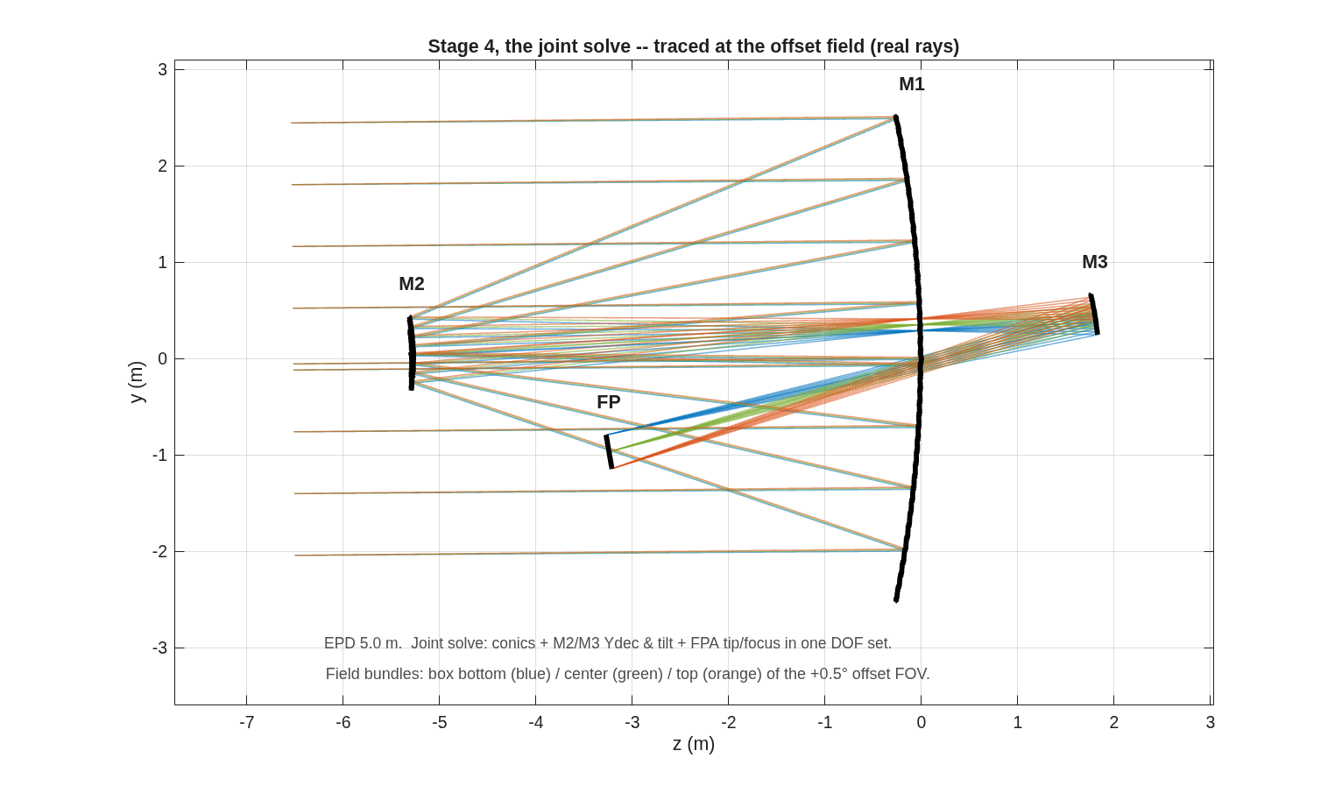
Challenge 1: MACOS solves match the re-traced CODE V designs
Re-traced designs land 0.991–1.003× of reported; the MACOS solves score 0.97× design vs design
design | MACOS, piston + tilt removed | bestfoc + LS tilt | CODE V reported
S2 verbatim | 482.8 / 272.0 | 371.4 / 201.4 | 374.6 / 200.0
S3 MACOS solve | 116.8 / 68.1 | 86.8 / 50.5 | 91.6 / 46.4
S3 CODE V re-traced | 121.0 / 67.9 | 91.9 / 50.2 | 91.6 / 46.4
S4 MACOS solve | 65.6 / 36.4 | 41.2 / 21.9 | 39.8 / 22.5
S4 CODE V re-traced | 67.6 / 36.7 | 39.8 / 22.1 | 39.8 / 22.5
• The metric decoded: the reported map subtracts per-field best focus + least-squares tip/tilt; re-scoring the same traces under that convention (third column) lands the re-traced designs at 0.991× / 1.003× / 1.000× of the reported max.
• Design vs design, the reproduction closes: the MACOS solves score 0.97× of the re-traced CODE V designs at both stages; under the reported convention the S3 solve (86.8 nm) beats the reported 91.6. Conics agree to 1.5×10⁻⁴, rigid-body DOFs land on the same compensation branch, all signs matching.
• The study returned more than it consumed: two engine defects found and fixed (a silently inert exit-pupil keyword; collimated sources tracing a pupil 5% oversize, hidden for decades), and the joint-solve doctrine — optics + focal-plane pose in one DOF set, never alternating.
The arrived-at configuration: the stage-4 joint solve traced at the offset field.
Box max / avg, nm, at the .seq configuration. Piston + per-field tip/tilt removed = a centroid-referenced sphere (a chief-referenced sphere leaves the tilt in). Full record: design/rodgers1 — packet with 10 addenda, every retraction in place.

Slide 12
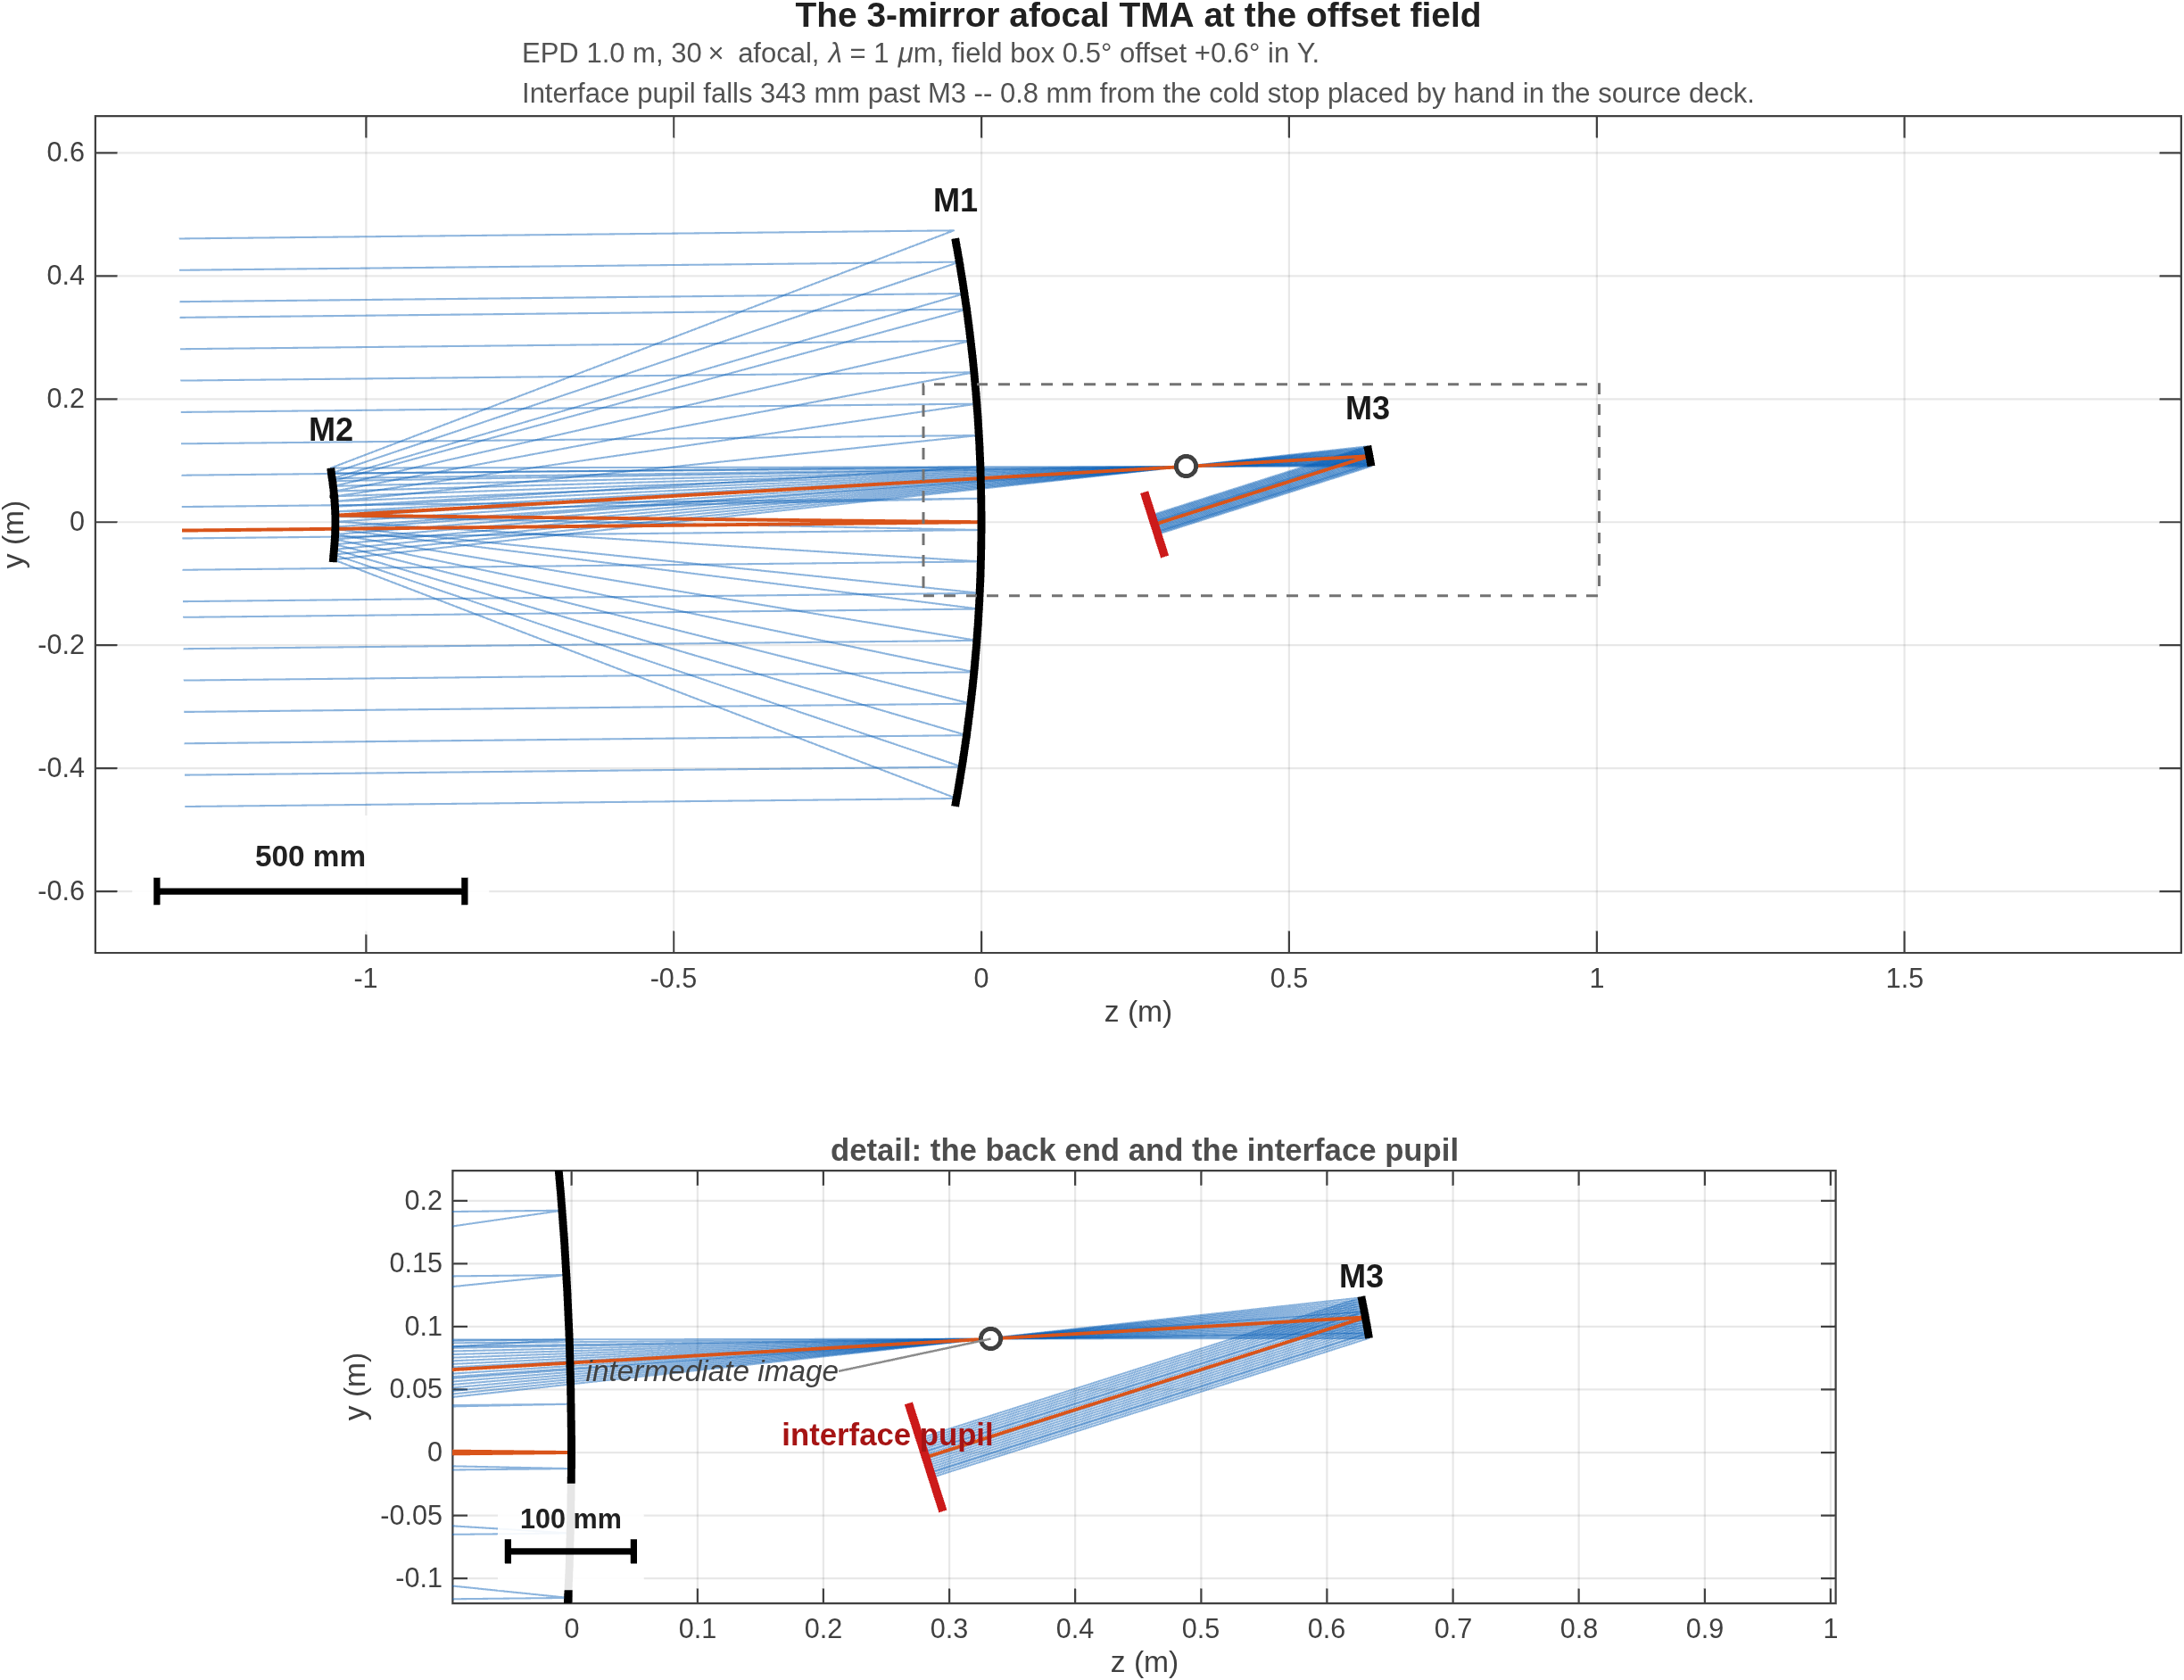
Challenge 2: a 30× afocal feeding an instrument through a tilted cold stop
Reproduced, then extended: the pupil measured, the trade priced, the package cleared
• The challenge: a three-mirror afocal, 30×, 1 m aperture, a 0.5°×0.5° field offset 0.6° — feeding an instrument through a tilted cold stop, with the pupil quality left unmeasured by the source.
• The pursuit: transcribe and audit the delivered sequences, decode the reporting reference, reproduce all four variants — then extend where the source stopped: measure the pupil, price the fourth mirror, clear the package.
• Achieved: all four variants inside 0.95–1.02×; the reported 28.7× magnification measures 28.686×; the computed exit pupil falls 0.8 mm from the stop placed by hand in the source deck.
variant | CODE V | MACOS / CODE V
on-axis | ≤ 15 nm | 0.99×
offset, frozen design | ≤ 430 nm | 1.01×
offset, re-solved | ≤ 160 nm | 0.95×
offset, tilt/dec | ≤ 119 nm | 1.02×
The transcribed system traced in MACOS: light enters left, M1 → M2 → M3; the computed exit pupil falls 0.8 mm from the delivered cold stop (detail panel).
The source's own pupil verdict — "with 3 mirrors, the pupil quality is not very good" — carries no metric; MACOS defines and measures one: next slide. Audit rigor: the coordinate break lands the cold stop on the traced beam to 2×10⁻⁷ mm, where the wrong sign convention misses by 211–247 mm. Full record: design/rodgers2.

Slide 13
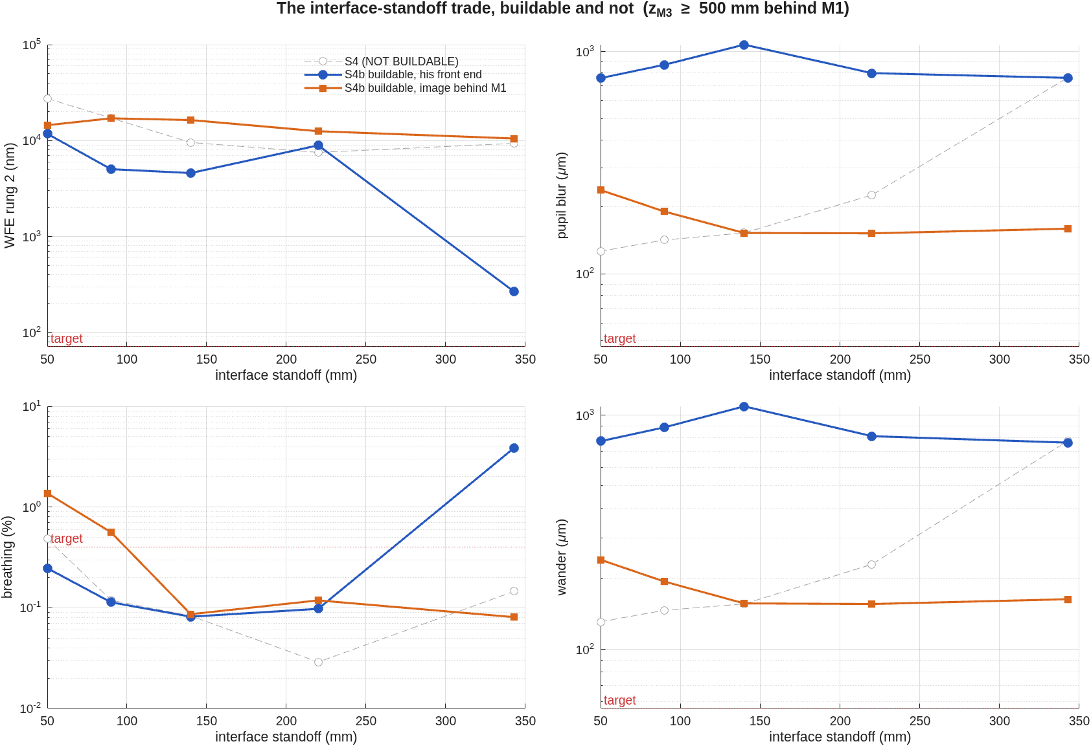
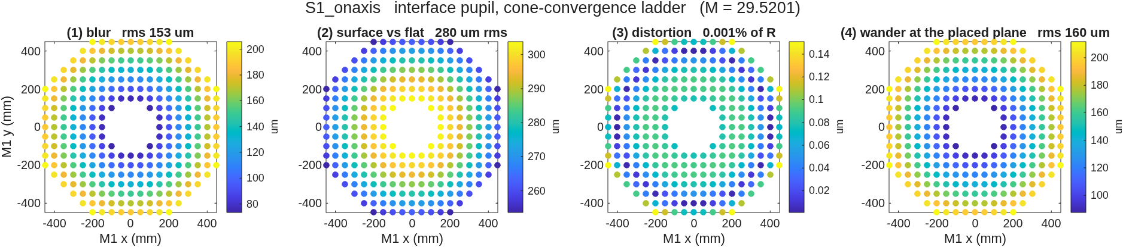
Challenge 2, extended: the pupil measured — and what a fourth mirror buys
Pupil blur 469 → 157 µm; the exchange costs image quality a factor 39
metric | 3 mirrors | + 4th mirror
pupil blur | 469 µm | 157 µm
footprint wander on the cold stop | 557 µm | 161 µm
magnification variation | ±3.6% | 0.12%
wavefront error — the price paid | 119 nm | 10.4 µm
• The two qualities pull opposite ways: the fourth mirror's power serves the pupil and costs the image — a factor-39 exchange. Declining the power (a flat fourth mirror) keeps 266 nm and the three-mirror pupil.
• The trade, constrained: with the last mirror held behind the primary, the solutions split into two families; pupil distances under 220 mm leave no room for an instrument after the fold — 343 mm admits a 464 mm diameter.
Both solution families beside the retracted unconstrained curve; the instrument-diameter column selects the 343 mm point.
Yardsticks: pupil imaging resolves 2.7 µm across the 33 mm pupil, depth of focus ~30 µm — the measured defects sit 50–350× above these floors. Per-point trade table: the design/rodgers2 record. Buildability re-prices this trade — next slide.
A point of M1 imaged at the pupil: the convergence clouds behind the pupil-blur metric, traced across the field.

Slide 14
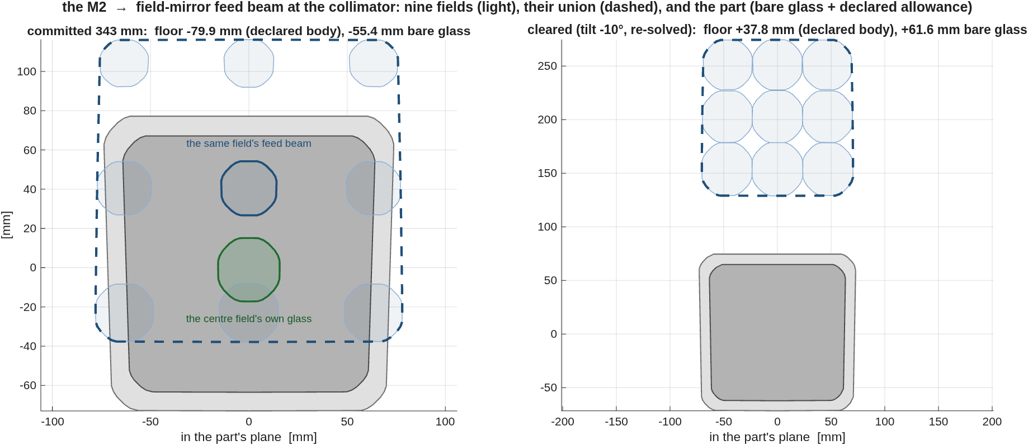
Challenge 2: packaging — and the defect no fold could fix
The collimator stood in its own feed beam by −80 mm; a −10° extraction tilt clears it at +38 mm — wavefront 14% better
Nine per-field feed-beam patches (light blue) at the collimator's plane, their union (dashed), and the part (gray). The centre field's beam (bold) clears its own glass (green) — it lands on the glass the other fields need. Left: committed, −79.9 mm. Right: cleared −10°, +37.8 mm.
• Why no single-field trace shows it, and no fold fixes it: each field's feed beam clears the glass its own light uses by 10–27 mm — the collision is with the glass the other fields need, and one monolithic mirror must carry them all. Body and beam unions are scaled copies of the same field box (separation needs a 2.43× scale ratio; measured 1.30), and a fold is an isometry: the best flat placement anywhere reproduces −79.9 mm to the last digit.
• The fix is optical, and priced: tilt the field mirror −10° and re-solve around it. Clears at +37.8 mm with zero rays lost; wavefront 8993 vs 10407 nm; the interface holds (30.015×, 33.57 mm exit beam). It packages itself — deepest optic 1.81× → 1.24× the M1–M2 spacing, zero fold flats. The price is the fourth mirror's pupil control: blur 157 → 553 µm, breathing 0.12 → 0.82% — still 4× steadier than three mirrors.
The union check is now a standing gate: fails the committed deck, passes the cleared one — a margin is a number, not a body. Three-way layouts: backup. Record: challenges/afocal4/{packaging,clearing}.

Slide 15
The agent asks: about this afocal family
Questions the 30× study could not settle
• The interface-pupil condition consumed the last two mirror powers — priced at 2.7× of wavefront — and field curvature owned 60–99.7% of every design's variance. Is that pupil requirement held this hard in shipped practice — and is a strongly curved opposite-sign corrector in the compressed beam near the exit a move you have seen work?
• Overnight we found an effect we cannot explain: decentering the pupil improved every mirror count tried — 3.5× at best, and the best absolute design in the study — measured under the full requirement set with three controls, while four mechanism hypotheses failed in turn. Do you recognize this effect?
Genuine question — the agent is live and will follow up.
This document has been reviewed and determined not to contain export-controlled information

Slide 16
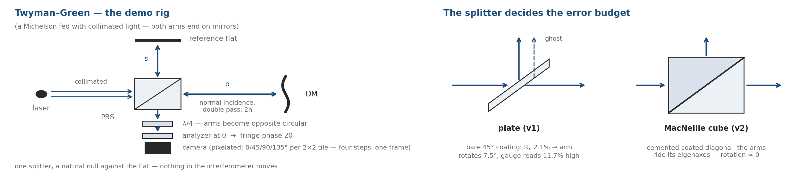
A second live demonstration: the AI drives an interferometer
A polarization Twyman–Green gauging a deformable mirror — armed in a terminal now, run on the room's cue
• Why a Twyman–Green for a DM: it is the Michelson topology fed with collimated light — both arms end on mirrors, so the DM takes one arm whole, at normal incidence, double pass (height counts twice), with a natural null against the reference flat. A Mach–Zehnder has no natural seat for a mirror — its isolated arms and two ports serve dynamics and transmission, not figure.
• Phase shifting, nothing moving in the interferometer: the arms carry orthogonal polarizations; a quarter-wave plate makes them opposite circular; the analyzer angle θ writes fringe phase 2θ. The analyzer sits in the recombined beam, where its motion adds only common phase — or is a pixelated camera (0/45/90/135° per 2×2 tile): all four steps in one snapshot.
• Cube against plate: the plate rig's diattenuation rotates one arm 7.5° and the gauge reads 11.7% high; the MacNeille cube parks each arm on a coating eigenaxis. Both are built — the cube runs today.
$ claude % a fresh AI session, in the terminal
> Let's run the IFO demo. Runbook is demo_session/RUNBOOK_ifo_demo.md
— arm it and wait for my cue.
Armed — v2, eight beats, beat 1 computed and waiting. Say the word.
> tell us about the next step ... > run it
BUILD → LAYOUT → COATING → NULL → POKE → SWEEP → RECOVER → CALIBRATE
(~45 s of compute across the run — the rest is conversation)
The dialog is the demonstration: the AI narrates each beat, runs it on the cue, pastes the real output, and answers the room's questions from the live session — figures open on the desktop as they draw. Every beat has a committed fallback figure.
The demo rig, and the splitter that decides its error budget.

Slide 17
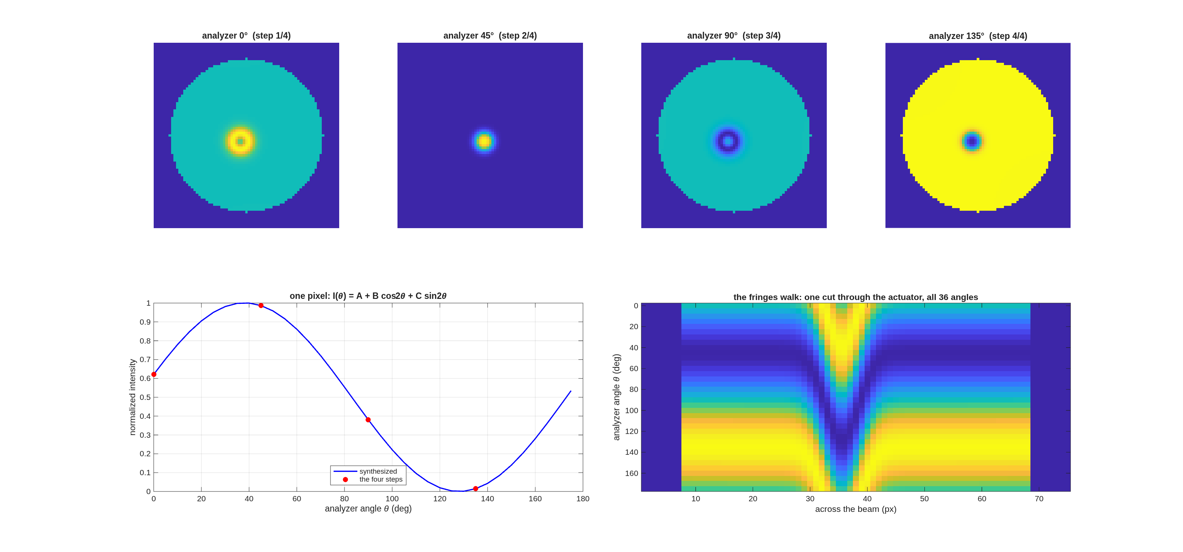
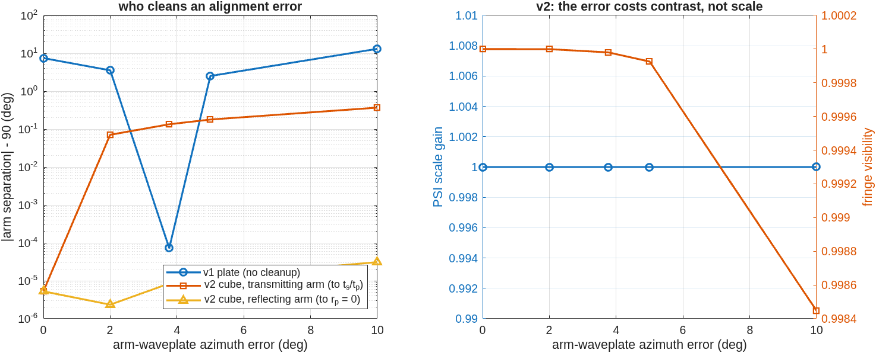
Recap: the interferometer, built and calibrated in the model
The plate rig's 11.7% error, caught and fixed — then designed out by a real MacNeille cube
• The rig: a polarizing Twyman–Green with a 16×16-actuator deformable mirror as the test optic — polarizers, waveplates, splitter and coatings are engine surfaces, not a Jones model appended after the trace. Two builds: the v1 plate rig, and a v2 with a real cemented MacNeille cube — one coated 45° interface (engine vs textbook thin-film at 10⁻¹⁰; R+T = 1.000000000000 measured).
• v1's catch: splitter diattenuation rotates the test arm 7.5° from orthogonal — the gauge reads 11.7% high while fringe contrast moves 0.17% (a 69× blind spot); fixed by re-clocking one waveplate 3.77°, solved in 5 traces.
• v2 designs the error out: each arm rides a coating eigenaxis, where a diattenuator cannot rotate it — and the error budget inverts: a waveplate error now costs visible contrast instead of invisible scale.
The analyzer sweep, from the run: phase-stepped fringes over the poked actuator — the phase walks, nothing in the rig moves.
 | plate (v1) | MacNeille cube (v2)
arm rotation from orthogonal | 7.479° | 5×10⁻⁶ °
PSI scale gain | 1.117 | 0.999999
alignment solve | +3.768° | none needed
delivered power | 0.169 | 0.384 (2.27×)
DM closure residual | 0.304 nm | 0.183 nm
Who cleans an alignment error: the plate's arm rotation walks with waveplate error; the cube's arms stay put — the error emerges as contrast, not scale.
Records: templates/90_polarization/tg_psi_dm (v1) + tg_psi_dm_v2 (the demo rig); 18 regression checks across the pair. A PBS converts an invisible systematic into a visible one — a better reason to buy one than throughput.

Slide 18
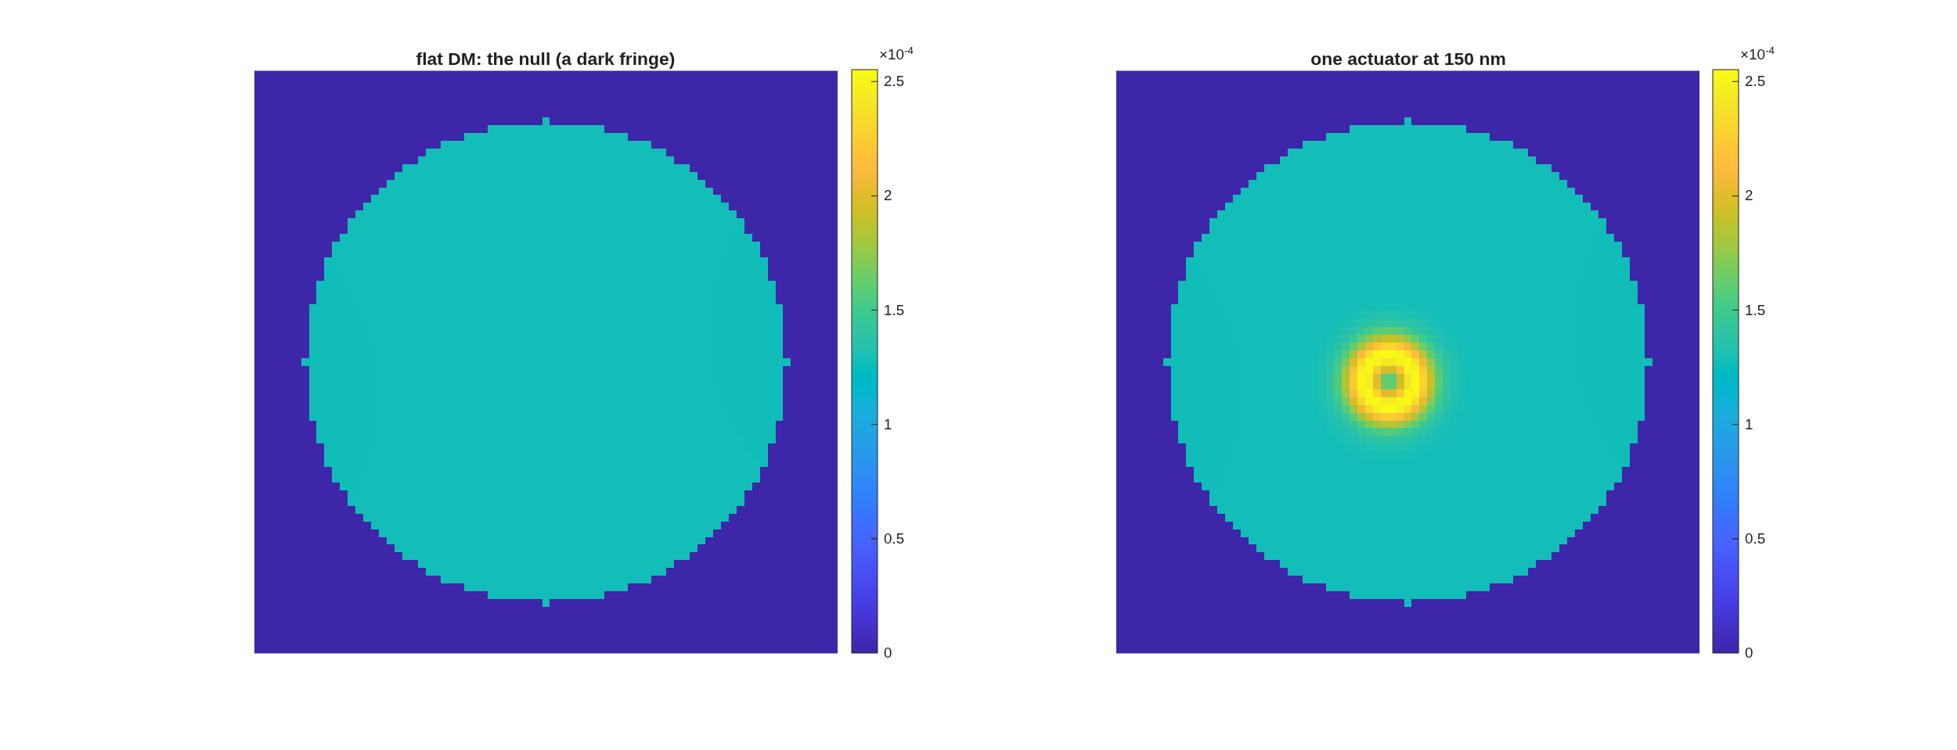
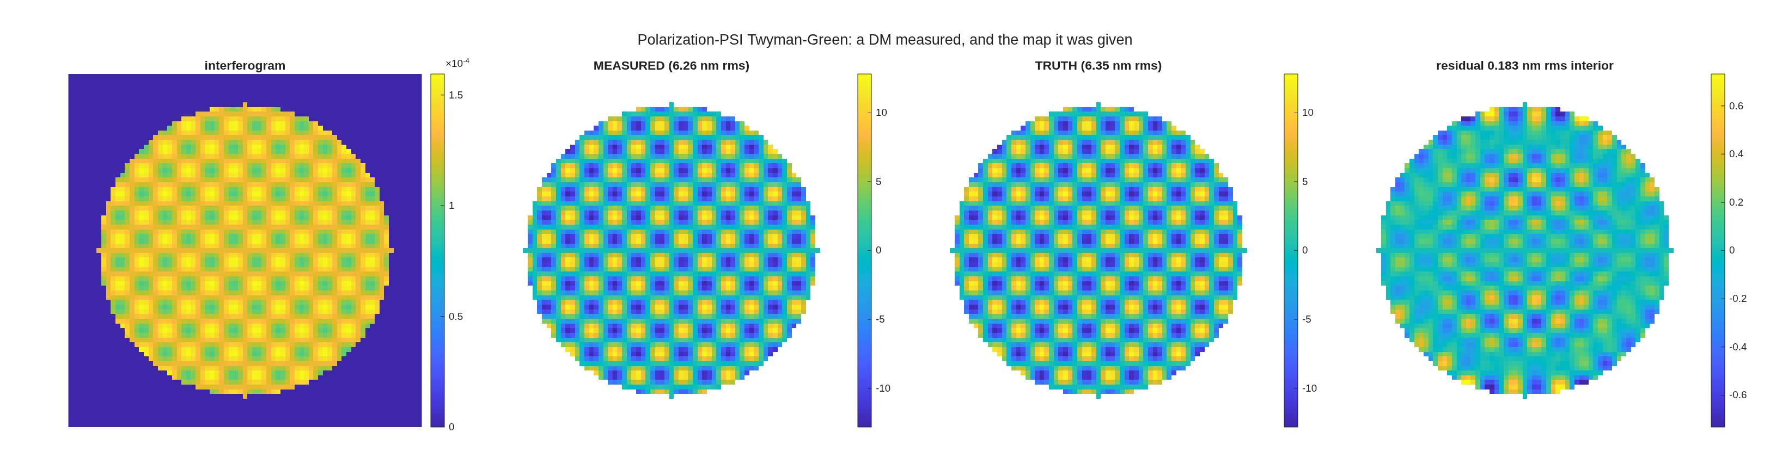
Recap: the measurement the room just watched
Eight beats, ~45 s of compute — 0.18 nm rms residual on 6.35 nm of figure
• The eight beats, replayed: build (the design condition hands back a dense flint, n = 1.6555 — why real polarizing cubes are not BK7) → layout → coating (R+T = 1.000000000000 measured; one termination choice moves R_p from 4×10⁻¹² to 2.1%) → null → poke → sweep → recover → calibrate.
• The numbers that landed: the null reads 73 pm with nothing aligned; the poked actuator recovers 146 nm against 150 injected — the bullseye's own half-fringe arithmetic; the full map lands 6.26 nm against 6.35 truth, 0.183 nm rms residual.
• The calibration question: gain 0.9912 ± 0.0020, linear to 0.00% — almost nothing to calibrate, and the two correlations say where the leftover error lives.
Beat 5 — one actuator poked: the fringes bend over it.
Beat 7 — the recovery beside the injected truth map.
Every number above is printed by the run itself; the sweep costs 36 frames and zero ray traces. Both rigs run the same demo (v1 49.8 s, v2 47.0 s wall) — the committed beat figures stand in if a live beat stalls.
This document has been reviewed and determined not to contain export-controlled information

Slide 19
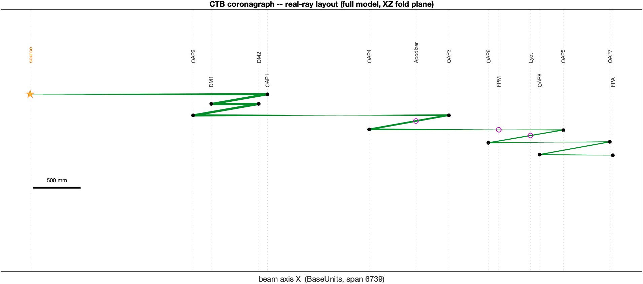
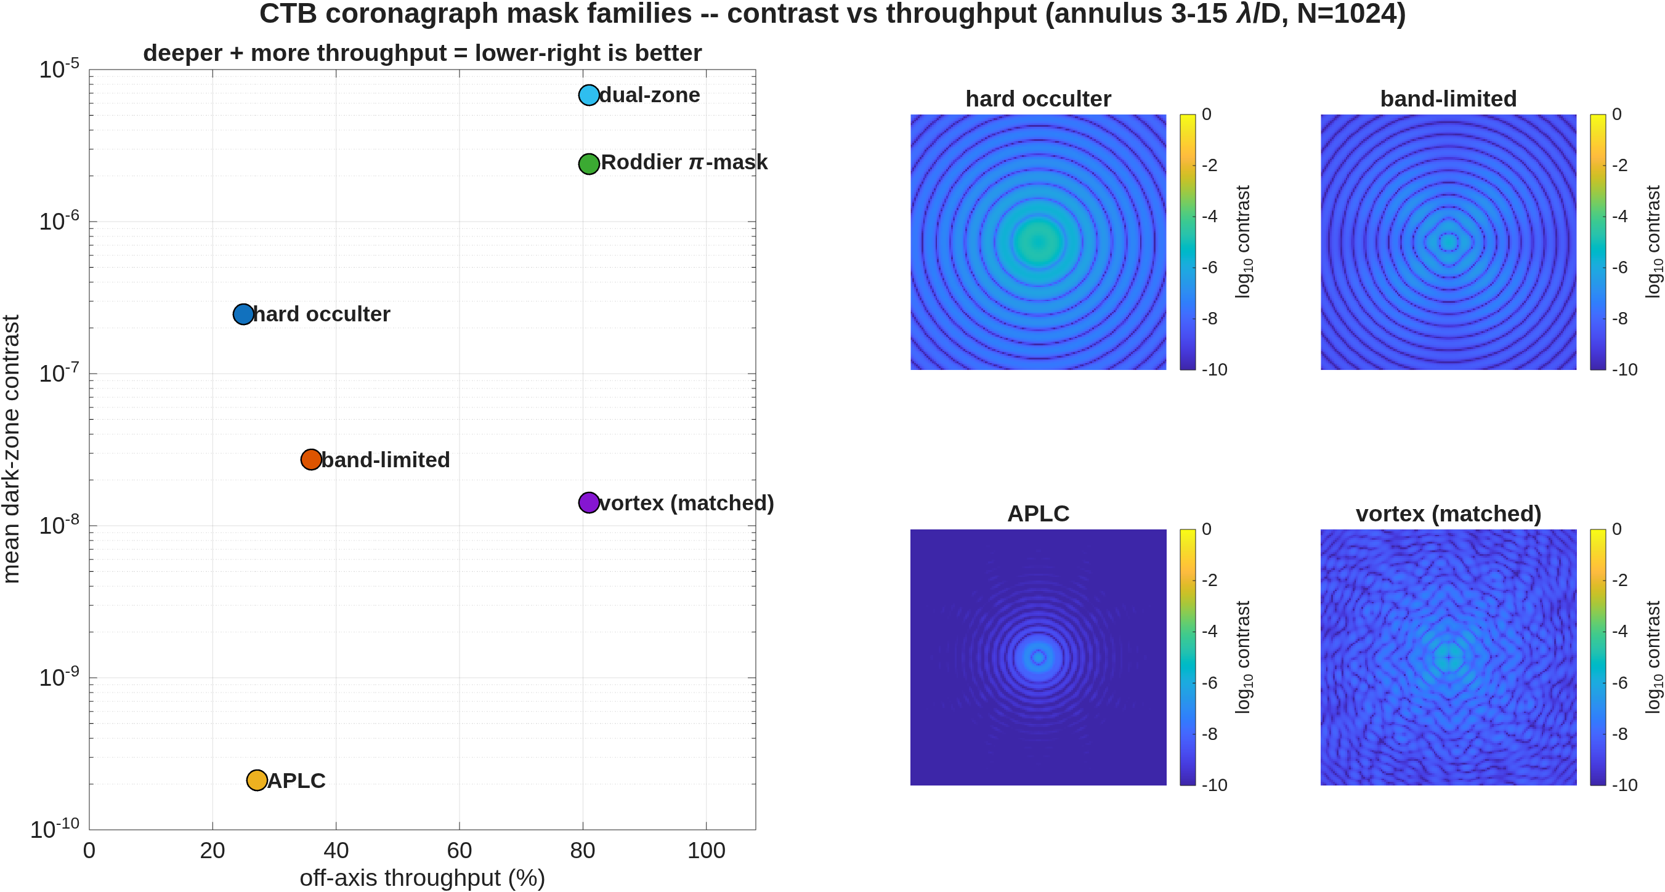
A coronagraph testbed, end to end
Six mask families from the literature, scored on one footing — validated against PROPER station by station
• The full testbed model — off-axis parabolas, focal-plane masks, Lyot stop, two 32×32-actuator deformable mirrors — every mask generated at 8× sub-pixel resolution and binned to the model grid.
• Validated externally: a pure-PROPER run reads only the exported planes — no macos anywhere — and reproduces the bare image at correlation 1.000000, forming the same dark zone.
The bench: the real-ray layout of the full model — source, DMs, OAP relays, apodizer, focal-plane mask, Lyot stop, camera.
mask (static, no control) | dark-zone mean | throughput
apodized-pupil Lyot (prolate) | 2.1×10⁻¹⁰ | 27%
vortex, matched Lyot | 1.4×10⁻⁸ | 81%
band-limited (4th order) | 2.7×10⁻⁸ | 36%
hard occulter | 2.5×10⁻⁷ | 25%
Roddier π-mask | 2.4×10⁻⁶ | 81%
Contrast against throughput for the mask families, static — lower-right is better: the apodized-pupil Lyot deepest, the pixel-averaged vortex second at three times its throughput.
Dark zone 3–15 λ/D, one grid, one normalization throughout; every mask formula taken from its source paper. Record: templates/30_instruments/bench_ctb.

Slide 20
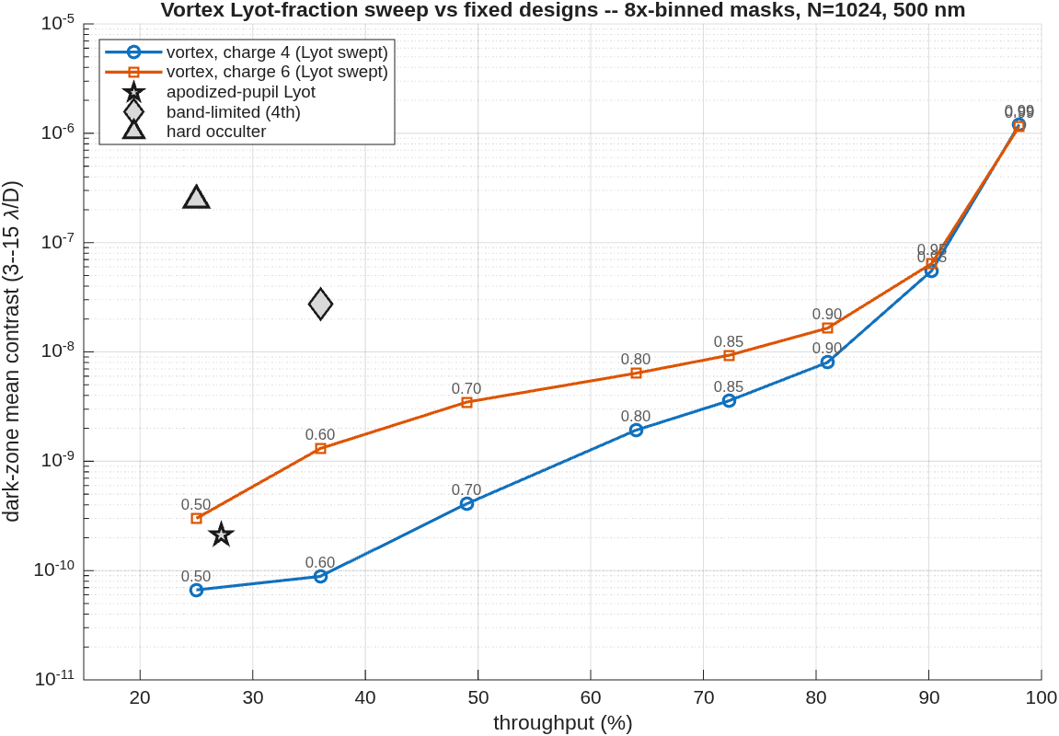
The vortex against the Lyot stop
Charge 4 under-runs every fixed design at every throughput: 8.8×10⁻¹¹ at the band-limited mask's own 36%
• One mask, one dial: the vortex phase is fixed; only the Lyot stop fraction moves — a genuine depth-for-throughput dial, where each fixed design is a single point.
• Readings from the curve: at the apodized-pupil Lyot's operating point, charge 4 is deeper (8.8×10⁻¹¹ vs 2.1×10⁻¹⁰) at more throughput (36% vs 27%) — with no apodizer to fabricate. At 81% throughput it still holds 8.0×10⁻⁹.
• Charge 4 runs ~4× deeper than charge 6 at every stop; the useful dial range is 0.50–0.90 — past 0.90 the rejected-starlight ring arrives inside the stop.
Dark-zone mean contrast against throughput: the swept charge-4 vortex (labels = Lyot fraction) against the fixed designs, on the same footing.
Same grid, annulus and normalization as the head-to-head; fixed-design markers read from the committed comparison, not re-scored.

Slide 21
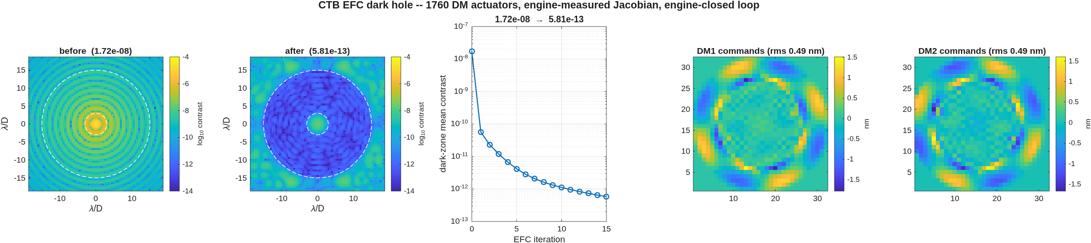
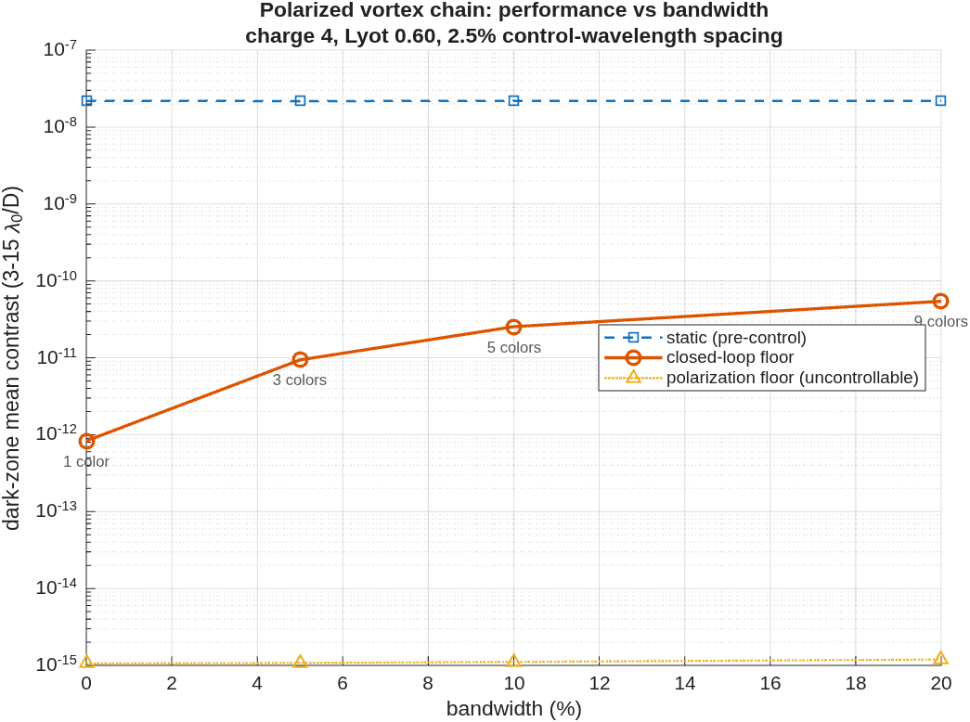
The mirrors close the loop
On the vortex chain: 1.7×10⁻⁸ → 6.8×10⁻¹⁵ — nothing left that the mirrors cannot remove
• The control matrix is measured, not modeled: every actuator poked and propagated through the full masked chain, so the correction solve has no model error to exploit; each iteration re-propagates and scores the measured contrast.
• Two chains, two kinds of floor: the hard occulter stops at 3.8×10⁻⁹ — physics, occulter-edge diffraction the mirrors cannot represent; the charge-4 vortex chain reaches 6.8×10⁻¹⁵ at half-nanometer strokes — the model's own double-precision floor.
• The physics layers, measured: the coated train's polarization floor rides flat at 1.1×10⁻¹⁵ at every bandwidth (a state change, not an aberration); the chromatic floor grows gently when control sampling matches the band — 8×10⁻¹³ mono to 5.4×10⁻¹¹ at a 20% band.
• The vector-vortex verdict: the zero-order plate's retardance leak is uncorrectable by any mirror but optically removable — a circular polarizer sandwich returns to the scalar floor under per-λ control; a crossed-linear sandwich goes decades deeper on the star, at the price of eight planet blind spots.
The vortex-chain dark hole: before and after (color floor 10⁻¹⁴), convergence, and the command maps.
The bandwidth map: static, closed-loop floor, and the flat polarization floor at each band.
6.8×10⁻¹⁵ = dark-zone mean 3–15 λ/D, Strehl-normalized, monochromatic, noiseless sensing — the numerical floor of the noiseless model, not a hardware prediction. Next layer of realism: camera-based sensing (pairwise probing), then FALCO driving the same DMs.

Slide 22
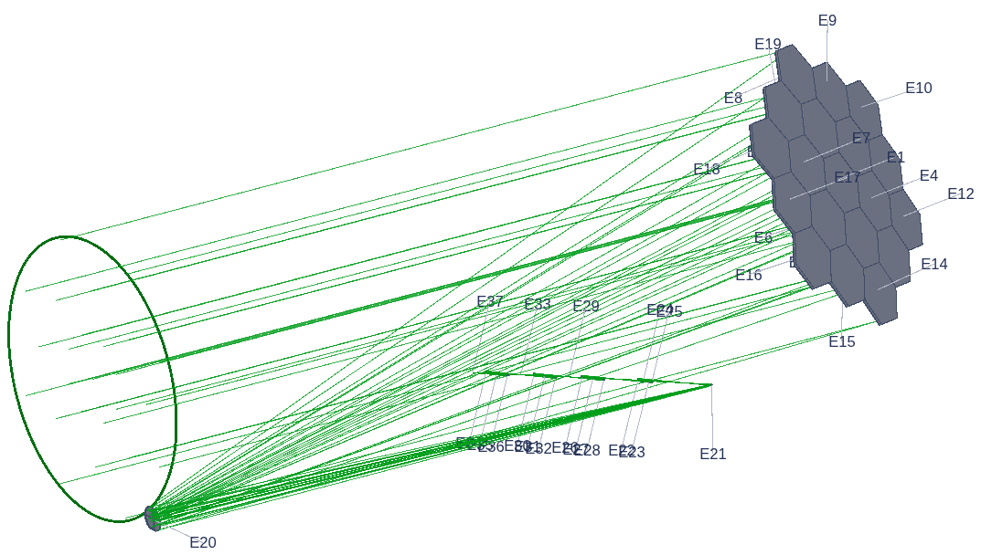
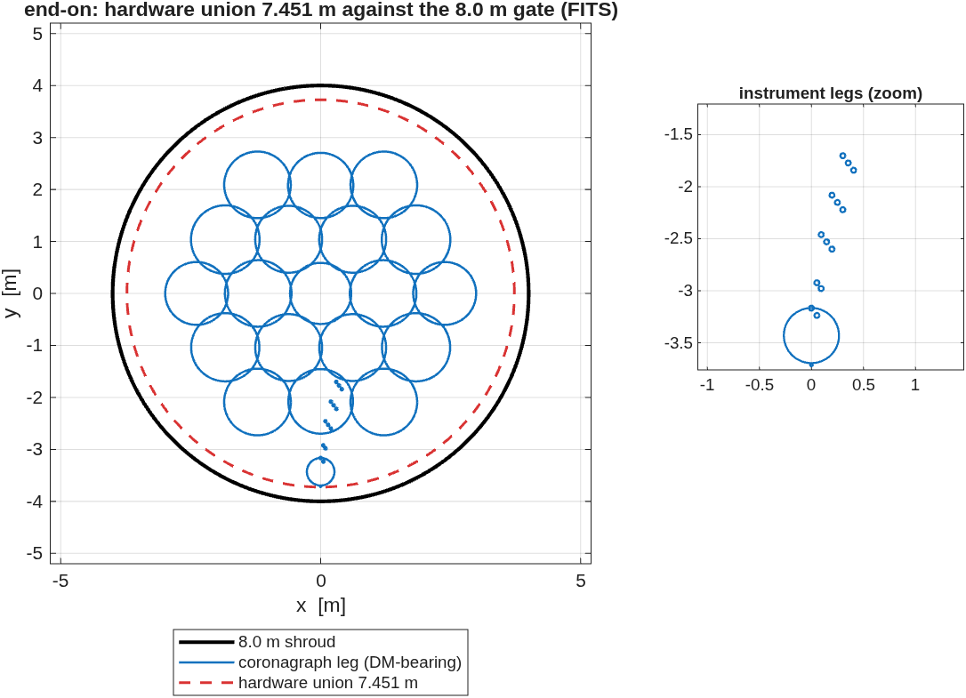
From the testbed to an observatory
The proven coronagraph modeling, carried onto a telescope designed for it
• The testbed is where the models are built and proven; the same modeling then builds the flight-like system: an unobscured 6 m telescope from the design-layer templates — imaging leg and coronagraph leg, with the same DMs, apodizer, focal-plane mask and Lyot machinery — the telescope packaged to an 8 m launch shroud.
• The coronagraph bench still needs packaging work: the body-in-beam gate built for challenge 2, run on this train, finds the bench nicking the M1–M2 beam and the DM pocket's folded legs overlapping. In the days ahead: the gate joins the template's standing checks; the bench clocks and drops out of the trunk beam by re-posing its pickoff fold — an optical null; the pocket's fold angles open with a small re-solve, priced in wavefront; the train re-verifies end to end.
The full train, traced: the segmented 6 m primary feeding the DM-bearing back end — 37 elements across the two instrument legs.
End-on in the shroud: the hex-19 telescope and instrument legs — hardware union 7.451 m against the 8.0 m gate.
The telescope is diffraction-limited at 500 nm (imaging-leg Strehl 0.9993). Record: templates/80_end_to_end/e2e6m_r2.

Slide 23
The linear model: state to wavefront to control
Every matrix is measured from the engine, then closure-checked against it
• The wavefront model: w = w₀ + J·x, J = [ ∂w/∂x ∂w/∂z ∂w/∂grid ]
– x stacks rigid-body states (6 DOF per optic and per group), segment Zernike figure modes, and grid/actuator influences; J's columns are engine-measured pokes through the full train, per field — the three families on the following slides.
• The metrology forward model: m = [ ∂l/∂x ; ∂e/∂x ]·x + n
– laser-gauge lengths l and edge-sensor gaps e; a sensor layout is scored by the control information it carries — minimize trace( J Px̂ Jᵀ ), the wavefront error the estimator leaves behind.
• Actuators to states: x = (∂x/∂u)·u , so ∂w/∂u = J·(∂x/∂u)
– Stewart-platform kinematics carry the actuator strokes u of each segment and of M2 into rigid-body states x; ∂w/∂u is the control Jacobian.
• Control using wavefront measurements: u = −(∂w/∂u)⁺·w
– Wavefront sensing and control in one step, enveloping telescope initialization controls.
• Estimation and control using metrology measurements: x̂ = ( HᵀWH + ρI )⁻¹ HᵀW·m ; u ← u − g·(∂x/∂u)⁺·x̂
– BLUE: weighted least squares with a ridge on the segment state; an integrator closes the rigid-body loop each frame.
Notation as in the code: run_sensitivities builds the J families; the MET stage scores layouts on the trace merit; the simulator runs the BLUE estimator and integrator — and jacobian_check re-pokes the engine against every J before it is trusted.
This document has been reviewed and determined not to contain export-controlled information

Slide 24
The physical-optics model: wavefront to field to contrast
The same engine — every plane PROPER-checked, every coating checked against the Fresnel closed forms
• From rays to fields: E = A·e^(−i·2πw/λ) at each pupil; plane to plane E′ = F⁻¹[ e^(−iπλΔz·f²) F[E] ] ; to a focal plane E_focal ∝ F[E]
– the ray-traced OPD w and aperture A seed the grid; Fresnel / angular-spectrum kernels carry it through apodizer, focal-plane mask, Lyot stop and field stop — the masks act on the field, plane by plane.
• The image and the score: I = |E|² ; contrast C = ⟨ I / I₀,peak ⟩ over the 3–15 λ/D dark zone
– Strehl-normalized to the bare unmasked peak; one grid and one normalization for Jacobian, control and scoring.
• The field Jacobian, from repeated propagations: G(:,k) = [ E(a+δeₖ) − E(a) ] / δ → Δa = −( Re(GᴴG) + λI )⁻¹ Re(GᴴE)
– every column is one full-chain propagation with actuator k poked; the EFC step is Tikhonov, line-searched against measured contrast — and re-linearized about the dug state as the hole deepens.
• Polarization: at each surface E → ( r_s ŝŝᵀ + r_p p̂p̂ᵀ )·E (multilayer coatings by the Airy recursion); vector diffraction propagates Ex, Ey, Ez as three planes; the Jones pupil J(u,v) yields diattenuation and retardance maps
– the machinery behind the interferometer demo and the coated-train contrast floors.
Conventions: exp(+iωt) time dependence, so phase = −2πw/λ. Anchors: PROPER station by station at 10⁻¹¹–10⁻¹³; coatings against Born & Wolf / Abelès at 10⁻¹²–10⁻¹⁴; published protected-Al Mueller data at ~10⁻¹⁴.
This document has been reviewed and determined not to contain export-controlled information

Slide 25
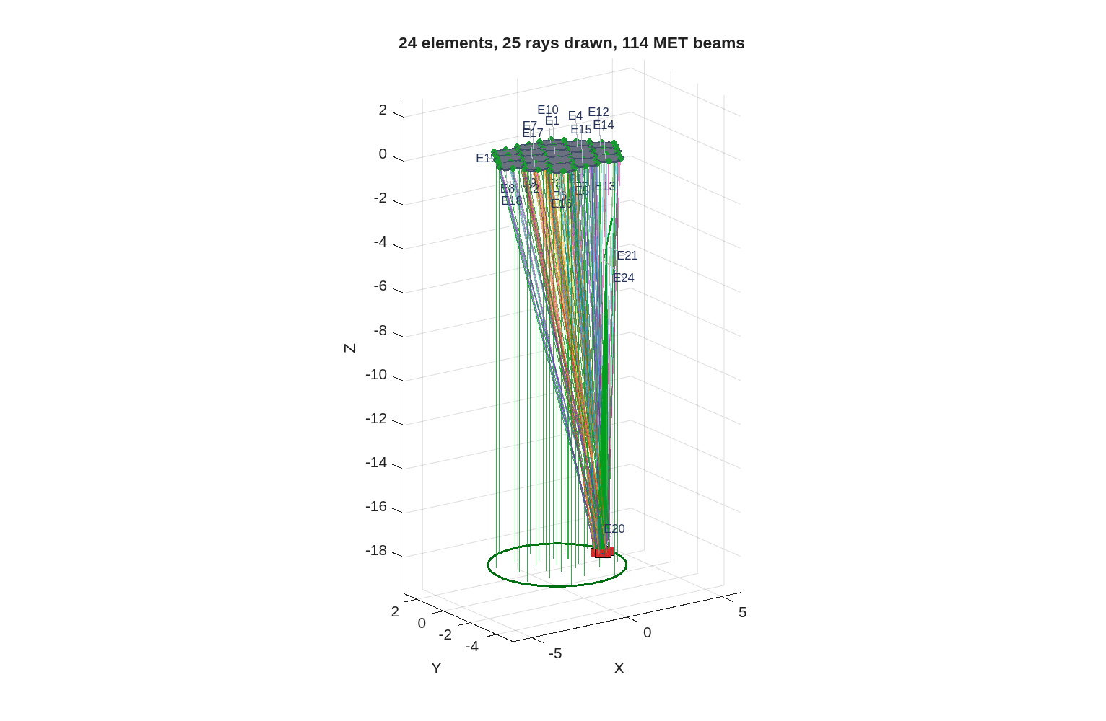
Segmentation, metrology, controls — on the observatory
The same segmentation and metrology machinery the smaller studies proved, at 6 m scale
• The primary segments hex-19 with physical apertures through the same segmentation product; every segment gets rigid-body and surface-figure sensitivity channels, stacked into one Jacobian — the control basis.
• Metrology and edge sensors are designed ON that Jacobian — 114 beams from the launcher stations shown — and the same matrices drive the estimator and the closed loop.
• The channels themselves — dw/dx, dw/dz, dw/dgrid — follow on the next three slides, at readable size.
The metrology on the observatory: 24 elements, 114 MET beams to the aft launcher station.
Record: templates/80_end_to_end/e2e6m_r2, sensitivities + MET stages.

Slide 26
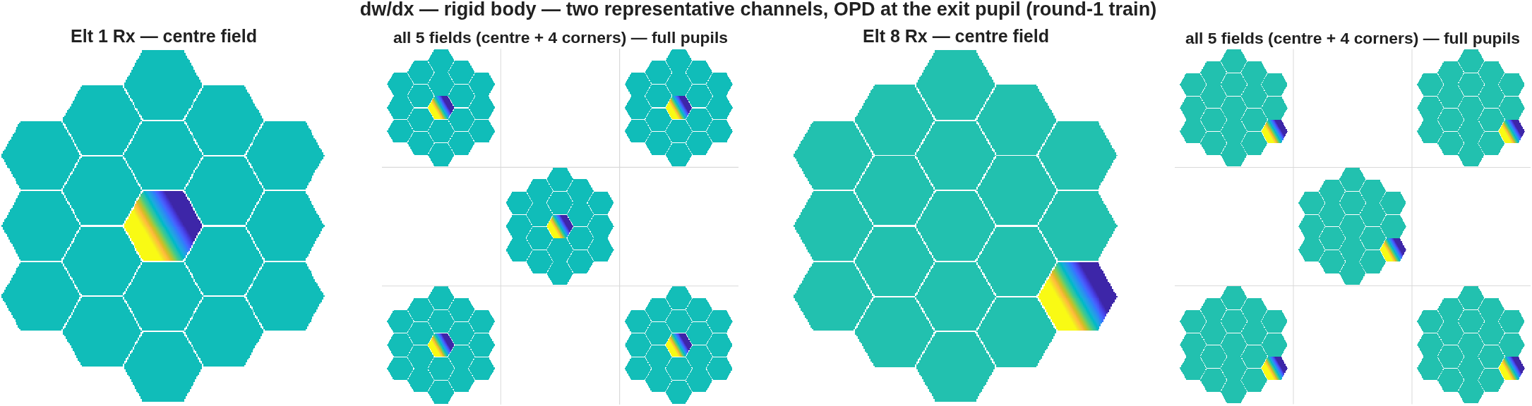
The state equations I: rigid-body channels — dw/dx
Runner: macos.dw_dx_multi, harvested by run_sensitivities (stage r3) — OPD at the coronagraph exit pupil per unit rigid-body motion
Two rigid-body channels: the centre segment (E1) and an outer-ring segment (E8), x-rotation — the centre-field OPD at full size, then the same channel at all five fields, every pupil full. Drawn from the round-1-train harvest, whose stops pass the whole box; the r2-train harvest matches at the centre field, but its DM-bearing coronagraph clips the corners — that instrument works the centre field. Piston removed; 1–99% color scale.
• Six rigid-body DOFs for every optic — the 19 segments, M2-M3, both DMs, the 8 OAPs — plus the whole primary as one rigid group, five fields each, stacked into the control Jacobian. The response lives on the moved segment's footprint and walks with field. The coronagraph works the center field only — its stops vignette the corners; the imaging leg sees the full box.
Harvest on r1_seg_prop.in, the deck the simulator propagates; per-field FEX reset; closure gated by jacobian_check. Every panel is one line from the saved Jacobian: OPD = v2m(dwdx(:,k), indx). Record: templates/80_end_to_end/e2e6m_r2.

Slide 27

The state equations II: segment-figure channels — dw/dz
Runner: macos.dw_dz_zernike_multi, harvested by run_sensitivities (stage r3) — MonZernike modes 4–11 on each segment
Two of the 152 channels: segments E1 and E8, MonZernike mode 4 — the centre field at full size, then all five fields (round-1-train harvest, full pupils). Piston removed; 1–99% color scale.
• Zernike figure modes 4–11 on each of the 19 segments, M2-M3, the 8 OAPs — five fields each. Each channel is confined to its own segment; the mode shape is visible at a glance.
• Any element can have deformations described by up to 65 Zernike modes.
• MACOS supports 4 types of Zernikes, in normalized or raw forms.
Same harvest, metric and gates as dw/dx. Record: templates/80_end_to_end/e2e6m_r2.

Slide 28
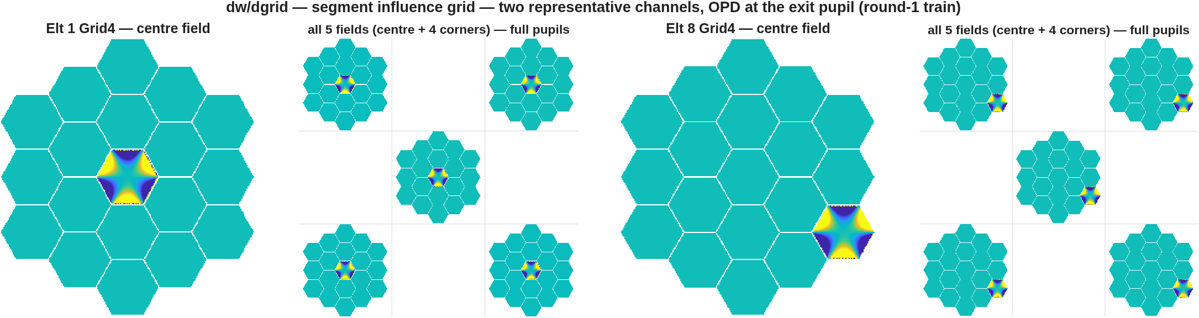
The state equations III: shape-normalized modes — dw/dgrid
Runner: macos.dw_dgrid_multi, harvested by run_sensitivities (stage r3) — the grid influence basis on each segment
Two of the 114 channels: segments E1 and E8, grid mode 4 — the centre field at full size, then all five fields (round-1-train harvest, full pupils). Piston removed; 1–99% color scale.
• GridData surfaces can be used to add nearly any surface departure form: as-measured aberrations, Gram-Schmidt orthogonalized Zernike modes, and DM actuations are all used in coronagraphic telescope models.
• These plots illustrate grid-basis influence shapes on 2 of the 19 segments, using the interface for measured influence functions and actuator maps.
• DM Jacobians use the same form: dw/dDM.
Same harvest, metric and gates as dw/dx. Record: templates/80_end_to_end/e2e6m_r2.

Slide 29
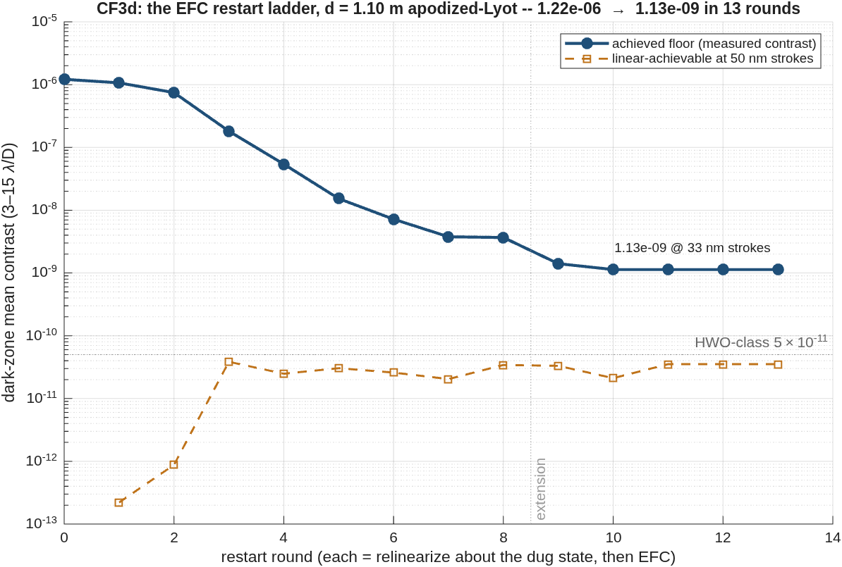
Digging the dark hole: the overnight restart ladder
1.2×10⁻⁶ → 1.1×10⁻⁹ — three decades from restart scheduling alone; no new hardware, no new physics
• The recipe: EFC to a floor, relinearize about the dug state, restart at that floor — rinse and repeat. Ten digging rounds, ~4 h unattended, on the d = 1.10 m two-DM variant — the spacing study's best linear substrate; three stall rounds then prove the plateau.
• The controller was the bottleneck, measured: a single linearization stalls at 9.0×10⁻⁷; every restart bought another step down. DM strokes end at 33 nm rms, well inside the 50 nm budget.
• The remaining 1.5 decades are priced: re-measured at every dug state, the linear-achievable floor holds at 2–4×10⁻¹¹ — HWO-class 5×10⁻¹¹ is within this substrate's reach. The plateau at 1.1×10⁻⁹ is the monotone Tikhonov step rule: the measured case for FALCO-grade step control on this same model.
The ladder: measured dark-zone floor by restart round, with the linear-achievable substrate re-measured at every dug state.
Record: templates/80_end_to_end/e2e6m_r2, CF3d stage — checkpointed and resumable; every round is a finished floor.
This document has been reviewed and determined not to contain export-controlled information

Slide 30
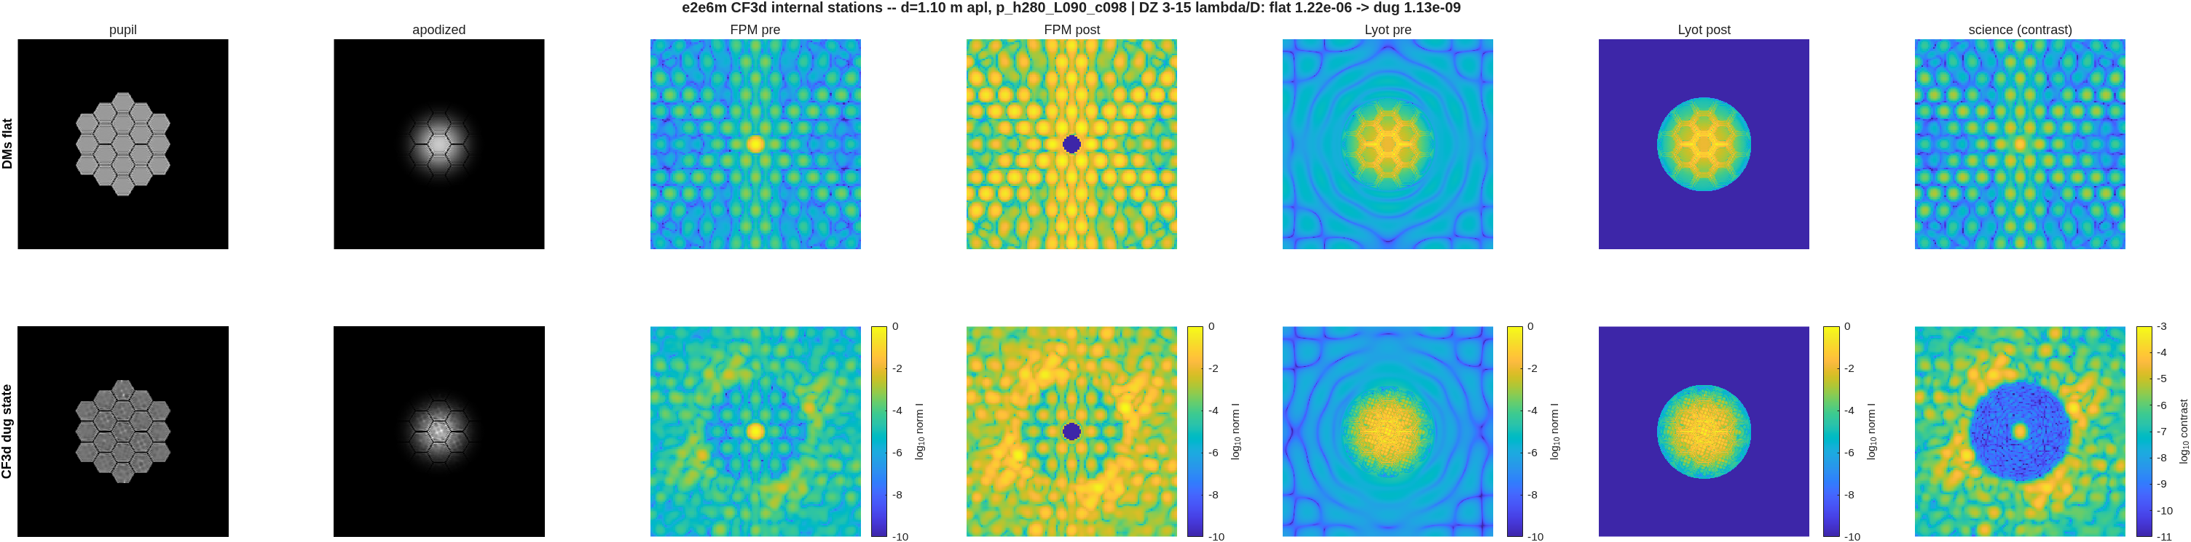
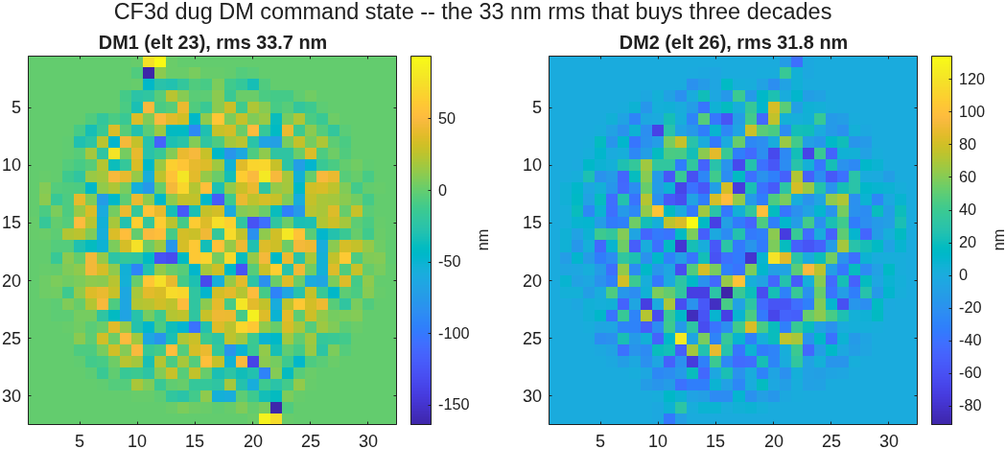
Inside the dig, station by station
Intensity at seven internal planes — the DM commands visibly do the gap work
Seven planes, DMs flat (top row) against the dug state (bottom): pupil, apodizer, focal plane before and after the occulter, Lyot plane before and after the stop, science-plane contrast. The dug row ends in the full 3–15 λ/D annular dark hole at the 10⁻⁹ floor; the in-walk dark-zone means reproduce the scored record exactly.
• DM1's command map imprints the hex-gap lattice — the controller is doing the gap-and-edge work the apodizer was bought for, actuator by actuator, at 33 nm rms; a no-apodizer A/B to price the throughput trade is the scoped follow-on.
• The 0.90 Lyot stop removes only ~0.1% of the post-occulter energy — this train's rejected light is interior gap structure, not edge rings, so the Lyot radius is not where the suppression happens.
The CTB documentation model — intensity at key planes, compact-vs-full — applied to the observatory train: same station layout, the two columns now DMs-flat vs dug.

Slide 31
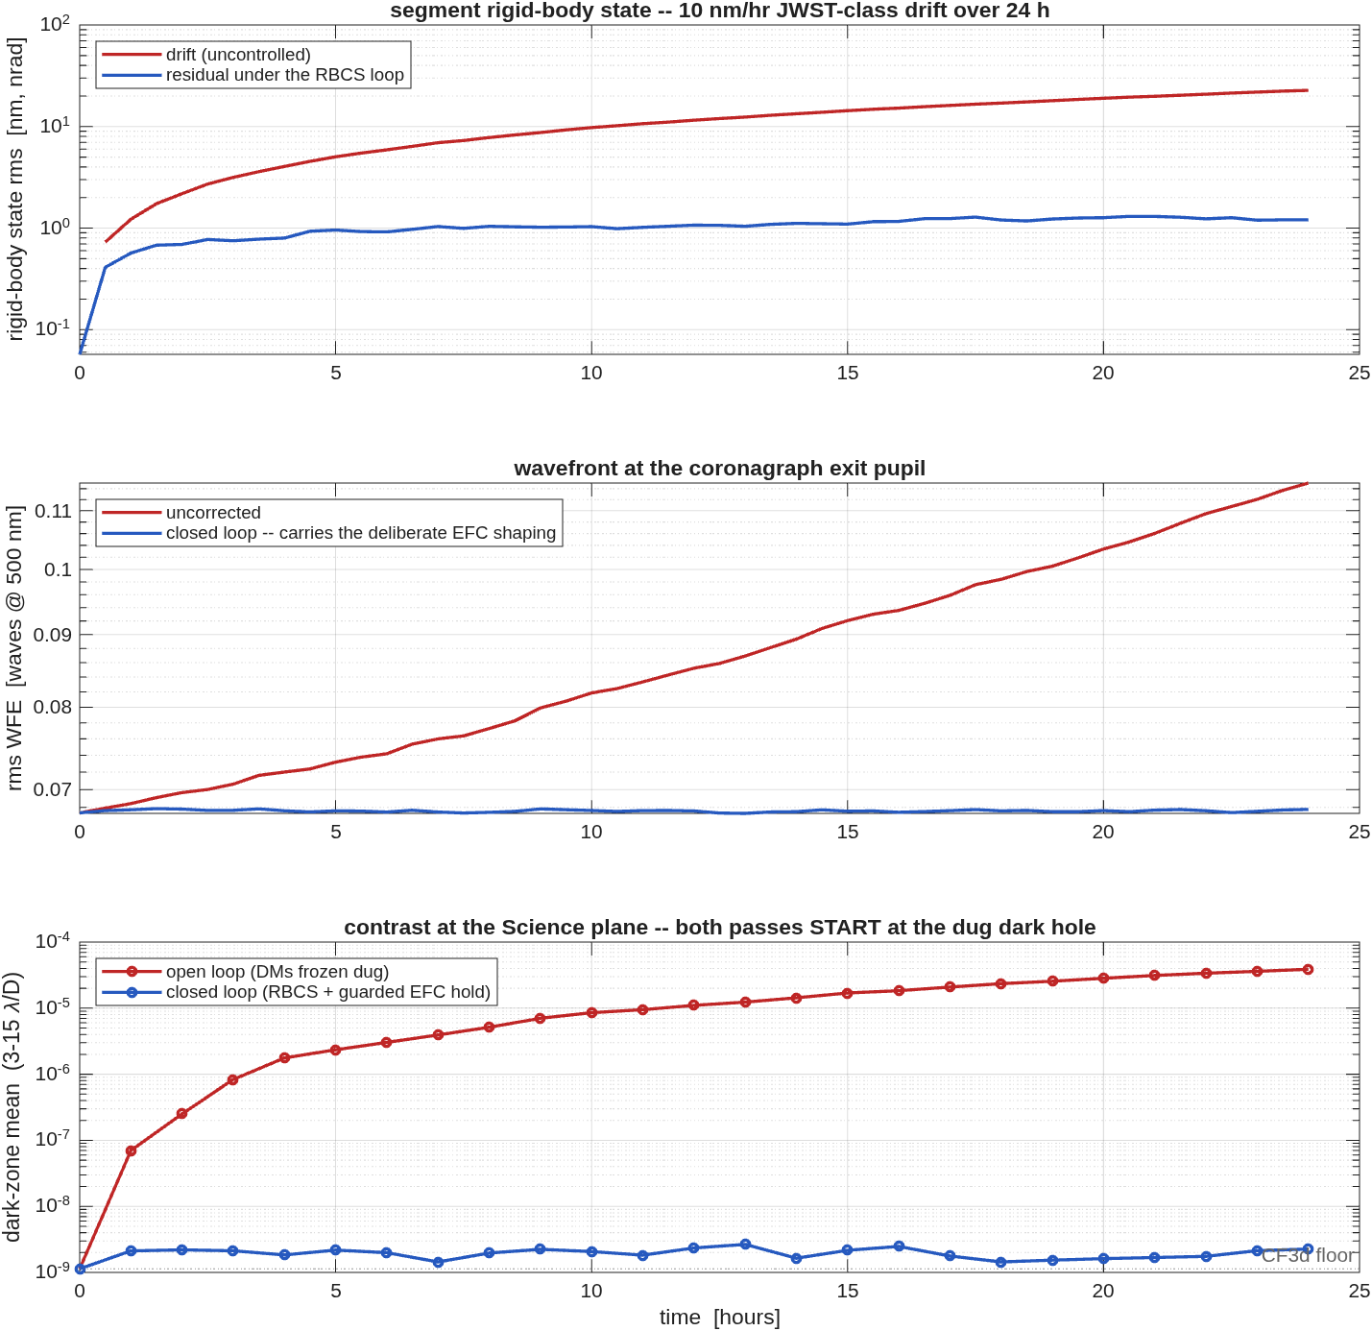
A randomly disturbed observatory, simulated
JWST-class drift on the dug dark hole: open loop decays 4.5 decades in a day — the loop holds 2×10⁻⁹
• The series starts at the new solution — frame one reproduces the dug floor (1.134 vs 1.133×10⁻⁹, a built-in gate) — and runs a random disturbance: a 10 nm/hr correlated drift ramp plus a 0.5 nm-per-step walk, 24 hours at 30-minute frames.
• Open loop, DMs frozen at the dug state: 1.1×10⁻⁹ → 3.9×10⁻⁵. The first decade is lost to the first nanometre of drift — at 10⁻⁹, continuous control is not optional.
• Closed loop: the rigid-body loop senses through the designed metrology and holds the segment state at 1.2 nm against 23 nm of accumulated drift; a guarded EFC hold — one damped step per hour about the dug-state Jacobian, 25 steps taken, none reverted — keeps the dark zone at ~2×10⁻⁹ for the full day.
• The disturbance interface is the point: the same channels ingest dynamical- and thermal-model time histories — simulating performance in the space environment.
Twenty-four hours random drift, both passes starting from the dug dark hole: segment rigid-body state, exit-pupil wavefront, and science-plane contrast — open loop against closed.
Record: templates/80_end_to_end/e2e6m_r2, CF5b stage — d=1.10 deck, G = the ladder's dug-state Jacobian.

Slide 32
The agent asks: what buys the last decade?
For coronagraph folks
• Our EFC restart ladder walled at 1.1×10⁻⁹ against a measured 3.5×10⁻¹¹ substrate — the step rule was the binder, not the optics. What buys the last decade and a half in your experience: β-bump schedules, per-mode regularization, constrained strokes?
– Control ≡ truth in these runs — the no-knowledge-error regime HCIT calls "optimal regularization"; estimation and gain-map knowledge errors are the next phase.
• The apodizer's real purchase measured as stroke economy: the same 10⁻¹¹-class substrate costs 33 nm of DM stroke apodized and microns bare, at 8× the throughput. Do micron-stroke amplitude solutions survive real hardware?
Genuine question — the agent is live and will follow up.
This document has been reviewed and determined not to contain export-controlled information

Slide 33
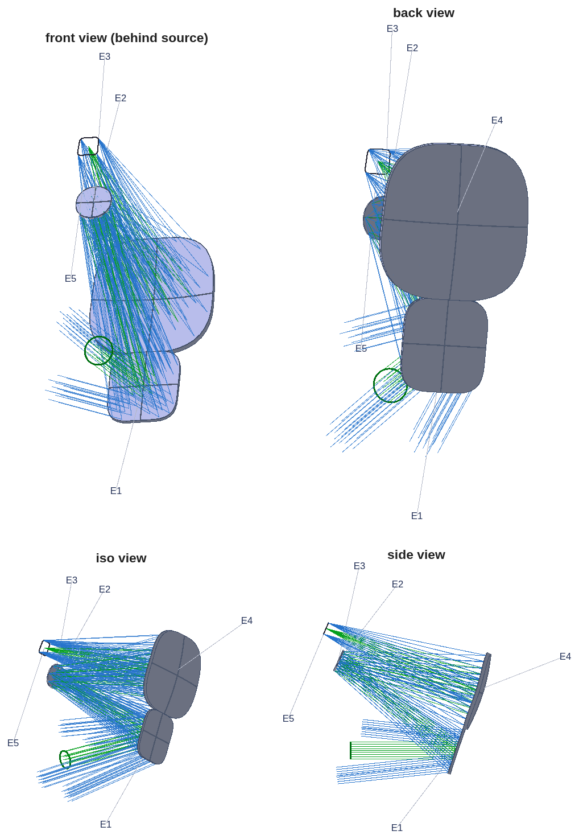
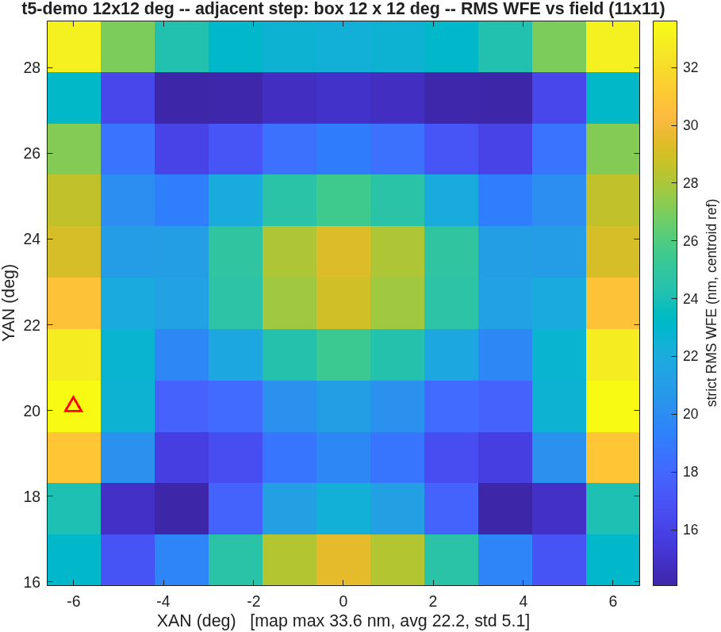
The live design, revealed
Predicted from the frontier before solving; solved in one warm-started step while we talked
• The ask: a field-box width, anywhere in 5–15°. The prediction, stated before the solve: interpolated from the committed frontier rows.
• The pre-run rehearsal of the default ask (12°): predicted 33.7 nm; solved 33.6 nm — 1.00× — at a 24.9 mm clearance floor, both checks pass, in 15 minutes.
• The run is deterministic to every printed digit, and every ask is a genuine continuation step — never a re-score of a stored design.
On demo day the live run's figures replace these panels; this pre-generated bundle is the fallback if the room's ask matches nothing better.
The 12° rehearsal design and its field map: 33.6 nm max against a 33.7 nm prediction.

Slide 34
AI in design and analysis — the working questions
What we ask of an AI-driven study before believing it
• How is a machine's result verified?
– Regression checks with negative controls
– Cross-checks with established results, codes, hardware experience
– Layout renders read against every claim — the checks caught the errors shown today.
• Where does the human rule?
– People pilot the AI – setting the problem, providing experience based prompts, catching obvious errors
– Constraints, metrics, and every outward claim — the AI proposes, the record decides.
• Is it reproducible? Every number in this deck rebuilds from committed scripts and committed records — including the design solved during this talk.
Offered as discussion questions, not settled doctrine — the next slide takes one of them to architecture.
This document has been reviewed and determined not to contain export-controlled information

Slide 35
The agent asks, last: could conventions ship as data?
The largest error class an AI produced in months of optical work
• The sign of a radius; which reference sphere a number is quoted against. Nothing cost this agent — or its human reviewers — more error than conventions, and today the answers live in manuals. Could the macro/API layer serve them as data — let a program, or an AI, ask the design which convention a number is in, instead of inferring it?
• The agent's other questions were asked where they arose: basins and merit scaling, the afocal family and its unexplained decenter effect, the testbed's last decade. All are genuine — answers relayed in the room reach it live.
These are the questions this work earned; the next slides are what we would recommend.
This document has been reviewed and determined not to contain export-controlled information

Slide 36
Discussion: where should the agent sit?
Three modes — two exercised by these studies, one open — and the boundary between them is the question
• A · The compiled tool, no agent — what ships: versioned, regression-tested, inspectable, and it runs unattended. But measured on a cold user, the docs alone did not carry them.
• B · An agent alongside the tool — what these studies did: it found and fixed the conceptual defects in hours and chose what was worth compiling. Its knowledge is current — but not versioned with the tool.
• C · A helper embedded in the tool — the open question: advice at the moment of use, catching the failure class that was documented and still fatal.
• Shapes for C, in increasing authority: agent-readable state (the user's own assistant drives the tool); a failure-triage assistant (fires on a failed check, returns a diagnosis and a next command); a policy assistant inside hard limits (chooses schedules and targets; the code enforces limits and logs every choice).
• At any level, tier the agents: an orchestrator plans and delegates bounded tasks; the committed records — not any agent's memory — are the shared memory.
A stale check fails loudly; stale advice fails silently. Measured: the tool alone did not carry a new user; an agent alongside it closed every gap — and most of what it learned is now in the tool, as checks and defaults.

Slide 37
If you asked us: AI around CODE V and LightTools
Add it around the optics, not in them — every claim below is measured, not speculative
• Make the tools agent-readable first — state, results, warnings and docs as structured data through the existing macro/API surface. Every user's assistant then attaches today, and the vendor ships no intelligence at all. This whole talk ran in that mode.
• Ship the conventions as data. The largest defect class our agent found was conventions — the sign of a radius, DAR versus a coordinate break, which reference sphere a number is quoted against. Make them queryable and the dominant error source disappears for humans and agents alike.
• Embed a failure-triage assistant first — it wakes on a failed trace or a stalled solve, reads the saved state, and returns one line of diagnosis plus a next command the person runs. Our stalled solve was a finite-difference step reading the gradient 17% low: a one-line answer sitting in state the tool already had.
• Put the agent in the search, never in the numerics — starting points and basins (a warm-started walk beat the cold start 8500×); variable-set audits (35% of a metric unclaimed because one freedom was never offered); optimization schedules (a restart ladder dug the dark hole 1.2×10⁻⁶ → 1.1×10⁻⁹ overnight); tolerancing and glass searches.
• Ship the trust machinery with it: every AI action a readable, replayable script — never an opaque state mutation; every proposal a before/after check with negative controls; the assistant's knowledge versioned with the release.
The agent proposes; the trusted engine disposes.

Slide 38
Backup Slides

Slide 39
Validation anchors
The trust base, by physics domain
domain | reference | agreement
geometric ray trace | CODE V comparison suite | 6,601 tests
physical optics | PROPER propagation library | 10⁻¹¹–10⁻¹³ well-sampled; 10⁻⁸–10⁻⁵ sampling-limited / post-focus
polarization | Born & Wolf / Abelès closed forms | 10⁻¹²–10⁻¹⁴
polarization, lab | published protected-Al Mueller data | ~10⁻¹⁴ vs the model
build integrity | two compilers, one tree | bit-identical
• The non-vacuity rule: every regression check is shown to fail against the pre-fix engine before it counts as protection.
Suites run per commit; counts as of 2026-08.
This document has been reviewed and determined not to contain export-controlled information

Slide 40
The adjacent-design rehearsal bundle
Three widths, pre-run end to end at the demo settings
ask | warm start | predicted | solved | clearance floor | checks | wall time
7°×7° | 5° step | 18.0 nm | 20.0 nm (1.11×) | 93.8 mm | pass | 15.2 min
12°×12° | 11° step | 33.7 nm | 33.6 nm (1.00×) | 24.9 mm | pass | 15.2 min
14°×14° | 13° step | 54.9 nm | 51.2 nm (0.93×) | 24.9 mm | pass | 15.2 min
• A repeat 12° run reproduces the bundle to every printed digit — the demonstration is deterministic.
• Wide asks pass: the committed frontier line understates the envelope (its widest rows stopped early on a wavefront-only criterion while the clearance penalty was still improving).
Bundle: templates/10_telescopes/offset_imager/demo_adjacent — figures, verdict text, prescriptions, run records.
This document has been reviewed and determined not to contain export-controlled information

Slide 41
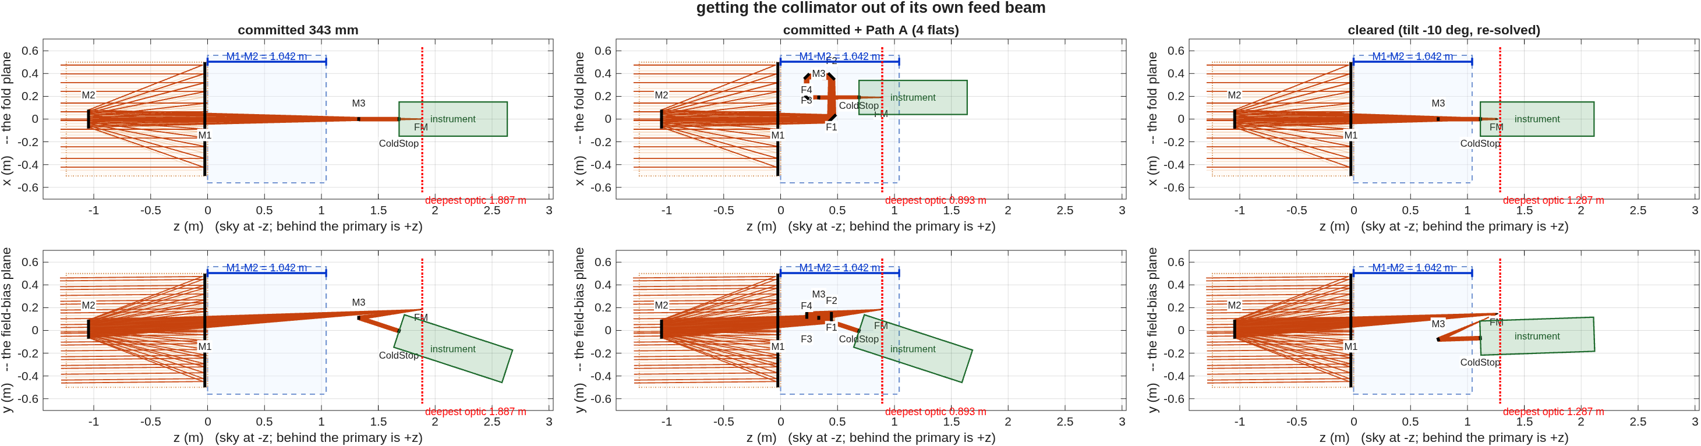
Challenge 2 packaging, three ways
The committed deck, the retired four-flat recipe, and the cleared tilt — engine truth on one scale
Reading the markers: the blue dashed box is the stated envelope — the slab one M1–M2 spacing deep directly behind the primary, inside the 0.56 m keep-out radius; the blue bracket is the M1–M2 yardstick the depth ratios read against; the red dotted line marks the deepest optic; the green patch is the instrument volume along the exit chief.
Committed: deepest optic 1.887 m = 1.81× the spacing, the feed beam through the collimator by −79.9 mm. Four-flat recipe: 0.893 m deep, but a fold is an isometry — the interference rides across — and it does not close on the cleared deck (96 routes, every admissible one loses rays). Cleared −10°: 1.287 m = 1.24×, zero flats, +37.8 mm of daylight. Record: challenges/afocal4/{packaging,clearing}.
This document has been reviewed and determined not to contain export-controlled information

Slide 42
Interferometer demonstration backups
One committed image per live beat
Beat 5 — one actuator poked: the fringes bend over it.
Beat 6 — the analyzer sweep: phase-stepped frames, no re-trace.
Beat 7 — the recovery beside the truth map.
All eight beats have committed figures in templates/90_polarization/tg_psi_dm_v2 (v1 likewise); the driver opens them on the desktop as each beat runs.

Slide 43
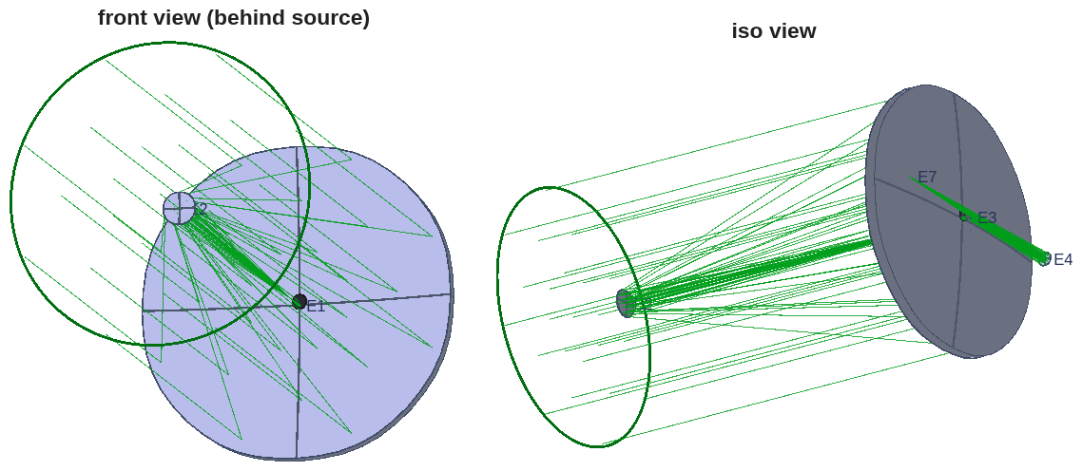
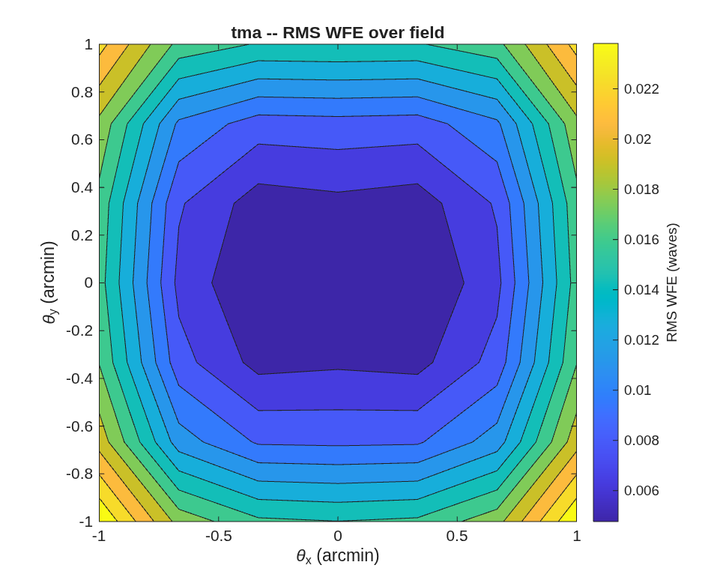
The e2e worked example: specification to design
A 4 m f/18 visible-band telescope from a closed-form seed — no starting prescription
• The stage-runner sequence on the smaller worked example: specification → design → segmentation → metrology → comparison → simulation, each stage a committed runner handing its prescription to the next.
• A 4 m f/18 telescope (f/1.75 primary) from a closed-form first-order seed; diffraction-limited over ±1′ alone, and the Offner ring-field relay buys the full ±2′ (Strehl floor 0.965, on pure spheres).
The telescope as designed (front + iso views), with the traced field.
Wavefront error over the field: diffraction-limited across the box.
Record: templates/80_end_to_end/e2e — staged worked example, committed at every step.
This document has been reviewed and determined not to contain export-controlled information

Slide 44
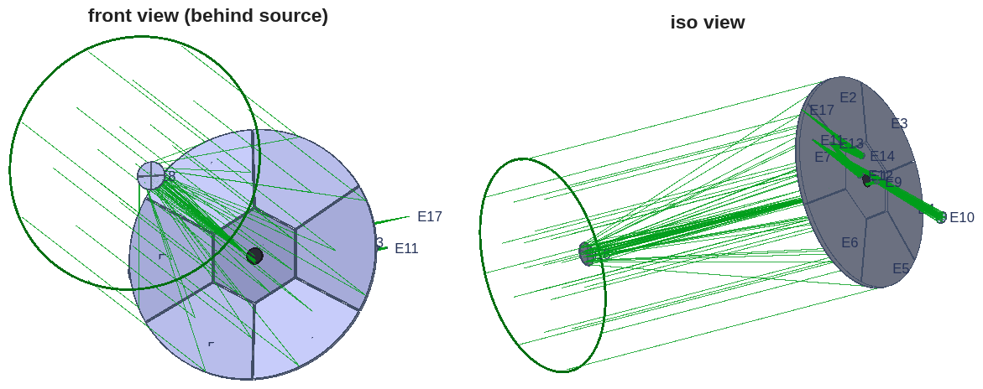
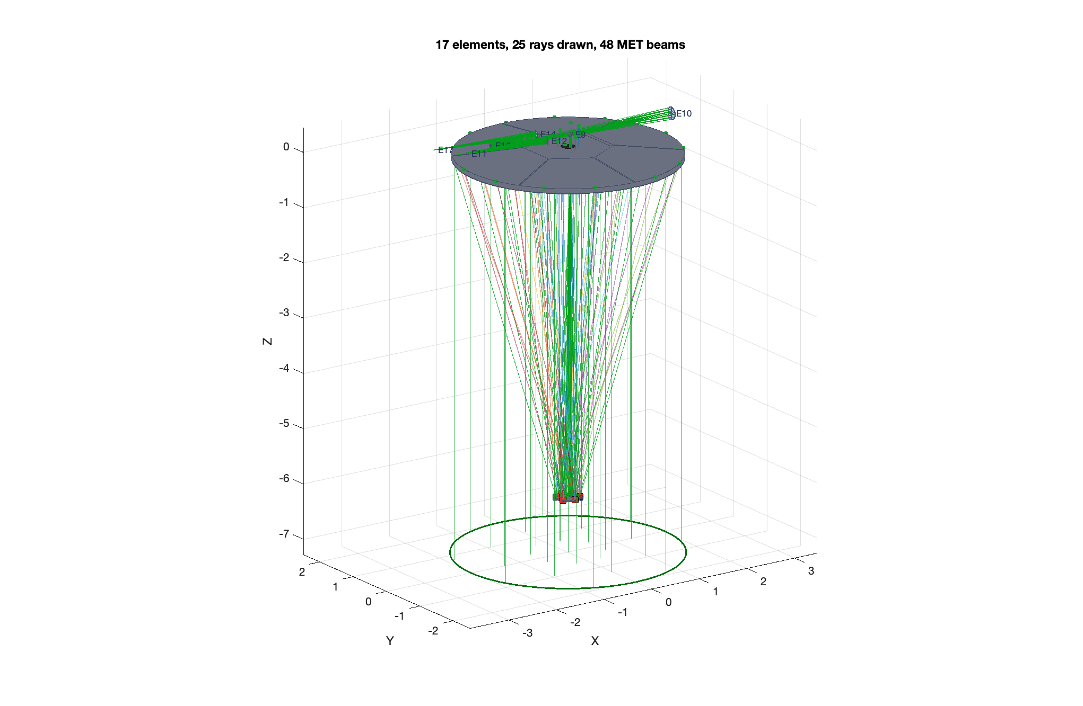
The e2e worked example: segmentation and metrology
The monolith segments in one call; the metrology is designed on the same Jacobian
• The primary segments into a pie or hex tiling with physical apertures; every segment gets rigid-body and surface-figure sensitivity channels, stacked into one Jacobian — the control basis.
• Metrology is an optimization on that basis: edge-sensor and beam-launcher layouts scored by the control information they carry, not by symmetry; the winning pattern exports as a reusable preset.
The segmented primary with physical apertures (front + iso views).
The optimized metrology layout on the segmented primary.
Record: templates/80_end_to_end/e2e, stages 3–5.
This document has been reviewed and determined not to contain export-controlled information

Slide 45
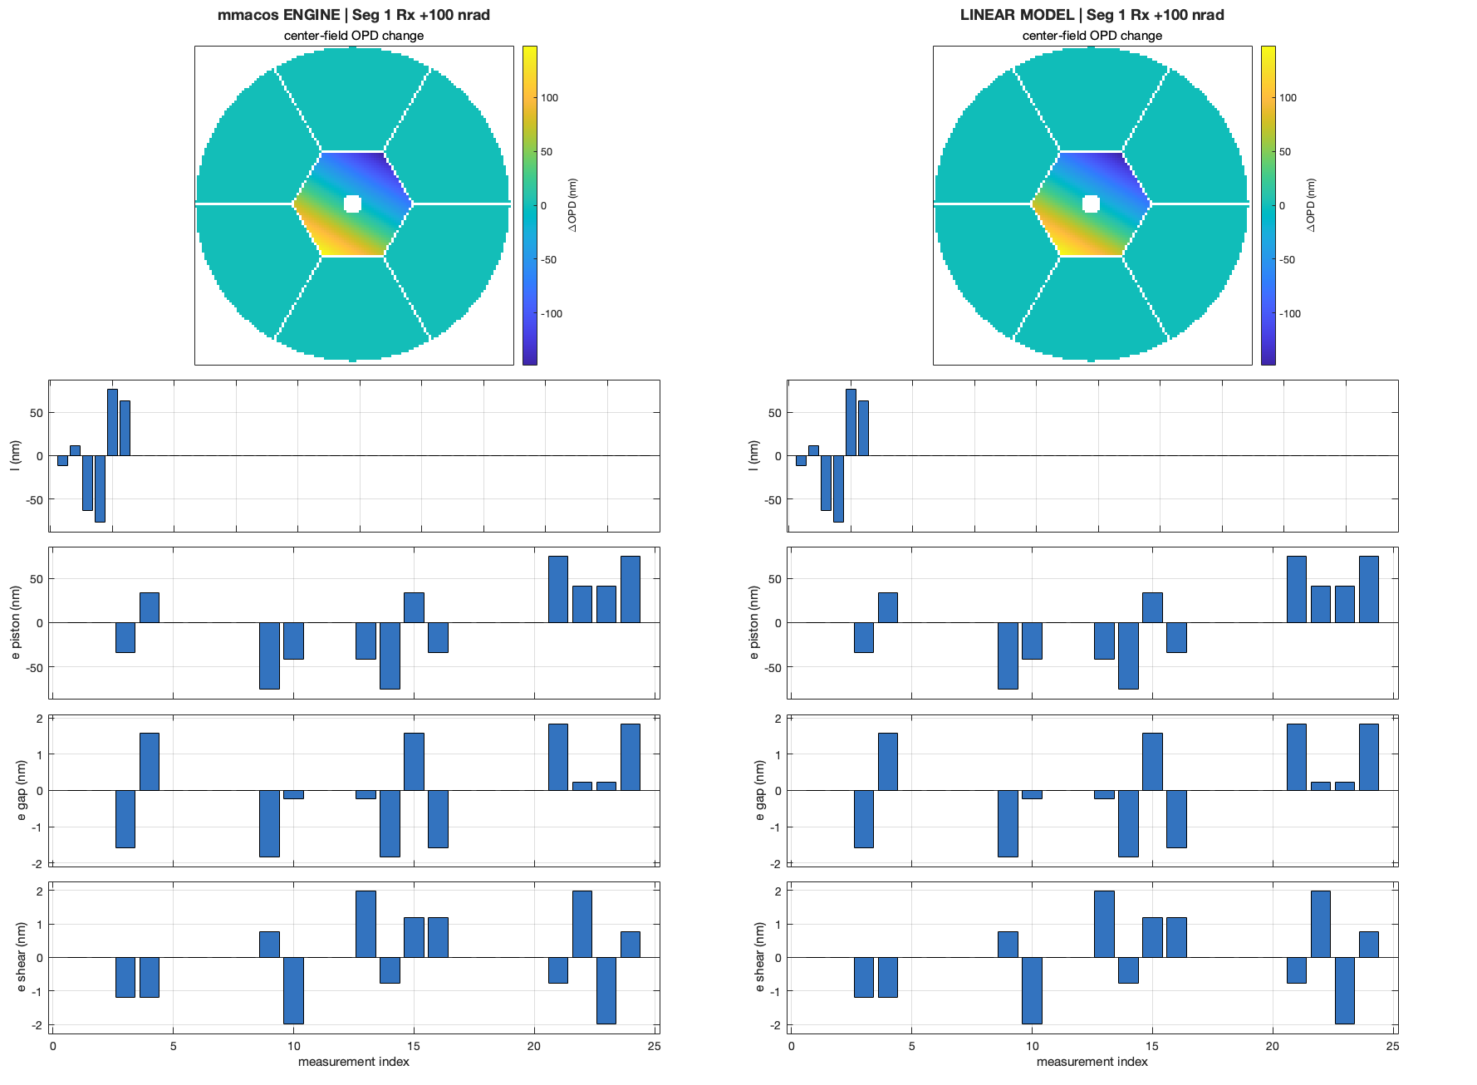
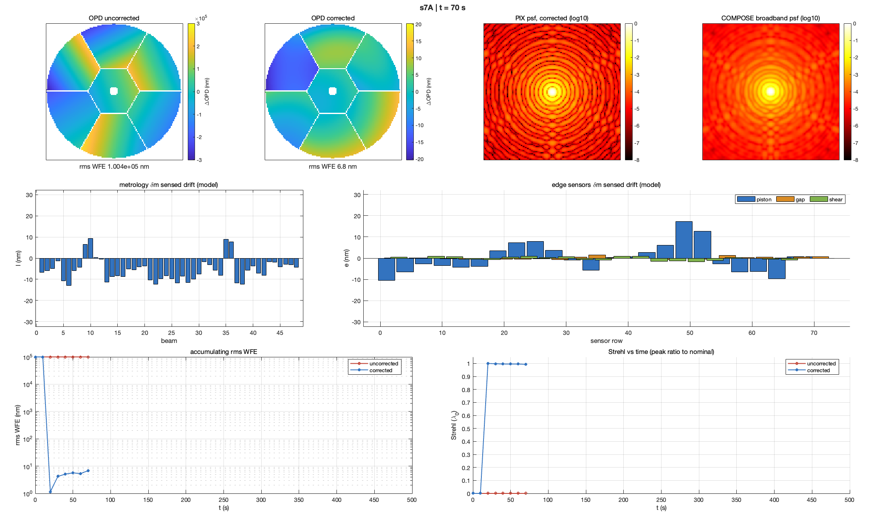
The e2e worked example: comparison and simulation
Segment drift of 10⁵ nm rms is sensed and held at ~7 nm corrected
• Every linear model is checked against the engine before it is trusted: step each channel, re-trace, render engine and model side by side (left). Then the simulator closes the loop on the same model: inject drift, sense with the designed metrology, estimate, correct (right).
The comparison stage: engine re-trace vs linear model, one perturbation channel (segment 1 Rx, +100 nrad).
The simulator at t = 70 s: uncorrected 1.0×10⁵ nm vs 6.8 nm corrected; accumulating WFE and Strehl vs time below.
Record: templates/80_end_to_end/e2e, comparison + simulator stages (s6/s7).
This document has been reviewed and determined not to contain export-controlled information

