Slide 1
DM Surface Gauge Comparison
Four ways to measure a 96×96 deformable mirror's surface to picometers on one optical bench — a phase-shifting interferometer, a Zernike sensor, its polarized version, and a point-diffraction sensor — scored on the same mirror, the same light, and the same three jobs: measure the surface, capture its shape after launch, and hold the surface to <<10 pm in a servo.
D. C. Redding, with Claude Code.
October 2026. For the JPL HWO WFS&C discussion group, 2026-10-08.
DRAFT — pending review. Every number here comes from a committed run of one shared, parameterized model (MACOS, mmacos); the run tags are on the provenance slide.

Slide 2
One optical bench to demo 4 surface gauges, in mirror and lens forms
Comparing accuracy, precision, repeatability and hold, for interferometers, scalar and vector Zernike WF sensors, and a point-diffraction sensor
the claim (interferometer, both rigs) | what it means here | lens rig | mirror rig
accuracy | the imaging's error in reading a 30 nm working surface, piston and tilt removed | 0.13 % (42 pm) | 0.29 % (92 pm)
 | the same, in the top spatial band (at the actuator Nyquist) | 0.5 % | 0.9 %
precision | one measurement, photon-limited, at 1e14 / 1e15 photons | 2.3 / 0.7 pm | 2.1 / 0.7 pm
repeatability | the same surface held in a servo, rms over 30 cycles, same photons | 1.4 / 0.5 pm | 1.3 / 0.4 pm
hold | photons per cycle to keep the surface inside 3 pm | 2.3e13 | 2.0e13
 | the same under a 2 pm per actuator per cycle random walk | 7.1e13 | 6.6e13
• Picometer measurement is photon-limited, not bench-limited. One measurement at 1e15 photons — 0.31 mJ, about 1.3 s of a 1 mW laser — repeats to 0.7 pm, and a servo fed at that rate holds under half a picometer. Both front ends agree to within 10 %. For scale, Steeves et al. (2020, Optica 7, 1267) demonstrate 1.6 pm in 4.3 s on a real interferometer: ours is photon-limited only, carrying no vibration, thermal drift or detector systematics, so it is the floor this design allows rather than a prediction of the built bench — and agreeing within a factor of two is the check that the model is in the right regime.
• Accuracy is systematic and proportional — a fraction of the figure read, so 30 nm costs tens of picometers and a 200 nm capture figure costs hundreds. It holds because the response matrix is measured on the surface, not assumed geometric.
• One disturbance is not photon-limited: under a 5 pm per cycle thermal ramp the loop lags at about 10 pm however many photons it is given — a cadence and thermal-control requirement, not a sensing one.
The table is the interferometer's, the one gauge scored on both front ends; the three sensors, scored on the mirror rig, read within 1 % and 2 pm of it on the same surface (the side-by-side slide). A 10 nm single-actuator change, what the servo corrects, reads against truth to 1.5 pm at gain 1.001 on lenses and 1.8 pm at 0.993 on mirrors. Run tags are on the provenance slide and on each slide that derives a number.

Slide 3
The three jobs, and how each is scored
Measure the mirror's surface to picometers; capture its post-launch shape, 100-200 nm of wavefront, into the servo's reach; hold it there in a servo
• The DM: 96×96 actuators on a 1 mm pitch, 96 mm across. On orbit its surface must stay constant to well under 10 pm, measured often and held by a closed loop. Every test runs on a random 30 nm rms working surface, not a flat: the gauge never operates at null.
• Job 1, measure: read a change of 10 nm on one actuator, of 1 nm on 47 actuators, and a dense random 10 nm pattern, on the 30 nm surface with the response matrix measured on it; and keep that accuracy as the surface moves away from the calibration (capture range).
• Job 2, capture: bring a large starting surface, 100-200 nm of wavefront, down to the servo's floor; every phase reading wraps at ±158 nm of surface (±π at 632.8 nm, double pass), so this is a wrapping problem before it is a noise problem.
• Job 3, hold: the servo at picometers on the 30 nm rms working surface, its set point: the light per cycle that holds changes about it to 3 pm rms under a 2 pm per-cycle random walk, and whether the reading leaves a fixed error.
score | meaning
gain | recovered change ÷ true change; 1.0 is perfect; quoted after calibration
floor | rms of the actuators that were not changed, in picometers
SNR | recovered change ÷ floor; above 5 counts as detected
photons per measurement | all frames of one measurement summed; 1e14 photons at 633 nm = 31 µJ = 0.13 s of a 1 mW laser at 25% throughput
capture range to 10% | the largest working surface at which a 10 nm change on the 47 sites reads within 10%, the matrix left as calibrated at 30 nm
capture | the largest starting surface the servo brings to 3 pm
hold, one number | photons per cycle that hold 3 pm rms in a 60-cycle loop at gain 0.5
Measuring a change costs two measurements. The 96×96 at 385 detector pixels per pupil is the flight-like sampling; most rows here are at 193 pixels, which the sampling study showed reads the same numbers.

Slide 4
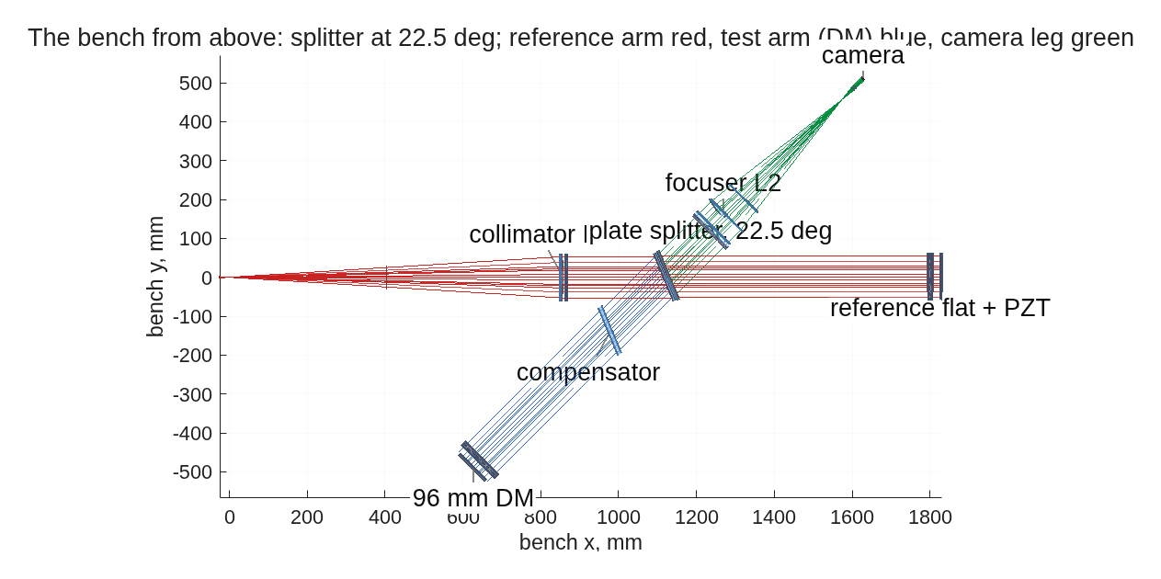
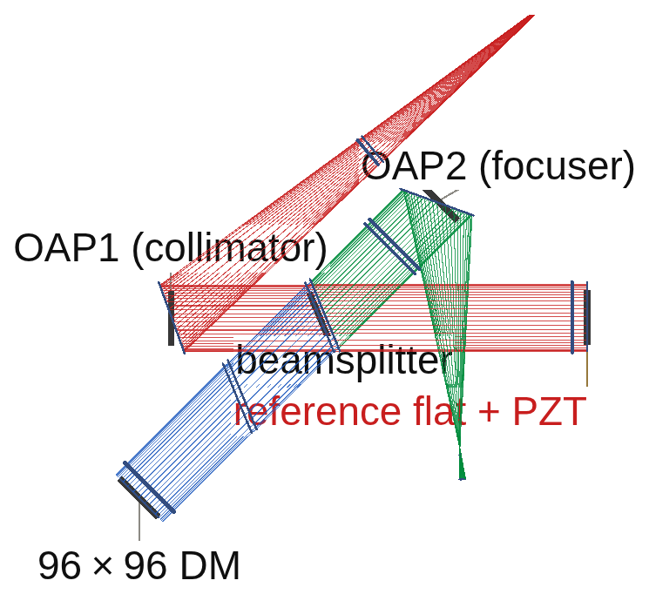
One bench, two forms, four ways of sensing
Everything shares the front end: a filtered HeNe, a collimator, a plate splitter at 22.5°, a 700 mm leg to the mirror, a focuser to an internal focus, a field lens to a camera at the pupil image; the collimator and focuser are lenses or off-axis parabolas
The lens rig as traced by the engine, from above: source at left, collimator L1, the 22.5° splitter, the 96 mm mirror on its 700 mm leg (blue), the reference arm and its flat (orange, the interferometer only), the focuser L2 toward the internal focus. The mask seat at that focus is where the four sensing methods differ.
The reflective rig, redesigned on the same splitter: the source and input polarizer in the diverging leg, OAP1 collimating at a 20° fold, the same node, OAP2 focusing at 25° toward the mask seat. Both drawings are the tools' own renders to scale; parts and thicknesses are on the next slides.
 | lenses (L1, L2: 103 mm singlets) | off-axis parabolas (OAP1 20°, OAP2 25°)
for | on axis, no polarization from folds; inexpensive parts | no glass in the beam: works at any color (a second color for capture is free), no ghosts; the focus lands on the mask without adjustment, and the residual with a flat mirror is 0.029 nm against the lens rig's 0.13; every part clears by 33 mm
against | one color at a time; each plate in the converging beam adds aberration (0.03 wave per 2 mm); the detector leg reaches its best focus only after a numerical adjustment; faces need anti-reflection coating | the metal folds polarize: the vector reading needs its two channels calibrated (634 pm raw, 0.054 pm calibrated; a quarter-wave overcoat halves the raw error); 10 µrad of mirror tilt moves the null 95-103 nm; the raw four-step reading wraps between 60 and 120 nm of surface on both rigs (a base past λ/2 reads 91 nm whatever it is); both capture with unwrapping
where it stands | reads 1.004 / 1.4 pm on a 10 nm change; holds 3 pm from 2.3e13 photons per cycle; captures from 200 nm to 3.1 pm in 60 cycles | reads 0.986 / 2.3 pm; holds 3 pm from 2.0e13; captures from 200 nm in 24 cycles; the pinhole and the calibrated vector pair pass
The reference arm (a 103 mm flat on a piezo, 564 mm leg) is the interferometer's; shuttered, the same bench is every other sensor. Run tags bench_bs22, oapdraw3, redo96_lens, redo96_oap, redo96_lensloop, redo96_oaploop, capt96_oap, capt96_lens, redo96_oapsens; the priced comparison is on the lenses-versus-mirrors slide.

Slide 5
Parts common to every configuration: the front end
The source, the collimator and the splitter node, from the parameter sheet; the substrates are now decided (10 mm splitter and compensator, 2 mm fused-silica plates under every polarizing element, a 2 mm mask plate, 4 mm lens edges) and go into every deck from here
part | size and figure | coating | count | purpose
laser, spatially filtered | HeNe 632.8 nm, 1 mW class; the source cone is baffled to 59 mm radius, overfilling the mirror by 11 mm | — | 1 | the source; 1e14 photons per measurement is 0.13 s
collimator: L1 or OAP1 | L1: f 857 mm, 103 mm, plano-convex conic (R 427.3, conic −0.583), 5 mm center. OAP1: parent f 757 mm (R −1514), 551 mm off-axis, 20° fold, 113 mm | L1 anti-reflection; OAP1 protected aluminum | 1 | collimates onto the mirror
plate splitter | 103 mm, 22.5°, 50/50, 10 mm thick; the glass shifts the transmitted beam 1.39 mm and takes the flat null 0.13 → 20 nm | 50/50 front coating, AR back | 1 | splits to the mirror and the reference arm
compensator plate | 103 mm, matched to the splitter, in the mirror leg | AR | 1 | balances the glass path through the splitter
deformable mirror | 96×96, 1 mm pitch, 96 mm, 700 mm leg | protected aluminum | 1 | the test object; its surface is the measurand
aperture on the mirror | 96 mm, at the actuator footprint | — | 1 | the stop: it defines the pupil, so the baffle never does
mounts, bench | 2 m × 1 m table; 103 mm mounts, 25 mm clearance | — | — | the 22.5° layout clears every part
The two front ends are alternatives, not additions: a rig is all lenses or all mirrors, and the conjugates are identical either way. One coating entry still needs a decision — the overcoat on the parabolas is modeled as a half wave of MgF₂, and the polarization cost of an overcoat reverses sign across the quarter-wave condition, so a quarter wave AT 632.8 nm is the specification to order if the mirror rig is built.

Slide 6
Interferometer: Twyman-Green, four phase steps
Its best form is the hybrid: a polarization snapshot for every change measurement, a piezo four-step for the absolute calibration; the reference arm makes it the one gauge that captures a whole wave of figure
• How it reads: the test beam from the mirror interferes with the flat's beam; four frames at four phase steps give the phase at every pixel. The snapshot form takes the four frames at once through polarization optics (no drift within a scan); the piezo form steps the flat in time (no polarization systematics). Each removes the other's error.
• On the 30 nm surface, matrix measured on it (lens rig; mirror rig in parentheses): 10 nm on one actuator 1.004 / 1.4 pm / SNR 7741 (0.986 / 2.3 pm / 6044); 1 nm on 120 sites 0.993 / 10 pm (0.981 / 4.4 pm); dense 10 nm 0.9995, 500 pm (0.977, 698 pm).
• Servo: 3 pm from 2.3e13 photons per cycle with noise only, 7.1e13 under a 2 pm per-cycle actuator walk (mirror rig 2.0e13 / 6.6e13); a noiseless 1 nm step settles to 0.015 pm (2.8 pm on the mirror rig), so no fixed error.
added to the front end | value
reference flat on a piezo stage | 103 mm, protected aluminum, 564 mm leg
compensator plate | matched to the splitter
snapshot form: input polarizer, two arm quarter-wave plates, output quarter-wave plate, analyzer | zero-order plates on 2-3 mm substrates (to be modeled); azimuths 45 / 0 / 45 / 0 / 0°
frames per measurement | 4 (snapshot: at once; piezo: in sequence)
Run tags redo96_lens, redo96_oap, redo96_lensloop, redo96_oaploop; the three phase-shift forms are priced in backup (lens_deck_se2).

Slide 7
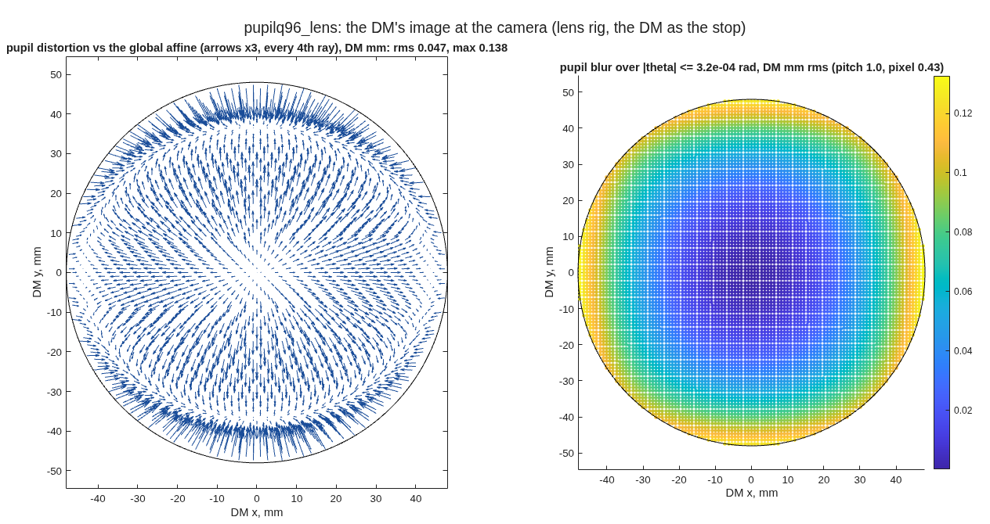
Interferometer: pupil image quality
The camera sees the DM sharply on both front ends; against a single global mapping the image is distorted by a seventh of a pitch at the edge on lenses and more than a pitch on mirrors, which the measured response matrix absorbs and a geometric mapping would not
DM mm unless stated | lens rig | mirror rig
distortion vs one affine: rms / edge | 0.047 / 0.138 | 0.62 / 1.19
blur over the actuator band: rms / max | 0.066 / 0.133 | 0.051 / 0.143
image surface: defocus / astig / tilt (mm of sag) | -0.0005 / -0.095 / 0.002 | -0.45 / 0.14 / 0.42
focal spot on axis / at the actuator-band tilt | 0.06 / 0.09 λF/D | 0.03 / 2.2 λF/D
• Pupil image quality supports picometer measurement on both rigs. Carried through to a reading it costs 0.13 % of the figure on lenses and 0.29 % on mirrors — 42 and 92 pm on a 30 nm working surface — and 0.5 % / 0.9 % in the top spatial band, where it is worst. That is the accuracy term; precision and repeatability are photon-limited and sub-picometer. It holds because the response matrix is MEASURED on the surface: the mirror rig's image is distorted by more than an actuator pitch at the edge, which a geometric mapping would carry straight into the surface.
• Method: the DM declared the stop, the field a tilt about it; two traces a small field step apart cross at each zone's image at the camera; scored in DM mm against the 1 mm pitch.
• The lens rig images the DM flat (0.5 µm of defocus across the pupil) and holds its mapping to a seventh of an actuator pitch. The mirror rig trades mapping for the front end: the OAP pair distorts the image by more than a pitch at the edge, which the measured matrix absorbs and the numbers above already include.
• The mirror rig's focus is perfect on axis and coma-limited off it (2.2 λF/D at the actuator-band tilt); not a pupil-image cost, a number to know for any off-axis reading at the seat.
The DM's image at the camera on the lens rig, the DM as the stop: left, distortion against the global affine (arrows ×3, DM mm); right, the blur of each zone's image over the band of tilts the DM can make. The runner's own figure.
Run tags pupilq96_lens, pupilq96_oap (tg96_pupilq, model 512, on the emitted redo decks, 2026-09-18); tg_psi_dm96_oap/REPORT_bench_realism.md section 6. Requested by Fang Shi. λF/D = 2.83 µm on the 96 mm beam, which the DM's aperture defines. Blur is quoted over the actuator band, edge zones included.

Slide 8
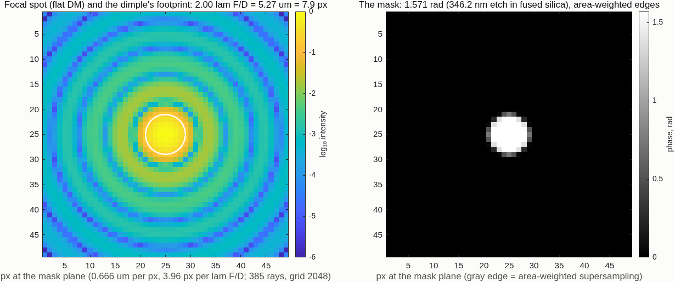
Zernike sensor: a quarter-wave dimple at the focus
The beam interferes with its own core: no reference arm; the best reading steps the dimple's depth through four frames and inverts pixel by pixel
• How it reads: a 5.3 µm etched dimple (2.0 λF/D) delays the center of the focal spot a quarter wave; that light spreads back over the pupil and acts as the reference. Three etch depths plus a clear frame make the four-frame stepped reading, which has no branch fold.
• On the 30 nm surface, matrix measured on it (mirror rig, 385 px): 10 nm on one actuator 0.993 / 5 pm / SNR 1987; 1 nm on 120 sites 0.995 / 4 pm; dense 10 nm 0.978, 0.75 nm.
• Servo: 3 pm from 2.6e12 photons per cycle noise only, 7.5e12 under the 2 pm walk; no fixed error (a noiseless step goes to 0.000 pm).
The flat mirror's focal spot (log scale) with the dimple's footprint on its core, and the mask's phase, at the model's sampling: 3.96 pixels per λF/D, the dimple 7.9 pixels across. It encloses 70.7% of the focused light.
Added to the front end: one fused-silica plate, 2-3 mm thick, with a 3×3 array of etched spots (one in the beam at a time; the 346 nm etch is a quarter wave at 632.8 nm), on a translation stage. Nothing else. The plate's thickness in the F/4.2 beam is 0.03 wave of spherical aberration and a 0.7 mm focus shift the tail absorbs (to be modeled). Run tags matbase, matbase385, loop193.

Slide 9
Vector Zernike sensor: the polarized dimple
A geometric-phase metasurface in the same seat delays the two circular polarizations by +90° and −90°; a quarter-wave plate and a polarizing cube send the two images to two cameras, both frames at once
• How it reads: the two images are the sensor with its dimple sign flipped; per pixel they give the cosine and sine of the phase together, so the inversion is exact with no branch choice and no stepping. Two simultaneous frames per measurement.
• On the 30 nm surface, matrix measured on it (mirror rig, 385 px): 10 nm on one actuator 1.008 / 2 pm / SNR 6364; 1 nm on 120 sites 1.001 / 4 pm; dense 10 nm 1.0035, 0.44 nm — the best line in the comparison.
• Servo (mirror rig): 3 pm from 2.2e12 photons per cycle noise only, 6.8e12 under the 2 pm walk; no fixed error.
added to the front end | value
metasurface | geometric-phase (half-wave) dimple in the etched plate's seat: +90° on one circular state, −90° on the other
quarter-wave plate | zero order on a 2 mm substrate (0.05 wave of spherical aberration in the F/3.6 leg, to be modeled), fast axis at 45° between the cube's s and p; spec λ/300
polarizing cube | 12.7 mm cemented MacNeille, behind the field lens
cameras | two, both 20.7 mm behind the cube at the 7.5 mm pupil image; a 6.5 µm sCMOS (13 mm sensor) binned 3 to 385
frames per measurement | 2, simultaneous
Two cameras rather than one: the 7.5 mm pupil image 32 mm behind the field lens would need a 17° split for side-by-side images, past a calcite prism's limit. Run tags v193base, vloop193.

Slide 10
Point-diffraction sensor: a stepped pinhole with a shutter frame
The best common-path form: a 5.3 µm pinhole with an attenuated surround at the focus, five phase steps of the substrate, plus one pinhole-only frame per state that keeps the calibration honest far from null
• How it reads: the pinhole passes the core of the focal spot as the reference; the surround, attenuated to 0.72 in amplitude, passes the rest. The substrate steps the surround's phase through five frames (the Schwider-Hariharan scan, insensitive to step error); a sixth frame with the surround shuttered measures the reference by itself.
• On the 30 nm surface, matrix measured on it (mirror rig, 385 px): 10 nm on one actuator 0.995 / 3 pm / SNR 3845; 1 nm on 120 sites 0.998 / 3 pm; dense 10 nm 0.994, 313 pm.
• Servo: 3 pm from 2.3e12 photons per cycle noise only, 7.0e12 under the walk; no fixed error. The shutter frame is what lets it read to 480 nm of surface (next slides).
• Not yet modeled: how the phase is stepped. These results step the surround's phase by an ideal increment ("magic"), with a step-error knob only. The photonic phase shifter of the two-arm form, and the stage or etched steps of this one, have no device physics yet: coupling, loss, drift.
added to the front end | value
pinhole substrate | fused silica, 2-3 mm, in the mask seat; pinhole 5.27 µm (2.0 λF/D at F/4.2), clear
surround | attenuated to 0.72 in amplitude (0.52 in power), phase-stepped on a stage
shutter | over the surround: one pinhole-only frame per state
frames per measurement | 6: the five-step scan plus the shutter frame
The P/SRI is this sensor's two-arm form and differs from it in more than the phase shifter: a 60/40 pickoff, a reference lens, a 3.7 µm pinhole feeding a single-mode waveguide with a thermo-optic shifter, a recombiner and its own camera — a non-common-path reference where the stepped pinhole's reference shares the plate and the leg. It pays 6× the photons at null and nothing off null; a capture instrument here, its trade in backup. Run tags pdi193fbase, ploop193, pdi193state.

Slide 11
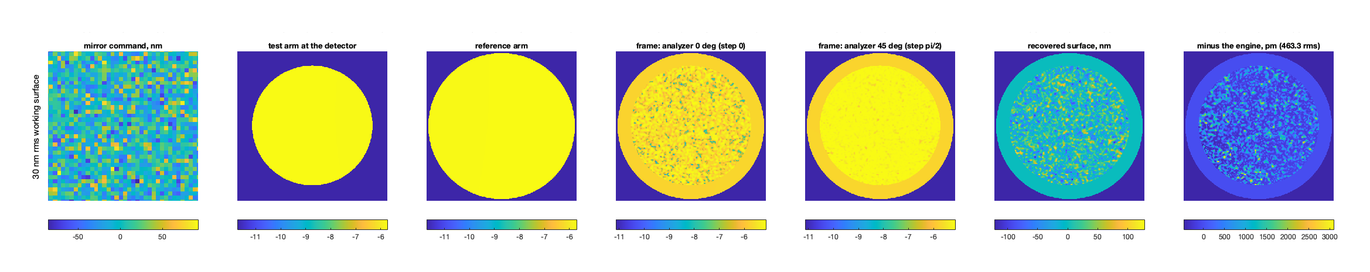
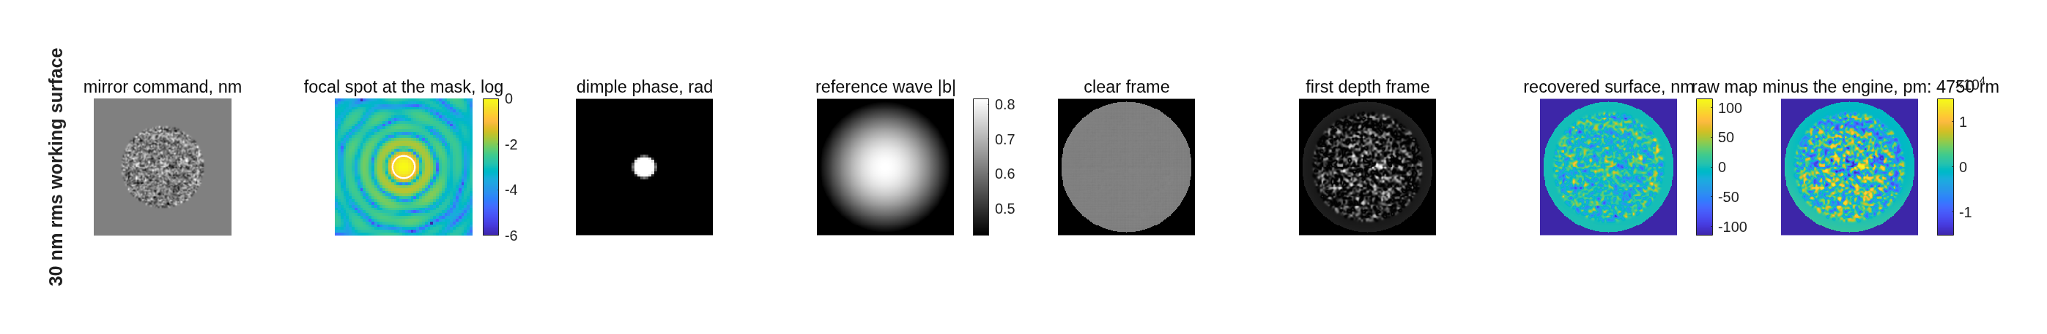
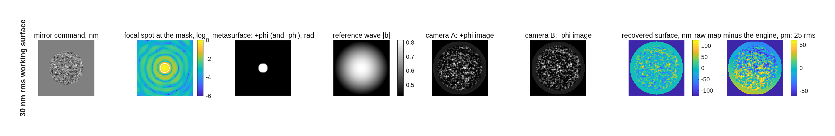
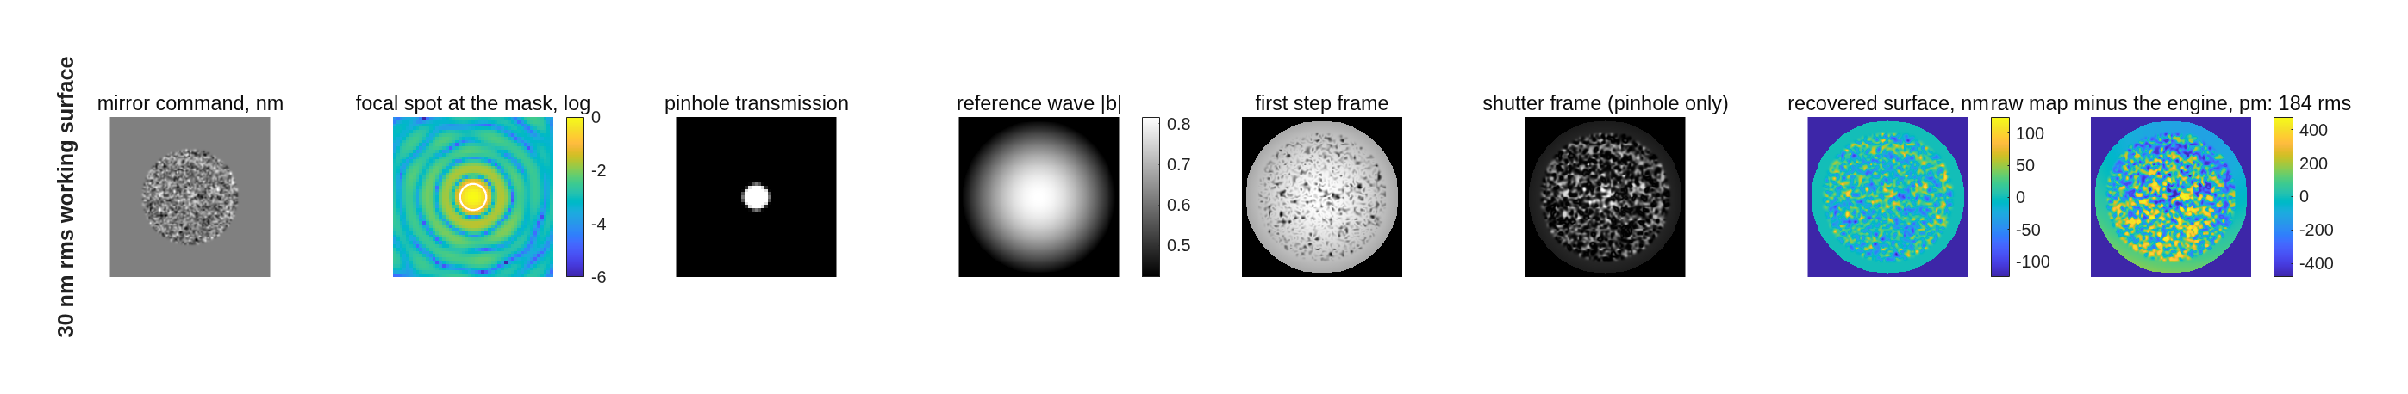
Each gauge reading the 30 nm working surface, station by station
The same mirror command through the four trains: what the camera sees, and what comes back; the last column is the raw map against the engine's own field, before any calibration
Interferometer (hybrid, mirror rig): the command; the test and reference arms at the camera; two of the four phase-stepped frames; the recovered surface; the raw map minus the engine's field, 463 pm (1.5 %).
Stepped Zernike: the focal spot with the dimple's footprint; the dimple's phase; the reference wave the dimple makes from the beam; the clear frame and the first depth frame; the recovered surface; raw map minus the engine, 4.8 nm (the beam-made reference, which the matrix measured on the surface absorbs).
Vector Zernike: the metasurface (+90° on one circular state, −90° on the other); camera A and camera B, both frames at once; the pixel-by-pixel solve; raw map minus the engine, 25 pm.
Stepped pinhole: the pinhole plate (clear pinhole, the surround at 0.72); the first step frame and the shutter frame (the pinhole's light alone); the recovered surface; raw map minus the engine, 184 pm.
Row 2 of each gauge's station-by-station figure (the full figures, with the flat mirror as row 1, are in the backup). Run tags redo96_oapstn (interferometer) and stations193 (the three sensors, 193 pixels per pupil).

Slide 12
Performance side by side
Every reading on the same 30 nm working surface, the response matrix measured on it: the four best readings are within 1% of each other and within 2 pm on the floor
reading (frames per measurement) | 10 nm on one actuator: gain / floor / SNR | 1 nm on 120 sites: gain / floor | dense random 10 nm: gain / error
interferometer, lens rig (4) | 1.004 / 1.4 pm / 7741 | 0.993 / 10 pm | 0.9995 / 500 pm
interferometer, mirror rig (4) | 0.986 / 2.3 pm / 6044 | 0.981 / 4.4 pm | 0.977 / 698 pm
Zernike, linear one frame (1) | 1.04 / 21 pm / 492 | 1.05 / 22 pm | 1.04 / 4.7 nm
Zernike, exact one frame (1) | 0.78 / 74 pm | 0.90 / 35 pm | 0.86 / 5.2 nm
Zernike, stepped (4) | 0.993 / 5 pm / 1987 | 0.995 / 4 pm | 0.978 / 0.75 nm
vector Zernike (2) | 1.008 / 2 pm / 6364 | 1.001 / 4 pm | 1.0035 / 0.44 nm
stepped pinhole (6) | 0.995 / 3 pm / 3845 | 0.998 / 3 pm | 0.994 / 313 pm
P/SRI, reference arm traced (4) | 0.9935 / 2 pm / 4895 | 0.9924 / 1 pm | 0.9926 / 144 pm
• The one-frame Zernike readings lose: the linear one is biased 4-5% and floors at 21 pm; the exact one-frame reading misreads the sign past the quarter-wave fold (7.8% of pixels on this surface) and diverges in a servo.
• The dense-pattern error is 0.3-0.75 nm for every reading, the interferometer's included; the single-actuator and grid rows, which the servo uses, are at 1-10 pm.
Run tags: redo96_lens, redo96_oap (interferometer, 385 px), redo96_oapsens (the three sensors on the mirror rig, 385 px); the one-frame Zernike readings and the P/SRI at 193 px (matbase, pfdeck).

Slide 13
Capture range: how far from null each reading works
With the calibration left as measured at 30 nm, the self-referenced sensors hold 10% accuracy only to 36-70 nm of surface; the externally referenced ones, and the pinhole with its shutter frame, hold to 480 nm and beyond
reading | range to 10%, calibration aging from 30 nm
Zernike exact one frame | 36 nm
Zernike stepped | 42 nm
Zernike linear | 44 nm
pinhole, no shutter frame | 62 nm
vector Zernike | 70 nm
pinhole with a shutter frame | 480 nm and beyond (1.02 / 1.06 / 1.13 at 120 / 240 / 480)
P/SRI | 480 nm and beyond (within 1% at 100)
interferometer, both rigs | 480 nm and beyond, single site and grid
Zernike stepped / vector / pinhole on the mirror rig, 385 px | 35 / 51 / 42 nm
• Why the sensors age: their reference is made from the beam's own core, and the core changes with the surface. Past 100 nm rms (2 rad of phase) the core collapses and the reading goes blind.
• The shutter frame fixes the pinhole's version of this: measuring the reference by itself each state removes the surface dependence, for one more frame.
• Re-measuring the matrix on the surface restores every reading's gain to within 5% at 60-160 nm — at a photon price (next slide).
Run tags cap385, cap385p, pdi193state, lens_deck, oap_deck, oapsens385 (the mirror rig at 385 px, the Mac); 385 pixels per pupil, 47 sites (52 for the interferometer).

Slide 14
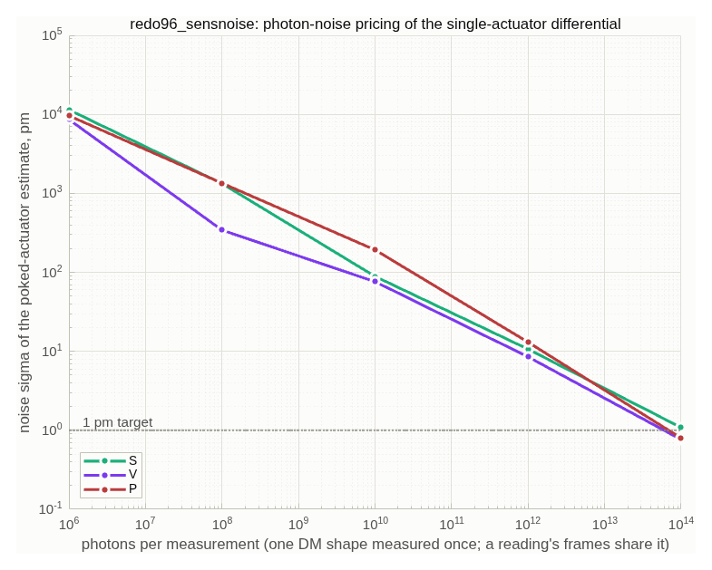
Photons for 1 pm
On the 30 nm working surface the vector Zernike needs 4.6e13 photons per measurement, the stepped Zernike 1.2e14, the pinhole 1.5e14, the interferometer 7e14 (mirror rig) to 1e15 (lens rig); a matrix measured on the flat costs the sensors less, the vector pair's cost barely moves
reading | photons for 1 pm, matrix on the flat | matrix on the 30 nm surface
vector Zernike, mirror rig | 4.3e13 | 4.6e13
stepped Zernike, mirror rig | 6.1e13 | 1.2e14
stepped pinhole, mirror rig | 1.3e14 | 1.5e14
interferometer, mirror rig | — | 7.0e14
interferometer, lens rig | — | 9.9e14
Noise on a single-actuator estimate against photons per measurement, per reading, with the 1 pm line: the runner's own figure.
One measurement at 1e14 photons is 31 µJ: 0.13 s of a 1 mW laser at 25% throughput. The camera's well depth, not the laser, sets the time (future-work slide). The interferometer's single-shot cost on larger surfaces: 5.3-4.4e14 at 60-160 nm on the mirror rig, 8.6-6.6e14 on the lens rig. Run tags redo96_sensnoisef (flat matrix), redo96_sensnoise (on the surface), redo96_oapph, redo96_lensph; 6 noise realizations per point.

Slide 15
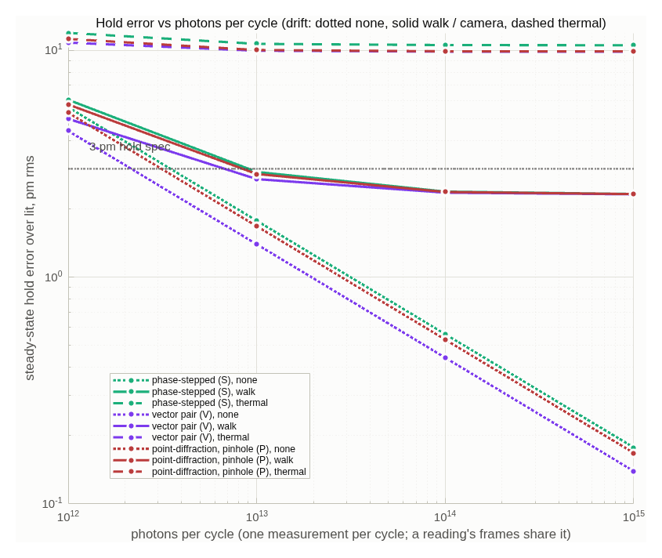
The servo: holding 3 pm
In closed loop at gain 0.5 the vector Zernike holds 3 pm from 2.2e12 photons per cycle, the pinhole from 3.1e12, the stepped Zernike from 3.5e12, and the interferometer from 2.0e13 on the mirror rig and 2.3e13 on the lens rig; the sensors carry no fixed error
reading | 3 pm, noise only | 3 pm under a 2 pm per-cycle walk | floor under a 5 pm per-cycle ramp | noiseless 1 nm step after 60 cycles
vector Zernike, mirror rig | 2.2e12 | 6.8e12 | 9.8 pm | 0.000 pm
stepped pinhole, mirror rig | 3.1e12 | 8.4e12 | 9.9 pm | 0.000 pm
stepped Zernike, mirror rig | 3.5e12 | 9.1e12 | 10.5 pm | 0.000 pm
interferometer, mirror rig | 2.0e13 | 6.6e13 | 11.5 pm | 2.8 pm
interferometer, lens rig | 2.3e13 | 7.1e13 | 10.2 pm | 0.015 pm
Steady-state hold error against photons per cycle for the stepped Zernike (green), the vector pair (purple) and the pinhole (red), with no drift, a 2 pm walk, and a 5 pm ramp: the runner's own figure.
7.5e12 photons per cycle is 2.4 µJ, 9 ms of a 1 mW laser. The ramp floor of 10 pm is the loop's lag (rate ÷ gain), the same for every reading with no fixed error, and it is low-order: 9.1-9.7 of its 10 pm sits below 4 cycles per aperture, so a faster or higher-gain low-order loop removes it while light buys nothing. Both drift floors are the textbook formulas, reproduced by the engine to 1%. The step response contracts by 0.49-0.51 per cycle for the vector pair and the pinhole, 0.66 for the stepped Zernike. Run tags redo96_sensloop2 (the sensors, mirror rig), redo96_lensloop, redo96_oaploop (the interferometer).

Slide 16
Capturing the initial figure
From a 100 nm rms surface (200 nm of wavefront) only the externally referenced readings converge: the interferometer with unwrapping alone (the mirror rig to 3 pm in 19-24 cycles, the lens rig to 3.1 pm at cycle 60); the pinhole and the P/SRI with unwrapping and a matrix re-measured every 10 cycles
reading | largest start brought to 3 pm | what it takes
Zernike stepped, linear | 30 nm | reading alone; unwrapping changes nothing
vector Zernike | 60 nm | reading alone
stepped pinhole, no shutter | 60 nm | reading alone
stepped pinhole with shutter frame | 100 nm (200 nm WFE) | unwrap + re-measure every 10: 0.21 pm at 1e15, 2.1 pm at 1e13, 3 pm by cycle 26
P/SRI | 100 nm | unwrap + re-measure: 0.25 pm; ceiling between 100 and 150
interferometer, mirror rig | 200 nm (400 nm WFE) | unwrap alone: 3 pm in 19 / 24 cycles from 100 / 200 nm, contraction 0.52
interferometer, lens rig | 200 nm (400 nm WFE) | unwrap alone: 3.1 pm at cycle 60 from 30, 100 and 200 nm alike, contraction 0.50-0.69; not under 3 pm within 60 cycles
• The wrap is not the limit for the self-referenced sensors: past 60 nm their differential comes back at 24-28 nm whatever the truth, with zero residues — the focal reference has collapsed, the reading is blind, not folded.
• Unwrapping alone is not enough for the pinhole or the P/SRI: the calibration measured at the start is wrong by the time the surface has moved; re-measuring it every 10 cycles (3 times in the descent) closes the loop. Cadence is not the constraint; the cycle count is.
• The interferometer needs no recalibration because its reference is the flat, not the beam.
1e13 and 1e15 photons per cycle give the same convergence: capture is reference-limited, not light-limited. Run tags capt96_oap and capt96_lens (the interferometer on the two built rigs, the control set inside the DM aperture: mirror rig 2.98 pm at cycle 60 from 100 and 200 nm, the 30 nm control at 2.97 pm; lens rig 3.08 / 3.06 / 3.12 pm); the sensor rows are the campaign's capture runs cap_nouw, cap_uw, cap_state_uw_recal, descent193, not yet repeated on the built bench.

Slide 17
Lenses or off-axis mirrors: the two front ends
Both rigs hold 3 pm at the same photon cost within 15 % and the mirror rig reads 1 pm for 30 % fewer photons; it is achromatic, puts no glass in the beam, captures faster, and is where the sensors were scored
 | lens rig | off-axis mirror rig (protected aluminum)
interferometer, 10 nm on one actuator | 1.004 / 1.4 pm / SNR 7741 | 0.986 / 2.3 pm / 6044
interferometer, 1 nm on 120 sites | 0.993 / 10 pm | 0.981 / 4.4 pm
interferometer, dense random 10 nm | 0.9995 / 500 pm | 0.977 / 698 pm
interferometer, photons for 1 pm on the 30 nm surface | 9.9e14 | 7.0e14
interferometer servo: 3 pm noise only / under the 2 pm walk | 2.3e13 / 7.1e13 | 2.0e13 / 6.6e13
noiseless 1 nm step, residual at cycle 60 | 0.015 pm | 2.8 pm
capture with unwrapping | 3.1 pm at cycle 60 from 100 and 200 nm | 3 pm from 100 nm in 19 cycles, from 200 nm in 24
flat-mirror null with the substrates in | 59 nm | 26.5 nm
sensors, 10 nm on one actuator (stepped / vector / pinhole) | not run on the lens rig | 0.993 / 5, 1.008 / 2, 0.995 / 3 pm
sensors' capture range to 10% (stepped / vector / pinhole) | — | 35 / 51 / 42 nm
alignment: 10 µrad tilt of a mirror | — | (D4 not yet run on this bench)
• The vector pair's raw error on the mirror rig is channel amplitude imbalance from the metal folds (1.08 between its two circular channels on bare aluminum; a quarter-wave overcoat halves the error), not channel phase; the calibrated reading passes its gate.
• Both rigs wrap between 60 and 120 nm of surface (a base the four-step cannot follow reads λ/2 ÷ √12 = 91 nm rms); the capture range is set by the unwrapping, not by the front end.
Run tags redo96_lens, redo96_oap, redo96_lensloop, redo96_oaploop, capt96_oap, redo96_oapsens. The two cells not run (the sensors on the lens rig; the 10 µrad tilt on this bench) are listed on the provenance slide.

Slide 18
What can spoil each reading, priced
Every systematic we could model is either calibrated by the response matrix measured through the sensor, or shown small; one line per approach
approach | term | uncalibrated size | after the matrix measured on the surface
interferometer | piezo step error 2% / 5% | gain 0.974 / 0.954; floor 2 → 5 / 9 pm | common mode in the servo: 5.4e12 vs 5.5e12
interferometer | camera 1/f walk, 1e-3 of signal within a scan | +13% light for 3 pm | —
interferometer, snapshot | splitter diattenuation (plate); cube R_p | at the built 22.5°: arm rotation 1.56°, gain +0.9% (11.7% at 45°); 2.1% (cube, naive stack) | residual after a measured matrix 1.4e-3 (lens), 5.5e-4 (mirrors); symmetric stack 0
Zernike | model out of focus (the early model); sampling; color | floor 744 → 67 pm on correction; dimple needs 6 pixels; one etch reads five colors within 3% | —
vector Zernike | metasurface retardance error 0.1 rad | 750 pm on a 12 nm figure | rows 0.9934 / 4 pm, the ideal numbers
vector Zernike | the arm's polarization (six tilted glass faces) | 9 pm on 12 nm; 6 nm per rad of channel phase | nothing to 0.1 rad; 10% gain loss at 0.3
vector Zernike | the analyzer: cube extinction; plate error λ/300 | 3.5 pm; 165 pm (1.4% of the figure) | gain within 0.7%, floors within 4 pm
pinhole | 2% step error | 4.9 pm with the five-frame scan (421 pm with four-step least squares) | differential rows error-free to the digit
pinhole, P/SRI | camera bias drifting within a scan | 5.3 / 10.7 pm at 1e15 (the linear Zernike: 10.8 nm) | —
P/SRI | its own reference arm walking | 4% more light over a hundredfold range of walk | a path change is piston, the mode the estimator nulls
Nothing is left open on the vector sensor's line. Run tags lens_deck_se2/se5, loop_lens_cam, tg_psi_dm, tg_psi_dm_v2, v2g, v3arm, an193, pdi193se_sh5, pcam193ri, rw193.

Slide 19
Recommendation
Hold with the vector Zernike sensor; capture with the interferometer, or with the stepped pinhole's shutter frame if a second arm is not wanted; build on lenses; build one bench that switches
• Hold: the polarized dimple is the best reading on every line — 3 pm from 2.2e12 photons per cycle, two frames taken at once, no stepping, no fold, no fixed error, and every systematic we modeled calibrated by the matrix measured through it. The stepped scalar dimple is the fallback with no polarization optics, at 1.6× the light.
• Capture: the interferometer takes 200-400 nm of wavefront to 3 pm in 19-24 cycles on the mirror rig with unwrapping alone (3.1 pm at cycle 60 on the lens rig). In the common path, the stepped pinhole with a shutter frame captures 200 nm of wavefront with unwrapping and three recalibrations. A second color is the sensors' own route (future work).
• Front end: either builds. The mirror rig matches the lens rig on the rows and the servo (interferometer 2.0e13 vs 2.3e13 photons per cycle noise only, 6.6e13 vs 7.1e13 under the walk), reads 1 pm for 30 % fewer photons (7.0e14 vs 9.9e14) and captures from 200 nm in 24 cycles where the lens rig stops at 3.1 pm; its sensors pass once calibrated; it buys any color and no glass in the beam, and costs alignment tolerance (10 µrad = 100 nm of null) and a polarization calibration of the vector reading. The measured trade is on the table for a ruling.
• The bench: one layout with the reference arm shuttered, the mask seat translated, the quarter-wave plate in or out, and the P/SRI arm behind a flip-in plate (the one-bench slide). Capture with the interferometer, hand off inside the sensor's 60 nm reach, hold with the sensor at a tenth of the light.
• What the numbers do not decide: the pinhole and the vector dimple read the working surface alike (0.995 / 3 and 1.008 / 2 pm); the dimple wins the servo by 1.4×, the pinhole wins capture range for one extra frame. A bench that carries both costs one substrate.
Draft stance approved 2026-09-13; the wording is for review.

Slide 20
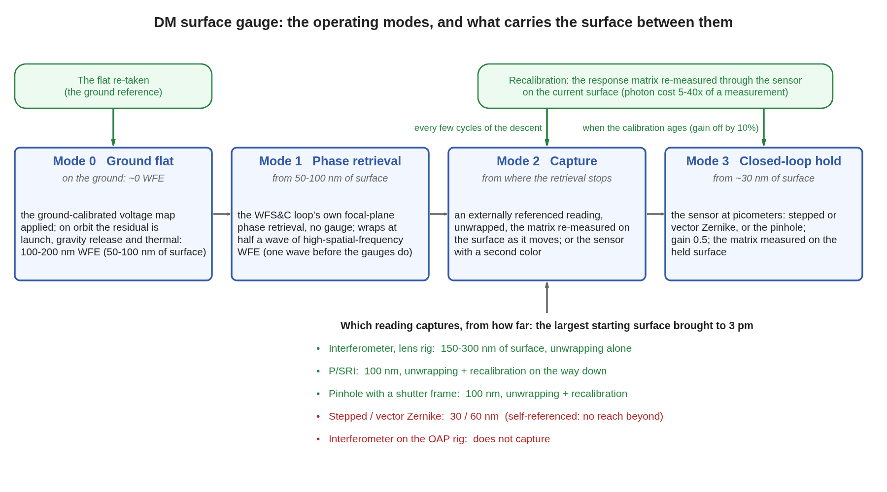
The modes, from launch to hold
Four operating modes and what carries the surface between them: the ground flat, the loop's own phase retrieval, capture, and the servo hold, with recalibration events
The operating modes as a flow: ground flat, image-based phase retrieval, capture, closed-loop hold; the readings' capture limits under the capture box; recalibration events above.
The loop's own focal-plane phase retrieval wraps at half a wave of high-spatial-frequency wavefront, one wave before the gauges do; its reach sets what capture must cover. Drawn by gauge_modes_flow.m.

Slide 21
What comes next, and how to run it
Three threads of future work, and one command line per gauge; every number in the deck is reproduced by the runners in the public repositories
• Capture beyond one wave with a second color: 632.8 + 700 nm gives a 6.6 µm synthetic wavelength and 1.6 µm of unambiguous surface at 10× the noise; the coarse pair captures, the single color holds. The runner already traces one mask at five colors (Backup).
• From this model to as-built performance: the camera's well depth sets the measurement time (1e14 photons is 1600 frames at 60 ke per pixel); surface, alignment, stability and polarization errors priced per reading (Backup).
• Other approaches worth a look: a modeled large-figure solve, phase diversity, white-light scanning, heterodyne detection, direct-sequence metrology (Backup).
• Interferometer (tg_psi_dm96_oap): tg96_run (lens rig); tg96_run('bench.optics','oap') (mirror rig).
• Zernike sensors (zwfs_dm96): zwfs_run (bench, battery, figures); zwfs_run('bench.optics','oap','readings',{'S','V','P'},'stages',{'bench','battery','noise','loop'}) for the mirror rig.
• Point-diffraction (pdi_dm96): P = pdi_params; out = pdi_run(P);.
• Where: MACOS_resources/mmacos/templates/40_benches/{tg_psi_dm96_oap, zwfs_dm96, pdi_dm96} and the shared dm_gauge_lib, branch dev-candidate; each directory's README carries the full command list and the run-tag index. A model-1024 run needs about 11 GB.
Every stage asserts its own gates (the mask round trip, the reference-wave surrogate, the fold, the pinhole, the analyzer); tDmgLoop 15/15; the mmacos fast suite 551/0 (2026-10-06). All code and documentation is public: nasa-jpl/macos and nasa-jpl/MACOS_resources on github.

Slide 22
Backup

Slide 23
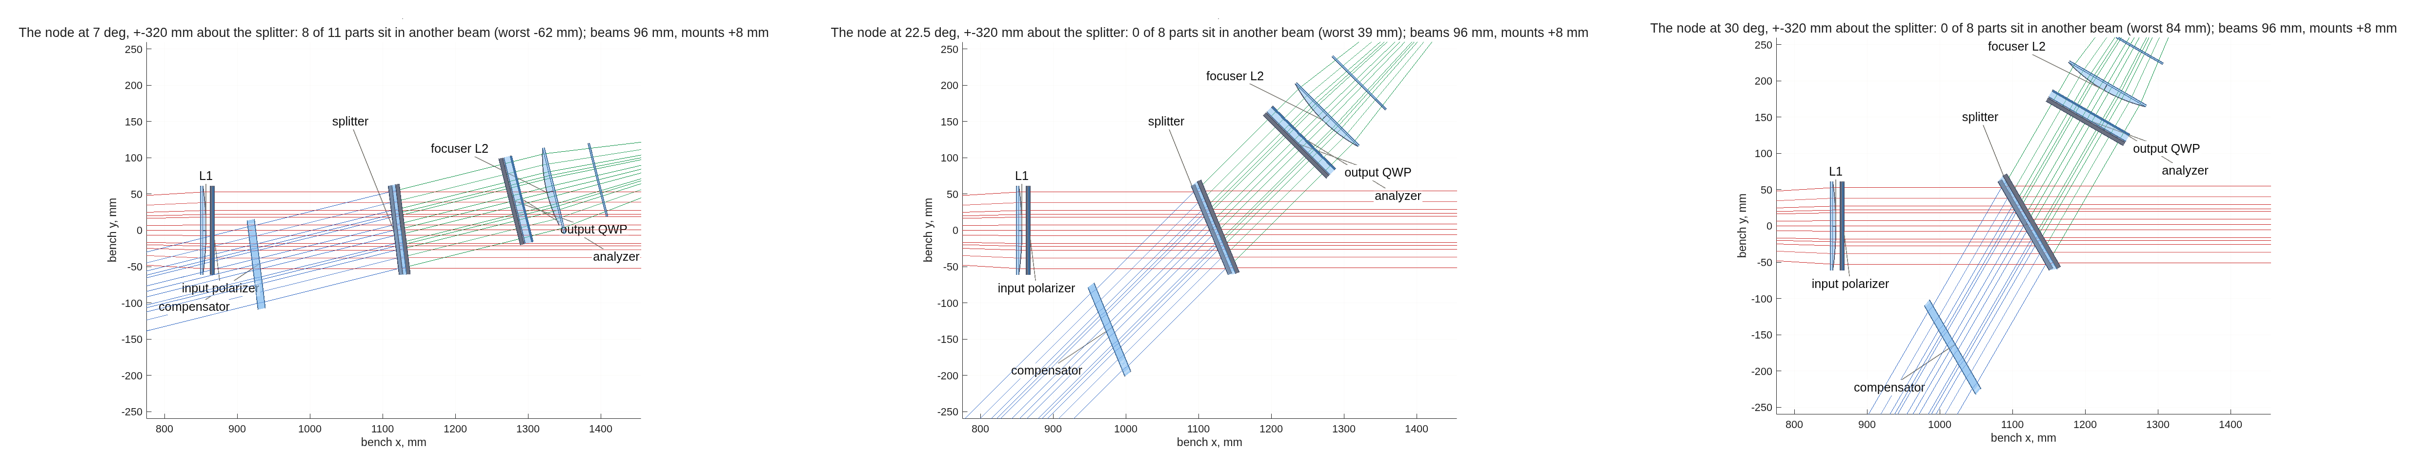
The splitter angle: three options
7° cannot be built; 22.5° clears every part and is the choice; 30° adds margin at the price of a wider bench and more plate polarization
The node at 7° (left: eight parts in another beam), 22.5° (middle, the choice: every part clears, the compensator by 16 mm) and 30° (right: the compensator by 57 mm); the output plate and analyzer moved to 160 mm behind the splitter in the last two. The three panels are the tool's own node drawings, placed side by side.
impact | 7° (record) | 22.5° (choice) | 30°
node clearance, worst part | −109 mm: not buildable | compensator +16 mm; output optics +55 / +65; L2 +100 | compensator +57; the rest +178 or more
bench shape | all four legs within 14° of one line | mirror leg at 45° to the source leg | mirror leg at 60°
plate's polarization (mean diattenuation, uniform) | 0.5% | 5.5% | 10%
pupil-varying part (the lenses; what the sensors feel) | 1.1e-3 rms | 1.1e-3 rms | 1.1e-3 rms
vector sensor, channel phase difference / 100 nm pokes | 1.63 mrad / 9.0 pm | 1.66 mrad / 8.8 pm | 1.69 mrad / 9.1 pm
transmitted beam shift in the 2.6 mm plate | 0.1 mm | 0.36 mm (1.4 at 10 mm) | 0.50 mm
interferometer snapshot form | the small-angle case | its plate systematics re-run at this angle | larger
The sensors reproduce their rows at every angle; the interferometer's snapshot form is the one thing the angle changes, through the plate's polarization, and the cube form is built for 45°. Run tags bs22_dev, bs30_dev; the panels at 7° and 30° are on the backup clearance slide.

Slide 24
Parts common to every configuration: the detector leg
From the focuser to the camera: focused once and shared by every configuration, so only the mask seat's contents and what follows the field lens change
part | size and figure | coating | count | purpose
focuser: L2 or OAP2 | L2: f 429 mm, 103 mm, plano-convex conic (conic −0.582), 8 mm center. OAP2: parent f 352 mm (R −704), 328 mm off-axis, 25° fold, 113 mm | L2 anti-reflection; OAP2 protected aluminum | 1 | the internal focus at F/4.2 where the masks sit
mask seat | translation stage at the internal focus | — | 1 | selects the sensor: clear window, dimple, metasurface, pinhole
field lens | f 43 mm, 21 mm, a conic: −2.11 at the seed station 10.8 mm past the focus, or −7.77 tuned — over the 2.4 mm of it the beam uses, 0.20 µm apart | AR | 1 | reimages the DM: 9.8 mm across on the 96 mm beam, 38 mm behind it
camera A | sCMOS 2048×2048, 6.5 µm binned 4 to 377 px across the 9.8 mm image; or 24 µm pixels unbinned (408) | — | 1 | every configuration's pupil image
The field lens's conic is the one part still open: the seed station images the mirror flat, the tuned station reads it 2.3x better, and the two differ by 0.20 µm over the 2.4 mm the beam uses.

Slide 25
Parts specific to the interferometer
What the reference arm and the two phase-shift forms add to the common bench
form | part | size and figure | coating / material | count | purpose
all | reference flat | 103 mm, λ/20; 564 mm leg | protected aluminum | 1 | the external reference: the arm that makes this the one gauge to capture a whole wave
piezo form | closed-loop piezo stage under the flat | stroke over one wave (633 nm) in four steps of λ/8 of surface; closed-loop, since the step error is read directly as phase | — | 1 | steps the reference phase; a 2% step error is priced in the servo, and the stepping is what exposes it to within-scan drift
snapshot | input polarizer; one quarter-wave plate in each arm, double-passed; output quarter-wave plate | 103 mm zero-order plates on 2-3 mm substrates; azimuths 45 / 0 / 45 / 0° | AR | 4 | codes the four channels in polarization
piezo | analyzer | 103 mm polarizer on a 2 mm substrate, 160 mm behind the splitter with the output plate | AR | 1 | sets the interference to be read; in the snapshot form the camera's own micro-polarizer array does this job four ways at once
snapshot | polarization camera, replacing camera A | micro-polarizer array 0 / 45 / 90 / 135° over a 2048×2048 sCMOS, 3.45 µm pixels in 2×2 super-pixels, 680 per orientation across the pupil | — | 1 | the four analyzer channels in one frame: no moving part, and immune to the drift within a scan that the piezo form pays for
cube (backup) | cemented polarizing cube in place of the plate and compensator | 103 mm class MacNeille, symmetric stack | ZnS / cryolite on n 1.655 glass | 1 | the split as polarization physics; no compensator
The hybrid form uses the snapshot parts for every change measurement and the piezo for the absolute calibration; both live on the same bench.

Slide 26
Parts specific to the sensors
What each focal-plane sensor adds to the common bench: one substrate on the mask seat, and the vector sensor's split behind the field lens
sensor | part | size and figure | material | count | purpose
Zernike | etched mask plate | fused silica, 2-3 mm; a 3×3 array of dimples 346 nm deep (a quarter wave), the chosen 5.3 µm (2.0 λF/D) | bare fused silica | 1 | the reference from the beam's own core; stepped by translating between depths
vector | geometric-phase metasurface | in the mask seat: a half-wave dimple pattern, +90° on one circular state and −90° on the other | dielectric metasurface on fused silica | 1 | the two images with opposite dimple sign
vector, split form | quarter-wave plate; polarizing cube; camera B | zero-order plate at λ/300 on a 2 mm substrate; 12.7 mm cemented MacNeille cube; a second sCMOS like camera A | AR; ZnS / cryolite | 3 | separates the two circular states onto two cameras, both frames at once
vector, snapshot form | quarter-wave plate; the interferometer's polarization camera in place of camera A | the same zero-order plate; the micro-polarizer array already on the bench for the snapshot interferometer | AR | 2 | the same two states read on one camera: one detector, no split leg to align, at a quarter of the pixels per state
stepped pinhole | pinhole plate on a phase-stepping stage; shutter | fused silica, 2-3 mm; 5.27 µm pinhole, surround attenuated to 0.72 in amplitude; steps of an eighth wave | metal-film attenuator | 2 | the reference from the core through the pinhole; the shutter frame reads the reference alone
The vector sensor is the one configuration with a choice of readout: the split form buys full pixel count per state, the snapshot form reuses the interferometer's camera. The Zernike, vector and pinhole plates share one substrate on the seat; full parts tables are in each lane's README. The P/SRI's nine parts are on its backup slide.

Slide 27
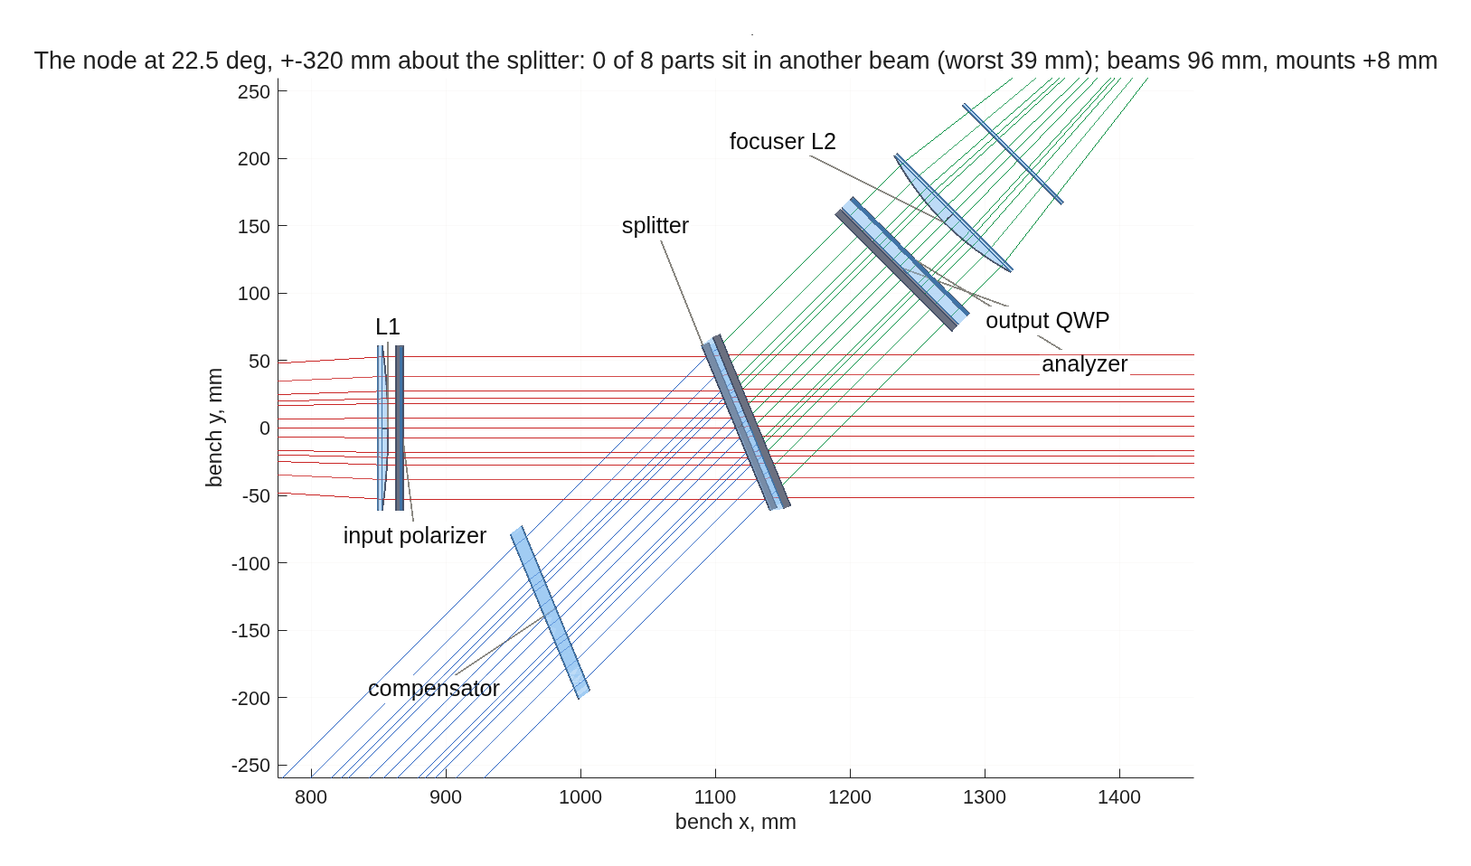
Interferometer: the node at 22.5°
Every part clears every beam it is not in; the output plate and analyzer sit 160 mm behind the splitter, ahead of the focuser; the four snapshot channels come from a polarization camera, not a rotating analyzer
The splitter node from above, as traced at 22.5°, ±320 mm about the splitter: L1 and the input polarizer, the splitter, the compensator on the mirror leg, the output quarter-wave plate and analyzer just ahead of the focuser L2; test arm blue, reference arm orange. The two "QWP" labels at the node mark builder placements; the physical plates sit at the mirror and the flat.
The analyzer's four orientations are taken at once by a polarization camera (a micro-polarizer array at 0 / 45 / 90 / 135° on the pixels); the model rotates an ideal analyzer between its four frames, the same measurement. A rotating stage would make the snapshot a sequential scan. The plates here are drawn as ideal surfaces; the next model round gives each a 2-3 mm substrate, which in these collimated legs adds path only. Drawn by dmg_bench_clearance.

Slide 28
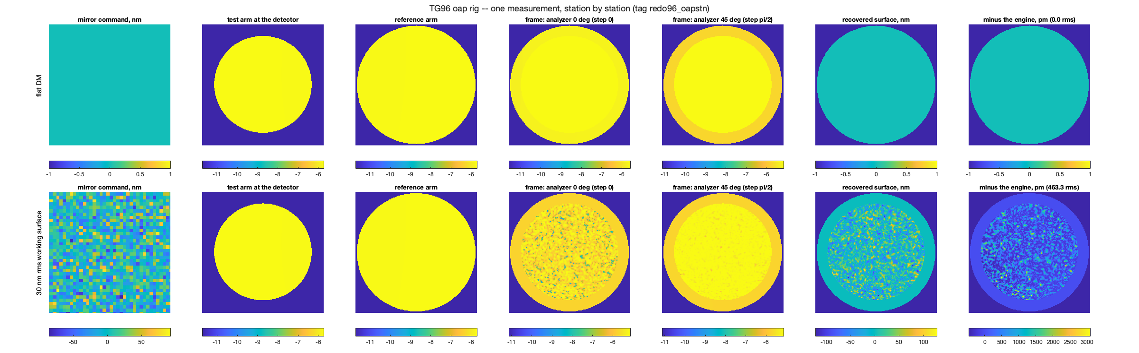
Interferometer, station by station
The key signals along the train for the flat mirror and for the 30 nm working surface, on the redesigned mirror rig: the absolute map is within 1.5% of the engine's field, the differential rows within 1.8 pm
Two rows (the flat mirror, the 30 nm rms working surface) by seven stations: the mirror command, the test-arm field at the camera, the reference-arm field, two of the four phase-stepped frames (0 and π/2), the surface recovered from the four-step, and the recovered map minus the engine's own field. The runner's own figure from the servo run.
• The residual column is the absolute read against the engine: 0.00 pm on the flat, 463 pm on the 30 nm surface (1.5% of the figure); the differential rows the servo uses read the same surface's changes to 1.8 pm, which is why the matrix is measured on the surface.
Run tag redo96_oapstn (the mirror rig). The lens rig's figure exists but its absolute residual reads 51 nm against the engine — a fold of the phase, not an imaging error (its differential rows read the same as the mirror rig's); under investigation, so it is not shown.

Slide 29
The question: must the pupil imaging be simulated, and how?
Is it possible or even necessary to simulate the effect of the pupil imaging geometry on the pupil images of the DM? Convolve the pupil image with the complex amplitude? (Dave, 2026-09-16)
• The right model is coherent imaging: the field at the camera is the field at the DM convolved with the complex point-spread function of the detector leg; equivalently, the leg's transfer function at a DM spatial frequency is the aperture function at the matching focal-plane position, phase included. A convolution of the intensity image would be wrong; a convolution of complex amplitudes is the Fourier statement of the same thing.
• For the mask sensors it is already in the runner: the mask sandwich propagates the field to the seat, applies the mask, and propagates back to the pupil image, mask shape and all.
• For the interferometer the aperture at the focus is wide (the field lens, 21 mm at F/4.2: a coherent resolution of 13 µm at the DM against a 1 mm pitch), so the leg's resolution is not the question. What is: the phase of the transfer function over the actuator band, set by how far each zone's image lies from the camera plane. That is simulated on the next slide.
• When a small field stop sits at the focus (a spatial filter of a few λ/D), the pupil image is low-pass filtered and actuator responses blur; then one aperture element at the seat through the existing sandwich answers it in one run.
The answer as given on 2026-09-16, before the simulation; the next slide supersedes its "not needed" with numbers.

Slide 30
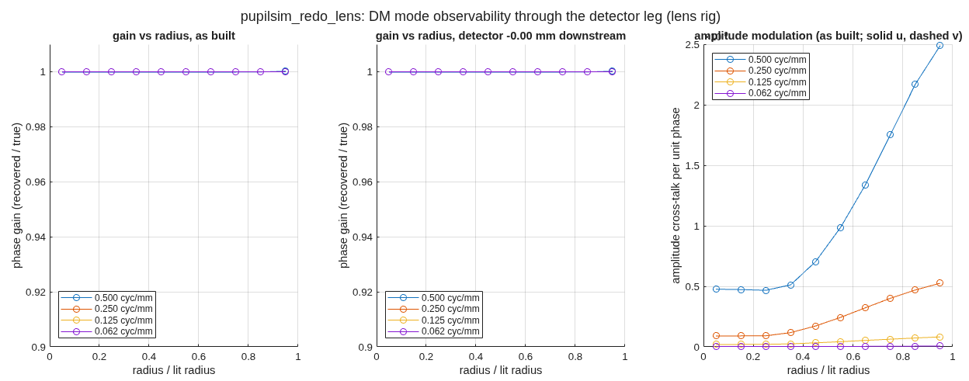
Pupil imaging: the DM's modes through the detector leg
The leg's point-spread function, zone by zone from the rays, applied to the DM's field and read out as the interferometer reads: every mode the DM can make is observable, and the camera sits at the pupil image on both rigs
gain at the actuator Nyquist (2 mm) | center | edge | worst | 30 nm surface, error
lens rig | 1.0000 | 1.0000 | 1.0000 | 42 pm
mirror rig | 0.9994 | 0.9994 | 0.9994 | 92 pm
• How: the DM the stop; 41 tilts over the actuator band; each zone's image walk integrates to its wavefront (defocus and astigmatism to 0.3 nm), whose transform is the zone's complex PSF; the DM field filtered zone by zone, the reference arm through the same leg, angle of the product read as the surface.
• The camera is at the pupil image, and the best detector move from here is −0.00 mm: there is nothing left to correct. The band-edge quadratic phase is 0.000 rad rms on lenses and 0.013 on mirrors, so the gain at the actuator Nyquist is 1.0000 and 0.9994.
• The beam of record under-filled the DM (77 / 82 mm of 96): the baffle is now opened and the aperture sits on the DM; runs from 2026-09-17 carry the full 96 mm.
Phase gain (recovered over true) versus pupil radius on the lens rig for DM sinusoids at 2, 4, 8 and 16 mm period, at the camera plane as built (left) and 4.3 mm downstream (middle); right, the amplitude cross-talk the four-step ignores. The runner's own figure.
Run tags pupilsim_redo_lens, pupilsim_redo_oap (tg96_pupilsim on the emitted decks, 2026-09-17; run it yourself: tg96_pupil_batch.sh both); REPORT_bench_realism.md section 7. The engine's own plane-to-plane check through reference surfaces is built and needs the station-to-station form (in progress).

Slide 31
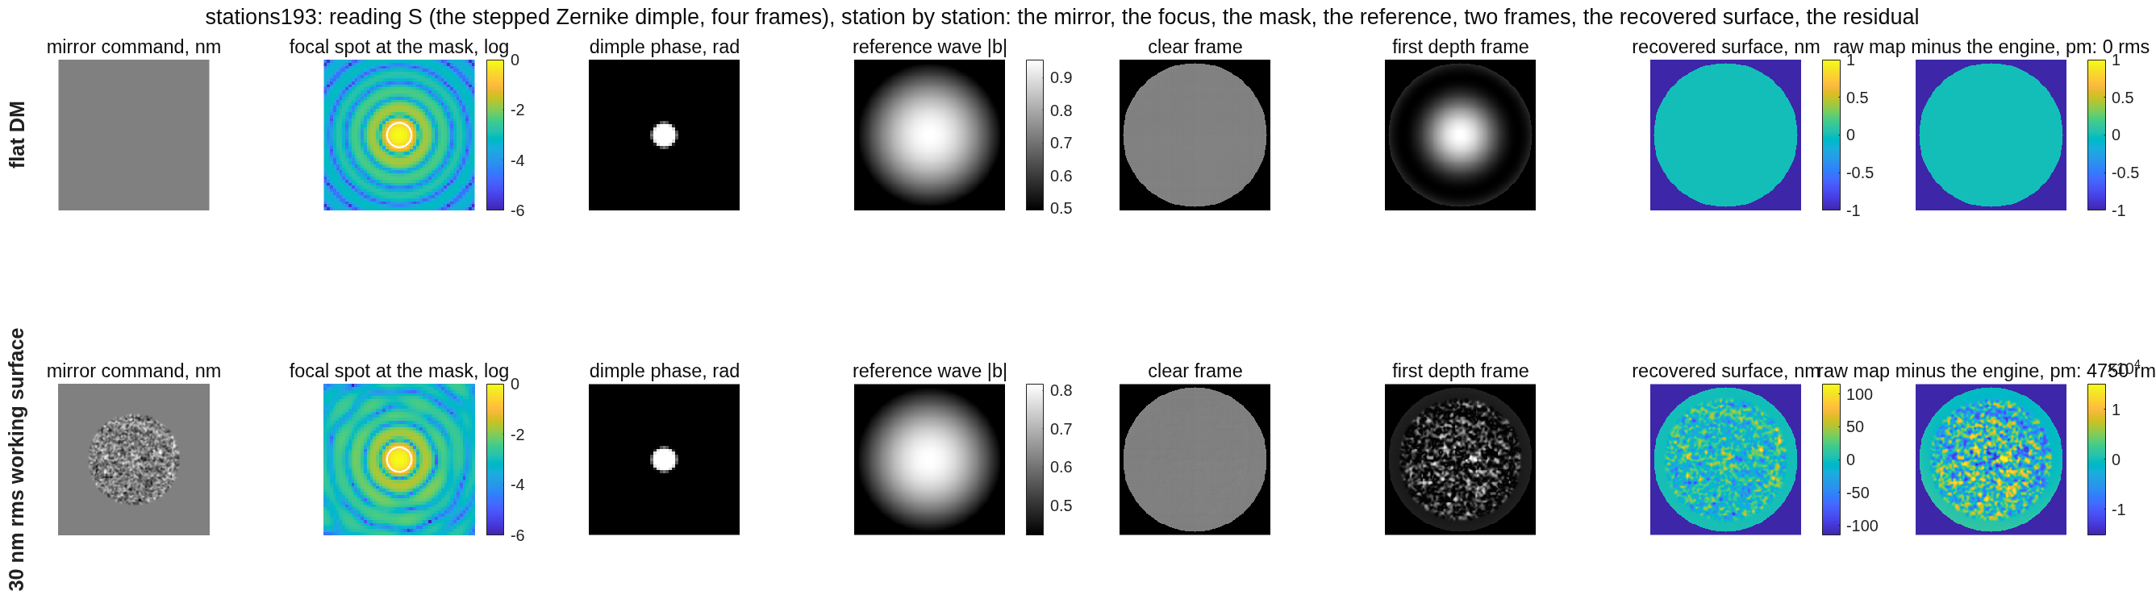
Scalar Zernike sensor, station by station
The key signals along the train for the flat mirror and for the 30 nm working surface: the raw pixel map on the working surface is off by 4.8 nm because the sensor's reference is made from the beam, which is why the response matrix is measured on the surface
Row 1 the flat mirror, row 2 the 30 nm working surface. Left to right: the mirror command; the focal spot at the mask (log scale) with the dimple's footprint; the dimple's phase; the reference wave the dimple makes at the detector; the clear frame and the first depth frame of the four; the surface recovered from the four frames; the raw map minus the engine's own field at the detector (0 on the flat, 4.8 nm rms on the working surface). The runner's own figure, run stations193 at 193 pixels per pupil.
• The reference wave (fourth column) is the core of the focal spot spread back over the pupil: on the working surface it has changed, so the raw four-frame map carries a 4.8 nm bias. The matrix measured on the surface absorbs it, which is how the stepped reading reaches 5 pm on its rows.
The residual column is the raw pixel map against the engine's field, before any calibration; the performance rows and the servo use the calibrated estimate.

Slide 32
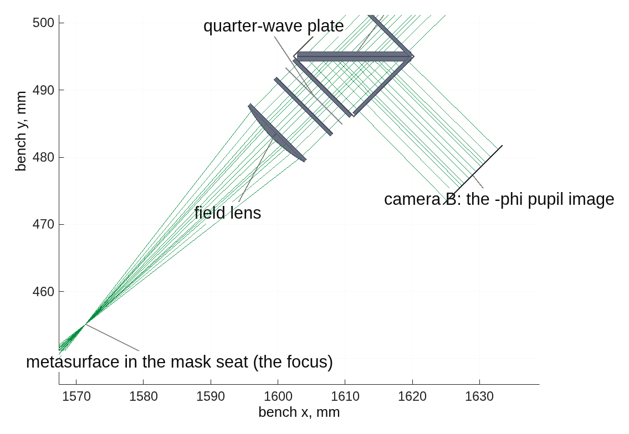
Vector Zernike sensor: the layout
The leg from the focus to the two cameras, both channel decks traced by the engine
The vector sensor's tail from above: the focus with the metasurface, the field lens, the quarter-wave plate, the 12.7 mm polarizing cube, camera A on the transmitted port (purple) and camera B on the reflected port (orange), both at the pupil image.
• The same polarization camera as the interferometer's snapshot form would replace the cube and one camera: behind the quarter-wave plate the two circular channels are the 0° and 90° pixels of the micro-polarizer array, so the two images land on one sensor, registered by construction. The price is half the pixels per channel and the array's extinction in place of the cube's, a term the model already carries (the analyzer, on the systematics slide).
Drawn by zwfs_vlayout.m from the two emitted decks (the engine does not split rays); the whole train is on the front-end slide. The metasurface and the plate are drawn as ideal surfaces and the cameras as planes; the next model round draws the substrates and the 13 mm sensors.

Slide 33
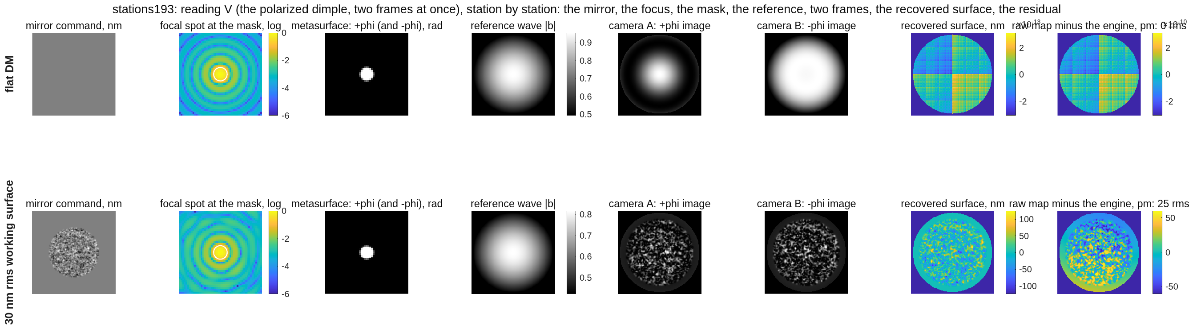
Vector Zernike sensor, station by station
The two images taken at once, and a raw map within 25 pm of the engine's field on the 30 nm working surface: the pixel-by-pixel solve needs no calibration to read the surface
Row 1 the flat mirror, row 2 the 30 nm working surface. Left to right: the mirror command; the focal spot with the metasurface's footprint; the metasurface's phase (+90° on one circular state, −90° on the other); the reference wave at the detector; camera A (the +φ image) and camera B (the −φ image); the surface recovered from the pair; the raw map minus the engine's field (0 on the flat, 25 pm rms on the working surface). Run stations193.
• On the flat the two images are complementary (dark center on A, bright on B: the dimple's sign); on the working surface each carries the surface's structure, and their per-pixel combination gives the phase with no branch choice and no stepping.
The 25 pm is the raw absolute map's error on a 30 nm surface with the flat's calibration; on the same surface the calibrated reading is 0.9935 / 4 pm.

Slide 34
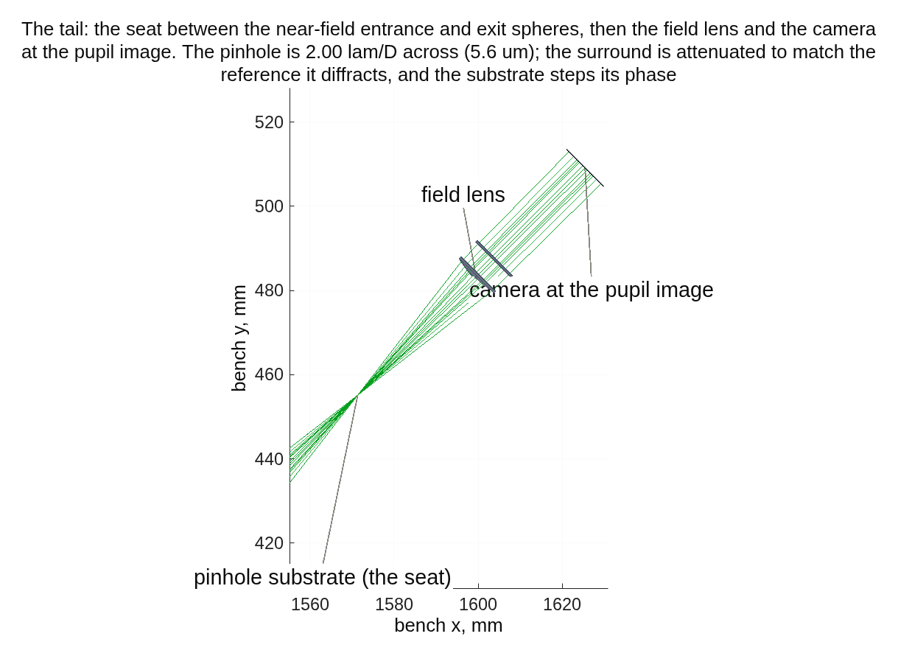
Point-diffraction sensor: the layout
The leg from the focuser to the camera, with the pinhole substrate at the internal focus
The point-diffraction tail from above, as traced: the focuser, the pinhole substrate in the mask seat at the internal focus (2.0 λF/D across, the surround attenuated), the field lens, the camera at the pupil image. Axes in bench millimeters.
Drawn by pdi_run from the emitted deck (pdi_layout.png in pdi_dm96); the whole train is on the front-end slide. The pinhole plate is drawn as a surface and the camera as a plane; the next model round draws the 2-3 mm substrate and the 13 mm sensor.

Slide 35
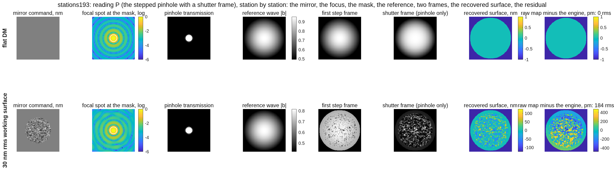
Stepped pinhole, station by station
The pinhole passes the core as the reference, the attenuated surround passes the rest; the first step frame and the shutter frame; a raw map within 0.18 nm of the engine's field on the working surface
Row 1 the flat mirror, row 2 the 30 nm working surface. Left to right: the mirror command; the focal spot with the pinhole's footprint; the pinhole plate's transmission (the clear pinhole, the surround at 0.72); the reference wave at the detector; the first frame of the five-step scan and the shutter frame (the surround closed, the pinhole's light alone); the surface recovered from the scan; the raw map minus the engine's field (0 on the flat, 0.18 nm rms on the working surface). Run stations193.
• The shutter frame measures the reference by itself, state by state; that is what lets this reading keep its calibration to 480 nm of surface where the dimple's self-reference collapses at 60.
The 0.18 nm is the raw map's error with the flat's calibration; through the matrix on the surface the pinhole reads 0.9935 / 4 pm, the same as the vector dimple.

Slide 36
Capture range, second half: the photon price of working off null
The matrix re-measured on the surface holds the gain to 1-6 %; the light for 1 pm then rises 30-100× for the self-referenced sensors between 30 and 160 nm (vector 4.6e13 → 4.5e15) and falls for the interferometer (7.0e14 → 4.4e14), whose reference does not move with the surface
reading | 1 nm on the grid sites, matrix re-measured at 60 / 120 / 160 nm: gain / floor | photons per measurement for 1 pm at 30 / 60 / 120 / 160 nm
stepped Zernike | 0.94 / 50, 0.99 / 26, 0.99 / 26 pm | 1.2e14, 5.3e14, 4.6e15, 7.5e15
vector Zernike | 0.99 / 6, 0.99 / 26, 0.99 / 26 pm | 4.6e13, 1.4e14, 2.4e15, 4.5e15
stepped pinhole | 0.98 / 16, 0.99 / 26, 0.99 / 26 pm | 1.5e14, 3.0e14, 3.0e15, 7.3e15
interferometer, lens rig | 1.001 / 2, 0.996 / 2, 0.996 / 2 pm | 9.9e14, 8.6e14, 5.9e14, 6.6e14
interferometer, mirror rig | 0.989 / 2, 0.995 / 2, 0.995 / 2 pm | 7.0e14, 5.3e14, 4.9e14, 4.4e14
interferometer, either rig | 0.99 / 2 pm to 60 nm; between 60 and 120 nm the raw four-step reading wraps (the base past λ/2 of surface reads 91 nm rms whatever it is) on lens and mirror rigs alike; unwrapping restores it (next slides) | —
• What this says: off null, a self-referenced sensor keeps its gain through recalibration but pays in light (4.5e15 photons is 1.4 mJ, 6 s of a 1 mW laser at 25 % throughput) and its floor rises to 26 pm; the interferometer pays nothing because its reference does not move with the surface.
All rows on the built bench. Interferometer: redo96_lensph, redo96_oapph (the re-measured matrix on each surface, 1 nm on 112 sites). Sensors, mirror rig at 193 px: redo96_senscap_b60/b120/b160 (1 nm on 77 grid sites, matrix re-measured on the surface), redo96_sensnoise and redo96_sensnoise_b60/b120/b160 (photons). Photons are per measurement, all frames summed, 6 noise realizations per point.

Slide 37
The reflective front end: the design
Fed at its focus and solved at the 22.5° splitter: every part clears by 33 mm, the focus lands on the mask seat without adjustment, and the residual with a flat mirror is 0.029 nm
 | value
collimation after the collimator | 0.00 µrad residual (the source at the parabola's focus)
blur at the mask seat, best focus | 0.000 λF/D at zero trim
residual with a flat mirror | 0.029 nm with no adjustment (lens rig 0.13 nm after adjustment)
clearance, worst part | +33.4 mm over 8 parts
rays lost | 0
• The rule a parabola enforces and a lens hides: an off-axis collimator must be fed at its focus — a 25 mm conjugate error becomes coma at the fold, linear in the fold angle (in the model that had it: 926 µrad of residual, 1.1 λF/D of blur at the mask seat, 12.9 nm of flat-mirror residual); a lens absorbs the same error into its tuned figure. Fed at the focus there is nothing left for a smaller fold angle to recover.
• Coatings: bare and protected aluminum give the same rows; the retardance variation they add is 0.5 mrad, a floor.
The redesigned reflective interferometer as traced by the engine, from above: the source and input polarizer in the diverging leg, OAP1 (collimator, 20° fold), the splitter at 22.5°, the 96 × 96 mirror on the test leg (blue), the reference flat on its piezo (orange), the output plate and analyzer, OAP2 (focuser, 25° fold) toward the mask seat.
Off-axis parabolas: OAP1 parent f 757 mm, off-axis 551 mm, 20°; OAP2 parent f 352 mm, off-axis 328 mm, 25°; each on a tip/tilt mount. Run tags oap22d, oapdraw3 (the layout), redo96_oap, redo96_oaploop, capt96_oap, redo96_oapsens (the rows).

Slide 38
Measuring the full complex amplitude, for two-mirror control
Every approach but the one-frame Zernike readings returns the pupil field's amplitude as well as its phase from frames it already takes; no separate camera is needed
reading | amplitude from its own frames? | how
Zernike, one frame | no | the solve assumes the flat's amplitude
Zernike, stepped | yes | its clear frame is the pupil intensity; the depths give the field
vector Zernike | yes, with one clear frame | the pair alone is ambiguous; the pair plus the clear frame is exact
pinhole, P/SRI | yes | the stepped solve is the field against a known reference
interferometer | yes | fringe modulation is the test amplitude times the reference's
• The vector pair alone cannot: its two images fix the field only up to a mirror image about the reference wave, and at gauge-level phases (a 100 nm poke is 1.9 rad) the true field crosses that line. Solving both from the pair diverges.
• The pair plus the state's clear frame reads both exactly: through a 5% and a 20% dip in pupil amplitude the phase comes back at 0.02 and 0.13 pm, where the phase-only solve misreads by 237 and 952 pm; the hold rows are unchanged to the digit. Three frames.
Run tag an193_clear; the runner's mask.v_clear reading and its amplitude-dip check. On orbit with starlight, the field's amplitude is what the second mirror's control needs.

Slide 39
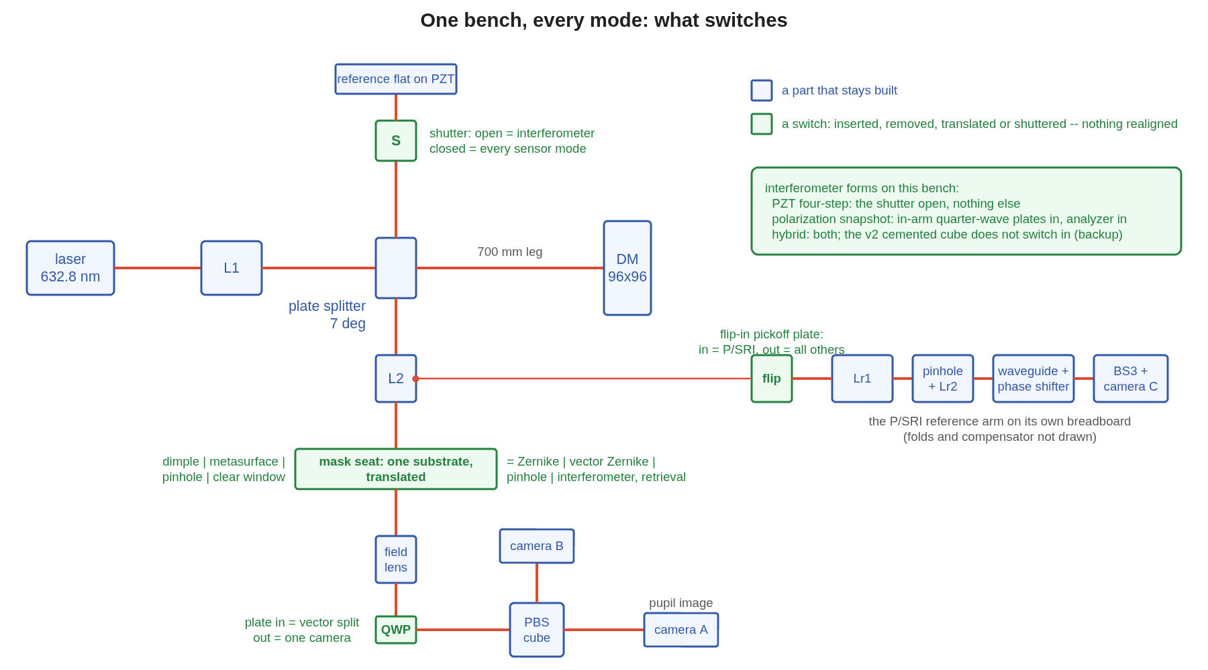
One bench, every mode
Nothing is realigned: the mask seat translates, the reference arm is shuttered, the quarter-wave plate goes in or out, and the P/SRI arm sits behind a flip-in plate
The switching schematic: the shared front end, the reference arm and its shutter, the mask seat with its four substrates, the vector tail with the plate and cube, and the P/SRI arm behind the flip-in pickoff. Green: a switch; blue: a part that stays built.
The polarizing cube and camera B stay in every mode: with the laser p-polarized the cube transmits 98% to camera A. The cemented-cube interferometer (backup) is the one form that does not switch in. An engine-traced drawing of this bench is a follow-up; the schematic is gauge_one_bench.m.

Slide 40
Future work: capture beyond one wave with a second color
Unwrapping works while neighboring pixels differ by less than half a wave; a figure of more than a wave with actuator-scale structure needs a coarse ruler
• Where unwrapping stops: at 4 pixels per actuator a 100-200 nm rms actuator pattern is 0.7-1.4 rad per pixel and unwraps; quilting, print-through or a stuck actuator at more than a wave does not.
• A second color makes a synthetic wavelength: 632.8 + 700 nm gives 6.6 µm, an unambiguous surface range of 1.6 µm (double pass); 632.8 + 780 nm gives 3.35 µm and 0.84 µm. The coarse pair captures, the single color holds; the coarse solve is 5-10× noisier.
• The machinery exists: the runner already traces one physical mask at five colors (the dimple is 1.57 rad at 632.8 nm, 1.42 at 700); the measurement to add is the start ladder with a two-color coarse solve feeding the single-color loop, per reading.
color pair | synthetic wavelength | unambiguous surface | noise cost
632.8 + 700 nm | 6.6 µm | 1.6 µm | 10×
632.8 + 780 nm | 3.35 µm | 0.84 µm | 5×
The two-color interferometer is the classic form; the same trick applies to the dimple and the pinhole through their color stage.

Slide 41
Future work: other approaches worth a look
Eight candidates, none modeled here, each with one sentence on what it would buy
• A model-based large-figure solve: the mirror's influence functions as the basis of a nonlinear fit to the sensor's frames; the estimator already carries the basis.
• Shack-Hartmann or modulated pyramid as the capture stage: many waves of range, no wrap, far from picometers; hands off to the gauge inside its range.
• Redesign the lenses as multi-element assemblies.
• Phase diversity (two defocused pupil images): wide range, common path, iterative; a capture candidate with the existing camera and one translation stage.
• White-light scanning in the interferometer: an absolute surface with no wrap, slow; a one-time capture tool.
• Vector Zernike with a polarization camera: one camera instead of the cube and two, at a quarter of the pixels per image.
• Heterodyne or lock-in detection: immunity to slow drift and 1/f electronics, for a frequency-shifted reference; the two-arm instruments can carry it, the common-path sensors cannot.
• Direct actuator metrology (capacitive, optical): a coarse reference the optical gauge is calibrated against.

Slide 42
Future work: from this model to as-built performance
The model today has ideal optics, a perfect camera, photon noise, and mirror and camera drift; five additions, in the order they are likely to matter
• The camera sets the measurement time, not the laser: 1e14 photons over 1e5 pupil pixels is 1e9 electrons per pixel; with a 1e5-electron well that is 1e4 co-added frames, 100 s at 100 frames per second, against 0.13 s of laser. Price well depth, frame rate, read noise (as the square root of the frame count), bit depth, gain nonlinearity, pixel-response nonuniformity, persistence between the stepped frames.
• Optical surface errors: every lens, mirror, plate and the mask substrate with a typical figure (λ/10 to λ/20, a 1/f² spectrum) on the element; the sensors' reference core sees the low orders (0.16 wave of defocus moved every number in the early model); the dimple's etch depth and the mask's flatness.
• Alignment and stability: the sensitivities exist (10 µm, 10 µrad); add the mask's centering drift on the focal spot, the bench's thermal expansion, source pointing and wavelength drift, laser polarization angle, and the two-arm instruments' non-common-path air and mounts.
• More drift in the loop: actuator hysteresis and creep, command quantization (14-16 bits: 0.1-0.5 nm steps as a floor), influence-function error, vibration within a stepped scan.
• The error budget in the JPL form: per reading, fixed terms after calibration, drift terms weighted by the servo bandwidth, noise terms in quadrature, to a held error at a stated light and time. This deck's comparison table is its first column.
The telescope-level version of this (an allocation table rolled through the sensitivity model, then the closed-loop predictor) is being planned separately; it is a later add to this deck.

Slide 43
How every configuration was analyzed
One repeatable path, ten steps, the same for all four approaches: a new sensor is a new reading class in the shared runner plus its gate, then steps 4 to 10 unchanged
step | what | gate or output
1 | one parameter sheet and one runner per approach; batch wrappers | every number has a run tag
2 | build the bench from the sheet, trace it; clearance of end bodies and node parts; detector-leg focus; sampling budget | every part clears by 25 mm; 6 pixels across the mask feature
3 | model gates before any number | mask round trip, reference-wave surrogate, working-state amplitude, the reading on 100 nm pokes
4 | calibration: the response matrix measured through the sensor, on the 30 nm working surface | piston null carried; stencil-site fit
5 | rows on the working surface: 10 nm on one actuator; 1 nm on 47 sites; dense 10 nm | gain, floor, SNR
step | what | gate or output
6 | capture range: the aging ladder to 10%; the matrix re-measured at 60 to 160 nm with its photon cost | range in nm; photons per rung
7 | photons: noise fit over 1e8 to 1e14 per measurement, flat and on-surface matrix | photons for 1 pm
8 | closed loop in the shared loop code: noise, walk, ramp; noiseless step; within-scan drift | photons per cycle for 3 pm; fixed error
9 | descent: the start ladder with unwrapping and recalibration on and off | largest start brought to 3 pm
10 | systematics one at a time, uncalibrated and through the matrix; layout drawn from the emitted deck; parts from the sheet; report numbers first | one line per term on the systematics slide
The scoring library (the loop, the unwrapper, the arm and analyzer maps, the clearance check) is shared by the three lanes; nothing is copied between them. The path is recorded as reference memory so the next configuration follows it in a day.

Slide 44
Run it yourself
One parameter sheet and one runner per approach, shared code underneath; every number here is reproduced by the commands below
• Interferometer (tg_psi_dm96_oap): tg96_run for the lens rig; tg96_run('bench.optics','oap','tag','oap') for the mirror rig; ./tg96_batch.sh lens_deck "'stages',{'bench','deck'},'battery.noise',true"; ./tg96_batch.sh loop_lens "'stages',{'bench','loop','figs'}".
• Pupil image (tg_psi_dm96_oap): tg96_pupilq('rig','lens'), tg96_pupilsim('rig','oap'); both tools, both rigs: ./tg96_pupil_batch.sh both (knobs: P.pupil in tg96_params).
• Zernike sensors (zwfs_dm96): out = zwfs_run; (bench + battery + figures); zwfs_run('tag','ng385','NGRID',385); zwfs_run('MODEL',2048,'NGRID',385,'param_file','macos_param_2048.txt'); ./zwfs_batch.sh loop193 "'stages',{'bench','loop','figs'}".
• Point-diffraction (pdi_dm96): P = pdi_params; out = pdi_run(P);; pdi_run('pdi.DIA_LAMD',1.0,'stages',{'bench','battery','figs'}); ./pdi_batch.sh TAG "pdi_params, 'stages',{'bench','loop','figs'}".
• The other gauges on the mirror rig: zwfs_run('bench.optics','oap','bench.coat_oap','bareAl','readings',{'L','S','V','P','PF'},'stages',{'bench','battery','noise','loop'},'mask.v_arm','engine').
• Where: MACOS_resources/mmacos/templates/40_benches/{tg_psi_dm96_oap, zwfs_dm96, pdi_dm96}, the shared scoring library dm_gauge_lib, branch dev-candidate. A model-1024 run needs about 11 GB; the batch wrappers run one at a time.
• Gates: every stage asserts its own gates (the mask round trip, the reference-wave surrogate, the fold, the pinhole, the analyzer); tDmgLoop 15/15; the mmacos fast suite 481/0.
Each directory's README carries the full command list and the run-tag index. All code and documentation is available from the public nasa-jpl github macos and MACOS_resources repos.

Slide 45
Improving the pupil image: the options, assessed
The tail geometry is the whole story: the seed field-lens station images the DM flat; the detector move is second-order once the tail is right; no flattener can fix the tuned bowl; true collimation is worth doing for itself
lens rig variant | zone image vs the detector, mm (on axis / mean / edge) | astigmatism | Nyquist gain, as built / worst | with the detector at the image mean | 30 nm surface error | distortion
tuned tail (field lens 39.8 mm past the focus, conic −2.59) | +2.6 / +4.3 / +6.0 | 1.05 mm | 0.979 / 0.954 | +4.3 mm: 0.993 worst | 1.2 → 0.4 nm | 0.27 mm
seed tail (field lens 10.8 mm past the focus, conic −2.11) | −0.5 / −0.7 / −1.0 | 0.08 mm | 0.9992 / 0.9986 | −0.7 mm: 0.9999 | 0.24 → 0.06 nm | 0.003 mm
tuned tail, spherical field lens | +2.6 / +1.5 / +0.3 | 0.59 mm | 0.996 / 0.992 | +1.5 mm: 0.994 | 0.54 → 0.34 nm | 0.30 mm
true collimation, tuned tail | +2.7 / +3.9 / +5.1 | 0.80 mm | 0.982 / 0.965 | +3.9 mm: 0.996 | 1.1 → 0.3 nm | 0.13 mm
true collimation, seed tail | −0.5 / −0.8 / −1.1 | 0.11 mm | 0.9991 / 0.9980 | −0.8 mm: 0.9999 | 0.26 → 0.08 nm | 0.035 mm
mirror rig, as built (seed tail) | −0.4 / −0.6 / −1.3 | 0.09 mm | 0.9993 / 0.9974 | −0.6 mm: 0.9994 | 0.23 → 0.09 nm | 0.72 mm
• The null tuner bought its 0.13 nm flat-mirror null with the pupil image: it moved the field lens to its own focal length behind the focus, where the pupil rides 4.6 mm high on a 12 mm asphere. At the seed station the pupil rides 1.2 mm high and the DM images flat. The null it gives up (9 nm) is a fixed pattern the reference frame removes.
• A flattener behind the tuned tail is not an optic: its bowl is a 5 mm-radius surface in image space. True collimation (a source 14 mm inside the hyperbolic collimator's focus, the case assessed here, is what the bench corrects) halves the distortion and is needed for any re-tune and for the physical-optics chain.
Recommendation: lens rig, field lens held at the seed station, conic and trim re-tuned with the image surface in the objective, detector at the image mean; mirror rig, the 0.6 mm move; collimator fixed first; rows re-run on the corrected tail and the 96 mm beam together. Run tag pupil_options (tg96_pupil_options); REPORT_bench_realism 7.1.

Slide 46
The interferometer's three phase-shift forms
The four frames are the same in the model; the forms differ in what they get wrong
form | how the four steps are made | what it gets wrong | priced
piezo four-step | the reference flat stepped in time | step miscalibration; camera and mirror drift within a scan | step error 2% / 5%: gain 0.974 / 0.954, floors 5 / 9 pm; in the servo common mode (5.4e12 vs 5.5e12); camera walk 1e-3 within a scan: +13% light; mirror walk within a scan: 1.6e13 vs 1.7-2.0e13
polarization snapshot | four analyzer channels at once | polarization systematics, fixed by design; no within-scan drift | plate rig at the record's 45°: the splitter's diattenuation rotates the test arm 7.5°, gain +11.7% (at the built 22.5°: 1.56°, +0.9%), nulled to 1.00000 by an analyzer sweep and a 3.8° plate clock; cube rig: R_p 2.1% for a naive stack, 0 for the symmetric one, 2.27× the delivered power
hybrid | snapshot for the change, piezo for the absolute step | each half removes the other's error | the recommended form; its value is the absolute calibration more than drift immunity: the four-step already tolerates all three sequential terms in hold
Run tags lens_deck_se2, lens_deck_se5, loop_lens_se2, loop_lens_cam, loop_lens_intra, tg_psi_dm, tg_psi_dm_v2.

Slide 47

The Zernike readings that lost, and the fold
One frame is not enough: the linear reading imprints error under a slow drift, and the exact one-frame reading diverges once actuators sit past the quarter-wave fold
• Linear, one frame: holds noise and walk like the stepped reading (2.1e12 / 7.3e12) but floors at 27.6 pm under the 5 pm ramp and is still creeping at cycle 60: a persistent low-order residual makes it imprint fine-scale error (26 pm above 12 cycles per aperture).
• Exact, one frame with a sign prior: a 1 nm step grows to 99 nm in 60 cycles, 10 nm to 178 nm; the actuators whose footprint lies past the fold read with the wrong sign.
• The fold: on the 30 nm surface 7.8% of pupil pixels sit past the quarter-wave fold (7.7 / 12.6 / 16.9 / 20.6% at 30 / 40 / 50 / 60 nm rms); a dense 10 nm change moves 3.3% of them across it. The stepped reading and the vector pair have no fold.
The stepped Zernike servo: residual per cycle at four light levels, with the noiseless 1 nm step decaying to zero.
Run tags loop193, fold_diag, matbase385.

Slide 48
The point-diffraction trades
The pinhole diameter of record is 2.0 λF/D; the P/SRI's traced reference arm moves with the state by 0.05% of the figure and costs twice the light
 | 2.0 λF/D pinhole | 1.0 λF/D pinhole
diameter | 5.27 µm | 2.64 µm
surround transmission (amplitude) | 0.72 | 0.28
throughput | 0.82 | 0.29
pixels across at the mask | 7.9 | 4.0 (below the 6 the sampling rule asks)
10 nm on one actuator | 0.9935 / 4 pm | 0.9937 / 4 pm
capture range, no shutter | 62 nm | 120 nm and beyond
photons for 1 pm on the surface | 9.8e13 | 2.1e14
3 pm under the walk | below 1e13 | 3.6e13
• The range the small pinhole buys, the shutter frame gives free at the large one's throughput: 1.02 / 1.06 / 1.13 at 120 / 240 / 480 nm.
• The P/SRI (pickoff plate 60/40, a 300 mm F/2.9 reference lens, a 3.7 µm pinhole feeding a single-mode waveguide with a thermo-optic phase shifter, a mirrored second lens, folds, a 21.9 mm compensator, a 50/50 recombiner): balanced to zero path difference in the trace. Its reference moving with the state costs 5.9 pm absolute on a 13 nm figure and 12% on the dense floor; frozen, 0.000.
• Five frames beat four: a 2% step error reads 4.9 pm (pinhole) and 2.2 pm (P/SRI) with the Schwider-Hariharan scan against 421 and 251 pm with four-step least squares.
Run tags pin20_1024, pin10_2048, pin20_loop, pin10_loop, pfdeck, pfdeck_frz, pdi193se_sh5, pdi193se_ls; layouts psri_layout.png and psri_render.png in pdi_dm96.
P/SRI parts (9): a 60/40 pickoff plate; two f 300 mm F/2.9 lenses; a 3.7 µm pinhole into a single-mode waveguide with a thermo-optic phase shifter; two 150 mm protected-metal folds; a 50/50 recombiner; camera C (sCMOS). Its photonic reference is modeled as the recollimated LP01 mode of a single-mode fiber (pickoff fraction, coupling and phase-step miscalibration priced); the waveguide's own loss, dispersion and thermal drift are not yet in these numbers.

Slide 49
Drift within a measurement
A mirror that drifts during a stepped scan helps the stepped readings; a camera that drifts during the scan hurts them; the simultaneous readings see neither
hold error at 1e15 photons per cycle | linear | stepped | vector | pinhole | P/SRI
2 pm walk, mirror still during a scan | 2.38 | 2.32 | 2.32 | 2.32 | 2.33 pm
2 pm walk, mirror drifting across the scan | 2.38 | 1.57 | 2.32 | 1.58 | 1.71 pm
5 pm ramp, mirror still | 27.6 | 10.05 | 9.87 | 9.86 | 9.88 pm
5 pm ramp, drifting across the scan | 27.6 | 7.16 | 9.87 | 6.70 | 7.30 pm
camera scale drifting 1e-3 across the scan | 10.8 nm | 5.4 | 89 pm | 5.3 | 10.7 pm
• Why the mirror's drift helps: a scan reads the surface at its midpoint, a free half-step of prediction; 26-32% less hold error for the stepped readings. The camera's drift is an additive bias, the opposite sign.
• The P/SRI's reference arm walking (a random path walk of 1e-3 to 1e-1 rad per cycle) costs 4% in light over that hundredfold range: a path change is piston, the one mode the actuator estimator nulls. Not benign for absolute field work; a tilting reference is outside the model.
• The paper's camera number (0.13 electrons per pixel per cycle) is invisible to every reading: an electron is 1e-4 of a lit pixel's shot noise at 1e13 photons.
Run tags intra193_0, intra193, pcam193, pcam193r, pcam193ri, rw193_1e3/1e2/1e1, loop_lens_intra, loop_lens_cam.

Slide 50
The vector sensor's polarization terms
The metasurface's retardance error, the arm's polarization aberration, and the analyzer, each from the engine's polarized traces of this bench
term | uncalibrated, on 100 nm pokes (12 nm rms) | through the matrix measured on the surface
metasurface retardance error 0.02 / 0.05 / 0.10 / 0.20 rad | 153 / 380 / 750 / 1461 pm | 0.9934 / 4 pm at 0.10 and 0.20: the ideal rows
the arm, laser at 45° / 0° / 90° to the fold plane | 9.0 / 17.2 / 11.2 pm (ideal 0.05) | nothing through 0.1 rad of channel phase; 10% gain loss at 0.3
the arm, design scan: 6 nm per rad of channel phase | 59 / 178 / 597 / 1877 pm at 0.01 / 0.03 / 0.1 / 0.3 rad | —
analyzer: cube extinction alone | 3.5 pm | 0.9934 / 4 pm
analyzer: plate λ/300; 1° azimuth; λ/100 | 165; 263; 496 pm | 0.9932 / 4; 0.9932 / 4; 0.9928 / 4 pm
• The arm: six 7° glass faces give 5e-3 diattenuation and 0.9 mrad retardance; because the Jones matrix is real, the two circular channels differ in phase only, 1.6 mrad rms at the worst laser angle and 2e-5 along the fold plane's axis. Rule: specify pupil-varying diattenuation, put the laser on the eigenaxis.
• The analyzer: a plate retardance error δ couples the two images with amplitude δ/2, an azimuth error θ with amplitude θ, engine-exact, opposite signs in the two ports; the cube's finite extinction adds 4-6e-4 incoherently. Spec a zero-order plate at λ/300, azimuth to 1°.
• A three-number fit on the flat's two images recovers the metasurface's constants to five digits (0.048 pm).
Run tags v2g, v2loop, v3arm, v3s, v3loop, an193_cube/q300/q100/az1; zwfs_dm96 README V2-V4.

Slide 51

The sensor model, sampling and color
The early Zernike model was out of focus by 4.9 m at the pupil image; corrected, every gate closes; the sampling rule and the color result follow from the corrected model
• The correction: the mask's exit reference sphere carried 23.9 mm against the entrance sphere's 352.7 mm, a 4.86 m defocus of the pupil image. Symmetric spheres take the unmasked round trip from 0.159 to 1.8e-15 and the pupil brightness modulation under a 30 nm surface from 29% to 4e-16; the single-actuator floor fell from 744 to 67 pm before any other change.
• Sampling: mask pixels per λF/D = 0.74 × model ÷ rays; the dimple needs 6 pixels; 385 rays on a 2048 grid is the compliant run (7.9 pixels, 5 pixels per actuator), and a stencil-site fix in the actuator fit took the test actuator from 0.935 to 0.996.
• Color: five colors through one 346 nm etch, dimple phase 2.10 to 1.27 rad; the combination's minimum transfer is 0.991 against 0.962 for the best single color — 3%, not 3×; the linear reading gets worse (480 nm reads negative).
The model correction: the runner's figure of the iterated reference-wave solve on the corrected model.
Run tags rec193full, m2048, m2048_lat, ng385_lat; zwfs_dm96 README S7-S9.

Slide 52
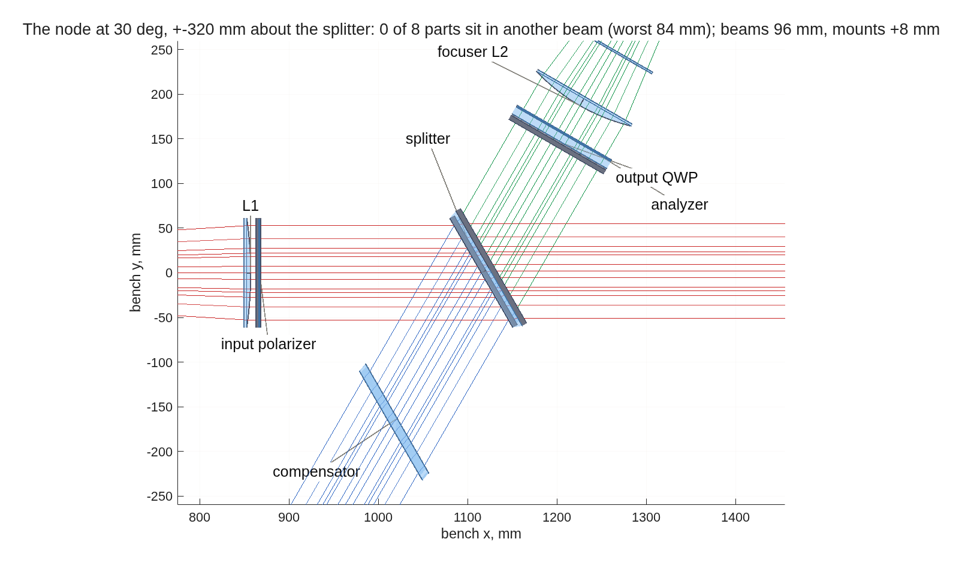
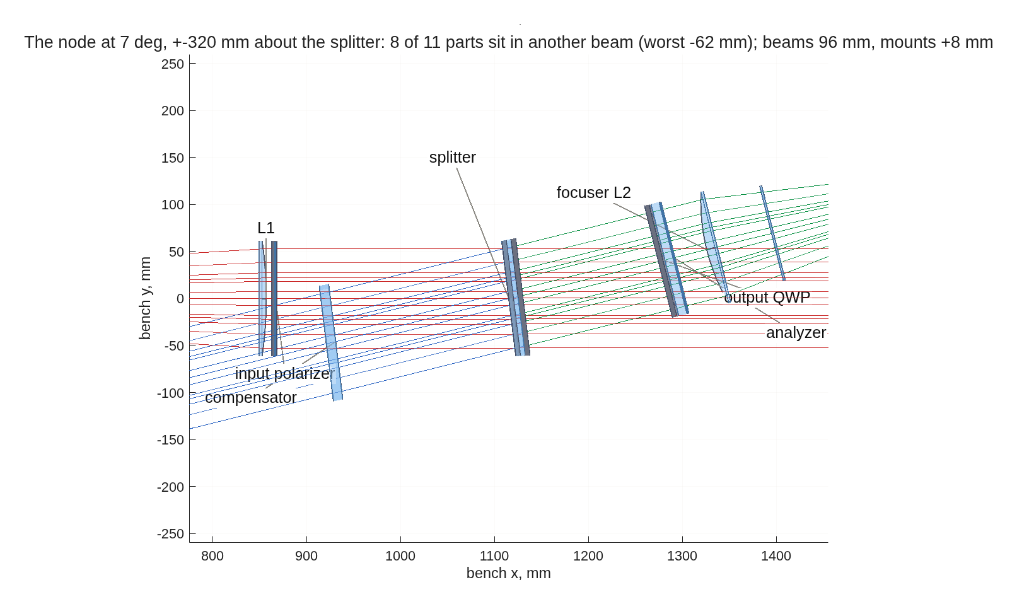
The clearance scan behind the 22.5° choice
The record's clearance solve cleared the mirror, flat and camera bodies at the leg ends and never looked at the node; two 103 mm beams 2θ apart clear a part at distance d only if d·sin 2θ exceeds about 111 mm
splitter | worst part | others
7° | output plate −109 mm | eight parts in another beam: reference plate, analyzer, compensator, L2, polarizer, L1
15° | compensator −27 mm | output plate −17, analyzer −11, L2 +10
22.5° | compensator +16 mm | output plate +55, analyzer +65, L2 +100, L1 +153
30° | compensator +57 mm | output plate +178, analyzer +196, L2 +257, L1 +350
The node at 30°: the compensator clears by 57 mm, the rest by 178 mm or more.
• What moves: the output plate and analyzer from 17 and 27 mm behind the splitter to 160 and 170 mm, just ahead of the focuser at 207 mm; nothing else, so the focused detector leg is untouched.
• What it costs the sensors: nothing. At 30° the Zernike rows reproduce (0.9943 / 5 pm against 0.9942 / 5), the mask gates pass, and the arm's channel phase difference is 1.69 mrad against 1.63; the plate's diattenuation rises to 10% but uniformly, a non-term with the laser on its eigenaxis.
The record's node at 7°: eight parts sit in another beam.
Clearance = lateral distance of a beam's chief where it crosses the part's plane, minus the beam radius (51 mm) and the part's radius plus an 8 mm mount. Tool dmg_bench_clearance; run tag bs30_dev. The interferometer's snapshot form feels the angle through the plate's polarization; its numbers re-run at the chosen angle.

Slide 53
What the Zernike-sensor literature offers, in priority order
Twelve papers read; the first import — re-computing the reference wave — is built and measured here (the S and V readings)
# | paper | what it gives this model
1 | Ruane, Wallace, Steeves et al. 2020, JATIS 6, 045005 | Exact per-pixel reconstruction from the pupil amplitude, the reference wave b and the masked image; a sensitivity factor per pixel; a four-term systematic budget; 1 pm reached at 4.4×10⁵ frames; no loss to 25 % bandwidth
2 | Doelman, Fagginger Auer, Escuti, Snik 2019, Opt. Lett. 44, 17 | Vector Zernike: ±π/2 on opposite circular polarizations gives two pupil images, an exact phase-and-amplitude solution, an iterated b, achromatic to 100 % bandwidth; the leakage terms are written down
3 | N'Diaye, Vigan, Dohlen et al. 2016, A&A 592, A79 (ZELDA II) | Second-order reconstruction with b from the mask model; 1.06 λ/D at π/2; range −0.14 to +0.36 λ; the sensitivity factor drifts 10 % day to day on SPHERE
4 | Chambouleyron, Cissé, Salama, Haffert, Wallace et al. 2024, SPIE 13097 | A phase-shifted pair (±π/2) yields cos φ and sin φ; iterative reconstructors reach about 1 rad rms; the bench limits were polarization crosstalk and defocus between the two pupils
5 | Haffert 2024, A&A 683, A113 | Iterative nonlinear reconstructors reach machine precision below 0.25 rad rms; phase sorting extends to 0.75 rad; adding wavelengths to 1.4 rad rms
6 | Darcis, Haffert, Chambouleyron, Doelman et al. 2025, A&A | Multi-wavelength gradient descent through the forward model: dynamic range for the scalar sensor, photon robustness across a wider band, two-wavelength unwrapping of petal errors
Priority = payoff against this campaign's measured weak results. Synopses and links: macos/REPORT_zwfs_lit_scan.md.

Slide 54
Demonstrations, segmented mirrors, and the in-house precedent
Picometers by alternating DM shapes and averaging; segment piston by model iteration, underestimated below 50 % Strehl
# | paper | what it gives this model
7 | Steeves, Wallace, Kettenbeil, Jewell 2020, Optica 7, 1267 | 1.6 pm repeatability in 4.3 s by alternating flat and waffle DM shapes and averaging the differences; a reconstruction robust at the highest spatial frequencies
8 | Wallace, Rao, Jensen-Clem, Serabyn 2011, SPIE 8126 | All-reflective phase-shifting Zernike interferometer: a dynamic, arbitrary core phase shift read in four steps gives phase and amplitude; low sensitivity to vibration, polarization and wavelength
9 | Moore and Redding 2018, SPIE 10698 | Nonlinear polychromatic physical-optics reconstruction for picometer differential metrology on LUVOIR; the in-house precedent for the reconstructor above
10 | Keck vector-Zernike segment control 2024 (arXiv 2404.08728); Wallace et al. 2022 (arXiv 2205.02241) | Segment piston by model-based iteration; 11 nm rms piston uncertainty; underestimation 2 to 4× below 50 % Strehl; fabricated shifts 0.30π and 0.68π instead of ±0.5π
11 | HiCAT mid-order Zernike sensor 2024 (arXiv 2409.03411) | Per-segment piston, tip and tilt by interaction matrix; a minimal step of 125 ± 31 pm at SNR 4; 14-bit DM quantization reads as steps in the response
12 | Shi et al. 2015, SPIE 9605 (Roman low-order sensor) | A reflective dimple on the focal-plane mask senses Z2 to Z11 from the rejected starlight: the spatially filtered form of the same sensor
Also read: PIAA-ZWFS (2026, arXiv 2606.28136), lossless pupil apodization that closes the gap to the fundamental sensitivity limit by 10× — a design lever, not a model change.

Slide 55
The path per configuration
The runner stages and knobs each approach went through, in the order they ran
step | interferometer (tg96_run) | Zernike, scalar and vector (zwfs_run) | point-diffraction (pdi_run over zwfs_run)
build + gates | stage A clearance, A2 sampling, B build both arms; the detector leg's focus from tg96_tail; the wrapped phase difference | bench: the symmetric mask sandwich (the S7 correction), the mask gauge factory, gates G1 to G4, G8, G9, the mask figure | the pinhole gauge in the same seat; G5 (pinhole at full transmission equals the stepped Zernike); the P/SRI's two decks, G6, G7
calibration + rows | stage deck: matrix on the 30 nm surface; single, 52-site grid, dense | battery: matrix on the surface (record mode, stencil fix); the same three rows; readings L, I, I+, S, V | battery through the shared runner; readings P (five-frame scan, shutter frame), PF (traced reference)
capture range | aging 30 to 480 nm; re-measured to 160; photons | the ladder with the capture-range print; base_rms rungs; noise stage per rung | the same knobs; the shutter frame's 480 nm
photons | S5 form and the loop's noise fit | noise stage: N(1 pm) flat and on-surface | noise stage; 2.0 vs 1.0 λF/D
loop | shared loop; PZT step error; camera and DM within-scan walks | shared loop: noise, walk, ramp, step; camera drift forms | shared loop; within-scan drift; reference-arm walk
descent | unwrap alone: 60 to 300 nm starts | the start ladder: self-referenced readings blind past 60 nm | unwrap + recalibration: 100 nm with the shutter frame
systematics | the three phase-shift forms; coatings; alignment (D4); OAP seat trim | V2 metasurface, V3 arm maps, V4 analyzer, V5 clear frame; color; sampling | step schemes; camera drift; reference motion and walk; pinhole diameter
layout + parts | the view_rx recipe: train, node, detector leg | zwfs_vlayout: both channel decks; the bench clearance tool | pdi_vfig_util: pinhole and P/SRI layouts
Directories tg_psi_dm96_oap, zwfs_dm96, pdi_dm96 and the shared dm_gauge_lib under MACOS_resources/mmacos/templates/40_benches; each README's "run it yourself" reproduces its column.

Slide 56
Provenance
Every number in this deck has a run tag in a committed run directory of the shared model; the three lane reports carry the full tables
• Interferometer (tg_psi_dm96_oap/runs): lens_deck, lens_deck_se2, lens_deck_se5, loop_lens, loop_lens_cam, loop_lens_intra, loop_lens_se2, descent_lens, oap_deck, loop_oap, descent_oap, oap_bareAl, oap_coat, oap_jones, zoap (the 7° rigs); lens22, lens22g, lens22h, node22t, fold1-4, loss, loss_src, loss_a2, conj, zseat, zseat2, oap22d, oapdraw3, oap22d_tail, tailA, tailB, oapifo2, oapifol2, oapdesc2, oapuw2, lensuw2, thk22, sub22, aoi_lens22, aoi_oap22, gate3_win, gate3_lens, wrapoap, wraplens, stnoap, stnlens, pupilq_lens, pupilq_oap (the 22.5° bench and the redesigned reflective rig); pdi_dm96/runs/psriclear2 (the P/SRI bench through the clearance tool). Reports REPORT_gauge_ifo.md (CCMac) with REPORT_oap.md, REPORT_bench_realism.md and REPORT_reflective.md (TO), and README.md.
• Zernike sensors (zwfs_dm96/runs): matbase, matbase385, m2048, m2048_lat, cap385, cap385_b60-b160, noise193_b30-b160, rec193full, loop193, loop385, v193base, v193noise, vloop193, fold_diag, v2g, v2loop, v3arm, v3s, v3loop, an193_ref/cube/q300/q100/az1/bound/clear, stations193, gate22_193, sub22, thk22 (the 22.5° bench with substrates and thicknesses), oapsens22, oapsens22n, vqw22, vmap22, oaploop22, oapnoise22 (the sensors on the redesigned mirror rig). README.md (CCL) and deck_zwfs.md.
• Point-diffraction (pdi_dm96/runs, and the pre-split records in zwfs_dm96/runs): pdi193f, pdi193fbase, pdi193state, pdi193se_ls, pdi193se_sh5, ploop193, pcam193, pcam193r, pcam193ri, pfdeck, pfdeck_frz, pfdeck_loop, cap385p, cap385p_b60-b160, noise193p_b30-b160, cap_nouw, cap_uw, cap_uw_recal, cap_state_uw, cap_state_uw_recal, descent193, descent193s, descent193f, intra193_0, intra193, rw193_1e3/1e2/1e1, pin20_1024, pin20_loop, pin10_2048, pin10_loop. Report REPORT_gauge_pdi.md (TO) and README.md.
• Plan and rulings: macos/BRIEF_gauge_deck.md sections 5-11. Raw material with every figure's pixel size: demo_session/deck_gauges_material.md.
• Engine: MACOS on dev-candidate; mmacos fast suite 481 pass, 0 fail (2026-09-14); the polarization physics (Jones pupils, coatings, retarders, the metasurface's leak) from the engine's own polarized traces.
Model sizes: 1024 grid with 193 rays for most rows, 2048 with 385 for the compliant sampling; one engine MATLAB at a time on the box, 11-20 GB.

