Slide 1
The Coronagraph Testbed Model
End-to-end diffraction on an all-reflective testbed — eight off-axis parabolas, two deformable mirrors — validated against PROPER
D. C. Redding with Claude Code — 26 August 2026. Model + drivers: MACOS_resources dev-candidate, mmacos/templates/30_instruments/bench_ctb (committed, with status record).
The diffraction layer, complete and validated: propagation prescriptions cross-checked against PROPER, dark-zone contrast with the standard mask families head-to-head, an off-axis companion, a hand-off package an external PROPER user runs with no macos, the two deformable mirrors closing a wavefront-control loop on the model itself — and the physics layered on top: finite bandpass, the coated train's polarization, and the vector vortex with a measured verdict on the polarizer-sandwich trade.

Slide 2
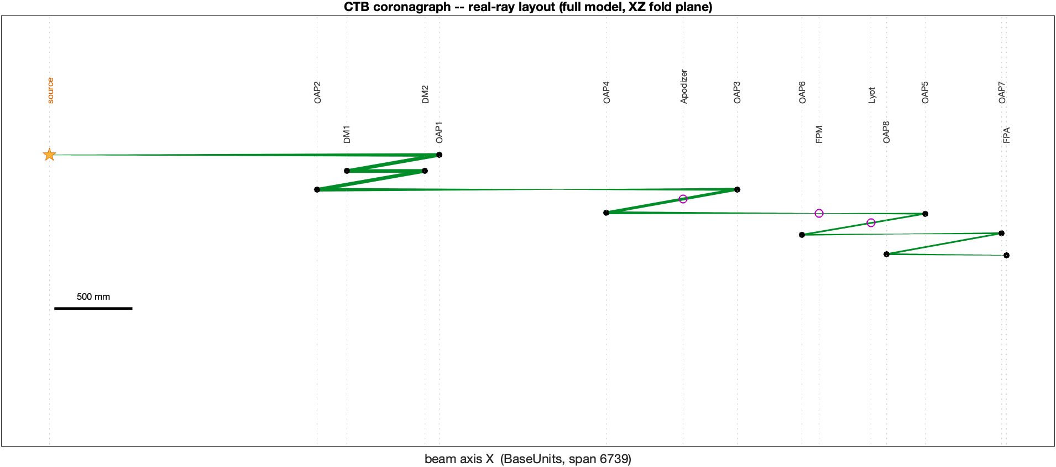
1 — The bench and the model
Two prescriptions, one physical train; every mask plane bracketed by its own exit-pupil reference sphere
• The bench: 8 off-axis parabolas, 2 deformable mirrors (DM1 is the aperture stop), apodizer and Lyot at pupil images, focal-plane mask and field stop at focus images, camera (FPA) at the final focus. Geometrically diffraction-limited (0.0014 λ).
• Two propagation prescriptions share the physical optics: a compact model (31 elements — one plane-to-plane leg DM1→DM2, a four-surface mask block at each focus, far-field to the FPA) and a full surface-to-surface model (44 elements — every inter-optic leg propagated).
• The four-surface mask block does the work: flat return at the mask plane, exit-pupil sphere carrying the first half-propagation, the mask plane carrying the second half, and the same sphere again — both sphere distances identical to all digits, which is exactly the condition that makes the block transparent when no mask is applied.
• Both prescriptions load pre-aligned and produce a centered point image; chief-ray intersections match the geometric bench to 10⁻¹³ at every optic.
The full model, fold plane: source through eight off-axis parabolas to the FPA; mask stations ringed on the beam.
Masks (apodizer, focal-plane mask, Lyot, field stop) are applied in MATLAB by multiplying the propagated complex field at the passive mask planes — the prescription carries the propagation, the script carries the masks.
Notes:
What is “four-surface mask block “? Seems like a 4-f relay?
“Geometric bench” == CODEV?

Slide 3
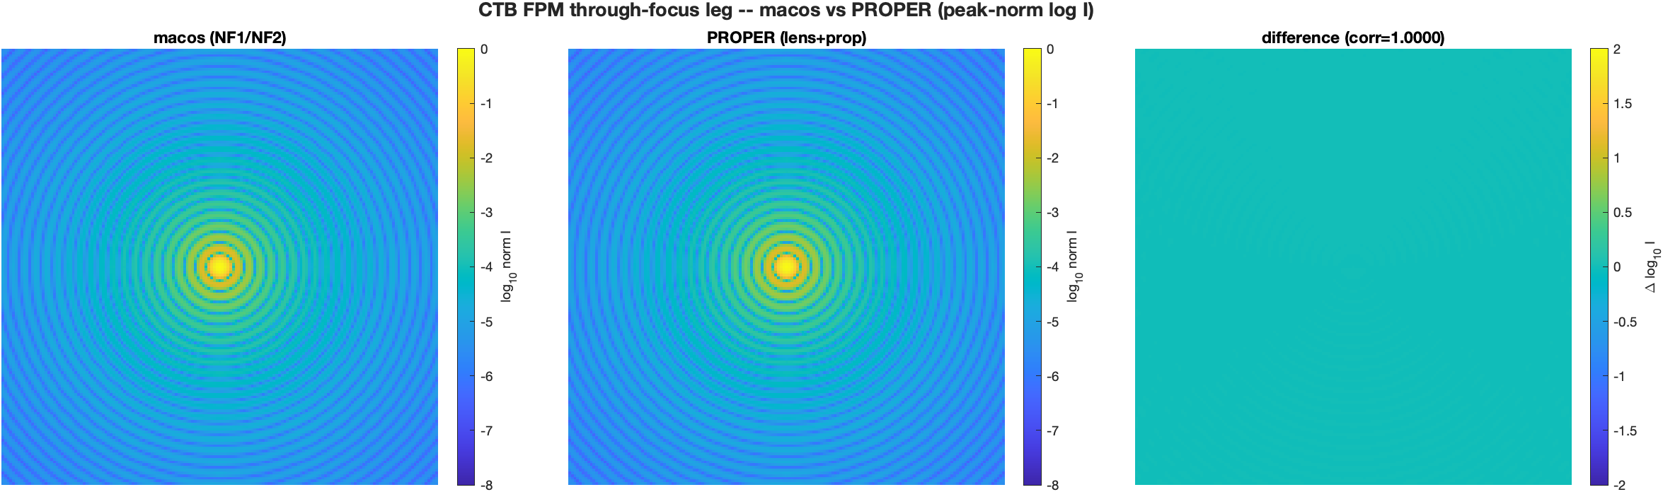
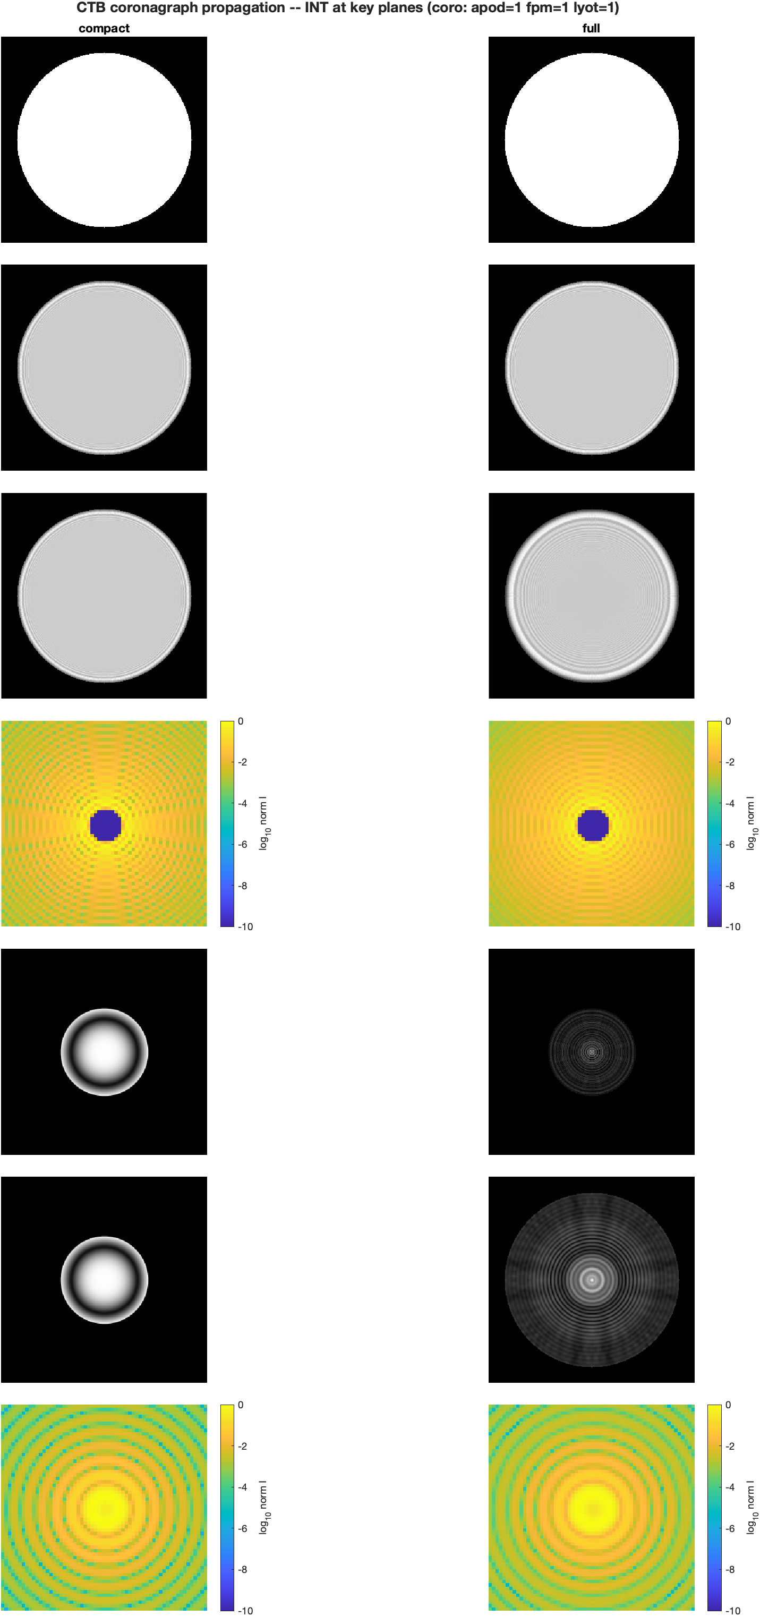
2 — Validation
The new propagation step reproduces PROPER exactly; the two models differ only where their fidelity differs
• The one propagation step this chain rests on that the earlier PROPER campaign never tested — the through-focus half-propagation from the exit-pupil sphere to the mask plane — was cross-checked against MATLAB PROPER at matched sampling: focal-plane pixel pitch ratio 1.0000, peak-normalized correlation 1.000000, centroid offset 0.000 px.
• The half-propagation pair round-trips to machine precision when no mask is applied (the sphere-distance identity), and the focal-grid pitch the engine reports now matches the deterministic value λR/(N·dx) to ratio 1.0000 — an earlier inconsistent pitch reading traced to the superseded block construction, not the engine.
• A wrong number found and fixed: the compact prescription's DM1→DM2 leg propagated 400 mm where the mirror spacing is 500 mm, with its end plane on the wrong side of DM1. The prescription generator flagged it; two independent fixes (lifting the full model's values) agree to every digit. Every figure and number here is from the corrected prescription.
• Compact vs full: bare point images agree to 0.9989 correlation with encircled energy within 0.3% (unchanged by the fix); with the coronagraph in, the suppression gap narrowed from 2.6× to 1.76× — the remaining gap is the mirror-to-mirror diffraction the compact model omits. PROPER remains the arbiter for both.
The through-focus leg, MACOS beside PROPER at matched sampling: identical pitch, correlation 1.000000.
Seven stations × two models with the coronagraph in: occulted core, Lyot rejection, suppressed FPA.

Slide 4
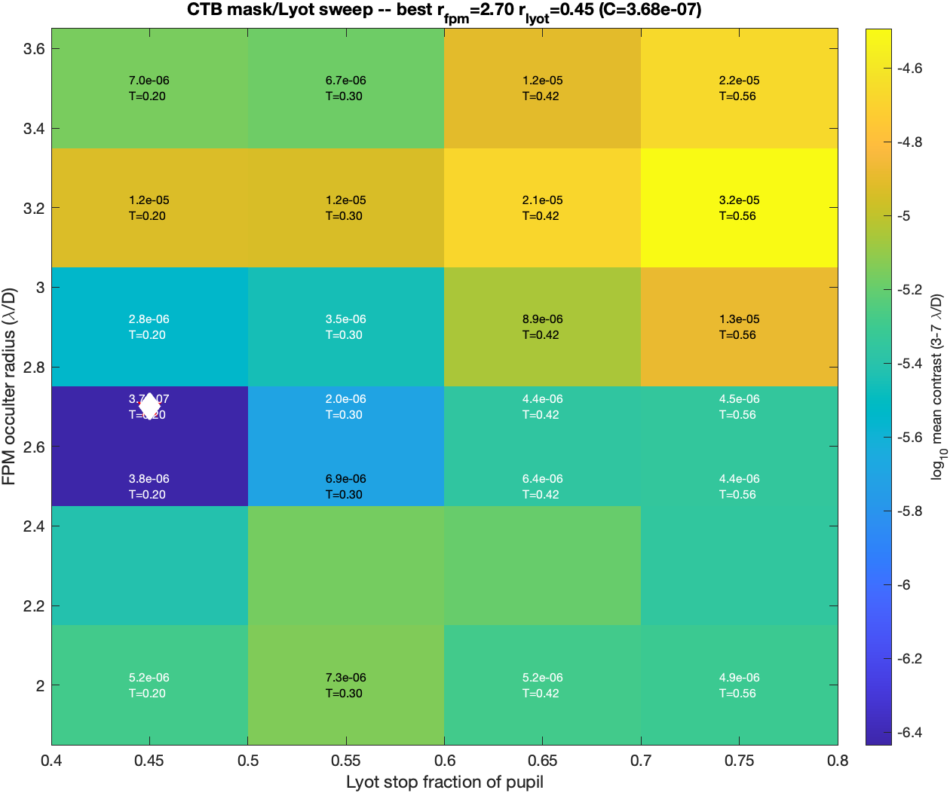
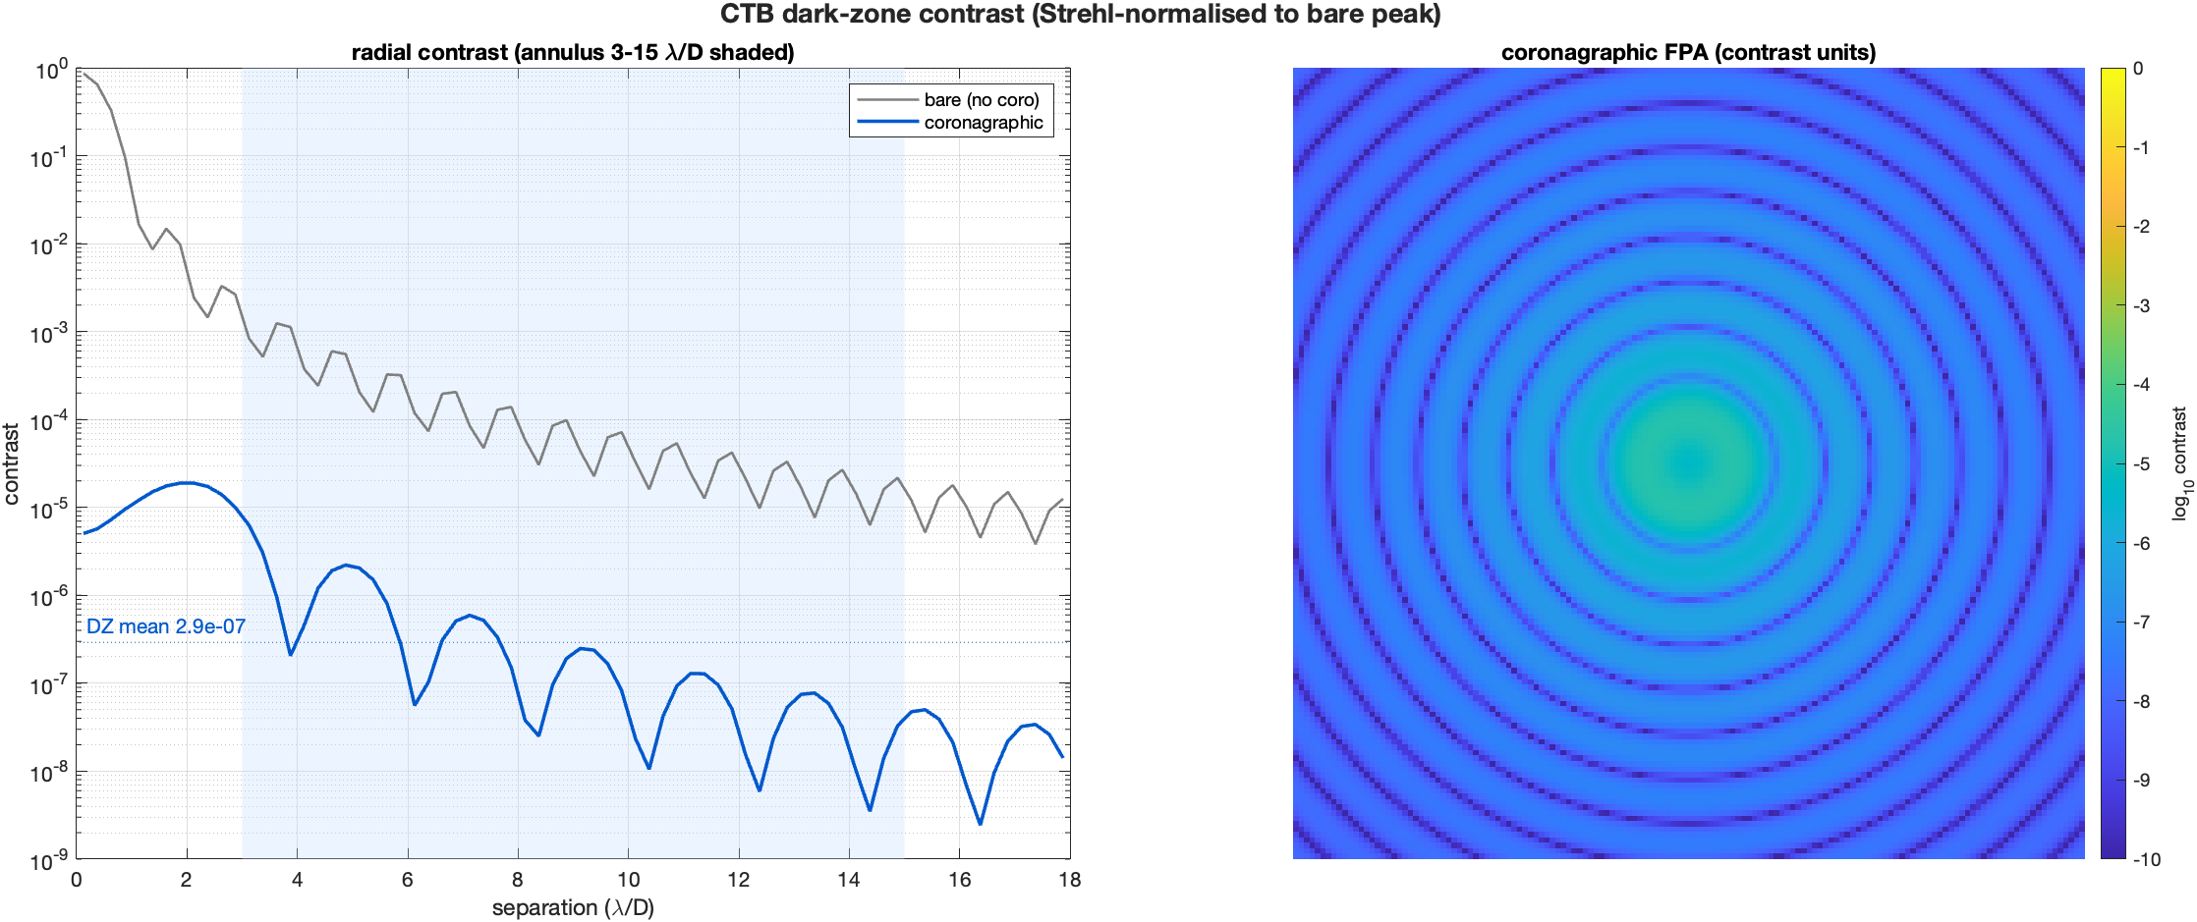
3 — Coronagraph performance
A half-pixel centering fix, 4× finer sampling, and a mask sweep bought 16× in contrast
• Centering: the mask builders sat half a pixel off the propagation's focus pixel — every occulter leaked asymmetrically. Fixed (shared mask builders centered on the focus pixel); the vortex, most sensitive to a decentered core, gained the most.
• Sampling: the FPA grid moved from 2.0 to 4.0 px per λ/D (model size 1024; the pupil grid is unchanged — zero-padding only), resolving clean symmetric rings.
• Mask sweep over the ranges the literature uses (occulter 1–3 λ/D, Lyot 75–90%): pure contrast pushes to the sweep edges, so throughput is recorded beside contrast. A widened sweep found a robust interior null at occulter = 2.70 λ/D — a diffraction resonance of this bench, persisting at both samplings — with Lyot 0.50 as the shipped default (25% throughput; the Lyot radius sets the throughput).
• Net: dark-zone mean contrast 4.6×10⁻⁶ → 2.9×10⁻⁷ (~16×); suppressed FPA peak 1.9×10⁻⁵ → 1.4×10⁻⁶. Deeper suppression takes shaped masks: the families on slide 5 reach three decades further.
The mask sweep: contrast against occulter and Lyot radius, with the isolated 2.70 λ/D null.
Radial dark-zone contrast at the FPA, normalized to the no-mask peak; the two DMs give a full annular zone.
Notes:
Is this full model or compact model?
This looks monochromatic – the Airy rings don’t fuzz out.

Slide 5
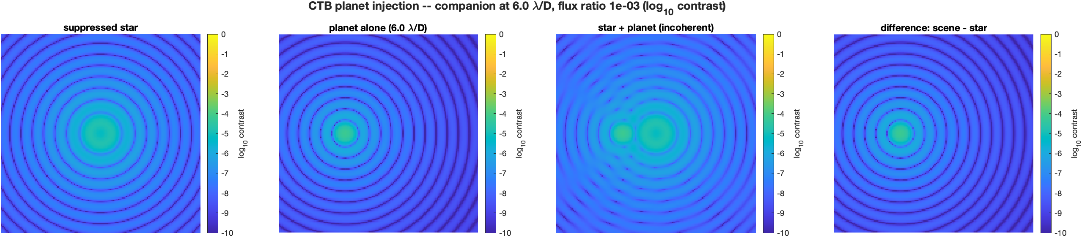
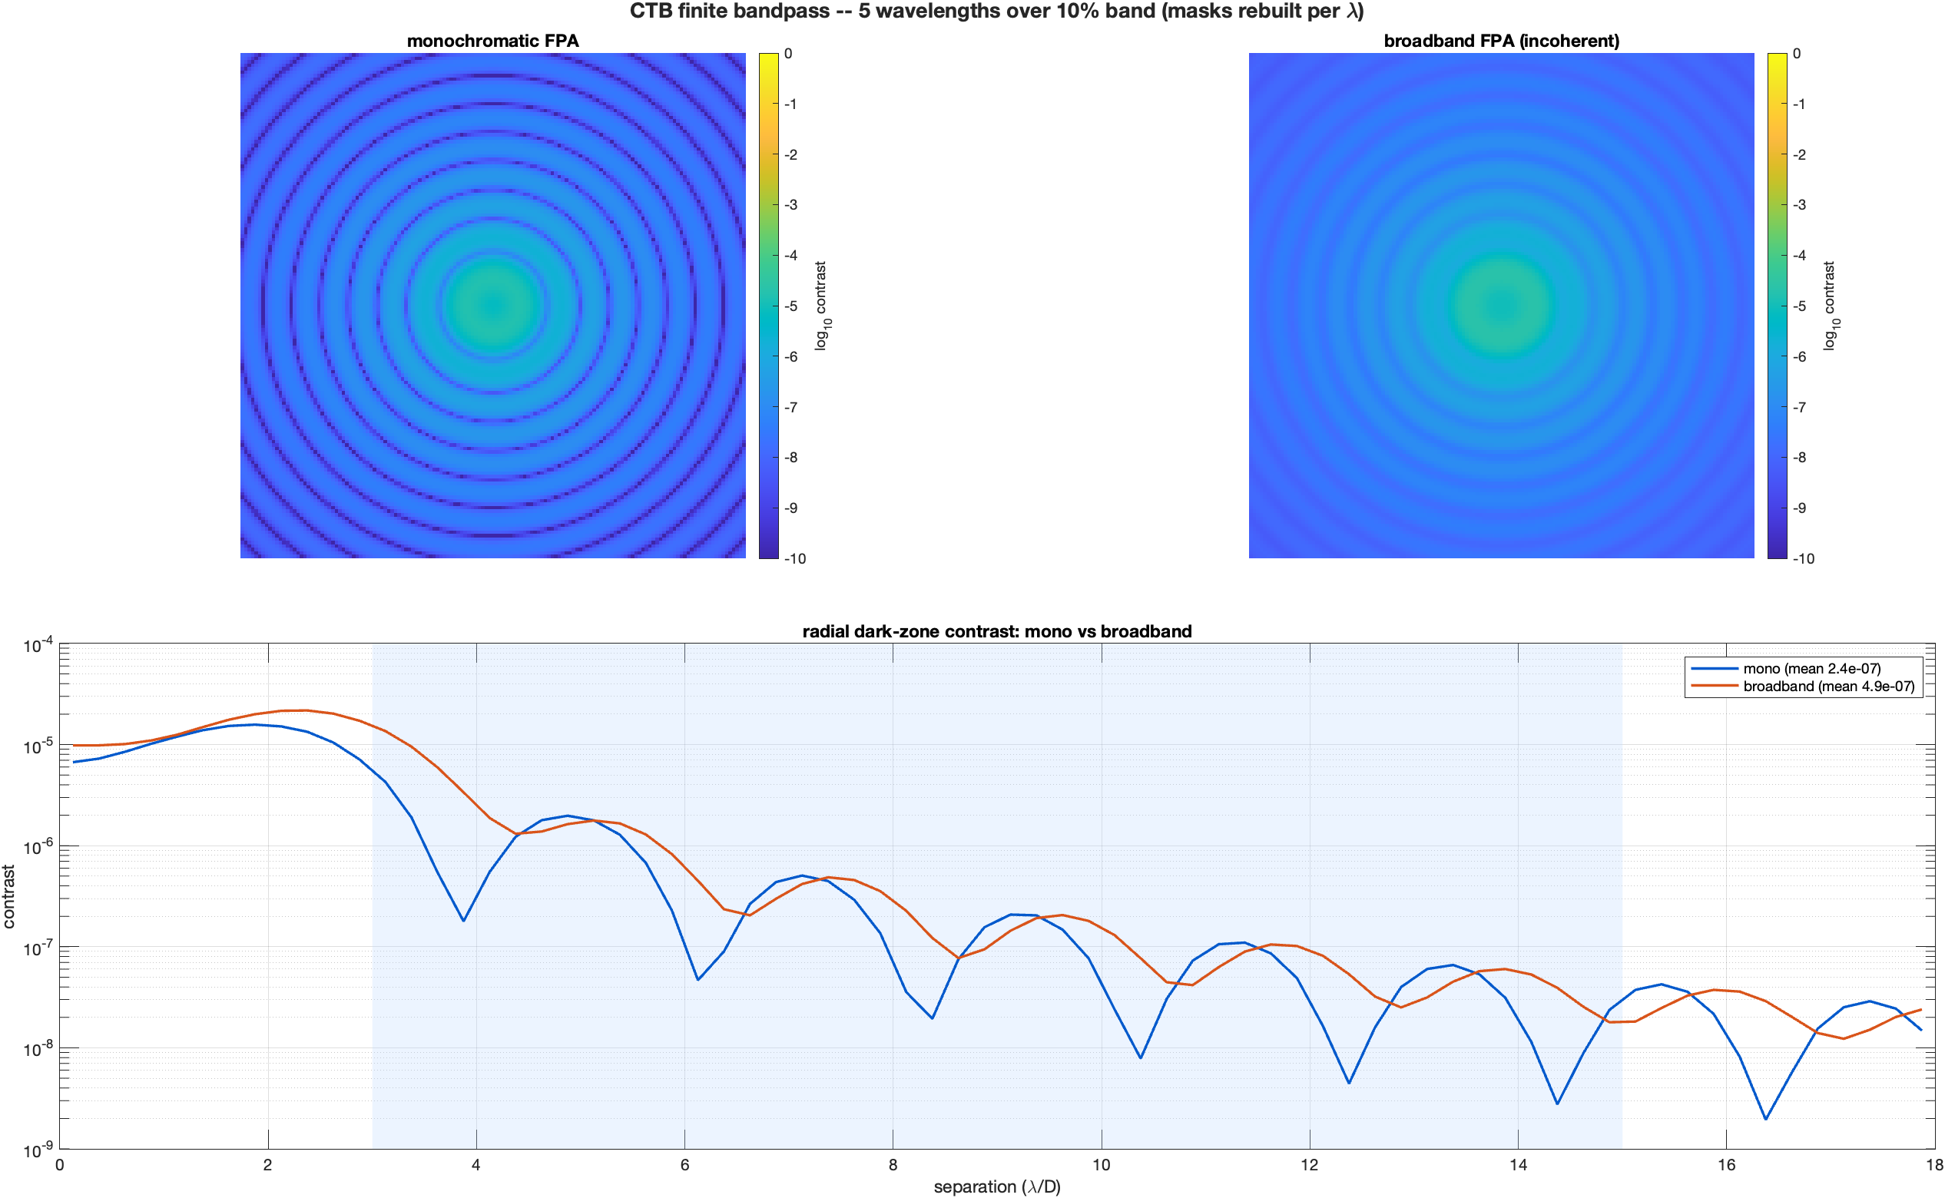
4 — A planet in the dark zone, and a finite band
Each run surfaced a modeling rule now on record
• Companion injection: the focal-plane window method from the earlier coronagraph examples does not displace a companion here — the alignment rule that puts every vertex on the chief ray re-centers every grid on the tilted chief, landing the "planet" back under the occulter. The working method is a pupil phase ramp on the complex field at DM1: k cycles across the pupil puts the companion at exactly k λ/D against the fixed masks. Verified: 6 λ/D commanded, 5.98 measured; at flux ratio 10⁻³ the companion stands above the stellar residual and the difference panel recovers it cleanly.
• Finite bandpass: wavelengths summed incoherently — after resampling each wavelength's point image onto one common physical detector grid. The far-field step re-grids per wavelength, so a naive array sum silently cancels chromaticity (the first attempt measured exactly zero chromatic effect — a trap now documented). With an occulter of fixed physical size over a 10% band, the deep 2.70 λ/D null degrades 2.1× (deep-vs-broadband is a real trade); the variant whose mask scales with wavelength confirms the machinery itself adds no chromatic error.
The companion at 6 λ/D, flux 10⁻³: star residual, star+planet, and the difference panel that recovers it.
Mono vs 10%-band broadband on the common detector grid: rings wash out, the deep null fills 2.1×.
Notes:
How many sub-wavelengths did you sum over?
Common physical detector grid also applies to FPM---I think that’s what you’re trying to say?

Slide 6
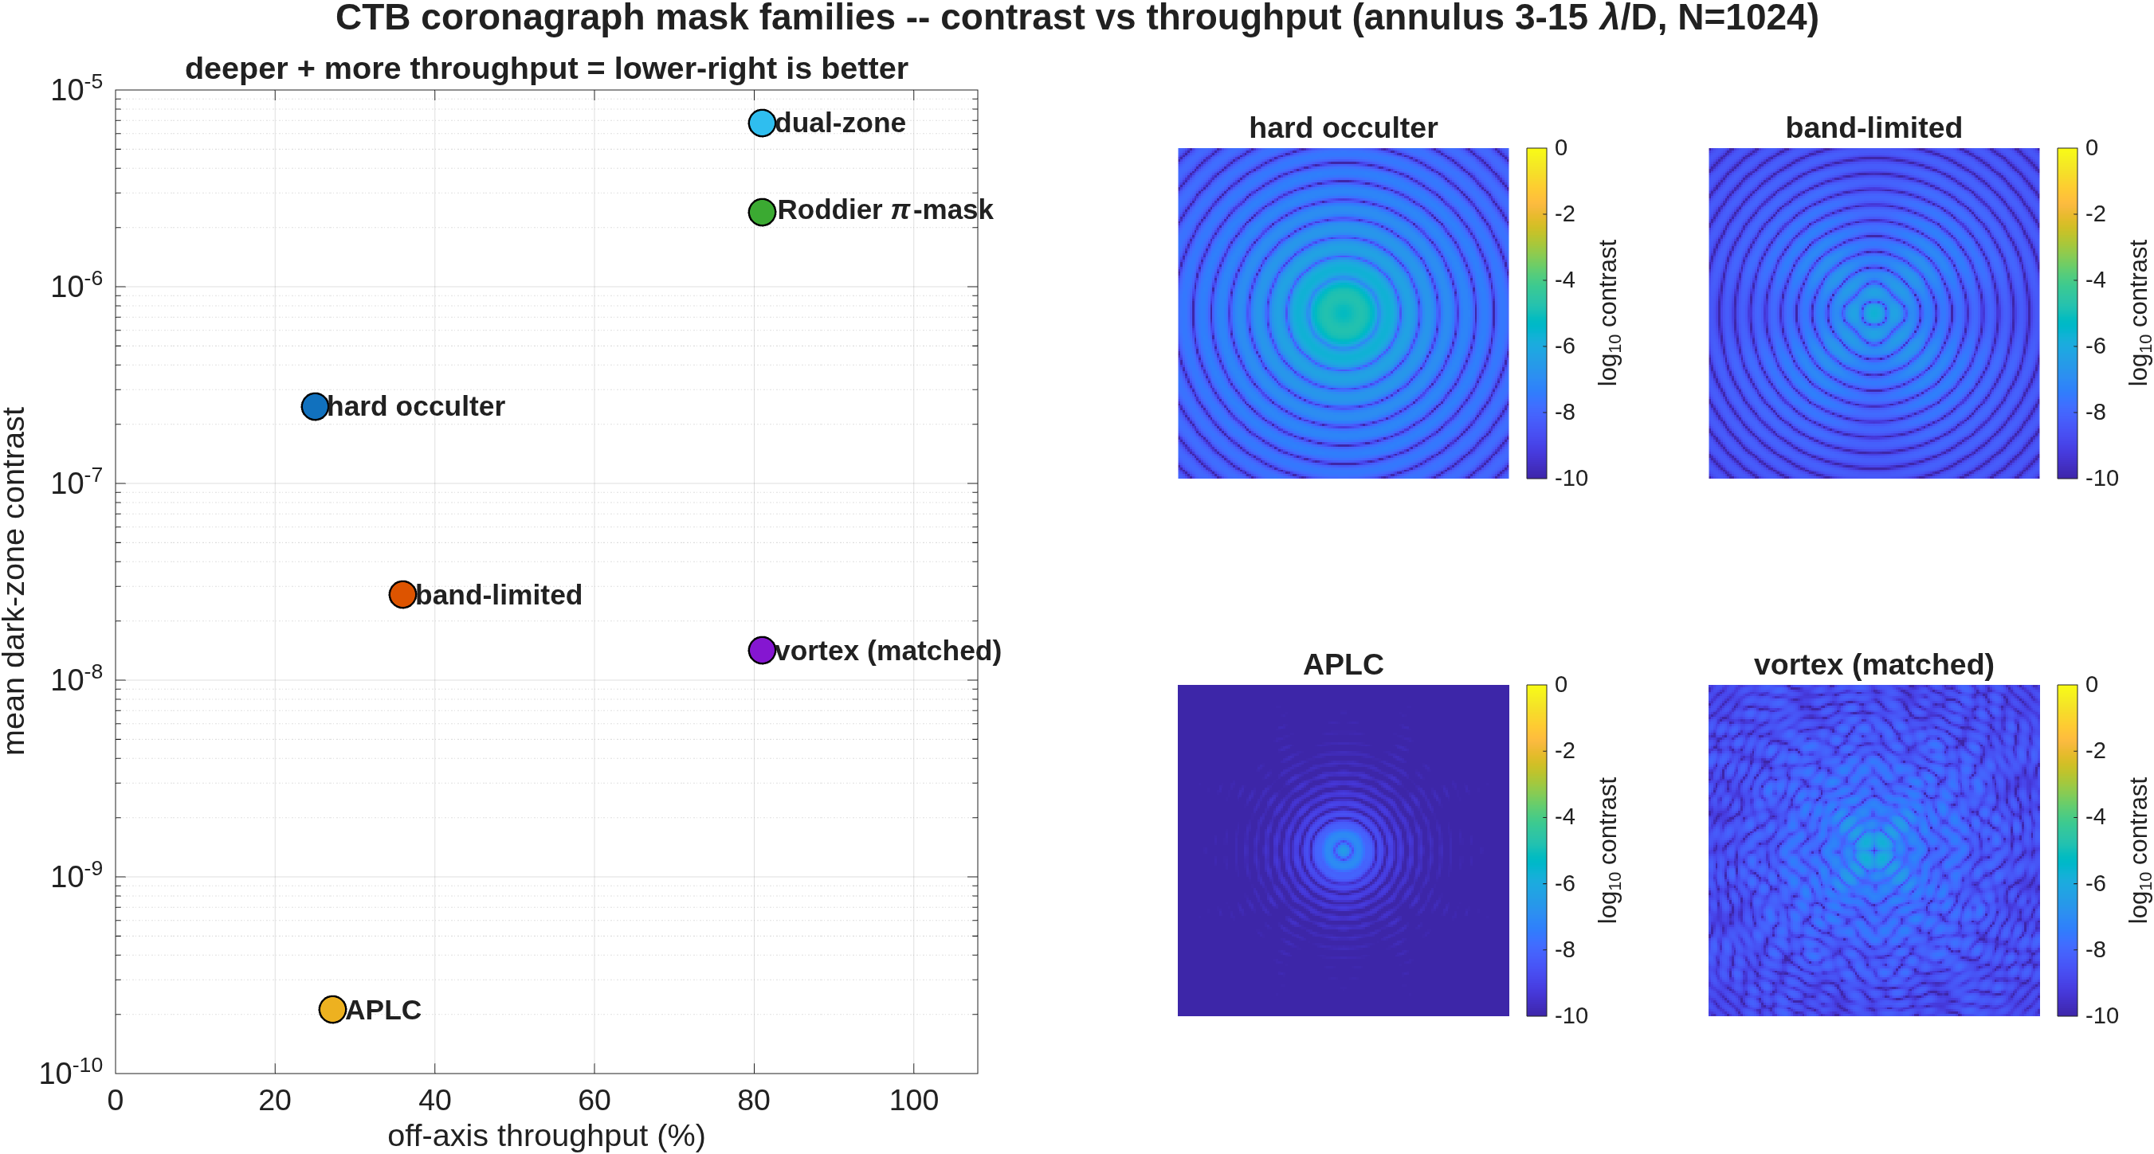
5 — The standard mask families, head-to-head
Static masks, before any DM control: the apodized-pupil Lyot is deepest; the pixel-averaged vortex second, at three times its throughput
• Five mask families from the literature, built as reusable mask functions on the existing complex-mask interface — no engine work. Every formula was taken verbatim from the source paper — secondary summaries get them wrong (band-limited masks are 1−sinc in amplitude, not intensity; the Lyot trims by 1−ε, not 1−2ε; the Roddier π-mask uses no apodizer).
• All six score on one grid, one annulus (3–15 λ/D), one normalization — the hard occulter of slide 3 re-scored on this common footing. Every mask is generated at 8× sub-pixel resolution and binned to the model grid (area-average for amplitude, complex-average for phase).
mask | static dark-zone mean | throughput
apodized-pupil Lyot (prolate) | 2.1×10⁻¹⁰ | 27%
vortex, matched Lyot | 1.4×10⁻⁸ | 81%
band-limited (4th order) | 2.7×10⁻⁸ | 36%
hard occulter | 2.5×10⁻⁷ | 25%
Roddier π-mask | 2.4×10⁻⁶ | 81%
dual-zone phase | 6.8×10⁻⁶ | 81%
Contrast against throughput for all six families, STATIC — lower-right is better; the apodized-pupil Lyot deepest, the pixel-averaged vortex second at three times its throughput.
• Everything above is the mask alone. With the two deformable mirrors closed-loop (slides 9–12, control at N=512), the floors drop by decades:
controlled chain | static | closed-loop floor
hard occulter, Lyot 0.50 (mono) | 2.9×10⁻⁷ | 3.8×10⁻⁹
vortex charge 4, Lyot 0.60 (mono) | 1.7×10⁻⁸ | 6.8×10⁻¹⁵
vortex charge 4, Lyot 0.60 (10% band, unpol.) | 2.2×10⁻⁸ | 2.0×10⁻¹¹
• The vortex row moved 21×: the direct-sampled mask's singular core — mis-phased pixels on the stellar image core, a sampling artifact, not vortex physics — had floored it at 2.9×10⁻⁷. Pixel-averaging cures it, and the Lyot becomes a real depth dial: charge 4 reaches 6.6×10⁻¹¹ at a 0.50 stop — apodized-pupil-Lyot class at the same 25% throughput. Full diagnosis in backup.
The hybrid Lyot coronagraph is deferred to the FALCO integration: its focal-plane mask is a product of the design loop, not a formula. Throughput = Lyot open area times apodizer transmission — an off-axis proxy, not an end-to-end planet throughput.
Notes:
Hard occulter, Lyot doesn’t match my understanding. I’m expecting > 1e-6 static and << 1e-9 after EFC. Maybe I’m it’s not what I’m thinking?

Slide 7
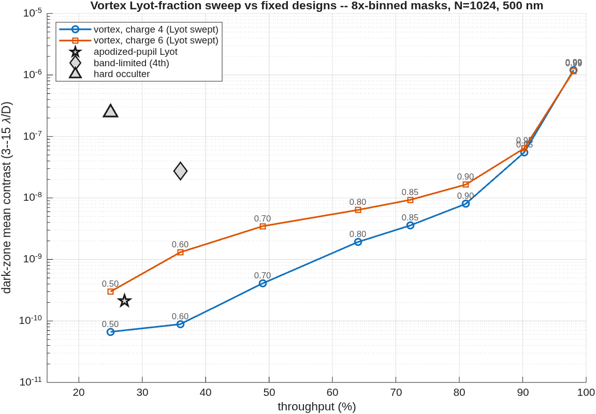
6 — The vortex against the Lyot stop
Charge 4 under-runs every fixed design at every throughput: 8.8×10⁻¹¹ at the band-limited mask's own 36%
• One mask, one dial: the vortex phase mask is fixed; only the Lyot stop fraction moves. Every point shares the head-to-head's grid, annulus (3–15 λ/D), and normalization, and the fixed-design markers are read from the committed comparison — the same footing, no re-scoring.
• The trade the cured core revealed: the starlight the vortex rejects piles just outside the geometric pupil edge, so contrast rises steeply as the stop opens toward it — a genuine depth-for-throughput dial where each fixed design is a single point. Charge 4 runs about 4× deeper than charge 6 at every stop (the smaller pixel-averaged core).
• Readings from the curve: at the apodized-pupil Lyot's operating point, charge 4 with a 0.60 stop is deeper (8.8×10⁻¹¹ vs 2.1×10⁻¹⁰) at more throughput (36% vs 27%) — with no apodizer to fabricate. At the band-limited mask's 36% it is 300× deeper; at 81% throughput it holds 8.0×10⁻⁹, thirty times below the hard occulter's contrast at three times its throughput.
• The steep rise past 0.90 is the leak ring arriving inside the stop (flux inside grows 0.1% → 1%); the useful range of the dial is 0.50–0.90.
Dark-zone mean contrast against throughput: the swept vortex (point labels = Lyot fraction) against the three fixed designs from the head-to-head.

Slide 8
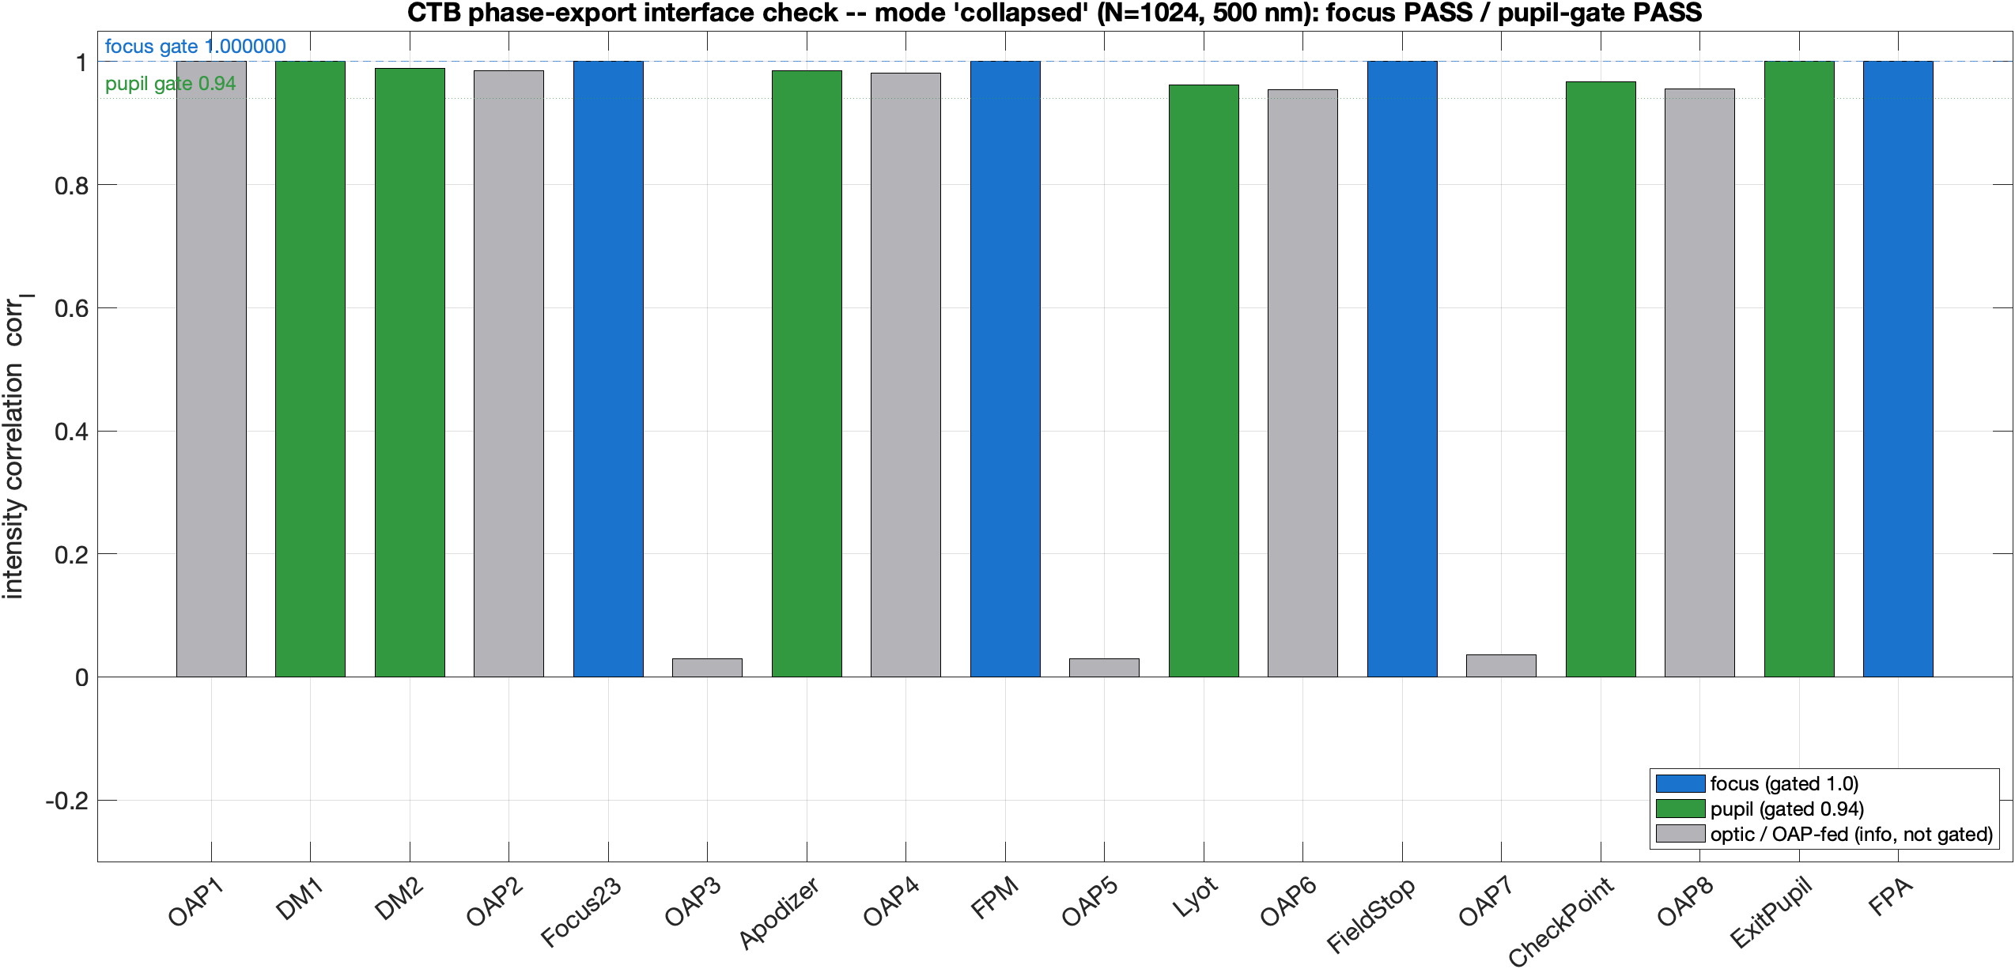
7 — Phase-factor export
External PROPER models can consume this model's planes, and check theirs against ours station by station
• One self-describing file carries the full 44-element model: 18 stations (complex field, amplitude, OPD, grid pitch, all in metres), the 17 propagation legs, the 4 reference spheres, and 18 per-plane phase screens — with the sign, orientation, and centering conventions stamped inside. The orientation is measured, not asserted: a +X pupil phase ramp lands the image peak where the file says it will.
• A companion PROPER run script reads only the exported file — no macos — and replays the model two ways: every leg propagated, or handing off at the exported fields. Focus stations reproduce at correlation 1.000000 in both modes; gated pupil planes ≥ 0.9998 replayed, ≥ 0.96 handed off.
• Rule 1, replaying a focus: start the PROPER propagation from the exported converging-sphere plane, not from the mirror before it. The focal-plane pixel size is set by the sphere's radius; starting at the mirror gives pixels 4.5× the wrong size, and nothing overlays.
• Rule 2, comparing between mirrors: compare intensities, not phase maps. The two codes measure phase from different baselines (this model from a flat plane, PROPER from its internal reference beam), so identical beams still show mismatched phase. Simplest: start each PROPER stage from the exported field at that plane — that agrees by construction.
Station-by-station intensity correlation of the external PROPER replay against the exported fields (hand-off mode): focus planes at 1.0, gated pupils above 0.96; grey bars are ungated mid-beam planes.
Export ≈320 MB, kept out of git: the committed truth is an 87 KB fingerprint plus a 3 MB downsampled preview, with one-command regeneration. Single wavelength; the exported OPD is wrapped (the complex field is the primary carrier). Per-wavelength export composes with the bandpass machinery when needed.
Notes:
Somewhere I worked out how to use PROPER’s reference radius to get the phase for fair comparison to another model. I could look that up if you want.

Slide 9
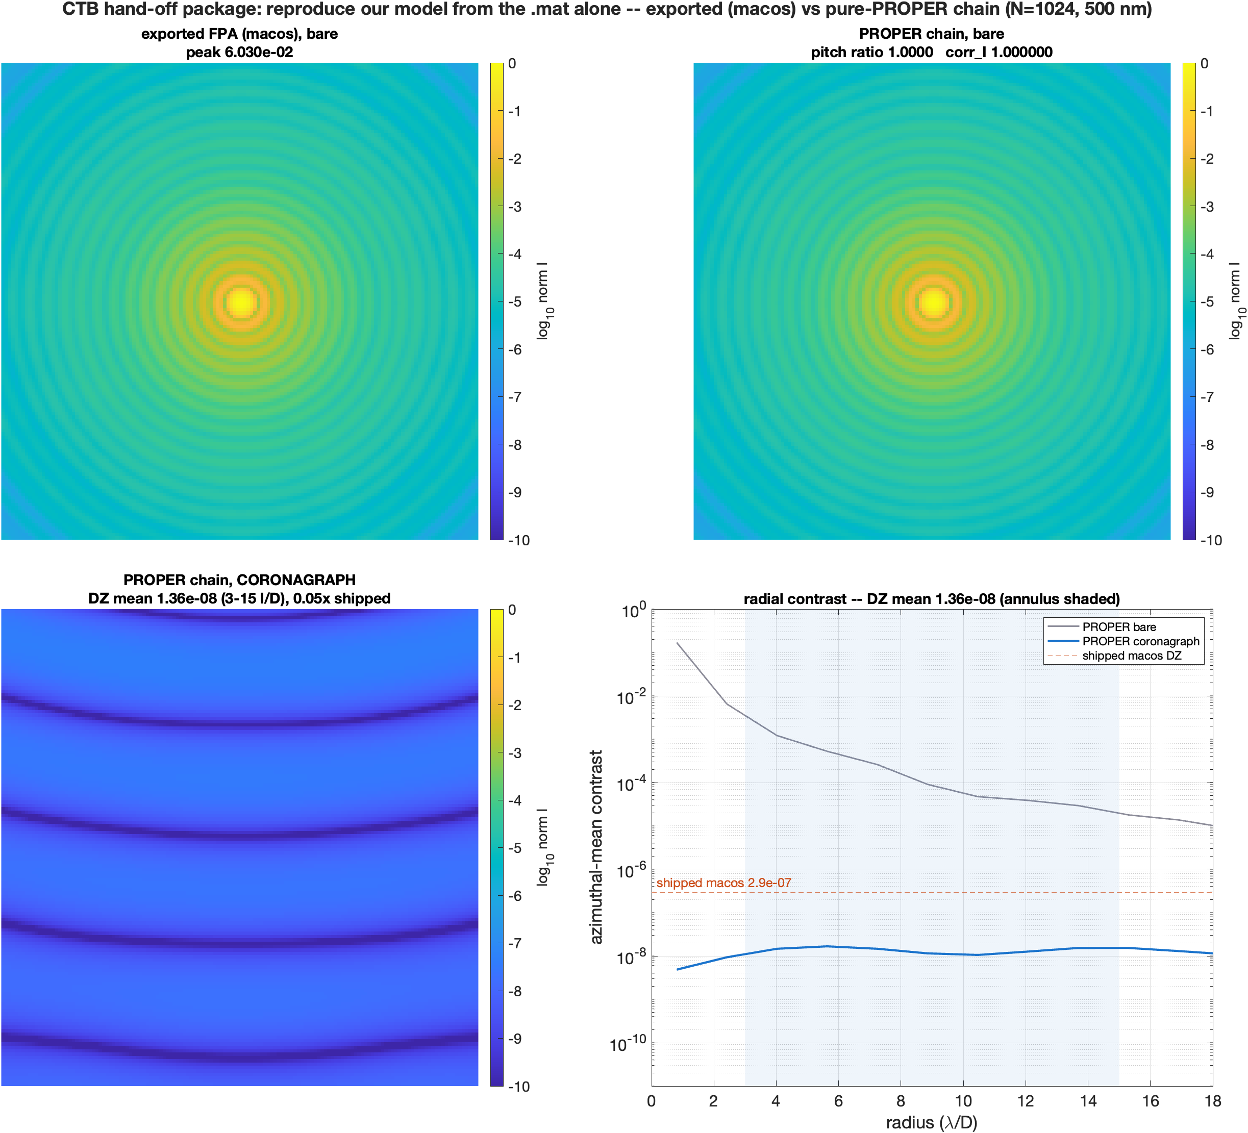
8 — External hand-off: a pure-PROPER run
From the exported data alone, PROPER reproduces the bare image exactly and forms the same dark zone
• The package is three files: the exported model (fields, legs, spheres, per-plane screens, mask arrays, all conventions stamped inside), a per-plane check script, and a run script that reads only the export plus PROPER — no macos anywhere. It asserts the orientation probe before trusting any comparison.
• A finding that shapes any external reconstruction: one single continuous PROPER beam cannot reproduce this model (focal pitch ratio 0.71, correlation 0.005). The model samples every intermediate focus at the system exit-pupil Fraunhofer pitch — set by the exit-pupil sphere radii, not by each parabola's own focal length — and one grid cannot carry both the pupil pitch and that focal pitch across a focus-to-focus relay. The shipped form is one pure-PROPER script seeded from the exported fields.
• Bare image: focal pixel pitch ratio 1.0000, intensity correlation 1.000000 — the exported and PROPER images are identical.
• Coronagraph: the PROPER cascade reaches dark-zone mean 1.4×10⁻⁸ over 3–15 λ/D. The check is one-sided by design: the idealized relay seeded at the apodizer carries the upstream aberration but omits the downstream real-mirror figure that scatters light in the full model, so it runs legitimately deeper than the shipped 2.9×10⁻⁷; the bound that matters is that it lands within 2× above the shipped value.
Exported (macos) beside pure-PROPER: bare images identical (correlation 1.000000); the PROPER coronagraph forms the dark zone with the shipped macos level marked.
Notes:
Don’t understand the second bullet. If you want PROPER to output the field at an intermediate focus, you have to explicitly ask it for that.
Don’t understand the radial contrast graph. Why are there no Airy rings? Why is “shipped contrast” a constant value?

Slide 10
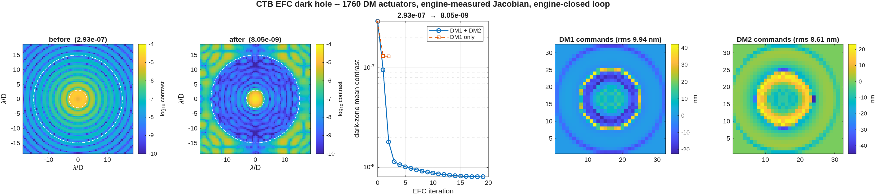
9 — The deformable mirrors close the loop
Electric-field conjugation on the model itself: dark-zone mean 2.9×10⁻⁷ → 8.1×10⁻⁹ (36×) at 10 nm strokes
• The DMs become controllable surfaces: each carries a 256-point displacement grid in its own element frame, driven by a 32×32 actuator lattice through Gaussian influence functions (12% nearest-neighbor coupling, 0.67 mm pitch = beam/32; 880 actuators of each DM sit inside the beam).
• The control matrix is measured, not modeled: every actuator is poked 2 nm and propagated through the full masked chain — 1760 pokes, 11 minutes — so the correction solve has no model error to exploit. Each iteration re-propagates the model, scores the measured contrast, picks the regularization by that measurement, and stops itself when no step improves.
• Result: 2.9×10⁻⁷ → 8.1×10⁻⁹ (36×) in 19 iterations at 9.9/8.6 nm rms surface stroke. The best any linear solve of the measured matrix can reach is 4.5×10⁻⁹ at 11 nm — the loop lands within 2× of that with a matrix measured once at the flat state; re-measuring it around the corrected state is the next depth increment. Restricted to DM1 alone, the same loop stalls at 1.3×10⁻⁷ (2.3×): the pupil mirror is phase-only control, and the full annulus also needs the amplitude lever the out-of-pupil DM2 supplies.
• Where the correction works hardest: with the 50% Lyot stop, 32 actuators steer light cleanly to about 8 λ/D on the final image scale — the inner half of the zone deepens 40×, the outer 25×, and the largest strokes ring the Lyot edge image on the mirror.
Before and after at the camera; contrast versus iteration, with the DM1-only loop overlaid stalling two decades short; the stroke maps commanded on both DMs. Dashed circles mark the 3–15 λ/D zone.
Sensing is assumed perfect — the loop reads the model's complex field directly. Estimating that field from camera images alone (pairwise probing, as a testbed must) is the next layer of realism.
Notes:
Why 880 actuators? Pi*16^2 = 804. Maybe you’re counting actuators where the influence function reaches into the pupil. That’s would be correct. Maybe make clear your criteria for including an actuator.
“The control matrix is measured, not modeled” – not sure what this means. Are you using the full model to “measure” the Jacobian? Does it refer to using differential poke rather than calculating the derivative by propagating jk*exp(jkz) as is done in CGI and historically in HCIT testbeds?
Then in this example, control model == testbed (truth) model
Is this example monochromatic? The “before” Airy rings tells me it’s monochromatic. I’m a little surprised the contrast does not go deeper.
We call this type of regularization “optimal regularization” because each iteration you are choosing the regularization that gives most improvement, and there is no model/testbed knowledge error.

Slide 11
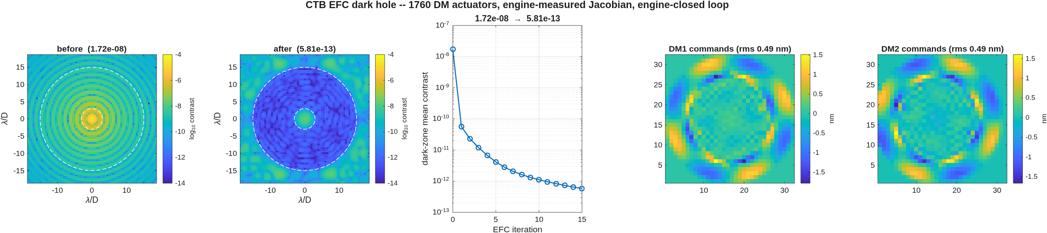
10 — Deeper: the loop on the vortex chain
1.7×10⁻⁸ → 6.8×10⁻¹⁵ at half-nanometer strokes — this chain leaves nothing the mirrors cannot remove
• The same loop pointed at the slide-6 configuration: charge-4 vortex, Lyot 0.60, no apodizer. Control runs at N=512, where this chain's static floor is 1.7×10⁻⁸ (the slide-6 sweep is N=1024 — the pixel-averaged core covers more of the λ/D scale at coarser sampling).
• The first iteration removes 300×, and commands never exceed ~0.5 nm rms: the residual field is so small that the measured control matrix is nearly exact, and the solve lands where it points.
• Going deeper is one re-measurement: rebuild the control matrix about the corrected state (7 minutes of pokes) and continue. The hard-occulter chain gains 2.1× to 3.8×10⁻⁹ and converges — consistent with its linear bound of 4.5×10⁻⁹ — while the vortex chain gains another 86× to 6.8×10⁻¹⁵.
• The reading: the hard occulter's floor is physics — occulter-edge diffraction the mirrors cannot represent. The vortex chain's floor is arithmetic — the residual field is ~3×10⁻⁸ of the peak amplitude, the roundoff of double-precision propagation. A real bench stops far earlier, at sensing noise and drift; those are the next layers of realism.
chain | static | fixed matrix | re-measured
hard occulter, Lyot 0.50 | 2.9×10⁻⁷ | 8.1×10⁻⁹ | 3.8×10⁻⁹
vortex charge 4, Lyot 0.60 | 1.7×10⁻⁸ | 5.8×10⁻¹³ | 6.8×10⁻¹⁵
• Strokes at the floor: 9.9/8.6 nm rms (hard chain), 0.49/0.55 nm rms (vortex chain, before/after re-measurement). Dark zone 3–15 λ/D, both chains, same annulus and normalization throughout.
The vortex-chain dark hole: before and after (note the color floor at 10⁻¹⁴), convergence, and the sub-nanometer command maps.
Notes:
Again, control model == truth model?
Somewhere above I think you said it was a 10% broadband model, but the Airy rings make me think monochromatic?
If it is broadband, then it must be a magical vortex FPM.

Slide 12
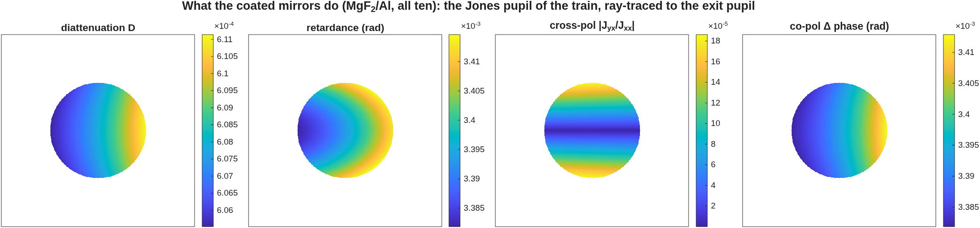
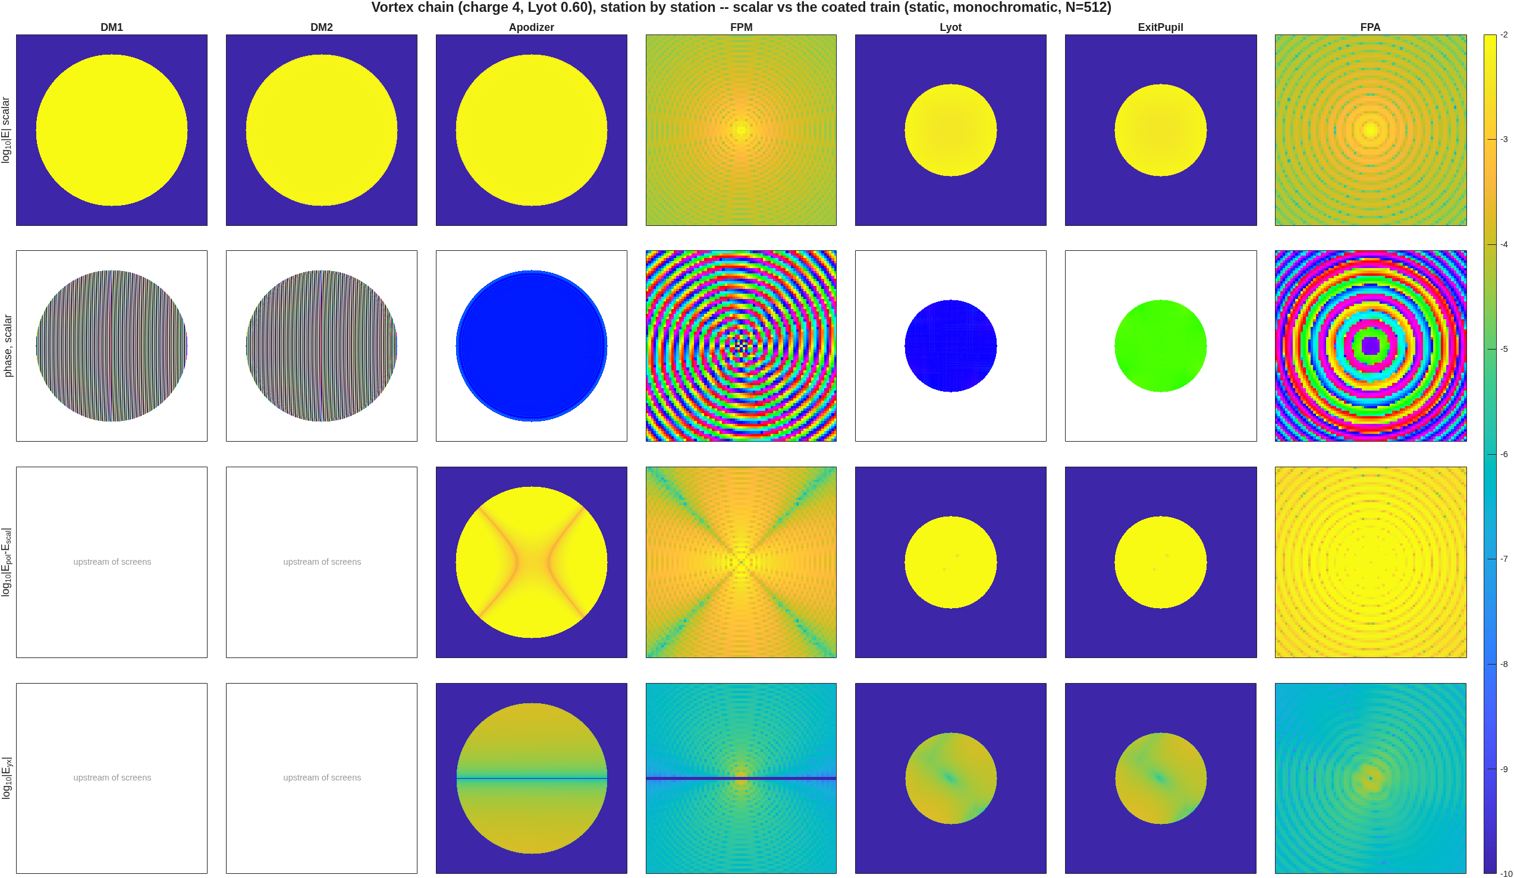
11 — Polarization: what the mirrors do
The coated train's uncontrollable residual is 1.1×10⁻¹⁵ at every bandwidth — a state change, not an aberration
• The model: the coated train's Jones pupil, ray-traced to the exit pupil (quarter-wave magnesium fluoride over aluminum, all ten mirrors), applied as per-component pupil screens — each of the four Jones components propagates as its own scalar chain, and unpolarized input is their half-weighted sum. One control matrix drives the co-polarized mean; the component spread about that mean is the measured, uncontrollable part.
• What the maps show: retardance across the pupil is 3.4 mrad MEAN with only 8.7 µrad rms variation; diattenuation 6.1×10⁻⁴ mean, 1.4×10⁻⁶ variation. The mean is a state change the loop absorbs; only the variation drives a contrast floor — and this train has almost none. Closed loop: 5.8×10⁻¹³, indistinguishable from the scalar result, with the uncontrollable part at 1.1×10⁻¹⁵. At these gentle incidence angles polarization does not set the floor — which is why coronagraph testbeds are folded gently.
• The station walk (right) makes the effect visible end to end: the coating imprint appears at the screen plane (the diattenuation saddle), propagates through the vortex, and the cross-polarized light — four decades down — carries its own two-lobe pattern to the camera.
• A measurement lesson, recorded with the drivers: normalize the Jones screens by the COMPLEX mean of the co-polarized element. Magnitude-only normalization leaves the coatings' global reflection phase in the screens, and corrections then land rotated by twice that phase and add energy (the achieved-vs-predicted correlation of −0.80 was the cos θ signature).
What the ten coated mirrors do at the pupil: diattenuation, retardance, cross-polarization ratio, and the co-polarized differential phase.
Station by station, the slide-2 planes: scalar amplitude and phase (the charge-4 spiral at the foci), the coating effect on the propagating field, and the cross-polarized light.
Notes:
It will be interesting when you do actual control model <> truth model with field estimation

Slide 13
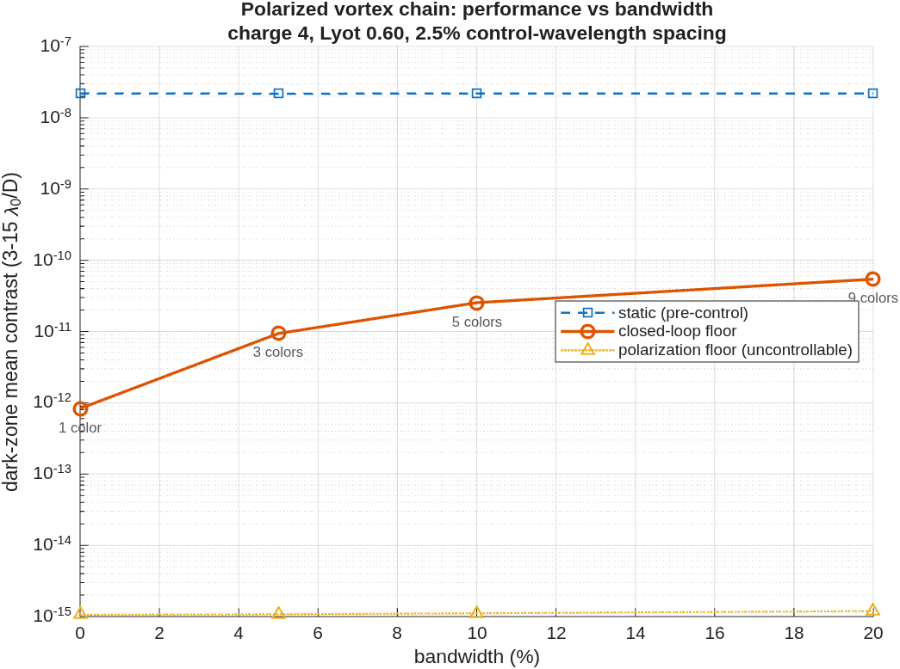
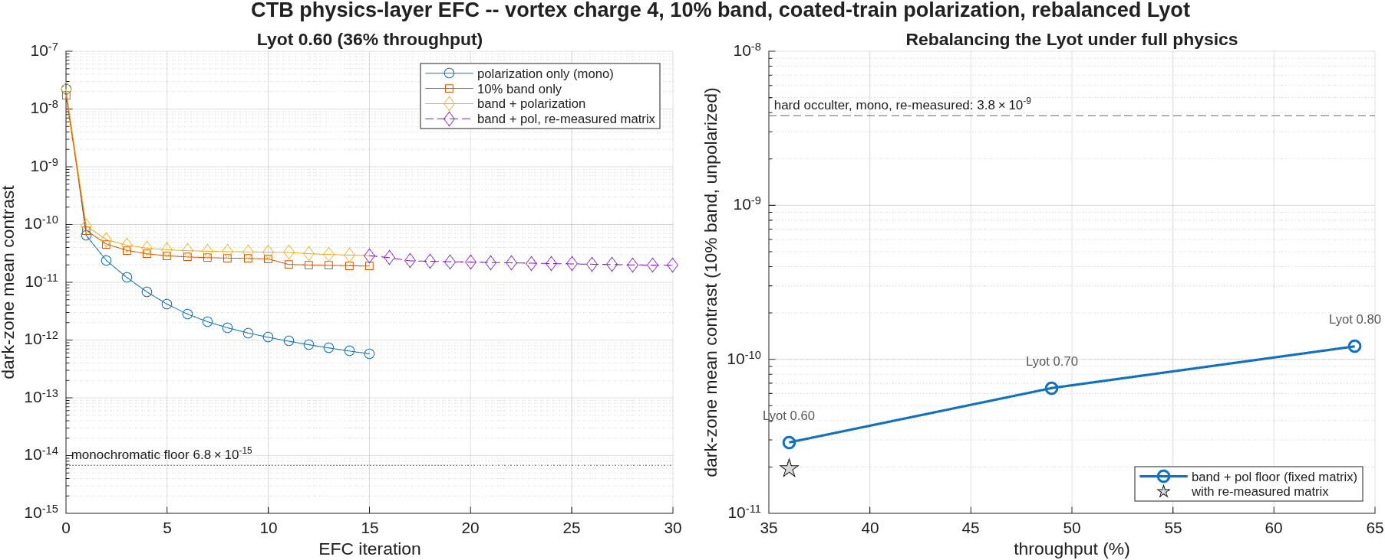
12 — Bandwidth: the chromatic floor
Mono 8×10⁻¹³ → 5%: 9×10⁻¹² → 10%: 2.5×10⁻¹¹ → 20%: 5.4×10⁻¹¹ — gentle growth once control sampling matches the band
• The model: per-wavelength propagation (the vortex mask is a pure angle map, so nothing rebuilds; the target is the fixed physical annulus), with control wavelengths at constant 2.5% spacing — 3 colors across the 5% band, 5 across 10%, 9 across 20% — so wide bands are not under-sampled between control points. One control matrix, measured over the 9-color superset, serves every band.
• The map (right): the closed-loop floor grows from 8.3×10⁻¹³ (monochromatic) through 9.4×10⁻¹² (5%) and 2.5×10⁻¹¹ (10%) to 5.4×10⁻¹¹ (20%) — only 2× from 10% to 20% — while the polarization floor rides flat at 1.1×10⁻¹⁵ at every bandwidth. The chromatic penalty is real but gentle when the control sampling keeps pace; re-measuring the matrix about the corrected state adds another ~1.5× (2.0×10⁻¹¹ at 10%).
• Rebalancing the Lyot under the 10% band: the stop opens for throughput at a measured cost — 0.70 holds 6.5×10⁻¹¹ at 49%, 0.80 holds 1.2×10⁻¹⁰ at 64% — every operating point decades below the hard-occulter chain.
The bandwidth map: static, closed-loop floor, and the flat polarization floor, with the control-color count at each point.
The campaign at Lyot 0.60: convergence of each physics configuration (left) and the Lyot trade under full physics (right).
Notes:
Ah, this answers my earlier comment about the magical FPM.
Just curious how you’re averaging intensity across the subbands (colors). There once was a long discussion about simple average across wavelengths at the center of each subband vs, e.g. trapezoid rule which would include wavelengths at the very edge of the full bandwidth. In a real testbed, and CGI, the NKT/Varia or color filters make three subbands, each 3.3%. If I remember right, John Krist’s PROPER model for CGISIM used a number of wavelengths across the 3.3% band, including the edges in some sort of trapezoid rule to make an intensity image for that subband. Then the mean of subband intensity images = total 10% image. This tries to replicate reality which uses 3.3% color filters for the control.

Slide 14
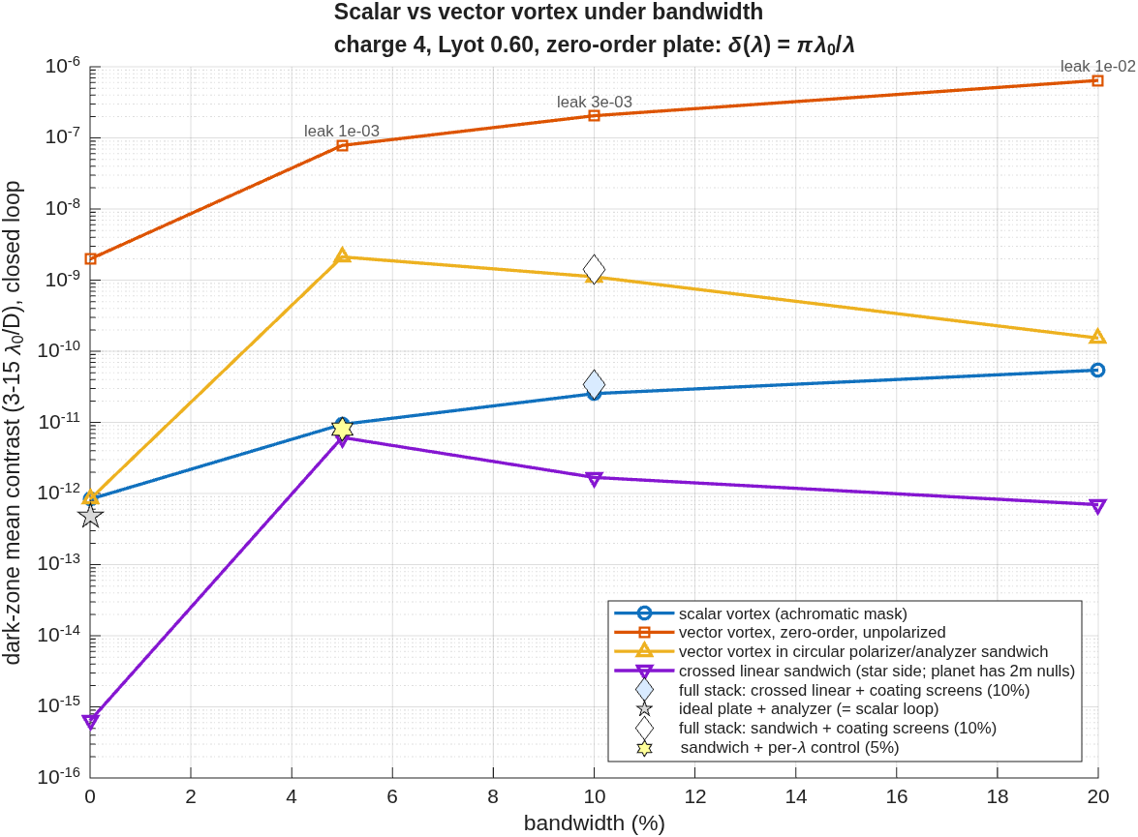
13 — The vector vortex
The retardance leak is uncorrectable but optically removable: a circular sandwich returns to the scalar floor under per-λ control — and a crossed-linear sandwich goes deeper still, at the price of eight planet blind spots
• The machinery: a vector vortex is a rotating half-wave plate — a 2×2 Jones focal-plane mask, not a scalar phase screen. Everything downstream of the mask is linear, so each output component is the coherent sum of two chain runs (the cos mθ and sin mθ entry masks, pixel-averaged at 8×) and the whole family runs with no engine change. The ideal plate (δ=π) validates it: static equals the scalar vortex exactly (leakage 4×10⁻³³), and analyzed, its loop reproduces the scalar floor (4.8×10⁻¹³).
• The zero-order plate leaks — and no mirror can fix it. δ(λ)=πλ₀/λ leaves cos²(δ/2) of the starlight un-spiraled (10⁻³ at 5%, 10⁻² at 20%), and the loop gains nothing: the leak amplitude flips sign across band center, so one DM setting cannot null both halves of the band. Unpolarized, even the ideal plate floors at 2.0×10⁻⁹ — one surface serving the ±m channels of both input polarizations at once (the two-spiral compromise).
• The circular sandwich (R in, L analyzed) removes the leak optically: statics return to the mono value at every band; floors 8.3×10⁻¹³ mono → 1.5×10⁻¹⁰ at 20%. The residual above the scalar chain is control, not physics — stacking the per-wavelength targets instead of collapsing them to a band mean recovers 265× at 5% (2.1×10⁻⁹ → 7.9×10⁻¹²), landing on the scalar chain's own floor.
• Would a crossed linear polarizer do better? On the star side, by two to three decades: the y-analyzed channel of an x-polarized star is the sin mθ mask chain — an eight-octant-mask analogue — statically 240× below the circular sandwich (7×10⁻¹¹) and closing to 6×10⁻¹⁶ mono → 7×10⁻¹³ at 20%, two to three decades below circular everywhere. The price is planetary: transmission ∝ sin²(mθ_p), eight azimuthal blind spots at charge 4 where the circular sandwich is flat — and the coated mirrors' cross-polarization re-injects leak the analyzer cannot strip (full stack 2.2×10⁻⁹ static, 3.4×10⁻¹¹ closed and still descending).
The verdict on one axis: unpolarized zero-order (leakage-pinned), the circular sandwich (optical leak rejection, per-λ control recovery), the crossed-linear sandwich (deepest star-side floors), against the scalar chain.
Notes:
I don’t follow the argument about linear sandwich vs circular sandwich, but I’m not the expert for this. I would defer to Garreth.

Slide 15
14 — Next
Toward a real coronagraph model, in dependency order
• Realistic sensing. The loop reads the model's complex field directly; a testbed estimates it from camera images (pairwise probing). That estimator is the remaining step between these floors and lab-representative ones — and FALCO, the community's standard wavefront-control software, can then drive the same DMs (the hybrid Lyot mask enters there, since its design comes from that control loop).
• Aberrations and drifts. As-built mirror surface maps (measured-quality power spectra), then alignment drifts as a time series against the delivered control loop — dark-zone maintenance, and how long the hole survives between corrections.
• Validation against testbed data — the capstone. Needs a named dataset from a real bench and the measured (not design) parameters that produced it.
Mechanical layer delivered and merged: a prescription generator that reproduces both hand-built models to round-off, regression tests pinning the validated numbers (two suites, 16 checks green), the example README, and the exit-pupil-finder guard in the engine (pushed).
Everything on slides 9–13 is reconstructible at other parameters with one call — ctb_study, in the backup section.
Notes:
So now we get to control model <> truth model.

Slide 16
15 — References
Sources for the mask families and the control method; every formula taken from the paper itself
• Band-limited masks: Kuchner & Traub 2002, ApJ 570, 900 (4th order); Kuchner, Crepp & Ge 2005, ApJ 628, 466 (8th order).
• Apodized-pupil Lyot: Soummer 2005, ApJ 618, L161 (the prolate apodizer); Soummer et al. 2011, ApJ 729, 144 (the GPI instrument configuration used here).
• Phase masks: Roddier & Roddier 1997, PASP 109, 815 (the π-spot); N'Diaye et al. 2012, A&A 538, A55 (the achromatic dual-zone); Soummer, Dohlen & Aime 2003, A&A 403, 369.
• Vortex: Mawet et al. 2005, ApJ 633, 1191; Foo, Palacios & Swartzlander 2005, Opt. Lett. 30, 3308; Jenkins 2008, MNRAS 384, 515 (the even-charge rejection property).
• Vector vortex: Mawet et al. 2009, Opt. Express 17, 1902 (the liquid-crystal-polymer VVC and its retardance-leakage term); Mawet et al. 2010, ApJ 709, 53 (laboratory results and first light). The 2×2 Jones form on slide 13 is the standard rotating-half-wave-plate algebra, re-derived in the driver's help text.
• Wavefront control: Give'on et al. 2007, Proc. SPIE 6691 (electric-field conjugation, the correction solve of slide 9).
• Diffraction reference code: PROPER — Krist 2007, Proc. SPIE 6675 (the arbiter for every propagation cross-check in this deck).
A companion three-slide deck (ctb_mask_families, committed beside the drivers) carries the code map: which script builds which mask, and the parameters a user can change.
Notes:
When you get to the point where control model <> truth model, and there is knowledge error in the control model, you will probably want to reference HCIT work on control strategies.
Hybrid-Lyot coronagraph such as CGI will be the strongest test of your EFC control because it requires much larger rms DM movements to achieve a dark hole than the other coronagraph types.

Slide 17
Backup Slides
• Galleries, per-family detail, the per-leg replay check, the control-loop diagnostics, and how to reconstruct the study at other parameters.

Slide 18
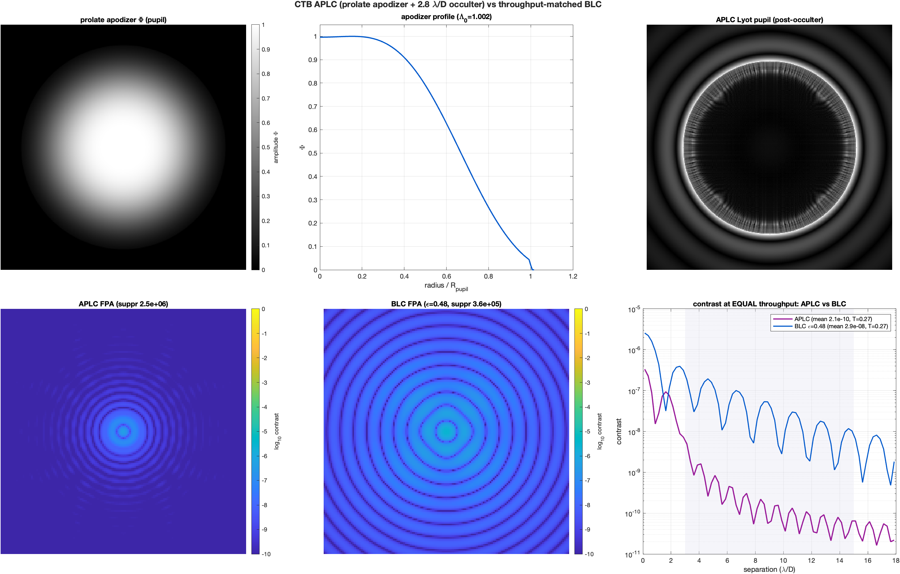
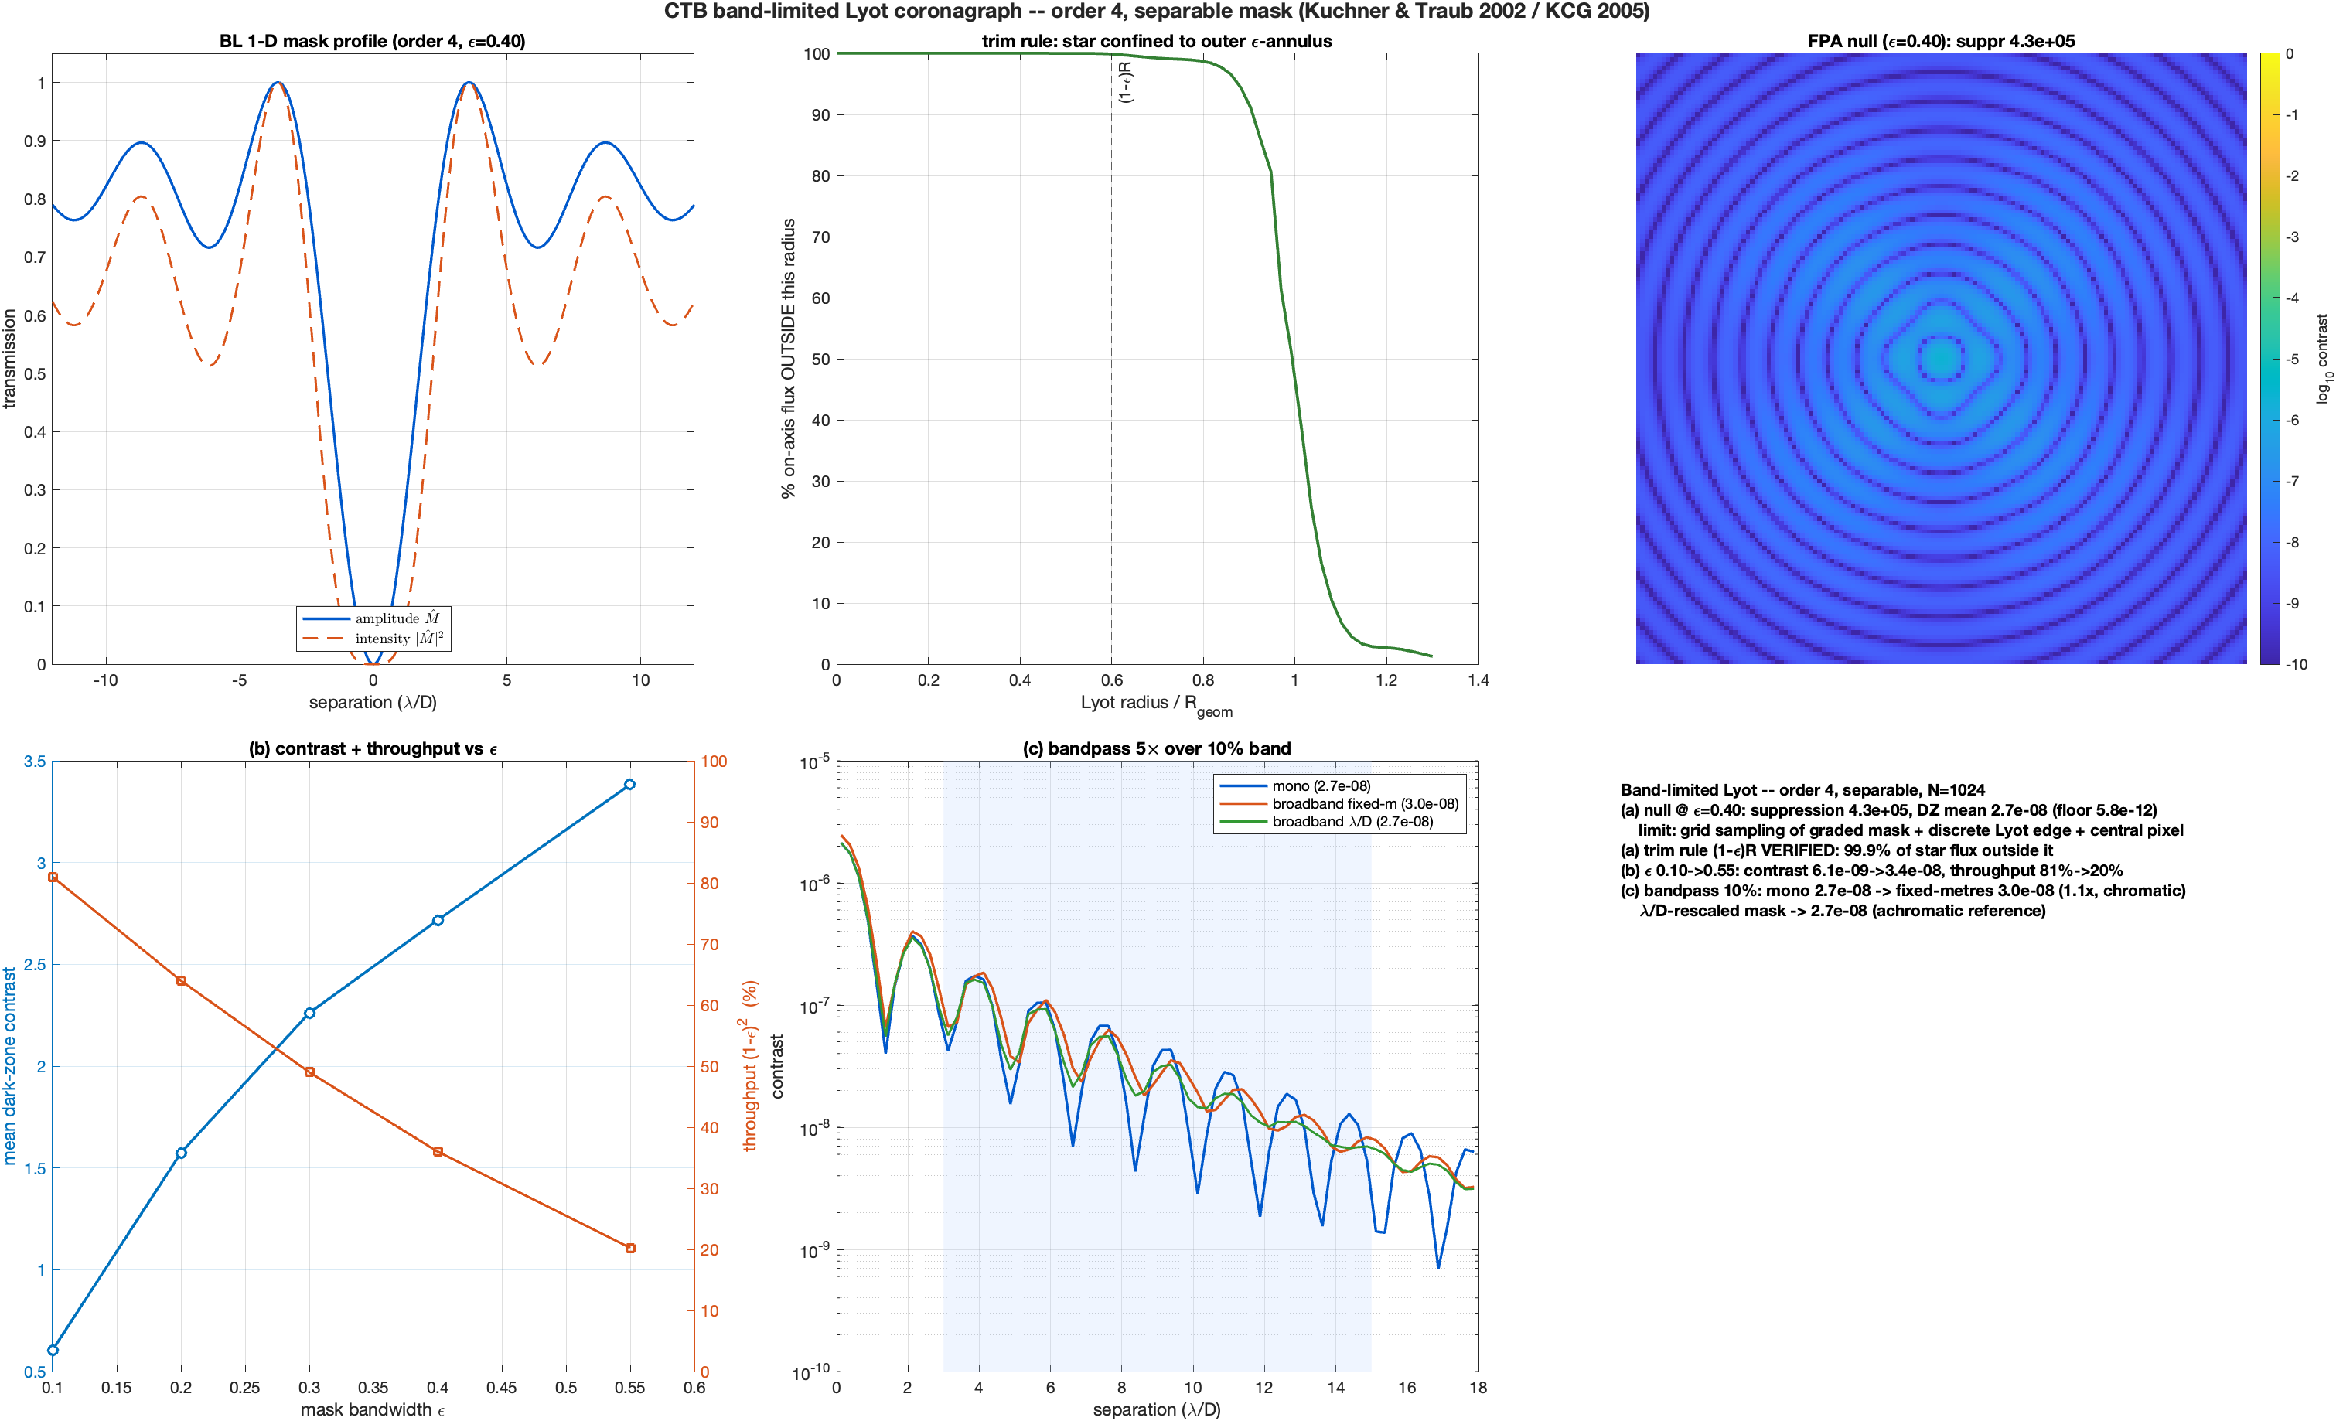
The mask families, one by one (1 of 2)
Apodized-pupil Lyot and band-limited
The apodized-pupil Lyot configuration: prolate apodizer, occulter, Lyot stop, and its dark zone.
The 4th-order band-limited mask: amplitude profile and its dark zone.

Slide 19
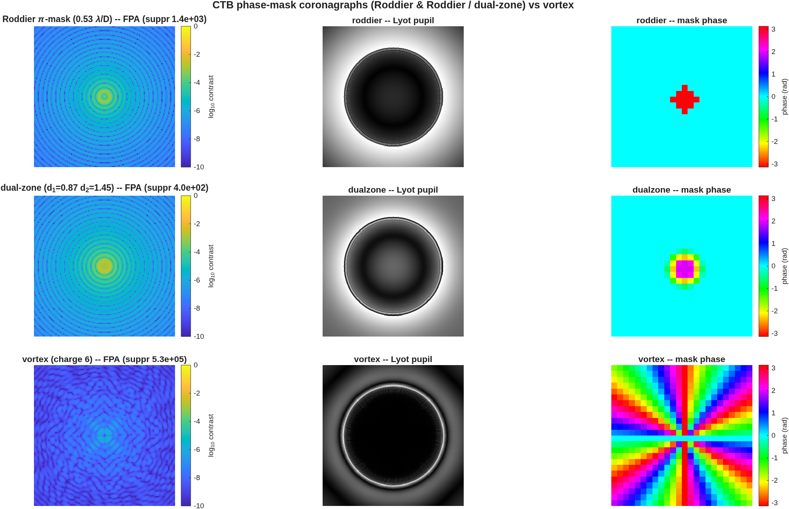
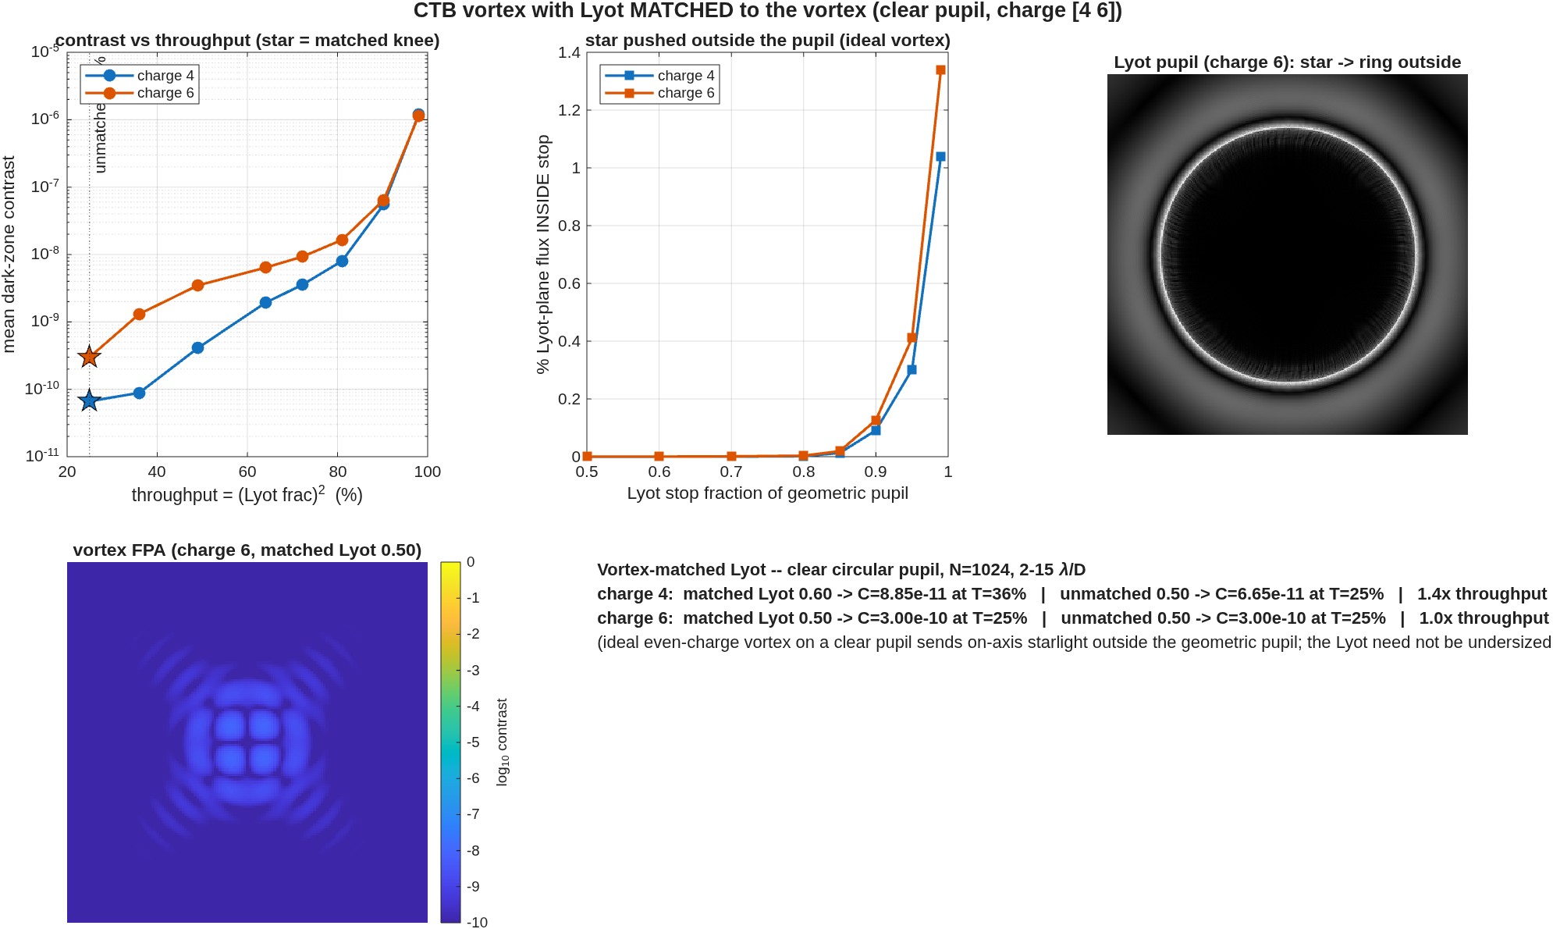
The mask families, one by one (2 of 2)
Phase masks and the vortex
The Roddier π-spot and dual-zone phase masks; both need their matched entrance apodizer to go deep.
The vortex with matched Lyot: even winding number on a clear pupil sends starlight outside the reimaged pupil.

Slide 20
The vortex core: sampling set the floor
An ideal-pupil probe with no bench reproduces the shipped 2.9×10⁻⁷ — and pixel-averaging removes it
• The probe: the same sampled charge-6 vortex in a pure Fourier chain on an ideal clear pupil (N=1024, 4 px per λ/D, Lyot 0.90) — no bench optics anywhere. Direct-sampled: 3.0×10⁻⁷, matching the shipped bench number. Supersampling the pupil edge changes nothing. The floor is the mask's own singular core: near the axis the phase wraps faster than the grid, and those mis-phased pixels sit exactly on the stellar image peak, scattering ~0.2% of the starlight back inside the Lyot.
• Generate-at-K× and complex-bin cancels the core phasors (transmission 0 at the core pixel, a smooth ~1-px taper): 4× gives 3.4×10⁻⁹, 8× gives 3.0×10⁻⁹ (converged). An explicit 1 λ/D opaque core dot is worse (9.8×10⁻⁹ — its own edge diffracts). Charge 2 is the counterexample: the medicine is for even charge ≥ 4.
• On the bench (8×-binned, charge 6, Lyot 0.90): 1.4×10⁻⁸ — the remaining gap to the ideal-pupil 3.0×10⁻⁹ is the bench's own residual, no longer the mask.
• With the core fixed, flux inside the stop is 0.0–0.1% out to a 0.90 fraction — the analytic "all starlight outside the pupil" property, visible at last — and the Lyot fraction becomes a genuine depth-for-throughput trade (it used to look free because every fraction hit the same artifact floor):
Lyot fraction | charge 4 | charge 6 | throughput
0.50 | 6.6×10⁻¹¹ | 3.0×10⁻¹⁰ | 25%
0.80 | 1.9×10⁻⁹ | 6.4×10⁻⁹ | 64%
0.90 | 8.0×10⁻⁹ | 1.6×10⁻⁸ | 81%
• Charge 4 at a 0.80 stop dominates the band-limited mask in both depth and throughput; at 0.50 it reaches the apodized-pupil Lyot's class.

Slide 21
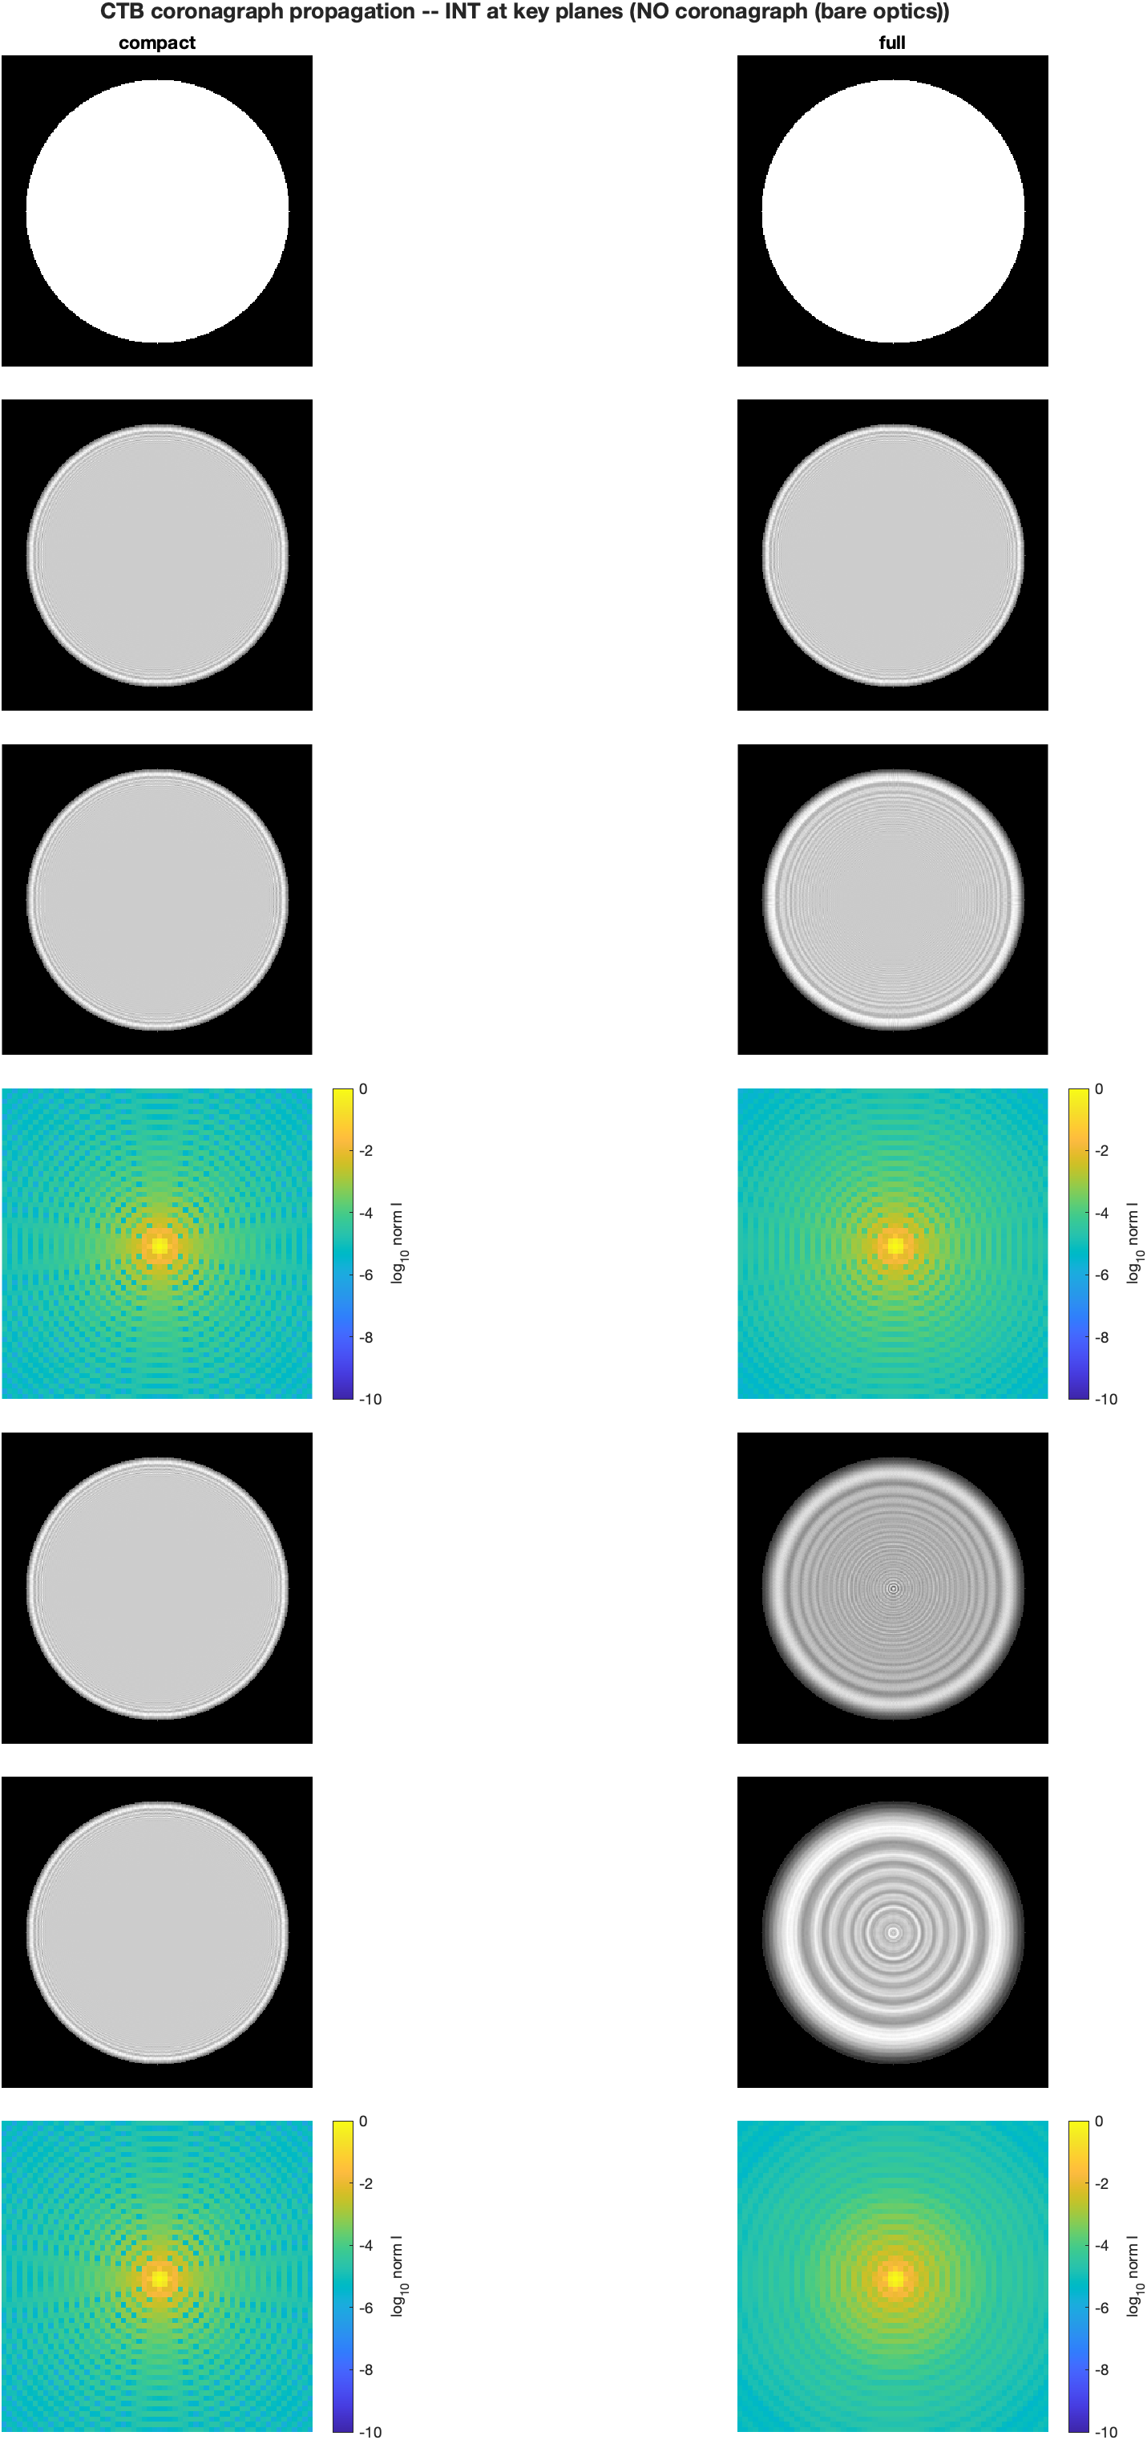
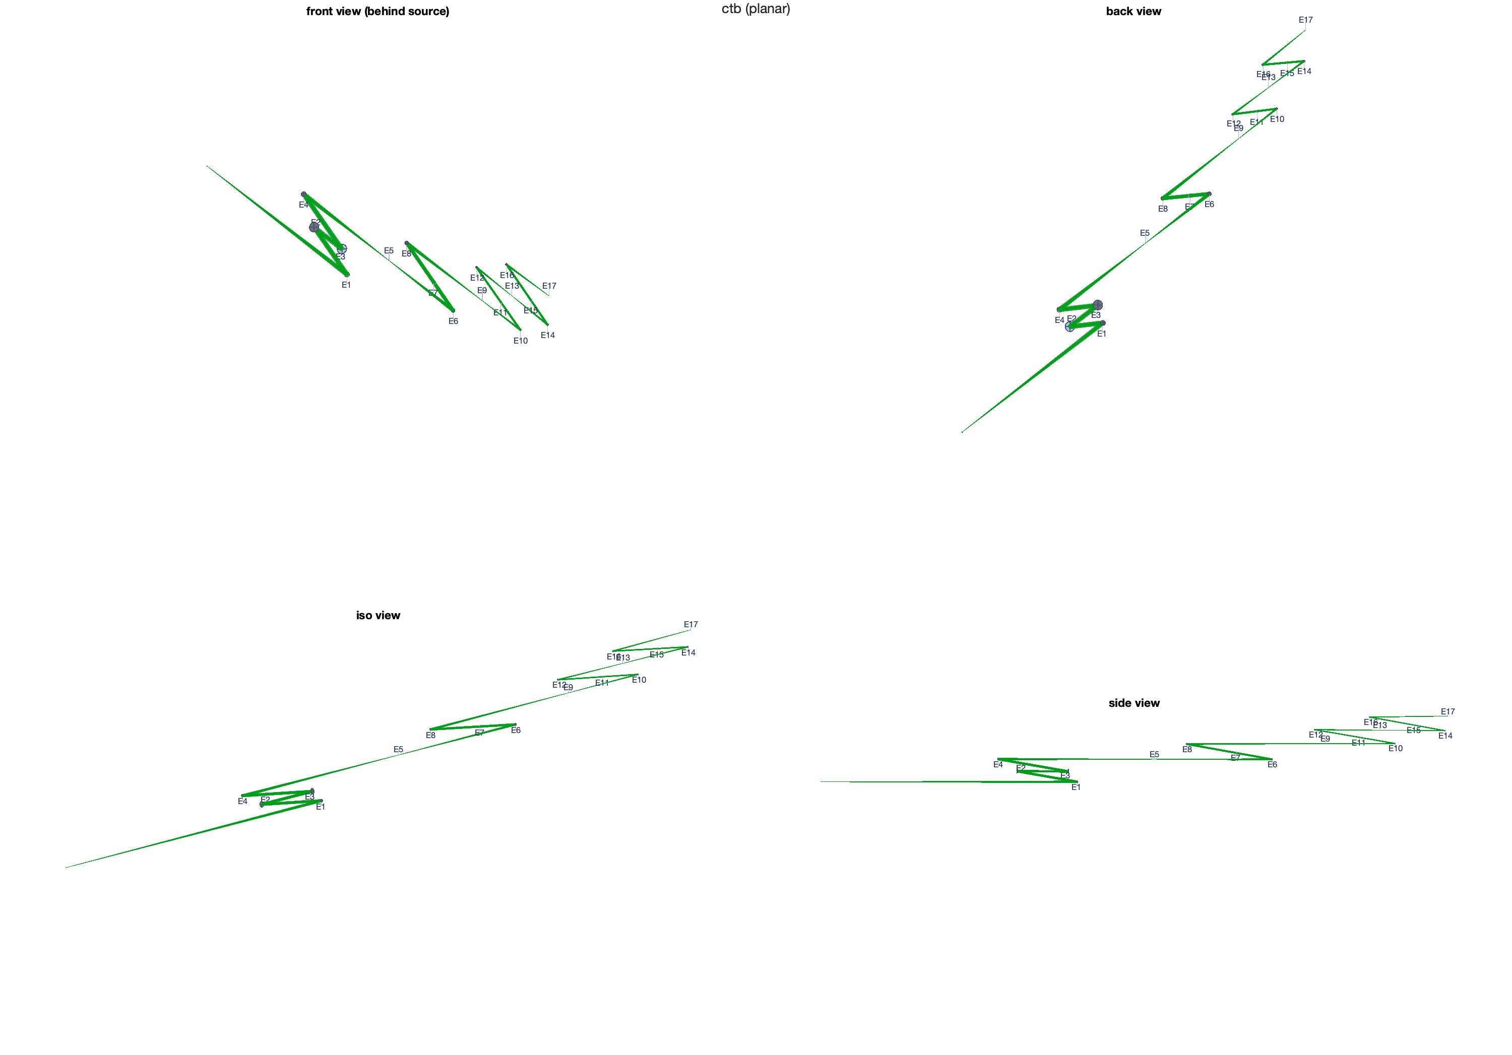
Bare-optics agreement, and the bench
The two prescriptions before any mask, and the geometric layout they share
The geometric bench: eight off-axis parabolas and two DMs, with the beam footprints the diffraction models inherit.
Seven stations × two models, no masks: point images agree to 0.9989 correlation.

Slide 22
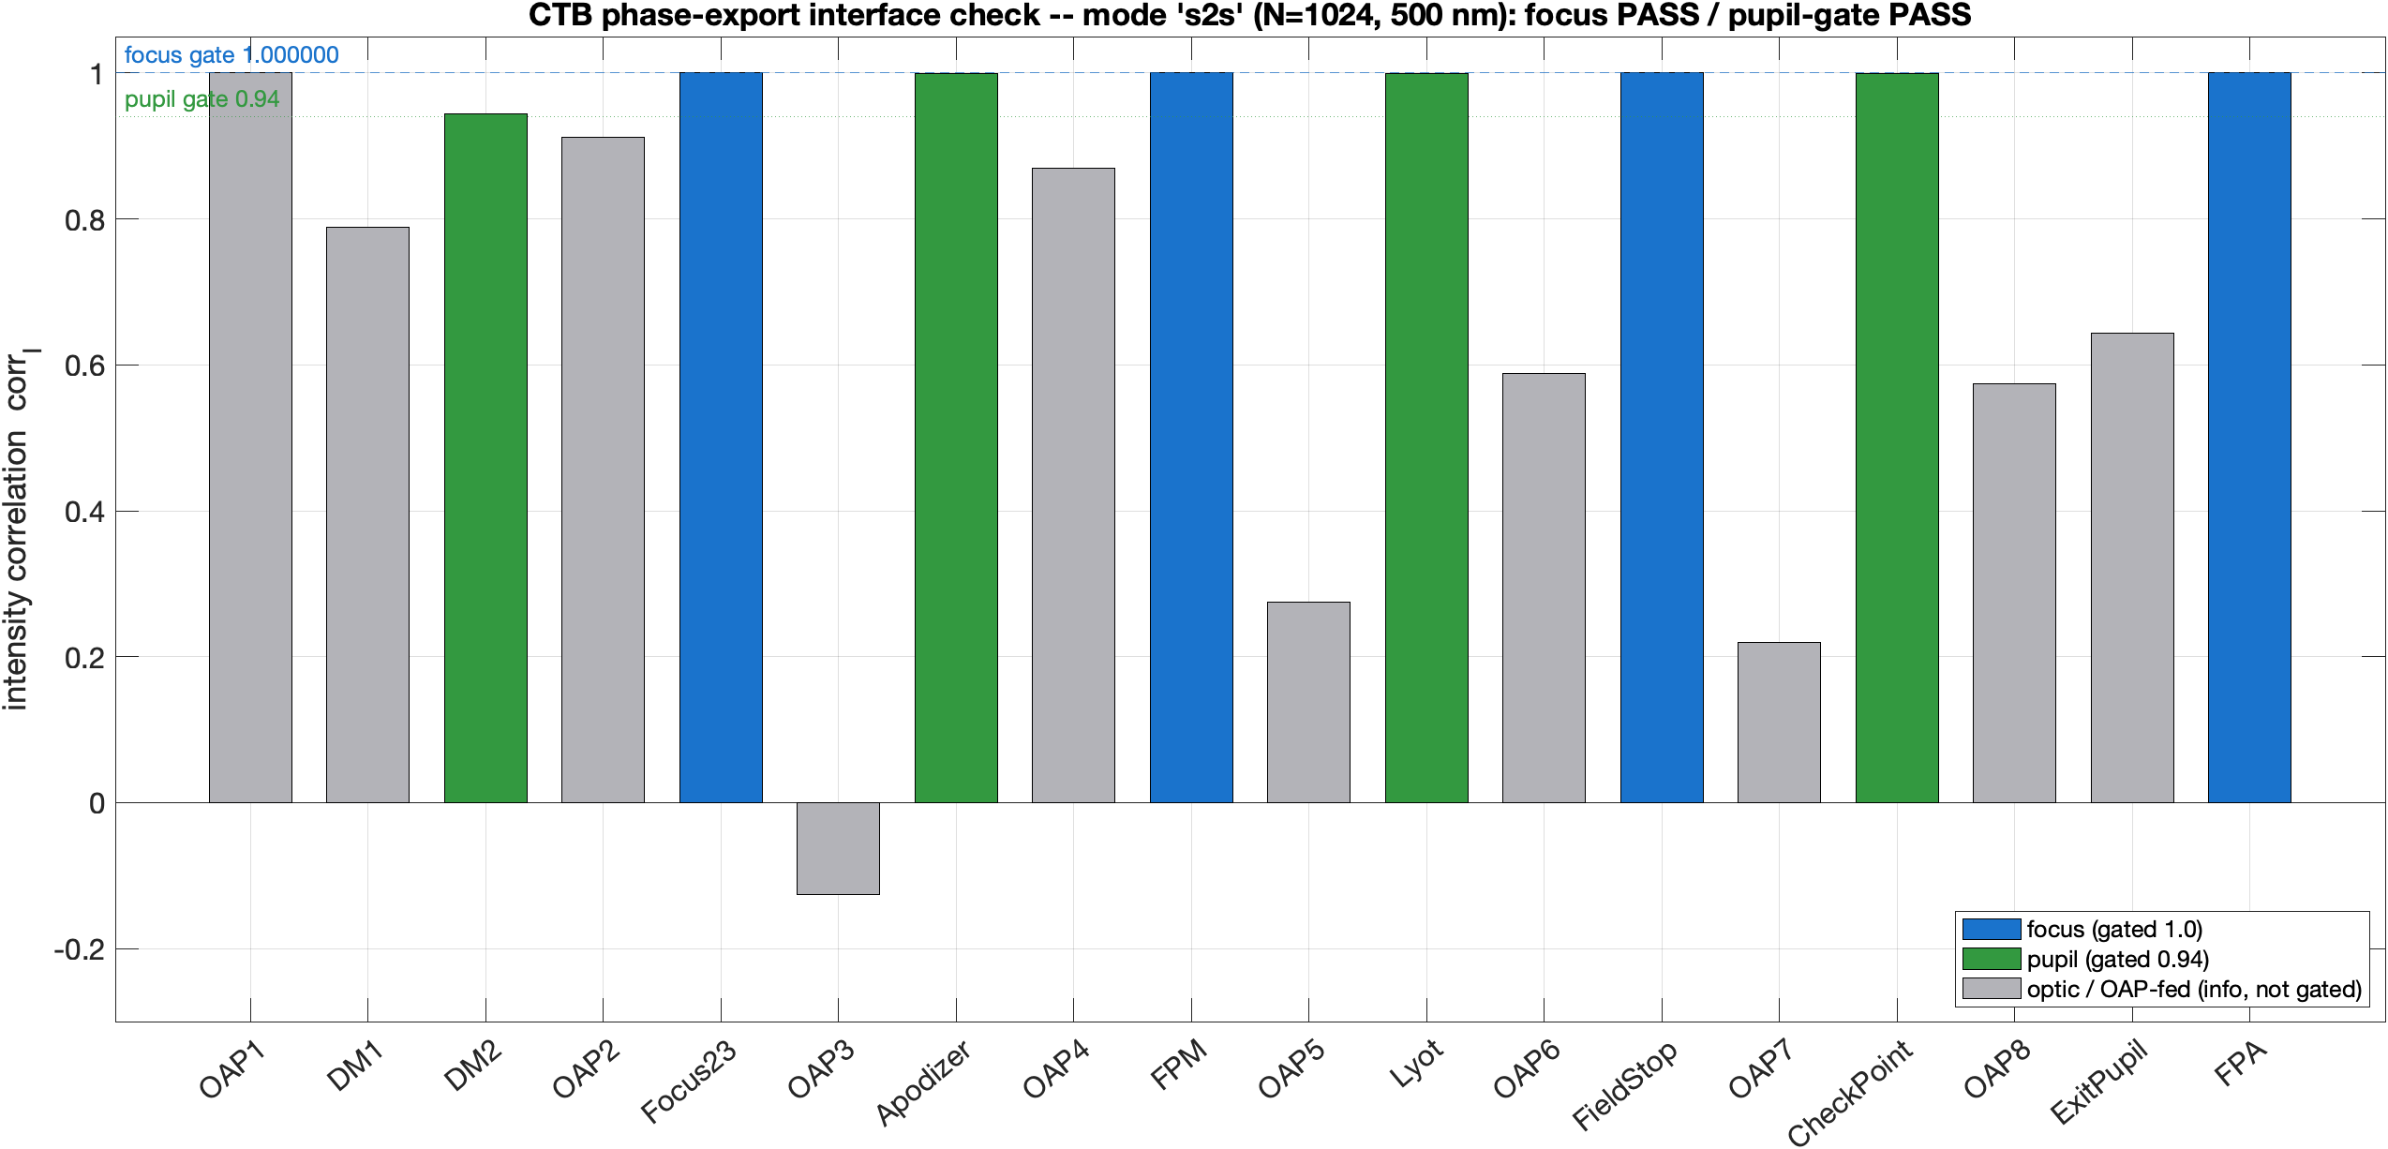
Per-leg replay check
Every station reproduced when each leg starts from the exported field
Station-by-station intensity correlation, per-leg replay mode: focus stations at correlation 1.000000, gated pupils ≥ 0.9998; grey bars are ungated mid-beam planes.

Slide 23
Control-loop diagnostics
Two silent failure modes, found and pinned by regression tests
• Commands are real numbers. The correction solve must treat the real and imaginary parts of the field as separate equations; a complex-valued solve returns complex commands whose imaginary half the MATLAB-to-engine interface silently discards. The symptom is quiet: the loop still improves, but crawls at 3% per iteration with the achieved field nearly uncorrelated with the prediction (correlation 0.13). Solved in the split form, the same loop digs 16× in two iterations. The DM model now rejects complex commands outright.
• Pupil wavefront maps must be read at the exit pupil. Read at the camera (the default), a DM bump smears into a smooth error ten times its physical size — it looks exactly like a surface-amplitude bug in the model and is not. At the exit pupil the response is 2·cos(incidence) times the commanded surface within 2%, at the commanded position to a pixel, with mirror symmetry exact.
• The validation ladder under the loop, all pinned by the regression suite: commanded surface read back bit-exact; two-poke superposition to 1 part in 10¹²; the propagation chain bit-repeatable run to run; poke response step-size-independent to 5%.

Slide 24
Reconstructing the study
One config, one call: ctb_study derives every stage, tag, cache, and figure
• The slides-9-through-13 sequence is one driver: ctb_study() audits or re-runs the shipped configuration, and name-value overrides — mask kind, charge, Lyot fraction, band ladder — re-run it at a new parameter point. 25 steps in dependency order: Jacobian → control loop → relinearization → physics (polarization / band / both) → bandwidth sweep → the 14-run vector-vortex ladder → verdict figure. About 7.6 hours of engine time from scratch at model 512.
• Every tag, cache file, and figure derives from the config. The shipped configuration maps to the historical file names; any other gets an automatic suffix (charge 6, Lyot 0.70 → _vc6L070), so parameter points never collide on disk. 'dry' prints the full call plan and cost without touching the engine.
• Resumable: a stage whose run state exists is skipped and its numbers fold into the manifest — the default run over complete states costs seconds and returns the audit table reproducing every number on slides 9–13 (run at build time for this deck: 24 states verified, all floors matched).
• The guard that makes cache reuse safe: Jacobian files are keyed by name, and a name cannot encode the full mask geometry — a stale G fights the loop with plausible-looking numbers. Every cache therefore carries a chain_opts stamp of the chain it was measured on, and ctb_jac_check refuses any load whose stamp mismatches the requested chain, naming the differing fields. The refusal is loud where the failure mode was silent.

