Slide 1
The 3k Dyson Module Brought to the Pixel
A freeform three-mirror telescope of the SBG VSWIR form, seeded from the published layout and solved to Joe's specification, feeding the 240 mm CaF₂ Dyson of record: smile 0.02, keystone 0.006, CRF 1.17 pixels, 0.85 of the energy in one pixel, end to end over the 9.4° strip.
D. C. Redding, with Claude Code.
October 2026. Working record; no proprietary prescription is used.
DRAFT — pending review.
Since the 2026-10-06 deck: Jim's answers and the project's own paper settled the trade toward two 3k modules and pointed at the telescope form; a design template built on that form reaches the pixel at every field of the strip, with the cone bounded and the slit telecentric; the 0.14-pixel "smile" that remained was the scorer's launch convention, not the optics. Both modules now meet the specification end to end; SRF sits at the two-pixel slit's floor. What is left is the spectrometer's: tolerances, the aspheric-lens form, throughput by band.

Slide 2
Contents
What changed, the seed, the telescope of record, the module scored, how the solve got there, the two smile conventions, the spectrometer, the comparison, the questions
• 3 The target and how it is scored
• 4 What changed since the last deck: Jim's answers and the paper
• 5 The seed: the SBG form, first order
• 6 The telescope of record: freeform three-mirror, R9
• 7 The 3k module, scored: spectrometer, telescope, and the two together
• 8 The 3k module, end to end
• 9 How the solve got there: six rungs and three lessons
• 10 Smile is a convention: the launch, not the optics
• 11 The cone, the spec and the paper's beam
• 12 The spectrometer: at the slit floor; what is left
• 13 Two of 3k or four of 1.5k, updated
• 14 Questions for Jim and Joe
• 15 Next steps
• 16 Run it yourself
• 17 Backup: the first order by the numbers; the rungs per field; the chief-tilt diagnostic; the engine finding; records

Slide 3
The target and how it is scored
Joe's specification at Jim's ground sample; the metrics stated once, with the paper's bounds in the same units
item | Joe (this work) | the SBG VSWIR paper
F-number | 1.8 | 1.8
aperture; focal length | 183 mm; 330 mm | 192 mm; 345 mm
pixels | 18 µm; 3000 cross-track, 500 spectral | 18 µm; 3072 × 512, 2 co-added spectrally
slit | 54 mm; 2 pixels (36 µm) | 54.45 mm; 36 µm
band | 380–2500 nm | 380–2500 nm
smile, keystone | < 0.1 px (1.8 µm) | 5 % of a co-added px (1.8 µm); 10 % of a px (1.8 µm)
SRF FWHM | 1.5–2.0 px (27–36 µm) | < 1.8 co-added px (64.8 µm)
CRF FWHM | < 1.5 px (27 µm) | < 2.8 px (50.4 µm)
ARF FWHM (telescope, across the slit) | – | < 2.8 px (50.4 µm)
field per module | 9.4° (3k) | 8.9°
• Smile: centroid drift along the slit at fixed wavelength; keystone: drift across wavelength at fixed slit position; both from ray centroids, in pixels.
• SRF, CRF: slit ⊗ line-spread function ⊗ pixel ⊗ Airy, FWHM (Mouroulis & Green 2018). With a 2-pixel slit a perfect spectrometer gives SRF = 2.000 px exactly: the slit's floor.
• Energy in one pixel: the fraction of a point image inside one 18 µm pixel; design rule 0.75.
• End to end is one prescription from the sky to the detector, the grating its stop, scored by the spectrometer's own scorer. Smile end to end depends on how each field is launched onto the slit — slide 10 — so it is given under both conventions.
• The paper's SRF is in co-added pixels (36 µm); its bounds are converted to micrometers in every table here.
Every number is a MACOS ray trace of a committed prescription; no coatings, no tolerances. Paper: Bradley et al., "Finalized optical design of the SBG VSWIR Wide Swath Imaging Spectrometer," ICSO 2024, Proc. SPIE 13699, 1369945 (Tables 1–3).

Slide 4
What changed since the last deck: Jim's answers and the paper
The trade leans to two 3k modules; the telescope is designed alone, telecentric at the slit, with its cone bounded; the air gap stands; the paper's form is the seed
• Two modules, not four. Jim: four telescopes, spectrometers and detectors cost integration, test and calibration, not mass; detectors come as 2k × 2k and 3k × 0.5k, a 1.5k × 0.5k is NRE. Materials are "almost always a tiny fraction of the instrument cost," so the CaF₂ volume is not the discriminator. The paper's own trade reached the same answer: two identical telescope + Dyson modules, each half of the 180 km swath.
• The telescope, designed separately. Jim: telescope and spectrometer each telecentric at the slit, the telescope a little faster than the spectrometer, and no rays at F/1.2. The paper: the telescope optimized alone for uniform small spots along the slit under constraints on F/# anamorphicity, baffle clearance and working distance; then the Dyson added for end-to-end keystone and CRF.
• The window is an order-sorting filter and cannot be bonded to CaF₂ (CTE); fused silica to silica has a bad bonding history. Six crossings, 0.81 uncoated, is the baseline.
• The paper's telescope is a freeform TMA at f 345 mm, 192 mm, 8.9°, chosen over an even-asphere TMA for tolerance insensitivity, not nominal performance: spots 2–3 µm, "diffraction limited over most of the band," all aluminum at 280–300 K.
• The paper's spectrometer is an aspheric CaF₂ Dyson lens with a conic grating (their Option B), no corrector lens, at 240 K; smaller than the telescope.
• The Offner does not go much below F/3 at reasonable size (Jim), which confirms the F/1.8 Offner's exit in the last deck.
• AR and blaze are tailored to the photon-starved long-wavelength end; throughput is a per-band number, not one figure.
Jim's comments of 2026-10-07 in line on the 10-06 note; the paper's numbers on this slide are its Tables 1–3 and Figs. 1 and 4. Recorded in BRIEF_to_dyson5.md addendum 47.

Slide 5
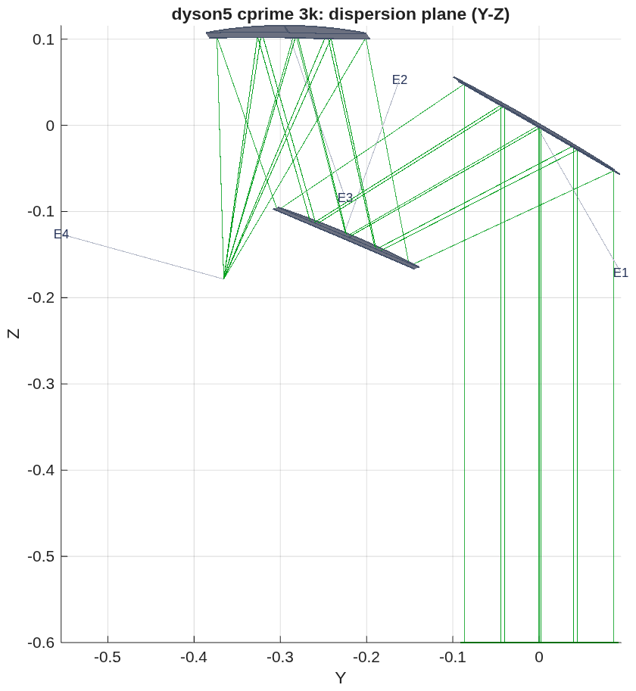
The seed: the SBG form, first order
The paper's layout digitized and scaled to Joe's focal length; with the stop at M2 the first order is telecentric in closed form, has no intermediate focus, and gives 299 mm of working distance for the Dyson
• The seed: the paper's Fig. 4b, read off its 200 mm scale bar and scaled by 330/345 — legs M1→M2 258 mm, M2→M3 246 mm, M3→slit 300 mm; chief incidence 30°, 37°, 15°; M2 the small mirror at the stop.
• Two facts the first order forces. (1) A tilted sphere cannot do it: the legs are the same in and across the fold plane, so each mirror needs local radii at the chief with R_t / R_s = 1/cos² i (1.33, 1.57, 1.07); an off-axis conic section does this natively, and with the parent axis at the incidence angle all three are off-axis paraboloids — the seed. (2) The stop at M2 makes telecentricity closed-form: M2 sits at M3's front focus. M1 weak concave (f +1012 mm), M2 convex (−452), M3 f +246 = the M2→M3 leg; the marginal ray never crosses the axis between mirrors, so there is no intermediate image — the Korsch with a real M2–M3 focus cannot be telecentric with the stop at M2, and this family has no such focus.
• In the engine, before any figure: chiefs within 0.093° of the slit normal over ±4.7°, plate scale 329.99 mm, every field admitted, M2 footprint 136 mm, clearance +10 mm, working distance 299 mm; not imaging (2 mm spots).
The telescope section as the engine traces it (meters): light enters from below; M1 (E1) at the right, M2 (E2) at the top, M3 (E3) at the left, the slit (E4) at the far left — a zig-zag, not a Korsch fold.
Template templates/10_telescopes/tma_longslit/ (parameters, runner, demo, README, test); first order tls_first_order.txt; BRIEF_to_dyson5.md addendum 48. Beams: 183 mm at M1, 136 at M2, 166 at M3.

Slide 6
The telescope of record: freeform three-mirror, R9
Off-axis conic sections with a pole-frame polynomial of degree 3–6 on each mirror: FWHM 1.02 × 1.02 pixels at every field of the strip, chiefs within 0.033° of the slit normal, marginal rays between F/1.80 and F/1.89, clearance +12 mm
field (±) | spot rms (µm) | FWHM along / across the slit (px) | energy in a pixel | chief to the slit normal | F/# along / across | chief − centroid across the slit (µm)
0 | 1.8 | 1.02 / 1.02 | 1.00 | 0.000° | 1.894 / 1.806 | 0.00
1.175° | 2.2 | 1.02 / 1.02 | 1.00 | 0.002° | 1.894 / 1.803 | –
2.35° | 2.5 | 1.02 / 1.02 | 1.00 | 0.008° | 1.893 / 1.801 | –
3.525° | 2.0 | 1.02 / 1.02 | 1.00 | 0.018° | 1.892 / 1.798 | –
4.7° | 2.3 | 1.02 / 1.02 | 1.00 | 0.033° | 1.889 / 1.797 | 0.03 (R7: 2.43)
• Geometry: the seed's legs and incidences kept; the layout stays the form (unbounded, the incidence angles collapse to a coaxial train that self-obscures). Plate scale 329.9 mm local, 330.1 along track. Footprints M1 235 × 202, M2 132 × 166, M3 215 × 173 mm; freeform departure 0.46 / 0.55 / 1.11 mm P-V over the lit patch (the 1.5k asphere telescope: 2.1 mm on M1). Clearance +12.1 mm; working distance 299.4 mm.
• Figure: a pole-frame polynomial (Surface= Monomial, degree 3–6, even in x); degree ≥ 3 leaves value, slope and curvature at the pole untouched, so the first order survives the figure. Even aspheres about the parent axis were the wrong basis on these sections (the poles sit 0.9–1.5 m off axis).
• The constraint rows that make it a long-slit front end, in every rung: the chief angle to the slit normal per field (telecentric); a hinge on the marginal rays' F/# at the slit, along and across, outside [1.7, 1.8] (the paper's F/# anamorphicity); and, in R9, the chief − centroid offset across the slit (slide 10).
• Not done: no tolerancing, no coatings, no stray-light or mirror sizing beyond the footprints.
Prescription challenges/dyson5/dyson5_cprime_3k.in (= tls_R9_ffo.in); engine numbers, model 256, nine fields over ±4.7°, mirror-symmetric. The gate tTmaLongslit re-scores it by name. REPORT_dyson5_cprime.md.

Slide 7
The 3k module, scored: spectrometer, telescope, and the two together
Both meet Joe's specification; together they image at the pixel over the strip; SRF is the two-pixel slit's floor
criterion | Joe | paper | spectrometer alone (240 mm CaF₂ Dyson) | telescope alone (R9) | together, end to end
smile | < 0.1 px | < 1.8 µm | 0.005 px | – | 0.022 px slit-filled (0.4 µm); 0.016 px point-source shift
keystone | < 0.1 px | < 1.8 µm | 0.006 px | – | 0.006 px (0.1 µm)
CRF FWHM | < 1.5 px | < 50.4 µm | 1.21 px | 1.02 px along the slit | 1.17 px (21 µm); 1.26 at roll 180°
SRF FWHM | 1.5–2.0 px | < 64.8 µm | 2.024 px (2-px slit) | 1.02 px across the slit (ARF) | 2.025 px (36.5 µm)
energy in one 18 µm pixel | > 0.75 | – | 0.82 | 1.00 | 0.85 (0.81 at roll 180°)
image blur (rms, as placed) | – | 2–3 µm (paper) | – | 1.8–2.5 µm | –
plate scale | 330 mm | 345 | – | 329.9 / 330.1 mm | 330.1 mm
chief rays at the slit | telecentric | telecentric | – | within 0.033° | –
marginal rays at the slit | – | F/# anamorphicity bounded | – | F/1.80–1.89, none below 1.7 | grating admits 98.9 %
clearance, worst pair | > 0 | – | +0.54 mm (slit vs block face) | +12.1 mm | +0.6 mm (the spectrometer's pair)
glass, mass | – | – | 4.5 L, 14.3 kg | mirrors not yet sized | –
Spectrometer: dyson5_jim_3a.txt (size:F:240); telescope: dyson5_cprime_3k.in, REPORT_dyson5_cprime.md; together: dyson5_t5f_cprime_centroid_roll000.txt / _roll180, _chief_roll000 (the point-source shift), 7 fields × 7 wavelengths. No coatings, no tolerances in any column. SRF 2.025 against a 2.000 floor: the Dyson adds 0.45 µm.

Slide 8
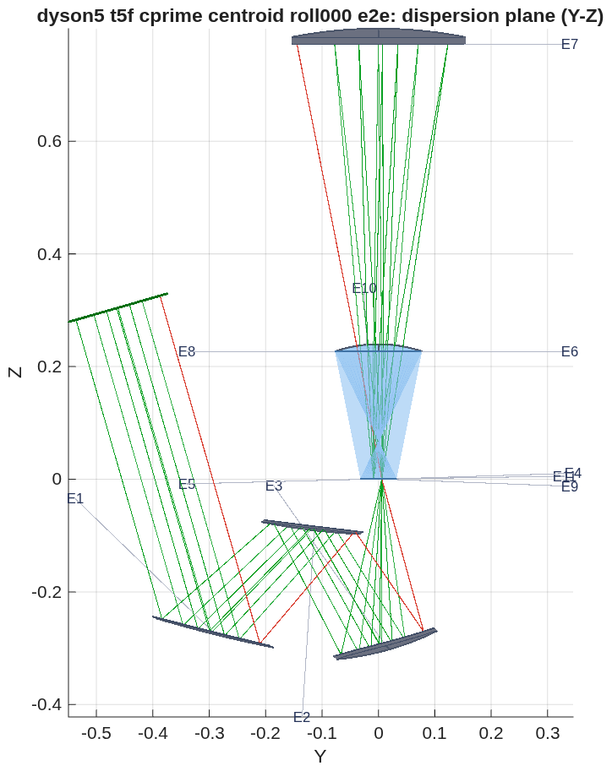
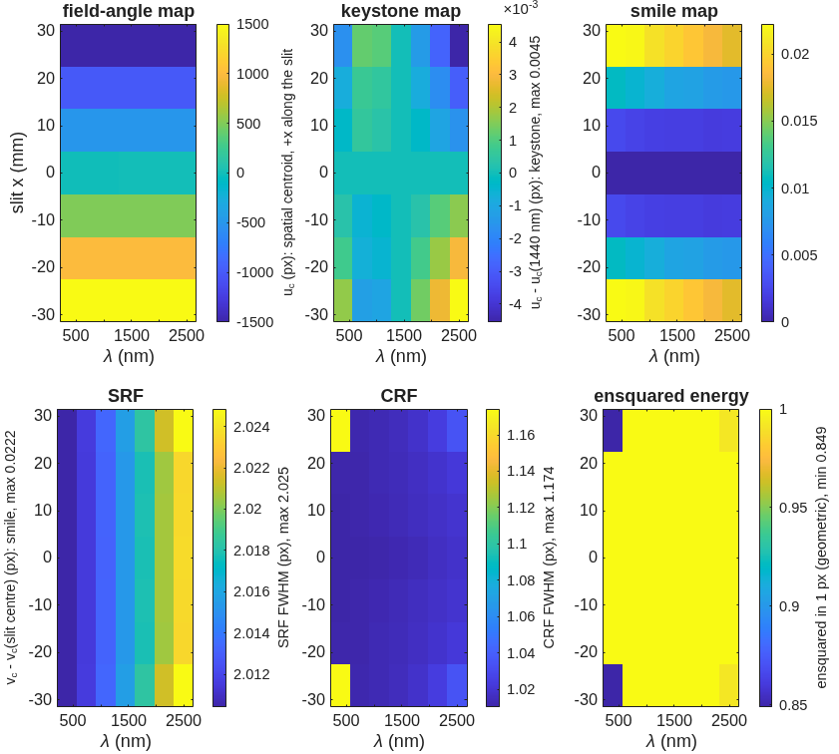
The 3k module, end to end
The freeform telescope feeding the 240 mm CaF₂ Dyson: smile 0.02, keystone 0.006, CRF 1.17, SRF 2.025 px at every slit position and wavelength; 98.9 % of the light through the grating; clearance +0.6 mm, the Dyson's own slit-to-block-face margin
Per slit position and wavelength (7 × 7): field angle, keystone, smile, the two response widths and the energy in one pixel, uniform over the strip. The runner's own figure.
• CRF 1.02 px at the inner fields and 1.17 at the strip ends; SRF 2.02 everywhere; smile 0.022 → 0.018 px from 380 to 2500 nm; keystone 0.006 px at the ends, 0 at the center. Against the (c) solve of the last deck (smile 1.64, CRF 4.02, SRF 4.99, 4–10 % in a pixel), every line moved to the pixel.
As the engine traces it (meters), the dispersion plane: the telescope's M1–M3 (E1–E3) below, the slit (E4) on the block's face at the origin, the 240 mm CaF₂ block, the grating (E7) at the top, the detector (E9) beside the slit. The 1 % of rays the grating stops are drawn in red.
Record dyson5_t5f_cprime_centroid_roll000.txt (each field's centroid on the slit line); the chief-launched twin _chief_roll000.txt gives the point-source shift 0.016 px; roll 180° about the chief: CRF 1.26, energy 0.81, the rest unchanged. Prescription dyson5_t5f_cprime_centroid_roll000_e2e.in (3 telescope + 8 slit/Dyson elements).

Slide 9
How the solve got there: six rungs and three lessons
The merit decided every step: equal weights spent the budget on the strip center; a constraint set weighted below one percent of the merit is not a test; the last tenth of a pixel of "smile" was the launch
rung | what changed | outer-field FWHM along the slit (px) | e2e smile, point-source (px) | keystone (px) | CRF (px) | SRF (px)
R4 | conics + even aspheres on the seed layout | 5–7 | 0.73 | 0.009 | 2.5 | 3.9
R5 | pole-frame freeform, centroid-bow rows added | 5–7 | 0.09 | 0.03 | 7.0 | 2.5
R6 | R5 + 3000 more evaluations | 5–7 | 0.15 | 0.04 | 7.2 | 2.5
R7 | warm from R4: along-slit rows ×3, outer fields ×2–3, bow rows kept | 1.02 | 0.14 | 0.006 | 1.18 | 2.025
R8 | R7 + telecentric rows ×30 (a test of the chief angle) | 1.02 | 0.14 | 0.005 | 1.18 | 2.025
R9 | R7 + chief − centroid rows across the slit ×1000 | 1.02 | 0.016 | 0.006 | 1.17 | 2.025
• Equal weights were the CRF wall. R5 and R6 weighted every field and both axes equally on rms spot size and spent it on the strip center (4 µm) while the outer half sat at 5–7 px along the slit; more budget on the same merit moved nothing. Weighting the along-slit rows and the outer fields, from R4, took every field to the Airy floor in one rung.
• A row set below one percent of the merit is not a test. R8's telecentric rows at ×30 were 0.4 % of the merit; the solver never worked on them and R8 is R7 to the third digit. R9's offset rows at ×30 would have been 0.07 %; at ×1000 they dominated, and the solve converged in 507 evaluations.
• The remaining 0.14 px of "smile" was the launch convention (slide 10), and the row that removed its cause cost nothing at the pixel.
REPORT_dyson5_cprime.md (every rung and the four solves thrown out); the template's README, "What the ladder taught." Each rung: 3000 evaluations of the engine's own trace (R9: 507), model 256.

Slide 10
Smile is a convention: the launch, not the optics
The join lands each field's chief ray on the slit line and scores the centroid, so the telescope's coma — the chief-minus-centroid offset across the slit — read as smile; the Dyson fed with the telescope's chief angles does not move
Dyson alone, each slit point's chief tilted by R7's angles | smile | keystone | CRF | SRF
base (the record) | 0.0050 | 0.0058 | 1.213 | 2.024
along-track component (−0.51 mrad at the strip end) | 0.0049 | 0.0061 | 1.213 | 2.024
cross-track component (±0.27 mrad) | 0.0048 | 0.0063 | 1.213 | 2.024
along-track × 2 | 0.0049 | 0.0064 | 1.213 | 2.024
both | 0.0048 | 0.0066 | 1.213 | 2.024
rung | predicted from the telescope's offset | e2e smile, chief launch
R4 | 0.655 | 0.732
R5 | 0.086 | 0.090
R6 | 0.122 | 0.149
R7 | 0.135 | 0.140
R8 | 0.133 | 0.138
• The offset predicts every rung: on R7 the chief sits 0 / 0.2 / 0.7 / 1.4 / 2.4 µm from the centroid across the slit at 0 / 1.2 / 2.4 / 3.5 / 4.7°; the spread of that offset is the e2e smile.
• Two conventions, both reported. Slit-filled (the paper's: its telescope-fed smile equals its spectrometer-alone smile): each field's centroid on the slit line — the spectrometer's smile, 0.022 px. Point-source: the chief on the slit line — where a star's spectrum lands, 0.016 px on R9 (0.14 on R7). R9's row on the offset closed the second without touching the first.
• The chief angle is not the cause: keystone moves (the hook is live), smile does not, even at twice the angle.
Diagnostic tls_dyson_chief_tilt (the spectrometer alone, the launch tilted per field); the join scorer dyson5_t5f now carries both launches (tel5f_launch chief | centroid), the record's rows reproduce under the first.

Slide 11
The cone, the spec and the paper's beam
The marginal rays leave the telescope between F/1.80 and F/1.89 in the two directions, none below F/1.7; the along-slit F/1.89 is Joe's own aperture at Joe's focal length
• Why it is a row: the last deck's 3k solve let its marginal rays run to F/1.19 into an F/1.8 spectrometer; the grating, sized for F/1.8, passed 95–98 % of the light, and nothing in the merit knew. Jim: "I don't see why some rays correspond to an f/1.2 cone." The paper constrains the F/# anamorphicity.
• The row: a hinge on the working F/# of the marginal rays at the slit, along and across, outside [1.7, 1.8], in every rung. R9: F/1.889–1.894 along the slit, F/1.797–1.806 across; the grating admits 98.9 % at every field.
• Along the slit it sits above 1.8, and that is the specification: D 183 mm at f 330 mm is F/1.803; a cone a little faster than the spectrometer's — Jim's "a little faster" — needs a larger entrance beam, the paper's 192 mm. A spec question for Jim and Joe, not a solve question; the telescope holds Joe's numbers.
• Across the slit the cone is F/1.80: the slit truncates the image in that direction, and the across-slit FWHM (the paper's ARF) is 1.02 px against its 2.8 px bound.
REPORT_dyson5_cprime.md, R9 per-field table; F/# from the marginal rays as 1/(2 sin u).

Slide 12
The spectrometer: at the slit floor; what is left
SRF 2.025 px is the two-pixel slit's 2.000 plus 0.45 µm of blur, and in the paper's units it is 36.5 µm against 64.8; the open spectrometer work is tolerances, the aspheric-lens form, and throughput by band
• SRF is not a miss. The scorer's SRF is slit ⊗ LSF ⊗ pixel ⊗ Airy; with a 2-pixel slit a perfect spectrometer gives exactly 2.000 px. The Dyson of record gives 2.024 alone and 2.025 behind the telescope: 0.45 µm of blur. Joe's "1.5–2.0" is met at its floor; 1.5 would need a narrower slit, not a better spectrometer. In the paper's co-added pixels our SRF is 1.01 against its 1.33 design and 1.8 requirement; our CRF 21 µm against its 50.
• The spectrometer of record for 3k stands: 240 mm CaF₂, spherical lens face and spherical grating, no meniscus; smile 0.005, keystone 0.006, CRF 1.21, 0.82 of the energy in a pixel; 4.5 L, 14.3 kg; the slit's package clears the block face by 0.54 mm.
• Tolerances, first. Nothing on either module is toleranced, and the paper chose both its forms for tolerance insensitivity (its spherical-grating option lost on exactly that: smile 0.3 % designed, 3.5 % as built). Next: a sensitivity ladder on both Dysons — lens and grating decenter, tilt, radius, index (the thermal soak), grating period and clocking, slit and detector position — scored alone and through the join with R9, each with its compensator, summed to a budget against the paper's as-built margins.
• Then the paper's form for margin: an aspheric CaF₂ lens with a conic grating (their Option B) on our 3k geometry, nominal and its own ladder — the claim to test is insensitivity, not nominal performance.
• Throughput by band: six crossings uncoated (0.81), a single- and a two-layer AR optimized for 2.0–2.5 µm, the blaze; per band, both modules.
BRIEF_to_dyson5.md addendum 49 (in progress). Energy in a pixel 0.82 alone is the one spectrometer number with room; the paper's Option B is where it would come from.

Slide 13
Two of 3k or four of 1.5k, updated
Both modules now image at the pixel end to end; the trade is labor, detectors and integration, not optics or glass — and Jim's and the paper's answer is two
 | 2 × CaF₂, 3k, 54 mm slit | 4 × fused silica, 1.5k, 27 mm slit
block radius = thickness | 240 mm | 130 mm
spectrometer alone: smile / keystone / CRF / SRF / energy in a pixel | 0.005 / 0.006 / 1.21 / 2.02 px / 0.82 | 0.007 / 0.009 / 1.03 / 2.02 px / 1.00
telescope | freeform three-mirror of the SBG form (R9): 1.02 px at every field | three off-axis aspheres: 0.4 px center, 0.8 px at the strip ends
end to end: smile / keystone / CRF / SRF | 0.02 / 0.006 / 1.17 / 2.025 px | 0.50 / 0.01 / 1.22 / 2.20 px
end to end: energy in one pixel | 0.85 over the strip | 0.30–0.89 (0.8 over the central third)
light admitted by the grating | 98.9 % per field | 99 % per field
clearance, worst pair | +0.6 mm (slit package vs block face) | +0.38 mm (detector package vs block face)
glass for 6000 pixels | 9.0 L, 28.5 kg CaF₂ (12.4 L single crystal to carve) | 3.0 L, 6.6 kg fused silica
telescopes / spectrometers / detectors | 2 / 2 / 2 × (3072 × 512, a standard format) | 4 / 4 / 4 × (1.5k × 0.5k, NRE)
integration, test, calibration | two of each | four of each (Jim: the cost that dominates)
materials | "a tiny fraction of the instrument cost" (Jim) | the same
Records dyson5_jim_3a.txt, dyson5_t5f_GM_1k5_bAs_ap.txt, dyson5_t5f_cprime_centroid_roll000.txt. The four-module block (0.97 × 0.41 × 0.76 m, 14.6 kg of optics) of the last deck stands as the fallback. The air gap at the window stands on both (six crossings, 0.81 uncoated).

Slide 14
Questions for Jim and Joe
Three the ray trace cannot settle
• The entrance beam. Joe's 183 mm at f 330 mm is F/1.803, so the telescope's cone along the slit is F/1.89 and cannot be "a little faster than the spectrometer" without a larger beam; the paper's is 192 mm. Is the aperture Joe's number or the paper's?
• The slit and SRF. With a 2-pixel slit the SRF floor is 2.0 px (36 µm), where this design sits; the paper's bound is 64.8 µm. Is the 1.5–2.0 px range read against a 2-pixel slit, or does the project want a narrower slit at the throughput's expense?
• The spectrometer's form. The spherical-faced CaF₂ Dyson meets the specification at nominal. The paper went to an aspheric lens and a conic grating for tolerances; before we build that ladder, what drove it in the build — smile and keystone as built, or energy in a pixel?
Still open from the last round: the detector window's gap (now answered: an order-sorting filter, not bonded) and the AR by band.

Slide 15
Next steps
The spectrometer's tolerances and form; the telescope's tolerances and sizing; the record
• Spectrometer (in progress): the sensitivity ladder on both Dysons with compensators, alone and through the join; the aspheric-lens + conic-grating form and its ladder; throughput by band with the blaze.
• Telescope: the same ladder on R9 (mirror decenter, tilt, figure; the slit's position), the mirrors sized with baffles, the two modules' lines of sight canted to their strips, as the four-module block was.
• The record: the template tma_longslit is general (one parameter file: f, D, F/#, strip, slit, the cone bound, working distance, the seed legs); its default run is this module. A note to Jim and Joe with this deck, superseding "the 3k module is not there yet."
• In the engine, from this round: the api's element stop now takes the CLI's range (it refused the secondary of a four-element telescope); both launch conventions in the join scorer; the spectrometer's chief-tilt diagnostic.
BRIEF_to_dyson5.md addenda 48–49.

Slide 16
Run it yourself
One parameter file, one runner, every stage through it; the telescope is a template any long-slit spectrometer can use
cd <path>/MACOS_resources/mmacos % the mmacos folder of the repository (the engine is built already)
matlab
>> run('mmacos_setup.m');
>> addpath('templates/10_telescopes/tma_longslit'); addpath('challenges/dyson5');
>> P = tma_longslit_params; % f, D, F/#, strip, slit, pixel, the telecentric and cone bounds, the seed legs
>> OUT = tma_longslit_run({'first_order','section','figure','score','e2e'}, P); % the ladder to the deck of record, then the join
>> OUT = dyson5_run(struct('stages', {{'t5f'}}, 'tel5f_deck', 'dyson5_cprime_3k.in')); % the 3k module end to end, both launches
• Changeable parameters live in two files: tma_longslit_params.m for the telescope (spec, seed, rows and weights, field set), dyson5_params.m for the Dyson (F-number, pixels, band, slit, block radius, glass, order, the join). Every record in this deck is a stage output under challenges/dyson5/ or the template's folder.
• Checks: ./run_mmacos_tests.sh tTmaLongslit tSpectrometerRx tTelescopeRx tStopReload and the grating, glass, propagation and root-pick classes, all in the fast suite (559 pass, 0 fail, 2026-10-07). tTmaLongslit re-scores the deck of record by name.

Slide 17
Backup

Slide 18
The first order by the numbers
The seed's legs at f 330 mm, the powers the telecentric closure gives, the beams, and where the alternatives fail
item | value
legs M1→M2, M2→M3, M3→slit | 258.3, 245.8, 299.4 mm (paper: 270, 257, 313 at f 345)
chief incidence M1, M2, M3 | 30°, 37°, 15°
focal lengths M1, M2, M3 | +1012, −452, +246 mm (M3's = the M2→M3 leg)
entrance pupil | virtual, 347 mm behind M1
beams at M1, M2, M3 | 183, 136, 166 mm
intermediate focus | none (the marginal ray never crosses the axis)
chief to the slit normal, section as emitted | ≤ 0.093° over ±4.7°
plate scale as emitted | 329.99 mm local, 329.87 at the edge
• Stop at M1, or between M1 and M2: also telecentric, but it flips the form and M2 grows to 310 / 220–250 mm.
• Tilted spheres: cannot meet the first order in both sections (R_t / R_s = 1.33, 1.57, 1.07 needed); off-axis conic sections can — paraboloids when the parent axis is at the incidence angle.
• The paper's drawing left one thing open — whether the beam passes through a focus between M2 and M3 — and the numbers settled it: it does not.
tls_first_order.txt; template README, "The two facts the first order forces."

Slide 19
The rungs per field
What each rung's telescope looked like along the slit, and what the join made of it
rung | DOFs | spot FWHM along the slit, fields 0 → 4.7° (px) | chief − centroid across the slit at 4.7° (µm) | e2e CRF / smile (point-source)
R4 | conics, θ, focus, h⁴ h⁶ | 1–2 center, 5–7 outer | 9.1 | 2.5 / 0.73
R5 | + pole-frame freeform 3–6, centroid-bow rows | 1 center, 5–7 outer | 1.1 | 7.0 / 0.09
R6 | R5, +3000 evaluations | as R5 | 1.5 | 7.2 / 0.15
R7 | from R4: along-slit ×3, outer fields ×2–3 | 1.02 everywhere | 2.43 | 1.18 / 0.14
R8 | R7 + telecentric ×30 | 1.02 | 2.4 | 1.18 / 0.14
R9 | R7 + offset rows ×1000 | 1.02 | 0.03 | 1.17 / 0.016
• The four solves thrown out (unbounded layout, free R_t / R_s, closure variants, a resume defect) are in the report; none changed the form.
REPORT_dyson5_cprime.md; tma_longslit/runs_*.log.

Slide 20
The chief-tilt diagnostic
How the smile's cause was isolated without a solve
• The hypothesis: the telescope's chief rays reach the slit up to 0.51 mrad from its normal in the dispersion direction, even in field and roughly quadratic — smile's shape — and a Dyson's spectral centroid moves with the input chief angle.
• Why it could not be tested by hand on the joined deck: each field has two sky angles but needs three conditions (land on the slit line, two chief-angle components), and the join re-aims every launch through the grating, so a telecentric error appears there as a pupil shift.
• The test: the spectrometer alone, each slit point's input chief tilted by the telescope's measured angles, scored as the record is (slide 10's left table). Smile 0.0050 → 0.0049; keystone moves, so the hook is live. The hypothesis is dead; the chief − centroid offset model (right table) predicts all five rungs.
• Why R8 said nothing: its telecentric rows were 0.4 % of the merit.
tls_dyson_chief_tilt.m (wraps the launch; the library untouched), its .mat; the template README.

Slide 21
An engine finding from this round
The api refused an element stop on the secondary of a four-element telescope
• stop_info_set refused iElt ≥ nElt−2 and nElt ≤ 3 — the original wrapper's range, with no engine reason — so macos.stop(2) failed on every M1-M2-M3-FP deck while the prescription keyword ApStop= and the CLI's STOP (1..nElt) accepted it. The template worked around it with one deck per field until the fix. Now the CLI's range; gate tStopReload/test_stop_accepts_the_secondary_of_a_four_element_deck.
• Also from this round, in the tools: both launch conventions in the join scorer (dyson5_t5f, tel5f_launch), the per-field chief-angle components in every rung table, the spectrometer's chief-tilt diagnostic.
macos a09cd59; resources 9845c2d.

Slide 22
Records behind each slide
Every number traces to a runner stage and its record file
slide | record
5 | tma_longslit/tls_first_order.txt, tls_section_layout.png; dyson5_cprime_3k_viewyz.png
6 | challenges/dyson5/dyson5_cprime_3k.in; REPORT_dyson5_cprime.md (R9); tTmaLongslit
7, 8 | dyson5_jim_3a.txt; dyson5_t5f_cprime_centroid_roll000.txt, _roll180.txt, _chief_roll000.txt; _e2e.in, _maps.png, _e2e_viewyz.png
9, 10 | REPORT_dyson5_cprime.md (R4–R9); tls_dyson_chief_tilt.mat; tls_e2e_both_conventions.mat
11 | R9 per-field table (REPORT_dyson5_cprime.md)
12 | dyson5_jim_3a.txt; BRIEF_to_dyson5.md addendum 49
13 | dyson5_jim_3a.txt, dyson5_t5f_GM_1k5_bAs_ap.txt, dyson5_block4.txt
All under MACOS_resources/mmacos/challenges/dyson5/ and templates/10_telescopes/tma_longslit/, branch dev-candidate; the reports under macos/. Public: nasa-jpl/macos, nasa-jpl/MACOS_resources.

