Slide 1
MACOS — Optical Modeling, Analysis and Design, with an AI in the Loop
One ray-trace and physical-optics engine, four language surfaces, an AI-driven design layer — with two elements run live
D. C. Redding, with Claude Code — 1 September 2026. Prepared for the Keysight CODE V team. DRAFT — pending source sign-off.
Live elements: a telescope designed during the talk to an audience-chosen field specification (asked and launched once challenge 3 is on the table, revealed before the closing discussion), and a polarization phase-shifting interferometer measuring a deformable mirror. All wavefront numbers are RMS wavefront error; each study states its reference convention where it reports.

Slide 2
Four decades of NASA optical modeling
Technology development to flight: Hubble, JWST, TMT
• Late 1980s: the engine originates in NASA telescope technology development
– Used for Star Wars control-system development and NASA SubMM telescope analysis.
• 1991: Hubble — prescription recovery correctly diagnosed the aberration from flight imagery
– Prescription retrieval from image data has served other missions as well.
• JWST: integrated observatory modeling and wavefront sensing and control development
– Testbeds validated the models, and the validated models proved the space system.
• TMT, Keck and many space missions: Observatory modeling, including segmented-aperture systems, testbeds, instrument studies.
– Validated against testbed and flight data across those programs.
• We are now modernizing and extending the capabilities of our modeling to meet new challenges.
– New elements: Freeforms with aberrations, polarizers, complex masks and apodizers, completely general surfaces added through the API
– The same functionality, streamlined: linear model generation, simulation, multi-path, metrology and edge sensors
– New capabilities: design layer
– Code cleanup: improved robustness, automated testing, updating documentation

Slide 3
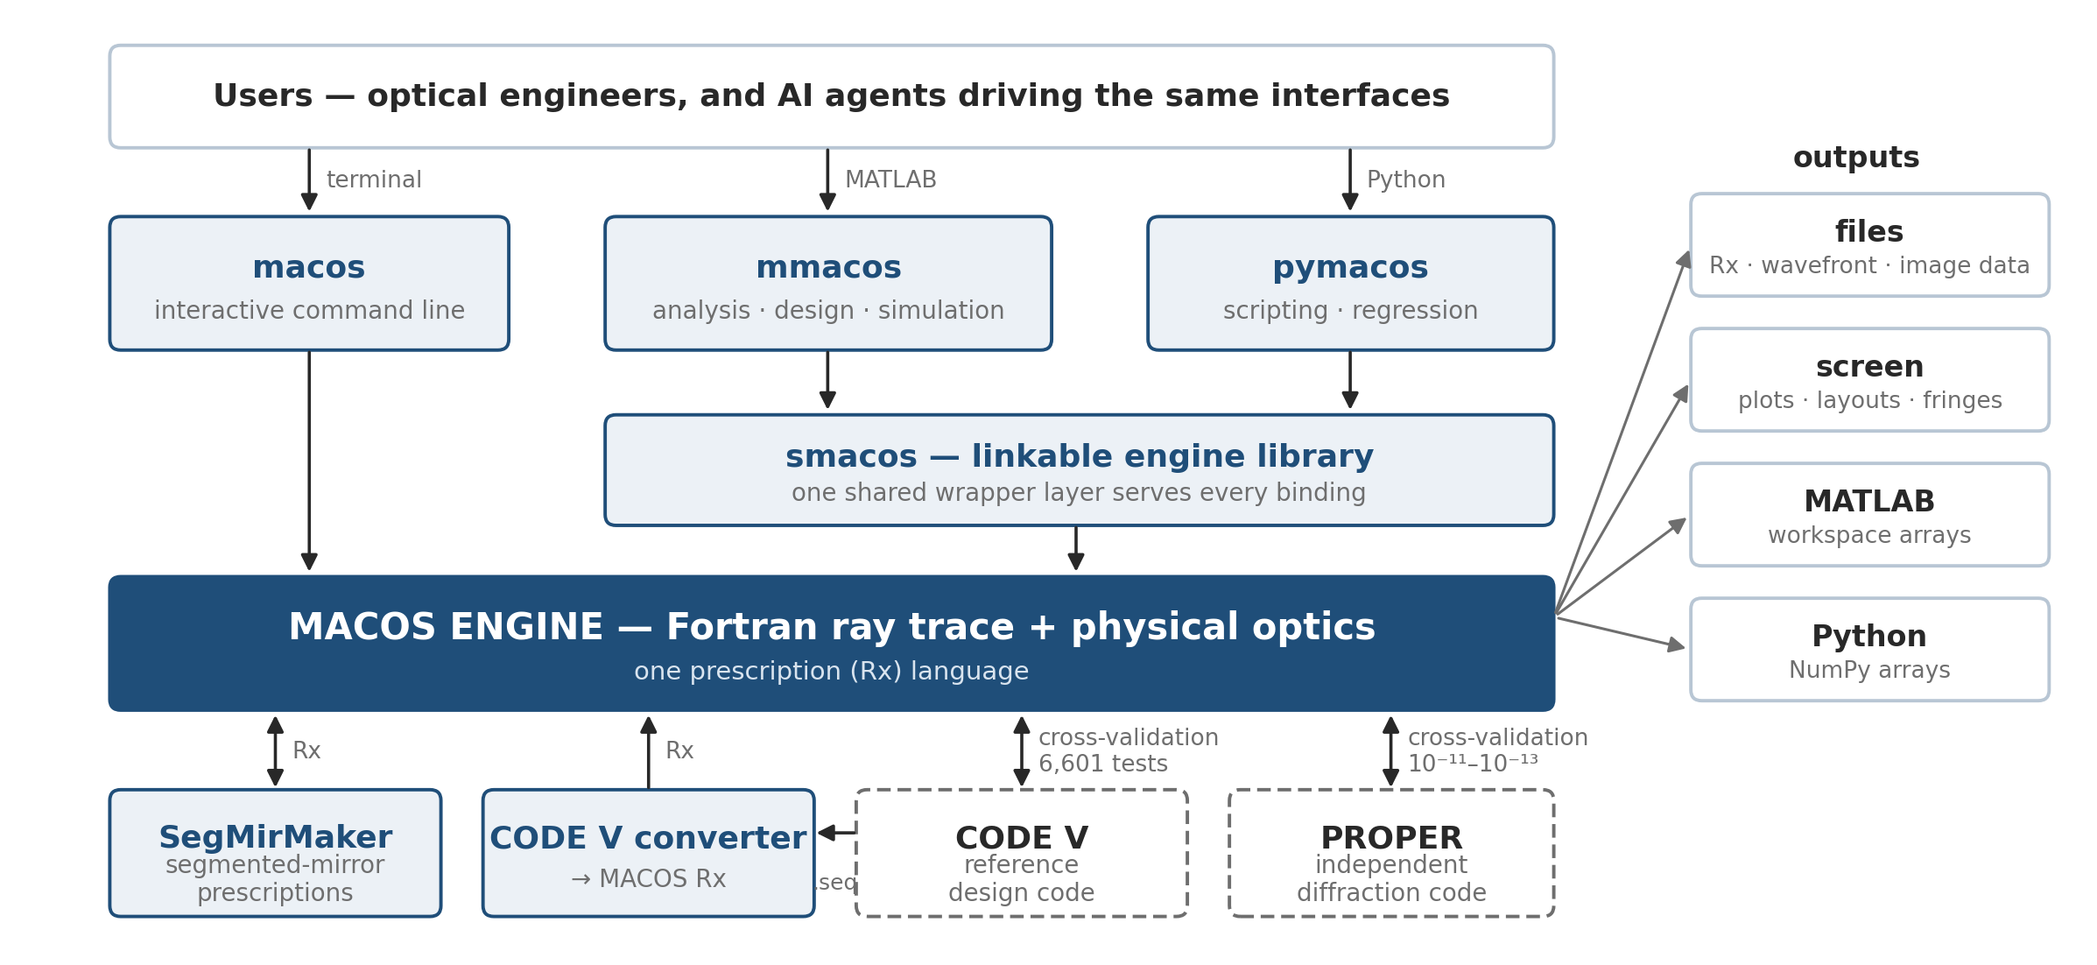
One engine, four surfaces
The same Fortran core answers a terminal, a library call, MATLAB, and Python
• Physics lives in the engine: a capability added there is everywhere at once
• One shared library layer serves the MATLAB and Python toolboxes.
• The prescription generators and the CODE V converter feed the same Rx language.
• CODE V and PROPER provide independent cross-checks.
• One source tree: github nasa-jpl/macos and /MACOS_resources contain it all.

Slide 4
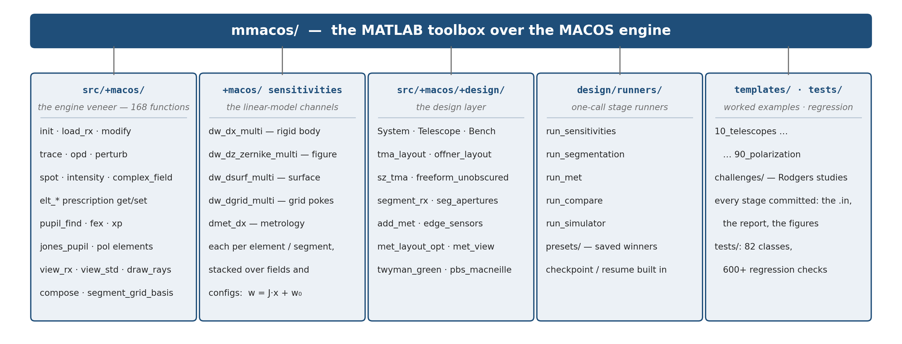
Inside the toolbox
Five areas, organized the way the work flows — veneer, sensitivities, design, runners, worked examples
Counts as of 2026-08. Every area is exercised by the committed test suites and by the worked examples beside it — the same templates this talk's studies live in. Rebuild the figure: make_mmacos_fig.py.

Slide 5
Three design challenges, one method
CODE V benchmark studies reproduced first, then extended
 | challenge 1 (July) | challenge 2 (August) | challenge 3 (August)
the task, as posed | a three-mirror telescope, f/20, 5 m aperture: a 0.2°×0.2° field box offset 0.5° off axis | a three-mirror afocal telescope, 30×, 1 m aperture: a 0.5°×0.5° field offset 0.6°, a tilted cold stop the interface to the instrument | a three-mirror imager, f/4, 75 mm aperture: a 20°×20° field box centered 22° off axis, exit beam horizontal, hard beam–mirror clearances
the ladder, in steps | on-axis → offset, frozen → re-solved → tilt/decenter | on-axis → offset, frozen → re-solved → tilt/decenter | on-axis → offset, frozen → re-solved → + clearance constraints → + Zernike freedom
reported ladder (max RMS WFE) | 2 → 375 → 92 → 40 nm | 15 → 430 → 160 → 119 nm | 159 → 8810 → 168 → 117 → 53 nm
reproduction | 0.83–1.11× | 0.95–1.02× | 0.99–1.10× (all five steps)
• Objective: meet the challenge, and use the solution to establish a design family.
– Build a solution code for each particular problem, using AI assistance.
– Build another code to rapidly generate adjacent solutions, without AI assistance.
• MACOS solves each problem with its own optimizer and the same degrees of freedom.
• MACOS separately re-traces the delivered prescriptions to compare design against design under one decoded metric.
• Challenges and solution prompts provided by Mike Rodgers (thanks Mike!).

Slide 6
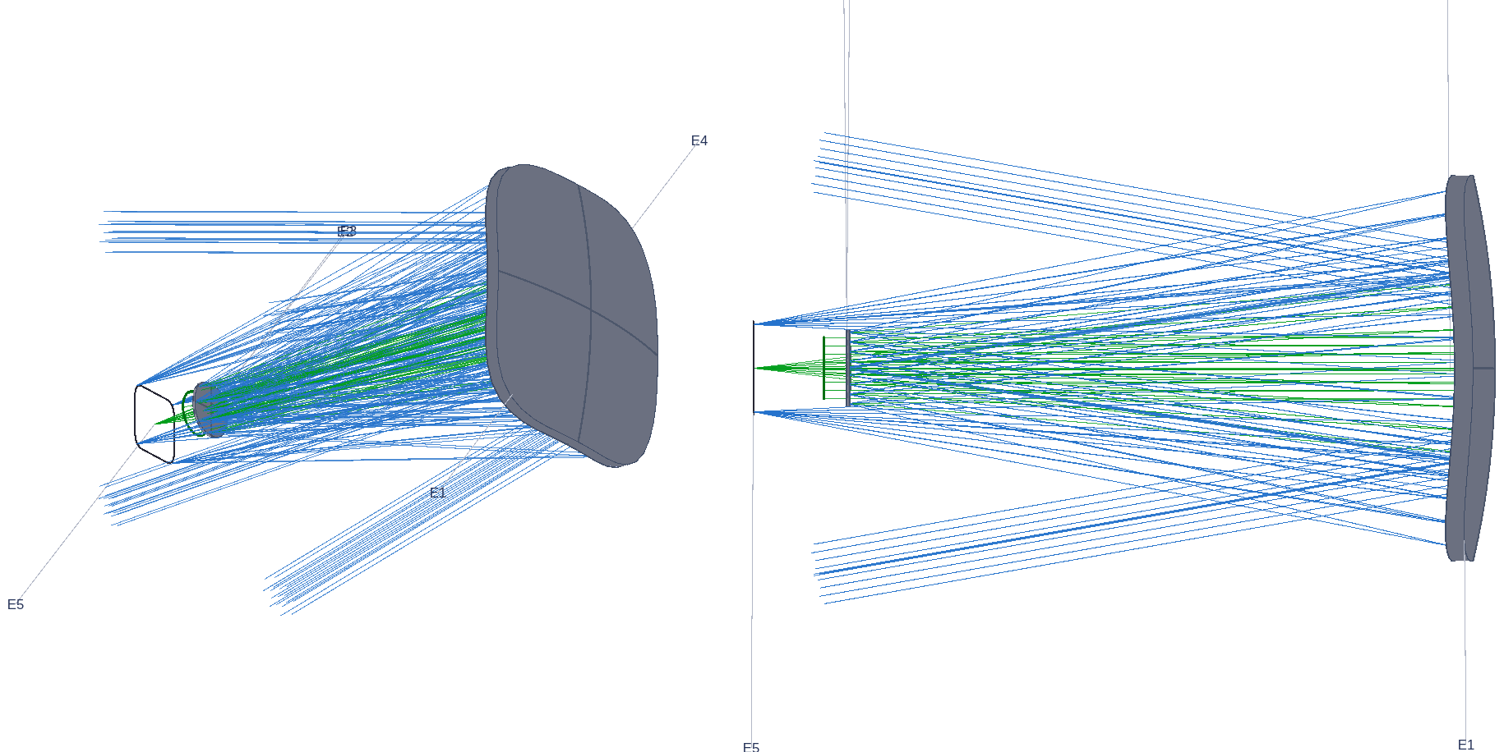
Challenge 3: moving a 20°×20° field 22° off axis
All five reported steps reproduce from the lens sequences before any extension is claimed
• The hardest of the three: a wide field box far off axis, an exit-beam pointing constraint, and hard clearance requirements between beam and mirrors.
• Reproduction first: all five reported design steps rebuild from the delivered lens sequences inside 0.8–1.25× — nothing tuned toward the reported numbers.
• The study became a template: one parameterized five-stage flow (solve on axis, map the offset, re-solve at the used field, add buildability constraints, add surface freedom) — re-running the whole study at new parameters is one call.
The offset imager as traced in MACOS at the stage-1 configuration (iso + side views).
Record: challenges/rodgers3 — packet, per-step prescriptions, regression checks with negative controls.

Slide 7
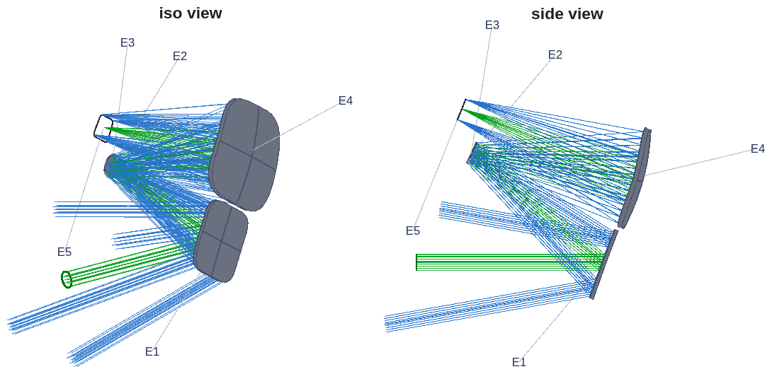
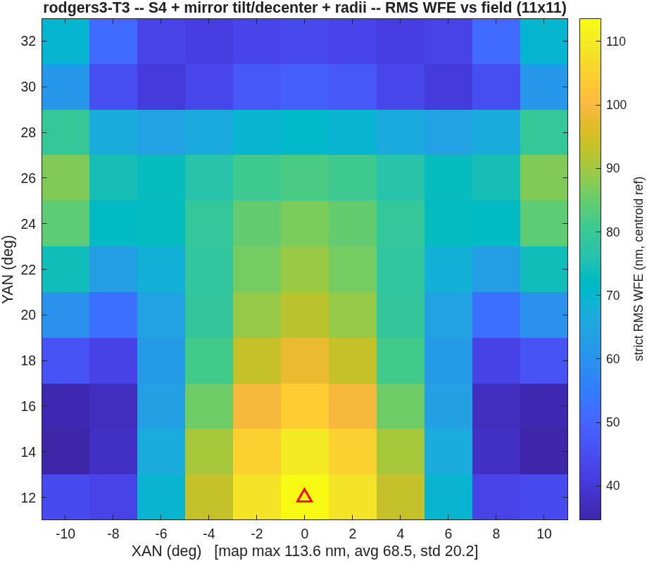
Challenge 3: the numbers
Paying the same constraints lands the same design space — then a diagnosis beats the reported result
• The buildability step: enforcing the reported ≥35 mm clearance lands 113.6 nm at a 34.1 mm floor, against the reported 117 nm — 0.97×, same design space. The final step, diagnosed then beaten: the gap to the reported 53 nm was the solve-field count, not physics; matching it lands 45.4 nm — 0.86× — at a floor 1.6 mm shy of the stated 35 mm.
• An unconstrained solve reads 58.3 nm — with the beam passing through the secondary. The layout figure caught it; clearance constraints are part of the problem statement.
The buildability-constrained design: a 34.1 mm clearance floor, traced (iso + side views).
Its field map: 113.6 nm max over the 20° box.
Metric, stated once for this study: strict RMS WFE, reference sphere on the spot centroid on the frozen focal plane, anchored at the exit pupil, piston-only removal; headline = maximum of a dense 11×11 field map.

Slide 8
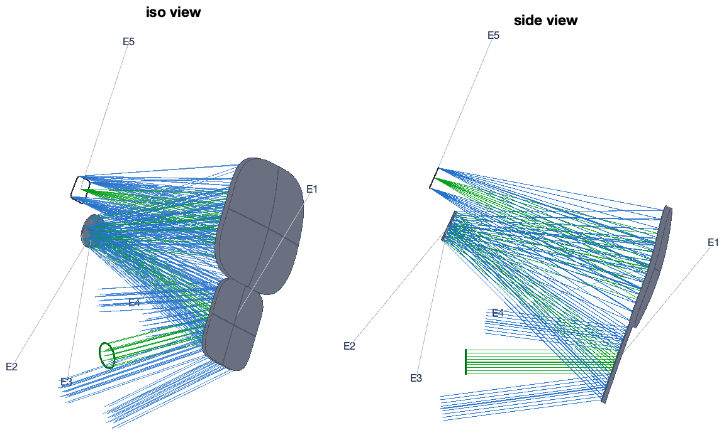
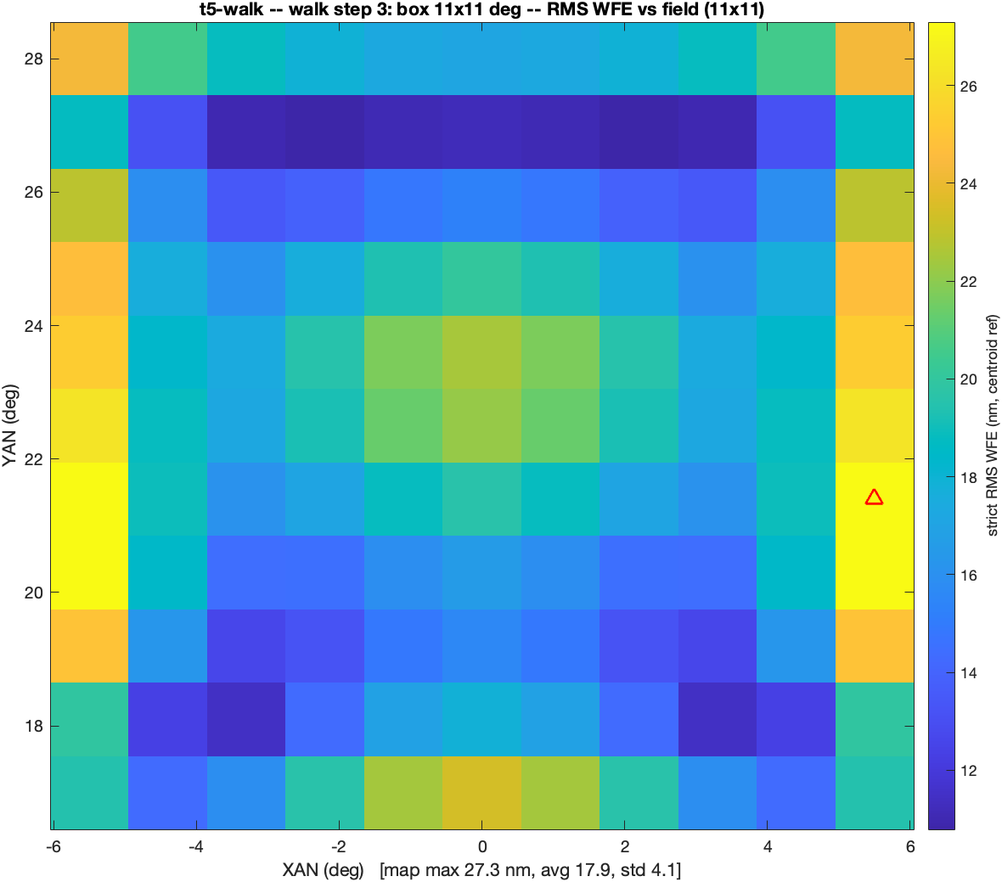
From one design to a design family
Warm-started continuation solves what a cold start cannot
• The cold start fails (596 µm, most field points lose every ray); the walk succeeds: solve an easy 5° box, widen in steps, each warm-started from the last — 10.9 → 21.5 → 27.3 → 40.0 → 69.8 nm at 5/8/11/13/15°, 8531× better than the cold start.
• The step table is the instrument's field-vs-packaging frontier: every row a finished, checked design; the largest spec-compliant box is 11°×11° at 27.3 nm with a 25.1 mm clearance floor.
The 15° endpoint of the continuation walk, traced with clearances (iso + side views).
The 11° step's field map: 27.3 nm max — the largest spec-compliant row.
This frontier is the basis of the live demonstration — next slide.

Slide 9
The live demonstration: an adjacent instrument, designed during this talk
Kicked off now, in MATLAB; predicted first, revealed before the closing discussion
• The ask: name a field-box full width, anywhere in 5–15°, for the same instrument class — 150 mm f/3.3 at the +22.5° offset, same envelope, same clearance rules.
• What happens: the frontier states the prediction first; one MATLAB call launches a full-freedom solve, warm-started from the nearest committed design below the ask, and it runs while the talk continues (~15 min).
• No AI in this loop: the design knowledge is compiled into the driver — this is the "adjacent solutions, without AI assistance" half of the objective, running live.
• What the reveal shows: the field map, the clearance floor and the exit-direction check, beside the stated prediction. Every ask is a genuine continuation step, never a re-score of a stored design; a repeat run reproduces every printed digit.
>> oi_demo_step(12) % the room's width goes here
warm start : committed walk step 3 (11 x 11 deg)
solve : S5 full freedom (conics+Zernike
+tilt/dec+radii+stop_y)
... ~15 min ...
DENSE MAP MAX : 33.6 nm predicted ~33.7 (1.00x)
clearance floor: 24.9 mm exit err 0.012 deg
gates : exit PASS / clear PASS
The rehearsal run's verdict (12° ask), abbreviated verbatim; the live run prints the same block for the room's width.

Slide 10
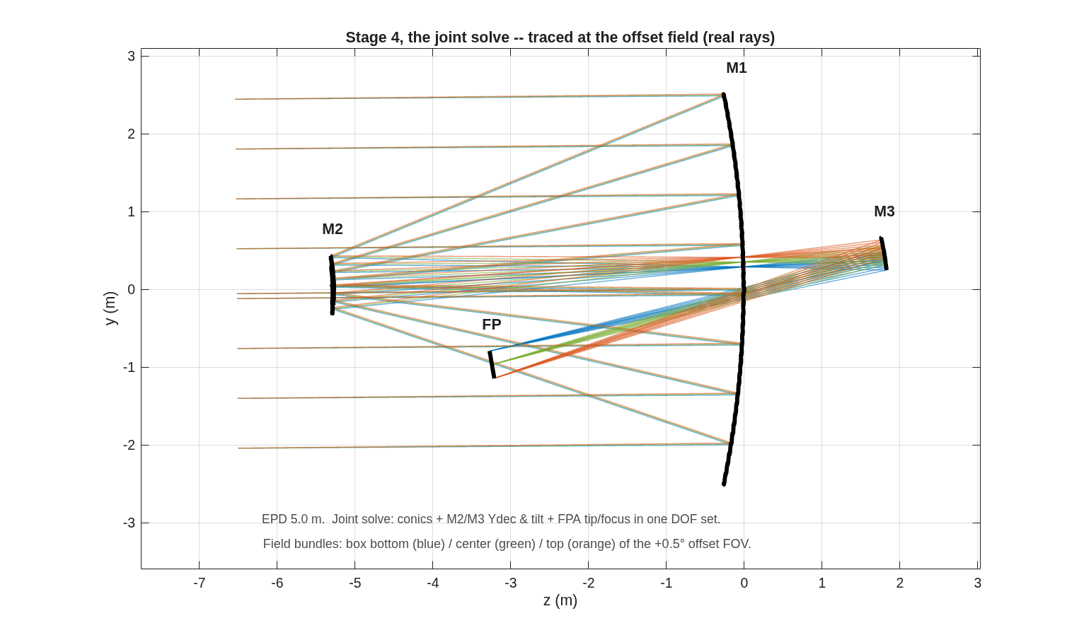
Challenge 1: MACOS matches or beats the re-traced CODE V designs
Re-traced designs land 0.991–1.003× of reported; the MACOS solves score 0.97× design vs design
design | centroid | (chief) | bestfoc + LS tilt | CODE V reported
S2 verbatim | 482.8 / 272.0 | (672.9 / 390.9) | 371.4 / 201.4 | 374.6 / 200.0
S3 MACOS solve | 116.8 / 68.1 | (173.4 / 95.1) | 86.8 / 50.5 | 91.6 / 46.4
S3 CODE V re-traced | 121.0 / 67.9 | (176.7 / 94.7) | 91.9 / 50.2 | 91.6 / 46.4
S4 MACOS solve | 65.6 / 36.4 | (115.9 / 56.9) | 41.2 / 21.9 | 39.8 / 22.5
S4 CODE V re-traced | 67.6 / 36.7 | (100.5 / 54.4) | 39.8 / 22.1 | 39.8 / 22.5
• The metric decoded: the reported map subtracts per-field best focus + least-squares tip/tilt; re-scoring the same traces under that convention (third column) lands the re-traced designs at 0.991× / 1.003× / 1.000× of the reported max.
• Design vs design, the reproduction closes: the MACOS solves score 0.97× of the re-traced CODE V designs at both stages; under the reported convention the S3 solve (86.8 nm) beats the reported 91.6. Conics agree to 1.5×10⁻⁴, rigid-body DOFs land on the same compensation branch, all signs matching.
• The study returned more than it consumed: two engine defects found and fixed (a silently inert exit-pupil keyword; collimated sources tracing a pupil 5% oversize, hidden for decades), and the joint-solve doctrine — optics + focal-plane pose in one DOF set, never alternating.
The arrived-at configuration: the stage-4 joint solve traced at the offset field.
Box max / avg, nm, at the .seq configuration; centroid reference primary, chief in parentheses. Full record: design/rodgers1 — packet with 10 addenda, every retraction in place.

Slide 11
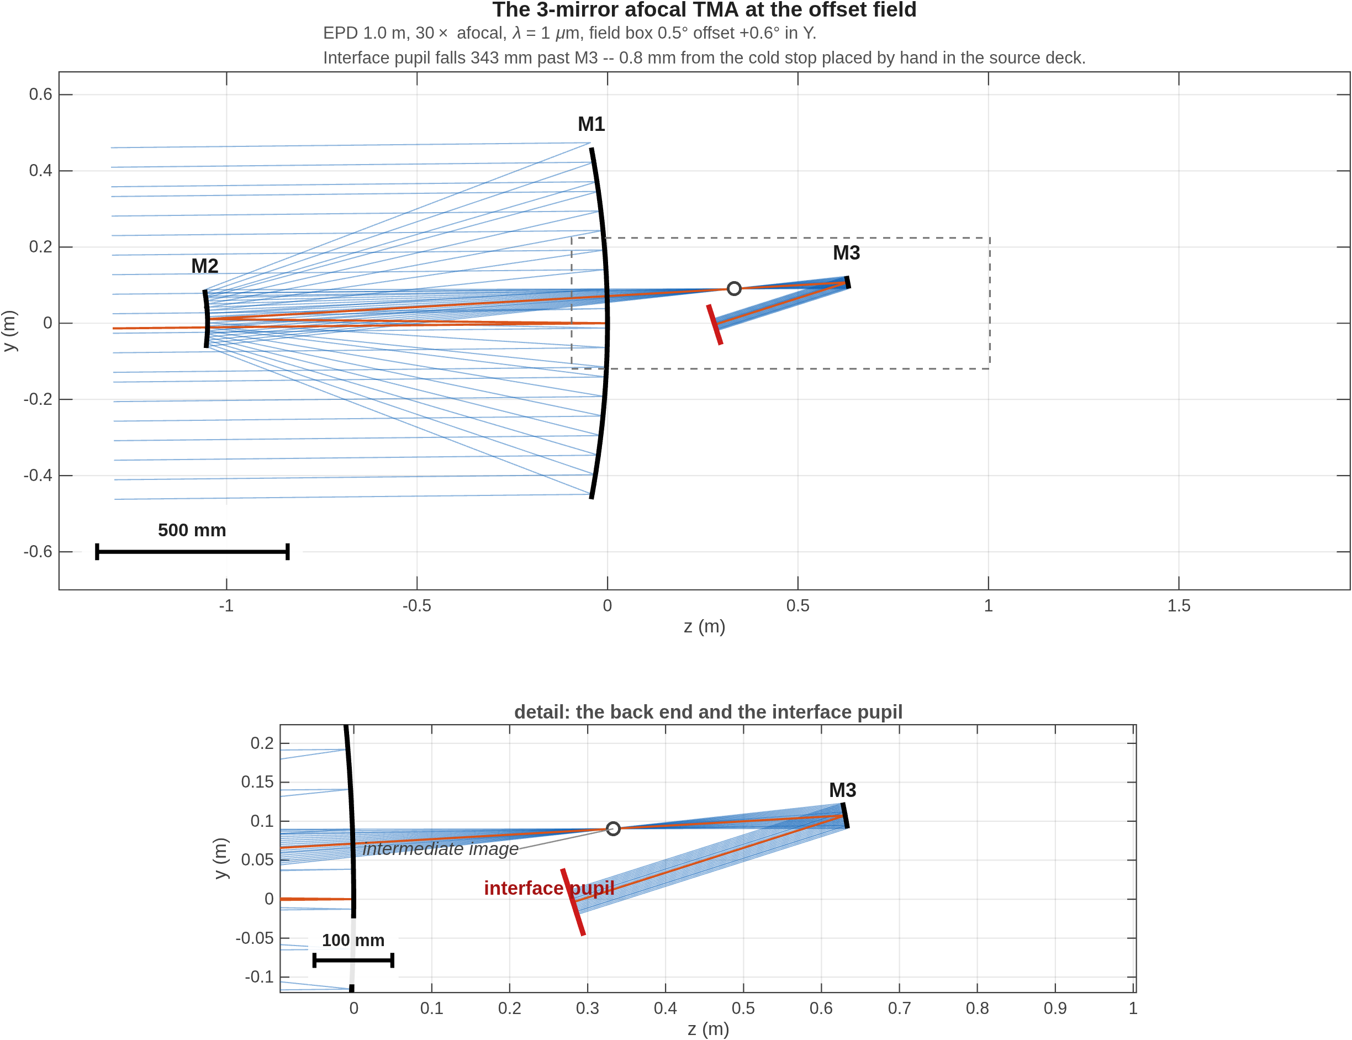
Challenge 2: the 30× afocal telescope, reproduced
Parameters matched to the micron; all four design variants at 0.95–1.02×
• Parameters matched: the lens sequences transcribe verbatim with a full audit; the coordinate break lands the cold stop on the traced beam to 2×10⁻⁷ mm (the wrong sign convention misses by 211–247 mm on a 33 mm beam); the computed exit pupil falls 0.8 mm from the stop placed by hand in the source deck.
• Performance matched: all four design variants reproduce the reported wavefront numbers at the decoded reference; the reported 28.7× magnification of the frozen-offset variant measures 28.686×.
variant | CODE V | MACOS / CODE V
on-axis | ≤ 15 nm | 0.99×
offset, frozen design | ≤ 430 nm | 1.01×
offset, re-solved | ≤ 160 nm | 0.95×
offset, tilt/dec | ≤ 119 nm | 1.02×
The transcribed system traced in MACOS: light enters left, M1 → M2 → M3; the computed exit pupil falls 0.8 mm from the delivered cold stop (detail panel).
The source deck reports wavefront error only; its pupil statement — "with 3 mirrors, the pupil quality is not very good" — has no metric. MACOS defines and measures one: next slide. Full record: design/rodgers2.

Slide 12
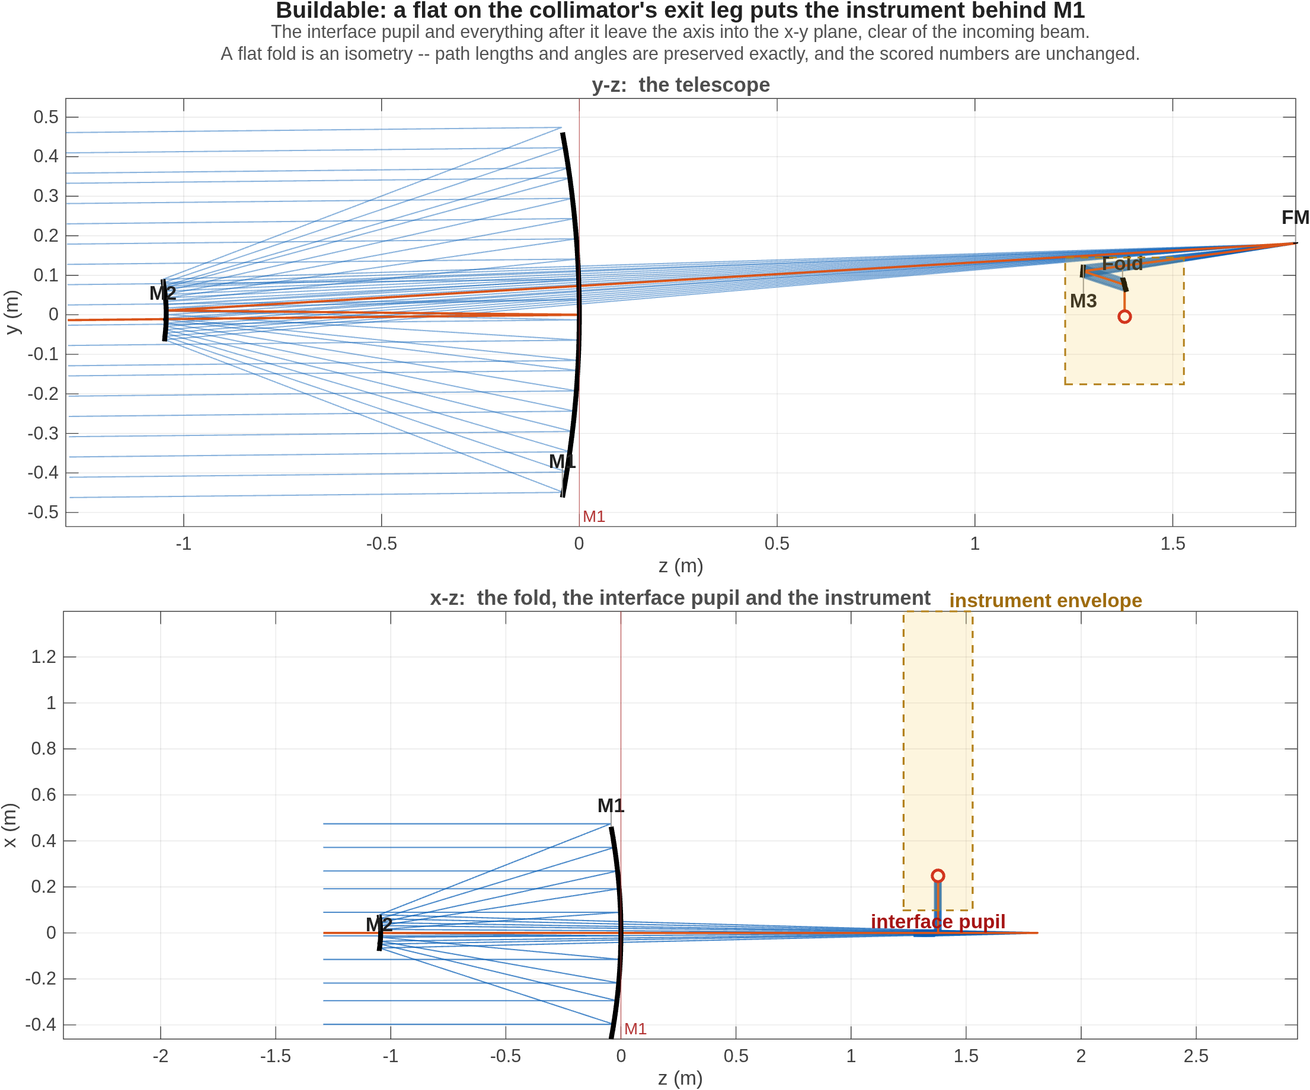
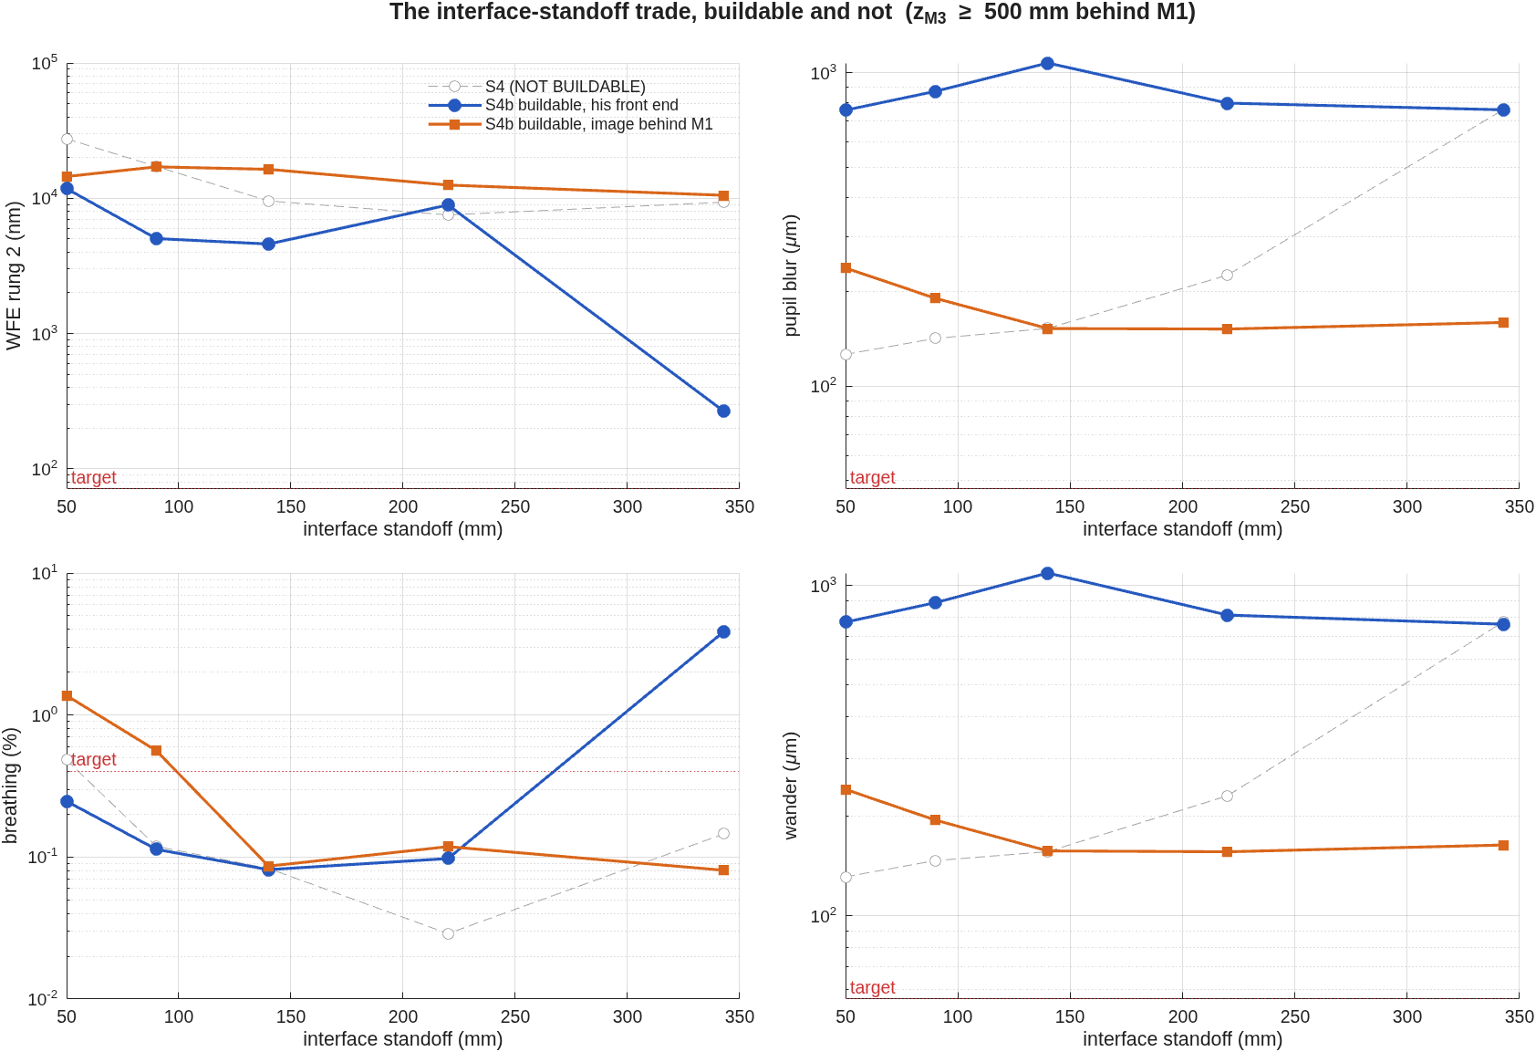
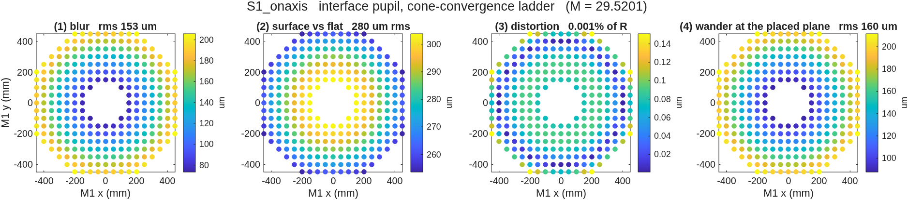
Challenge 2, extended: the pupil measured — and what a fourth mirror buys
Pupil blur 469 → 157 µm; the exchange costs image quality a factor 39
metric | 3 mirrors | + 4th mirror
pupil blur | 469 µm | 157 µm
footprint wander on the cold stop | 557 µm | 161 µm
magnification variation | ±3.6% | 0.12%
wavefront error — the price paid | 119 nm | 10.4 µm
• The two qualities pull opposite ways: the fourth mirror's power serves the pupil and costs the image — a factor-39 exchange. Declining the power (a flat fourth mirror) keeps 266 nm and the three-mirror pupil.
• The trade, packaged: with the last mirror held behind the primary, the solutions split into two families; pupil distances under 220 mm leave no room for an instrument after the fold — 343 mm admits a 464 mm diameter.
The constrained design, folded: the instrument volume behind the primary.
Both solution families beside the retracted unconstrained curve; the instrument-diameter column selects the 343 mm point.
A point of M1 imaged at the pupil: the convergence clouds behind the pupil-blur metric, traced across the field.
"3 mirrors" = the best delivered variant. Yardsticks: pupil imaging resolves 2.7 µm across the 33 mm pupil, depth of focus ~30 µm — the measured defects sit 50–350× above these floors. Per-point trade table: the design/rodgers2 record.

Slide 13
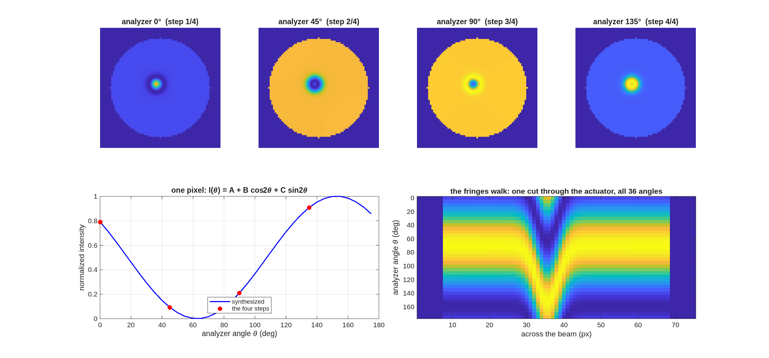
A Twyman–Green interferometer for measuring DM surfaces
Phase-shifting with no moving parts: the analyzer angle is the phase step
• Why a Twyman–Green for a DM: normal incidence (double pass, 2× sensitivity), a natural null against the flat reference, the fewest reference surfaces of any two-beam layout. A Mach–Zehnder buys arm isolation, two ports and transmission testing — dynamics, not figure.
• The polarization trick: the two arms carry orthogonal polarizations, so they cannot interfere until projected; an output quarter-wave plate makes them opposite circular, and an analyzer at angle θ then writes fringe phase 2θ.
• Four analyzer angles — 0 / 45 / 90 / 135° — are the four phase steps of standard PSI, with nothing in the interferometer moving: the vibration immunity of polarization phase shifting.
• The factor of two: DM surface height h enters the optical path as 2h at normal incidence; the recovery closes against the injected map with exactly that factor.
The analyzer sweep on the poked DM: phase-stepped fringe frames — the phase walks, the rig stands still.
Topology ruling and full physics: the template README, templates/90_polarization/tg_psi_dm.

Slide 14
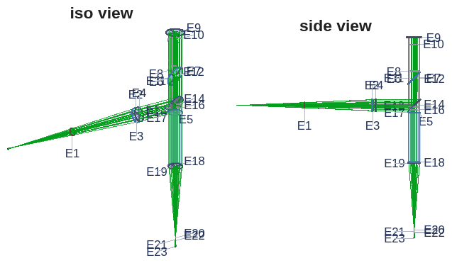
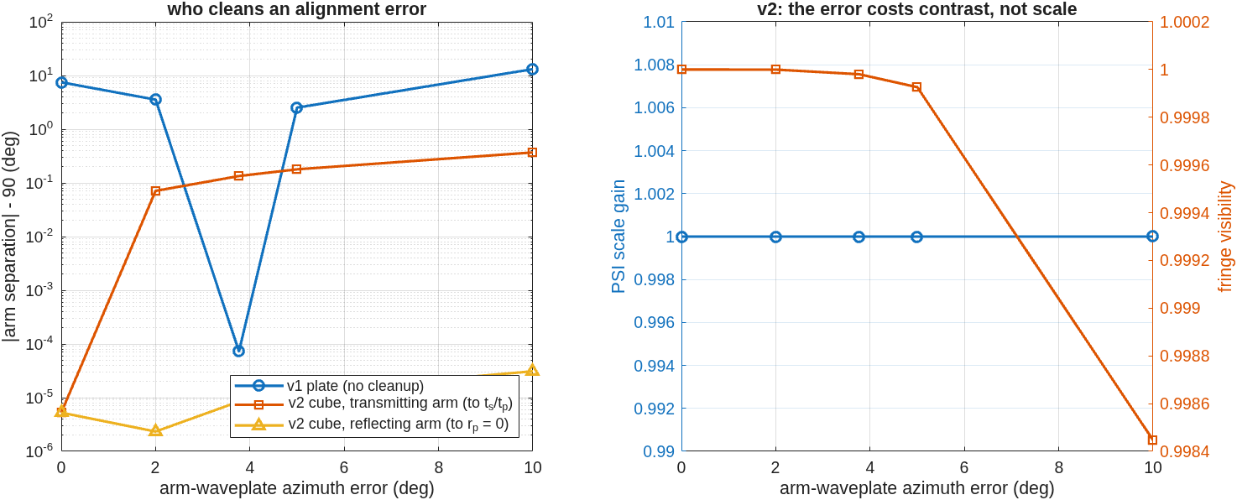
The interferometer, built and calibrated in the model
The plate rig's 11.7% error, caught and fixed — then designed out by a real MacNeille cube
• The rig: a polarizing Twyman–Green with a 16×16-actuator deformable mirror as the test optic — polarizers, waveplates, splitter and coatings are engine surfaces, not a Jones model appended after the trace. Two builds: the v1 plate rig, and a v2 with a real cemented MacNeille cube — one coated 45° interface (engine vs textbook thin-film at 10⁻¹⁰; R+T = 1.000000000000 measured).
• v1's catch: splitter diattenuation rotates the test arm 7.5° from orthogonal — the gauge reads 11.7% high while fringe contrast moves 0.17% (a 69× blind spot); fixed by re-clocking one waveplate 3.77°, solved in 5 traces.
• v2 designs the error out: each arm rides a coating eigenaxis, where a diattenuator cannot rotate it — and the error budget inverts: a waveplate error now costs visible contrast instead of invisible scale.
The rig as built (iso + side): source in from the left, the polarizing splitter at the cross, reference and test arms, shared detector leg.
 | plate (v1) | MacNeille cube (v2)
arm rotation from orthogonal | 7.479° | 5×10⁻⁶ °
PSI scale gain | 1.117 | 0.999999
alignment solve | +3.768° | none needed
delivered power | 0.169 | 0.384 (2.27×)
DM closure residual | 0.304 nm | 0.183 nm
Who cleans an alignment error: the plate's arm rotation walks with waveplate error; the cube's arms stay put — the error emerges as contrast, not scale.
Records: templates/90_polarization/tg_psi_dm (v1, the rehearsed demo default) + tg_psi_dm_v2; 18 regression checks across the pair. A PBS converts an invisible systematic into a visible one — a better reason to buy one than throughput.

Slide 15
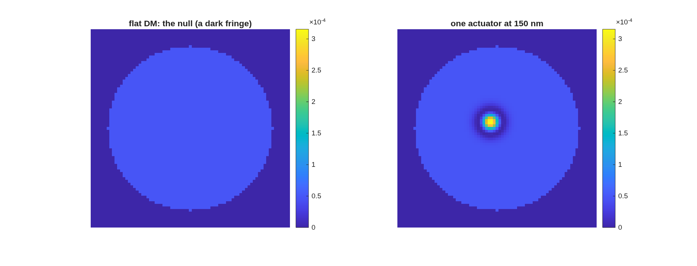
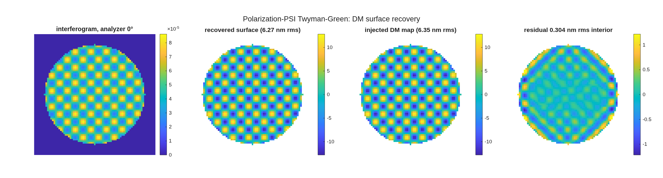
Live: measuring the deformable mirror
Seven steps, each seconds-fast — 0.30 nm rms residual on 6.35 nm of figure
• The seven steps, from the MATLAB command line: build the bench in one visible call → layout view → align (solve the waveplate re-clock, 7 traces) → null fringes (the analyzer basis, 6 traces) → poke one actuator live (3 traces) → sweep the analyzer, 36 frames with zero traces → full DM map, four-step PSI, closure.
• What to watch: the fringes bend exactly over the poked actuator; the sweep walks the fringes with the rig standing still; the recovered map lands beside the injected truth at 0.304 nm rms interior residual.
• Nothing takes long enough to lose a room: the longest step is ~5 s; the 36-frame sweep costs 0.036 s.
One actuator poked: the fringes bend over it.
The recovery beside the injected truth map.
Timings measured, in the template README; every step has a pre-rendered backup image — a live hang costs ten seconds, not the demonstration. Either rig runs the same seven steps (whole-demo v1 49.8 s, v2 47.0 s) — the rig choice is the presenter's.

Slide 16
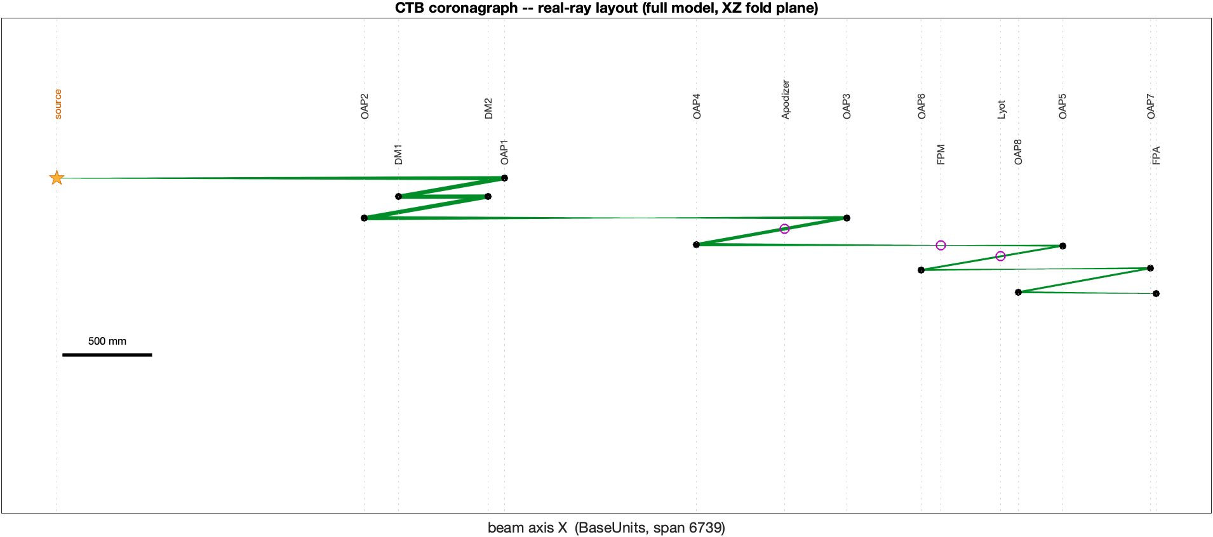
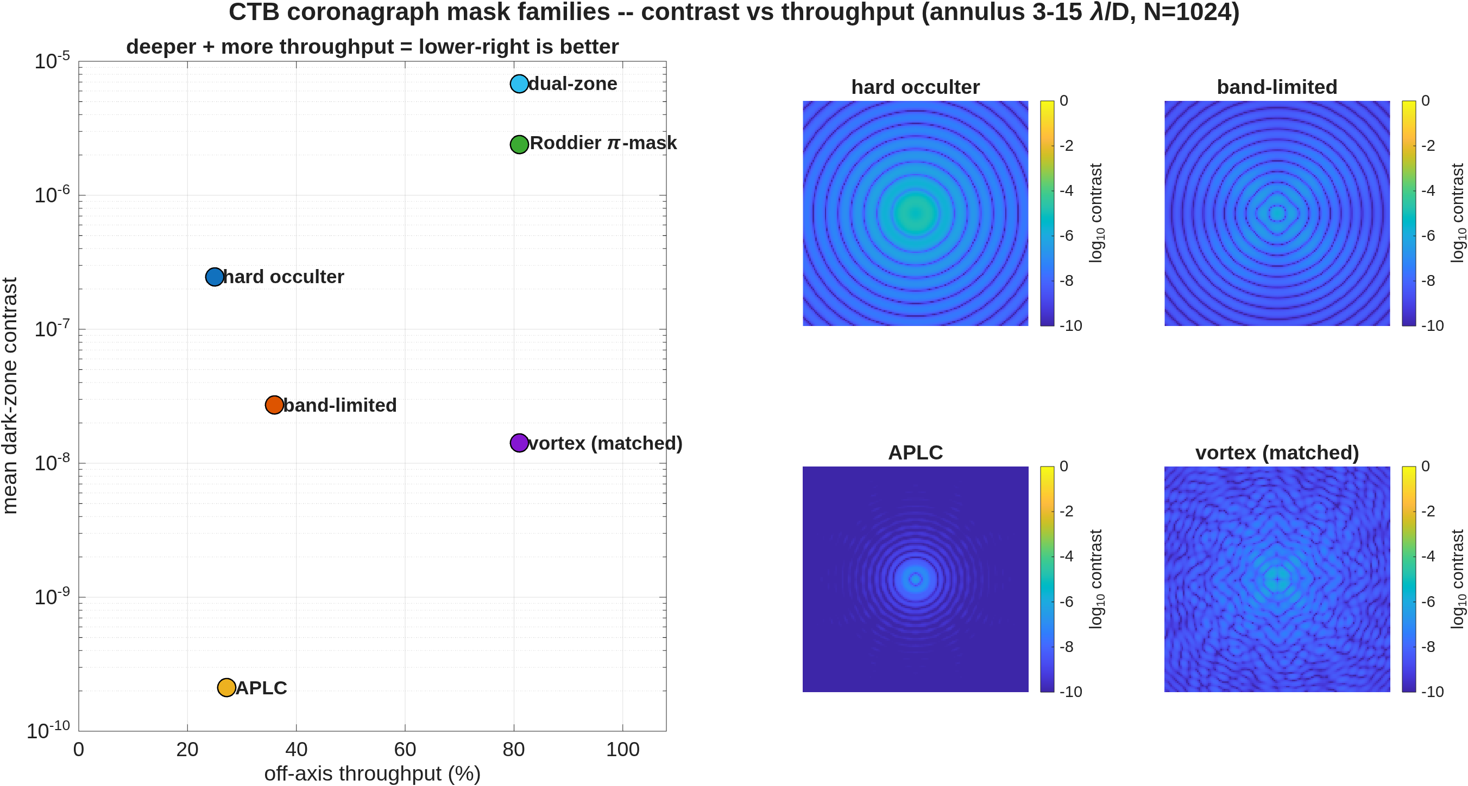
A coronagraph testbed, end to end
Six mask families from the literature, scored on one footing — validated against PROPER station by station
• The full testbed model — off-axis parabolas, focal-plane masks, Lyot stop, two 32×32-actuator deformable mirrors — every mask generated at 8× sub-pixel resolution and binned to the model grid.
• Validated externally: a pure-PROPER run reads only the exported planes — no macos anywhere — and reproduces the bare image at correlation 1.000000, forming the same dark zone.
The bench: the real-ray layout of the full model — source, DMs, OAP relays, apodizer, focal-plane mask, Lyot stop, camera.
mask (static, no control) | dark-zone mean | throughput
apodized-pupil Lyot (prolate) | 2.1×10⁻¹⁰ | 27%
vortex, matched Lyot | 1.4×10⁻⁸ | 81%
band-limited (4th order) | 2.7×10⁻⁸ | 36%
hard occulter | 2.5×10⁻⁷ | 25%
Roddier π-mask | 2.4×10⁻⁶ | 81%
Contrast against throughput for the mask families, static — lower-right is better: the apodized-pupil Lyot deepest, the pixel-averaged vortex second at three times its throughput.
Dark zone 3–15 λ/D, one grid, one normalization throughout; every mask formula taken from its source paper. Record: templates/30_instruments/bench_ctb.

Slide 17
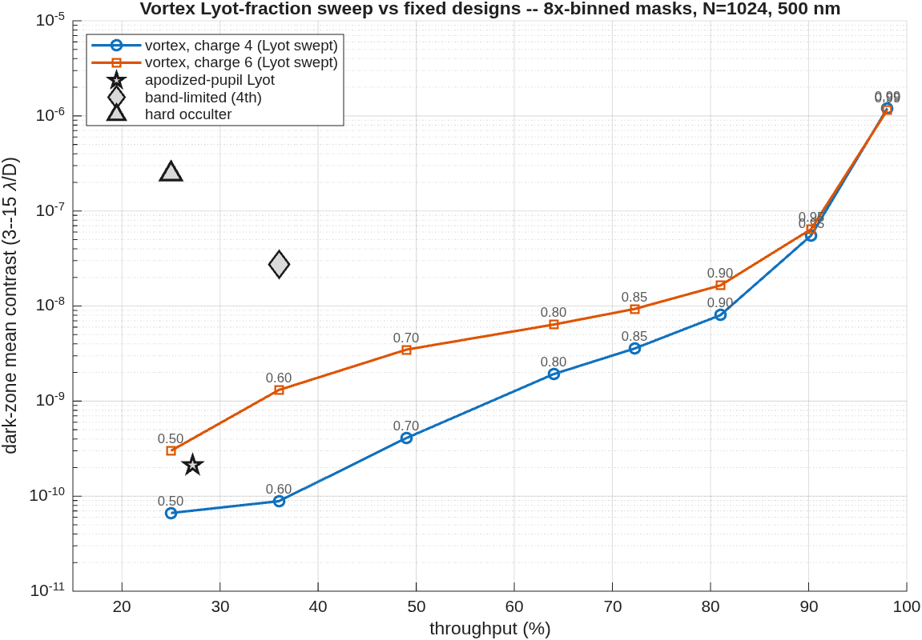
The vortex against the Lyot stop
Charge 4 under-runs every fixed design at every throughput: 8.8×10⁻¹¹ at the band-limited mask's own 36%
• One mask, one dial: the vortex phase is fixed; only the Lyot stop fraction moves — a genuine depth-for-throughput dial, where each fixed design is a single point.
• Readings from the curve: at the apodized-pupil Lyot's operating point, charge 4 is deeper (8.8×10⁻¹¹ vs 2.1×10⁻¹⁰) at more throughput (36% vs 27%) — with no apodizer to fabricate. At 81% throughput it still holds 8.0×10⁻⁹.
• Charge 4 runs ~4× deeper than charge 6 at every stop; the useful dial range is 0.50–0.90 — past 0.90 the rejected-starlight ring arrives inside the stop.
Dark-zone mean contrast against throughput: the swept charge-4 vortex (labels = Lyot fraction) against the fixed designs, on the same footing.
Same grid, annulus and normalization as the head-to-head; fixed-design markers read from the committed comparison, not re-scored.

Slide 18
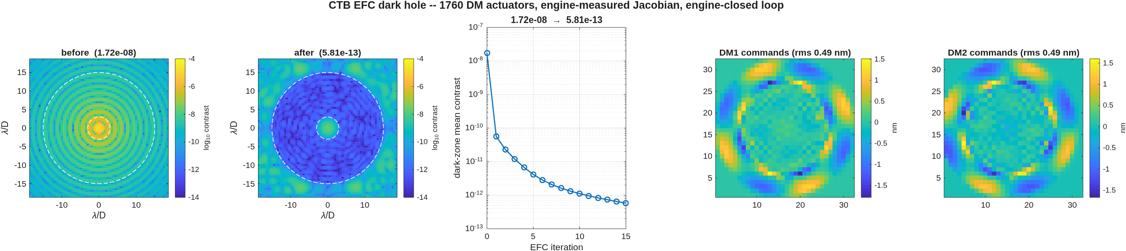
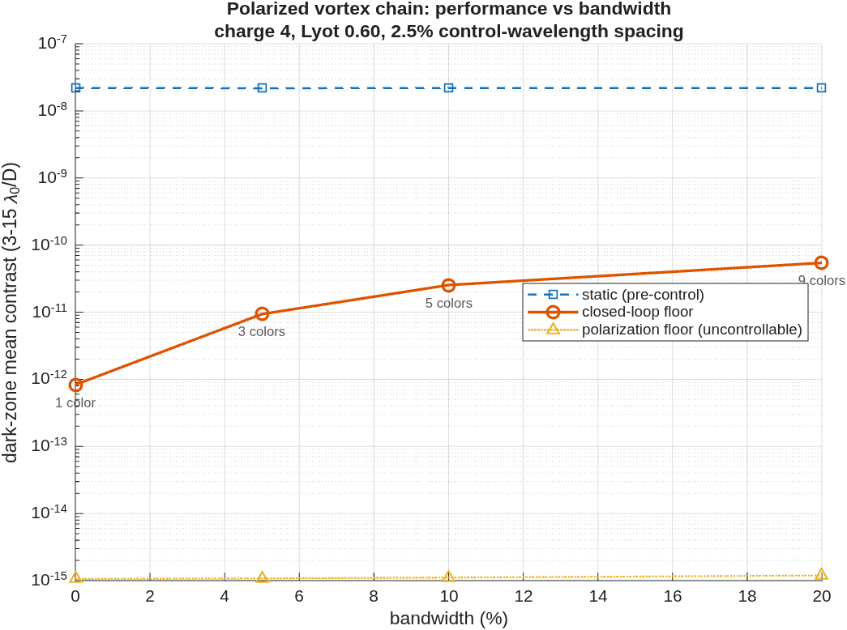
The mirrors close the loop
On the vortex chain: 1.7×10⁻⁸ → 6.8×10⁻¹⁵ — nothing left that the mirrors cannot remove
• The control matrix is measured, not modeled: every actuator poked and propagated through the full masked chain, so the correction solve has no model error to exploit; each iteration re-propagates and scores the measured contrast.
• Two chains, two kinds of floor: the hard occulter stops at 3.8×10⁻⁹ — physics, occulter-edge diffraction the mirrors cannot represent; the charge-4 vortex chain reaches 6.8×10⁻¹⁵ at half-nanometer strokes — the model's own double-precision floor.
• The physics layers, measured: the coated train's polarization floor rides flat at 1.1×10⁻¹⁵ at every bandwidth (a state change, not an aberration); the chromatic floor grows gently when control sampling matches the band — 8×10⁻¹³ mono to 5.4×10⁻¹¹ at a 20% band.
• The vector-vortex verdict: the zero-order plate's retardance leak is uncorrectable by any mirror but optically removable — a circular polarizer sandwich returns to the scalar floor under per-λ control; a crossed-linear sandwich goes decades deeper on the star, at the price of eight planet blind spots.
The vortex-chain dark hole: before and after (color floor 10⁻¹⁴), convergence, and the sub-nanometer command maps.
The bandwidth map: static, closed-loop floor, and the flat polarization floor at each band.
6.8×10⁻¹⁵ = dark-zone mean 3–15 λ/D, Strehl-normalized, monochromatic, noiseless sensing — the numerical floor of the noiseless model, not a hardware prediction. Next layer of realism: camera-based sensing (pairwise probing), then FALCO driving the same DMs.

Slide 19
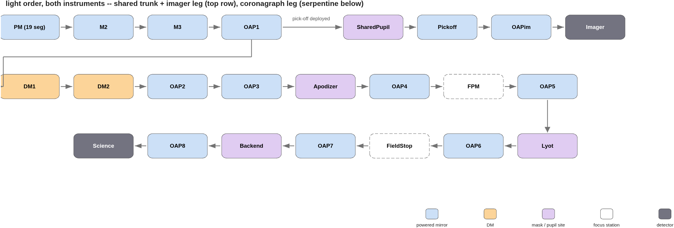
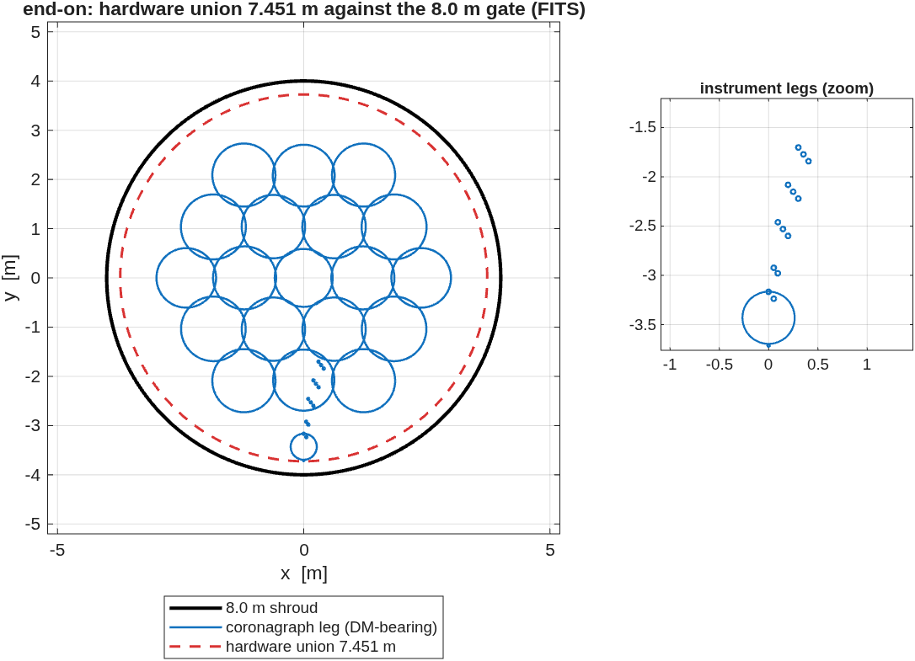
From the testbed to an observatory
The proven coronagraph modeling, carried onto a telescope designed for it
• The testbed is where the models are built and proven; the same modeling then builds the flight-like system: an unobscured 6 m telescope from the design-layer templates — imaging leg and coronagraph leg, with the same DMs, apodizer, focal-plane mask and Lyot machinery — packaged to an 8 m launch shroud, drawn and checked.
The light order, both instruments: the shared trunk, the deployable-pick-off imager leg, and the DM-bearing coronagraph leg.
End-on in the shroud: the hex-19 telescope and instrument legs — hardware union 7.451 m against the 8.0 m gate.
The telescope is one of the design-layer templates, diffraction-limited at 500 nm (imaging-leg Strehl 0.9993). Record: templates/80_end_to_end/e2e6m_r2.

Slide 20
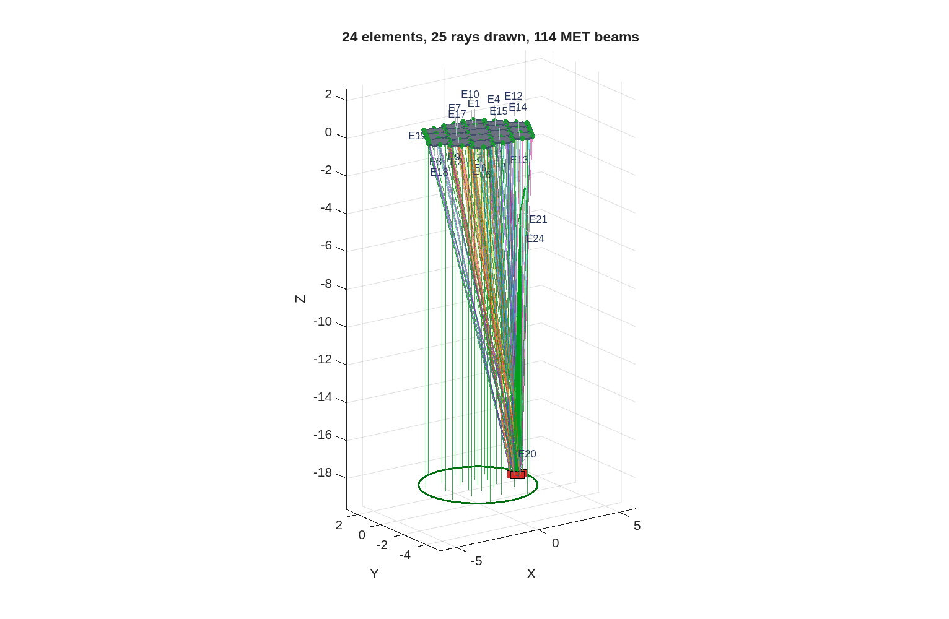
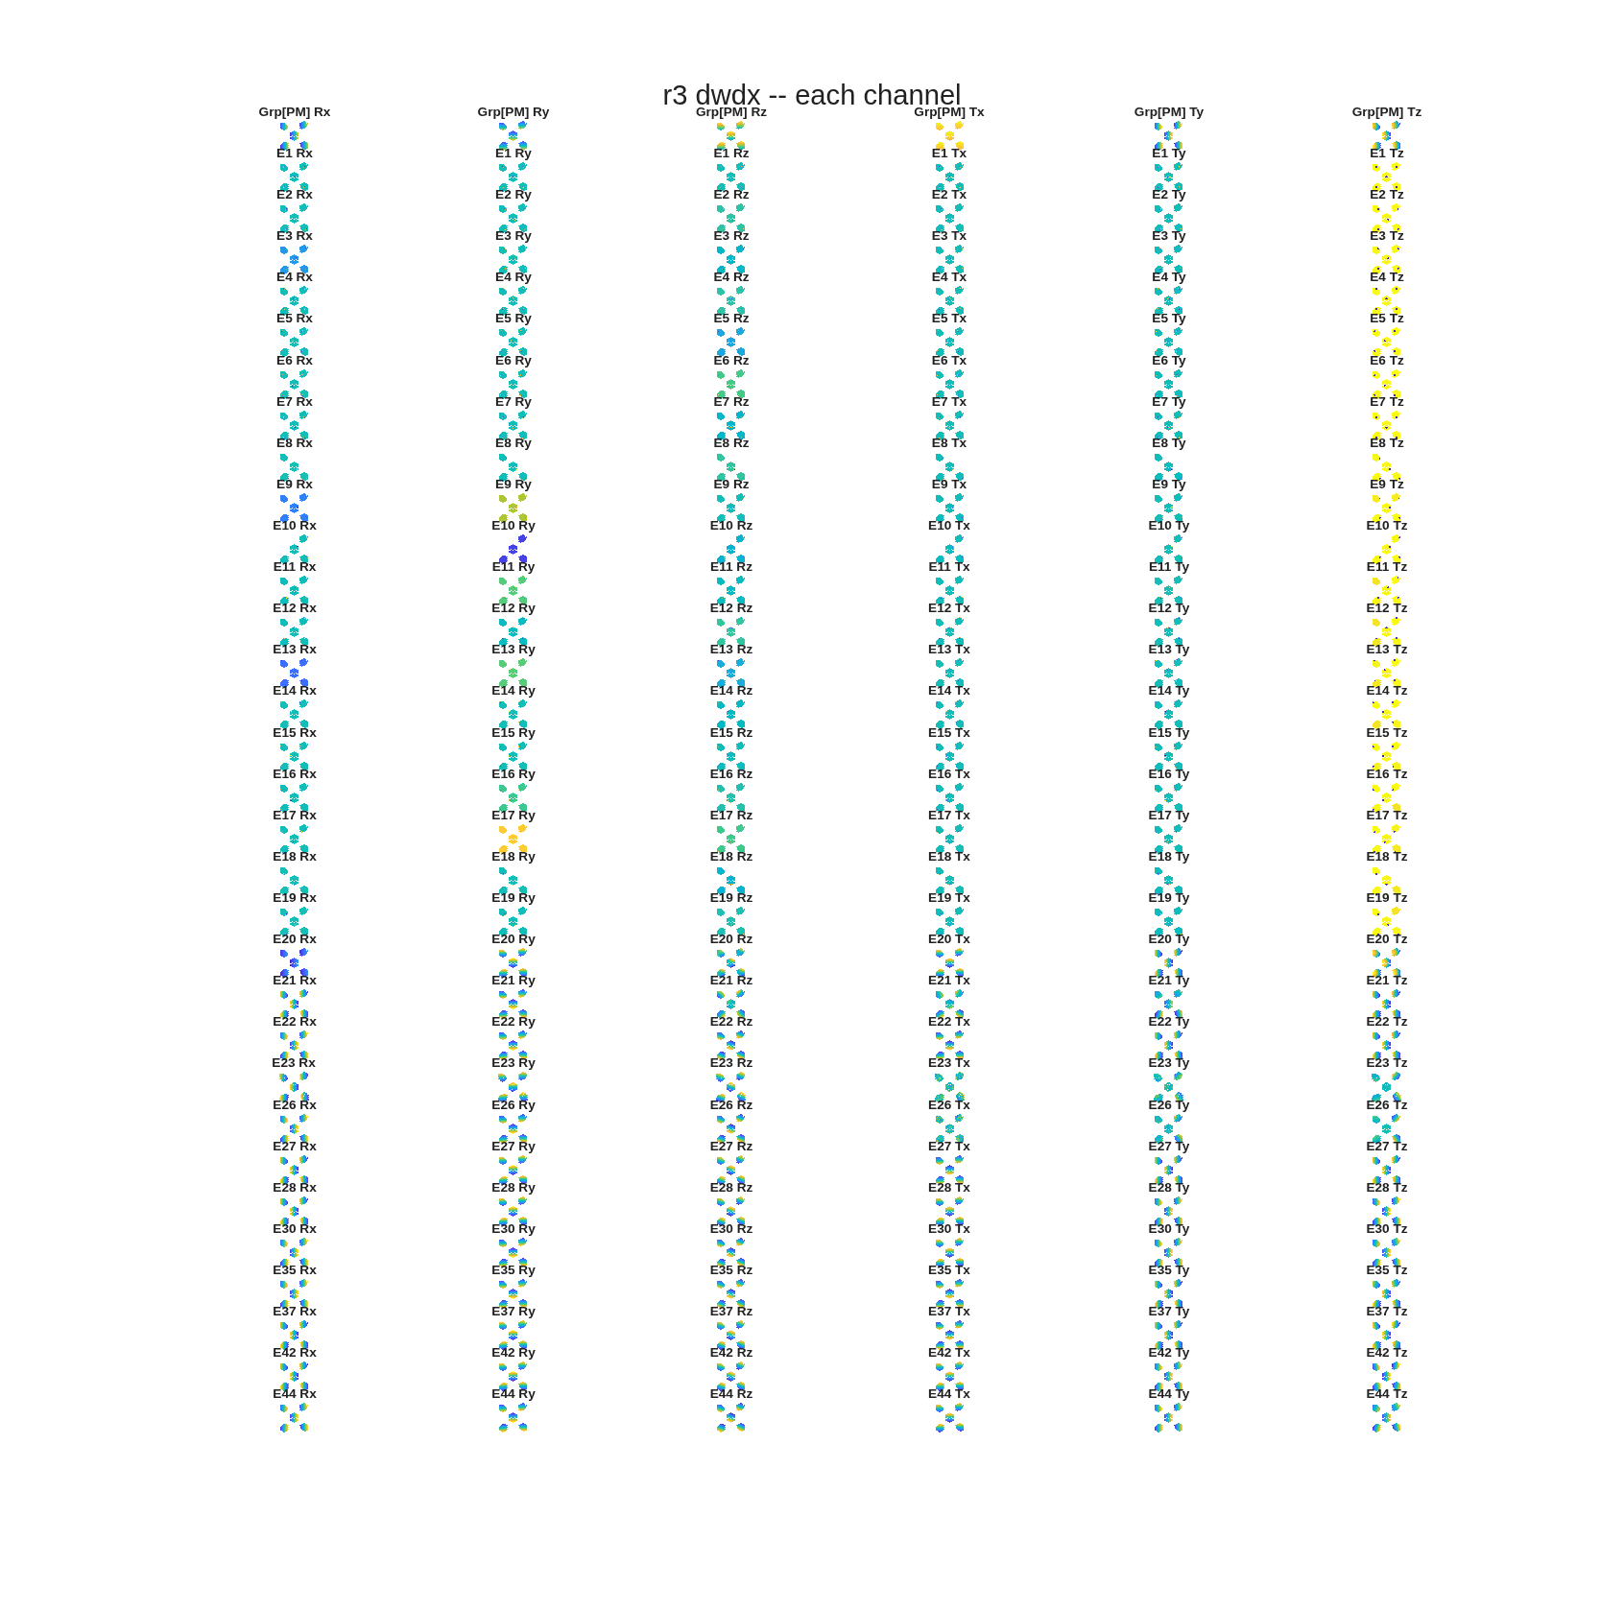
Segmentation, metrology, controls — on the observatory
The same segmentation and metrology machinery the smaller studies proved, at 6 m scale
• The primary segments hex-19 with physical apertures through the same segmentation product; every segment gets rigid-body and surface-figure sensitivity channels, stacked into one Jacobian — the control basis.
• Metrology and edge sensors are designed ON that Jacobian — 114 beams from the launcher stations shown — and the same matrices drive the estimator and the closed loop.
The metrology on the observatory: 24 elements, 114 MET beams to the aft launcher station.
Per-segment wavefront sensitivity channels — the control basis.
Record: templates/80_end_to_end/e2e6m_r2, sensitivities + MET stages.

Slide 21
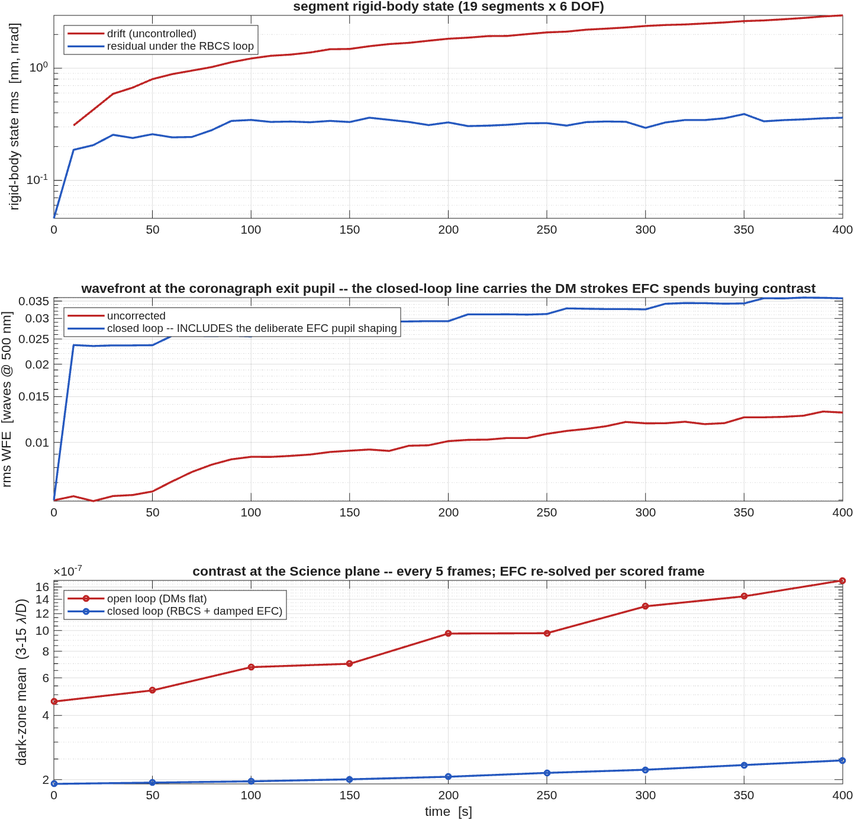
A randomly disturbed observatory, simulated
The closed loop holds dark-zone contrast at 2.5×10⁻⁷ where the uncontrolled series drifts to 1.7×10⁻⁶
• Random segment drift is injected; the rigid-body loop senses through the designed metrology, estimates and corrects, while EFC re-solves the dark zone per scored frame — all on one model.
• The disturbance interface is the point: the same channels are built to ingest dynamical- and thermal-model time histories — simulating performance in the space environment. Work in progress.
• Honest gap, attributed: the segmented-pupil contrast floor sits above the clear-pupil testbed's — the gaps and edges carry it, not the control.
Four hundred seconds under drift: segment rigid-body state, wavefront at the coronagraph exit pupil, and science-plane contrast — open loop against closed.
Record: templates/80_end_to_end/e2e6m_r2, time-series stage.

Slide 22
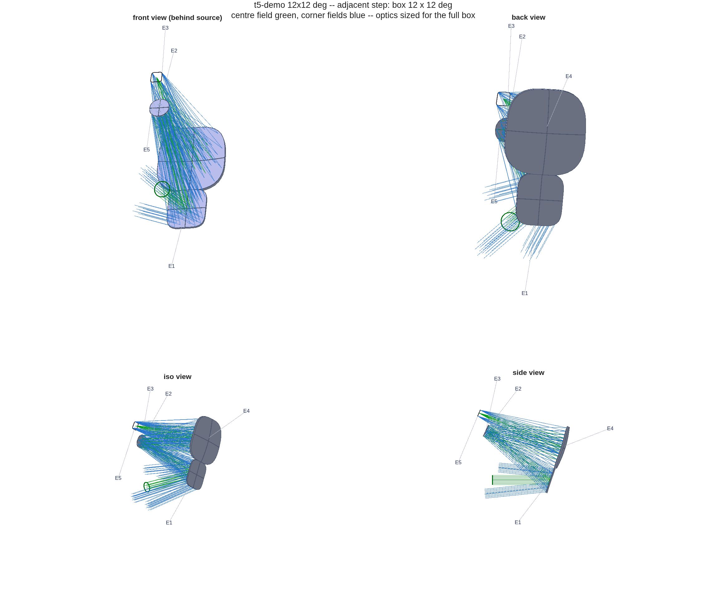
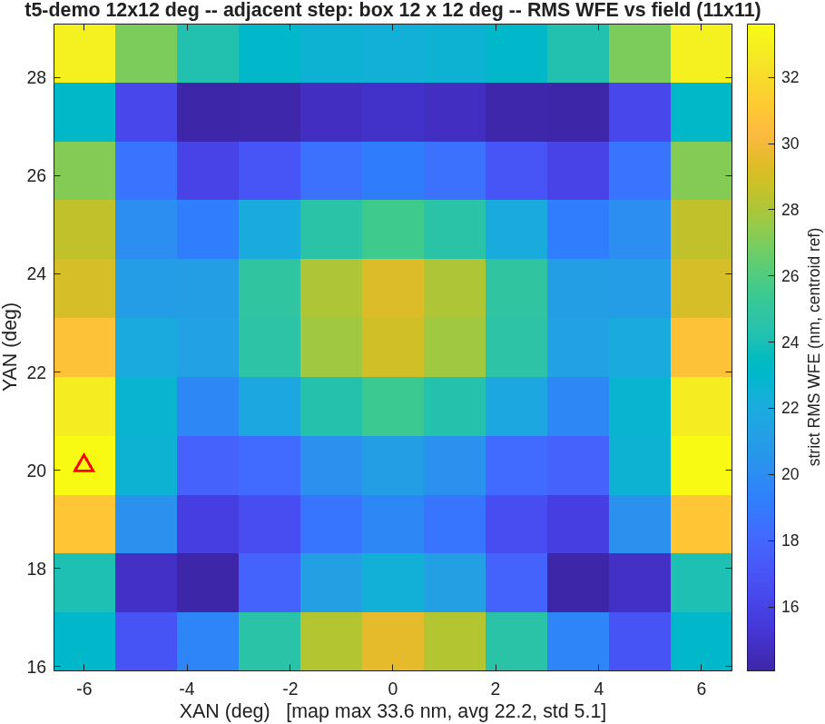
The live design, revealed
Predicted from the frontier before solving; solved in one warm-started step while we talked
• The ask: a field-box width, anywhere in 5–15°. The prediction, stated before the solve: interpolated from the committed frontier rows.
• The pre-run rehearsal of the default ask (12°): predicted 33.7 nm; solved 33.6 nm — 1.00× — at a 24.9 mm clearance floor, both checks pass, in 15 minutes.
• The run is deterministic to every printed digit, and every ask is a genuine continuation step — never a re-score of a stored design.
The 12° rehearsal design and its field map: 33.6 nm max against a 33.7 nm prediction.
On demo day the live run's figures replace these panels; this pre-generated bundle is the fallback if the room's ask matches nothing better.

Slide 23
AI in design and analysis — the working questions
What we ask of an AI-driven study before believing it
• How is a result verified when the designer is a machine? Here: regression checks with negative controls, layout figures read against every claim, and corrected signed measures — the checks caught the errors shown today.
• Where does the human rule? Constraint choices, metric definitions, and every outward claim carry a human sign-off; the AI proposes, the record decides.
• Is it reproducible? Every number in this deck rebuilds from committed scripts and committed records — including the design solved during this talk.
These are offered as discussion questions, not settled doctrine.

Slide 24
Summary
One engine, validated; a toolbox that designs; an AI that drives it — all public
• One validated engine behind four language surfaces; a MATLAB design layer that took three CODE V benchmark studies from reproduction to extension.
• Two things happened live: a telescope designed to the audience's field specification in one warm-started step, and a polarization interferometer measuring a deformable mirror to 0.30 nm.
• The code is public: github.com/nasa-jpl/macos.
Contact and records: all studies cited are committed with packets and regression checks.

Slide 25
Backup Slides

Slide 26
What MACOS does today
System-level modeling from design through control
• Applications: error budgeting, integrated observatory simulation, wavefront sensing and control for segmented telescopes, coronagraph testbeds and instruments.
• The linear-model workflow: w = J·x + w₀ — wavefront sensitivity channels per element, per segment, per surface mode; stacked over fields and configurations; element groups move as one.
• From model to control: the same sensitivity matrices drive metrology design, estimator synthesis, and closed-loop simulation — one model, one bookkeeping, design to control.
Every capability shown today is in the committed test suites; validation anchors: next slide.

Slide 27
The MATLAB toolbox and the design layer
Design → segmentation → sensitivities → metrology → simulation, each one call — fully public-domain
• Drivers: telescope/bench design builders, sensitivity supervisors (rigid-body, alignment, surface-grid), metrology placement, model-vs-model comparison, closed-loop simulators, study orchestrators.
• One-call reconstructible studies: every figure in this deck rebuilds from a committed script and committed records.
• Utilities: trace, wavefront, perturb, pupil find; layout and ray-bundle viewers; Jones pupils, polarization elements; segment grid bases and grid file IO; multi-wavelength composition; spot, intensity, complex field.
• Why a design layer: the whole stack is public-domain — a design study needs no proprietary prescription to start from.
The two live demonstrations exercised exactly these layers: the bench builder and a design-family driver.

Slide 28
Validation anchors
The trust base, by physics domain
domain | reference | agreement
geometric ray trace | CODE V comparison suite | 6,601 tests
physical optics | PROPER propagation library | 10⁻¹¹–10⁻¹³ well-sampled; 10⁻⁸–10⁻⁵ sampling-limited / post-focus
polarization | Born & Wolf / Abelès closed forms | 10⁻¹²–10⁻¹⁴
polarization, lab | published protected-Al Mueller data | ~10⁻¹⁴ vs the model
build integrity | two compilers, one tree | bit-identical
• The non-vacuity rule: every regression check is shown to fail against the pre-fix engine before it counts as protection.
Suites run per commit; counts as of 2026-08.

Slide 29
The adjacent-design rehearsal bundle
Three widths, pre-run end to end at the demo settings
ask | warm start | predicted | solved | clearance floor | checks | wall time
7°×7° | 5° step | 18.0 nm | 20.0 nm (1.11×) | 93.8 mm | pass | 15.2 min
12°×12° | 11° step | 33.7 nm | 33.6 nm (1.00×) | 24.9 mm | pass | 15.2 min
14°×14° | 13° step | 54.9 nm | 51.2 nm (0.93×) | 24.9 mm | pass | 15.2 min
• A repeat 12° run reproduces the bundle to every printed digit — the demonstration is deterministic.
• Wide asks pass: the committed frontier line understates the envelope (its widest rows stopped early on a wavefront-only criterion while the clearance penalty was still improving).
Bundle: templates/10_telescopes/offset_imager/demo_adjacent — figures, verdict text, prescriptions, run records.

Slide 30

Interferometer demonstration backups
One pre-rendered image per live step
Step 5 — one actuator poked: the fringes bend over it.
Step 6 — the analyzer sweep: four phase-stepped frames, no re-trace.
Step 7 — the recovery beside the truth map.
All seven steps have backups in templates/90_polarization/tg_psi_dm.

Slide 31
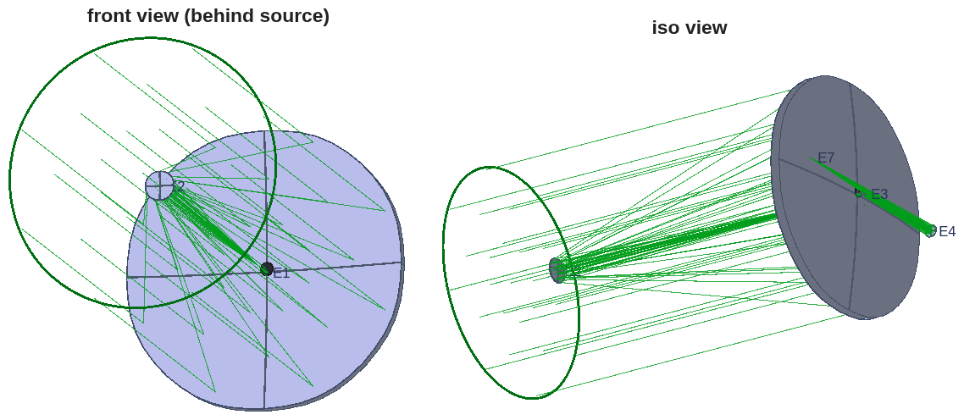
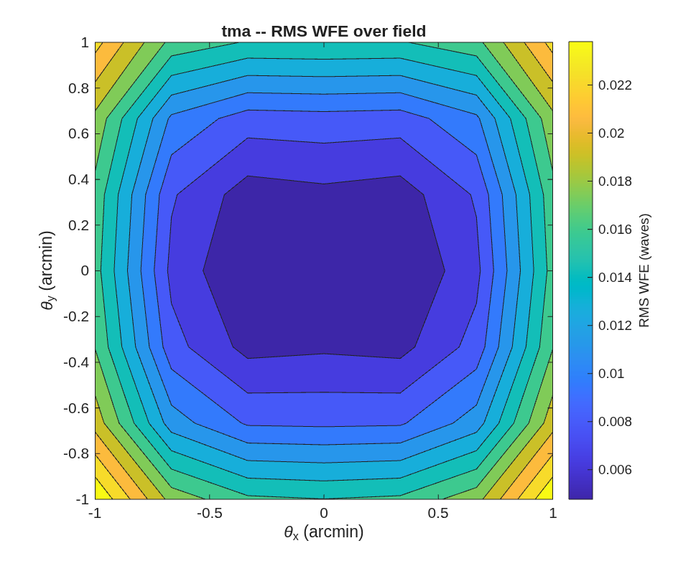
The e2e worked example: specification to design
A 4 m f/18 visible-band telescope from a closed-form seed — no starting prescription
• The stage-runner sequence on the smaller worked example: specification → design → segmentation → metrology → comparison → simulation, each stage a committed runner handing its prescription to the next.
• A 4 m f/18 telescope (f/1.75 primary) from a closed-form first-order seed; diffraction-limited over ±1′ alone, and the Offner ring-field relay buys the full ±2′ (Strehl floor 0.965, on pure spheres).
The telescope as designed (front + iso views), with the traced field.
Wavefront error over the field: diffraction-limited across the box.
Record: templates/80_end_to_end/e2e — staged worked example, committed at every step.

Slide 32
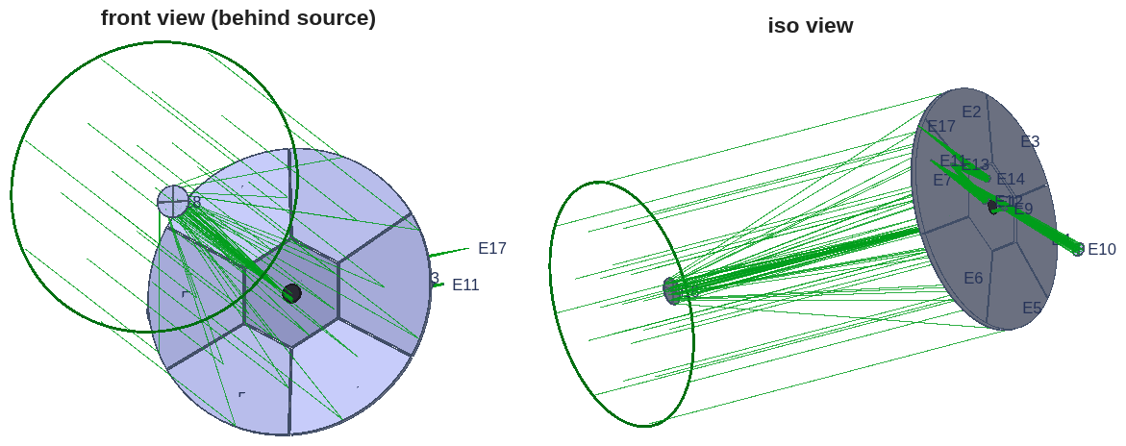
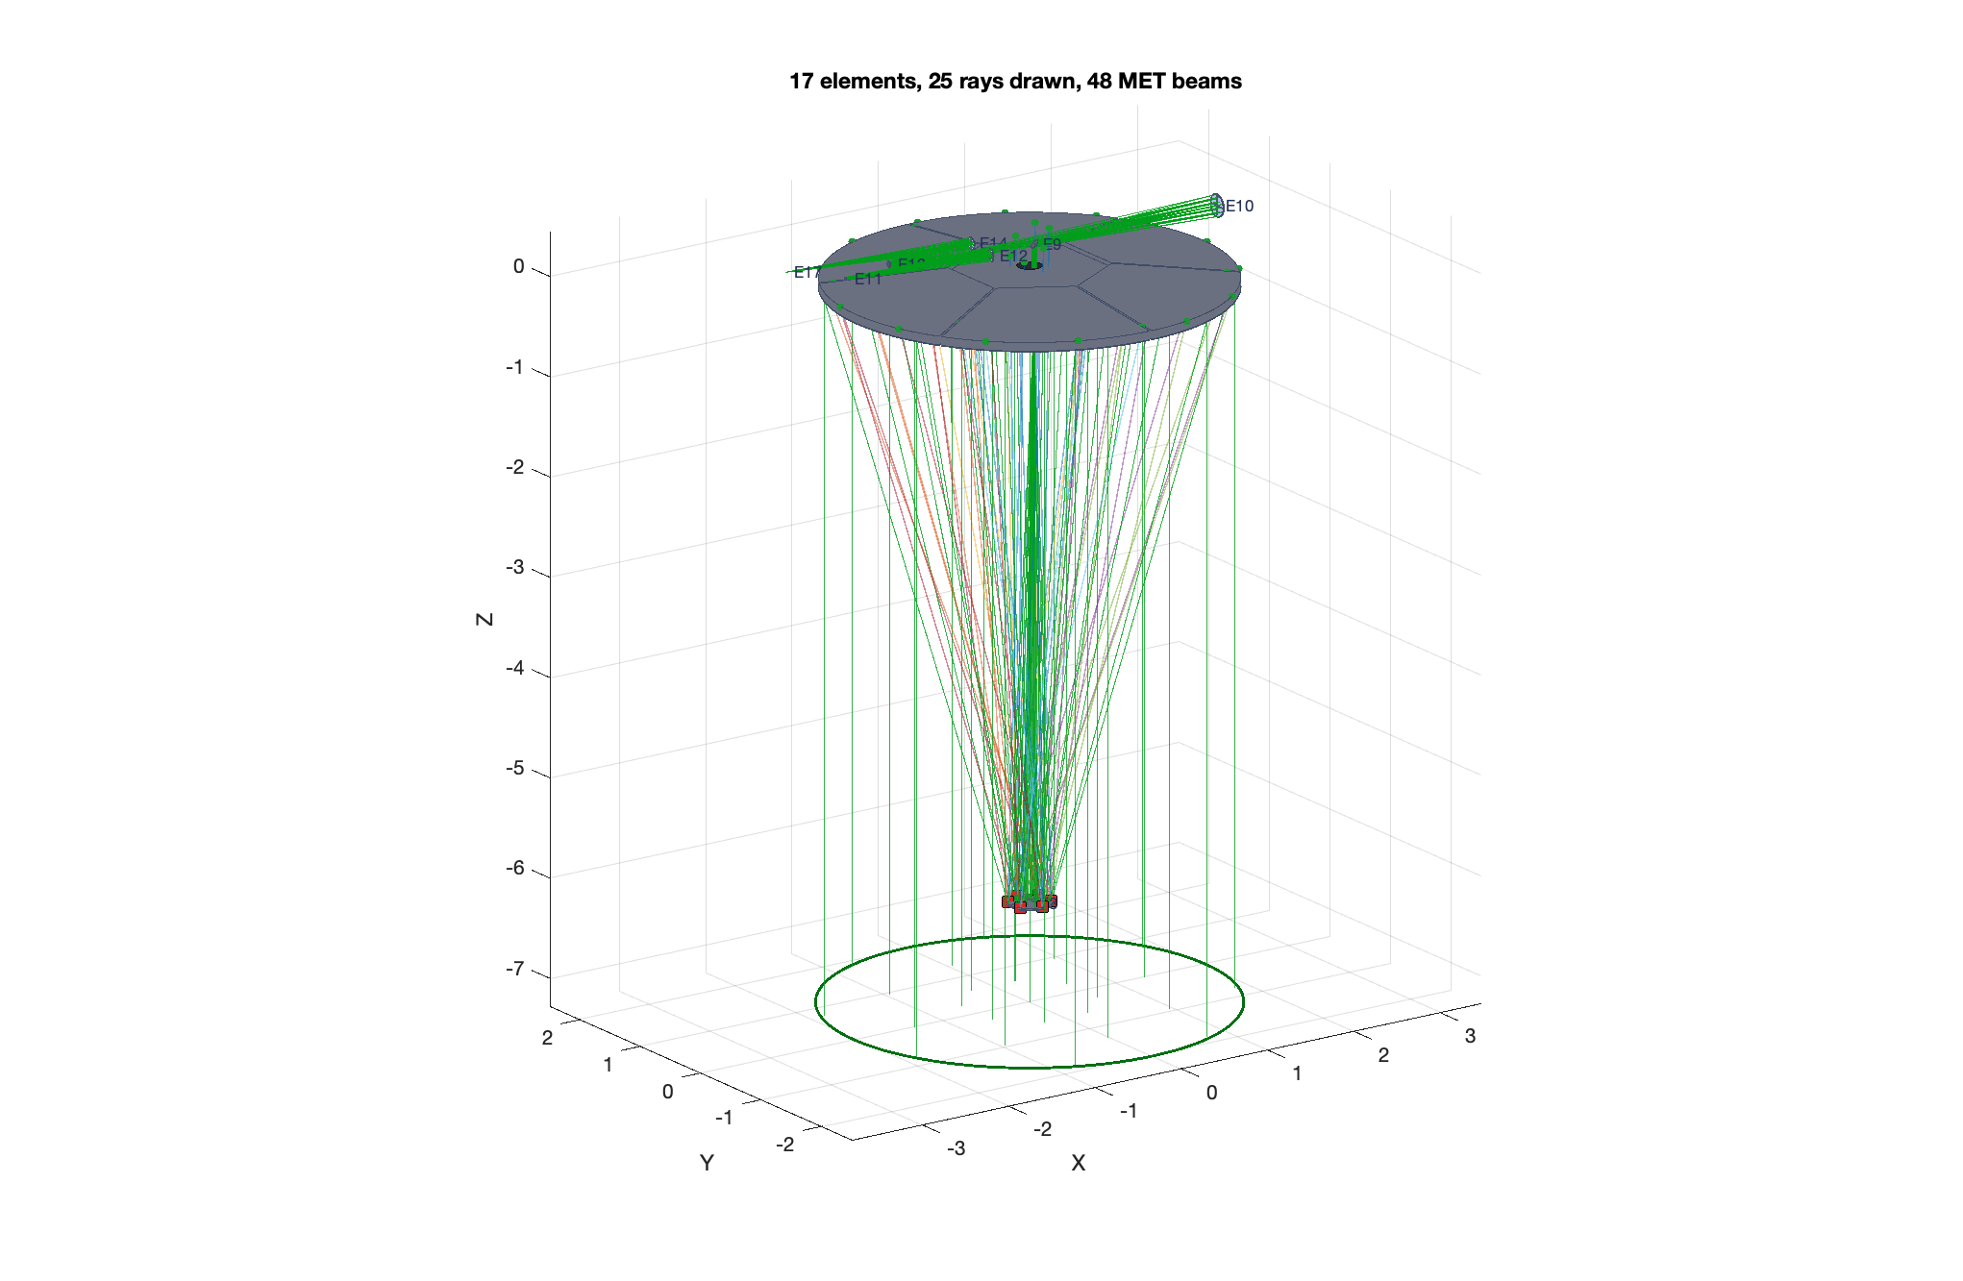
The e2e worked example: segmentation and metrology
The monolith segments in one call; the metrology is designed on the same Jacobian
• The primary segments into a pie or hex tiling with physical apertures; every segment gets rigid-body and surface-figure sensitivity channels, stacked into one Jacobian — the control basis.
• Metrology is an optimization on that basis: edge-sensor and beam-launcher layouts scored by the control information they carry, not by symmetry; the winning pattern exports as a reusable preset.
The segmented primary with physical apertures (front + iso views).
The optimized metrology layout on the segmented primary.
Record: templates/80_end_to_end/e2e, stages 3–5.

Slide 33
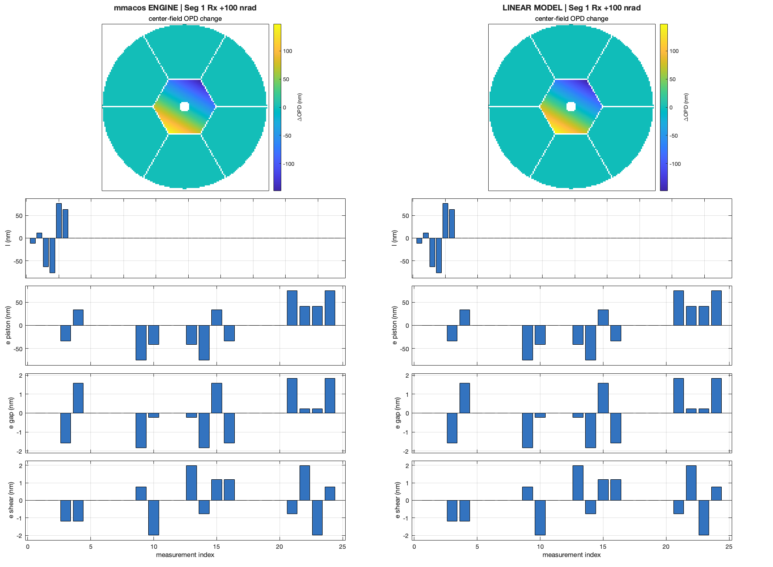
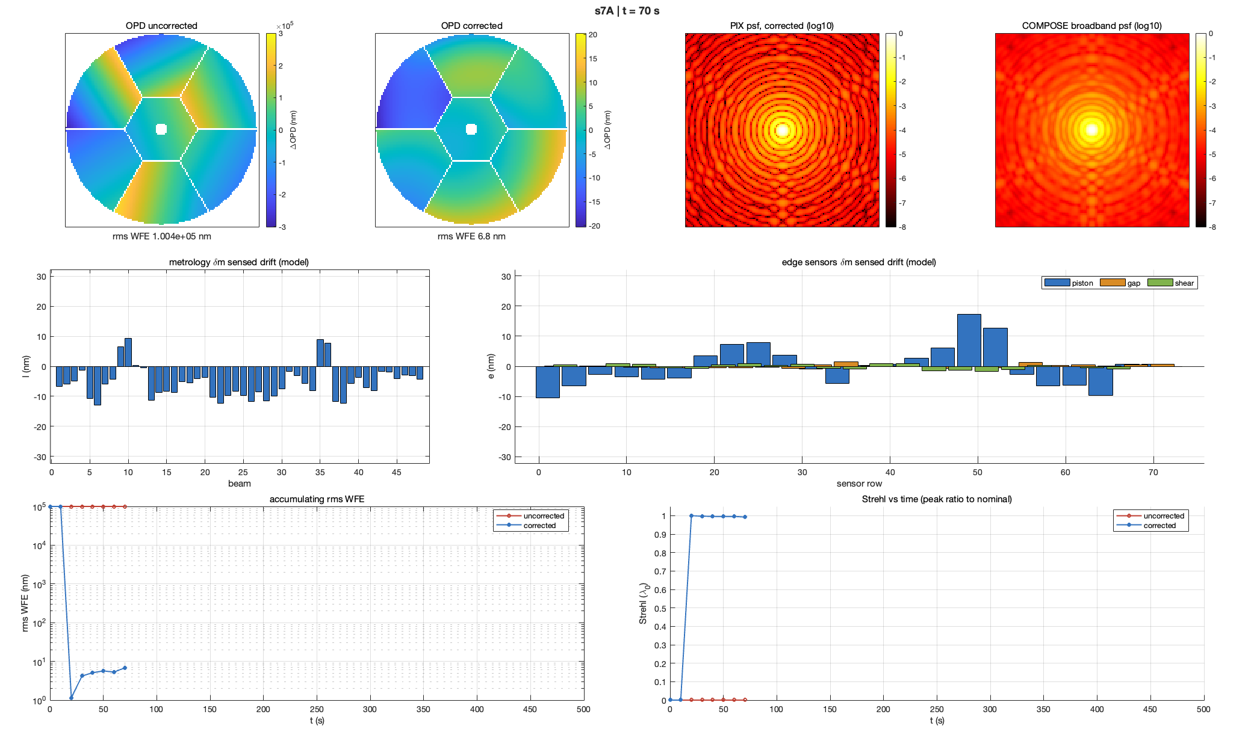
The e2e worked example: comparison and simulation
Segment drift of 10⁵ nm rms is sensed and held at ~7 nm corrected
• Every linear model is checked against the engine before it is trusted: step each channel, re-trace, render engine and model side by side (left). Then the simulator closes the loop on the same model: inject drift, sense with the designed metrology, estimate, correct (right).
The comparison stage: engine re-trace vs linear model, one perturbation channel (segment 1 Rx, +100 nrad).
The simulator at t = 70 s: uncorrected 1.0×10⁵ nm vs 6.8 nm corrected; accumulating WFE and Strehl vs time below.
Record: templates/80_end_to_end/e2e, comparison + simulator stages (s6/s7).

