Slide 1
COPHI as the Fifth DM Gauge Bench Sensor
Feng Zhao's heterodyne camera interferometer, scored on the same bench, the same 30 nm surface and the same rows as the interferometer, the Zernike sensors and the pinhole — and a faster alternative using lock-in detectors
D. C. Redding, with Claude Code (TO: the bench stages).
October 2026. Working record.
DRAFT — pending review.
Feng's proposal (COPHI_for_DM_gauge.pptx, 2026-05-19): a single-frequency laser split to two AOMs at 80 MHz and 80 MHz + 7.5 Hz on a Rb standard, a fiber LO combined before a 30 fps camera imaging the DM, four frames per beat, the four-frame phase. Purpose: to hold each DM in a local loop against drift, to << 10 pm. What does that read on our bench, and what does it cost?

Slide 2
Feng's proposal, in one slide
A heterodyne interferometer whose phase steps are set by frequency, with a fiber-fed local oscillator at the camera, and an array detector providing many parallel channels to resolve 96 × 96 actuators
• Layout: laser → 1×2 coupler → AOM-1 (80 MHz) and AOM-2 (80 MHz + 7.5 Hz), both synthesizers on a 10 MHz Rb standard; the measurement beam to the DM, the LO fiber to a splitter before the camera; the ×4 multipliers mixed to a 30 Hz camera trigger: four frames per 7.5 Hz fringe cycle – see next slide.
• Algorithm: I = I₀ (1 + γ cos(φ + 2π f t)); frames at α = 0, π/2, π, 3π/2; φ = atan2(I₄ − I₂, I₁ − I₃); surface = ½ (φ/2π) λ (double pass). Backup: the N-frame least-squares solution (Zygo's four-step is N = 4).
• Main purpose: stabilize the DM! Run each DM in a local loop to hold it — our job 3. For us to figure out: the camera, the photon budget, the error terms, estimated performance.
• Built on our DM Gauge bench: the bench with mirror and lens layouts, the 96 × 96 DM, swappable sensors: the core Twyman-Green interferometer (IFO), scalar and vector Zernike wavefront sensors (ZWFS), point-diffraction interferometers.
• The same scoring: on a 30 nm working surface, the response matrix measured through the reading, the hold loop, the capture ladder, the photon rows.
• What is new: the Local Oscillator (LO) arm (a fiber tip and collimator where the reference flat sat); frequency-set steps; each frame integrating a quarter of the beat; the LO's wavefront drift; the differential fiber phase within a scan; trigger jitter; a camera chosen for the job.
• What is absent: the polarizing train — no analyzer, no quarter-wave plates, the same polarization in both arms — so the polarization gain the IFO carries (0.983–1.004) does not exist here.
Feng's slide 8 is the implementation example this deck's block diagrams follow; TOM3 (SPIE 6268) is the photodiode heritage.

Slide 3
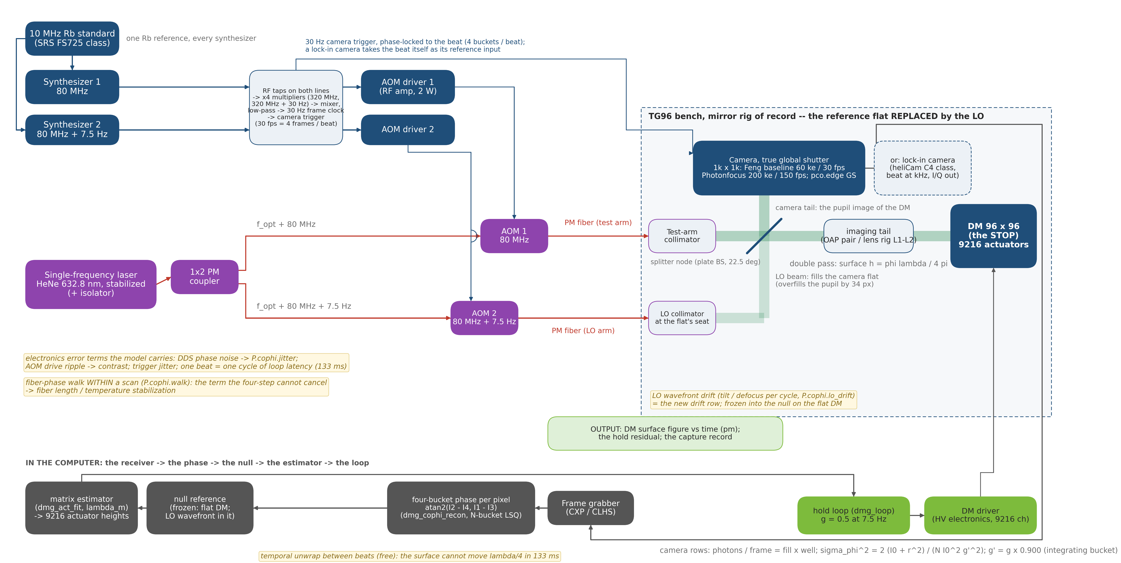
COPHI on the DM Gauge bench: the four-step run continuously
The record interferometer's piezo four-step with the steps set by a Rb-clocked beat, a quarter-cycle integrating bucket per frame, and a fiber LO; the reconstruction is the same
• Feng's four-frame method, one-color version, for the hold job. Every box is a component of the TG96 DM Gauge bench.
• Blue = RF / timing · Red = PM fiber · Green = free-space beam · Gray = data
make_cophi_block_fig.py

Slide 4
Our implementation of Feng's approach
COPHI using a framing camera; the lock-in camera (next slide) changes the camera, the beat and the trigger chain only
part | Feng's proposal | our implementation (what the model runs) | why
laser | single-frequency, λ unstated | 632.8 nm, the record bench's; a 1.3 µm row for InGaAs | the other four gauges' surface, matrix and photon rows
RF and timing | AOMs 80 MHz / 80 MHz + 7.5 Hz, 10 MHz Rb | as proposed; camera trigger on the same reference, 30 fps = 4 × 7.5 Hz; jitter a knob, nominal 0 | frequency-set steps on one clock
buckets | four frames per beat | each frame integrates a quarter cycle: contrast × 0.900; N > 4 = the least-squares backup | the four-step, with the bucket priced
local oscillator | a fiber LO before the camera | PM fiber tip + collimator at the reference flat's seat (slide 9); LO/test ~1, contrast 0.98 | the seat registers on both rigs
beam train | one polarization, plain splitter | the plain splitter scored; the polarizing train priced beside it (same pm, ×1.5 laser) | no analyzer: no polarization gain
camera | a 30 fps array, part unstated | four surveyed rows, read noise in each: baseline 1k² 60 ke⁻ 30 fps; Photonfocus 200 ke⁻ 150 fps (the "Feng's camera" row); pco.edge GS; C-RED 2 | well × frame rate decides (slide 14)
exposure, resolution | 96 × 96 resolved | frame mean at half the well; model 3.3 px per actuator, real cameras 5–21 | oversampling costs no photons (slide 11)
reconstruction | atan2 four-step; surface = φλ/4π | the same about the bucket centers; LO-only annulus median-filled; unknowns = control set | the record's estimator
errors, hold, capture | "stabilize the DM" | fiber walk, jitter, LO drift, shot + read noise, the record's drifts (slide 15); the record's loop at the camera's cadence; two colors from cold (slides 16–17) | the other gauges' loop and ladder
Sheet cophi_params.m (every row is a field there); records in the footnotes of the slides cited; detector rows from NOTE_detectors_survey.md (web, unverified).

Slide 5
The lock-in camera: COPHI's algorithm built into the sensor
Feng's camera takes four frames per beat and the computer demodulates; a lock-in camera demodulates in every pixel at a kHz beat and reads the whole lattice in a second — same optics, same RF chain; its rows run through every table that follows
• Ruling: every mode we care about (EFC probes included) runs at full actuator resolution — so the second implementation is a per-pixel demodulating reading at ≥ 1 element per actuator, assumed to exist.
• Lock-in = synchronous detection inside each pixel:
– the photocurrent is multiplied by the beat reference and by its 90°-shifted copy, and integrated
– the stores are I = I₀γ cos φ (in-phase) and Q = I₀γ sin φ (quadrature) — not intensities; φ = atan2(Q, I)
– the DC term never reaches the well; I and Q leave at the frame rate
• Heliotis heliCam C4 / C4M (vendor data, 2026-10-28): 542 × 512 (1024 × 1102) px of 24 µm (12), 305 Hz–134 kHz, 500 ke⁻ per internal image, 2 × 10-bit X/Y at 460 e⁻ per count, quarter-period trigger, QE 73 % at 633 nm, 4960 frames/s; ~USD 22k / 27.5k, 4 weeks.
• Vendor answers (Heliotis, 2026-10-28: datasheets, manual, noise calculator): the well is per internal image; at AC/DC ≈ 1 the X/Y output's full scale (±512 × 460 e⁻ = 236 ke⁻ per frame) binds first; read 489 e⁻ per frame; frames averaged on the FPGA, ~20 images/s over GigE. Confirmed 2026-10-29: the FPGA averages frames at the sensor's 4960 frames/s; the output gain is fixed (X/Y signed ±512 by default); background suppression off, as the row has it (on, it doubles the noise).
the two implementations, same optics and RF | Feng's camera (Photonfocus row) | lock-in camera (heliCam C4, as surveyed)
beat | 7.5 Hz | 5 kHz (305 Hz–134 kHz)
what leaves the sensor | 4 frames per beat | I/Q per pixel, one frame per beat period (4960/s), averaged on the camera to ~20 images/s
pixels per actuator | 9.4 | 5.3 (C4M 10.6)
per-reading noise | 39.5 pm | 61.8 / 67.2 pm per 0.2 ms frame, mirror / lens (read 489 e⁻ in the row)
seconds per pm | 42 | 0.77 / 0.91 (mirror / lens; the output's full scale at 4960 frames/s; ×1.23 in time for two-tap demodulation)
loop latency | one beat, 133 ms | one averaged image, ~50 ms (one 0.125 s cycle as the loop's upper bound)
• The lock-in is ~55× the Photonfocus and ~500× Feng's baseline (seconds per pm 42 / 0.77 and 385 / 0.77).
– the bound is the output's full scale, not the well: 1.2 × 10⁹ e⁻/s per pixel, read noise equal to shot noise at full scale; no adjustable output gain (vendor 2026-10-29): the sensor's 'sensitivity' setting only shortens the internal exposure, the same as dimming
Stage format (runs/format_lens_plain); the lock-in rows runs/c4_noise_{oap,lens}; NOTE_lockin_arrays_survey.md (web survey; the heliCam row verified by its vendor). Also ranked there: 128² CMOS at 20–40 kfps, time-of-flight demodulators, digital-pixel ROICs, coherent photonic arrays.

Slide 6
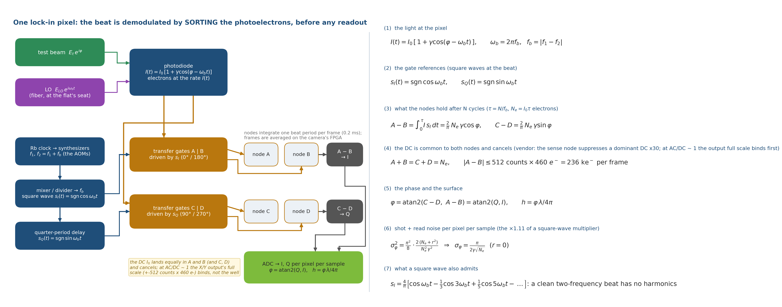
How the lock-in detector works
One pixel sorts its photoelectrons into two storage nodes by a square-wave reference at the beat frequency; the node difference IS the lock-in product, formed before any readout — Feng's four-step inside the pixel, integrated over thousands of cycles
• The reference: a 20 kHz square wave (0–5 V; four pulses per beat period f_b = |f₁ − f₂| = 5 kHz; the camera's DivideBy4 input gates the pixels directly, delay stable for hours — vendor), locked to the AOMs through the Rb clock — one clock; software does only atan2(Q, I).
• The ADC is on chip: readouts are digital I and Q.
• Against a frame camera: N cycles per sample, not 1 sample per quarter cycle.
– one beat period per 0.2 ms frame, the frame's I/Q at the output's full scale: 1.2 × 10⁹ e⁻/s per pixel usable vs the Photonfocus's 3 × 10⁷ (200 ke × 150 fps); that 40× in photons is most of 42 → 0.77 s per pm
make_cophi_lid_fig.py; the pixel is CSEM's demodulation pixel (Lange & Seitz 2001), the heliCam's "dual-phase lock-in".

Slide 7
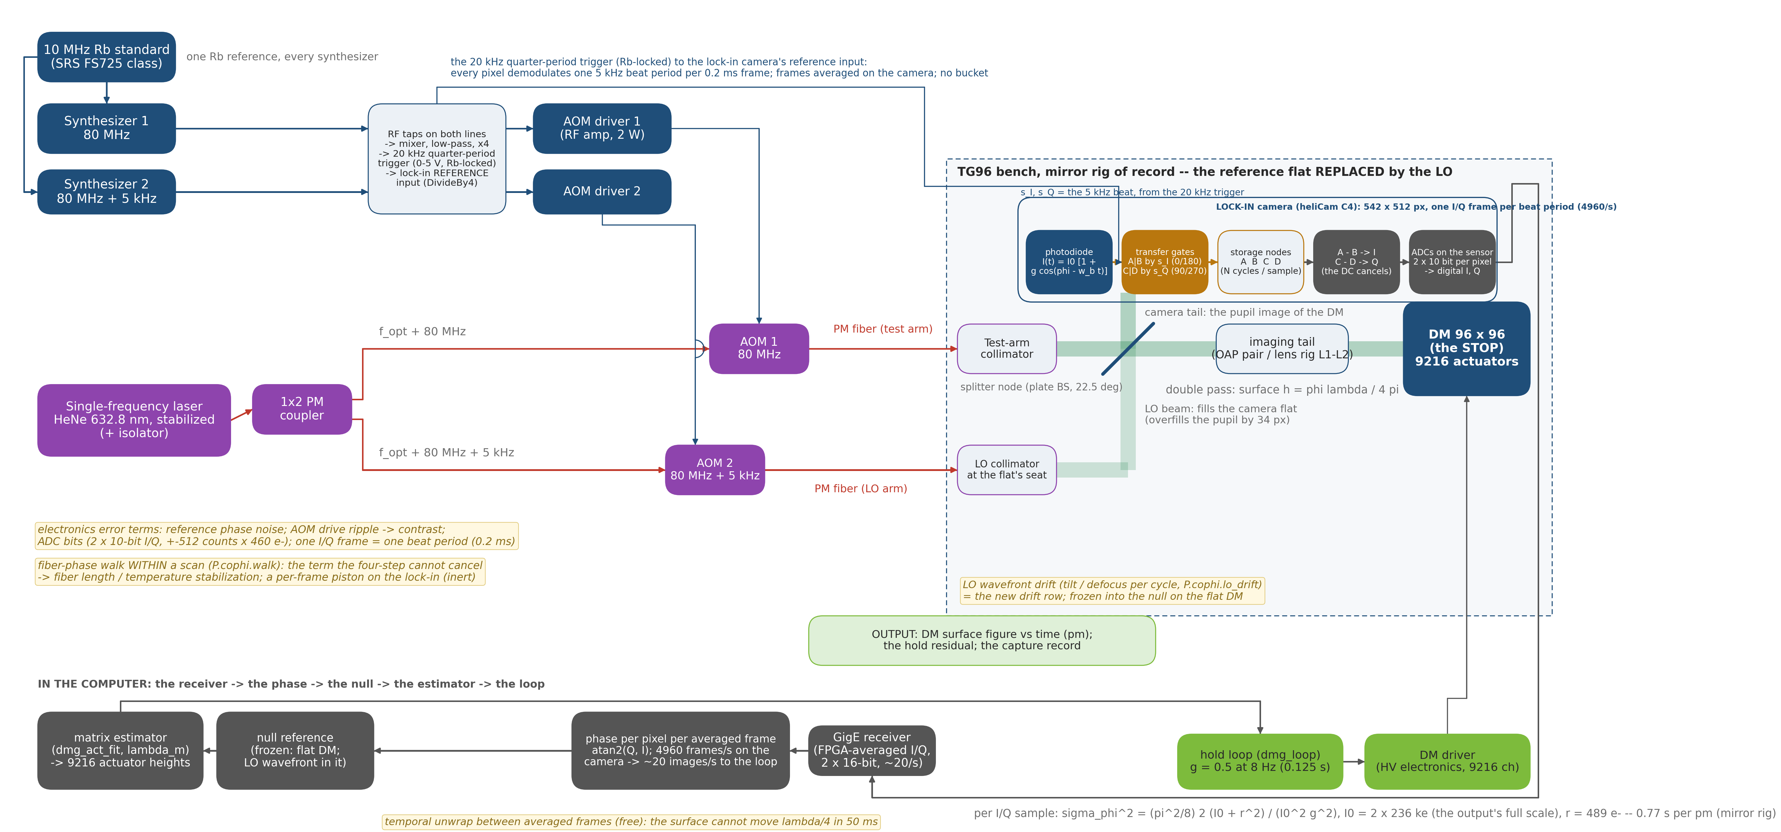
COPHI with a lock-in camera: the block diagram
Same laser, fibers, LO and bench; the beat moves to 5 kHz and its quarter-period trigger goes to the camera's reference input; no bucket; I/Q frames, averaged on the camera, go straight to the phase
• What changes from slide 3: synthesizer 2 at 80 MHz + 5 kHz; the 20 kHz trigger to the pixels' gates; the camera is one pixel's chain (slide 6), frames averaged on its FPGA; atan2(Q, I) per image. Fiber, LO, loop unchanged.
• Blue = RF / timing · Red = PM fiber · Green = free-space beam · Gray = data
make_cophi_block_fig.py

Slide 8
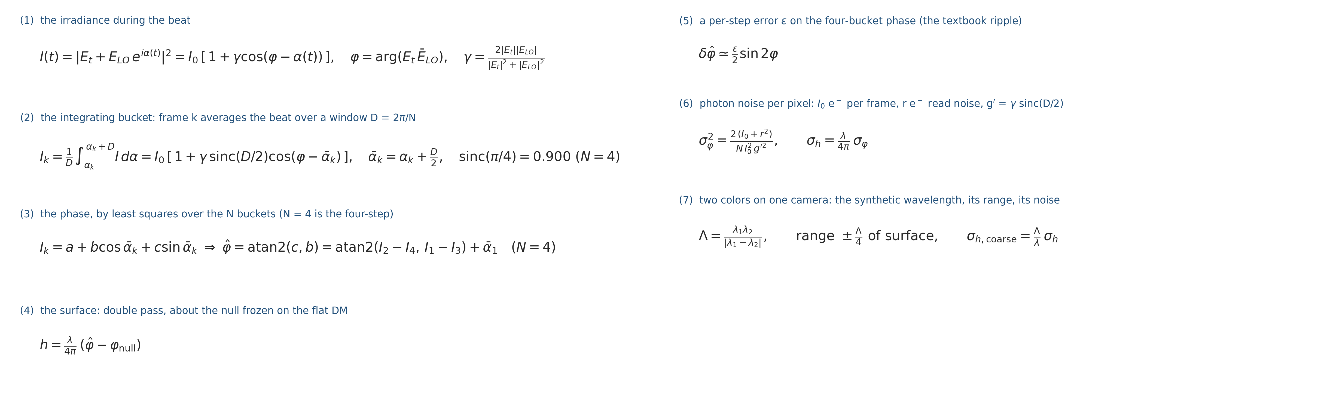
The reading's algebra, pinned before the bench
What the camera records, how the phase and the surface come out, and what the gate measured: the quarter-cycle integration costs 10 % of contrast, a step error is not cured by more frames, read noise is in the photon law
• Step error (5): steps of D(1 + ε) instead of D give a phase error (ε/2) sin 2φ — a ripple at twice the fringe frequency (Schwider 1983, Creath 1988).
– more buckets do not cure it: an 8-bucket fit with the same step error is 1.43× worse
– knowing the steps does: the fit at the true ᾱ_k is exact, and a Rb-clocked scan knows them
• Photons (6): shot noise ∝ 1/√I₀ (measured slope −0.500 ± 0.02 over two decades); read noise adds in quadrature.
– a fiber walk or trigger jitter within a scan passes through at 0.13 of its size, with 4 or 8 buckets alike — no algorithmic cure
• Integrating bucket (1)–(2): a frame cannot sample the beat at an instant; it integrates while the LO phase advances a quarter cycle.
– the phase is kept (referred to the bucket center ᾱ_k); the amplitude shrinks by sinc(π/4) = 0.900; nothing else changes
• Phase (3): a least-squares fit of the N frames to a + b cos ᾱ_k + c sin ᾱ_k.
– for N = 4 it is Feng's atan2 exactly (his sign is for cos(φ + 2πft))
Gate tCophi (8 tests) pins each line; dm_gauge_lib/dmg_cophi_*; TeX source deck_cophi_equations.tex.

Slide 9
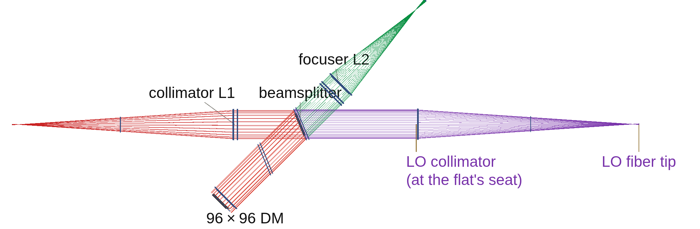
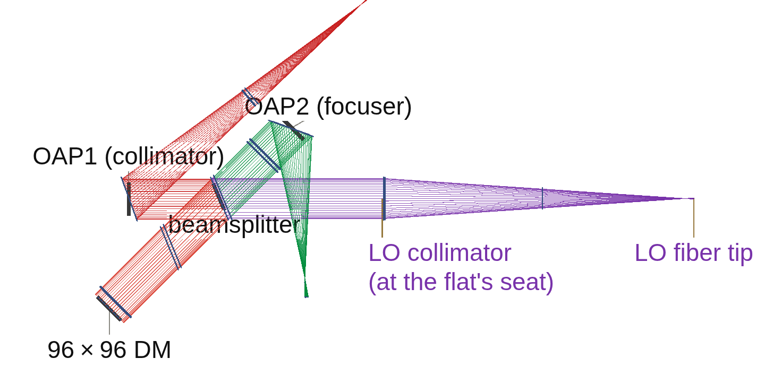
The LO on the DM Gauge bench replaces the IFO's reference flat
A fiber tip and collimator, its powered face at the reference flat's seat, on both rigs; it registers to a pixel and the flat-DM null is sub-nanometer
Lens rig from above: source arm red (fiber tip at left, collimator L1); LO leg purple, from its fiber tip (right) through the LO collimator at the reference flat's seat to the beamsplitter; test arm to the DM blue; camera leg green
Mirror rig from above: source arm red; LO leg purple, from its fiber tip (right) through the LO collimator at the reference flat's seat to the beamsplitter; test arm to the DM blue; camera leg green (OAP1 collimates, OAP2 focuses)
• Registration: chief ray 0.000 px on both rigs; the LO overfills the test pupil by 34 px (radius ratio 1.215).
• Null on the flat DM: lens rig 0.000 nm; mirror rig 0.746 nm rms, mostly tilt.
– the LO collimator's own wavefront, frozen into the null as the IFO freezes its reference; its motion is the LO-drift row (slide 15)
• Contrast: 0.982 at LO/test power 1.47, as 2√r/(1 + r) says.
• Two findings for any traced LO:
– the tail places the detector field by ray index, not camera position (null 681 nm by index, 0.45 nm by position) — the LO is placed by position
– the plain mirror train had kept a source trim solved with the polarizer plate: OAP1 fed off focus (84 nm defocus) — now trimmed to zero
• Two trains priced: the polarizing train and Feng's plain splitter read the same picometers (the camera is well-bound); the polarizing train costs light only (throughput 0.271 vs 0.408, ×1.5 laser). The plain splitter is scored.
Stage bench (runs/bench_{lens,oap}; the layouts = bench_{lens,oap}_vlayout.png, the engine's own renders), gate tCophiBench 9/9 (registration, poke 1.001 converged, LO tilt, no-fringe refused by name, dark camera refused).

Slide 10
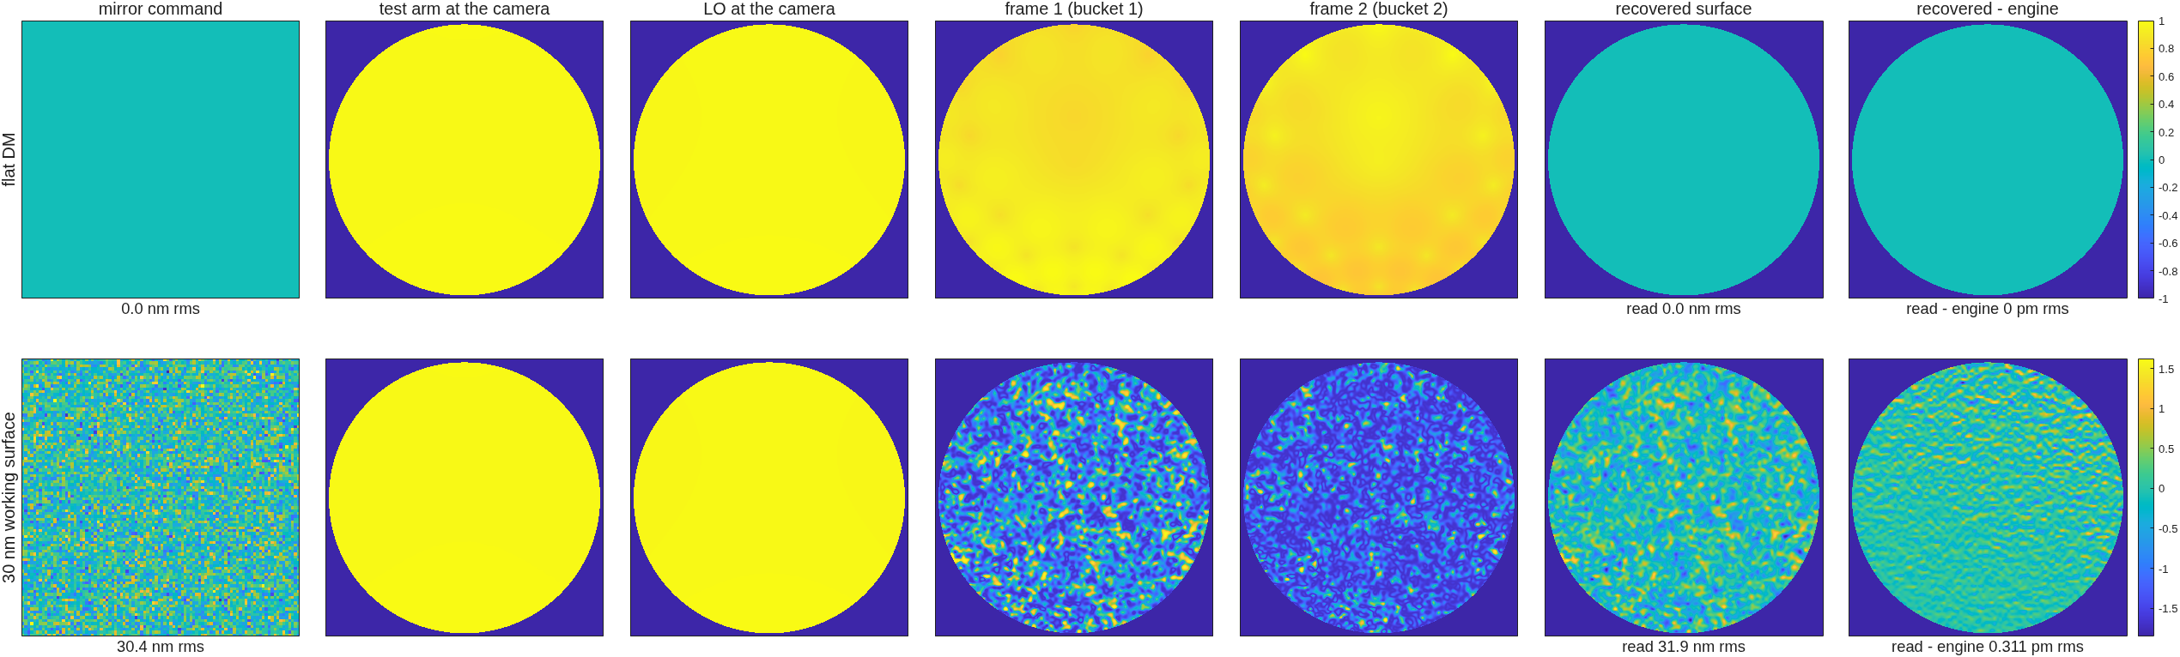
Reading the 30 nm working surface, station by station
The same mirror command through the heterodyne train on the mirror rig, plain splitter; the last column is the raw map against the engine's own field
COPHI, mirror rig: the command; the test arm and the LO at the camera; two of the four buckets; the recovered surface, 31.9 nm rms; recovered minus the engine's field, 0.31 pm rms; the flat DM reads 0
• Resolution shown: camera grid 1024 × 1024, pupil 315 px across — 3.3 pixels per actuator across, ~11 per actuator in area (6948 lit actuators on ~77,900 pupil pixels).
– every real camera on the table samples finer (5–21 px per actuator, slide 11); what resolution buys and costs is slide 20
Stage figs (runs/figs_oap_plain), noise-free; the deck's station-figure format (row 1 flat DM, row 2 the working surface).

Slide 11
Resolution and timing, camera by camera
The model samples the pupil at 3.3 pixels per actuator; every camera on the table oversamples the 96 × 96 lattice, so resolution costs no photons — the time to a picometer is well depth × frame rate, not pixel count
sensor / camera | pixels across the pupil | pixels per actuator (96 across) | pm per reading | seconds per pm (SNR 1 at 1 pm)
the model's grid (both rigs, 1024 grid; the station figure) | 315 | 3.3 | — | —
COPHI, Feng's camera, 1k², 60 ke, 30 fps | ~900 | 9.4 | 57.7 / 53.7 | 443 / 385 (≈ 7 min)
COPHI, Photonfocus 1024², 200 ke, 150 fps | ~900 | 9.4 | 39.5 / 36.5 | 42 / 36
COPHI, pco.edge 5.5 in GS mode, 2560 × 2160, 30 ke, 50 fps | ~2000 | 21 | 40.2 / 38.3 | 129 / 117
COPHI at 1.3 µm, C-RED 2, 640 × 512 (placeholder at 632.8 nm) | ~480 | 5.0 | 19.6 / 18.7 | — (the 1.3 µm stage)
COPHI, lock-in camera, heliCam C4, 542 × 512 | 512 | 5.3 | 67.2 / 61.8 | 0.91 / 0.77 (full scale at 4960 frames/s)
COPHI, lock-in camera, heliCam C4M, 1024 × 1102 | ~1000 | 10.6 | (C4 pixel assumed) | about the same (4× pixels, 1390 frames/s)
• Resolution is free down to ~1.5 pixels per actuator: a camera's photons per second are pixels × well × rate over the pupil; binning finer pixels onto the lattice changes only the read noise per sample.
– measured (slide 20): 1 px per actuator fails the single-actuator row, 1.5–2 px holds at 1.6–2× the time, 3.3 and 4 are the same — 5 px per actuator is the floor on this table
– nothing coarser is modeled (ruling: every mode of interest is commanded at full actuator resolution)
• Cameras were put on the model grid by binning (well × k², read × k): the pm-per-reading rows are the full camera's photons at the model's sampling.
Stage noise and format; the pupil in pixels is the camera's short side filled by the pupil image (the tail's magnification is set for it); the model's 315 px = 157.45 px radius (stage bench). The lock-in rows carry ×1.11 in σ for square-wave (two-tap) demodulation.

Slide 12
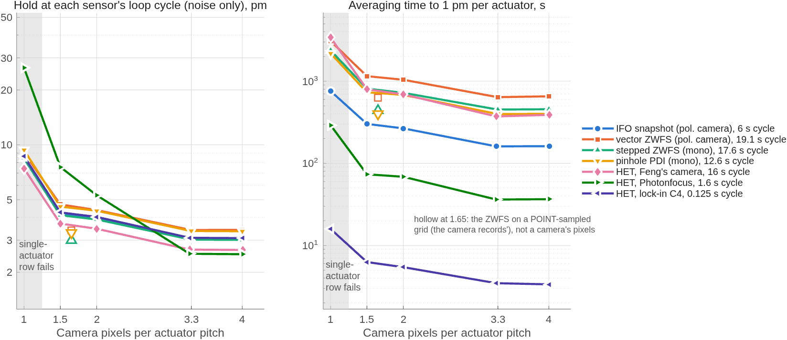
How much resolution? IFO, vector ZWFS, HET — the sweep's records
Camera pixels per actuator swept at 1 / 1.5 / 2 / 3.3 / 4 for all six readings, the matrix measured through the resampled reading: 1 px fails the single-actuator row, 1.5–2 px cost 1.6–2× the time, above 3.3 nothing changes
Left: noise-only hold at each sensor's own loop cycle; right: averaging time to 1 pm per actuator — both vs camera pixels per actuator pitch, one line per reading; shaded = the single-actuator row fails; hollow = the ZWFS on a point-sampled grid, not camera pixels.
• 1 px per actuator fails every reading the same way: single-actuator floor 13–32 pm (from 1.2–2.6), converged gain off 0.4–0.5 %; the "wrong actuator" never happens — the fit degrades, it does not swap.
• 1.5–2 px holds but pays in time: HET 69–74 s per pm against 36 at 3.3 (Photonfocus); IFO 266–302 against 161; vector ZWFS 1040–1150 against 639 — 1.6–2×, because a coarser pixel INTEGRATES the fringe (the point-sampled ZWFS at 1.65, hollow, costs nothing).
• Above 3.3 px nothing changes (4 = 3.3 to the digit); the records at 3.3 stand.
– registration: a ±0.1-pitch shift after calibration costs gain 0.95 and a 16–18 pm floor at EVERY sampling ≥ 1.5 — the camera must stay registered to ~0.03 pitch, whatever the pixel count
• The lock-in's advantage survives the sweep: the sweep (run on the survey's row) costs the lock-in the same 1.6–1.9× at 2 / 1.5 px that it costs every reading; on the vendor's row that is 0.77 / 1.2 / 1.4 s per pm (scaled by the sweep's ratios) — 55× the Photonfocus at every sampling.
ressweep_run / ressweep_zrun / ressweep_figs (cophi_dm96/runs/ressweep_*, TO 2026-10-13); mechanism dmg_camres (frames box-integrated onto camera pixels, the matrix measured through them); gate tResolutionSweep 7/7.

Slide 13
Performance side by side: HET against the IFO on the same surface
HET = the heterodyne (COPHI) reading; IFO = the record's Twyman-Green polarization interferometer. Same seed, surface and matrix: HET matches the IFO's floor, halves its mirror-rig random-surface error, and is exact where the IFO is not
reading, rig (estimator) | 10 nm on one actuator: gain / floor | 1 nm on the grid: gain / floor | dense random 10 nm: gain / error
HET (COPHI), lens (one-step) | 0.9947 / 2 pm | 0.9964 / 2 pm | 0.9967 / 180 pm
IFO (Twyman-Green), lens (one-step) | 1.0001 / 1 pm | 1.0046 / 2 pm | 1.0053 / 179 pm
HET, mirror (one-step) | 0.9941 / 1 pm | 0.9949 / 1 pm | 0.9950 / 118 pm
IFO, mirror (one-step) | 0.9832 / 2 pm | 0.9838 / 2 pm | 0.9844 / 223 pm
HET, lens (converged) | 1.0008 | 1.0022 | 1.0024
HET, mirror (converged) | 1.0000 | 1.0005 | 1.0005
IFO, lens (converged) | 1.0064 | 1.0106 | 1.0112
IFO, mirror (converged) | 0.9887 | 0.9892 | 0.9896
HET, lock-in camera (record, noise-free) | converged 1.0000 | 1.0006 | 1.0005 — the same reading, the same algebra
• The one-step rows sit 0.5 % low for HET on both rigs — the estimator, not the reading: the reading is exact (a 1.000 nm poke reads at slope 1.000000); the 0.5 % is the one-step Tikhonov shrinkage at the record's λ_m = 10⁻³ (1.0007 at 10⁻⁵) — the "matrix bias" every gauge carries, now a number.
• Driven to convergence (the servo use), HET reads exactly on the mirror rig, and the IFO shows its polarization gain in the open: IFO/HET = 1.006–1.009 (lens rig), 0.989 (mirror rig); the IFO's lens-rig "1.000" was polarization gain cancelling the shrinkage.
Stage battery (runs/battery_{lens,oap}, the IFO column = redo96_<optics>ph: tail md5, lit 6948, seed 7, the 64-state matrix on the surface); the gain probe (runs/gainprobe_lens); the converged estimator (dm_gauge_lib/dmg_converge, gate tConvergedEst 4/4; runs/conv_H_, tg_psi_dm96_oap/runs/conv_I_; H and I are the reading-class letters in the records); the one-step rows reproduce the record to the digit.

Slide 14
Photons for 1 pm, camera by camera
A heterodyne read is photon-limited at full well: pixels × well × frame rate decides; Feng's baseline camera is seven minutes per picometer, the deepest-well 1k global-shutter part is 40 seconds, the lock-in under a second
camera (survey, to verify) | read noise r, e⁻ (σ penalty √((I₀ + r²)/I₀) at half well) | pm per reading, lens / mirror | SNR at 1 pm per reading | seconds to SNR 1 at 1 pm, lens / mirror | to SNR 10
as proposed: 1k², 60 ke, 30 fps | 5 assumed (1.000) | 57.7 / 53.7 | 0.017 | 443 / 385 (≈ 7 min) | 12 / 11 h
Photonfocus MV1-D1024E, 200 ke, 150 fps | 220 (1.22) | 39.5 / 36.5 | 0.025 | 42 / 36 | 70 / 60 min
pco.edge 5.5, true global-shutter mode, 30 ke, 50 fps | 2.2 (1.000) | 40.2 / 38.3 | 0.025 | 129 / 117 | 3.6 / 3.3 h
C-RED 2 (InGaAs), at 632.8 nm as a placeholder | 30 assumed (1.001) | 19.6 / 18.7 | 0.051 | — (the 1.3 µm stage) | —
lock-in camera, heliCam C4 (vendor data) | 489 (1.41) | 67.2 / 61.8 per frame | 0.016 | 0.91 / 0.77 | ~1.5 / 1.3 min
• Read noise is in every row (σ_φ² ∝ I₀ + r²): the Photonfocus's 220 e⁻ costs 22 % in σ at half well and it still wins on well × rate.
– the baseline's and the C-RED's read noise are assumed (not in Feng's deck; the survey's value unconfirmed)
• SNR at the 1 pm target: one reading gives SNR 0.02–0.05; SNR 1 takes (pm per reading)² readings — the seconds-per-pm column; SNR 10 takes 100× that.
– a hold loop never needs SNR 10 in one measurement: it integrates readings (next slide)
• Model and bench agree: the per-pixel noise on the bench equals the tCophi formula to 1.000 ± 0.002 on every camera, rig and train.
• Rolling-shutter cameras are out: rows exposed in sequence see different beat phases — a phase ramp across the image. Needed: true global shutter, hardware trigger from the Rb clock, full-frame streaming.
• Why the camera, not the pixel count: a 1k camera oversamples the lattice ten to one; well depth × frame rate is the budget.
Stage noise (runs/noise_{lens,oap}[_plain]; the lock-in rows runs/c4_noise_{oap,lens}: 236 ke⁻ per 0.2 ms frame at 4960 frames/s, ×1.23 in time for two-tap demodulation), 12 draws, cameras binned onto the model grid (well × k², read × k, frame mean at half well). Mask convention from the lock-in runs on: the LO-only annulus (no test light) is filled with the fringe pixels' median, not zero — a zero there made any common phase a pupil-edge step the edge actuators fit; the bucket camera's electronics rows move ≤ 9 % under it.
• The metric: the piston-free robust floor over the unpoked actuators (1.48 MAD, median of 12 draws).
– the raw single-actuator noise is mostly a common piston (165 vs 76 pm) — unobservable and inert on a DM; the composite deck puts every gauge on this metric

Slide 15
Holding 3 pm: the servo at the camera's cadence
COPHI holds 3 pm against the record's drifts: Feng's baseline camera needs a 16 s cycle, the Photonfocus 1.6 s, the lock-in camera ~30 ms (record 3.20 pm at 25 ms cycles, 1.44 at 0.125 s; fiber term inert); the LO's pointing is the term the loop cannot see past
drift (gain 0.5, 60 cycles, seed 77) | hold, pm rms, lens / mirror
noise only, baseline camera (120 readings per cycle, 16 s) | 2.75 / 2.67
noise only, Photonfocus (60 readings, 1.6 s) | 2.60 / 2.52
noise only, lock-in camera (620 frames per cycle, a cycle every 0.125 s) | 1.44 (converged 1.46); at 125 frames (25 ms cycles) 3.20 (converged 3.25)
random walk 2 pm per cycle | 3.60 / 3.53
thermal ramp 5 pm per cycle | 10.3 / 10.3 (the lag rate/gG — every gauge)
camera offset walk | 2.85 / 2.77 (immune: zero-sum frames)
one cycle of sensor latency (one beat; for the lock-in one whole 0.125 s cycle as the upper bound) | 3.65 / 3.54 (+0.9 pm); lock-in 1.91 (+0.5 pm)
differential fiber walk at the budget / at 3× (baseline camera) | 3.95 / 9.2 (mirror); Photonfocus 4.8 / 12.7; lock-in 1.44 / 1.44 = its noise-only hold: a per-frame piston, inert
LO drift, 0.1 nrad tilt + 1 pm defocus per cycle | 29.6 / 29.4 (lock-in 29.3: the LO is the same term in every form)
• LO drift is not separable from DM drift: the matrix takes an LO tilt as a DM tilt one-for-one (1 nrad reads as a surface tilt of 1.008 × θ/2), and the loop drives the DM to follow it.
– the LO pointing must hold ~10 prad per cycle (~10 pm of fiber-tip motion at the collimator's focal length), or be referenced — the requirement the plain-splitter layout adds, beside the fiber's
• Fiber phase errors are not observable: the four-step cannot cancel a differential fiber-phase walk within its own four frames.
– budget at the photon floor (mirror rig): 3.9 × 10⁻³ rad per frame = 0.39 nm of differential OPD per 33 ms, ~12 nm/s, ~1.2 mK/s per meter of uncommon fiber — co-routed, thermally tied, or servoed
– with the lock-in camera the walk is a per-frame piston: inert (record)
• How the loop reaches 3 pm from 55 pm readings — two integrators:
– the estimator's regularization (λ_m) is a spatial low-pass over the matrix's small-singular-value directions, where photon and read noise live; it trades a 0.5 % gain for a lower floor (the converged estimator removes the bias but admits ×2.1 the white noise)
– the loop averages across cycles at gain g (steady state σ_n √(g/(2 − g)), plus M readings per cycle); in the loop the one-step and converged estimators agree to 0.1 pm on every row
• Electronics, the rest: trigger jitter < 2.8 × 10⁻³ rad, AOM drive ripple < 1.8 × 10⁻³ — both easy with a Rb-locked DDS; latency one beat (133 ms at 7.5 Hz).
Stage loop (runs/loop_{lens,oap}_plain, runs/loopfib_*), plain splitter, dmg_loop with the delay row; the mirror rig on the fixed feed (SRC_TRIM 0; every row within 0.02 pm of the mis-fed run, kept in runs/oap_plain_misfed); the fiber rows at the corrected budget (3.5 × 10⁻³ rad/frame as run; 3.9 × 10⁻³ under the median-fill convention); the noise stage's first fiber number was 2.3× low (a 12-draw Monte Carlo of three random numbers) and is replaced by the exact expectation.

Slide 16
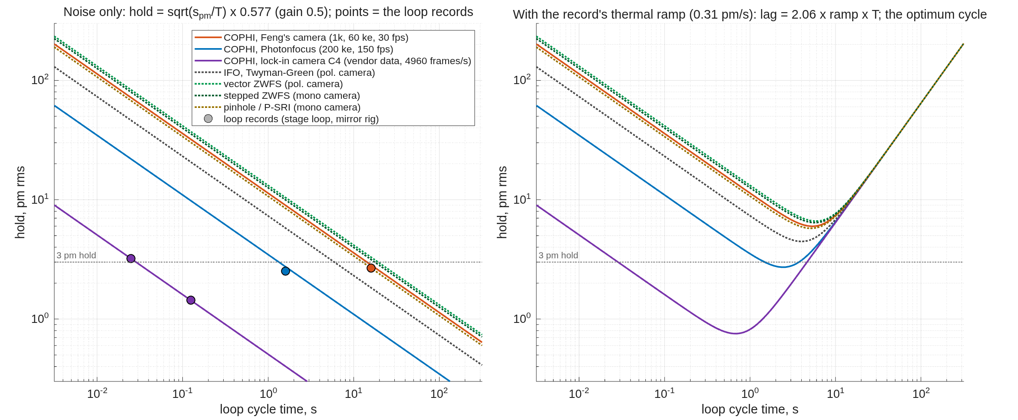
Hold vs cycle time: what the fast cycle buys
At a fixed cycle time a sensor averages (cycle time ÷ seconds per pm) readings, so the hold floor is √(s_pm / T) × 0.577: the lock-in's 0.77 s per pm is 500× fewer than Feng's camera — 22× less noise at any cycle time; the loop records sit on the budget curves
Left: noise-only hold vs loop cycle time, every sensor on the table (budget lines; circles = the mirror-rig loop records). Right: with the record's thermal ramp (0.31 pm/s), whose lag grows with the cycle — each sensor has an optimum cycle time.
• At 1.6 s cycles: Feng's camera 9.0 pm, Photonfocus 2.7, lock-in 0.40; IFO 5.8, vector ZWFS 10.4 (on their polarization cameras). Records match the law to 8 %.
• Against a drift rate the cycle has an optimum (right): Feng's camera 6.0 pm at 5.5 s, Photonfocus 2.7 at 2.5 s, lock-in 0.75 at 0.7 s — the fast reading holds a drift under a picometer where the slow cameras cannot.
cophi_hold_vs_cycle (runs/figs_hold_vs_cycle/); seconds per pm from the records (stages noise / format / c4_noise; camI_oap, camS_oap); the lag from stage loop's thermal row; the markers are the loop records (lock-in: c4_loop_oap, c4_loop_oap_m125). A budget, no new runs.

Slide 17
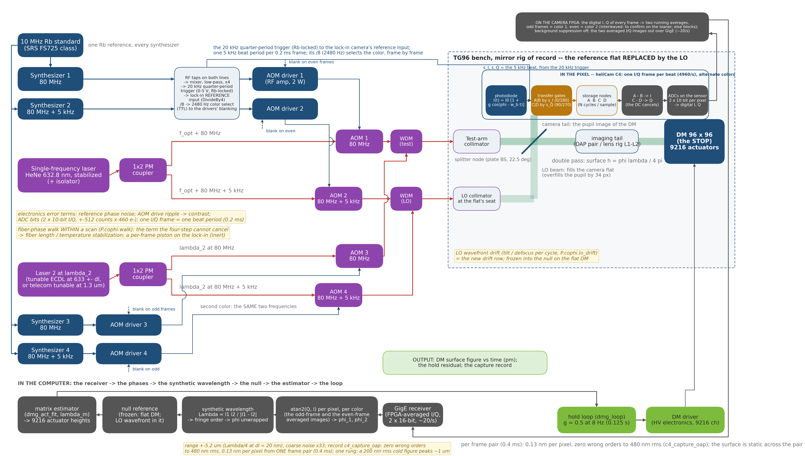
Capture from cold on the lock-in camera: two colors on alternate frames
Laser 2 at λ₂ through its own AOM pair at the same 5 kHz beat, WDM-combined into the same two fibers; the trigger's ÷8 blanks one color per 0.2 ms frame; the pixel demodulates, the camera's FPGA averages odd and even frames apart, the computer unwraps
• Separating the colors: time, not frequency. One reference and one accumulator pair per pixel, so one color at a time: the trigger ÷ 8 (2480 Hz TTL) blanks the AOM drivers, 1 + 2 on odd frames, 3 + 4 on even. RF off = no first-order beam, so the AOM is the shutter (~1 µs): nothing of the other color reaches the sensor, not even its DC. Both colors run the same 5 kHz beat.
• Where the processing is: pixel = the demodulation (gates, nodes, A − B and C − D); camera FPGA = the ADCs and the frame averaging, odd and even apart; computer = atan2 per color, the synthetic wavelength, the null, the estimator, the loop.
• Record: zero wrong orders to 480 nm rms, 0.13 nm per pixel from one 0.4 ms frame pair (slide 18).
• To confirm on the loaner: an interleaved (odd / even) average on the FPGA; else the colors alternate in N-frame blocks, 2 × N × 0.2 ms per reading, the same reading while the surface is still.
Blue = RF / timing · Red = PM fiber · Green = beam · Gray = data. make_cophi_block_fig.py; record runs/c4_capture_oap; the four-frame camera's frequency-multiplexed form is in the backup.

Slide 18
Capture from a cold start: the numbers, and the parts it adds
Zero wrong fringe orders on the whole capture ladder to 480 nm rms; a single color wraps from 40 nm; temporal unwrapping holds a running loop, not a cold start
• Two colors, one reading: 632.8 + 652.8 nm (synthetic Λ = 20.65 µm, range ±5.2 µm), each color read by its own buckets (crosstalk 4 × 10⁻¹⁶ rad).
– zero wrong orders to 480 nm rms, both cameras (0.15 / 0.10 nm per pixel); one color is 74 % wrong at 480
– a 200 nm rms figure is captured from cold in one 0.27 s reading
– any Δλ from 1 to ~100 nm works (the fine requirement at Δλ = 20 nm is 1.7 nm against ~0.1 nm per pixel): one rung of the synthetic-wavelength ladder is enough here
• Temporal unwrapping: holds at 0.9 × λ/4 per reading, fails at 1.1 ×: 1.19 µm/s at the peak pixel (baseline camera), 5.9 µm/s (Photonfocus) — ~0.24 / 1.2 µm/s rms for a 30 nm-class shape.
• With the lock-in camera (record, slide 17): the two colors take alternate 0.2 ms frames, each color's AOM pair gated on for its frame, so ONE color is on the sensor at a time (2480 frames/s per color, 0.4 ms per pair) — zero wrong orders to 480 nm rms, 0.13 nm per pixel; temporal unwrapping at 4960 frames/s tolerates 785 µm/s.
– the pixel has one reference and one pair of accumulators: both colors on at once would put the second beat and the second color's DC into A−B and C−D. That form works only with beats an integer number of frame rates apart (the cross term then integrates to zero over the frame, square-wave harmonics included) and costs √2 in shot noise and half the well per color; not modeled.
part added for the second color | count | note
laser 2 at λ₂ (tunable ECDL at 633 ± Δλ, or a telecom tunable at 1.3 µm) | 1 | the only costly part at 633; cheap at 1.3 µm
1×2 PM coupler | 1
AOMs 3 and 4 + drivers | 2 + 2 | the second beat 3.75 Hz
synthesizers 3 and 4 on the same Rb reference | 2 | the beats coherent
WDM combiners (test fiber, LO fiber) | 2 | both colors in the same two fibers
processing: the second demodulation + the synthetic-wavelength unwrap | software | dmg_cophi_recon twice
Stage capture (runs/capture_{lens,oap}_plain); truth = the engine's per-pixel OPD unwrapped; λ₂ is a re-trace of both decks. Caveat: the model's lenses are dispersion-free, so the tail's chromatic refocus (~0.5 mm of focuser travel for silica at Δλ = 20 nm, to verify) is not shown; its static part freezes into each color's null. At 1.3 µm the base range doubles and telecom tunables are cheap (ruling 2).

Slide 19
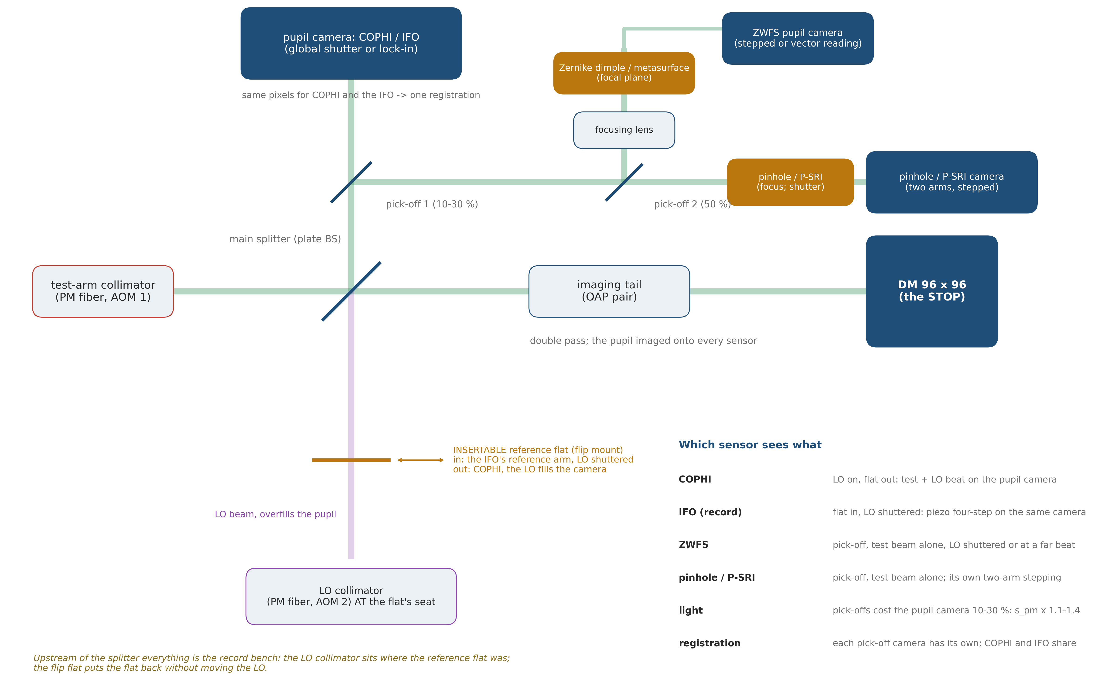
One bench, five sensors: COPHI's LO beside the record gauges
The testbed keeps every sensor: the LO collimator at the flat's seat, an insertable reference flat in the LO path for the IFO, and a pick-off behind the splitter that feeds the scalar and vector Zernike and pinhole arms from the test beam alone
• COPHI: LO on, flat out — the beat on the pupil camera; IFO: flat in (flip mount), LO shuttered — the record's four-step on the SAME camera and pixels, one registration for both.
• ZWFS and pinhole / P-SRI: a 10–30 % pick-off on the camera port, taken before the LO joins the test beam, so each reads the DM alone; the pick-off costs the pupil camera that fraction of its photons (seconds per pm × 1.1–1.4).
• The DM Gauge testbed: 5 sensors provide an independent hold cross-check, each gauge's own systematics on the same surface at the same time, and the Zernike's photon economy for a hold-only mode. Capture from cold stays COPHI's two colors (slide 18): the Zernike captures 62 nm (vector) / 39 nm (stepped) to 10 % and has its own piston null.
• Costs: two more cameras with their own registrations; the flip flat's repeatability enters the IFO's null only (COPHI never sees it).
make_cophi_multisensor_fig.py; the Zernike capture rows are zwfs_dm96/runs/an193_* (capture range to 10 %); nothing in the model moves.

Slide 20
Electronics: what each gauge needs behind the optics
The IFO and the vector Zernike sensor read with a polarization camera in one frame; COPHI adds an RF chain, a fiber LO and three control loops of its own; the lock-in camera moves the demodulation on-chip
 | TG96 IFO (polarization camera, one frame) | stepped / vector Zernike (vector: polarization camera, one frame) | pinhole / P-SRI | COPHI, Feng's camera | COPHI, lock-in camera
source | HeNe, isolator | dedicated laser | laser | single-frequency laser, 1×2 coupler, PM fibers | same
modulation | none for the snapshot (piezo + HV driver for the four-step calibration only) | none (vector); mask stepper (stepped) | pinhole stepper / shutter; phase shifter (P-SRI) | 2 AOMs, 2 synthesizers, Rb standard, ×4 + mixer → trigger | same, beat at kHz
detector | polarization sCMOS (micro-polarizer array 0/45/90/135) | camera / polarization sCMOS | camera | 1k² global-shutter camera, grabber | lock-in camera, I/Q out
latency per reading | 1 frame | 1 frame (vector) / 4 (stepped) | 1–5 frames | 4 frames = one beat (133 ms) | one averaged image (~50 ms); a frame is 0.2 ms
sensor's own loops | — | — | — | laser frequency; two RF chains; fiber phase; LO pointing (10 prad) | same
error terms carried | polarization gain (0.98–1.01, calibrated by the four-step) | — | stepper repeatability | DDS phase noise → jitter; drive ripple → contrast; fiber walk; LO drift | reference phase noise; ADC bits
photons per measurement for 1 pm (gauge deck, 30 nm surface) | 7 × 10¹⁴ (mirror) – 1 × 10¹⁵ (lens) | 1.2 × 10¹⁴ stepped / 4.6 × 10¹³ vector | 1.5 × 10¹⁴ | (this deck: 57.7 pm per reading at 1.9 × 10¹² ph/s) | (61.8 pm per 0.2 ms frame)
seconds to SNR 1 at 1 pm (SNR 10 = 100×) | 189 / 160 s (lens / mirror; IMX250MZR-class polarization camera, record camI_*) | 475 s stepped (mono camera, 4 frames) / 519 s vector (polarization camera, mirror rig, camS_oap) | 342 s (mono, K frames) | 443 (Feng's camera) / 42 (Photonfocus) | 0.77 / 0.91 (mirror / lens)
Camera timings on an IMX250MZR-class polarization camera (2448 × 2048, 75 fps; well ~10 ke⁻, read 2.4 e⁻, unconfirmed). The sensors run 10–40× slower than photons ÷ sensor rate would say: the ZWFS core sets the exposure, the frame mean sits at half well, two orientations go unused. Parts counts and TRL to follow (campaign brief sec. 9.1).

Slide 21
COPHI against the Zernike sensor with a dedicated laser, for the hold job
Feng's deck poses this comparison; on our bench the answer is photons and time: the vector Zernike holds 3 pm from 2 × 10¹² photons per cycle, COPHI with Feng's camera from ~1 × 10¹⁴ — and COPHI with a lock-in camera reaches a picometer in under a second, captures from cold, and reads absolutely
 | vector Zernike (dedicated laser, pol. camera) | COPHI, Feng's camera | COPHI, Photonfocus | COPHI, lock-in camera (C4, vendor data)
photons per 3 pm hold cycle | 2.2 × 10¹² (gauge deck) | ~1 × 10¹⁴ (120 readings) | ~1 × 10¹⁴ (60 readings) | ~2 × 10¹³ (125 frames)
time per 3 pm hold cycle | ~60 s on the assumed pol. camera (519 s/pm ÷ 9: its 10 ke⁻ well, the core's dynamic range, two unused orientations — the camera is the ZWFS's own question) | 16 s | 1.6 s | ~30 ms (3.20 pm at 25 ms; 1.44 at 0.125 s)
seconds to SNR 1 at 1 pm | 519 (pol. camera, record) | 443 / 385 | 42 / 36 | 0.77 / 0.91 (×1.23 for two-tap)
capture from cold | no: the reference ages past 36–70 nm | two colors, one 0.27 s reading | same | two colors on alternate frames; zero wrong orders to 480 nm
absolute read | reference iterated or matrix re-measured | exact (slope 1.000000) against the LO | exact | exact
its own stabilities | none beyond the bench | fiber 0.39 nm per frame; LO 10 prad per cycle | same | LO the same (29.4 pm); fiber a per-frame piston, inert
• For hold alone, the vector Zernike is cheapest in photons (~50×) and needs no stabilities of its own — but on the assumed polarization camera it is the slowest (~60 s per cycle). Feng's camera makes COPHI slow (16 s), the Photonfocus fast (1.6 s), the lock-in the fastest on the table (~30 ms) on the vendor's numbers.
• For capture and the absolute figure: COPHI in either form.
• For a flight DM: hold only and photons scarce → the Zernike sensor with a camera chosen for it; hold + capture + absolute, or speed → COPHI (the lock-in fastest by 60–2000×). The hybrid — Zernike for the hold, COPHI's two-color read for capture — stays the conservative answer until the loaner confirms the vendor's numbers on the bench.
The Zernike rows are the gauge deck's (redo96_sens, zloop) with the polarization-camera timing from camS_oap; the COPHI rows this deck's; the lock-in rows are records on the vendor's row (runs/c4_).

Slide 22
Recommendations
COPHI is a credible fifth gauge: it matches the IFO's floor, reads exactly, and captures from cold in one reading; its cost is the fiber and the LO, its speed is set by the camera's frame rate, with the lock-in detector the clear winner
• Add COPHI to the DM Gauge plan as the fifth column, with the converged estimator and the piston-free photon metric for every gauge (both found here, both apply to the record).
• Consider a swappable splitter (Feng's layout); the current polarizing train costs ×1.5 of laser and nothing else.
• Camera: the Photonfocus-class 1k global-shutter part (42 s per pm, 3 pm held in 1.6 s cycles) over Feng's baseline (7 min, 16 s); the lock-in camera faster yet.
– verify the survey against the vendor sheets before a part is named
• The lock-in camera is the fast form: 0.77 s per pm on the vendor's numbers, 3 pm held in ~30 ms cycles.
– the two open items are answered (2026-10-29: averaging at 4960 frames/s, no gain); next the offered loaner on the bench
• Implement two colors from the start: capture from cold in one reading; at 1.3 µm, telecom tunables and twice the base range — the InGaAs stage.
• Open in the record: the lens rig's +0.1–0.2 % converged gain (a matrix-model term); the polarization-camera timings through the noise hook (slide 19).
• Model next: the tail's chromatic refocus at Δλ = 20 nm (dispersive glass in the model); the LO referenced against the test arm's own flat; parts counts and TRL for all five gauges; Kent's ZWFS reconstruction.
Everything reproduces from templates/40_benches/cophi_dm96/ (cophi_run, the stage tags in each footnote); gates tCophi, tCophiBench, tConvergedEst, tDmgLoop.

Slide 23
What to develop: what, why, how, how long
Five items, each a requirement this deck put a number on; durations are estimates for a bench team with the parts in hand
item | what | why (the number) | how | how long
1 Fiber phase | the two PM fibers' differential OPD held to 0.39 nm per 33 ms frame (~12 nm/s; ~1.2 mK/s per m of uncommon fiber) | the one term the four-step cannot cancel: 66 pm per 0.01 rad/frame; 3× the budget doubles the hold floor | passive first: one coupler, co-routed in one jacket, < 1 m uncommon, one thermal mount; then a pickoff between the fiber ends and a stretcher servo (SIM-MET style); with a lock-in camera the term is a per-sample piston, inert (record) — the requirement belongs to the four-frame camera form | passive: weeks; servo: 2–4 months
2 LO pointing | the LO collimator's tilt held to ~10 prad per cycle (~10 pm of fiber-tip motion), or measured and removed | the loop reads LO drift as DM drift one-for-one: 0.1 nrad per cycle = 29 pm of hold | a monolithic collimator mount on the splitter block, thermally tied; or a referenced LO: a quad cell on an LO pickoff, or a flat on the DM mount read by the same frames (the next model stage) | mount: weeks; referenced LO: 1–2 months
3 Lock-in camera | a heliCam C4 at a 5 kHz beat on the record bench, 20 kHz trigger, on-camera averaging | 55× the Photonfocus's speed on the vendor's numbers (0.77 s per pm); the vendor's answers in hand (2026-10-29) | the offered loaner on the bench, reading class H unchanged; noise / loop re-run on measured numbers | bench: 1–3 months
4 Two-color source | laser 2 (ECDL at 633 ± 20 nm, or a 1.3 µm telecom tunable), 2 AOMs + drivers, 2 synthesizers, 2 WDM combiners | capture from cold in one 0.27 s reading, zero wrong orders to 480 nm rms; temporal unwrapping cannot start cold | 633: an ECDL (costly, a few nm); 1.3 µm: cheap PM-native tunables but an InGaAs camera and a refocused tail — model the 1.3 µm stage first, then choose the band | model: 2–3 weeks; hardware: 3–6 months
5 Chromatic refocus | dispersive glass in the model (today n = 1.5 fixed); the ~0.5 mm focuser travel at Δλ = 20 nm traced; its effect on the pupil image and the null | the one caveat on the capture result | the glass catalog is in the engine (GlassElt=): re-emit the lens rig with real glass, re-trace at λ₂, re-run capture | 1–2 weeks (model)
Numbers from stages noise and loop (1–2), the vendor's data and stages c4_noise / c4_loop (3), capture (4–5). "How long" is an engineering estimate, not a record.

Slide 24
Backup

Slide 25
Feng's N-frame algebra, and ours
The same least squares; the sign convention differs by the direction of the beat
• Feng: I = I₀(1 + γ cos(φ + 2πf_h t)), α_k = 0, π/2, π, 3π/2; φ = atan2(I₄ − I₂, I₁ − I₃). N frames: the linear least squares for (I₀, I₀γ cos φ, I₀γ sin φ).
• Ours (the record's sign): I_k = I₀[1 + γ sinc(π/N) cos(φ − α_k)], α_k the bucket centers; φ = atan2(I₂ − I₄, I₁ − I₃) + α₁ for N = 4; the N-bucket least squares dmg_cophi_recon is the same solve. Surface h = φ λ/4π about a frozen null.
• Two colors on one camera: the beats 7.5 and 3.75 Hz are both integer frame counts at 30 fps (4 and 8), so one 8-frame set serves both colors; each color's frames are demodulated at its own bucket centers; the colors do not interfere (THz apart).
• Synthetic wavelength Λ = λ₁λ₂/|λ₁ − λ₂|; range ±Λ/4 of surface; the coarse phase's noise is amplified Λ/λ and must resolve the fine fringe — one rung suffices here (Λ = 20.65 µm); a ladder is needed only for ranges beyond ±5 µm.

Slide 26
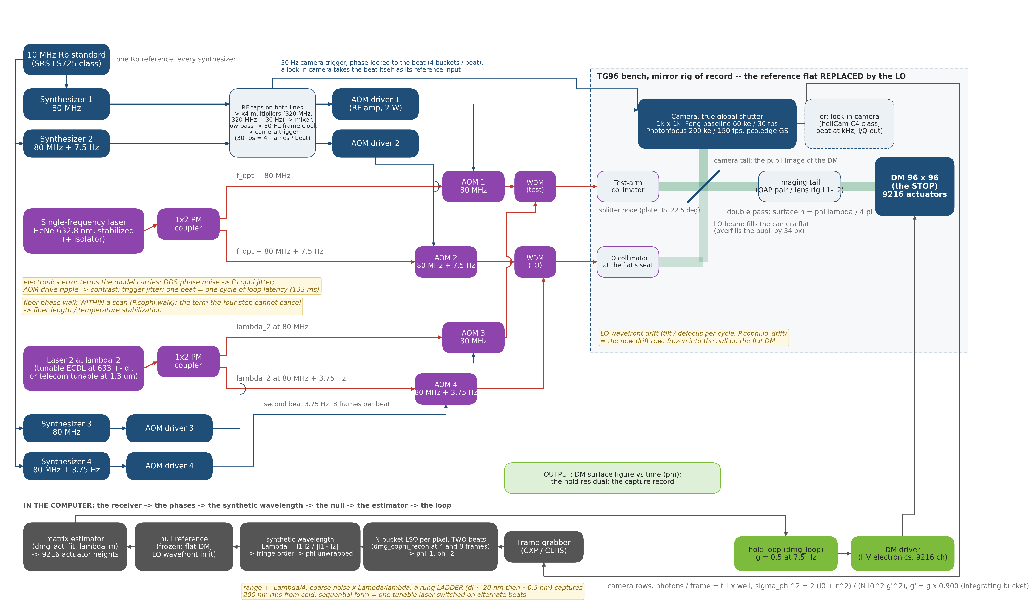
Two colors on the four-frame camera, frequency-multiplexed
A second laser at λ₂, its own AOM pair at a second beat, WDM combiners into the same two fibers; all four synthesizers on one reference; the processing adds the synthetic-wavelength block
• Two colors, one camera, one 8-frame set
– beats 7.5 and 3.75 Hz = 4 and 8 frames per beat at the same 30 fps
– each color demodulated at its own bucket centers from the same frames; no interference (THz apart)
– lock-in form: time-multiplexed, one color per 0.2 ms frame (slide 17)
• Blue = RF / timing · Red = PM fiber · Green = free-space beam · Gray = data
make_cophi_block_fig.py; the sequential form — one tunable laser switched on alternate beats — uses the one-color hardware and half the cadence.

Slide 27
The detector survey, and its caveats
Web surveys, every number sourced; the heliCam row verified by its vendor, the others not; the rows the deck uses and the question each needs answered
part | the number the deck uses | to verify
Feng's baseline camera | 1k², 60 ke⁻, 30 fps, read noise assumed 5 e⁻ | the part itself (not named in the deck)
Photonfocus MV1-D1024E-160 | 1024², 200 ke⁻, 150 fps, 220 e⁻ read, 10.6 µm | datasheet; ROI frame rates
pco.edge 5.5 GS mode | 2560 × 2160, 30 ke⁻, 50 fps GS, 2.2 e⁻ | the GS-mode well and rate
First Light C-RED 2 | 640 × 512 InGaAs, 1.4 Me⁻, 600 fps | read noise at low gain; the 1.3 µm stage
Heliotis heliCam C4 / C4M | 542 × 512 / 1024 × 1102, 305 Hz–134 kHz, 500 ke⁻ per internal image, 2 × 10-bit X/Y at 460 e⁻ per count, read 489 e⁻ per frame, 4960 frames/s, 20 kHz quarter-period trigger, QE 73 % at 633 nm | VERIFIED by the vendor 2026-10-28 (datasheets, user manual, noise calculator); 2026-10-29: no adjustable gain (X/Y signed ±512; 0–1023 by API), FPGA averaging at the sensor's 4960 frames/s, DivideBy4 confirmed, background suppression off
NOTE_detectors_survey.md (2026-10-09), NOTE_lockin_arrays_survey.md (2026-10-11); the 1 pm yardstick: 2 × 10⁻⁵ rad of phase at 633 nm double pass → ~2.5 × 10⁹ e⁻/s per element shot-limited.

Slide 28
Run tags and records
Every number in this deck, where it came from
stage | record | headline
bench | runs/bench_{lens,oap} | registration PASS, null 0.000 / 0.746 nm, contrast 0.982
battery | runs/battery_{lens,oap}, I = redo96_<optics>ph | H vs I same surface; the 0.5 % one-step shrinkage
gain probe | runs/gainprobe_lens | reading exact (slope 1.000000); λ_m names the 0.5 %
converged estimator | runs/conv_H_, tg_psi_dm96_oap/runs/conv_I_ph | H 1.0000 mirror; I/H 1.006–1.009 / 0.989
noise | runs/noise_{lens,oap}[_plain] | pm per reading per camera; both trains; electronics terms
loop | runs/loop_{lens,oap}_plain, runs/loopfib_* | 3 pm held; LO 29.6 pm; fiber 4.2 / 9.9
capture | runs/capture_{lens,oap}_plain | two colors: zero wrong orders to 480 nm
lock-in | the lock-in as a reading on the vendor's row: runs/c4_ (noise both rigs, loop at 0.125 s and 25 ms, capture); the survey-row runs runs/lockin_ (battery: the reading is exact) | 0.77 / 0.91 s per pm; 1.44 pm held at 0.125 s, 3.20 at 25 ms; fiber inert
figs | runs/figs_oap_plain | the station figure
the other gauges on a polarization camera | tg_psi_dm96_oap/runs/camI_{lens,oap}, zwfs_dm96/runs/camS_oap | IFO 189 / 160 s per pm; stepped 475, vector 519, pinhole 342
MACOS_resources/mmacos/templates/40_benches/cophi_dm96/, README per stage; gates tCophi 8, tCophiBench 9, tConvergedEst 4, tDmgLoop 17.

