Slide 1
A test of length 10
if
then
MOVE(distance=d?)
ROTATE(angle=a?) where P(d,a)
0
1
2
3
4
5
6
7
8
9
position 2

Slide 2












Slide 3
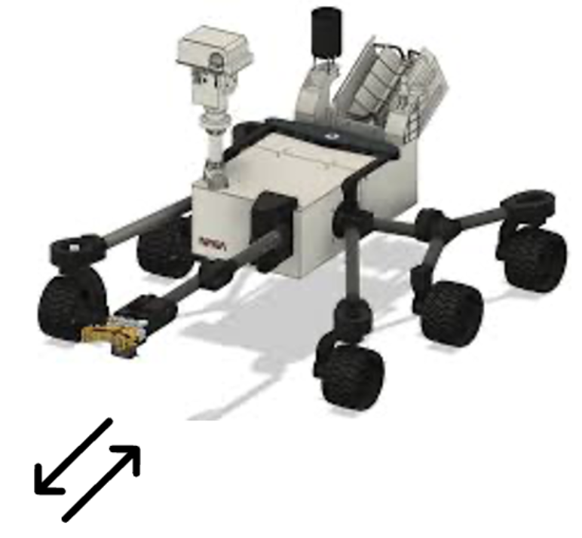
COLLECT
SCRIPT
SEND
ROTATE
STORE
PIC
GOTO
MOVE

