Slide 1
Module 2 Working with data: introduction to tabular data

Slide 2
Tabular data
Data arranged in rows and columns
Can be numerical or categorical or a mixture
Common data formats: comma separated value (CSV, .csv), tab separated value (TSV, .tsv)
Tools: Excel, Google Sheets
Python libraries: Pandas, NumPy
“header”
column names
individual data point
“index”
row names

Slide 3
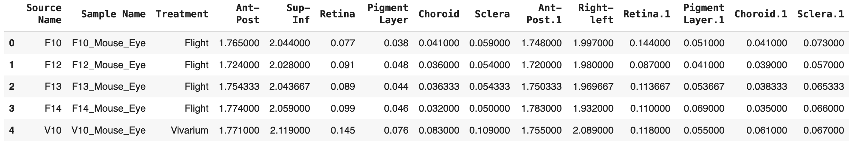
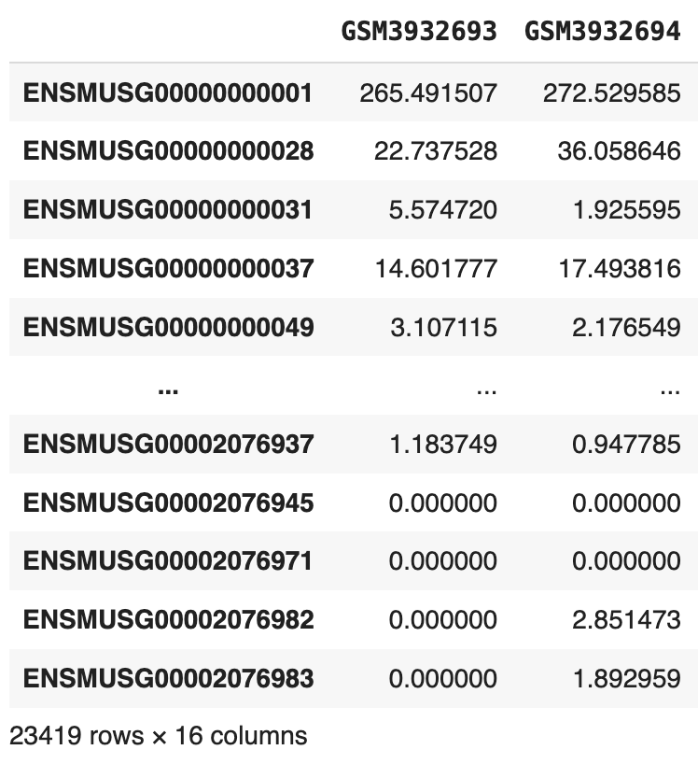
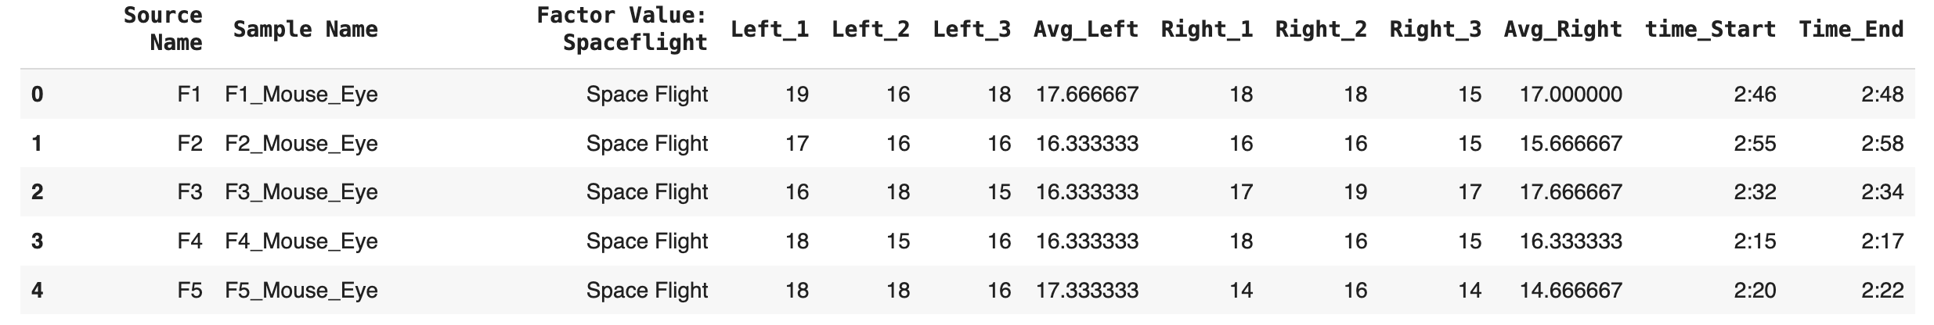
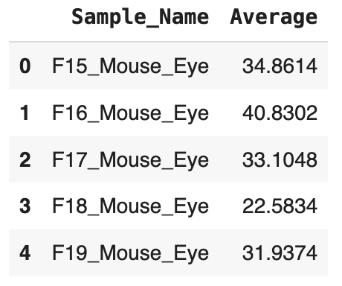
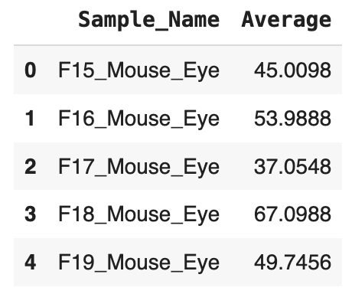
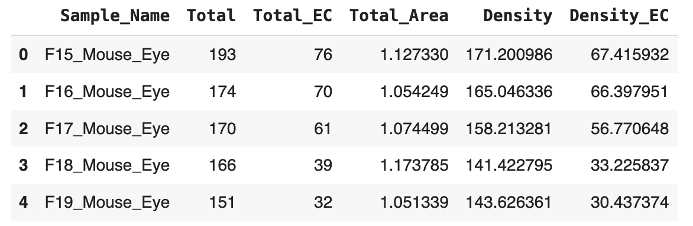
Many biological data types are captured in tabular format
microCT (OSD-557)
RNA sequencing (OSD-255)
Intraocular Pressure (OSD-583)
ZO, PECAM, TUNEL Microscopy Staining (OSD-568)
Notes:
HNE, a marker for oxidative stress
Zonnula occludens (ZO) are scaffolding proteins
Terminal deoxynucleotidyl transferase dUTP nick end labeling (TUNEL) is an assay that that detects apoptotic cells undergoing extensive DNA degredation.
Platelet endothelial cell adhesion molecule (PECAM) is a protein that functions as an adhesive stress-response to both maintain cell junctional integrity and speed restoration of vascular permeability.

Slide 4


Working with tabular data in python
NumPy
Library for working with numerical data
“Array” format
Capabilities for umerical operations, mathematical functions, statistical analysis
Fast processing of large datasets
Pandas
Library for flexible analysis of structured data
“DataFrame” format for tabular data
Capabilities for data cleaning, aggregation, summarization, analysis

Slide 5
data loading and exploration with pandas
pandas.read_csv()
Read in a CSV or TSV file (specify separator if TSV) to DataFrame format
dataframe.head()
View the first 5 rows of a DataFrame
dataframe.info()
Print information about a dataframe (values in each column, data types)
dataframe.describe()
Summary table of the dataframe (mean, standard deviation...)

Slide 6
Using pandas and numpy together
Mathematical operations in NumPy can use Pandas DataFrames as input
numpy.mean(dataframe)
numpy.std(dataframe)
Specify rows or columns using axis parameter

Slide 7
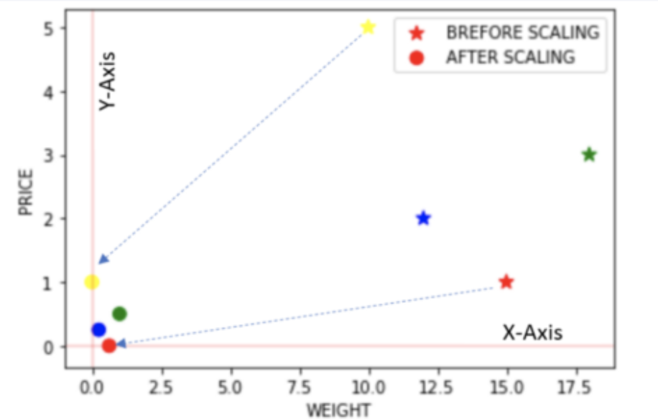
Feature scaling for machine learning
Feature Scaling: an important preprocessing step in many machine learning workflows
Ensures all features contribute equally to the model by bringing them to a common scale
Prevents features with larger scales from dominating the learning process and skewing results
Enhances model interpretability as the impact of each feature is on a comparable scale
Essential for algorithms like K-Nearest Neighbors and Support Vector Machines, which rely on distance calculations
https://towardsdatascience.com/all-about-feature-scaling-bcc0ad75cb35

Slide 8










Types of feature scaling for numerical data
Normalization
Standardization
Scales the data using minimum and maximum values (e.g. minimum 0, maximum 1)
Data values are constrained to a specific range
Useful when feature distribution is not consistent
Scales the data using mean and standard deviation (e.g. mean 0, standard deviation 1)
Data values are not constrained to a specific range
Useful when feature distribution is consistent
$$X^{′}=\frac{X −Xmin}{Xmax −Xmin}$$
$$X^{′}=\frac{X − μ}{σ}$$
$X^{′}=$ scaled data
$X^{′}=$ scaled data
$X=$ non-scaled data
$X=$ non-scaled data
$Xmin=$ minimum value of that feature
$μ=$ mean
$Xmax=$ maximum value of that feature
$σ$ = standard deviation

