Slide 1
Introduction to Machine Learning Classification Algorithms
Notes:
Welcome to the introduction to machine learning classification algorithms

Slide 2
Objectives
Discuss the goals of classification
Describe the decision tree algorithm
Describe the random forest algorithm
Describe the single layer perceptron algorithm
Define how to measure performance for classification
Notes:
The objectives of this lesson are to first discuss the goals of classification. We will then describe the decision tree algorithm, followed by a description of the random forest algorithm (which uses decision trees), and we will describe the single layer perceptron algorithm. And finally, we define how to measure the performance of a classification algorithm.

Slide 3
Discuss the goals of classification
Notes:
In this first section, we discuss the goals of classification.

Slide 4
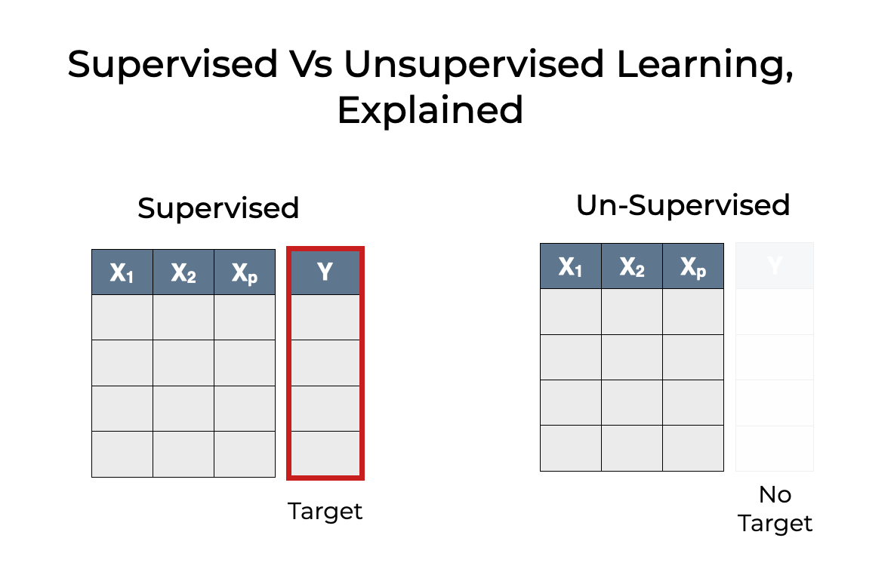
Recall supervised vs unsupervised machine learning
Notes:
Recall the difference between supervised and unsupervised learning. In supervised learning, we have features (say x1, x2, up to xp) that the algorithm uses to predict a target (say Y). In unsupervised algorithms, we do not have a target associated with the features. Classification is a supervised algorithm, so it requires having a target value to predict.

Slide 5
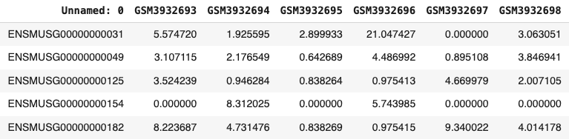

What can we classify in space biology?
RNA-seq data
ML classifier
classes
low IOP
high IOP
Notes:
What can we classify in space biology? Classification involves the training of a machine learning algorithm to classify input features into a finite number of classes. This slide shows an example of using the feature space representing RNA sequencing data as predictors of low or high intraocular pressure – a phenotypic response to space flight. In this example, we wish to train a binary machine learning classifier (i.e. one with 2 possible outcomes) that can examine RNA transcript counts to determine whether the intraocular pressure in the sample’s eye is high or low.

Slide 6
What questions can we answer in classification?
RNA-seq data
ML classifier
classes
low IOP
high IOP
Given a gene expression profile, do we predict the IOP to be high or low?
Which genes (if any) are implicated in the reduction of IOP?
Notes:
If a machine learning classifier can predict whether the IOP will be high or low based on gene expression, then we can identify which genes are responsible for that effect. Knowing which genes are responding to space flight may help us monitor, diagnose, or even prevent this deleterious effect.

Slide 7
Describe the decision tree algorithm
Notes:
In this section, we describe our first machine learning classifier – one which you’ve probably already seen – the decision tree.

Slide 8
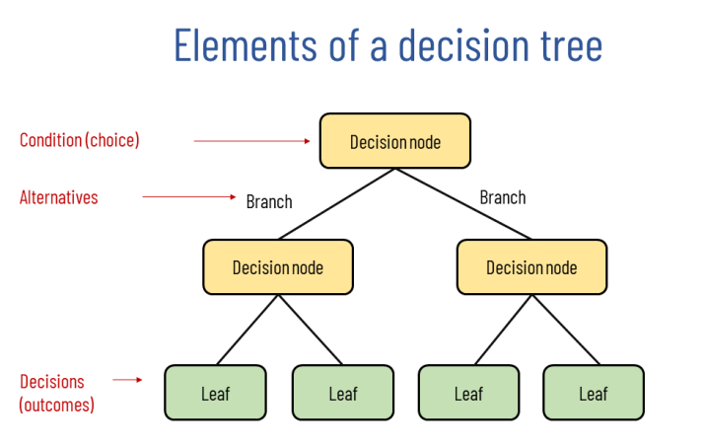
Elements of a decision tree
https://why-change.com/2021/11/13/how-to-create-decision-trees-for-business-rules-analysis/
Notes:
A decision tree is a form of graph that has a singular root (the starting point of the decisions). At each decision node, a yes-no (or true-false) question is asked of the data. The tree then branches into children nodes, each of which ask subsequent true-false questions which continue to branch until all the nodes are classified in the leaf nodes. The questions do not need to be binary (i.e. have 2 possible answers), they can have multiple answers as we will see in the next slide.

Slide 9
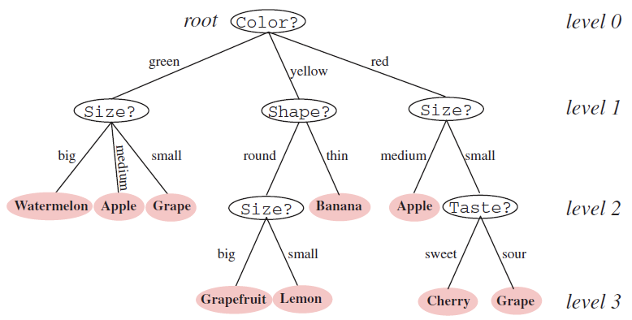
Example decision tree
Notes:
In this example, we’ve constructed a decision tree which is trained to classify a fruit given it’s color, size, shape, and taste. Starting at the top level (the root node), the tree asks the question: “what is the color of the fruit?”. If the answer is “green”, then the tree branches to the next question : “what is the size of the fruit?”. If the answer is “big”, then the decision tree decides that the fruit must be a watermelon (since it is green and big). If the size is medium, the decision tree decides the fruit is an apple (since it’s green and medium-sized). If the answer is “small”, the decision tree decides the fruit is a grape (since it’s green and small). All the leaf nodes in the decision tree represents the decisions (i.e. the classifications) of the fruit given the data color, size, shape and taste.

Slide 10
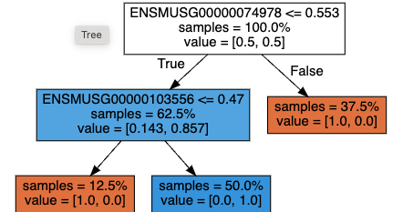
Example decision tree
Notes:
In this example decision tree, the model first asks the question: “is the gene ENSMUSG74978 count less than 0.553?”. If the answer is True, it then asks the question: “is the gene ENSMUSG103556 count less than or equal to 0.47”. If the answer to this second question is True, then 12.5% of the sample values are classified as “low”. The first number in the list of values is “low” and the second number is “high”. If the answer is False, then 50% of the samples are classified as “high”. so you can see that the percentage of the all a node’s children must add up to that nodes percentage of samples. In this case, 12.5% + 50% = 62.5%. Going back to the first question at the root node, if the answer is False, then all of those samples (which constitute the remaining 37.5% of the data) are classified as “low” value. In this tree, we only needed 2 gene expression values to classify all of the samples IOP measurements as low or high. Please note that these fractional gene count values (which are normally integers) are due to the fact that the data were standardized first.

Slide 11
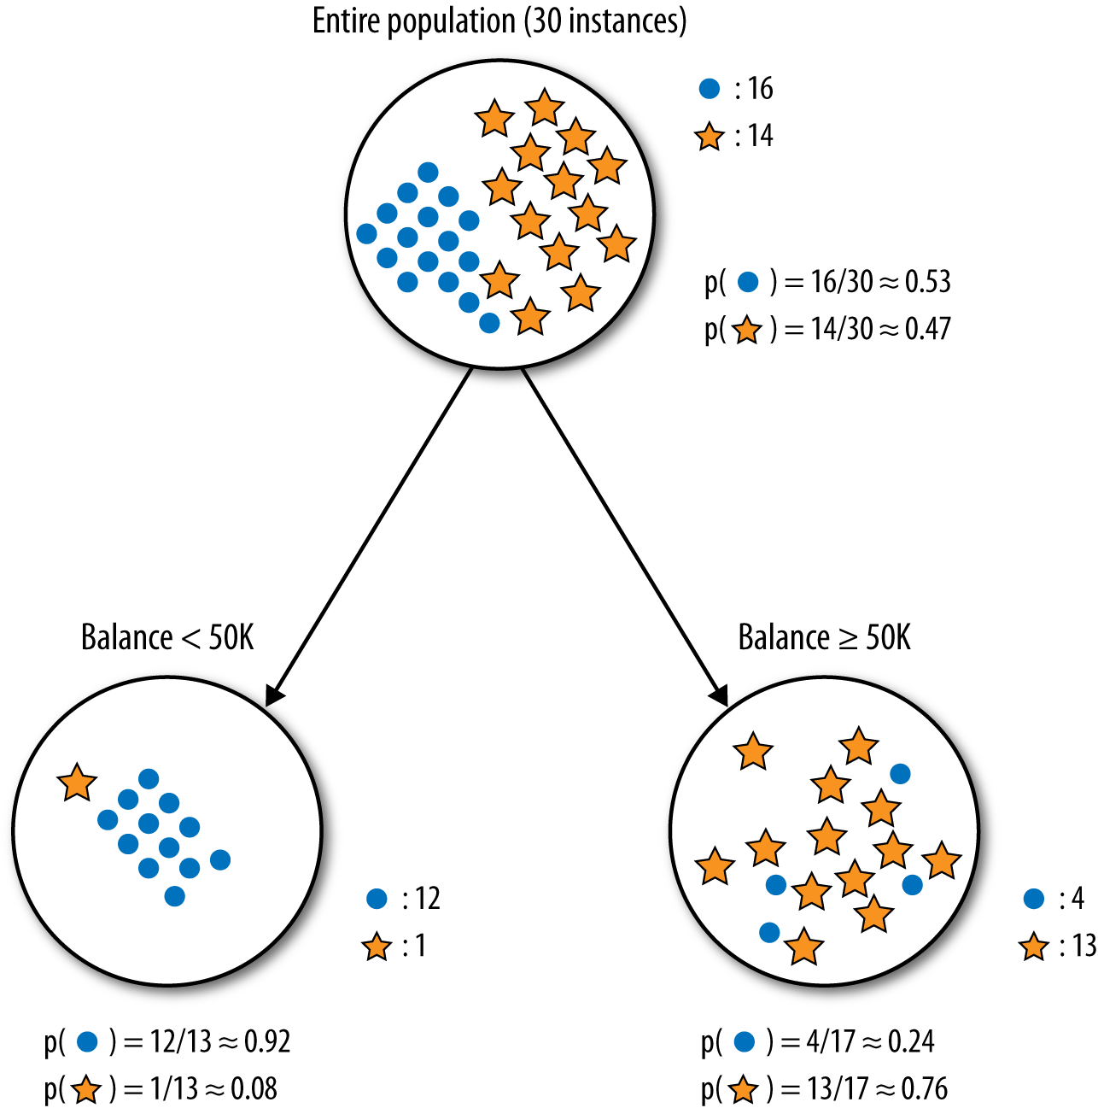
Information gain and entropy
x1 < 100
x1 >= 100
Notes:
Informally, information gain is a method to quantify the “goodness” of the question being asked at a node in a decision tree. The best questions asked in a parent node separate one class from another in their children nodes. The worst questions don’t do anything to distinguish one class from another in their children nodes. In this way, information gain is a quantitative measure that measures how much information is gained (i.e. how well does the question separate one class from another) by asking that question. The “questions” are derived from the input features, and some questions are better than others. In this example, the root node has 30 total samples: 16 samples in the blue circle class and 14 samples in the gold star class. Asking the question: “is the value of x1 less than 100?” classifies all but 1 sample as blue and “is the value of x1 greater than or equal to 100” classifies all but 4 samples as gold stars. It’s not a perfect separation of classes, but it seems like this question gained a lot of information in the decision tree.
Entropy is a measure of surprise or uncertainty, and if you were to blindly select a sample from the parent node in this tree, you’d have a roughly 50-50 chance of getting either a blue circle or a gold star. If you were to continue this experiment replacing that sample back into the “bag” ad infinitum, you would select approximately half blue circles and half gold stars, and each time you wouldn’t have any good idea of what the outcome would be. For that reason, we say that the root node has high entropy. On the other hand, if you were to repeat the experiment of blindly selecting a sample with replacement from the left child node, you’d likely select a blue circle and you wouldn’t be very surprised by that outcome. For that node, we say the entropy is low.
Formally, information gain is the difference in entropy between the parent node and it’s children nodes. Entropy is beyond the scope of this course but worth looking into for greater understanding of machine learning.

Slide 12
Describe the random forest algorithm
Notes:
In this section, we’ll describe the random forest algorithm which is built on multiple decision trees.

Slide 13
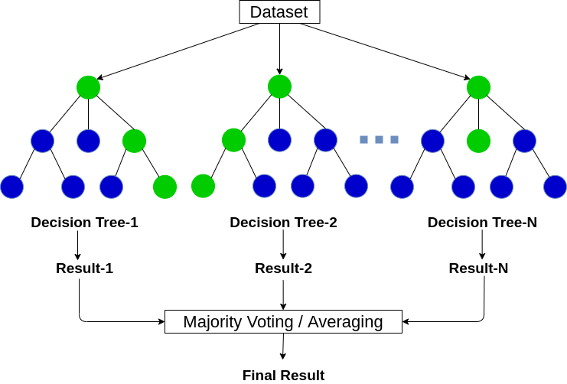
Graphical representation of random forest
Notes:
A random forest model is comprised of multiple decision trees – thus the name “forest”. Each tree is created by using a subset of the training data selected at random and with replacement – thus the name “random”. After all the trees in the forest are trained, the model passes the data through each tree to reach a classification (i.e. decision) for that input. The model chooses the classification that the majority of the trees voted for as the final result of the model.

Slide 14
Hyperparameters of machine learning models
a hyperparameter of a model is a configurable, tunable setting that effects how the model is trained
examples of hyperparameters for decision tree include:
maximum depth of tree
metric used for information gain
examples of hyperparameters for random forest include:
number of trees
number of features used for each tree
all decision tree hyperparameters (e.g. max depth, information gain, …)
Notes:
A hyperparameter of a model is a configurable parameter that affects how a machine learning algorithm behaves. In the case of the decision tree, one hyperparameter you can define a priori is the maximum depth of the tree. This guides the decision tree algorithm and tells it to not have levels go deeper than a certain value. This happens to prevent overfitting which we will talk about later in this lesson. Another hyperparameter of a decision tree is which metric to use for information gain. We discussed the use of entropy earlier in this lesson for information gain, but there are other metrics which we won’t discuss here.
Because random forests are collections of decision trees, all the hyperparameters that apply to decision trees also apply to the random forest. Plus it has additional hyperparameters such as the maximum number of trees and the number of features used to build each tree.

Slide 15
Describe the single layer perceptron algorithm
Notes:
In this section, we describe the single layer perceptron member of the family of supervised algorithms.

Slide 16
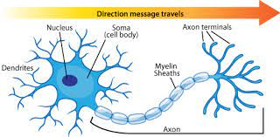
Biological neuron
Notes:
This is a diagram of a single brain cell – the neuron. There are approximately 100 billion neurons in the adult human brain, and they are highly interconnected. The dendrites on the left side of the diagram connect to the axon terminals of other neurons, and the axon terminals on the right side of the diagram connect to the dendrites of other neurons. There are an estimated 100 trillion connections in the adult human brain. Some connections are stronger than others. A neuron collects its electrical input from upstream neurons through its dendrites, and once a threshold of input is reached, the neuron fires a signal out through its axon terminals, sending signals downstream through its axon terminals. A neuron fires between 2 and 5 times per second on average.

Slide 17
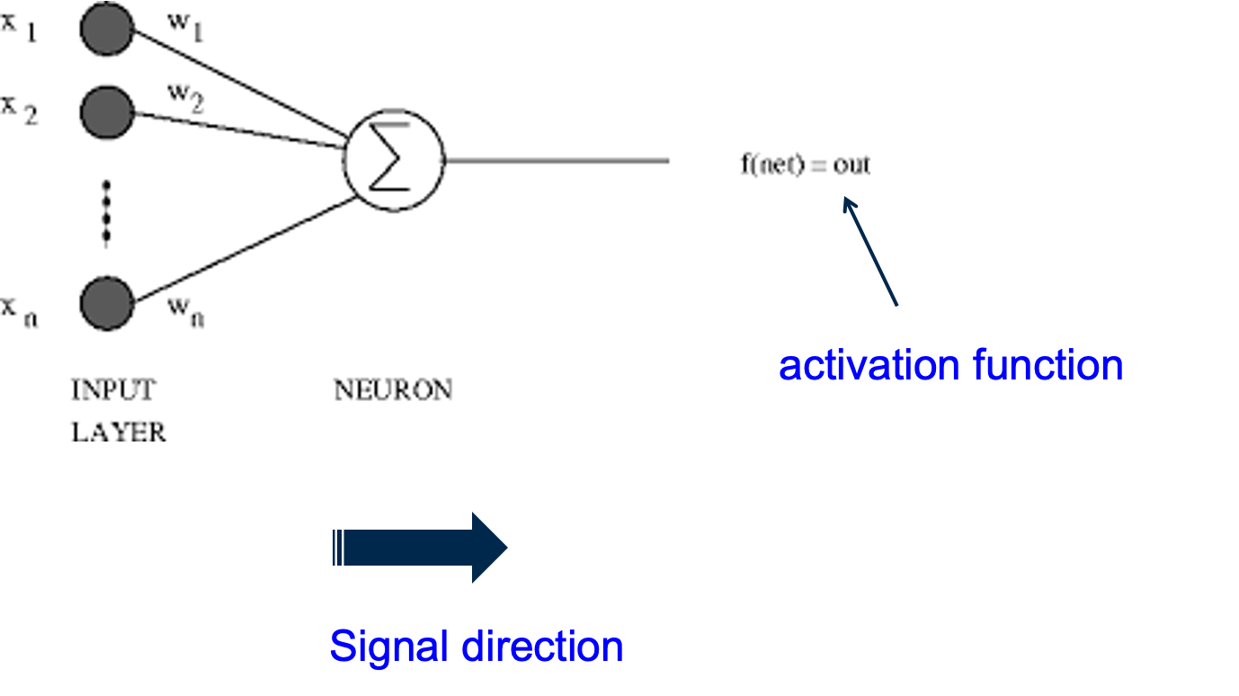
Artificial neuron
Notes:
Back in the 1950’s, scientists created the artificial neuron which is modeled after the biological neuron. In this diagram, the inputs x1 through xn are akin to the biological neuron dendrites. Those inputs are summed (represented by the sigma symbol) and when a certain threshold is reached (represented by the activation function), the artificial neuron fires output to downstream artificial neurons.

Slide 18
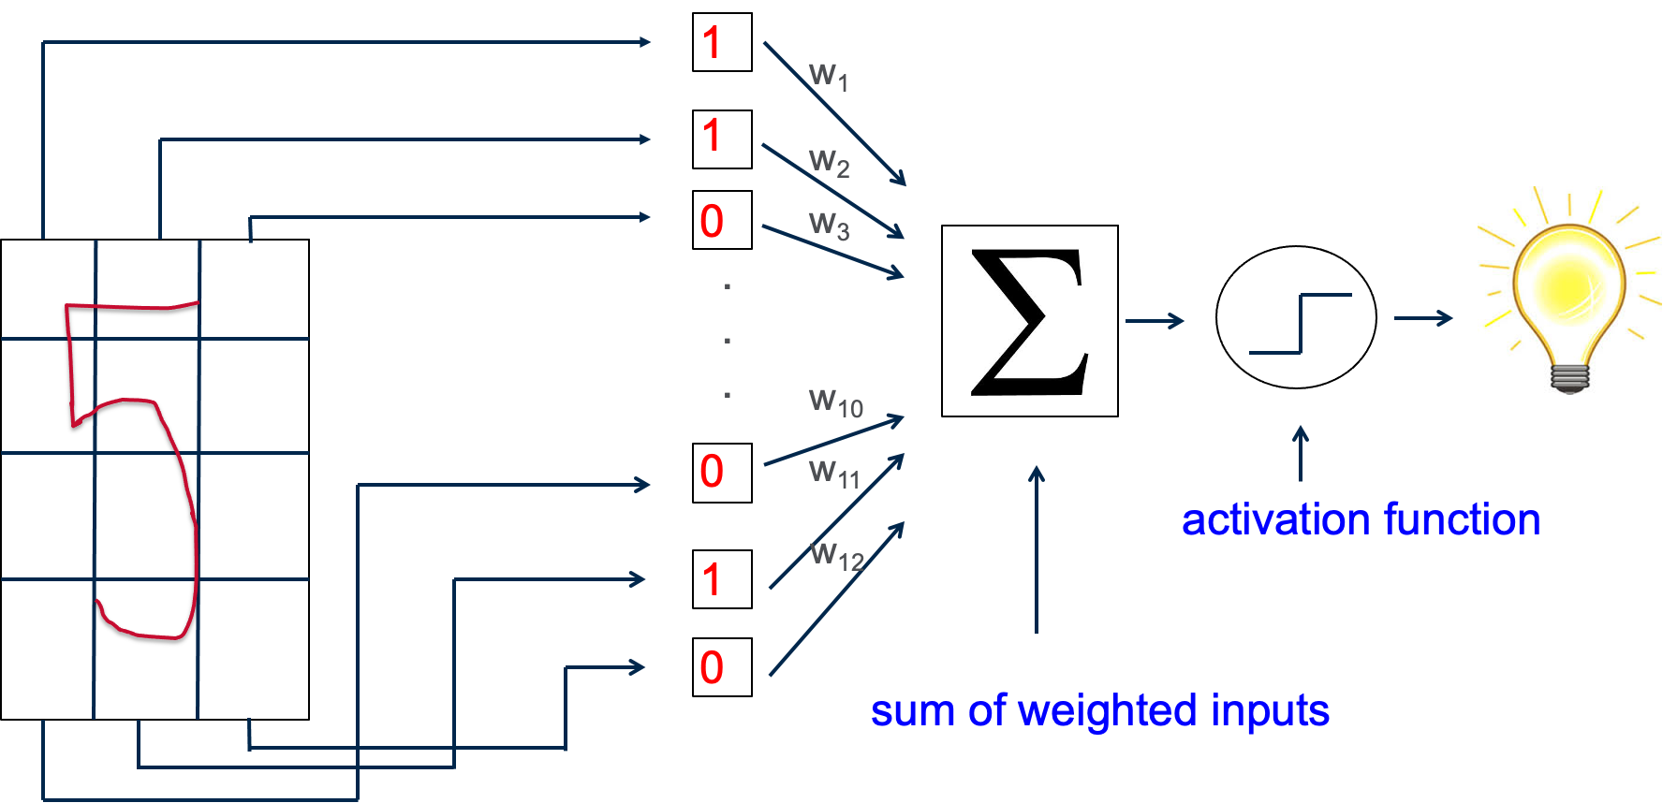
Handwritten digit : even or odd?
Notes:
This is a single layer perceptron model that is trained to perform a very simple task. It takes as input a grid in which a handwritten digit is placed - this particular grid has 4 rows and 3 columns, so 12 cells in all. If a cell has some “handwriting” in it from the digit, we put a 1 for that cell. If a cell is empty, we put a 0 for that cell. We then take all those 1’s and 0’s, multiply each by a weight, add them up, and if the sum is greater than a threshold, we “fire” a 1 to indicate the number is odd. If the sum is less than a threshold, we “fire” a 0 to indicate the number is even. The single layer perceptron algorithm learns those weights w1 to w12 in an iterative process we discuss in the next slide. The activation function in this case is called a step function (it looks like a step, right?). The horizontal axis represents the sum, and the vertical axis of the step function represents a 0 or 1 (or low or high, or in this case even or odd). There are many activation functions available that we won’t discuss here.

Slide 19
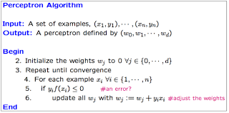
Single-layer perceptron training algorithm
Notes:
This slide represents the single layer perceptron training algorithm in a form of pseudo-code. The input to the algorithm is a set of points (x1, y1), (x2, y2), … up to (xn, yn). The output of the model is the set of weights that are multiplied for each x input. The initial values of the weights are set to 0. We iterate through lines 4-6 until model convergence, which is either when the weights stop getting updated (we found a minimum error) or when a number of iterations is reached (we can’t do this forever). For each input xi, we multiply the xi by the weights and get a sum. If the answer is correct, we continue to the next point in the dataset. If the answer is wrong (i.e. the predicted value f(xi) is not equal to the actual value yi, then we update the weights.

Slide 20
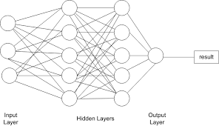
Multi-layer perceptrons
Notes:
The single layer perceptron was found to be too simplistic a model for certain tasks and was later replaced with multi-layer perceptrons, or MLPs. MLPs have an input layer and an output layer like the SLP, but additionally has 1 or more hidden layers. The number of hidden layers and the number of nodes per layer are 2 hyper-parameters of the MLP. The more nodes and layers in the model, the more complexity the model can capture in the dataset.

Slide 21
Define how to measure performance of classification algorithms
Notes:
In this section, we discuss how to measure the performance of classification algorithms.

Slide 22
Accuracy
accuracy = number correct / total number → general classification
accuracy = (TP + TN) / (TP + FP + TN + FN) → binary classification
Usually accuracy is represented as a percentage 0% to 100%, but 0 is not necessarily considered the worst for all classifiers. (e.g. binary classifier)
Notes:
Accuracy is the most common metric used to evaluate a classification algorithm. It’s like a score a student gets on an exam – the number of correct answers divided by the total number of questions.
In binary classification there are 2 possible outcomes (positive and negative, 0 and 1, or true and false, or whatever). For this discussion we will say that the 2 outcomes or classes are called positive and negative. There is a concept of true and false positive and negative. A true positive is a prediction of positive when the actual value was positive, and a true negative is a prediction of negative when the actual value was negative. A false positive is a prediction of positive when the actual value was negative, and a false negative is a prediction of negative when the actual value was positive.
In a binary classification, if you build a model which just flips a fair 2-sided coin and assign one value to heads and the other value to tails, over time you would expect to get the answer correct about 50% of the time. This baseline performance is not informed by the data at all and is often referred to as the null model. In machine learning, we strive to build models that do better than the null model.

Slide 23
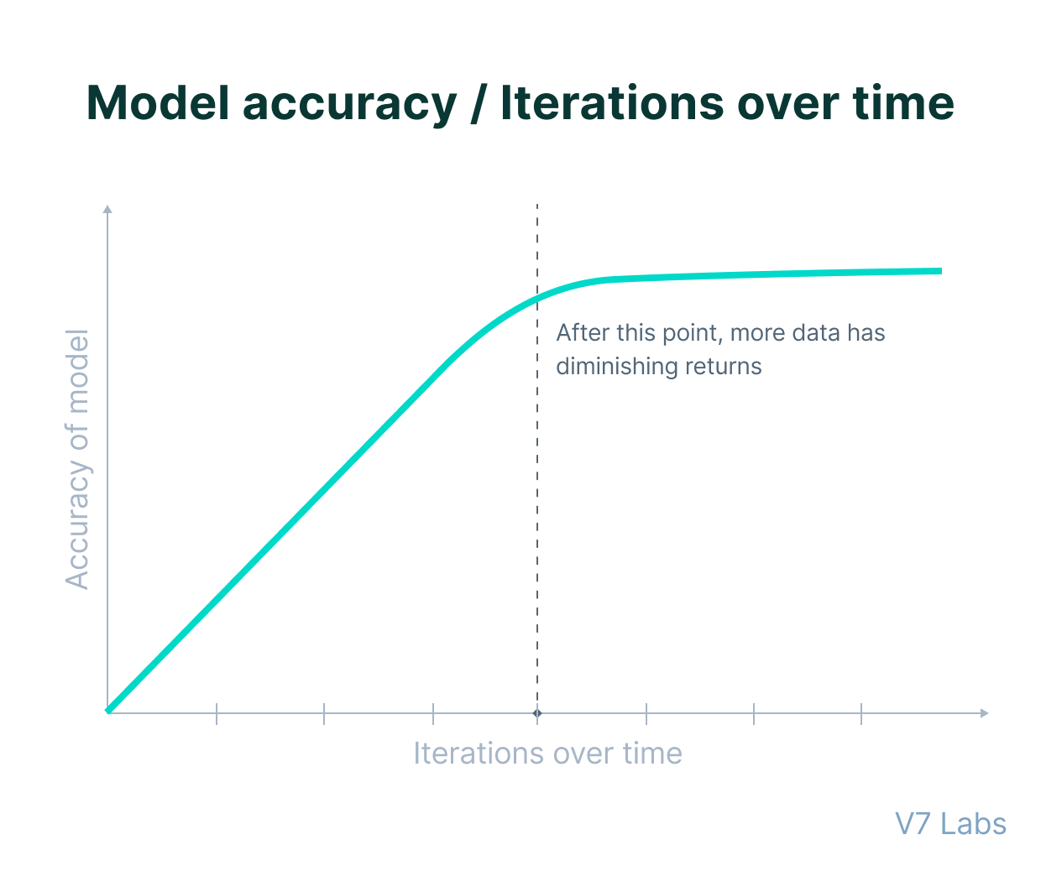
Accuracy
Notes:
Model accuracy usually improves the longer you train a model. There may come a point in time when the accuracy ceases to improve. We say that, at this point, the model has converged and you can stop training. Another reason to stop training a model is when you’ve reached a certain predefined number of iterations, and accuracy is no longer improving. We call these stop conditions for when to stop training.

Slide 24
Accuracy not always best metric
95%
5%
Notes:
Accuracy is not always the best metric to use when evaluating a machine learning model. For example, if you have a dataset which is heavily biased in favor of a particular outcome, then you could just design your model to always predict that outcome and it will mostly be correct. Suppose as in the slide, the data set is comprised of the green class with 95% and the red class with 5%. One could design a model that always predicts “green” and it would be, on average, 95% accurate. This is called an imbalanced data set and just one reason accuracy is not always the best metric.

Slide 25
Accuracy not always best metric
- $5
- $500
cost of misclassification
Notes:
Another reason accuracy is not always a good metric is when there is some cost and benefit associated with a classification. In the slide’s contrived example, the cost of classifying the green class incorrectly is $5 and the cost of misclassifying the red class is $500. We’d need to do what’s called a cost-benefit analysis and calculate the expected value - beyond the scope of this course but worth looking into - to evaluate such a model. Cost and benefit are not necessarily represented as monetary values either - the cost of misclassification could be the cost of misdiagnosing a patient with a fatal disease, for example.

Slide 26
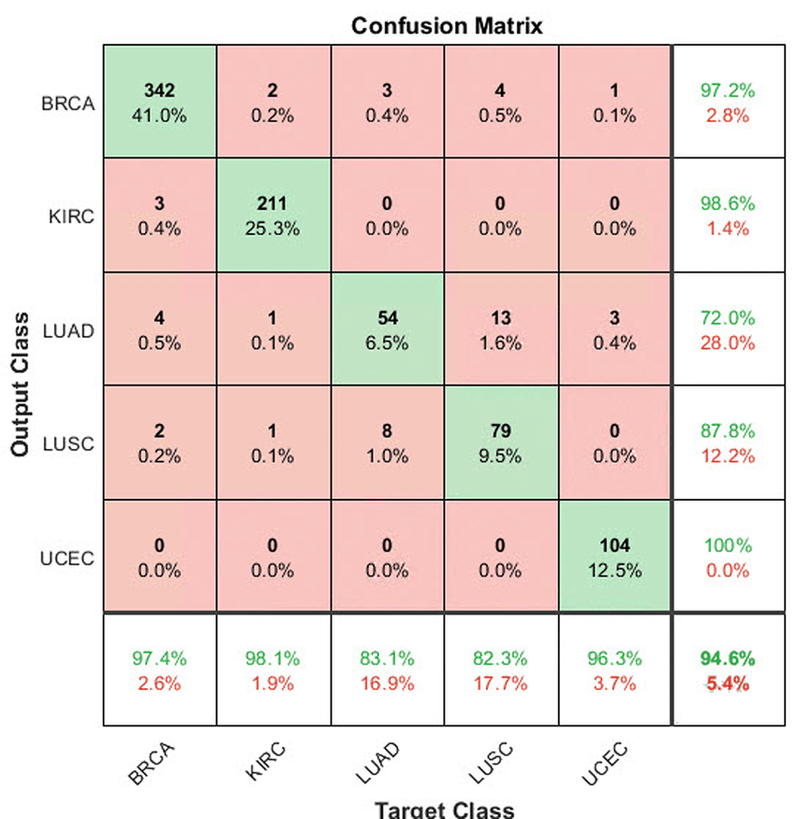
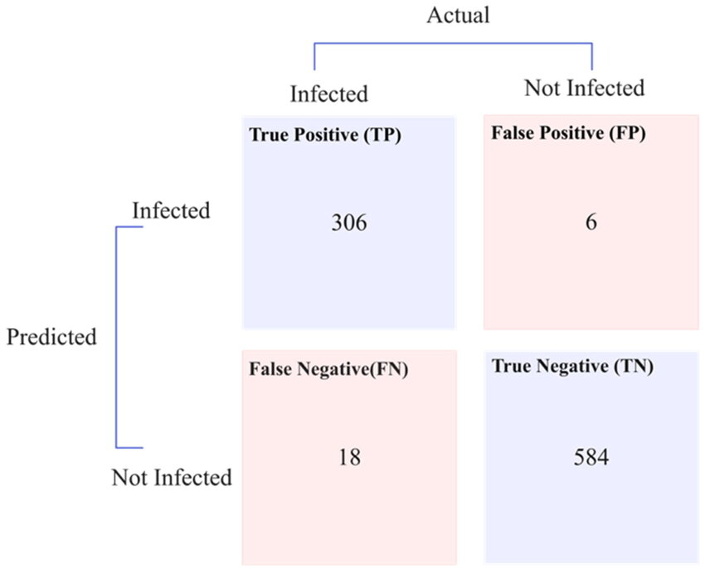
Confusion matrix
gene classifier
flu test
Notes:
Another way to evaluate a classification model is by using a confusion matrix. The confusion matrix on the left is for a binary classification where there is only positive and negative (or true and false or 0 and 1 or whatever). Suppose you’ve designed a flu test. A true positive is a diagnosis of a person having the flu when they really do have the flu, and a true negative is a diagnosis of a person being healthy when they really are healthy. A false positive is a diagnosis of a person having the flu when in fact they are really healthy, and a false negative is a diagnosis of a person being healthy when in fact they really have the flu.
The confusion matrix on the right is a generalization of the confusion matrix when there are more than 2 classes. The values along the diagonal represent correct classifications and the values off the diagonal represent incorrect classifications. This particular confusion matrix measures the performance of a gene classifier that classifies or predicts genes based on some input.

Slide 27
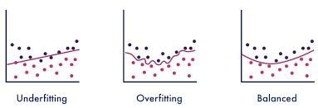
Overfitting/underfitting
Notes:
You can design a decision tree to fit every single data point in the training set (i.e. all the data points are leaves in the tree). But such a model would be considered “overfit” and would not generalize well to data it has not seen before. On the other hand, a model which is too generic (like the model on the left) is considered “underfit” and would also not generalize well to data it hasn’t seen before.
We wish to design our models (not just decision trees) to be “just right”, balanced – not overfit and not underfit. There’s a method called regularization which penalizes a model for being too complex. In the case of decision trees, limiting the depth of the tree and limiting the total number of decision nodes are 2 ways to regularize the model. Another technique is called pruning where the algorithm will remove a portion of the decision tree after it’s built. In the case of random forests, limiting the maximum number of trees in the forest is one way to regularize the model, along with limiting max depth and number of nodes per tree.

Slide 28

Notes:
And that brings us to the end of this lecture in which we discussed various concepts of classification from the supervised family of machine learning algorithms, including decision trees, random forests, single layer perceptron, accuracy, confusion matrix, and overfitting and underfitting. In the hands-on activity, you will have the opportunity to use the algorithms and tools we learned in this lesson. Specifically, you’ll use random forest and the single layer perceptron to classify phenotypic responses using RNA-seq data as predictors.

