Slide 1
Introduction to Clustering
Notes:
Welcome to this lesson: introduction to clustering

Slide 2
Objectives
Identify the goals of clustering
Describe the K-means clustering algorithm
Describe hierarchical clustering with heatmaps
Describe Gaussian mixture model clustering
Discuss principal components analysis as a clustering algorithm
Notes:
The objectives of this lesson are as follows: we will first identify the goals of clustering, then we will look at our first clustering algorithm called k-means; then we will describe hierarchical clustering with heatmaps; we will describe gaussian mixture model clustering; and finally we discuss principal components analysis as a clustering algorithm

Slide 3
Identify the goals of clustering
Notes:
In this first section, we will identify the goals of clustering

Slide 4
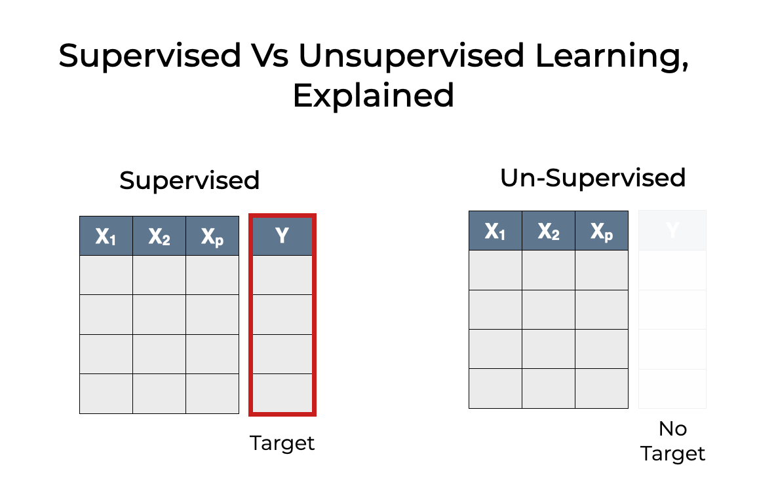
Recall supervised vs unsupervised machine learning
Notes:
Recall the difference between supervised and unsupervised learning. In supervised learning, we have features (say x1, x2, up to xp) that the algorithm uses to predict a target (say Y). In unsupervised algorithms, we do not have a target associated with the features, or more generally, we do not use any targets or labels in unsupervised training even if we have them. Un-supervised training is usually equivalent to clustering - the topic of this lesson.

Slide 5
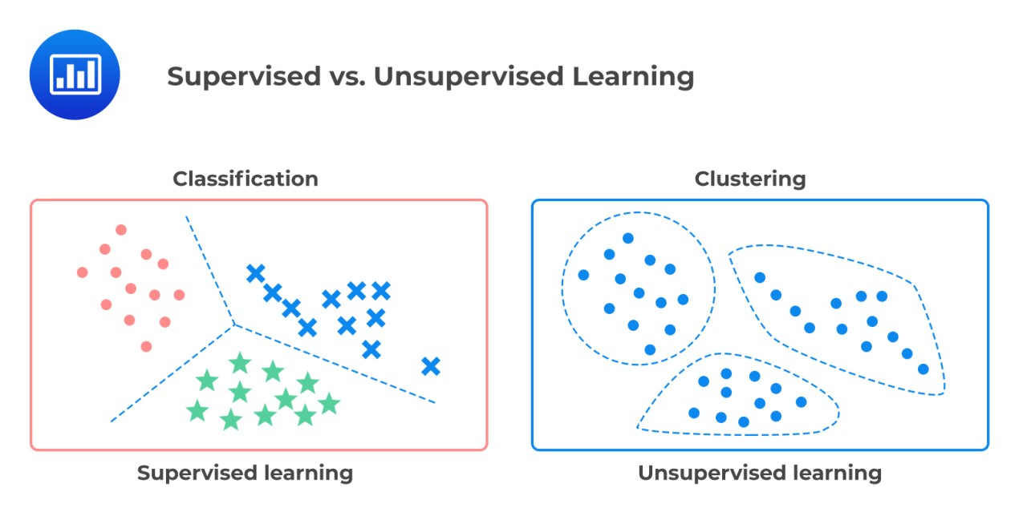
Finding groups (clusters) of similar data points
Notes:
Where classification of data is a supervised technique which uses the input features to classify each sample in one of a fixed number of classes, clustering is an unsupervised technique which uses the input features to form groups or clusters of similar samples. In the example in this slide, the same feature space is used for both classification and clustering. On the left, there are apparently 3 classes in this data set as targets: red circles, green stars, and blue x’s. The dashed lines represent some decision boundary which separates those classes in 2 dimensions. On the right, those same samples have been clustered using some algorithm into 3 clusters delineated by the dashed blue lines. Note that all the samples are colored as blue circles to denote that there is no class association with each sample – they are unlabeled.

Slide 6
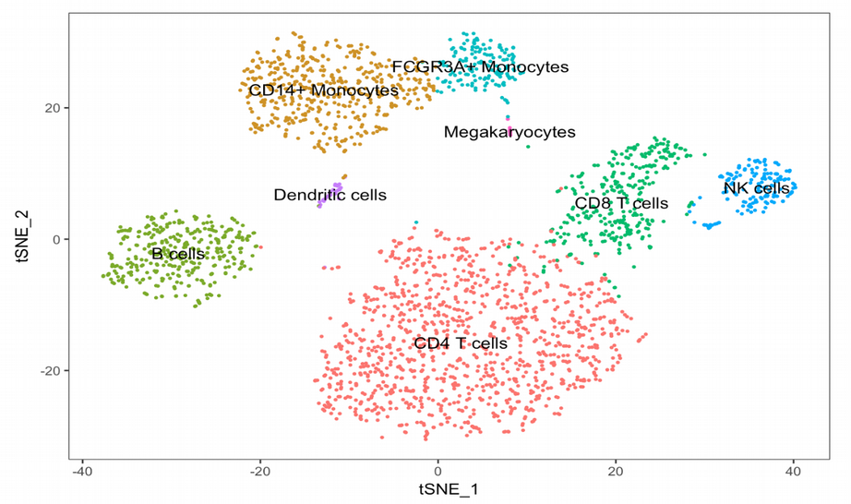
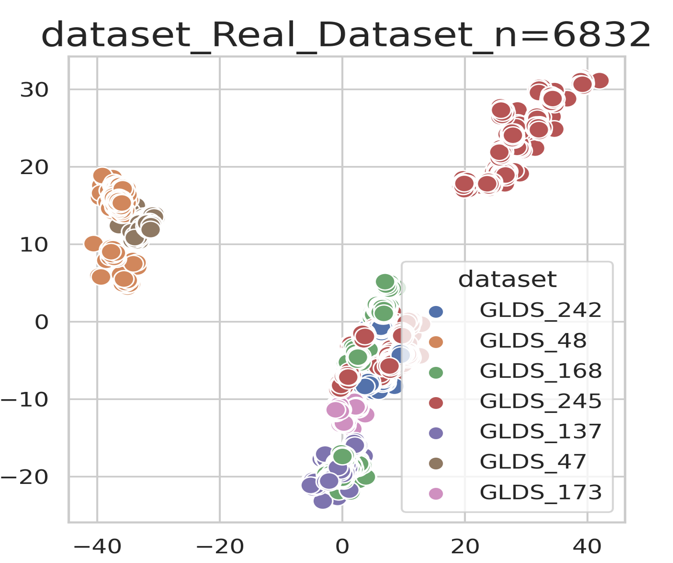
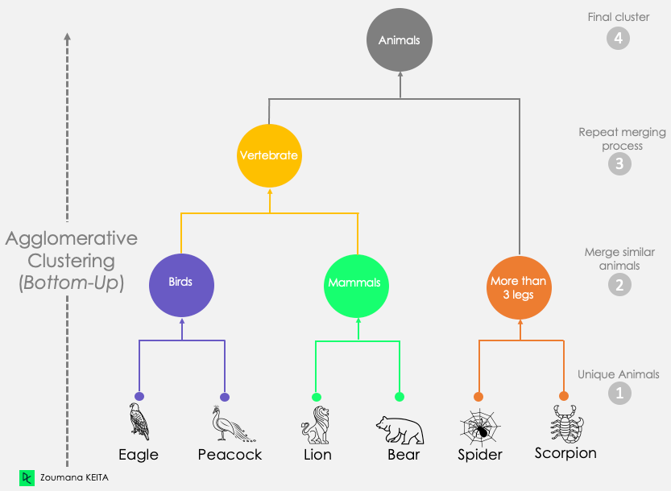
Clustering application examples
which cells are most similar?
is there a batch effect between experiments?
which organisms are most similar?
Notes:
There are several applications of clustering, three of which are shown in this slide. One application is to determine whether there are what are called batch effects in the data set. A batch effect in RNA sequencing is a technical artifact that manifests when the same experiment is conducted with a certain bias. In this example, there are 7 data sets from GLDS (the old name for OSDR). It is clear that these experiments have batch effects – all the samples from GLDS-168 are in their own isolated cluster, and GLDS-48 and GLDS-47 share a cluster distinct from the others. A second example on the top right of the slide asks the question: which cells are most similar? This data is from a single cell RNA-sequencing experiment where individual cells from a tissue are isolated, tagged, and then sequenced, as opposed to bulk RNA sequencing experiment where cells are grabbed en masse from a tissue sample. It’s clear that the cells distinguish from one another based on their cell type – CD4 from CD8 T cells, megakaryoctyes from monocytes, … etc. In the bottom example, data are observed from different organisms (perhaps phenotype data) and then used to see which species most closely resemble which other species? In this example, eagles and peacocks are most similar (both birds), and lions and bears are most similar (both mammals), and spiders and scorpions are most similar as they both has more than 4 legs. As we go up the tree, our clustering becomes more generalized, so the birds and the mammals cluster together. Then finally, all the organisms cluster into a single root which is the animal kingdom.

Slide 7
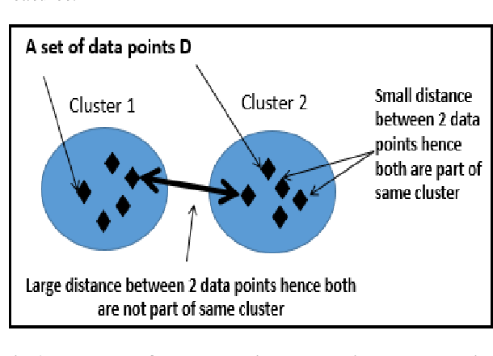
Similarity within and dissimilarity between clusters
Notes:
How clustering algorithms work is they use some metric of similarity to determine how close or far 2 data points are. One metric for data that is numeric is euclidean distance, and clustering seeks to both minimize the distance between points in the same cluster (similarity within the cluster) and maximize the distance between clusters (dissimilarity between clusters).

Slide 8
Describe the K-means clustering algorithm
Notes:
In this section we describe the k-means clustering algorithm.

Slide 9
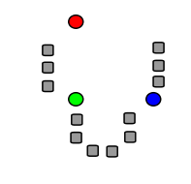
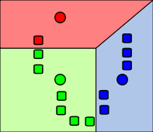
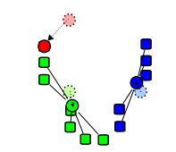
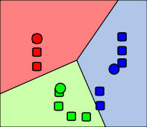
Graphical representation of K-Means algorithm
Step 4: Each data point is assigned to its closest centroid.
Step 1: the k=3 cluster centroid are initialized randomly in the feature space.
Step 2: Each data point is assigned to its closest mean.
Step 3: The means are re-calculated to be the mean value of all its members.
Notes:
This slide is a graphical representation of the k-means algorithm. The algorithm starts at step 1 where the cluster centroids are initialized randomly in the feature space. In step 2, each point is assigned to its closest centroid using whatever distance metric is defined. In step 3, the centroids (which are means in the case of k-means) are recalculated as the means of the points which were assigned to it in step 2. Step 4 is really step 2 again, where each point is assigned to it’s closest centroid. So the data points do not move in this algorithm (that wouldn’t make sense). What moves in each iteration is the centroid.

Slide 10

Mathematical representation of K-Means algorithm
Initialization step
Assignment step
Update step
Stop conditions
assign initial coordinates to k centroids {m₁, m₂, … , m_{k}}
Min change of mean from last iteration
Sufficiently small intra-cluster distance (WCSS)
Sufficiently large intercluster distance
Notes:
This slide represents a slightly more formal description of the algorithm - using mathematical symbols. The first step is called initialization and may be performed in a number of ways but most often is random – i.e. the k centroids are placed in the n-dimensional space among the data points. The centroids m_i are stored in a set. The second step is called the assignment step where the ith set S is constructed of all those data points x_p such that the distance between x_p and the centroid m_i is less than the distance between x_p and all other centroids m_j for j among the centroids. The superscript t denotes the t-th step of the algorithm which iterates until some stop condition. The third step is called the update step where the ith centroid m_i is set to the mean value of all the members assigned to it in the previous step (the mean is derived by adding up all the values x_j in that set S_i divided by the total number of those points in S_i. This algorithm repeats back between the assignment step and the update step until a stop condition is reached. Some possible stop conditions are described in the slide – for example if the centroids don’t move much from one iteration to the next, stop the algorithm. Or if the distance of all the points to their centroids is minimum, stop the algorithm. Or if the distance between the centroids is sufficiently large, stop the algorithm.

Slide 11
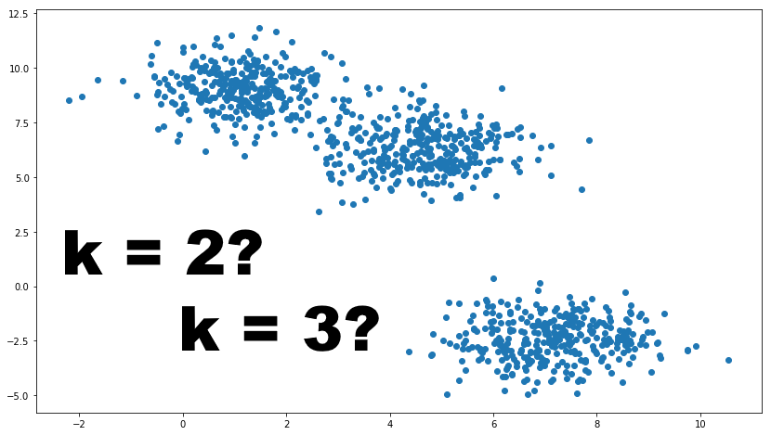
How to find the right value for k?
Notes:
The hyper-parameter k in the k-means cluster algorithm is the user’s choice. Even when you eyeball the data, as in this slide, it’s hard to tell what the right value of k should be. It’d be great if there was some way we could find the ideal value of k for a given data set programmatically.

Slide 12
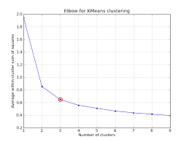

Within-cluster-sum-of-squares elbow method
Notes:
Once such programmatic way to find an optimal value for k is using what’s called the elbow method. The way it works is that you run the k-means clustering algorithm again and again, starting with k=1 and calculating some metric like the within-cluster-sum-of-squares that we mentioned earlier, and finding the point of inflection in the curve that gets traced. Obviously as the number of clusters increases, that WCCS distance should get smaller and smaller until the number k is equal to the total number of samples in the data set. At that point, each sample is a cluster of one and the WCCS is 0. This is not an exact method – there’s nothing necessarily optimum about the elbow, but it’s a decent tradeoff between a k that is too small and one that is too large.

Slide 13
Hyper-parameters of k-means algorithm
hyper-parameters of a model are those configurable parameters that affect how the algorithm runs
In k-means, one of the hyper-parameters is the value of k (the number of clusters we’re asking the algorithm to separate the data points into)
Another hyper-parameter of k-means is the initialization of the centroids – should they be initialized randomly? at the origin (0, 0)? something else
Another hyper-parameter of k-means is that distance metric used to measure the “goodness” of the clustering
Notes:
The hyper-parameters of a model are those configurable parameters that affect how an algorithm behaves. In the case of the k-means algorithm, one hyper-parameter is the value of k in k-means which defines the number of clusters we’re asking the algorithm to separate the points into (each cluster has its own mean, so if we set k=10 we’re asking k-means to find k means which are each the centroid of a cluster with some number of data points assigned to it. A second hyper-parameter for k-means is how these k centroids get initialized. Typically they are initialized randomly, but there may be some other more informed methods which improve overall clustering Another initialization method is called the forgy method and it selects k random points from the data set as the initial centroids. Yet another hyper-parameter of k-means is the distance metric that is used to measure how “good” the clusters are for the underlying data. One metric is the sum of the average intra-cluster distances which measure how similar points in a cluster are to each other, and another is the sum of the inter-clusters distances which measures how dissimilar points in different cluster are from each other.

Slide 14
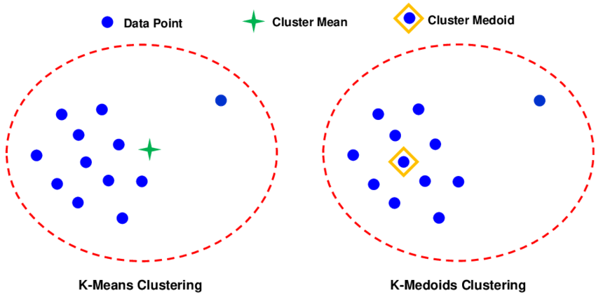
Means are sensitive to outliers 🡺 use k-medioids
Notes:
One issue with using k-means clustering is that the algorithm (like the mean) is sensitive to outliers. A single data point that is far out from all the other data points can dramatically change the nature of the clustering because the mean includes those extreme values in its calculation. Instead, using the median a measure of central tendency is not affected by outliers. Replacing the mean with the median in this clustering algorithm is called k-medioids.

Slide 15
Describe hierarchical clustering
Notes:
In this section, we describe hierarchical clustering.

Slide 16
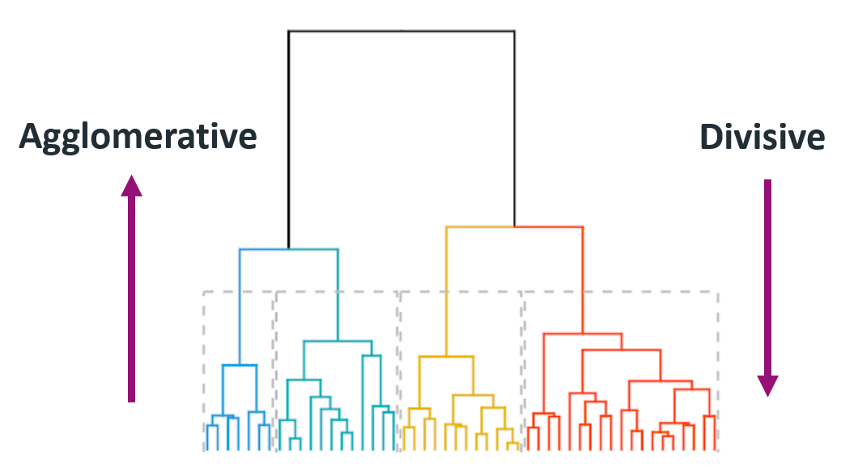
Graphical representation of hierarchical clustering
Notes:
Hierarchical clustering creates hierarchies of clusters – clusters of clusters - to capture similarity and difference between samples in a data set.
Agglomerative clustering and divisive clustering are two approaches to hierarchical clustering, but they differ in how they build the hierarchy of clusters:
Agglomerative Clustering: This is the most common approach to hierarchical clustering. In agglomerative clustering, each data point initially represents a single cluster. Then, at each step, the two closest clusters are merged into a single cluster until all data points belong to one cluster. This process creates a dendrogram, which is a tree-like structure showing the hierarchy of cluster mergers. Agglomerative clustering is also known as "bottom-up" clustering because it starts with individual data points and builds up the hierarchy by merging clusters.
Divisive Clustering: Divisive clustering, on the other hand, is the opposite of agglomerative clustering. It starts with all data points belonging to a single cluster (the root cluster), and then it recursively divides the data into smaller clusters until each cluster only contains one data point. This process also generates a dendrogram, but it's built from the top down, as opposed to bottom-up in agglomerative clustering. Divisive clustering is also called "top-down" clustering because it begins with a single cluster and splits it into smaller clusters.

Slide 17
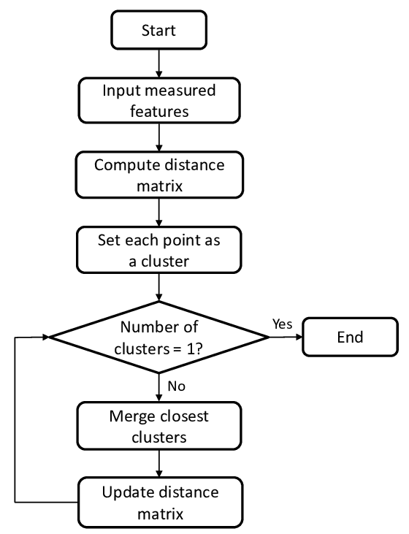
Flow-chart representation of agglomerative clustering
Notes:
The flow chart represents the agglomerative clustering algorithm. We start at the start node of the chart and proceed to inputting the measured features to the algorithm. Using some metric for similarity (e.g. euclidean distance or cosine similarity), we compute the pairwise distance between each pair of points in the data set. We start with every point belonging to their own cluster (so if there are 100 data points in the data set, there are 100 clusters to start with). Then while the number of clusters is not equal to 1, repeat the following steps. Merge the closest clusters and update the distance matrix between the clusters. When the number of clusters reaches 1 (i.e. all the points belong to clusters and all the clusters are clustered into 1 cluster), the algorithm terminates.

Slide 18
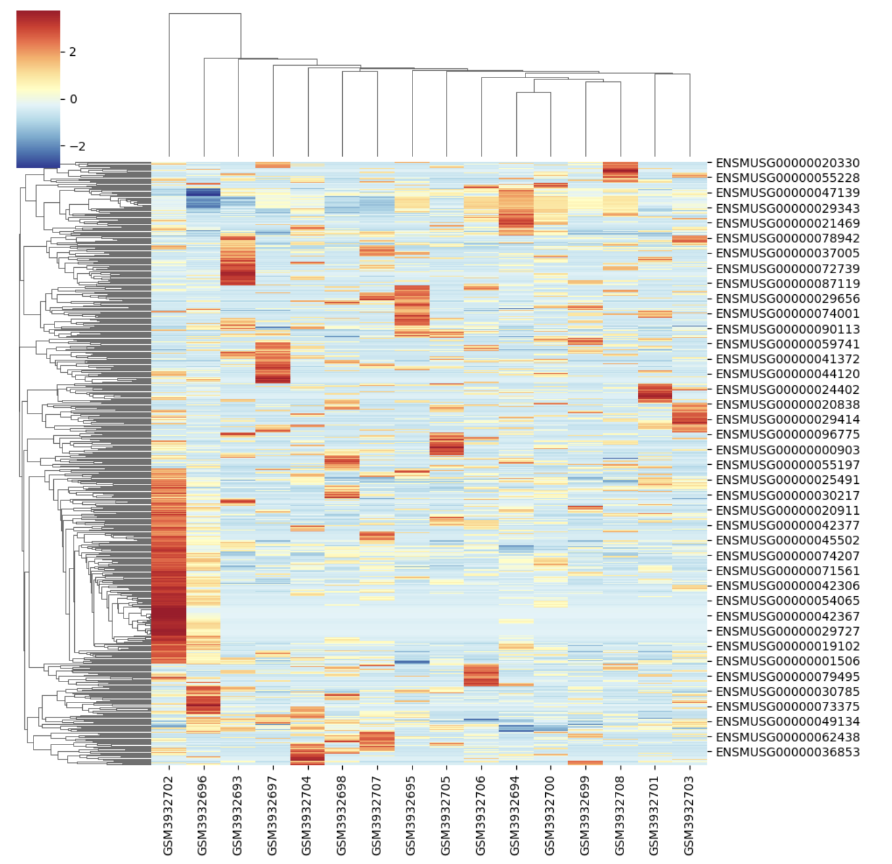
Heatmap with hierarchical clusters
Notes:
A heatmap is a 2-dimensional grid that associates a sample with a level for a given feature. For example, this slide heatmap shows samples horizontally and gene expression vertically. A particular cell represents how much of that gene was expressed for that particular sample, and it is colored according to the legend. A very red score indicates high expression (heat) and a very blue score indicates low expression (cold) – thus the moniker heatmap. In this example, the first sample GSM3932702 seems to have the highest (hottest) gene expression for several genes on the left side of the heat map. In addition to graphically showing the different levels of expression for different genes in different samples, heatmaps also get plotted with hierarchical clusters that show which gene expressions are most similar (along the left of the heatmap in this example) as well as which sampes are most similar (along the top of the heatmap in this example). Looking at this heatmap, it seems the first sample GSM3932702 is least similar to all the other samples combined. We can tell this by observing the height of the hierarchical cluster is highest between the first sample and all other samples. The genes most similar are seen as the shortest connections on the left side hierarchical cluster. Indeed these genes seem to be the hottest genes expressed in the heatmap.

Slide 19
Describe Gaussian mixture model clustering
Notes:
In this section, we describe Gaussian mixture model as a method of clustering.

Slide 20
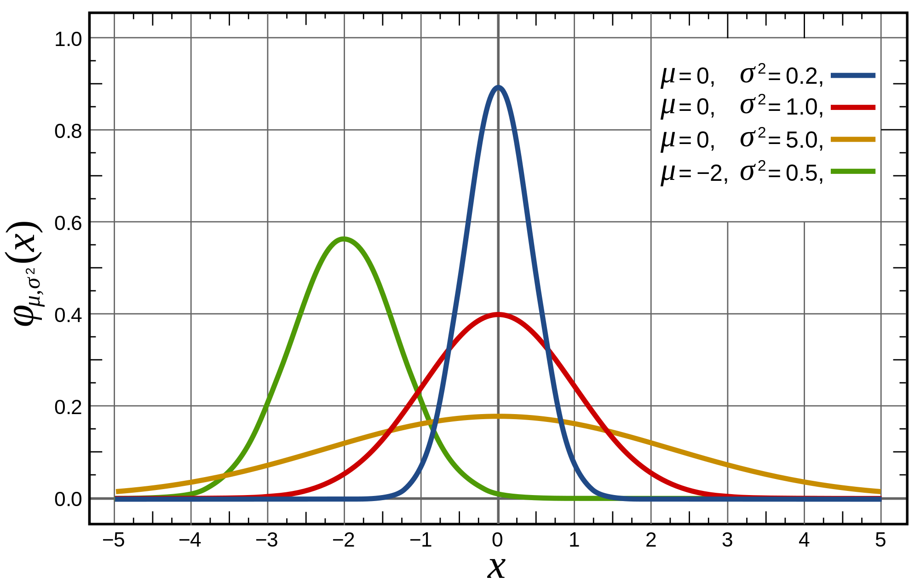
Gaussian distributions
Notes:
Gaussian distributions, also known as normal distributions are statistical distributions which are parameterized by their mean and variance. Different values of the mean and variance give rise to different shapes of the normal distribution. In this slide, there are 4 normal distributions shown. The blue curve has a mean of 0 and a variance of 0.2. With the smallest variance of the 4 distributions, it is the most narrow or skinny and is centered at X=0. By contrast, the green curve has mean of -2 and a variance of 0.5, so it is shifted to the left of 0 and is a little wider than the blue distribution. The gold distribution is the widest distribution as it has the largest variance of 5.0. The normal distribution is widely used in statistical inference and is often a good approximation of a sample distribution.

Slide 21
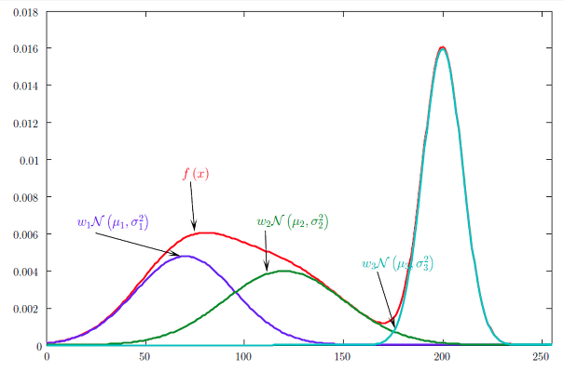
Graphical representation of Gaussian Mixture Models
Notes:
The Gaussian mixture model approach to clustering approximates the distribution of all the data as the combination of multiple individual Gaussians – each gaussian representing a different cluster. In this slide, the red distribution f(x) is the dataset that we are trying to cluster. Just as with k-means and agglomerative clustering, we need to specify the number of clusters that the algorithm should use to approximate the original distribution. Here we’ve specified 3, and you can see how the mean and variance of each of these 3 distributions sum to the red distribution. It can be viewed as a curve-fitting exercise where we are using some number of normal curves with different means and variances to approximate a real curve. With these distributions in place, our clusters are in place. Note that a point along the X axis could belong to multiple of these 3 distributions. The height of the curve defines the probability of the point being in that distribution. So for example, the point X=50 has a very small probability of belonging to the green distribution but a much higher probability of belonging to the purple distribution. The algorithm chooses the highest probability as the cluster assignment for each point.

Slide 22
Discuss principal components analysis as a clustering algorithm
Notes:
In this section, we describe using principal component analysis as a clustering algorithm.

Slide 23
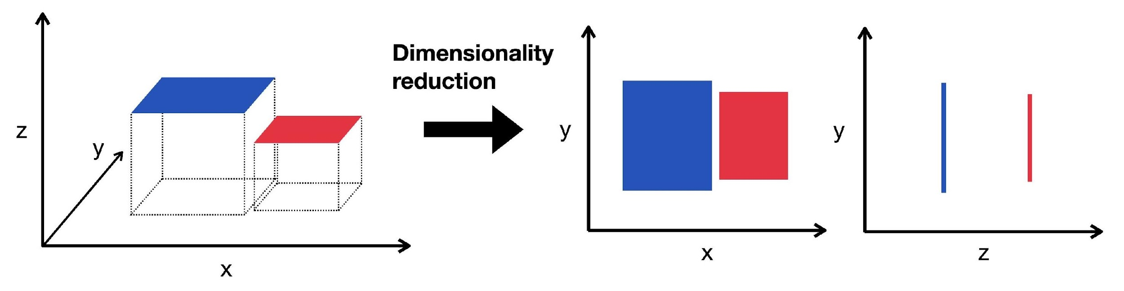
Dimensionality reduction
Notes:
Dimensionality reduction is a method to reduce the number of features under consideration in machine learning. Consider our RNA-seq data set from OSD-255. It has 16 samples and about 23,000 genes. Each gene represents a dimension, and 23,000 is highly dimensional. Not all 23,000 genes contribute a so-called signal (or valuable information) to the building of a machine learning model. For example, if a particular gene has identical expression across all the samples in the cohort, it offers zero information to distinguish one sample from another and could be removed from the dataset prior to model training.
In the example in this slide, we begin with 2 data points in 3 dimensions (each is a cube). Reducing from 3 dimensions to 2 dimensions flattens those cubes into rectangles. Then reducing by one more dimension goes from 2 dimensional rectangles to one-dimensional line segments.

Slide 24
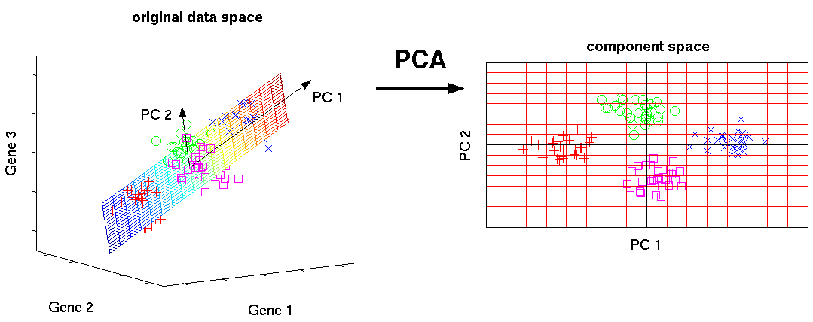
Graphical representation of PCA
Notes:
Principal component analysis, or PCA, is a form of dimensionality reduction which first searches across the feature space for the vector which captures the highest degree of variance. This first vector is called PC1 and is not necessarily parallel to the original feature axes (in this example, gene1, gene2, and gene3). The algorithm then considers all vectors which are orthogonal to PC1 and chooses the vector which captures the next highest degree of variance in the dataset. This second vector is called PC2 and is also not necessarily parallel to the original feature axes. The algorithm continues to find as many principal components as you’ve asked for (yes, the number of PC’s is a hyper-parameter to the PCA algorithm). In this example, we used PCA to project the 3 dimensional gene expression data into 2 dimensions. Then we can colorize the points in 2 dimensions to see if the data that cluster together share some common metadata (like, for example, perhaps the spaceflight samples share a cluster and the ground control samples share a different cluster).

Slide 25

Notes:
And that brings us to the end of this lecture in which we discussed various concepts of clustering – the unsupervised family of machine learning algorithms. In the hands-on activity, you will have the opportunity to use the algorithms we learned in this lesson. Specifically, you’ll use k-means, PCA, GMM, and heatmaps with hierarchical clusters on the RNA-seq data from RR9.

