Slide 1
Introduction to Regression
Notes:
Welcome to the lesson “Introduction to regression” in which we will discuss the regression model member in the family of supervised algorithms.

Slide 2
Objectives
Discuss the goals of regression
Describe ordinary least squares
Define how to measure performance for regression
Describe the balance between bias and variance in regression
Notes:
The objectives of this module are to discuss the goals of regression, describe the ordinary least squares algorithm, define how to measure performance of a regression model, and finally to describe the balance between bias and variance in regression.

Slide 3
Discuss the goals of regression

Slide 4
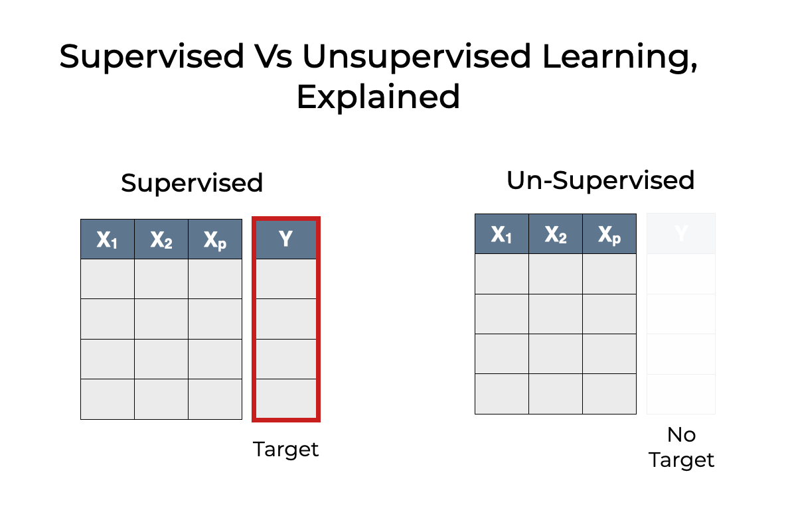
Recall supervised vs unsupervised machine learning
Notes:
Recall we have 2 families of machine learning algorithms: supervised learning which uses labeled target values and un-supervised learning which does not use labeled target values. Regression is a supervised learning algorithm, so we will use regression to predict a target or label based on inputs x1 to xp.

Slide 5
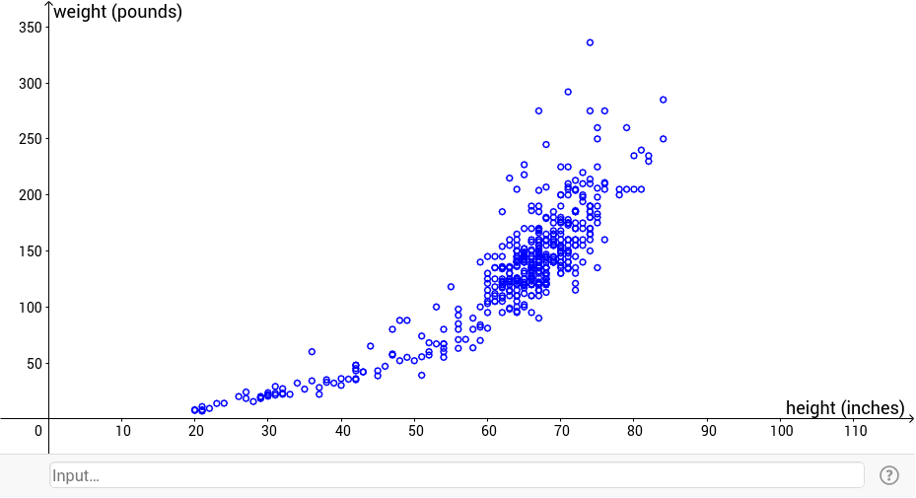
Example: given the height of a sample, predict its weight
Notes:
For example, suppose we have collected and recorded the weight and height of many individuals. We wish to build a model that predicts the weight based on the individual’s height.

Slide 6
Example: given the height of a sample, predict its weight
Notes:
One way to do this is to try to find a line that “fits” the data. We can draw such a line and represent it using the familiar y=mx+b notation where y in this case is the weight we’re trying to predict and x in this case is the height. The value m represents the slope of the line and the value b represents the y-intercept when x=0. In this example, we’re using one independent variable (height) to predict the dependent variable (weight). When we do our hands-on exercises, we’re going to be predicting a dependent variable (one of those phenotypes like intraocular pressure or microscopy values) from the retina gene expression values (the independent variables - which in that case number in the thousands of genes).

Slide 7
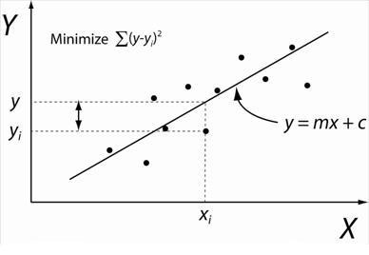
y = mx + c
Notes:
There’s a way to quantify how well the line we plot fits the data we’re given. In this slide, we have 10 points (xi, yi) and we’ve plotted a line using the formula y=mx+c (some mathematicians use c instead of b to represent the y-intercept for some reason). To quantify the goodness of fit, we add up all the squared differences of the actual yi values from the line we plotted. We square the difference (also known as the residual) because some differences are positive and some are negative. The objective of the linear regression algorithm is to minimize the sum of that squared distance.

Slide 8

Linear model general form
Notes:
The previous slide showed only 1 independent variable as a predictor of y, but in practice we will have many independent variables. This slide shows the general form of the linear model we’re trying to build where each value Y-hat (designating an approximation of the value for y) is predicted using a linear model w-nought (the y-intercept term) + weight w1 times input x1 plus weight w2 times input x2 plus …. plus weight wp times input xp.

Slide 9
Describe ordinary least squares
Notes:
In this section, we describe the method of ordinary least squares as an algorithm to fit the best regression line through a set of given points.

Slide 10
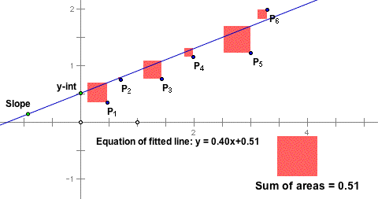
Graphical representation of OLS
Notes:
Ordinary least squares, or OLS, squares the difference between the actual y value and the predicted y value for each point p1 to p6 in this slide. The red squares represent the fact that we are squaring the differences. We sum up the squares to get the sum of squares, in this case 0.51. The equation of the line of best fit in this case is given as y=0.40x + 0.51, so the slope is 0.4 and the y-intercept is 0.51.

Slide 11
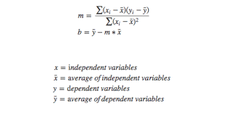
Algebraic representation of OLS
Notes:
The algebraic representation of OLS is shown in this slide. Don’t fret the mathematical notation – it’s super easy. In order to find a linear model y=mx+b, we need to find the slope m and the y-intercept b. These equations show us how to do exactly that. The slope m is given by the top formula and the intercept b is given by the bottom formula. Let’s unpack the top formula for slope. x-bar is the mean of the x values, so you just add them all up and divide by the number of values. y-bar is the mean of the y values, so you just add them all up and divide by the number of values. xi -x-bar is the difference between the ith x value and the mean of x, and yi - y-bar is the difference between the ith y value and the mean of y. Take the product of those differences and add them all up, and that gives you the numerator for the slope m. The denominator of the slope m is the sum of the squares of the differences between each value xi and the mean value x-bar. Once you calculate m, you can calculate b as the difference between the mean value y-bar and the product of m and the mean value x-bar.
We call this a “closed form solution” meaning we can calculate exactly the values of m and b rather than approximate them. All you have to do is roll up your sleeves and do the arithmetic. Of course, because we’re data scientists, we’ll want to automate this using software.
In the next slide, we’ll see an example.

Slide 12
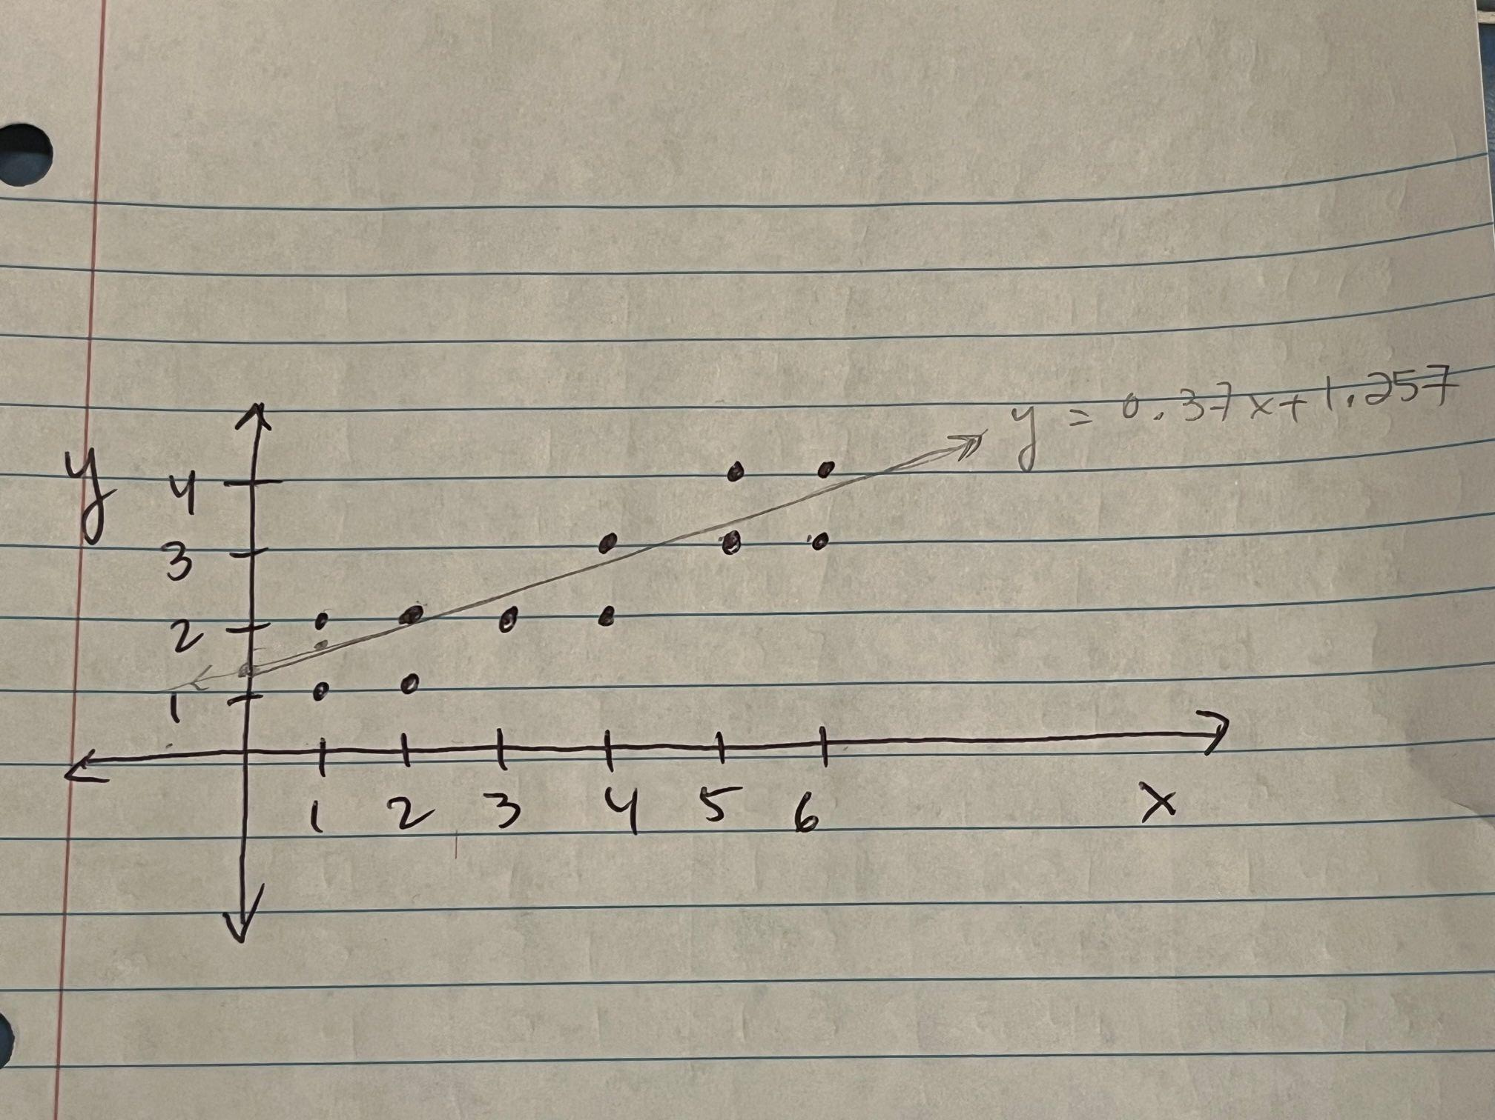
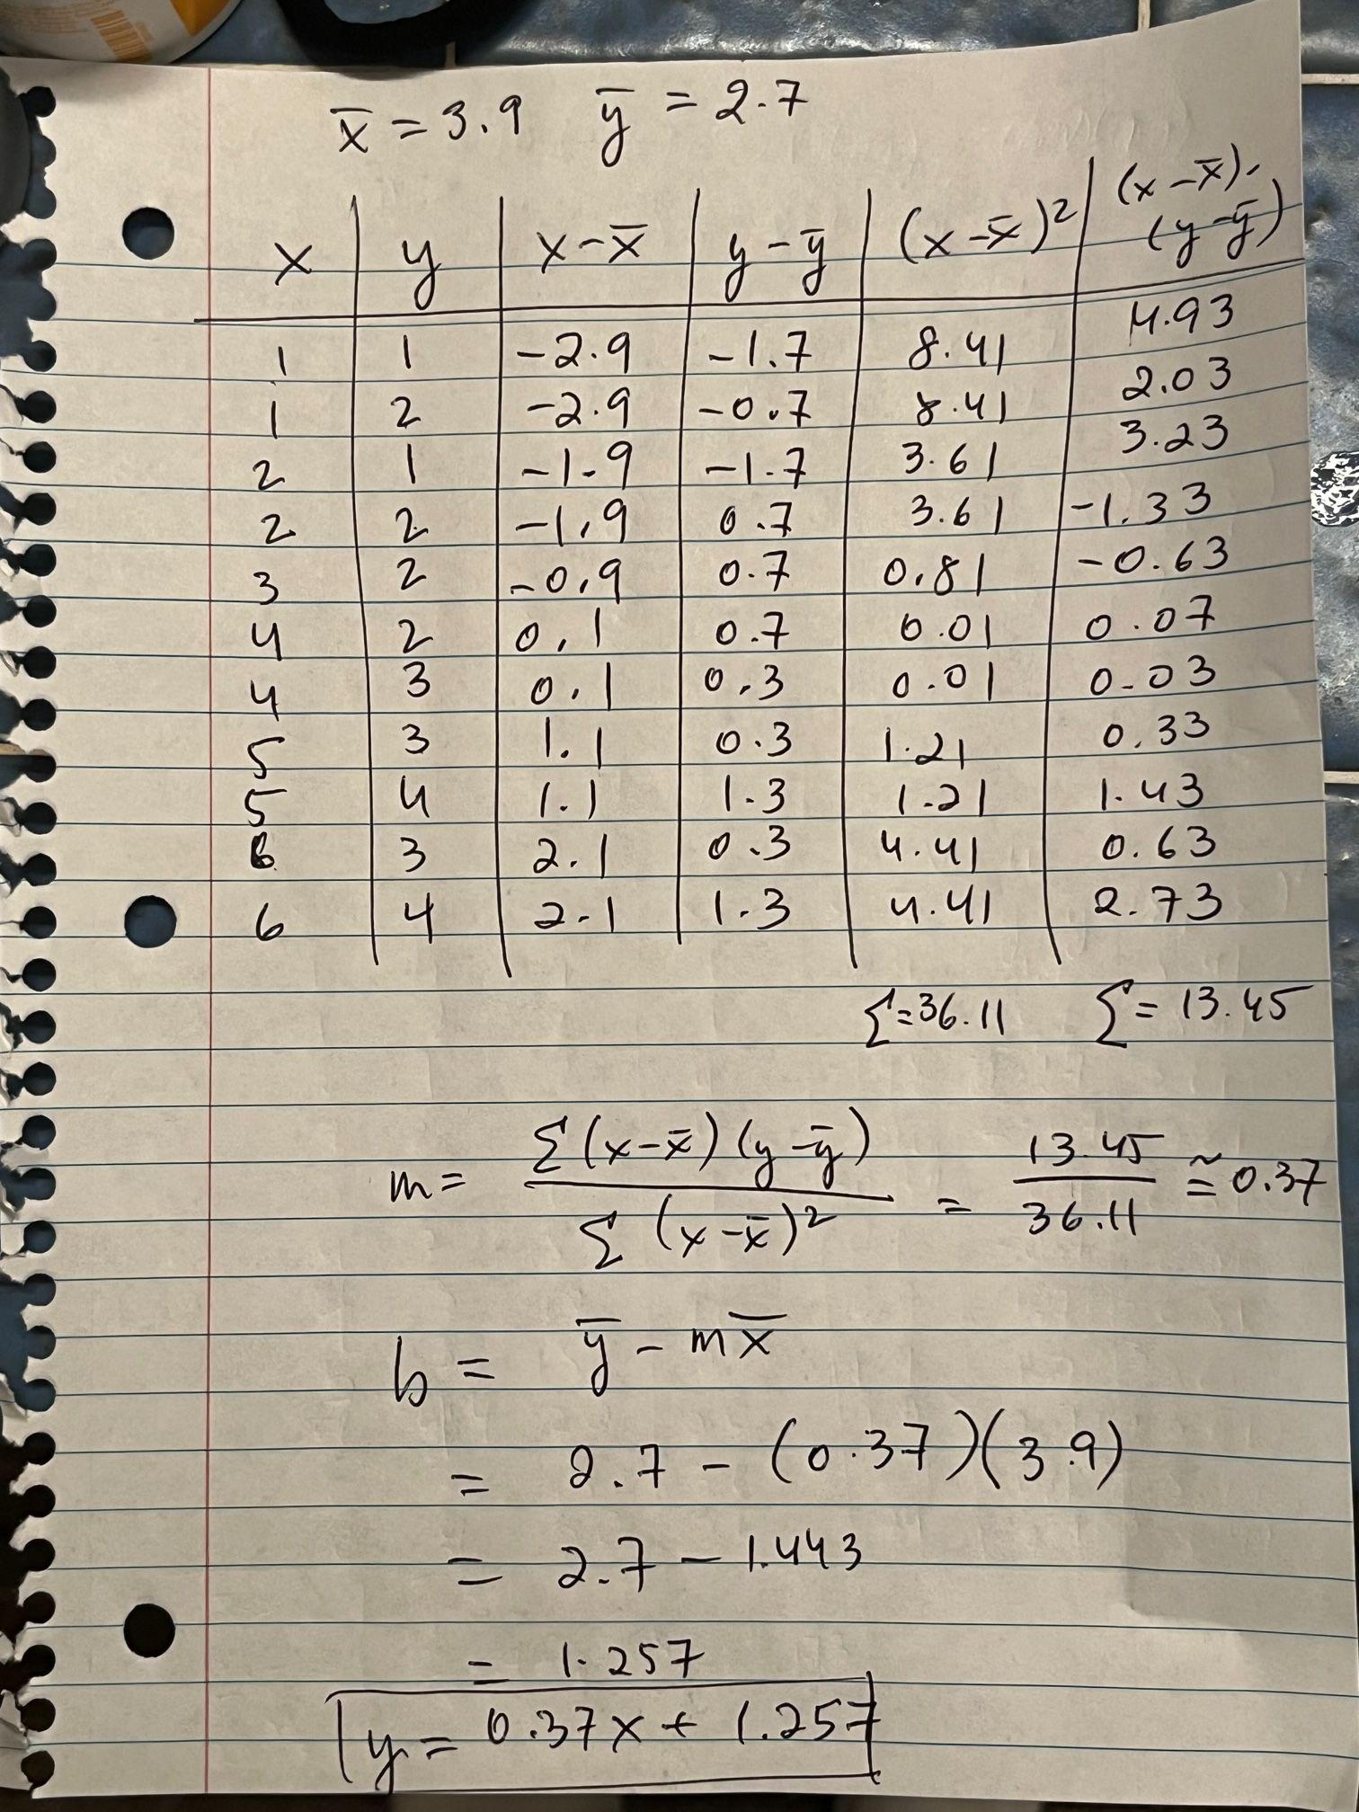
Example: calculate m and b using OLS
Notes:
Let’s walk thru this example

Slide 13
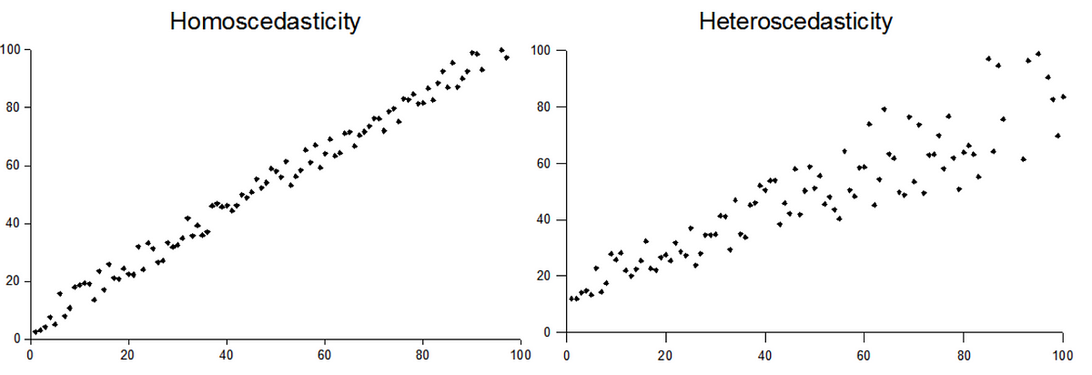
skedasticity
Notes:
One note of caution when using linear regression is that the OLS algorithm assumes a constant variance across the distribution of data – something known as homoskedasticity. If the variance of the data is not constant across the data – something known as heteroskedasticity – then the error terms are not consistent and the OLS will be sub-optimal. We mention this here because some of the data we will be working with – particularly count data like RNA-seq gene expression data – is often heteroskedastic. We will ignore skedasticity in our hands-on sessions but we want you to be aware of it.

Slide 14
Describe how to measure performance of regression models
Notes:
In this section, we describe how to measure the performance of regression models. There are 3 metrics typically used which we will discuss: mean absolute error, mean squared error, and r^2.

Slide 15
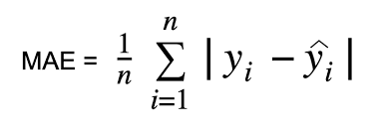
mean absolute error
Notes:
Mean absolute error is exactly what it sounds like – the average of absolute value of the differences between the actual y values yi and the model-predicted y values yi-hat. The vertical bars denote absolute value, the greek letter sigma denotes sum (in this case from i=1 to i=n), and 1/n denotes the fact that we’re find the mean or average of these values.

Slide 16
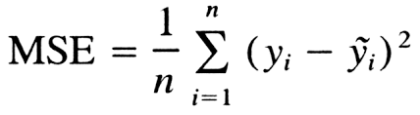
mean squared error
Notes:
Mean squared error is exactly what it sounds like – the average of the squares of the differences between the actual y values yi and the model-predicted y values yi-hat (or here denoted y-tilde). Again, the greek letter sigma denotes sum (in this case from i=1 to i=n), and 1/n denotes the fact that we’re find the mean or average of these values. The MSE has the effect of amplifying outlier error terms (because for numbers greater than 1, a square is always greater than its absolute value). The number doesn’t mean much unto itself however because it depends on the scale of your y values. If all your y-values are between 0 and 10, say, then you’ll have a very small MSE regardless of your model. If all your y-values are between 0 and 1,000,000, then your MSE can be very large. So how do we use MSE (or MAE)? Use it to compare different regression models on the same dataset for model selection.

Slide 17
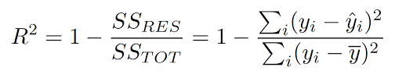
R^2
Notes:
R-Squared (R² or the coefficient of determination) is a statistical measure in a regression model that determines the proportion of variance in the dependent variable that can be explained by the independent variable. In other words, r-squared shows how well the data fit the regression model (the goodness of fit). R-squared is a better metric of performance than MAE and MSE when comparing 2 different models on 2 different data sets. When comparing 2 different models on the same dataset (i.e. model selection), R-squared will work also.
The formula for r-squared is given in the slide as 1 minus the ratio of the sum of the squares of the residuals to the total sum of the squares. The latter term ranges between 0 and 1, so the difference 1 minus that term ranges between 0 and 1. The closer to 1, the better the fit. The closer to 0, the worse the fit.
As we will see in our hands-on lab, a very high r-squared value simply means the line is a very good fit to the given data points but it does not mean that the regression model will perform well on out-of-distribution data.

Slide 18
Balancing bias and variance
Notes:
In this section, we discuss the concept of bias and variance and how to balance them in regression modeling.

Slide 19
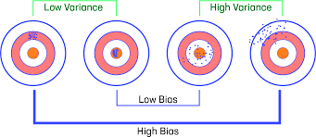
Bias and variance
Notes:
Bias and variance are terms used in statistics to capture prediction error and model variation. This slide shows a set of 4 targets to portray high and low bias and variance. Take the first target on the left. The dots in the target (potentially formed by someone throwing darts at a dartboard) are tightly clustered in the first ring away from the bulls-eye. This dart thrower was very precise (the darts were consistently thrown very close to each other) but not very accurate (the darts were not that close to the bulls eye). The consistency of the throws is captured by the variance term. There isn’t much variance between the dart throws. The error of the throws is captured by the bias terms. There is high bias in all the dart throws.
If you look at the third target from the left, the all the dots are surrounding the bulls eye. This indicates that the dart thrower was accurate. But the dots are scattered all around the bulls eye. This indicates that the dart thrower wasn’t consistent. A model which predicts as such is said to have low bias and high variance.
Take a moment to talk yourself through the other two targets (low variance, low bias is the 2nd from the left, and high variance, high bias is the one on the far right).

Slide 20
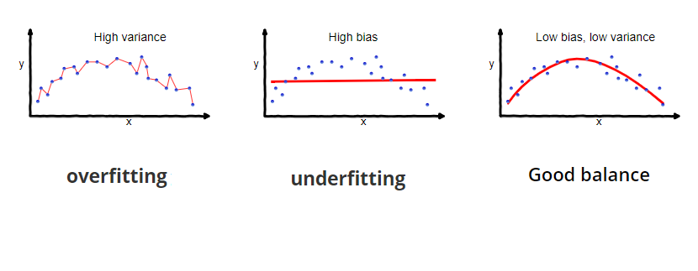
Overfitting/underfitting
Notes:
So we’ve seen that some models are better than others. In the previous slide we discussed bias and variance as descriptors of a dart thrower. Now we discuss how bias and variance contribute to the goodness of a model. Looking at the slide we see 3 different models in red, all designed to capture the trend of the data points in blue. It’s sort of like the goldilocks of regression models.
The model on the left is the extreme version of trying to capture exactly the distribution of the data points. It has no flexibility but it’s extremely accurate. The problem with this model is that while it fits the training data very well, it will not likely perform well on data it hasn’t seen before. We say that such a model with high variance and low bias does not generalize to out-of-distribution data.
The model in the middle is the opposite of that. It’s very flexible but not very accurate. The problem with this model is that, even though it’s very general and flexible, it doesn’t fit the training data well nor should we expect it to perform well on data it hasn’t seen before. We say that such a model with low variance and high bias also does not generalize to out-of-distribution data.
The model on the right is just right :) It balances permits some bias and some variance in the model (but not too much as to underfit or overfit the data).

Slide 21
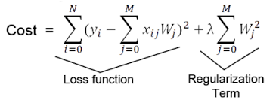
Regularization as a penalty in regression model
Notes:
In the previous slide, we used our eyes to judge whether a regression model was underfit, overfit, or just right. But we build models using software and wish to automate as much as we can, and software doesn’t have eyes. So we need to capture the over/under fitness of a model numerically. This slide suggests that number and calls it “cost”. The cost is typically represented by the error in the model (the term on the left called “loss”), and the algorithms we use try to minimize that error when building models. One way for us to prevent the algorithm from overfitting the data is to introduce a term called a regularization term. This term is the sum of the squares of all the weights. The more weights the model uses for regression, the more overfit the model is to the data. So by adding this term to the cost for the algorithm to minimize, we’re forcing the algorithm to take into account how complex the model is. The more complex ⇒ the more overfit ⇒ the higher the regularization term ⇒ the higher the total cost. The lambda coefficient in front of the regularization term is a hyperparameter for us when using regularization. Lambda dictates how much we want to penalize model complexity, and the value ranges from 0 (no regularization) to an arbitrarily large number (maximal regularization).

Slide 22

Notes:
And that brings us to the end of this lecture in which we discussed various concepts of regression modeling from the supervised family of machine learning algorithms. In the hands-on activity, you will have the opportunity to use the algorithms and tools we learned in this lesson. Specifically, you’ll use linear regression to predict phenotypic responses from gene expression data using plain old linear regression as well as regularized regression. As a bonus, you’ll also evaluate the gene expression feature space for skedasticity.

