Slide 1
Explainable AI
Notes:
Welcome to this lesson on explainable AI

Slide 2
Objectives
Define model explainability
Determine feature importance using Shapley values
Determine feature importance using feature permutations
Notes:
The objectives of this lesson are to define model explainability, determine feature importance using Shapley values, and to determine feature importance using feature permutations.

Slide 3
Defining model explainability
Notes:
In this first section, we define the concept of model explainability.

Slide 4
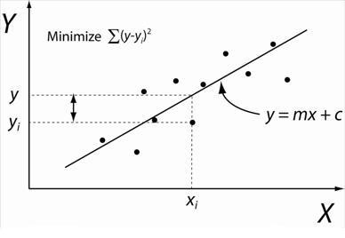
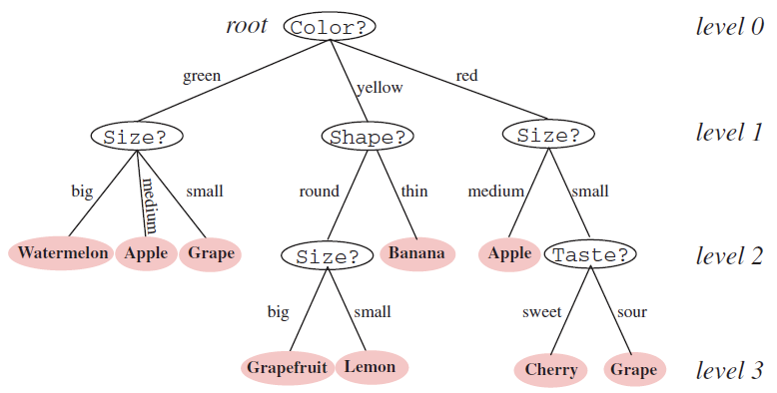
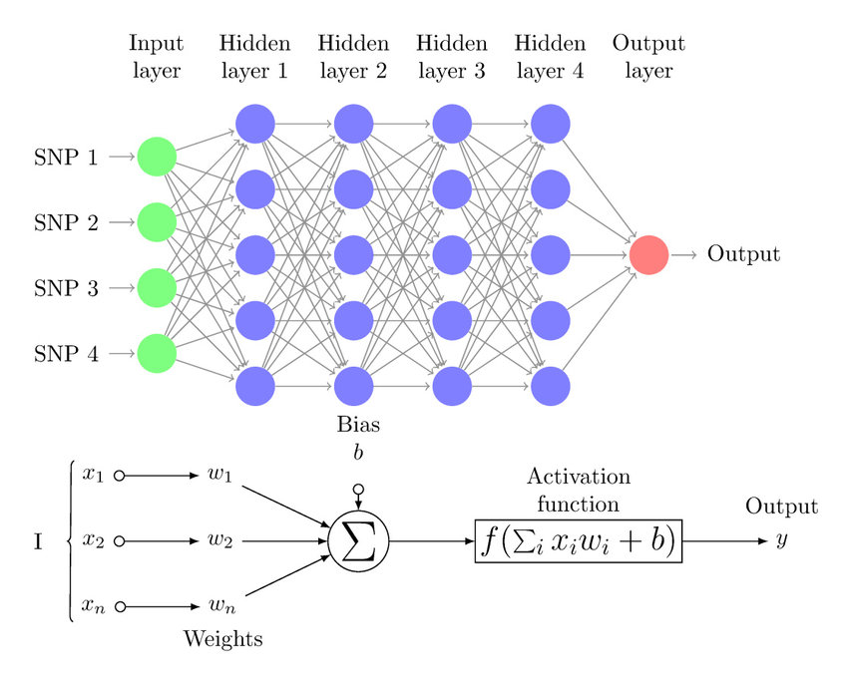
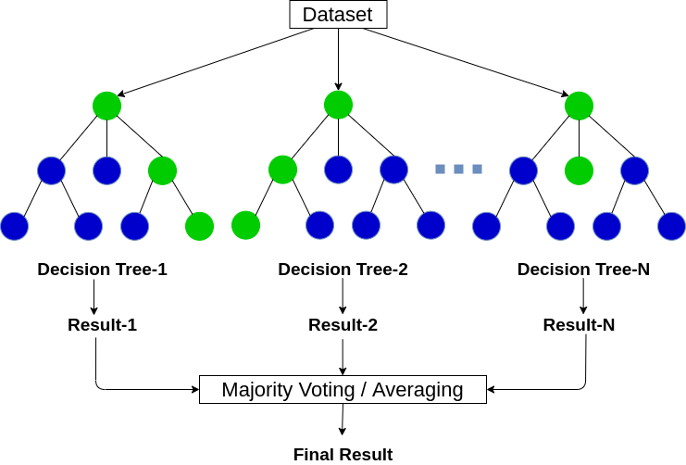
How do models make choices?
decision tree
linear regression
random forest
neural network
Notes:
We use machine learning models to help us make decisions. The models themselves choose between multiple classes in classification or multiple output values in regression. How do the models make those choices?
In the case of the decision tree, the classification of a sample is chosen based on its features. Each node in the decision tree asks a question about the sample features, and based on the answer to that question for that sample, the process flows through the tree until it reaches the bottom. At the bottom are the so-called leaves of the tree which represent the possible classes for the samples.
In the case of a random forest, we use multiple decision trees (thus the name forest) with a random subset of the features to be used for asking questions at each node (thus the name random forest). Each decision tree makes a choice about which class the sample belongs to, and then the majority vote is taken to provide the final classification for a given sample.
In the case of regression, the model chooses (or rather calculates) the response Y based on the features X of a given sample.
These 3 models that we’ve studied closely are referred to as “white box models” because they provide easy-to-interpret insights on how the classification or regression value was determined.
And last, the neural network is referred to as a black box model because it’s not at all easy to interpret insights on how the classification was determine. Recall in a neural network, the features of a sample are sent through the network as input on the left, getting multiplied by weights, summed together at each layer, and then sent through an activation function to fire an output value to the next layer. This continues for each node at each hidden layer until the output layer where a classification of the sample is made. In order to understand how the model is making its choice, we’d need a special tool or approach.

Slide 5






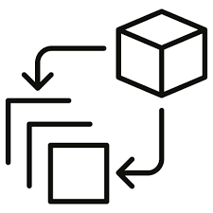
Why do we want to explain how models choose?
transparency
accountability
compliance
bias detection
feature selection
debugging
insights
Notes:
Explaining AI is crucial for several reasons:
Transparency: Understanding how AI models make decisions helps users trust them more. When users comprehend why a particular decision was made, they can better evaluate the reliability and fairness of the system.
Accountability: In many applications, especially those with significant impact on individuals or society, it's essential to know who or what is responsible for a particular decision. Explainable AI provides insights into the decision-making process, which can help assign accountability when needed.
Compliance: Regulatory bodies often require transparency and accountability in AI systems, particularly in sensitive domains such as healthcare, finance, and criminal justice. Explainable AI helps organizations comply with these regulations.
Bias Detection and Mitigation: Understanding how AI models work allows researchers and developers to identify and mitigate biases that may exist in the data or the algorithms themselves. Explainability facilitates bias detection and helps ensure fair and equitable outcomes.
Feature selection. In high dimensional datasets (such as the RNA-seq data we’ve been working with), we’d like to select only the most important features to train model. Explainable AI is related to feature selection.
debugging. We can use explainable AI to debug individual incorrect predictions. Knowing which features to attribute to an incorrect prediction may shed light on a problem in the data preprocessing step.
Insights. Explainable AI can help us learn novel relationships and correlations b/w predictors and responses.

Slide 6
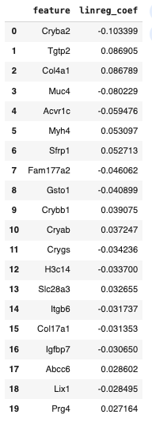
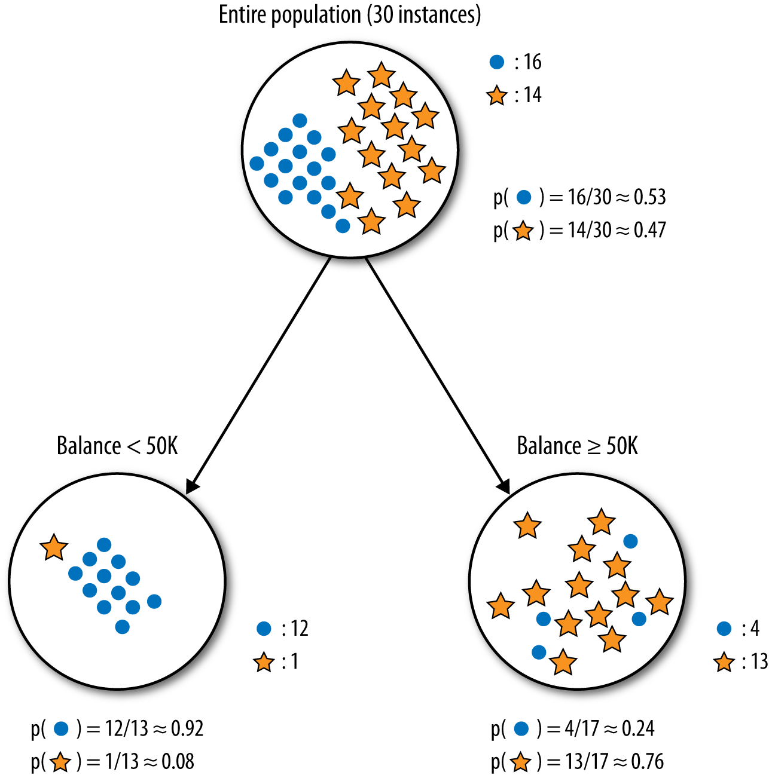
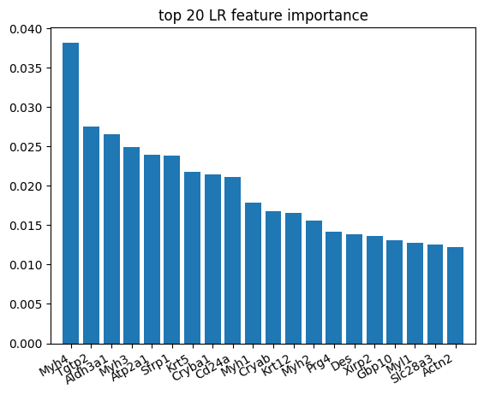
What are some techniques in xAI?
logistic regression
random forest
Shapley values
permutation feature importance
linear regression
Notes:
Some AI/ML models have feature importance built into them. For example, in logistic regression, the coefficients of the regression model may be used as a crude form of feature importance. The larger the coefficient, the more it contributes to the model classification. However, this requires that the data first be standardized to the same scale because the magnitude of the coefficient may be proportional to the magnitude of the feature itself. Random forest uses a mean decrease in impurity to determine how much a feature separates one class from the others. Recall that impurity is a measure of how mixed the sample classes are at each node. Similar to logistic regression, in linear regression, the magnitude of the coefficients may be used to indicate the relative feature importance as long as the features have been standardized to the same scale.
There are 2 other techniques we will discuss in this lesson - namely Shaply values and permutation feature importance - which are agnostic to the model.

Slide 7
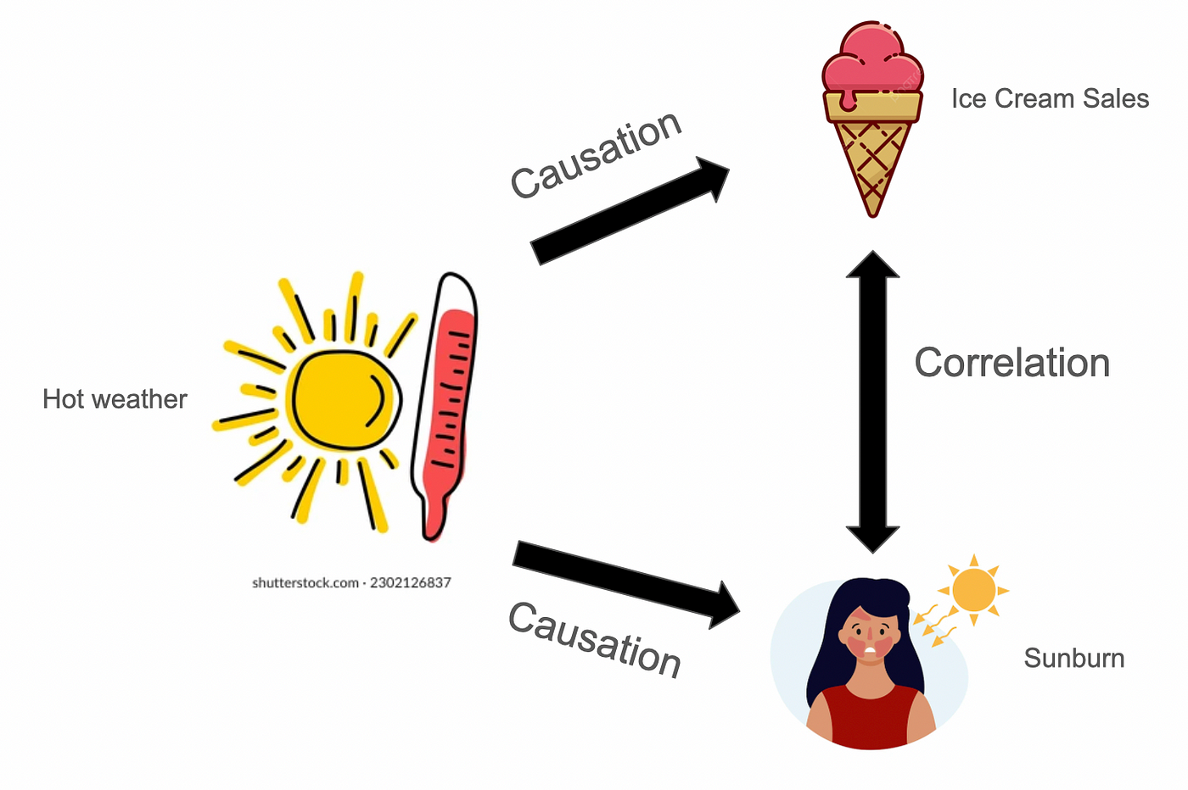
A word of caution: correlation is not causation
Notes:
Predictive machine learning models become even more powerful when paired with interpretability tools which identify the most informative relationships between the input features and the predicted outcome. It is tempting to take this analysis one step further and assume that interpretation tools can also identify what features should be manipulated in order to change the responses. However, this can often be misleading.
The reason relates to the fundamental difference between correlation and causation. In the cartoon, we see that sunny hot weather causes people to buy more ice cream and simultaneously sunny hot weather causes people to buy ice cream. It would be a mistake to assume that an increase in ice cream sales causes sunburn. Of course it does not: the relationship between ice cream sales and sunburn is referred to as a spurious correlation rather than a causative one.Each of those outcomes are caused by the sunny hot weather.

Slide 8
Determining feature importance using Shapley values
Notes:
In this section, we discuss determining feature importance using Shapley values.

Slide 9
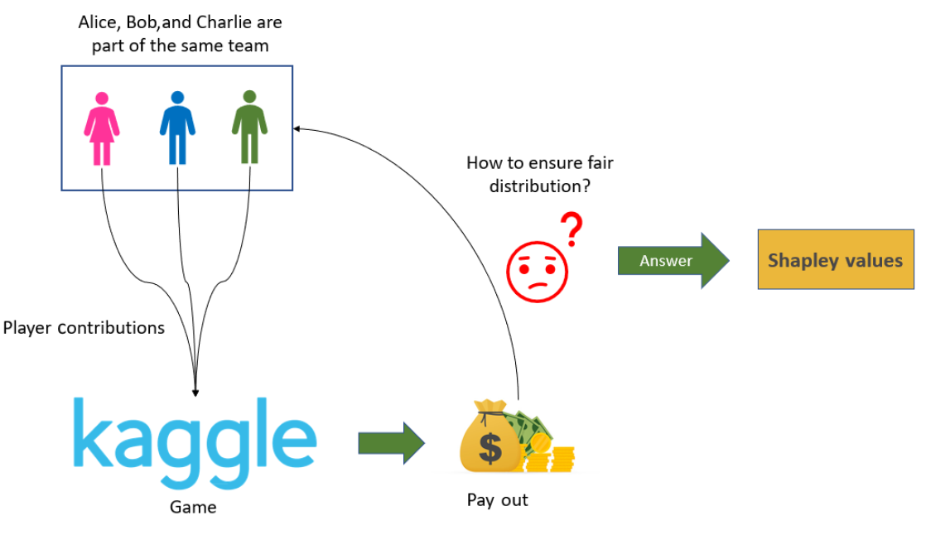

What are Shapley values?
1st place = $10K
2nd place = $7.5K
3rd place = $5K
Notes:
The concept of Shapley values originates from cooperative game theory and was developed by Lloyd Shapley in 1953 for which he won the Nobel Prize in Economics. Shapley values provide a way to fairly allocate the "payout" (or contribution) of each player to the coalition, considering all possible combinations of players. A combination of players is called a coalition, and in the next slide we’ll look at how Alice, Bob, and Charlie may have cooperated in different coalitions to win different prizes. At the end of those competitions, the question is: how do we fairly split up the prize winnings among the participants?

Slide 10
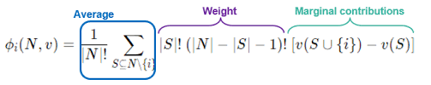
Shapley value = average marginal contribution
i = player
N = total number of players
S = subset (coalition) of players
v = value function associated with subset
Notes:
The slide shows the formula for how a Shapley value is calculated. It may look a little intimidating, but it’s actually very intuitive when you unpack it. The Shapley value is calculated for each player i over all subsets S of N players. The shapley value is the average weighted marginal contribution of a particular player in the game. The marginal contribution is the difference in the value of a subset containing player i minus the value of the subset not containing player i. In other words, the marginal contribution for a player is a measure of how much better (or worse) does a group of players perform when this player joins them.
In the next slide, we look at a simple example.

Slide 11



Shapley values example
C(ABC) - C(BC) = $10K - $5K = $5K
C(AB) - C(B) = $7.5K - $5K = $2.5K
C(AC) - C(C) = $7.5K - 0 = $7.5K
C(A) - C(0) = $5K - 0 = $5K
avg marg. contrib = $5K(⅓) + $2.5K(⅙) + $7.5K(⅙) + $5K(⅓) = $4.6K
payout per coalition
C(ABC) = $10K
C(0) = $0
C(AB) = $7.5K
C(AC) = $7.5K
C(BC) = $5K
C(A) = $5K
C(B) = $5K
C(C) = $0
C(ABC) - C(AC) = $10K - $7.5K = $2.5K
C(AB) - C(A) = $7.5K - $5K = $2.5K
C(BC) - C(C) = $5K - 0 = $5K
C(B) - C(0) = $5K - 0 = $5K
avg marg. contrib = $2.5K(⅓) + $2.5K(⅙) + $5K(⅙) + $5K(⅓) = $3.75K
C(ABC) - C(AB) = $10K - $7.5K = $2.5K
C(AC) - C(A) = $7.5K - $5K = $2.5K
C(BC) - C(B) = $5K - $5K = $0K
C(C) - C(0) = $0K - $0K = $0K
avg marg. contrib = $2.5K(⅓) + $2.5K(⅙) + $0K(⅙) + $0K(⅓) = $1.25K
Notes:
In this completely fictitious example, imagine that these 3 players used all possible combination of players in multiple versions of the competition. Namely, when Alice Bob and Charlie (ABC) play together, they win the $10K prize. If no one participates, then the payout is obviously $0 - no one wins if no one plays. If Alice and Bob form a coalition of 2, they win $7.5K, Alice and Charlie win $7.5K, and Bob and Charlie win $5K. If Alice plays by herself, she wins $5K (and so does Bob). When Charlie plays alone, he wins $0. Again, these are fictitious values but we present them here just as an example.
To calculate the weighted average marginal contribution for Alice, we examine the payout for all the coalitions she is part of and subtract the payout for the coalitions she is not part of. When we take the weighted average of these marginal contributions for Alice, we get $4.6K. Doing the same for Bob, we get a weighted average marginal contribution of $3.75K. And for Charlie, we get $1.25K. Based on these calculations, we conclude that Alice is the most valuable player, followed by Bob, and Charlie is the least valuable player averaged over all the possible coalitions of players.
These weighted average marginal contributions are the Shapley values. The higher the Shapley value, the more valuable the player is in the competition.
So what does this have to do with machine learning?

Slide 12
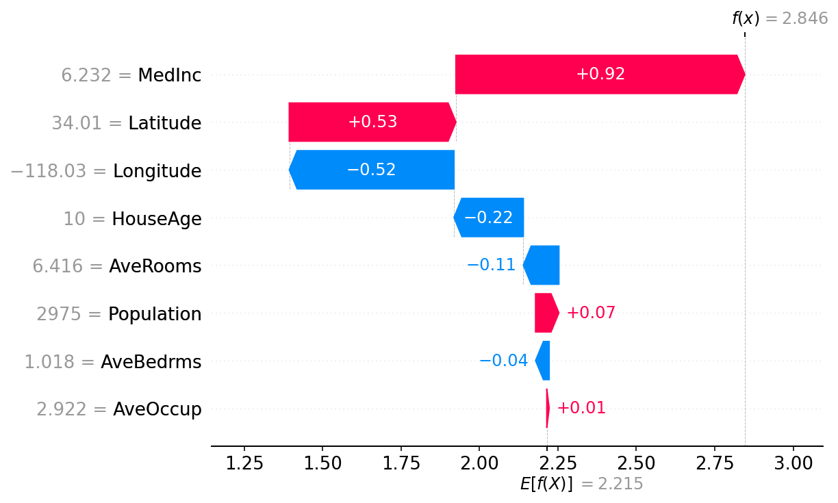
How are Shapley values used for feature importance in AI/ML?
player = feature
payout = performance
f = model
X = sample
X1 - X8 = sample features
f(X) = model prediction for sample
E[f(X)] = average f(X)
X8
X7
X6
X5
X4
X3
X2
X1
Notes:
Think of a machine learning prediction task as a cooperative game where the features of the dataset are players in the game. The goal of the game is to predict the output (or target) as accurately as possible. The "payout" or "payoff" in this game is the prediction error (or another measure of prediction performance) that the coalition of features achieves together.
The Shapley Value Calculation takes into account the contribution of each feature. The Shapley value of a feature calculates its contribution by considering all possible combinations or subsets of features that could precede it and determining what extra value this feature adds beyond the subsets without it. The shapley value calculates the average marginal contribution per feature. Specifically, for each possible subset of features that does not include the feature in question, we look at the difference in the prediction output (or model performance) when the feature is added to this subset versus when it is not included. The Shapley value is essentially the average of these marginal contributions across all possible subsets.
One of the fundamental properties of Shapley values is that they always sum up to the difference between the game outcome when all players are present and the game outcome when no players are present. For machine learning models this means that SHAP values of all the input features will always sum up to the difference between baseline (expected) model output and the current model output for the prediction being explained. The easiest way to see this is through a waterfall plot that starts at our background prior expectation for a function 𝐸[𝑓(𝑋)] and then adds features one at a time until we reach the current model output 𝑓(𝑥). This is what is shown in the slide above.
We see that the expected value of the model f(X) – which is simply the mean value of f(X) – is 2.215. Starting from the X axis, the first feature we use is X1, and it contributes 0.01 towards the actual predicted value f(x). Then the feature X2 is added to the coalition and its contribution goes in the wrong direction by -0.04. When the X3 feature is added to the model prediction, it moves the prediction 0.07 in the correct direction towards f(x). And we continue in the same fashion until X8 which contributes 0.92 to the model prediction f(x). Based on this example, we would say X8 has the best contribution and X6 has the worst contribution. One thing to note here is that these Shapley values are calculated for a particular input X to determine the feature importance for that prediction f(X). A different input X will have a different set of Shapley values per feature.

Slide 13

Shapley value summary
pros | cons
model-agnostic | computationally expensive even for small datasets (N!)
no assumptions about data distribution | no predictive power (i.e. can’t predict change in prediction with change in feature value)
nice properties (e.g. efficient, symmetric, additive) | dependency on choice of performance metric
https://shap.readthedocs.io/en/latest/
Notes:
We will be using the Shap library which is a python implementation for calculating shapley values.

Slide 14
Determining feature importance using feature permutation
Notes:
In this section we discuss using feature permutation to determine feature importance.

Slide 15
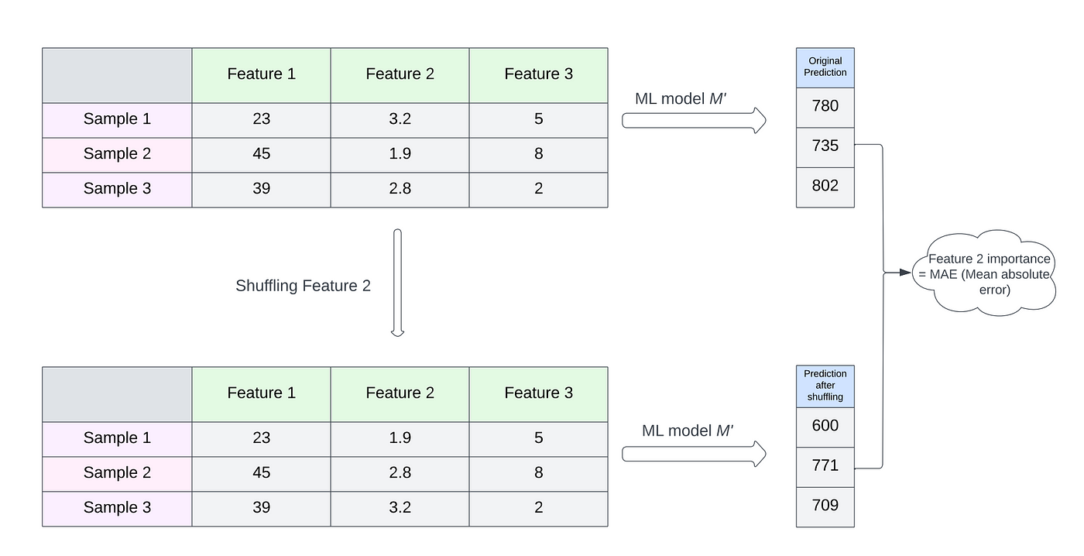
What is feature permutation?
Notes:
Permutation feature importance is a technique used to measure the importance of individual features in a predictive model based on the decrease in the model's performance when the values of each feature are randomly shuffled. This method is model-agnostic, meaning it can be applied to any machine learning model, and is straightforward to understand and implement. Here’s how it works at a high level:
Model Training: First, you train your model using the full dataset and measure its performance (accuracy, F1 score, RMSE, etc.) on a held-out validation set or through cross-validation. This initial measurement serves as the baseline performance of the model.
Feature Permutation: For each feature in the dataset, you:
Temporarily shuffle the values of that feature across the data points in the validation set, which breaks the relationship between the feature and the target. This means that only the values for one feature are shuffled at a time while the other features remain unchanged.
With the shuffled feature, you then re-evaluate the model's performance on the same validation set.
Performance Decrease: You calculate the difference in model performance with the original (unshuffled) data and with the shuffled data for the feature. A significant drop in performance indicates that the model relies heavily on the feature for making accurate predictions, suggesting high importance.
Repetition for Robustness: Often, the shuffling and evaluation process is repeated multiple times for each feature to account for variability in the data shuffling. The average drop in performance across these iterations is then taken as the feature’s importance score.
Ranking Features: After calculating the importance for all features, you can rank the features based on the observed decrease in model performance. Features that cause a large performance decrease when shuffled are considered more important than those that cause little to no change.

Slide 16
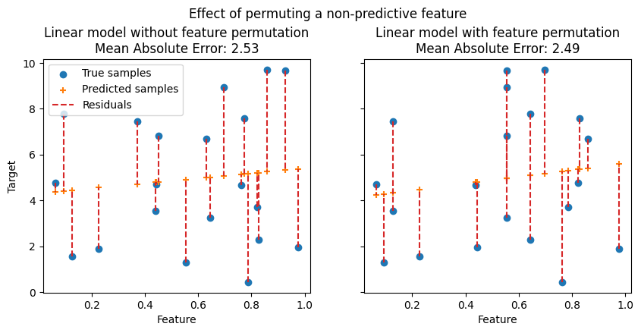
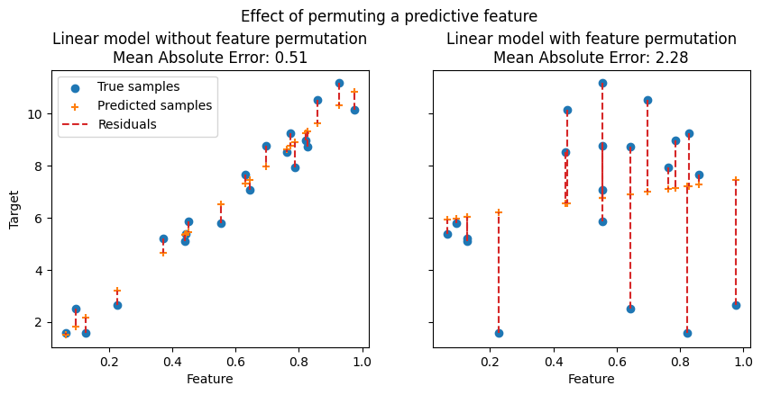
Feature permutation example
change in MAE = 2.53 - 2.49 = 0.04
⇒ not a significant difference (p=0.15)
change in MAE = 0.51 - 2.28 = -1.77
⇒ significant difference (p=0.00001)
Notes:
In this slide, we compare the residuals (which are the differences between the predicted values and the actual values) for a non-predictive feature (on the left) and a predictive feature (on the right).
On the left-side figure, we observe that permuting a non-predictive feature does not significantly degrade the model statistical performance. The change in model performance (here mean absolute error) is 2.53 minus 2.49 or 0.04. This 0.04 residual is not statistically significant (p-value of 0.15). From this we interpret that the feature we permuted is not important in the overall model predictions.
On the right-side figure, we observe that permuting a predictive feature breaks the correlation between the feature and the target, and consequently the model statistical performance decreases. The change in model performance (again mean absolute error) is 0.51 - 2.28 or -1.77. This -1.77 residual is statistically significant (p-value of 0.00001). From this, we interpret that the feature we permuted is important in the overall model predictions.

Slide 17

Feature permutation summary
pros | cons
model agnostic | random shuffling can lead to misleading results
no assumptions about data distributions | computationally expensive for large datasets or complex models
easy to implement and understand | dependency on choice of performance metric
https://scikit-learn.org/stable/modules/permutation_importance.html
Notes:
We will use the permutation_importance module from the scikit-learn package as our implementation in the hands-on exercises.
Benefits of Permutation Feature Importance:
Model Agnostic: It works with any model type, whether linear, tree-based, or neural networks.
No Assumptions: Unlike parametric approaches (e.g., using coefficients from linear models), it does not assume anything about the distribution of the variables or model linearity.
Easy to Implement: It is conceptually simple and easy to implement using many modern machine learning libraries that often include built-in functions for calculating permutation importance.
Limitations:
Random Chance: The random shuffling can sometimes lead to misleading results, especially with datasets that have many correlated features.
Computationally Expensive: It can be computationally expensive, especially for large datasets or models that are slow to predict because the model needs to be evaluated multiple times for each feature.
Dependency on Performance Metric: The changes in feature importance can depend heavily on the choice of performance metric and the specific dataset used for evaluation.
Overall, permutation feature importance provides a useful and straightforward approach for understanding which features your model is relying on most, helping in interpreting the model’s behavior in real-world applications.

Slide 18

Notes:
And that brings us to the end of this lecture in which we discussed performing DGEA, PEA, and GSEA. In the hands-on activity, you’ll have the opportunity to experience using Shapley values and feature permutation and compare them to built-in feature-importance functions to interpret the results of your machine learning models.

