Slide 1
Producing and consuming open science
Notes:
Welcome to this lesson on producing and consuming open science.

Slide 2
Objectives
Open literature and open science
Open data and open science
Open software and open science
Notes:
The objectives of this lesson are to first describe the relationship b/w open literature and open science, then discuss the relationship b/w open data and open science, and finish by discussing the relationship b/w open software and open science.

Slide 3
Discuss role of open literature in open science
Notes:
First let’s discuss the role of literature in open science.

Slide 4


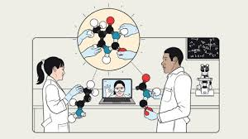
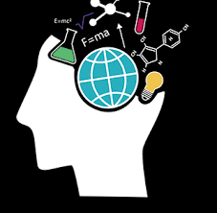


What is the role of open literature in open science?
access
collaboration
reproducibility
impact
education
responsibility
Notes:
What is the role of open literature in open science?
Access and Dissemination: Open access literature is crucial in open science as it removes paywalls that can restrict access to research findings. This ensures that all scientific outputs, including journal articles, books, and conference papers, are freely available to anyone with internet access.
Increased Collaboration: Open literature promotes more collaborative research opportunities. Scientists across the globe can access the latest studies and datasets, enabling them to contribute or build upon others' work without access restrictions.
Enhanced Reproducibility: Open access to literature is often linked with the availability of underlying data and methodologies. This transparency is essential for reproducibility, allowing other researchers to verify results and reuse data in new contexts.
Public Engagement and Education: By making scientific literature openly accessible, researchers can engage more effectively with the public, policymakers, educators, and students. Open literature helps demystify science, making it more accessible and understandable to non-specialists.
Citation and Impact: Studies have shown that open access articles are cited more frequently than those behind paywalls. Increased citations not only help in fulfilling the academic requirement of demonstrating impact but also enhance the visibility and influence of researchers' work.
Ethical and Social Responsibility: Open access is often seen as an ethical imperative. Making research findings available to everyone, regardless of their institution's ability to afford journal subscriptions, promotes a more equitable dissemination of knowledge.

Slide 5
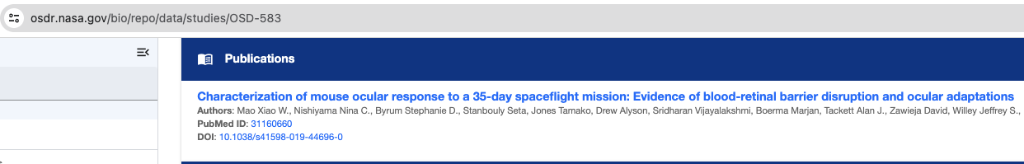
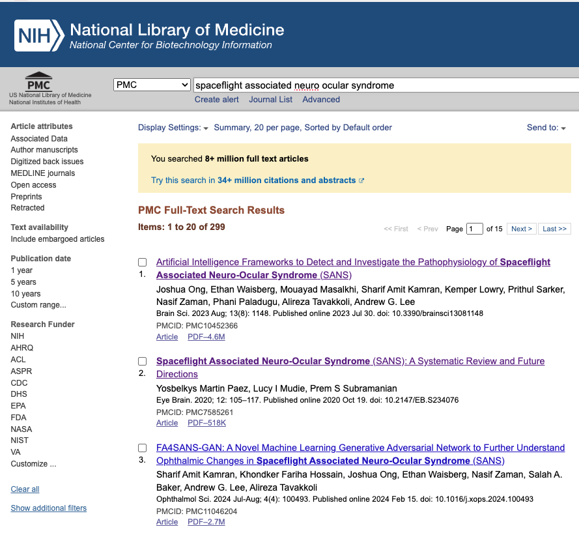
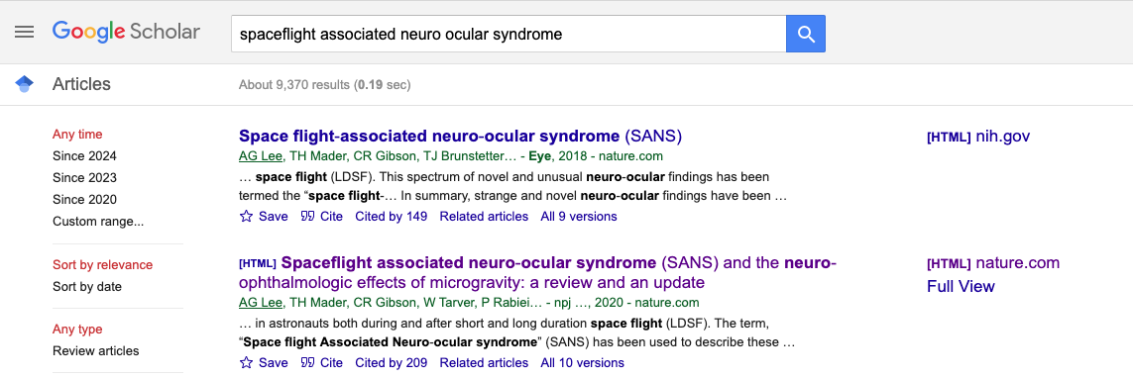
Where to find relevant articles?
https://www.sciencedirect.com
https://plos.org
https://doaj.org
Notes:
Where can you find articles relevant to your research?
One place to find relevant articles is in the datasets of OSDR. In the slide at the top is a screenshot of OSD-583 (the dataset which includes the microscopy images we used in our hands-on exercises) from OSDR. All publications coming out of an OSDR dataset are linked. On the left of the slide is a snapshot of searching for “spaceflight associated neuro-ocular syndrome” at PubMed Central - the full-access subset of PubMed. note that there are more filters you can provide in your search, such as year of publication. On the right of the slide is a snapshot of searching for “spaceflight associated neuro-ocular syndrome” at google scholar. You can also filter by date and type of article here, and additionally this shows the number of citations in the search results. Besides those 3, there are several more sites that support searching for open access articles such as sciencedirect, PLOS, and DOAJ.

Slide 6
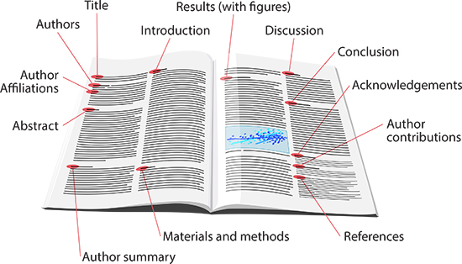
How to consume scientific literature?
data and code availability
Notes:
How do you consume scientific literature?
Start by reading the title and abstract. These provide a summary of the research question, methods, results, and conclusion. This step helps in deciding if the article is relevant to your interests or research needs.
Next, move on to the introduction, which lays the foundation for the research. It should explain the background of the study, the specific problem the research addresses, and the hypothesis or objectives. Note any terms or concepts you don't understand for further investigation.
The materials and methods section describes how the research was conducted. It includes information on participants, materials, procedures, and analysis. This is crucial for understanding how the results were obtained and assessing the validity of the study.
The results section describes the outcomes of the research, often with tables, graphs, and statistical data. You should focus on understanding the data presented, especially in the figures provided.
The discussion interprets the results, explaining how they fit into the larger context of the field, their implications, and any limitations of the study. The conclusion summarizes the findings and their importance. This section often suggests areas for future research.
The references section lists the sources cited in the article. This can be a useful resource to find more information on a topic, see where the current research came from, and how it builds on previous work.
Many authors provide the source code and the data to the public as listed in the data and code availability statements.

Slide 7
Discuss role of open data in open science
Notes:
In this second section, we discuss the role of open data in open science.

Slide 8




What is the role of open data in open science?
transparency
collaboration
innovation
engagement
preservation
education
Notes:
What is the role of open data in open science?
Transparency and Reproducibility: Open data ensures that researchers can review, replicate, and validate each other's findings. This transparency is crucial for the scientific process, helping to maintain high standards of accuracy and reliability.
Increased Collaboration: Open data facilitates collaboration across different disciplines and geographic boundaries. Researchers can combine datasets from multiple sources to enrich their analyses, leading to more robust findings and innovative solutions to complex problems.
Accelerating Innovation: By making data freely available, open data can speed up the pace of scientific and technological innovation. Companies, policymakers, and non-governmental organizations can use open datasets to develop new products, services, and policies.
Enhancing Education: Open data provides a valuable resource for educators and students, allowing them to work with real datasets to learn about the latest scientific methodologies and discoveries. This exposure can help train the next generation of scientists in data analysis and critical thinking.
Public Engagement: Making data openly available invites the public to understand and participate in science more actively. This can help demystify scientific research, increase public awareness about science, and encourage citizen science initiatives, where non-professionals contribute to scientific projects.
Data Preservation: Open data practices encourage proper data management and preservation. By preparing data for sharing, researchers must organize, describe, and store their data systematically, which benefits the long-term preservation of scientific data.

Slide 9
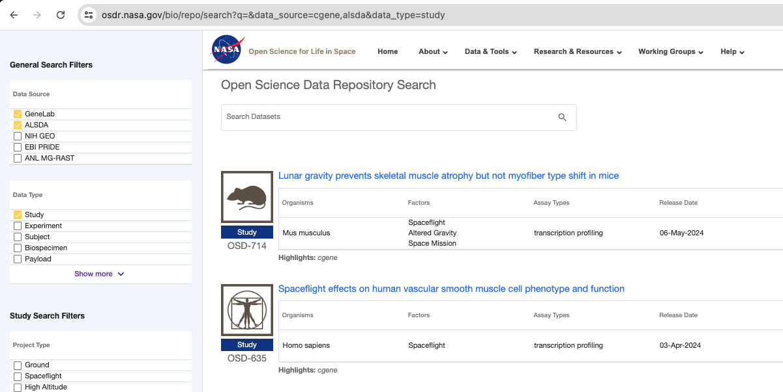
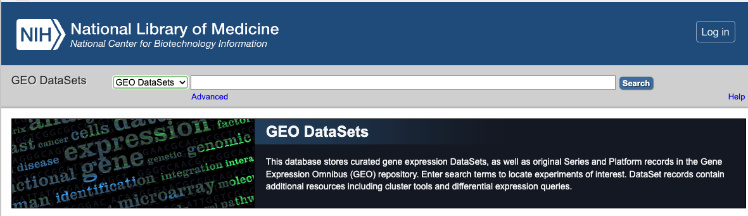
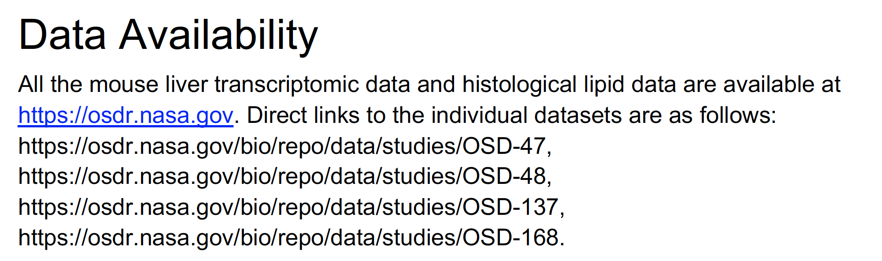
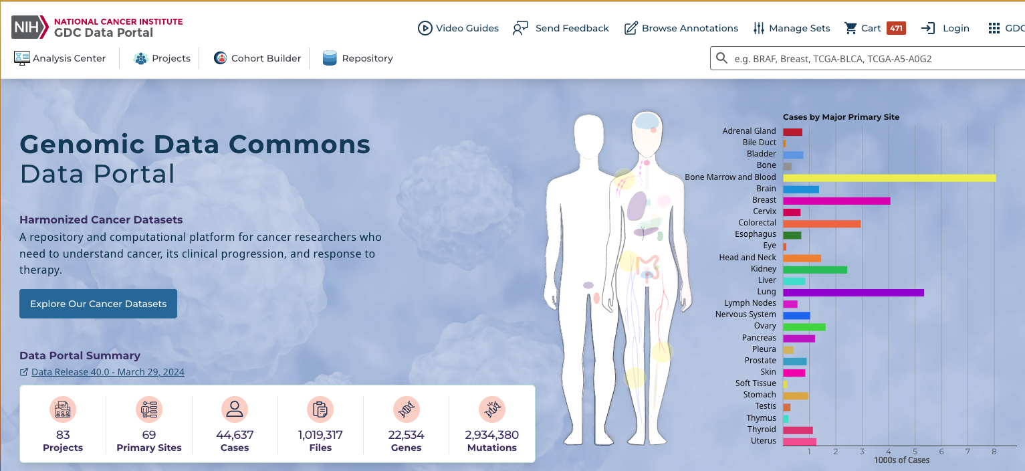
Where to find open data?
https://data.gov
https://portal.gdc.cancer.gov/
https://registry.opendata.aws/tcga/
https://maayanlab.cloud/archs4/
https://huggingface.co/datasets
https://www.informatics.jax.org/
https://www.ebi.ac.uk/ena/browser/home
Notes:
Where can you find open data?
There are a number of organizations which make biomedical data available for citizen science. One of those organizations is the top left of the slide: National Library of Medicine (part of NIH). They provide “GEO” datasets (gene expression omnibus) which is a collection of human and model organism transcriptomic data. On the bottom left of the slide is the National Cancer Institute portal (also part of the NIH). They provide the “genomic data commons” which is a repository and computational platform for cancer researchers who need to understand cancer, its clinical progression, and response to therapy. On the top right of the slide is NASA’s Open Science Data Repository (OSDR) which contains data from controlled experiments with humans as well as other organisms including mice, plants, microbes, and worms. OSDR is where we are getting all the data for our hands-on exercises. Don’t forget to check data availability statements in journal articles. And last, there are many more sites that provide free and open access to data including data.gov, the TCGA, and huggingface.

Slide 10
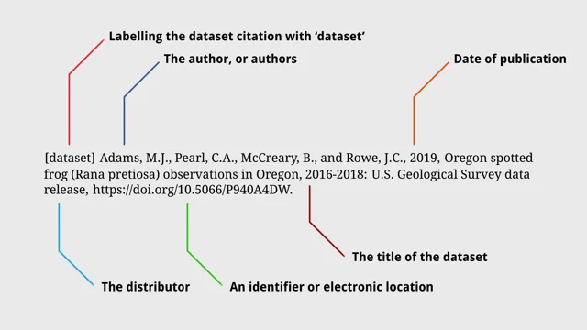
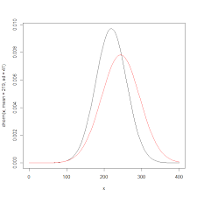

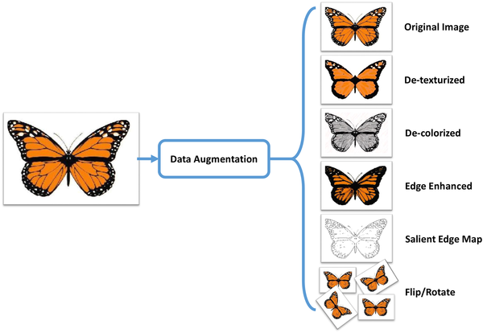
How to use open data?
cite
novel research
compare
data transformation
reproduce
augment
Notes:
How can you use open data?
Many AI/ML algorithms require a lot of data to train, test, and validate models. But in space biology, the problem is often the lack of sufficient data. One way to use open data in your space biology research is to augment your data. Data augmentation provides a means to improve model accuracy and balance imbalanced datasets. Another use of open data for your space biology research is to compare the results of a published experiment with your own results. This can serve to either help validate your AI/ML modeling, or it could serve to extend the results of already published research. As is often the case, after a principal investigator has published findings on data they have subsequently shared, scientists can re-use that data to either reproduce the results or for novel research. In any case, don’t forget to cite your data sources in your research.

Slide 11
Discuss role of open software in open science
Notes:
In this last section, we discuss the role of open software in open science.

Slide 12
What is the role of open software in open science?
transparency
collaboration
innovation
engagement
preservation
education
Notes:
What is the role of open software in open science?
Transparency and Reproducibility: Open software ensures that researchers can review, replicate, and validate each other's findings. This transparency is crucial for the scientific process, helping to maintain high standards of accuracy and reliability. When researchers share their software openly, it allows others to test the reproducibility of results, which is a fundamental aspect of building trust and credibility in scientific research.
Increased Collaboration: Open software facilitates collaboration across different disciplines and geographic boundaries. Researchers can combine software from multiple sources to enrich their analyses, leading to more robust findings and innovative solutions to complex problems. This collaborative environment can accelerate scientific discovery and increase the efficiency of research investments.
Accelerating Innovation: By making software freely available, open software can speed up the pace of scientific and technological innovation. Companies, policymakers, and non-governmental organizations can use open software to develop new products, services, and policies.
Enhancing Education: Open software provides a valuable resource for educators and students, allowing them to work with real datasets to learn about the latest scientific methodologies and discoveries. This exposure can help train the next generation of scientists in data analysis and critical thinking.
Public Engagement: Making software openly available invites the public to understand and participate in science more actively. This can help demystify scientific research, increase public awareness about science, and encourage citizen science initiatives, where non-professionals contribute to scientific projects.
Code Preservation: Open software practices encourage proper software management and preservation. By preparing software for sharing, researchers must organize, describe, and store their software systematically, which benefits the long-term preservation of scientific software.

Slide 13
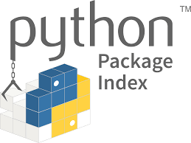



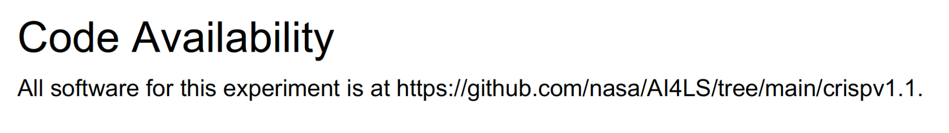
Where to find open software?
Notes:
Where can you find open software?
There are a number of Web sites that make software free and available, and by far the most popular of which is GitHub. It’s free to create a software repository on GitHub, and you can invite collaborators to help develop the software with you. There are lot of tools in git that enable streamlined collaboration, making it the goto option for sharing code. HuggingFace is a repository of software and models dedicated to AI/ML. You can also share and download free datasets there and even run models. Jupyter is a great software collaboration tool that enables the entire lifecycle of research from initial exploratory data analysis to creation of publication-ready images. Our hands-on activities on google colab are based on the jupyter notebook technology. The pypi portal is the primary source of python software which you install using the pip command. Last, don’t forget to check code availability statements in journal articles where authors share the code they used to run the experiments that the research is based on.

Slide 14
How to use open software? (understanding licenses)
license category | description | examples
Permissive | least restrictive free to use, modify, redistribute (even for proprietary projects) | MIT License Apache License 2.0 BSD License
Copyleft | free to use modify, redistribute derivative works must be distributed under same license (ie you can’t attach a more or less restrictive license to your software based on this) | GNU General Public License GNU Lesser General Public License Mozilla Public License 2.0
Public domain | dedicate software to public domain where possible or grant equivalent freedom where dedication not possible | Create Commons Zero The Unlicense
Notes:
How can you use open software?
Open source software licenses are crucial for defining how software can be used, modified, and distributed. They ensure that the software remains free and accessible while specifying the terms under which developers and users can operate. The slide shows some of the key types of open source licenses. Permissive licenses are the least restrictive and allow you to use, modify, and redistribute the software under a different license. Examples of permissive licenses include MIT, Apache, and BSD. Copyleft (a play on the word copyright) licenses also allow you to reuse, modify, and redistribute the software, but you cannot change the license in your derivative work. Examples of copyleft licenses include GNU and Mozilla. The last license category is public domain, and software in the public domain mu

Slide 15

Notes:
And that brings us to the end of this lecture in which we discussed the role of open literature, open data, and open software in the context of open science. This particular lesson does not have an associated hands-on exercise, but we encourage you to always consider being as open, transparent, and collaborative as you can when you embark on your own research projects.

