Slide 1
Using scikit-learn
Notes:
Welcome to the lesson “Introduction to Space Biology Data”.

Slide 2
Objectives
Describe what scikit-learn is
Identify ML implementations in scikit-learn
Describe training, testing, and validation data
Define performance metrics from scikit-learn
Notes:
The objectives of this lesson are:
Identify model organisms used for space biology research
Describe experiments for space biology research
Define data types and formats for space biology experiments
Define data types and formats for machine learning models
Describe training, testing, and validation data

Slide 3
Describe what scikit-learn is
Notes:
In this first section, we will identify model organisms which are used for space biology research.

Slide 4
Scikit-learn is a collection of ML algorithms
Extensions to SciPy (scientific python) are called “SciKits”
SciKit-Learn provides machine learning algorithms:
supervised and unsupervised
built on SciPy and Numpy / somewhat compatible with Pandas
Standard python API interface
Leverages C libraries for performance (LAPACK, LibSVM, Cython)
Open Source: BSD License (technically part of Linux)
Well-documented and well-used
Very easy to use

Slide 5

Scikit-learn is a collection of ML algorithms

Slide 6
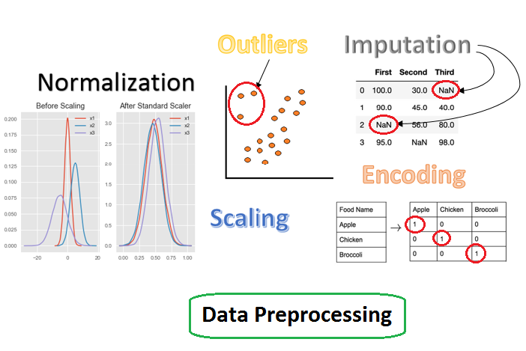
Scikit-learn is also a collection data preprocessors

Slide 7
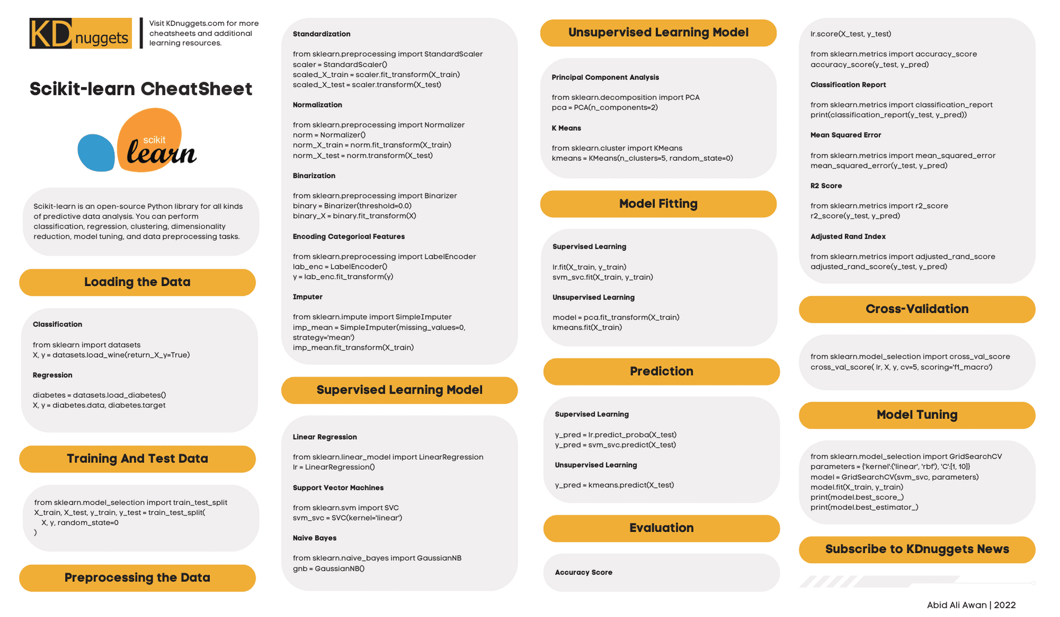
Scikit-learn is almost a one-stop shop for ML

Slide 8
Identify ML implementations in scikit-learn
Notes:
In this first section, we will identify model organisms which are used for space biology research.

Slide 9
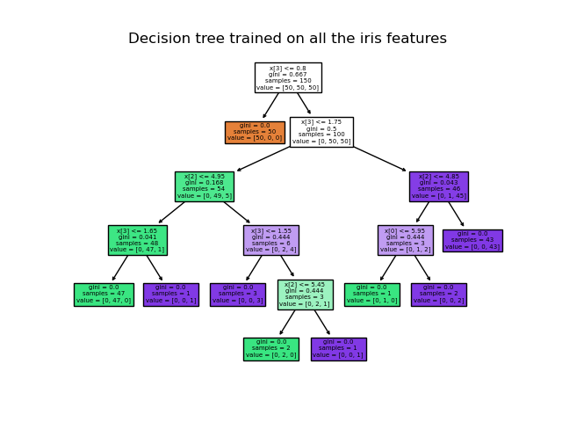
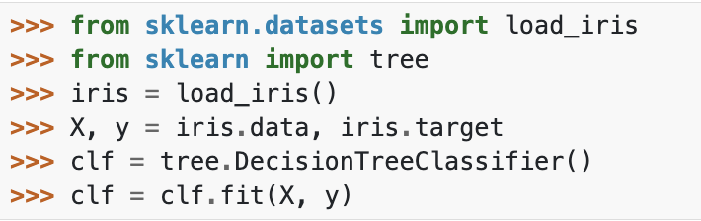
Scikit-learn decision tree

Slide 10
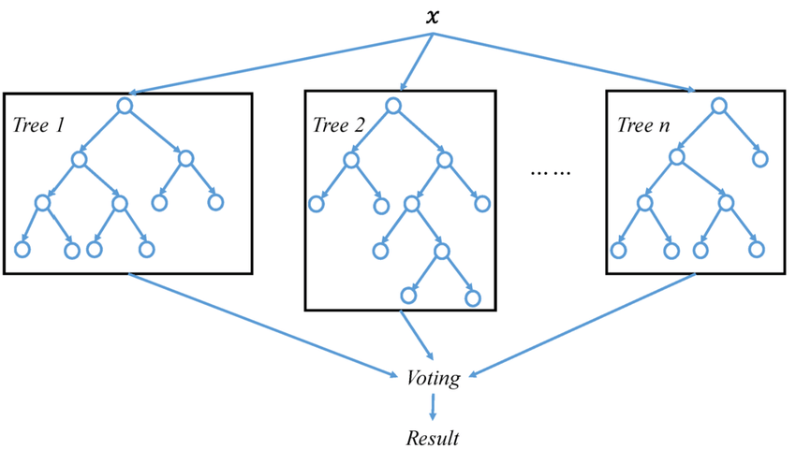
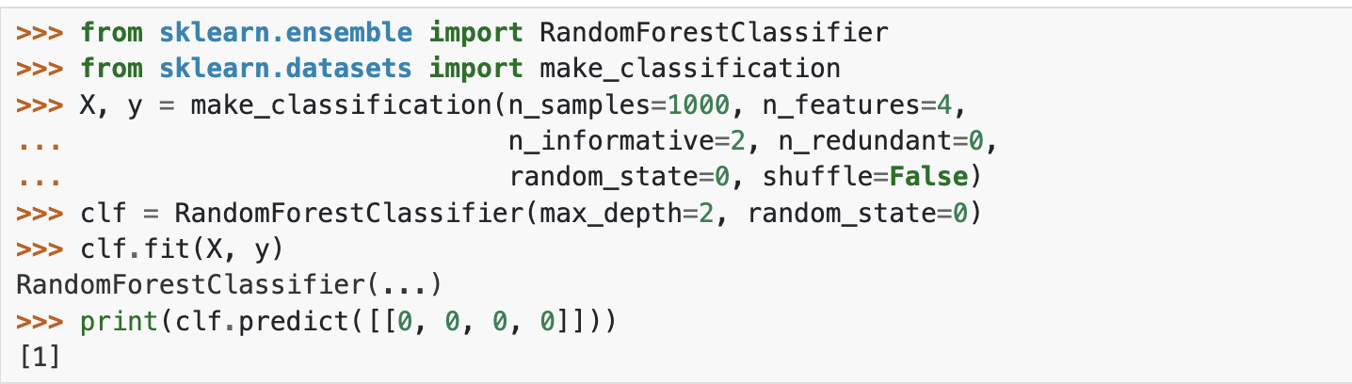
Scikit-learn random forest

Slide 11
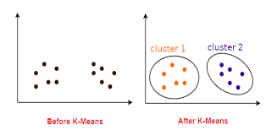
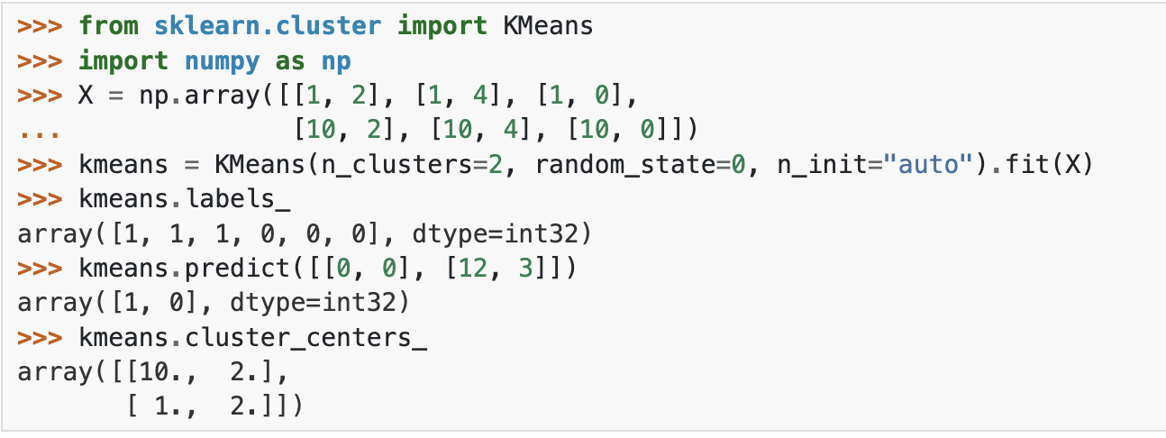
Scikit-learn k-means cluster

Slide 12
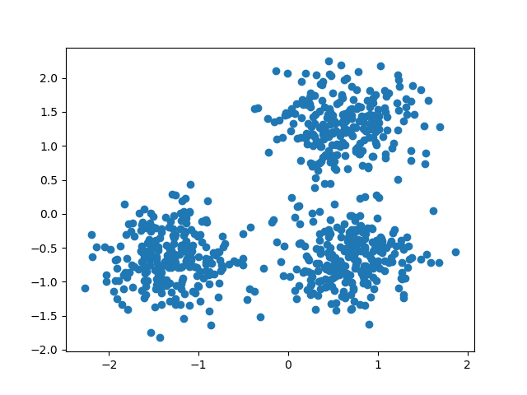
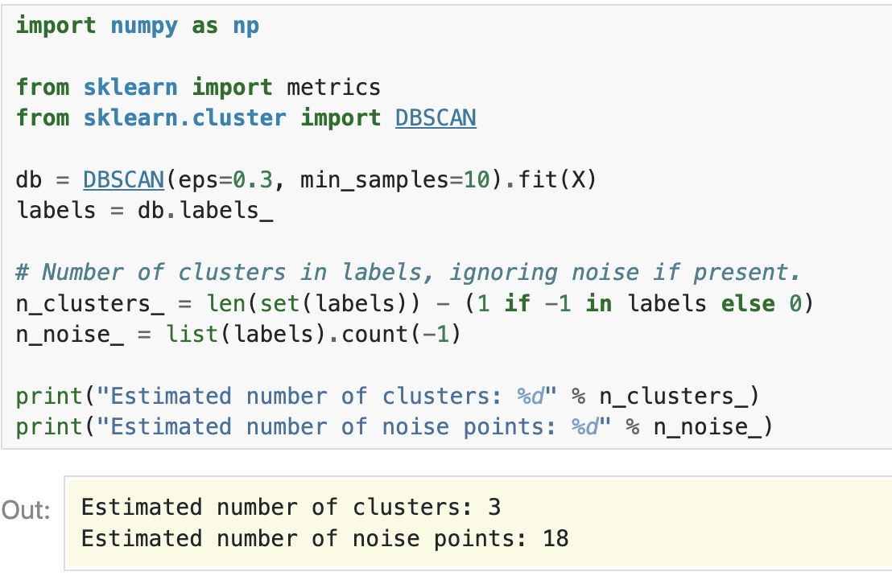
Scikit-learn dbscan cluster

Slide 13
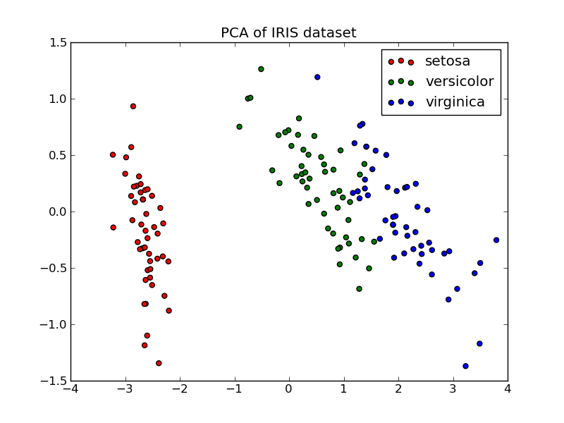
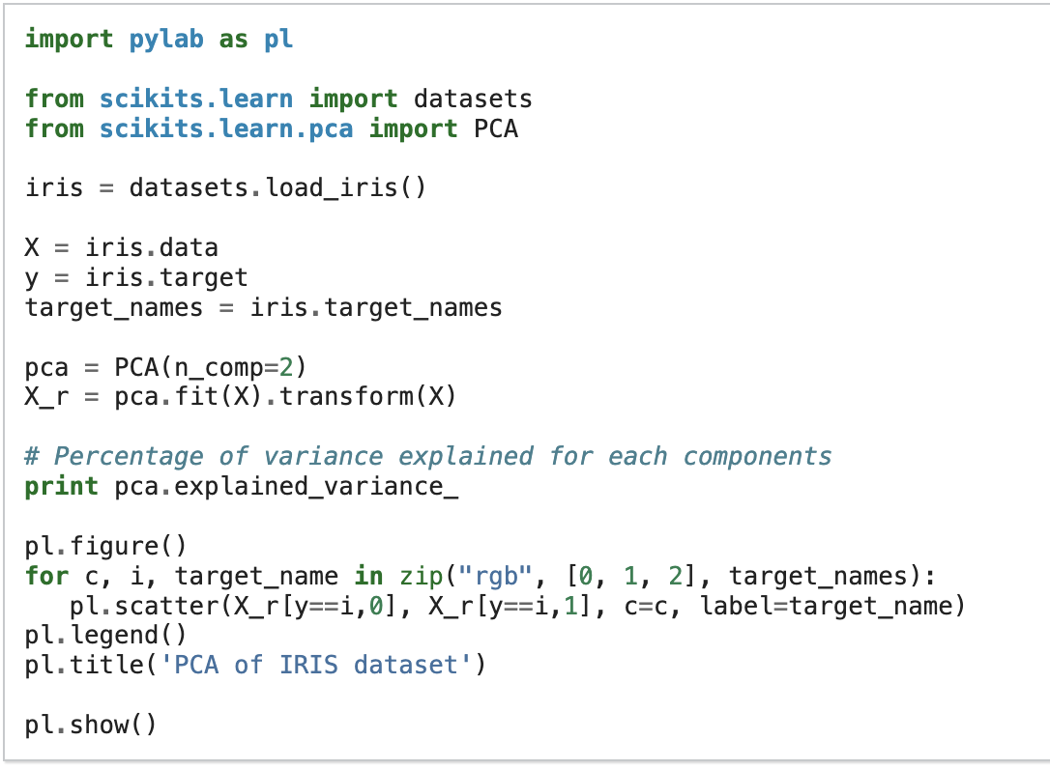
Scikit-learn PCA

Slide 14
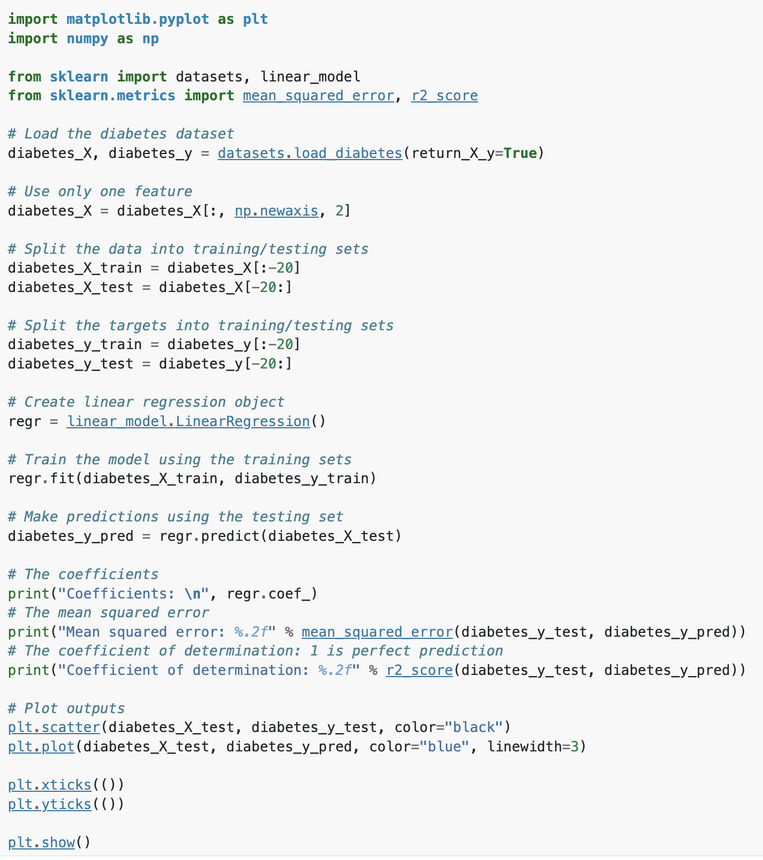
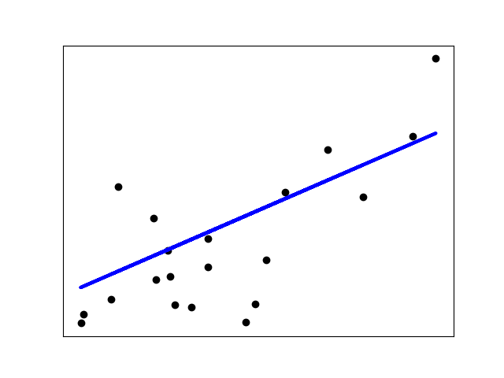
Scikit-learn linear regression

Slide 15
Training and testing data

Slide 16
Splitting data into train, test, and validation sets
all data
training data
(70%)
testing data (15%)
validation data (15%)
what are the parameters of the model?
which parameters are best?
how good is the model?

Slide 17
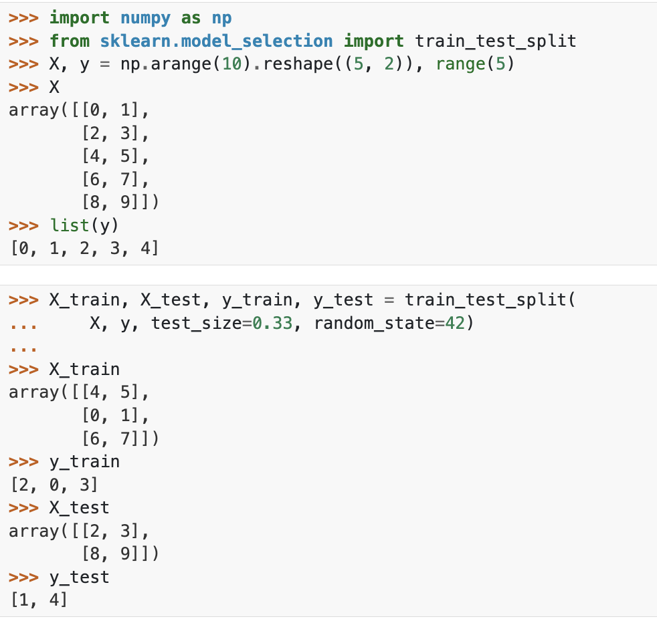
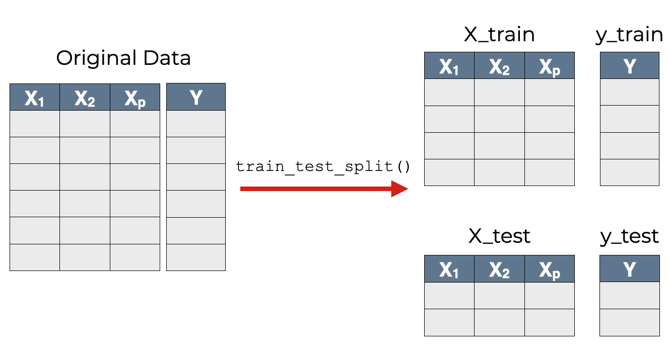
Splitting data into training and testing sets

Slide 18
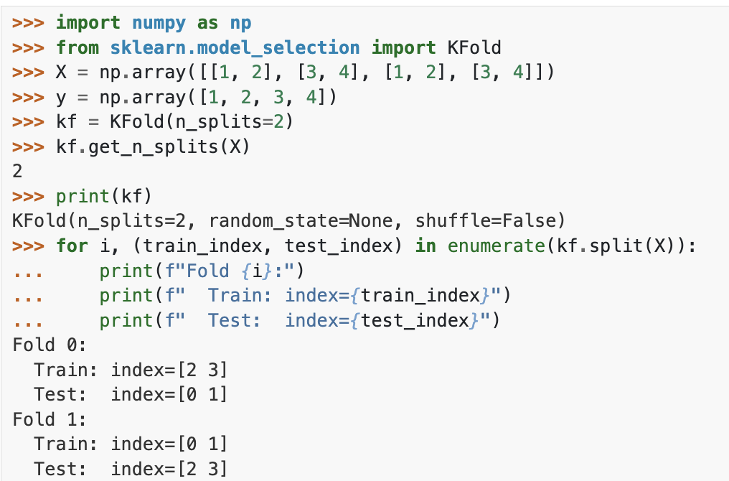
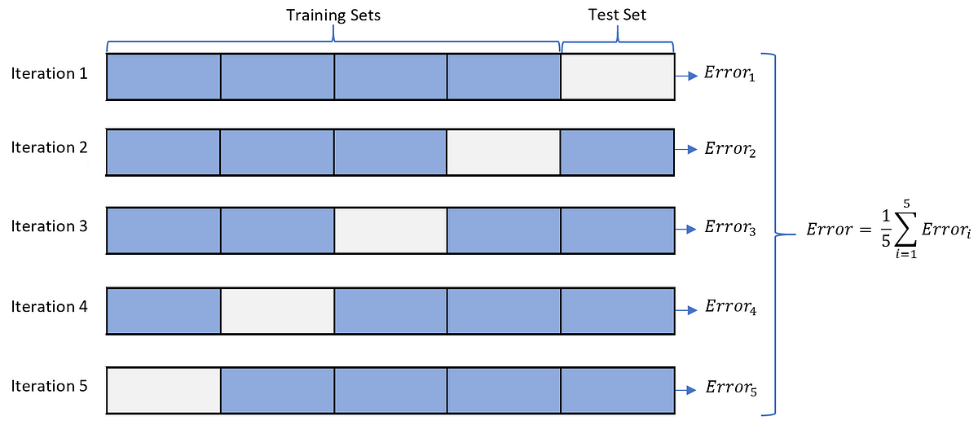
k-fold cross validation

Slide 19
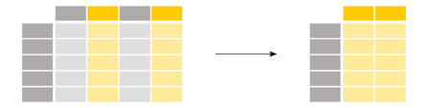
Subsetting columns in Pandas
df = df.drop(columns=['col0', col2’]), inplace=False)

Slide 20
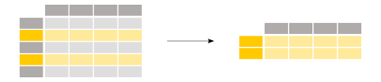
Subsetting rows in Pandas
df=df[df[‘col0’].isin(filter_list)]

Slide 21
Performance metrics

Slide 22
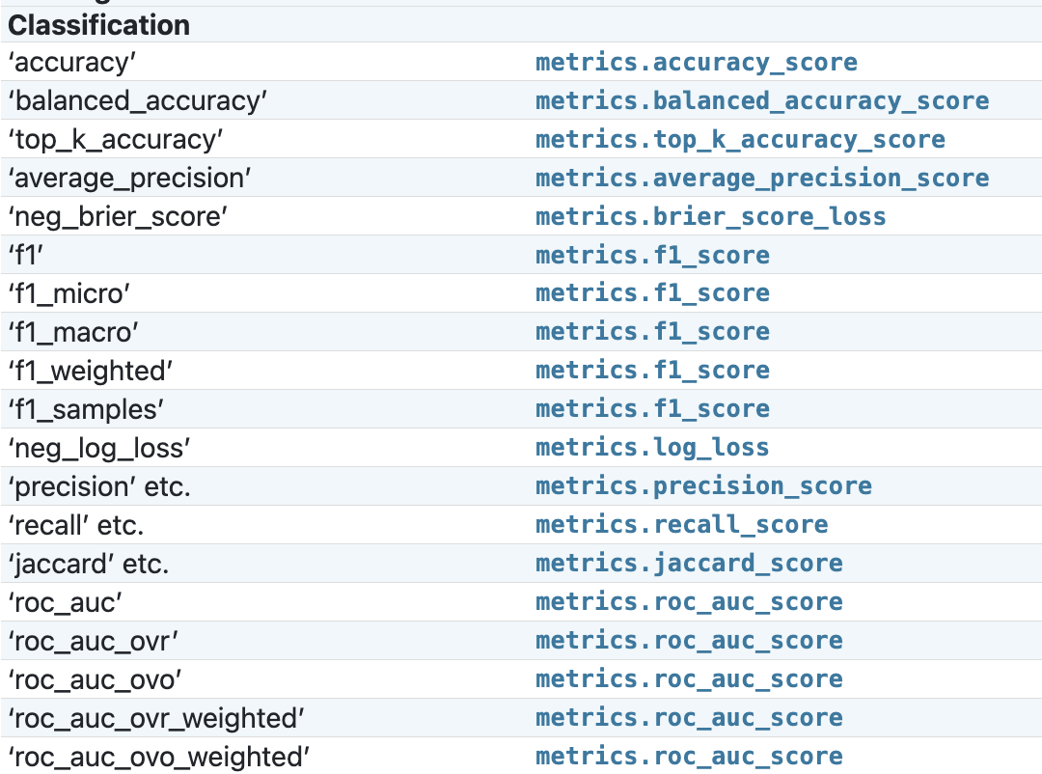
Classification metrics

Slide 23
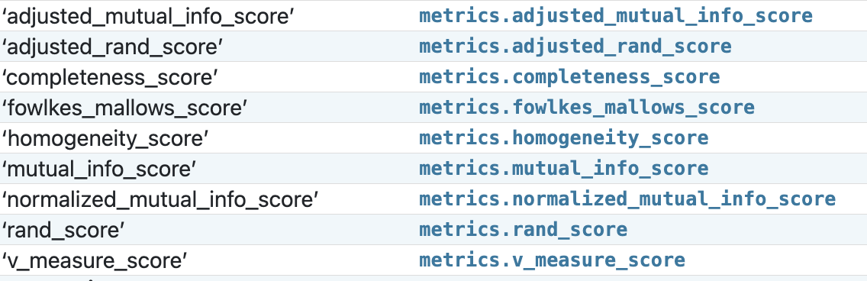
Clustering metrics

Slide 24
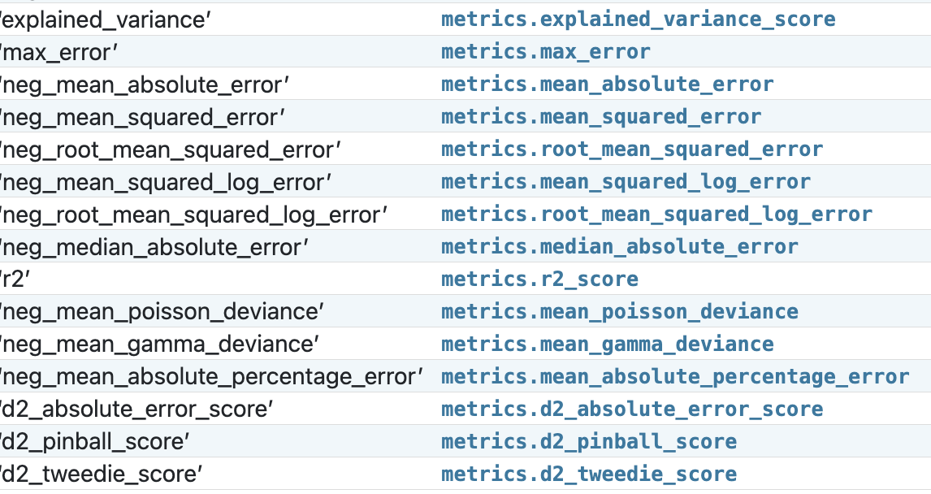
Regression metrics

