Slide 1
ML Bioinformatics Pipeline
Ensemble Machine Learning + Differential Expression Analysis
Microservices Architecture | Docker + gRPC | Python + R

Slide 2
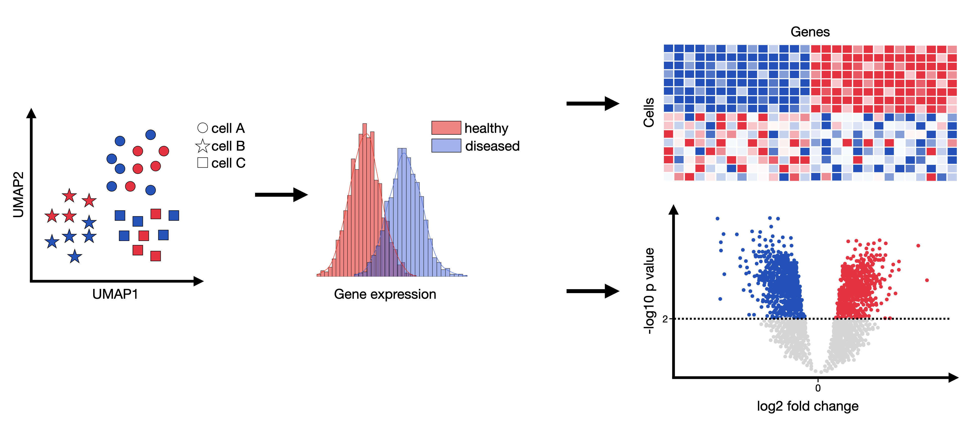
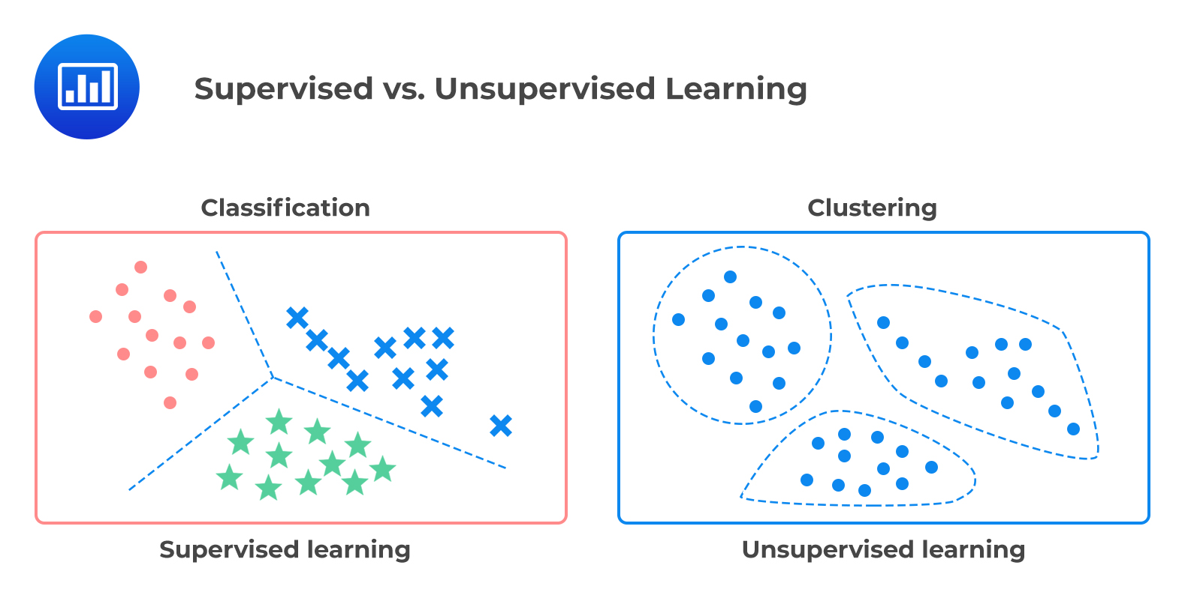
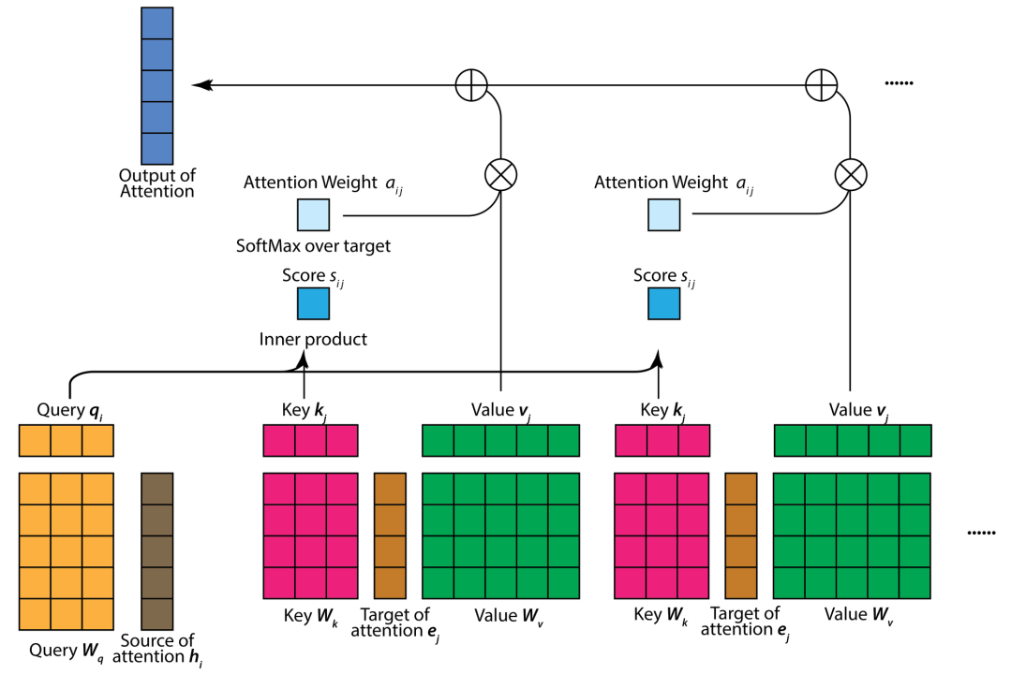
Statistical approach (e.g. DGEA)
Goals:
Find intersecting genes from each approach
Compare/contrast performance from each approach
Identify ”best” genes
ML approach (e.g. random forest)
AI approach (e.g. transformers)

Slide 3
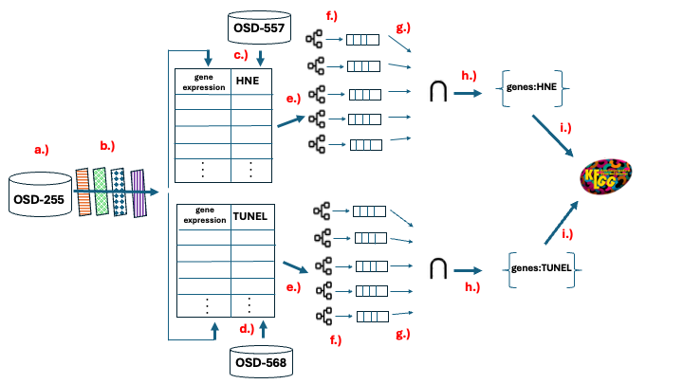
Ensemble approach

Slide 4
Dataset(s)
Select from OSDR
Provide your own
In any case, validate choice
Transformation(s)
TPM
Median of ratios
Log
Standardization
etc
Augmentation
Synthetic (cVAE, cGAN, etc)
Variance-stabilizing (boxcox, VST, etc)
Power transformations
etc
Algorithms
Classification (RF, LR, SVM, MLP, etc)
Regression (linear, ridge, lasso, elasticnet, etc)
Unsupervised (PCA, tSNE, uMAP, k-means, etc)
Feature importance
built-in
Recursive feature elimination
Permutation feature importance
SHAP values
Coefficient magnitude
Performance metrics
Classification (accuracy, AUC, F1 score, etc)
Regression (RMSE, R^2, etc)
Graphs/tables/figures
Box-and-whisker
QQ
mean vs variance
PCA (or TSNE etc)
Probability densities
train/test/validation performance
Genes most predictive
Graphical abstract
Analyses
Statistical (KS-test, t-test, wilcoxon, etc)
DGEA
Pathway / gene set / overrepresentation analysis
Knowledge graph integration
CRISP (IRM, NLIRM, ICP, NLICP, etc)
Artifact generation
Abstract, intro, methods, results, conclusion, bibliography
Or just hypothesis generation
Or just synthetic data
Or just compare ML vs scGPT vs DGEA vs CRISP
Or just some graphs/tables/figures
Or just … etc

Slide 5
Summary
What is built
A modular, microservices-based ML bioinformatics pipeline
Downloads RNA-seq data from NASA OSDR
Applies CV filtering for feature selection
Trains ensemble of 5 ML algorithms
Computes consensus feature importance
Runs DESeq2 differential expression
Tracks all experiments for reproducibility
Key Innovations
Dual Analysis: ML consensus + DESeq2 statistics
Same Gene Filtering: Fair comparison between methods
Ensemble Approach: Robust feature selection
Docker + gRPC: Reproducible, scalable, language-agnostic

Slide 6
System Overview
End-to-End Pipeline
1. Download RNA-seq
2. Filter & Transform
3. Train Ensemble
4. Feature Importance
5. Consensus Aggregation
6. DESeq2 Analysis
7. Compare Results
Key Outputs
127 consensus ML features (≥3 models)
847 DESeq2 significant genes
43 high-confidence genes (ML ∩ DESeq2)

Slide 7
Microservices Architecture
7 Independent Services | Docker + gRPC
Data Service:50051
ML Service:50052
Feature Importance:50053
Bioinformatics Service (R):50054
Experiment Service:50055
Orchestration Service (REST API):8000

Slide 8
Why gRPC + Docker?
gRPC Benefits
Docker Benefits
Type Safety: Protocol buffers enforce contracts
Performance: Binary protocol, 5-10x faster than REST
Streaming: Efficient for large datasets
Language Agnostic: Python ↔ R seamlessly
Isolation: Each service has own dependencies
Reproducibility: Same environment everywhere
Scalability: Easy to replicate services
Development: Services tested independently
Result: Modular, maintainable, scalable pipeline

Slide 9
Data Service
Port 50051 | Data Acquisition, Storage, Transformation
Key Features
NASA OSDR Integration: Download RNA-seq data from public repository
Smart Caching: MD5-based cache to avoid redundant downloads
CV Filtering: Select most variable genes (55K → 3K features)
Transformations: log, standardize, TPM for ML
gRPC Streaming: Efficient transfer of large datasets
Three Dataset Types
Raw
Filtered
Transformed
Untransformed counts
CV-filtered, raw (DESeq2)
CV-filtered + log + standardize (ML)

Slide 10
ML Service
Port 50052 | Ensemble Training & Model Management
Ensemble Training
Trains 5 algorithms simultaneously on same train/test split:
Random Forest
XGBoost
SVM
Logistic Regression
Neural Network (MLP)
Benefits of Ensemble
Robust feature selection from multiple perspectives
Fair comparison (same data split)
Consensus reduces overfitting to any single algorithm

Slide 11
Feature Importance Service
Port 50053 | Compute Feature Rankings
Permutation importance
Random feature elimination
How it works:
1. Baseline model score
2. Shuffle each feature
3. Re-score model
4. Importance = drop in score
Pros:
✓ Works for any model
Cons:
✗ Slow (many predictions)
How it works:
1. Baseline model score
2. Randomly eliminate a feature
3. Re-score model
4. importance = drop in score
Pros:
✓ Works for any model
Cons:
✗ Slow (many predictions)
Output: Ranked features for each of 5 models

Slide 12
Consensus Feature Aggregation
Combining Rankings Across 5 Models
Algorithm
1. Extract top-N features from each model (default: 100)
2. Track which models selected each gene
3. Filter genes appearing in ≥ M models (default: 3)
4. Sort by: # models (desc), then average rank (asc)
Example Consensus Results
Gene
Models
Avg Rank
Avg Importance
Confidence
GENE_A
5/5
2.1
0.42
Very High
GENE_B
5/5
4.3
0.38
Very High
GENE_C
4/5
6.8
0.31
High
GENE_D
3/5
12.4
0.24
Medium

Slide 13
Bioinformatics Service
Port 50054 | R-based Analysis (DESeq2, KEGG)
DESeq2 Differential Expression
Gene set enrichment
Input: Filtered raw counts (NOT transformed!)
Requirements:
Raw integer counts
Genes as rows, samples as columns
Condition metadata mapped to samples
Statistical Analysis:
Negative binomial model for count data
Library size normalization
Multiple testing correction (Benjamini-Hochberg)
Input:
list of genes
List of gene set libraries to analyze
Statistical Analysis:
Negative binomial model for count data
Library size normalization
Multiple testing correction (FDR)
Why DESeq2 + ML Consensus?
Genes in both = highest confidence biomarkers

Slide 14
Pipeline Results
Example: OSD-48 (Spaceflight vs Ground Control)
92
83
43
Consensus ML Features
DESeq2 Significant Genes
Overlap (High Confidence)
Model Performance
Gene Categories
Random Forest: 95% accuracy
XGBoost: 93% accuracy
SVM: 91% accuracy
Neural Network: 92% accuracy
Logistic Regression: 89% accuracy
43 genes: ML + DESeq2 (strongest)
92 genes: ML only
83 genes: DESeq2 only

Slide 15
Strengths
Modularity & Maintainability
Independent services, clear boundaries, easy to understand
Reproducibility
Docker containers, experiment tracking, data caching
Scalability
Horizontal scaling, resource allocation, async operations
Robust Feature Selection
Ensemble voting reduces overfitting, consensus increases confidence
ML + Traditional Bioinformatics Integration
Best of both worlds: ML feature selection + DESeq2 statistics

Slide 16
Weaknesses & Limitations
Small Sample Size
18 samples (14 train, 4 test) → high overfitting risk
Feature Order Bias (Current Bug)
Top genes are alphabetically first → needs debugging
No Hyperparameter Tuning
Using default parameters → missing potential performance gains
No Web Interface
Command line only, not user-friendly for non-programmers

Slide 17
Future Directions
Short Term (1-2 month)
Fix Feature importance
Order Bias (CRITICAL)
Debug alphabetical ordering
Speed up
randomize
Add Cross-Validation
5-fold or 10-fold CV instead of single split
More reliable performance estimates
Hyperparameter Tuning
Grid search or random search
Optimize for each dataset
Add multiple data sets
Add data augmentation to address small sample size
Integrate CRISP
Add graphs, tables, figures
Pretrain on ARCHS4 (e.g. predict tissue) and fine-tune on OSDR (e.g. predict flight)?

Slide 18
Future Directions
Medium Term (2-3 months)
Integrate other assets
Integrate KG
Integrate FM?
Integrate CVAE?
Web Dashboard (HIGH PRIORITY)
React/Vue frontend with real-time progress
Interactive visualizations (D3.js, Plotly)
Browse and compare experiments
Performance Monitoring
Grafana dashboards

