Slide 1
EphemerisPc Example
March 2026

Slide 2
Introduction
The ‘Example’ folder in the EphemerisPc directory contains the inputs and outputs for a high relative velocity LEO conjunction scenario, which can be run using ‘RunExamples.m’.
The example is similar to the high relative velocity LEO case in the paper, "Ephemeris-Based Satellite Collision Rates and Probabilities," by Doyle Hall.
  The paper provides a more detailed breakdown, along with low relative velocity LEO and GEO cases.
This slide package presents summary plots from the example scenario in order to familiarize new users with EphemerisPc outputs.

Slide 3
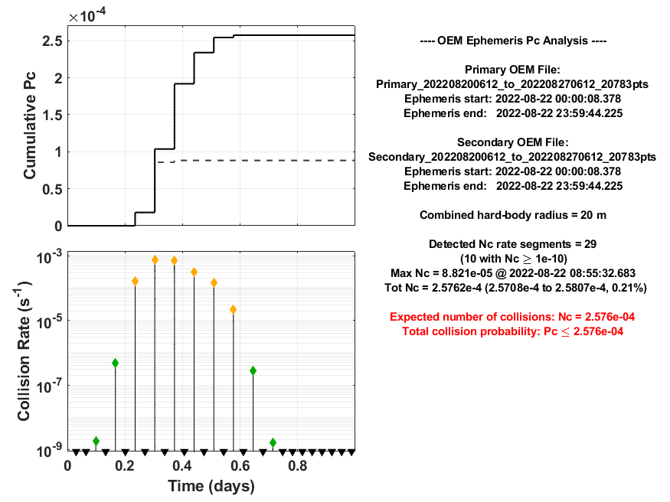
Multi-Encounter Summary
The cumulative Pc bounds are the primary EphemerisPc outputs.
The cumulative Pc is not calculated by this tool, but it is bounded by Pc Max (solid line) and Pc Min (dashed line).
Pc Max corresponds to full statistical independence between encounters, while Pc Min represents the opposite extreme.
For high relative velocity multi-encounter interactions, such as this example, the cumulative Pc tends to match the cumulative Pc Max. This has been confirmed by comparing BFMC-Pc results to Pc Max and finding that they are statistically consistent (see the paper for more details).
Accuracy indicator: Conservative upper limit on the uncertainty of the Nc and Pc Max estimates due to ephemeris interpolation errors or other numerical estimation inaccuracies.
An accuracy indicator > 5% should raise questions about whether the ephemeris tables are inadequately sampled.
Each of these collision rate peaks represents an encounter segment. They look like vertical lines because of their short duration. Color coded diamonds are used for represent the Pc level for each segment, with red marking Pc >= 1e-4, yellow diamonds marking 1e-7 <= Pc < 1e-4, and green diamonds marking a 1e-10 <= Pc < 1e-7. The black downward-pointing triangles indicate peaks with Pc < 1e-10 that are below the bottom axis.

Slide 4
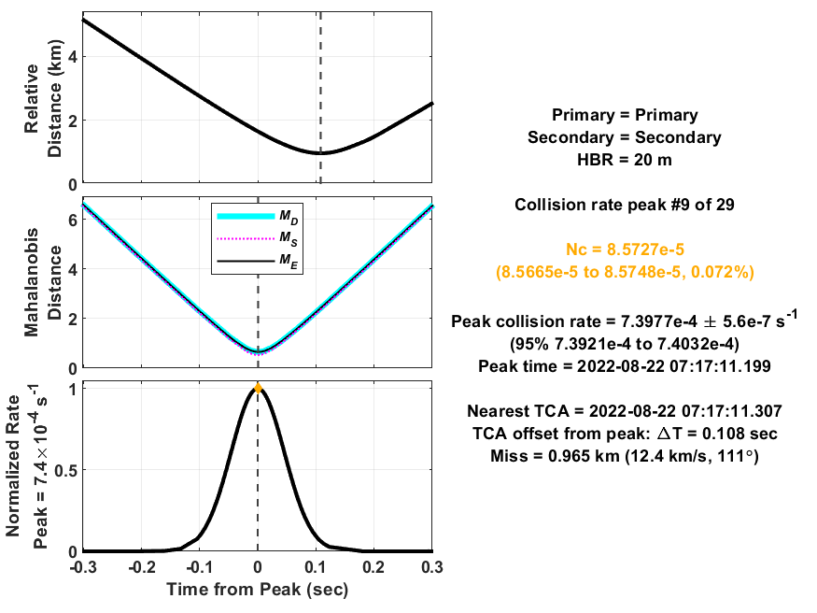
Encounter Segment Summary
A summary plot like the one shown here is generated for each encounter segment. They show zoomed in views of each collision rate peak from the previous slide. The complete set can be found in the Outputs folder.
For high relative velocity encounters, such as this example, Nc ≈ Pc. Note that the rate peak is not the same as Nc, which is obtained by integrating the rate over the encounter duration.
The encounter segment duration is short resulting in independent encounters that do not blend together.

