Slide 1
EvaluateLightPollution Software to Evaluate Astronomical Light Pollution Risks from Satellite Constellations
Doyle Hall
Omitron, Inc. – CARA Analysis Team
Last Update: 2024 November 25

Slide 2
Outline
Motivation, objectives, and software overview
Photometric observations of constellation satellites
Evaluation of light pollution levels for selected constellations
EvaluateLightPollution software usage instructions
Description of program inputs and outputs
Installation and troubleshooting contact information

Slide 3
Motivation
The Astronomical Community
Constellations can interfere with ground-based astronomy
Metrics and tools are required to quantify the effects
The NASA CARA Team
Recommendation from the “NASA Spacecraft Conjunction Assessment and Collision Avoidance Best Practices Handbook”
If the constellation, given its population, orbit, and constituent satellites, is likely to affect ground-based astronomy, reassign the satellite orbits or modify the satellite construction to eliminate this effect.

Slide 4
Research and Development Objectives
Research: Develop indicators to quantify light pollution effects
The brightness of individual constellation satellites, including the effects of temporal variability
The statistically expected number of visible and illuminated constellation satellites above a ground-based observer
The expected number that are brighter than the maximum brightness limit recommended by the astronomical community
Development: Implement a software tool for use by the CARA team that issues recommendations with supporting analysis
Use global and yearly peak of light pollution indicator #3 above, which incorporates the effects of a constellation’s population, orbital distribution, brightness, and variability
Enable evaluation for both current and proposed constellations, as well as single- and multi-shell constellations

Slide 5
Overview of Constellation Light Pollution Evaluation Software
The Matlab program EvaluateLightPollution analyzes astronomical light pollution risks created by current or proposed constellations of Earth-orbiting satellites
Evaluates potential light pollution levels and associated risks to visible and near-IR band ground-based astronomy
Based on the maximum brightness recommendations of the astronomical community, as provided in the AURA/AAS SatCon workshops^{1,2}
Uses a semi-empirical approach that incorporates measured satellite brightness magnitudes and variability, as applied to multi-shell constellations
Provides an efficient means to use current satellites as analog objects to enable evaluations for proposed or pre-launch constellations
Allows investigations of average satellite brightness reductions required to achieve acceptably low constellation light pollution levels
The underlying theory and quantitative metrics for the evaluation algorithm have been documented in detail³
¹Walker, C., et al., “Impact of Satellite Constellations on Optical Astronomy and Recommendations Toward Mitigations” SatCon-1 Workshop, 2020
²Walker, C., et al., “Report of the SatCon2 Workshop” 2021
³Hall, D., “Semi-Empirical Astronomical Light Pollution Evaluation of Satellite Constellations,” Journal of the Astronautical Sciences, Jan. 2023 (included in distribution)

Slide 6
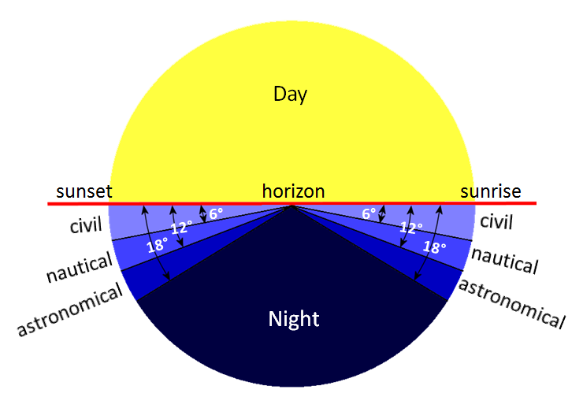
Overview of Constellation Light Pollution in the Visible and Near-Infrared Spectral Bands
Visible/near-IR brightness is typically dominated by reflected sunlight
The solar depression angle (SDA) measures how far the sun is below an observer’s local horizon
Twilight period: 0° < SDA < 18°
Astronomical night: SDA ≥ 18° (often the most valuable observation time)
Goal: Mitigate global light pollution during astronomical night time
Light pollution analysis parameters
Intrinsic satellite brightness/variability
Constellation orbital shell populations, altitudes, and inclinations
Observation solar depression angle
Observation zenith angle
Satellites in lower altitude constellations can be brighter because they are closer to ground-based observers
High Altitude Orbit
Low Altitude Orbit
But satellites in higher altitude constellations can be illuminated much longer into astronomical night
Observer
Zenith
Observation zenith angle
Earth’s shadow

Slide 7
Program EvaluateLightPollution
Photometric Observations
of Constellation Satellites

Slide 8
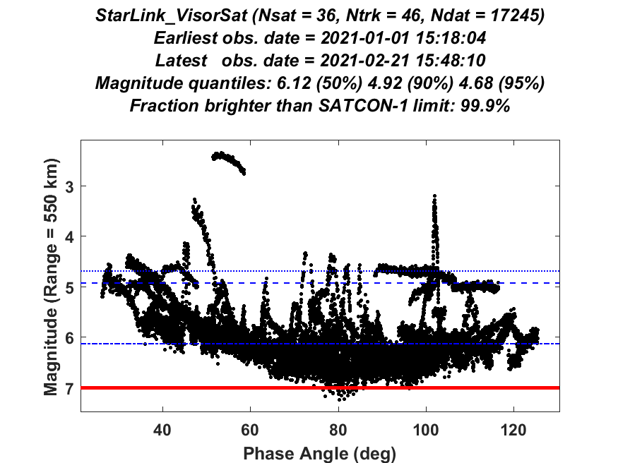
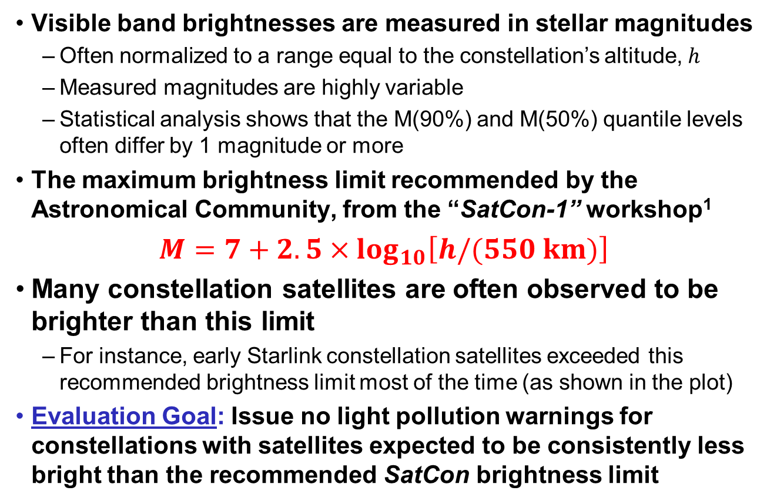
Observed Brightnesses of Constellation Satellites
Visible band brightnesses are measured in stellar magnitudes
Often normalized to a range equal to the constellation’s altitude, $h$
Measured magnitudes are highly variable
Statistical analysis shows that the M(90%) and M(50%) quantile levels often differ by 1 magnitude or more
The maximum brightness limit recommended by the Astronomical Community, from the “SatCon-1” workshop¹
$$M=7+2.5×\log_{10}\left[h/(550 km)\right]$$
Many constellation satellites are often observed to be brighter than this limit
For instance, early Starlink constellation satellites exceeded this recommended brightness limit most of the time (as shown in the plot)
Evaluation Goal: Issue no light pollution warnings for constellations with satellites expected to be consistently less bright than the recommended SatCon brightness limit
Range-normalized magnitudes for 36 Starlink satellites² observed during the first 50 days of 2021
¹Walker, C., et al., “Impact of Satellite Constellations on Optical Astronomy and Recommendations Toward Mitigations” SatCon-1 Workshop, 2020.
²Malama, A., “The Brightness of VisorSat-Design Starlink Satellites” 2021.

Slide 9
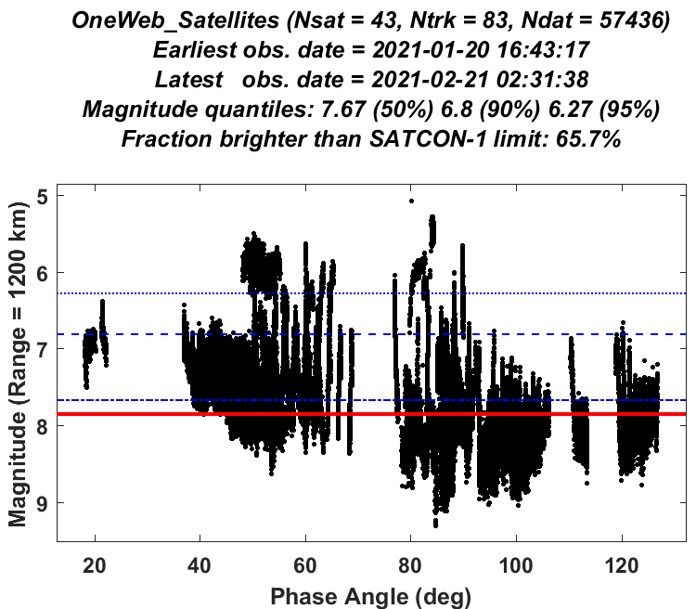
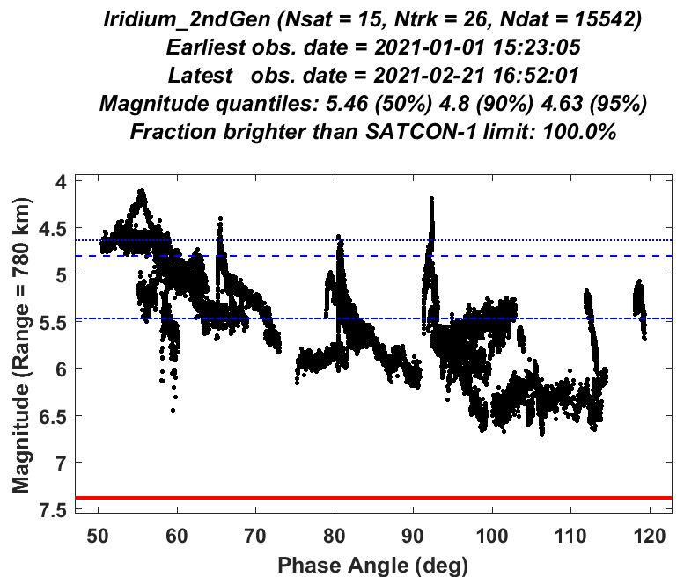
Comparing Satellite Brightnesses for Three Current Constellations
Starlink Constellation
1st Shell
99.9% of observed zenith brightnesses exceed the SatCon recommendation marked with red line*
OneWeb Constellation
Phase 1
65.7% of observed zenith brightnesses exceed the SatCon recommendation marked with red line*
Iridium 2nd Generation
Constellation
100% of observed zenith brightnesses exceed the SatCon recommendation marked with red line*
*Neglecting atmospheric extinction, and based on clear-filter photometric light-curve data measured by the MMT automated observatory: Karpov, S., et al., “Photometric Calibration of a Wide-Field Sky Survey Data from Mini-MegaTORTORA,” Astronomical Notes, 2018.

Slide 10
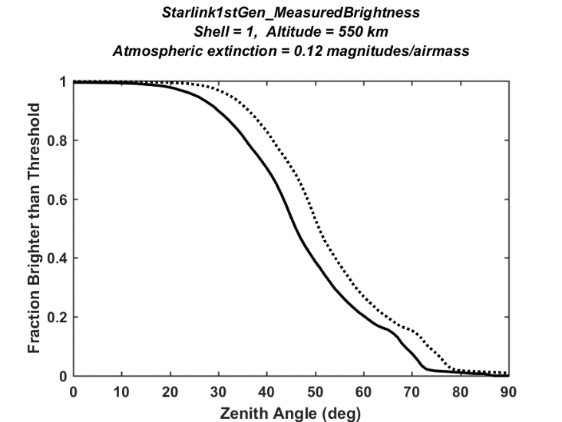
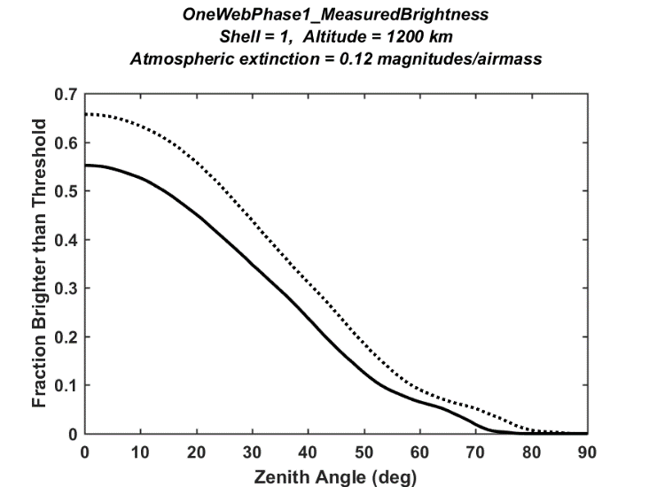
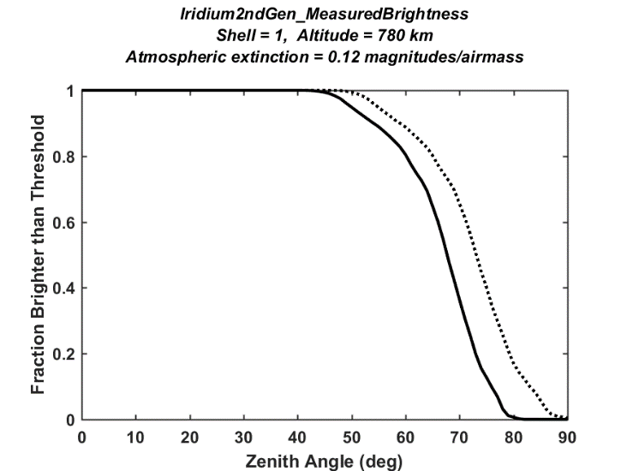
Apparent Magnitudes Change with the Observation Zenith Angle*
Starlink Constellation
1st Shell
For a 60° zenith angle (i.e., at 30° elevation), about 20% of apparent brightnesses exceed the SatCon recommended threshold
OneWeb Constellation
Phase 1
For a 60° zenith angle (i.e., at 30° elevation), about 6.5% of apparent brightnesses exceed the SatCon recommended threshold
Iridium 2nd Generation
Constellation
For a 60° zenith angle (i.e., at 30° elevation), about 80% of apparent brightnesses exceed the SatCon recommended threshold
*These graphs show empirically estimated fractions of the sunlit constellation satellite populations that are brighter than the SatCon recommendation, plotted as a function of observation zenith angle (which is the complement of the observation elevation angle). The solid lines show apparent brightness estimates that include an atmospheric extinction of 0.12 magnitudes/airmass; the dotted lines neglect atmospheric extinction.

Slide 11
Program EvaluateLightPollution
Evaluation of
Light Pollution Levels
for Selected Constellations

Slide 12
Constellations Analyzed in Provided EvaluateLightPollution Examples^{1,2}
Constellation Name (and component shell ) | Number of Satellites | Orbital Altitude (km) | Inclination (degrees) | SatCon-1 Recommended Threshold Magnitude
Starlink 1st Generation | 11,926 total | 335.9 – 570 | 42.0 – 97.6 | 6.46 – 7.04
shell 1 | 1,584 | 550 | 53.0 | 7.00
shell 2 | 1,584 | 540 | 53.2 | 6.98
shell 3 | 720 | 570 | 70.0 | 7.04
shell 4 | 348 | 560 | 97.6 | 7.02
shell 5 | 172 | 560 | 97.6 | 7.02
shell 6 | 2,493 | 335.9 | 42.0 | 6.46
shell 7 | 2,478 | 340.8 | 48.0 | 6.48
shell 8 | 2,547 | 345.6 | 53.0 | 6.50
Starlink 2nd Generation | 30,000 total | 328 – 614 | 30.0 – 148.0 | 6.44 – 7.12
shell 1 | 7,178 | 328 | 30.0 | 6.44
shell 2 | 7,178 | 334 | 40.0 | 6.46
shell 3 | 7,178 | 345 | 53.0 | 6.49
shell 4 | 2,000 | 360 | 96.9 | 6.54
shell 5 | 1,998 | 373 | 75.0 | 6.58
shell 6 | 4,000 | 499 | 53.0 | 6.89
shell 7 | 144 | 604 | 148.0 | 7.10
shell 8 | 324 | 614 | 115.7 | 7.12
OneWeb Phase 1 | 1,980 | 1,200 | 87.9 | 7.85
OneWeb Phase 2 | 6,372 total | 1,200 | 55.0 – 87.9 | 7.85
shell 1 | 1,764 | 1,200 | 87.9 | 7.85
shell 2 | 2,304 | 1,200 | 40.0 | 7.85
shell 3 | 2,304 | 1,200 | 55.0 | 7.85
Iridium 2nd Generation | 75 | 780 | 86.4 | 7.38
¹Bassa, C., et al., “Analytical Simulations of the Effect of Satellite Constellations on Optical and Near-infrared Observations,” A&A, Vol. 657. P. A75, Jan 2022
²Hall, D., “Semi-Empirical Astronomical Light Pollution Evaluation of Satellite Constellations,” Journal of the Astronautical Sciences, Jan. 2023.

Slide 13
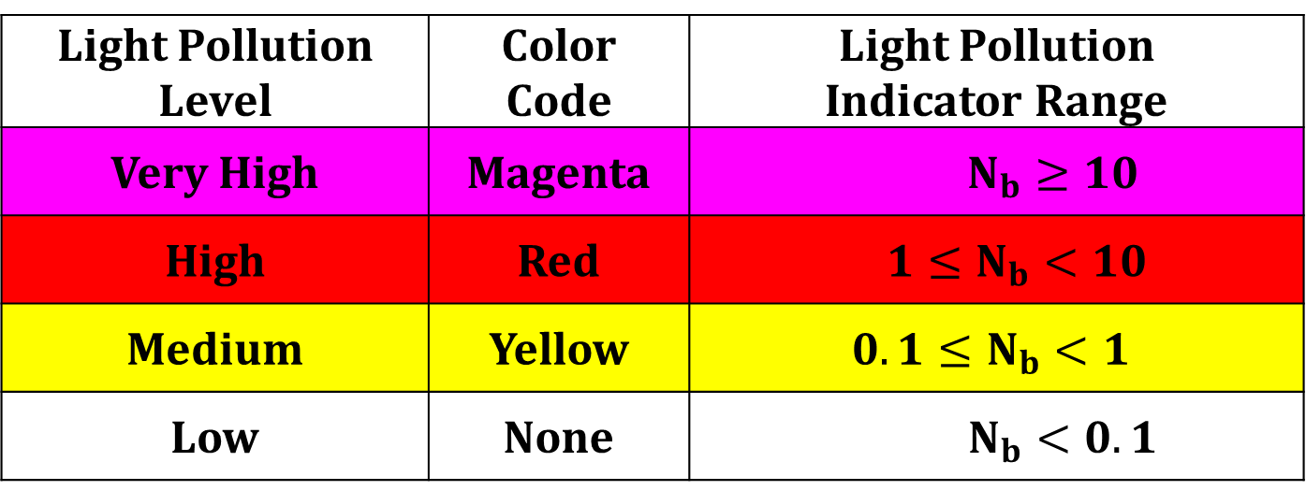
Constellation Light Pollution Color Coded Evaluation Levels
Light Pollution Evaluation Indicator: N_{b} = the statistically expected global and yearly maximum number of brighter-than-recommended satellites above ground-based observers during astronomical night time periods*
Light Pollution Level | Color Code | Light Pollution Indicator Range
Very High | Magenta | $N_{b}≥10$
High | Red | $1≤N_{b}<10$
Medium | Yellow | $$0.1≤N_{b}<1$$
Low | None | $N_{b}<0.1$
*Hall, D., “Semi-Empirical Astronomical Light Pollution Evaluation of Satellite Constellations,” Journal of the Astronautical Sciences, Jan. 2023.

Slide 14
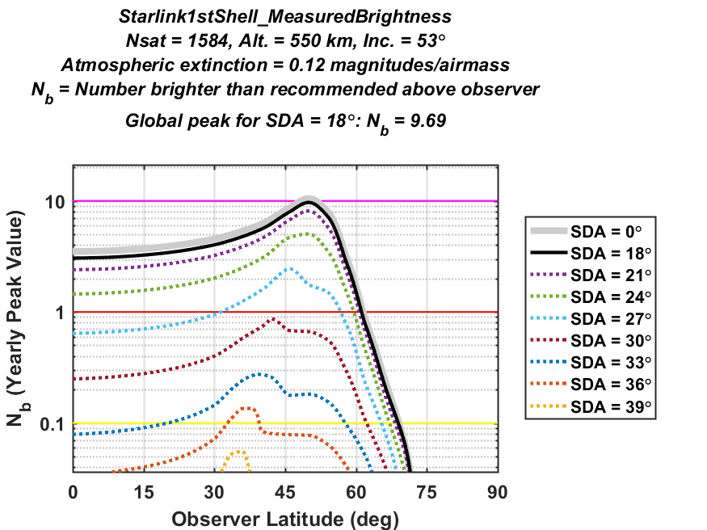
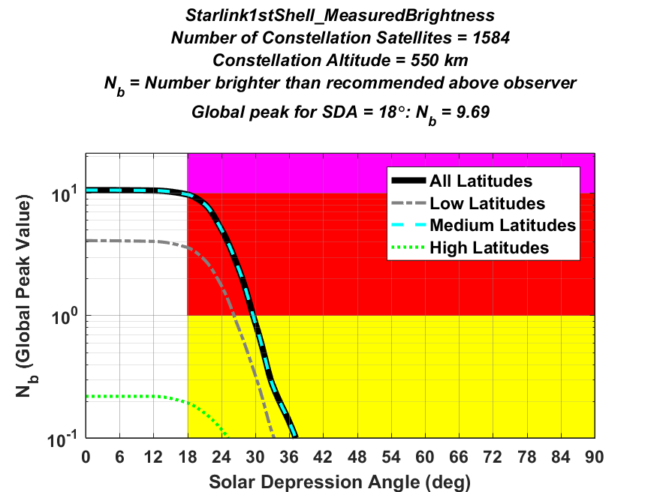
EvaluateLightPollution Software Light Pollution Summary Plots
The top plot shows the peak number of brighter-than-recommended satellites expected above ground-based observers as a function of latitude
Solid black line corresponds to SDA = 18°
Other dotted curves correspond to higher SDA values.
Magenta, red and yellow horizontal lines show very high, high and medium levels of light pollution, respectively
The bottom plot shows the light pollution indicator as a function of solar depression angle
SDA ≥ 18° represents astronomical nighttime
Magenta, red and yellow shaded regions show different levels of light pollution
These two specific plots show the light pollution evaluation for the 1st shell of the Starlink 1st Gen. constellation
1,584 satellites at 550 km altitude and 53° inclination
Light pollution peaks for observer latitudes of about 50°
The black curves indicate a global peak of about 9.7 brighter than recommended satellites, a high light pollution indicator level

Slide 15
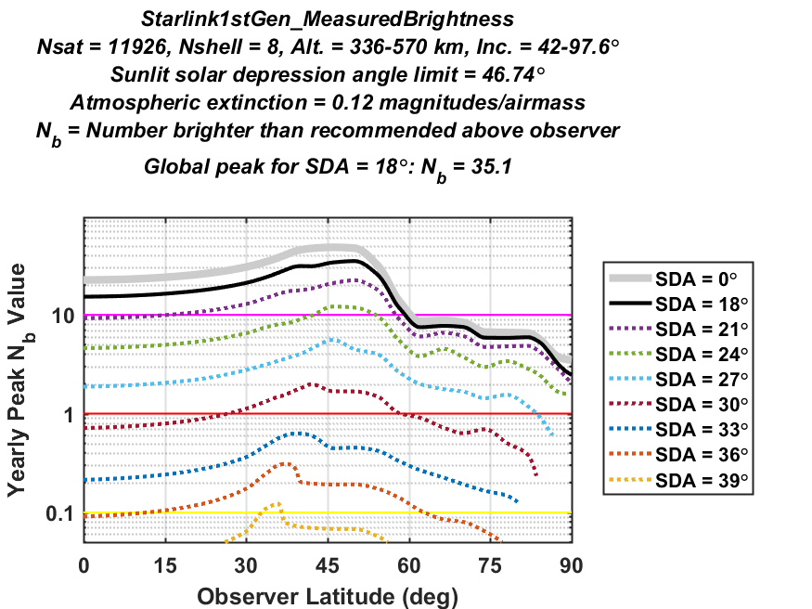
Light Pollution Indicator Changes with Solar Depression Angle (SDA) and Latitude
Starlink 1st Gen. Constellation – 1st Shell
Light pollution peaks for observer latitudes of about 50°. The maximum of the solid black curve represents a global peak of ~10 brighter than recommended satellites above ground-based observers, i.e., a high light pollution level
Starlink 1st Gen. Constellation – all 8 shells
Pollution peaks for observer latitudes of about 50°, but with a wide distribution. The maximum of the black curve represents a global peak of ~35 brighter than recommended satellites above observers, i.e., a very high light pollution level

Slide 16
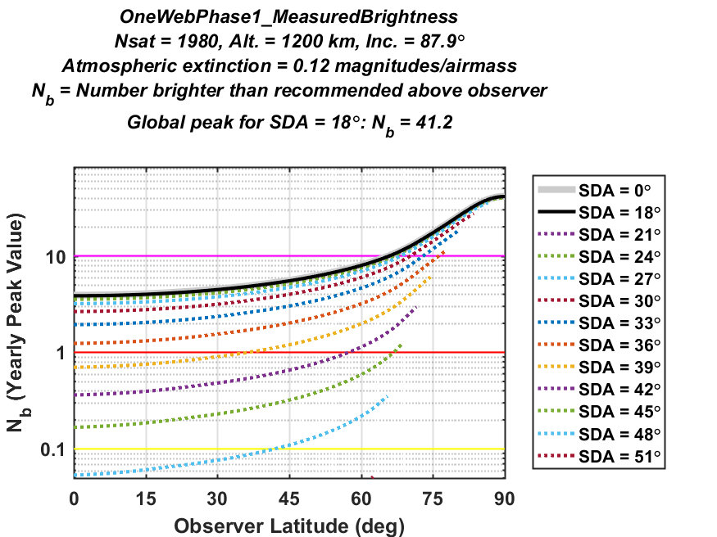
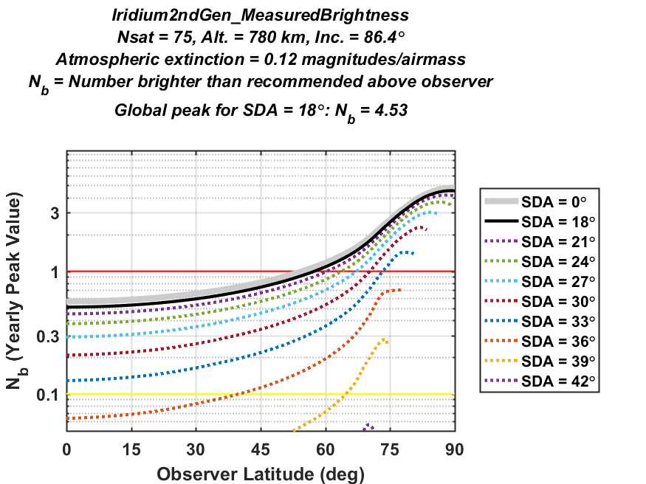
Light Pollution from Different Constellations Varies Differently with SDA and Latitude
Starlink 1st Generation
Light pollution peaks for observer latitudes of about 50°. The peak of the solid black curve represents ~35 brighter than recommended satellites above ground-based observers, a very high global peak level
OneWeb Phase 1
Light pollution peaks for observer latitudes of 90°. The maximum of the solid black curve represents ~41 brighter than recommended satellites above ground-based observers, a very high global peak level
Iridium 2nd Generation
Light pollution peaks for observer latitudes of 90°. The maximum of the solid black curve represents ~4.5 brighter than recommended satellites above ground-based observers, a high global peak level

Slide 17
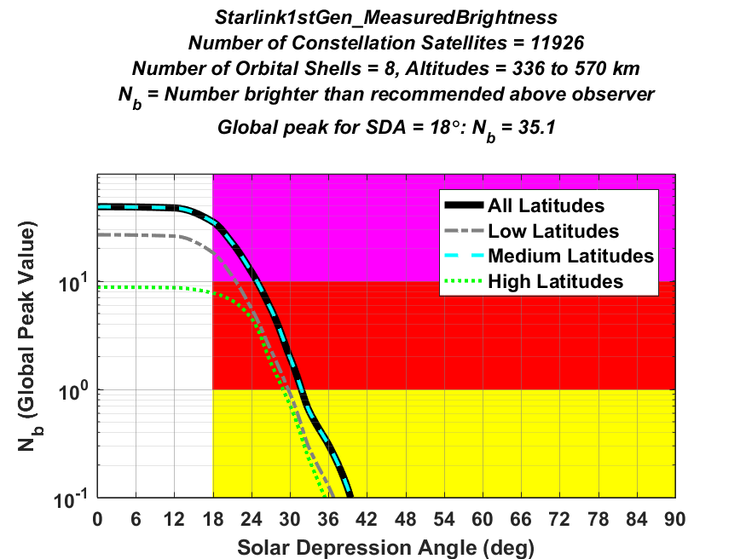
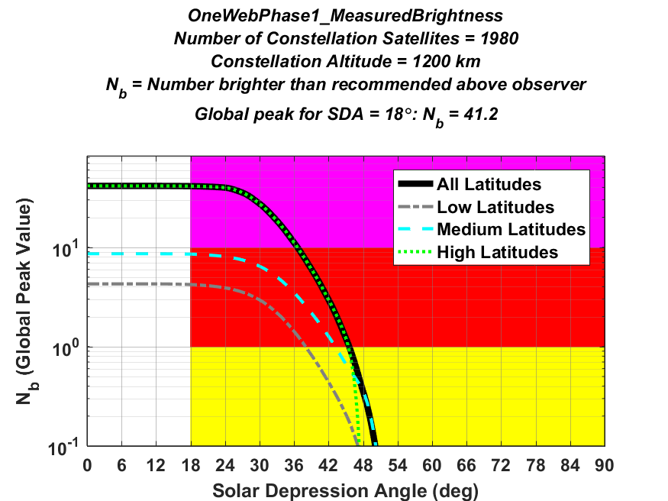
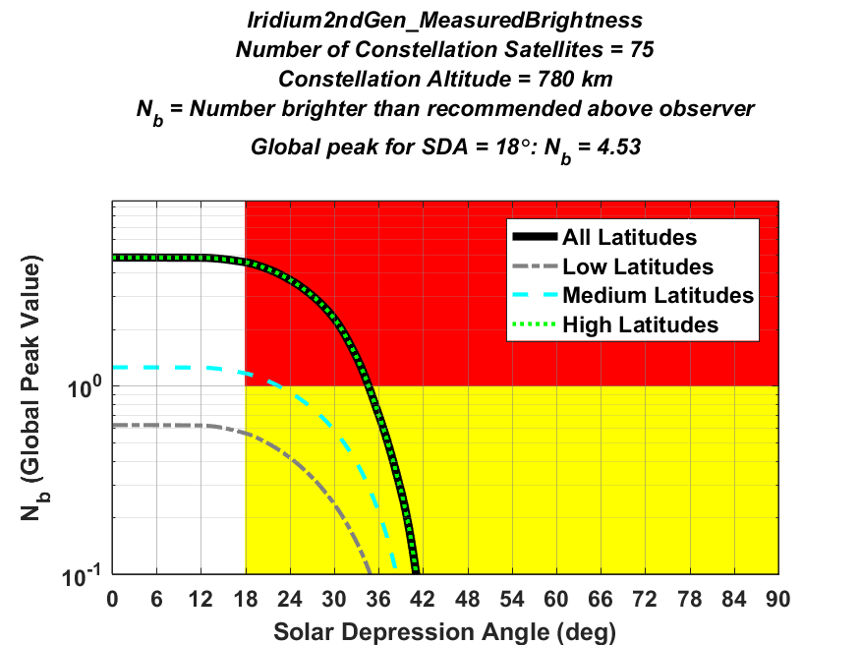
High Altitude Constellations Create Light Pollution Later into Astronomical Night
Starlink 1st Generation
Astronomical night time light pollution peaks at Nb = 35, a very high global peak level, and decreases to low levels for solar depression angles greater than ~40°
OneWeb Phase 1
Astronomical night time light pollution peaks at Nb = 41, a very high global peak level, and decreases to low levels for solar depression angles greater than ~50°
Iridium 2nd Generation
Astronomical night time light pollution peaks at Nb = 4.5, a high global peak level, and decreases to low levels for solar depression angles greater than ~42°

Slide 18
Program EvaluateLightPollution
Usage Instructions

Slide 19
Usage Instructions for EvaluateLightPollution Page 1 of 2
EvaluateLightPollution analyses are performed by constructing project parameter files
Each project is represented by a Matlab file stored within in the \params directory
For instance, the file \params\Starlink1stShell_MeasuredBrightness.m contains an example evaluation for the 1st shell of the Starlink 1st Generation constellation deployed at an altitude of 550 km.
Several other usage examples are provided in the \params directory; these can be used as templates for future projects and analyses.
The function “RunExamples” executes nine example analyses distributed with the EvaluateLightPollution software, each of which requires a few to several minutes to run on a typical computer
EvaluateLightPollution analyses can be based on observed satellite brightnesses for currently-orbiting constellations
The program current processes photometry from the Mini-MegaTORTORA (MMT) automated observatory, which measures clear-filter photometric magnitudes that are roughly equivalent to V-band measurements.
MMT temporal light-curve data for these constellations, and an extensive array of other satellites, can be obtained from the http://mmt9.ru/satellites/ website. The provided examples cannot be run until this data is downloaded.
The exact files used in the examples can be downloaded. Navigate to the constellation subfolders in “data/MMT/”, which each contain a “IDs_[Constellation].txt” file. The first line is an array of satellite IDs corresponding to all satellites used in the examples for that constellation. To retrieve these satellites, copy the entire line, paste it into the website’s “ID” field, and then click “Search”.
For new analyses, use the website’s search filters to choose a representative set of satellites.
For each satellite, download magnitude data files by selecting the “T” icon in the “RCS” column to “Download all tracks.” Files will be saved in the format “satellite_[####].txt”.
Place the files into an appropriate subfolder in “data/MMT/”.
Data from other facilities can also be used, if written into data files with the same format.

Slide 20
Usage Instructions for EvaluateLightPollution Page 2 of 2
EvaluateLightPollution analyses can also be performed for a proposed or pre-launch constellation using a set of photometric analog satellites
The analog satellite photometric data also can be downloaded from the MMT website.
The analog satellite brightnesses are adjusted for the different orbital altitude of the new constellation
The analog satellite brightnesses are also adjusted for any differences in the physical size of the individual constellation satellites as compared to the analogs.
For nadir-velocity stabilized satellites, this adjustment is based on the nadir-facing area of the satellites’ main bus and communications arrays (i.e., everything but the solar panels, which must be provided for both the proposed constellation satellites and the analog satellites See the OneWebPhase1_IridiumAsAnalog.m parameters file for an example of this case
Alternatively, the adjustment can be based on the size of the smallest box that encloses the satellites’ main bus and communications arrays. For this less-often used option, the height, width and length (H,W,L) this enclosing box is provided for both the proposed constellations satellites and the analog satellites.
After a parameters file is created and any required analog satellite data is downloaded, the program should be executed from the main EvaluateLightPollution as in the following example: EvaluateLightPollution(‘params\Starlink1stGen_MeasuredBrightness’)
Analysis results will be shown in plot format, and the constellation evaluation report will be shown on the console, as well as written to a file.
All plots, tables, and report files are written to an subdirectory in the output/ directory, which has the same name as the parameters file (i.e., ‘output\Starlink_MeasuredBrightness’ for the example shown above).
Photometric data being processed for the first time requires a bit more execution time, but is saved in the \data directory for efficient repeated analyses
Photometric data and plots for analog satellites adjusted to correct for satellite altitude and size differences is saved in the \output directory

Slide 21
Program EvaluateLightPollution
Description of
Project Parameter Files
and associated
Input Parameters
and
Output Quantities

Slide 22
Program EvaluateLightPollution: Source Code and Input/Output Parameters
The source code and usage example files for Matlab program EvaluateLightPollution can be found in the CARA SVN directory
\DistributedMatlab\EvaluateLightPollution
Contains subdirectories for source code files, documentation, photometric data, and project parameter files (\src, \doc, \data, and \params, respectively)
The core function EvaluateLightPollution.m uses the following calling sequence: Output = EvaluateLightPollution(params);
“params” denotes a file or structure of input parameters
“output” denotes a structure of the output quantities
Descriptions of these inputs and outputs can be found in the functions EvalLightPollution_default_params.m
Each EvaluateLightPollution analysis entails constructing a project
Each project has a Matlab parameter file stored within in the “params” directory
E.g., \params\Starlink1stGen_MeasuredBrightness.m contains an example that evaluates the Starlink 1st generation constellation based on measured ground-based photometry
Run as follows: EvaluateLightPollution(‘params\Starlink_MeasuredBrightness’)
Evaluations based on observed brightnesses require photometric data files
Before execution, data files need to be downloaded from the MMT website following usage instructions on slides 19 and 20.

Slide 23
Example Input Parameter File* Starlink1stShell_MeasuredBrightness.m
% Function EvaluateLightPollution parameter specification file
% for the 1st shell of the Starlink 1st generation constellation
% Parameters of the new or proposed constellation to evaluate
% Number, altitudes and inclinations of the satellites
% in each shell of new constellation
params.New.Nc = 1584; % Number of satellites in constellation
params.New.Altitude_km = 550; % Altitude of constellation
params.New.Inclination_deg = 53.0; % Inclination of constellation (degrees)
% Parameters for the observed analog satellite(s)
params.Analog.Type = 'SameSatelliteDesign';
params.Analog.Altitude_km = 550;
params.Analog.datapath = 'data\MMT\StarLink_VisorSat'; % MMT data path
params.Analog.UTbegin = '2021-01-01 00:00:00.000'; % MMT data start
params.Analog.UTend = '2021-03-01 00:00:00.000'; % MMT data end
*Additional detailed lists and descriptions of input parameters can be found in the functions EvalConstellation_default_params.m

Slide 24
Example Input Parameter File* Starlink1stGen_MeasuredBrightness.m
% Function EvalConstellation parameter specification file for the all
% eight orbital shells of the of the Starlink 1st generation constellation
% Parameters of the new or proposed constellation to evaluate
% Number, altitudes and inclinations of satellites in each shell of
% the new or proposed constellation
params.New.Nc = [1584 1584 720 348 172 2493 2478 2547];
params.New.Altitude_km = [ 550 540 570 560 560 336 341 346];
params.New.Inclination_deg = [53.0 53.2 70.0 97.6 97.6 42.0 48.0 53.0];
% Parameters for the analog satellite(s)
params.Analog.Type = 'SameSatelliteDesign';
params.Analog.Altitude_km = 550;
params.Analog.datapath = 'data\MMT\StarLink_VisorSat'; % MMT data path
params.Analog.UTbegin = '2021-01-01 00:00:00.000'; % MMT data start
params.Analog.UTend = '2021-03-01 00:00:00.000'; % MMT data end
*Additional detailed lists and descriptions of input parameters can be found in the functions EvalConstellation_default_params.m

Slide 25
Example Output Report File Starlink1stGen_MeasuredBrightness_ZenMax90_Extinct0.12_Report.txt
------------------------------------------
---- Constellation Evaluation Results ----
------------------------------------------
Evaluation ID: Starlink1stGen_MeasuredBrightness
Number of constellation satellites = 11926
Number of constellation orbital shells = 8
Altitude(s) of constellation shells = 336 to 570 km
Inclinations(s) of constellation shells = 42 to 97.6 km
MMT data path for satellites: data\MMT\StarLink_VisorSat
Fraction of orbital shell 1 measured to be brighter than SATCON-1 recommendation of 7 mag at zenith = 99.86%
Fraction of orbital shell 2 measured to be brighter than SATCON-1 recommendation of 6.98 mag at zenith = 99.88%
Fraction of orbital shell 3 measured to be brighter than SATCON-1 recommendation of 7.04 mag at zenith = 99.75%
Fraction of orbital shell 4 measured to be brighter than SATCON-1 recommendation of 7.02 mag at zenith = 99.8%
Fraction of orbital shell 5 measured to be brighter than SATCON-1 recommendation of 7.02 mag at zenith = 99.8%
Fraction of orbital shell 6 measured to be brighter than SATCON-1 recommendation of 6.46 mag at zenith = 100%
Fraction of orbital shell 7 measured to be brighter than SATCON-1 recommendation of 6.48 mag at zenith = 100%
Fraction of orbital shell 8 measured to be brighter than SATCON-1 recommendation of 6.5 mag at zenith = 100%
Overall fraction measured to be brighter than SATCON-1 recommendation at zenith 99.94%
Maximum observation zenith angle considered = 90 deg
Overall light pollution level = 35.1 and light pollution risk = VERY HIGH
RECOMMENDATION: Constellation redesign recommended to mitigate the estimated VERY HIGH level of light pollution risk

Slide 26
Example Output Evaluation Table Starlink1stGen_MeasuredBrightness_ZenMax90_Extinct0.12_AllLats.xlsx
SolarDepression | Nabove | Nsunlit | Nbright | Maxbright | LightPollutionLevel | LightPollutionRisk
0 | 510.21 | 510.21 | 48.36 |  |  | N/A
12 | 510.21 | 410.51 | 47.13 |  |  | N/A
18 | 510.21 | 330.46 | 35.06 | 1 | 35.06 | VERY HIGH
21 | 510.21 | 287.10 | 22.42 | 1 | 22.42 | VERY HIGH
24 | 510.21 | 241.35 | 12.14 | 1 | 12.14 | VERY HIGH
27 | 510.21 | 192.43 | 5.57 | 1 | 5.57 | HIGH
30 | 510.21 | 144.39 | 1.98 | 1 | 1.98 | HIGH
33 | 510.21 | 100.75 | 0.63 | 1 | 0.63 | MEDIUM
36 | 510.21 | 67.79 | 0.31 | 1 | 0.31 | MEDIUM
39 | 510.21 | 44.78 | 0.12 | 1 | 0.12 | MEDIUM
42 | 510.21 | 20.70 | 0.01 | 1 | 0.01 | VERY LOW
45 | 510.21 | 4.05 | 0.00 | 1 | 0.00 | NONE
48 | 510.21 | 0.00 | 0.00 | 1 | 0.00 | NONE
51 | 510.21 | 0.00 | 0.00 | 1 | 0.00 | NONE
54 | 510.21 | 0.00 | 0.00 | 1 | 0.00 | NONE
57 | 510.21 | 0.00 | 0.00 | 1 | 0.00 | NONE
60 | 510.21 | 0.00 | 0.00 | 1 | 0.00 | NONE
63 | 510.21 | 0.00 | 0.00 | 1 | 0.00 | NONE
66 | 510.21 | 0.00 | 0.00 | 1 | 0.00 | NONE
69 | 510.21 | 0.00 | 0.00 | 1 | 0.00 | NONE
72 | 510.21 | 0.00 | 0.00 | 1 | 0.00 | NONE
75 | 510.21 | 0.00 | 0.00 | 1 | 0.00 | NONE
78 | 510.21 | 0.00 | 0.00 | 1 | 0.00 | NONE
81 | 510.21 | 0.00 | 0.00 | 1 | 0.00 | NONE
84 | 510.21 | 0.00 | 0.00 | 1 | 0.00 | NONE

Slide 27
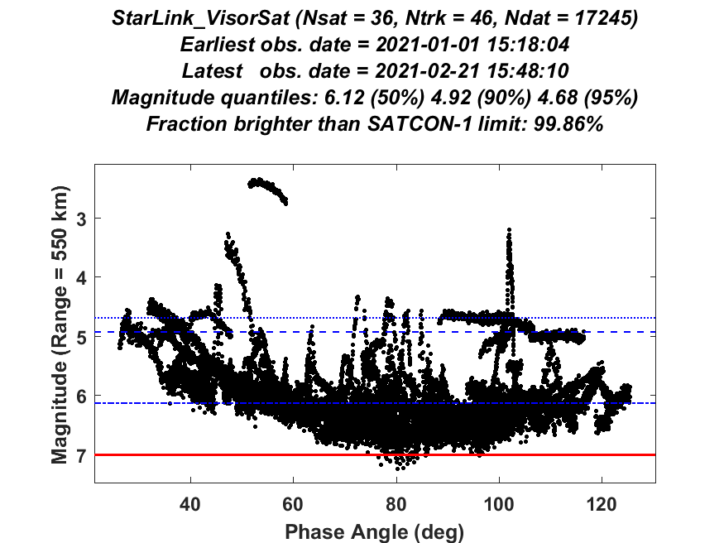
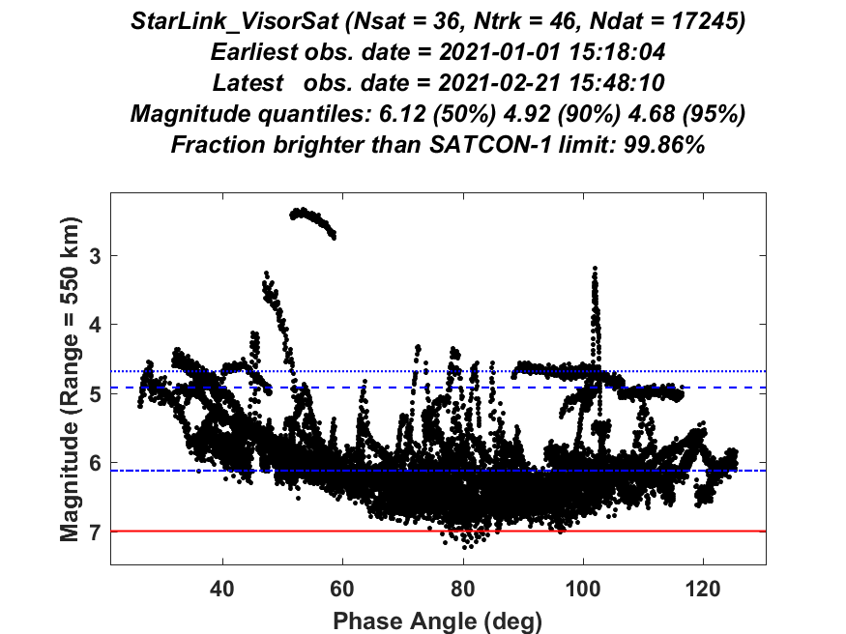
Example Photometric Analysis Plot StarLink_VisorSat_550km_Sc1_20210101_20210221_Ns36_Nt46_Nd17245_Nc3_MagPhase.png

Slide 28
Program EvaluateLightPollution
Distributed
EvaluateLightPollution
Analysis Examples

Slide 29
EvaluateLightPollution Analysis Examples (function RunExamples.m)
%% ------ Run examples for the function EvaluateLightPollution
%% ------ Single-shell constellation examples
% Starlink 1st orbital shell constellation based on measured brightness
EvaluateLightPollution('params/Starlink1stShell_MeasuredBrightness');
% OneWeb Phase 1 constellation based on measured brightness
EvaluateLightPollution('params/OneWebPhase1_MeasuredBrightness');
% Iridium 2nd Gen. constellation based on measured brightness
EvaluateLightPollution('params/Iridium2ndGen_MeasuredBrightness');
% OneWeb Phase 1 analysis using Iridium satellites as analog objects
% (to demonstrate analysis for proposed constellations with no orbiting
% satellites)
EvaluateLightPollution('params/OneWebPhase1_IridiumAsAnalog');
%% ------ Multi-shell constellation examples
% Starlink full 1st and 2nd gen. constellations based on measured
% brightness
EvaluateLightPollution('params/Starlink1stGen_MeasuredBrightness');
EvaluateLightPollution('params/Starlink2ndGen_MeasuredBrightness');
% OneWeb Phase 2 constellation based on measured brightness
EvaluateLightPollution('params/OneWebPhase2_MeasuredBrightness');
%% ------ Multi-shell constellation required brightness reduction example
% OneWeb Phase 2 constellation analysis showing that an average
% brightness reduction of 1.7 magnitudes changes the evaluated light
% pollution level from "very high" to "medium"
EvaluateLightPollution('params/OneWebPhase2_ReducedBrightness');
%% ------ Multi-shell constellation comparison example
% Starlink constellations compared to OneWeb and Iridium constellations
EvaluateLightPollution('params/Starlink1stGen_CompareConstellations');
Notes:
Photometric data files will need to be downloaded and placed in the appropriate subfolder of the “data” directory before execution of these examples
Each of the nine provided example analyses takes a few up to several minutes to execute on a typical computer
Upon completion of the nine examples, the analysis directories and files in the newly created “output” directory should match those already provided in the “output_with_distribution” directory

Slide 30
Program EvaluateLightPollution
For installation or troubleshooting issues please contact:
Jonathan Halpin
Omitron, Inc.
E-mail: jonathan.halpin@omitron.com
Mobile: 917-207-1720
or
Luis Baars
Omitron, Inc.
E-mail: Luis.Baars@omitron.com
Office: 719-698-9221
or
Doyle T. Hall
Omitron, Inc.
E-mail: Doyle.Hall@omitron.com
Office: 719-698-9220

