Slide 1
Input Device Framework - Technical
Derek Bankieris
ER7
This presentation is does not reflect the changes introduced with the Ouput class, but is otherwise correct.

Slide 2
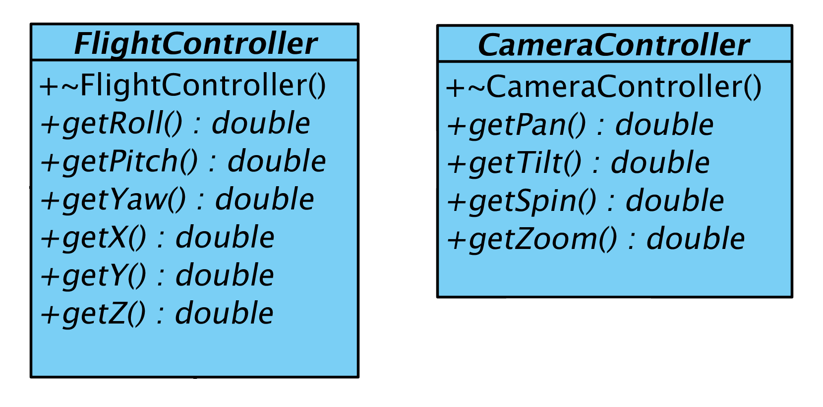
Controller Base Classes
Represents a simulation interface to a particular system
Lists minimum set of data a device must provide to act as such a controller
Abstract – does not implement any functionality

Slide 3
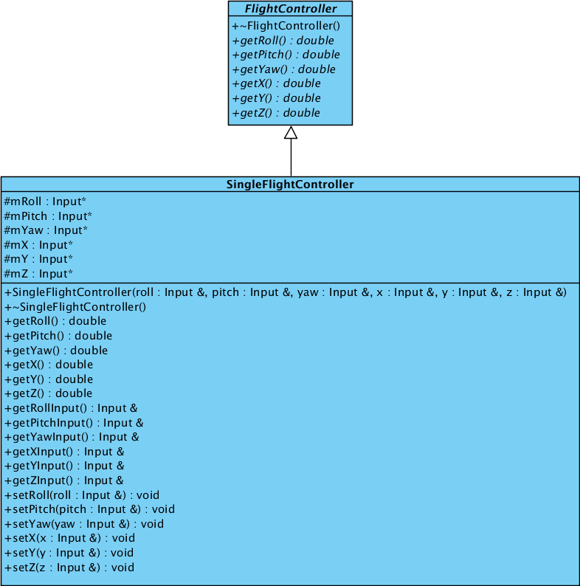
Single Controller
Represents an individual (virtual) controller
Implements base class contract
Contains an “Input” for each element of the required data set
Provides methods for setting/getting inputs

Slide 4
Single Controller
Does not represent a physical device
Represents a virtual device that fulfills a system control contract
Does not contain actual inputs
Contains pointers to inputs, which allows for arbitrary mapping to physical devices (which do contain actual inputs)
(we'll get to inputs in a moment)

Slide 5
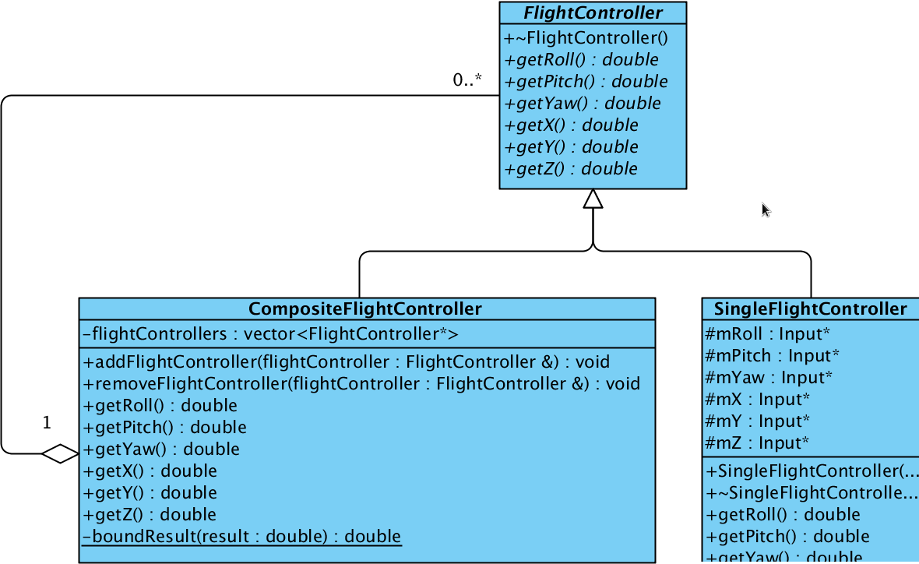
Composite Controller
Collection of single controllers
Composite design pattern eliminates distinction between one and many
Allows multiple controllers to service a single interface

Slide 6
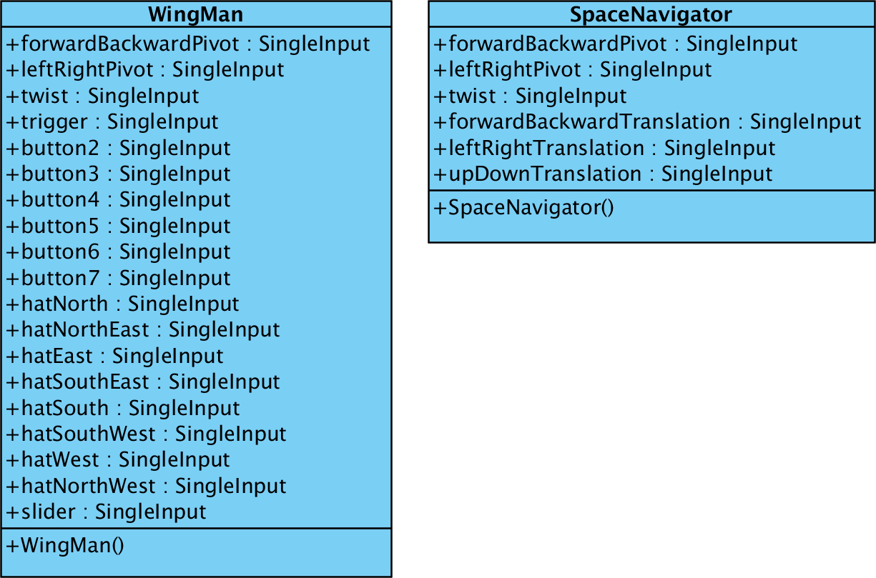
Input Layout Classes
Represents the collection of inputs available on specific physical devices
Does not specify how those inputs are populated with data
Does not specify a communication medium

Slide 7
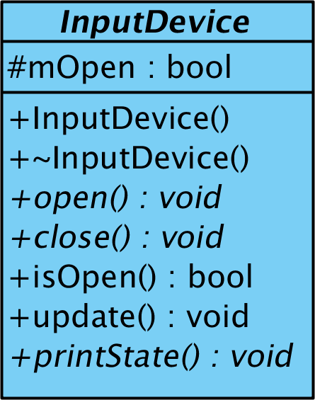
Input Device Base Class
Abstract base class for all physical devices
Declares methods that all devices must implement
Performs some generic error checking

Slide 8
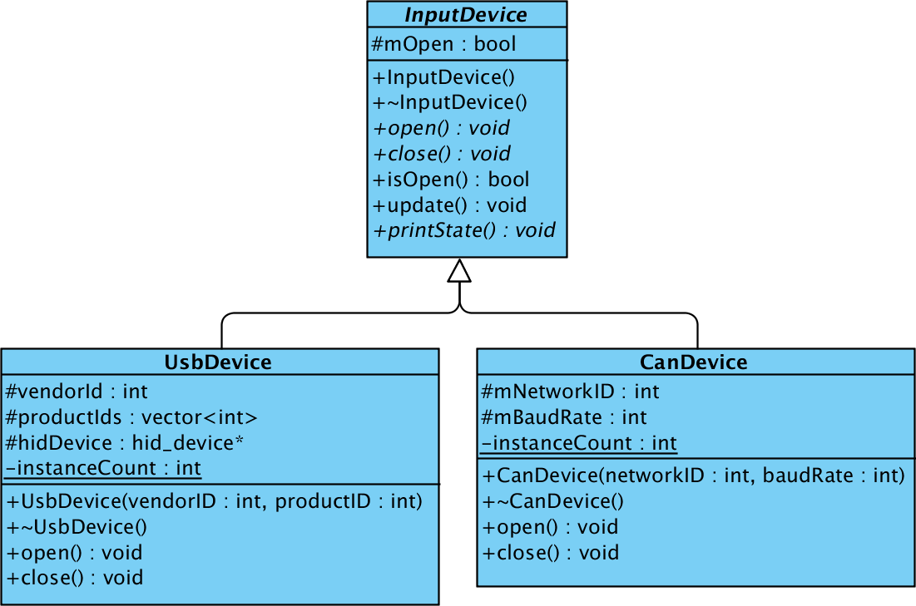
Communication Medium Classes
Represents devices which communicate over a particular medium
Contains data & methods specific to that medium and common to devices of that type
Performs one-time set-up and tear-down operations

Slide 9
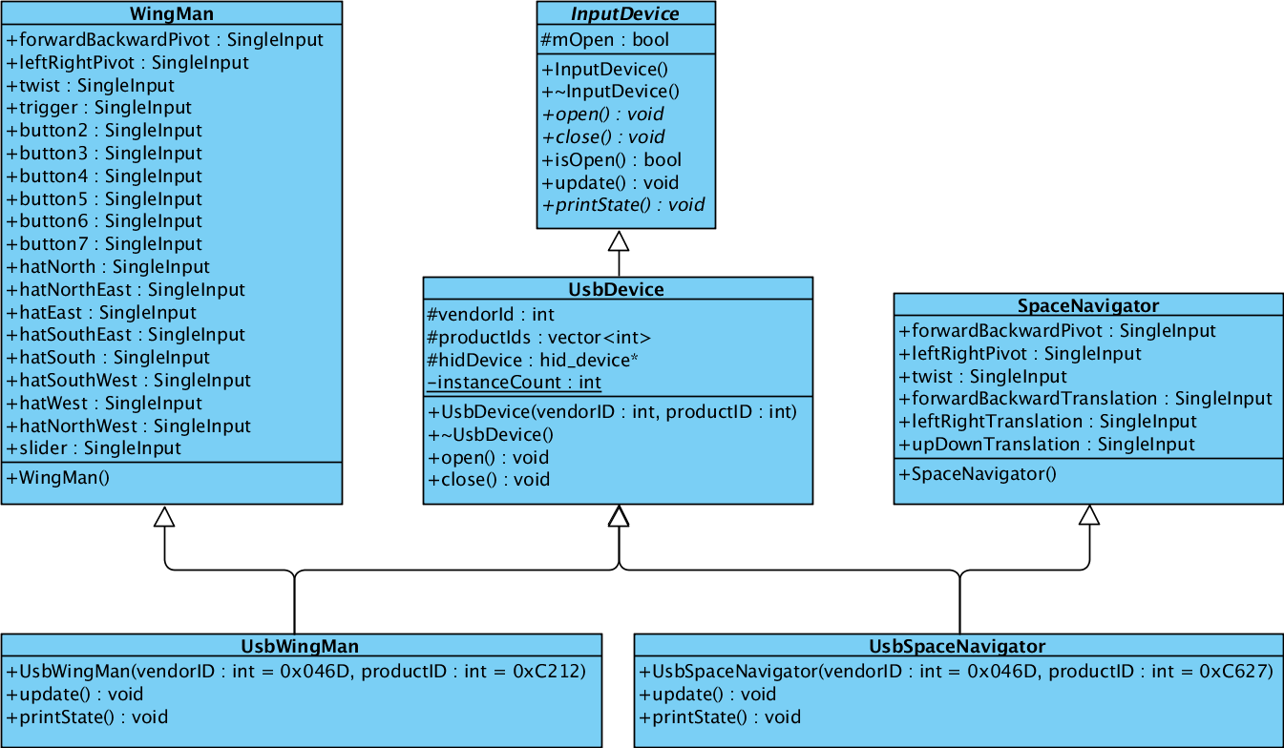
Physical Device Classes
Represents a physical device
Ties a particular button layout to a specific medium of communication
Responsible for reading and decoding data from the device and populating the inputs

Slide 10
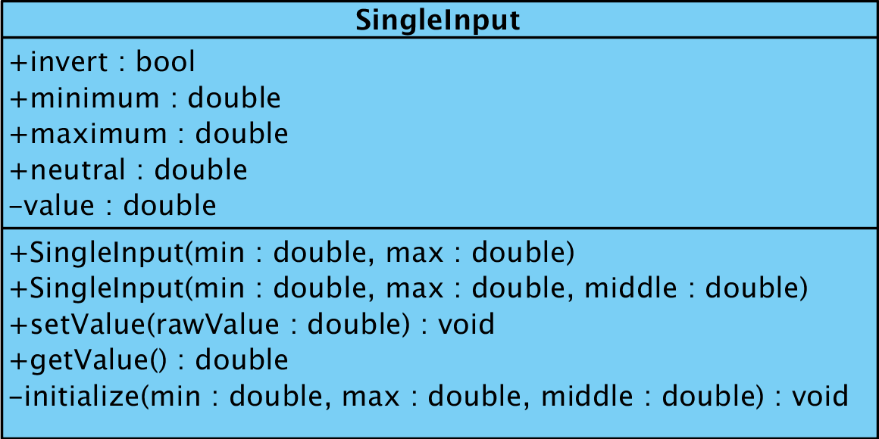
Single Input
Represents a single dimension of a physical input
Allows specification of minimum, maximum, and (optionally) neutral raw values
Scales raw values to [-1, 1]

Slide 11
Single Input
Binary inputs (buttons)
  Raw values are 0 or 1
  Processed values are -1 or 1, respectively
N-ary inputs (DOF, sliders, 3-state switches)
  Raw values take on a range
  -1 corresponds to the minimum raw value
  1 corresponds to the maximum raw value
  0 corresponds to the “neutral” (not necessarily median) raw value

Slide 12
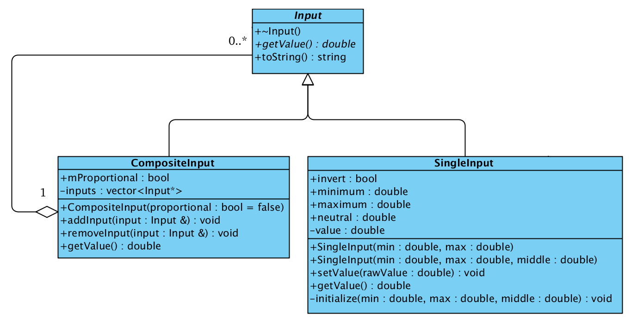
Composite Input
Composite design pattern again
Allows the combining of multiple inputs into a single entity
Provides for additively or proportionally combining values (still restricts output to [-1, 1])

Slide 13
Tying It All Together –
Hierarchy Layers
Simulation Interface Layer
  Declares the inputs that the simulation requires for each control system
  Insulates control system code from the details of physical controllers
Hardware Interface Layer
  Represents physical devices
  Responsible for all aspects of communication with devices
Input Abstraction Layer
  Exposes physical inputs available on particular devices
  Acts as the conduit through which virtual controllers are tied to physical devices

Slide 14
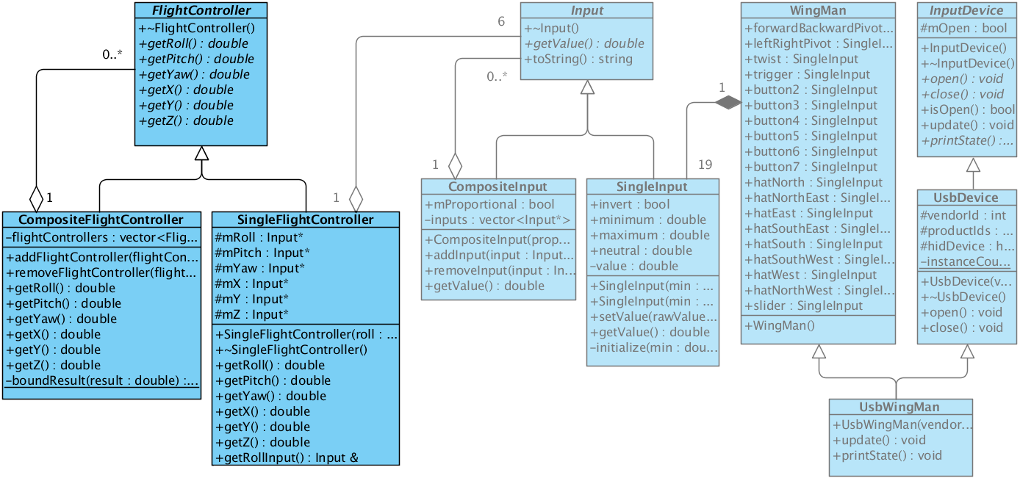
Simulation Interface Layer
Consists of composite design patterns, one for each type of control system
Only layer with which control system code should interact

Slide 15
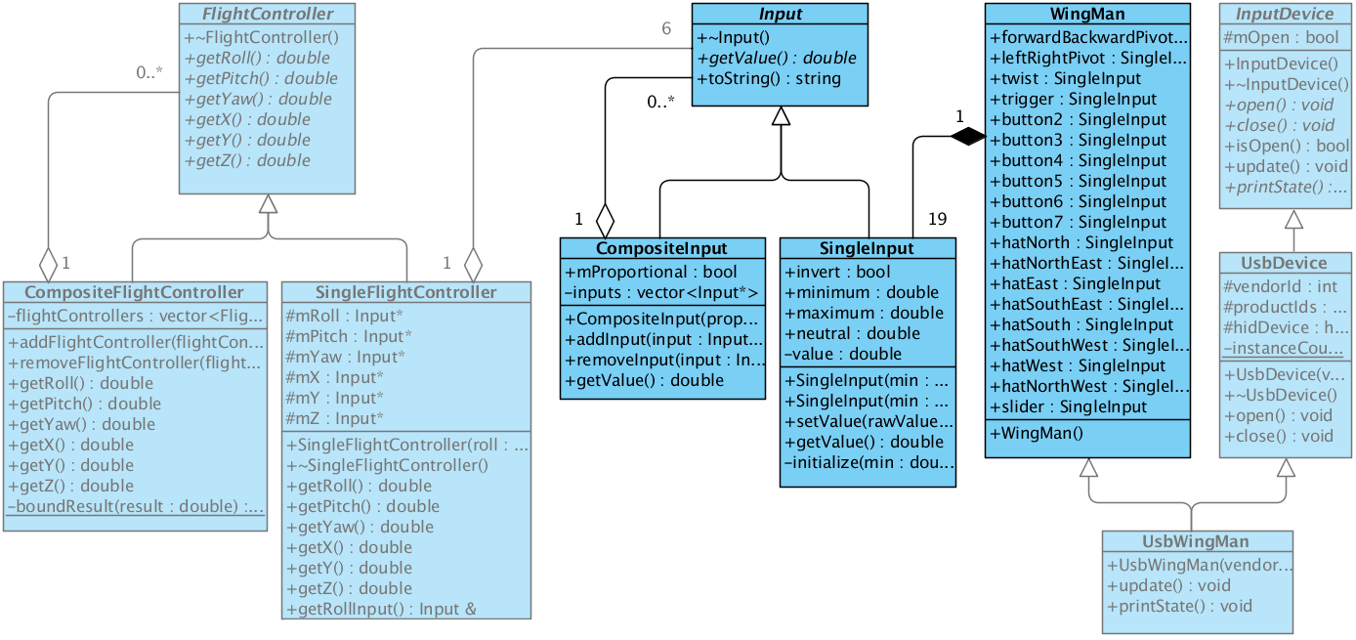
Input Abstraction Layer
Contains the Input composite design pattern and a class for each collection of inputs available on a specific physical device
This abstraction allows an identical input layout to be shared by devices whose only difference is the communication medium

Slide 16
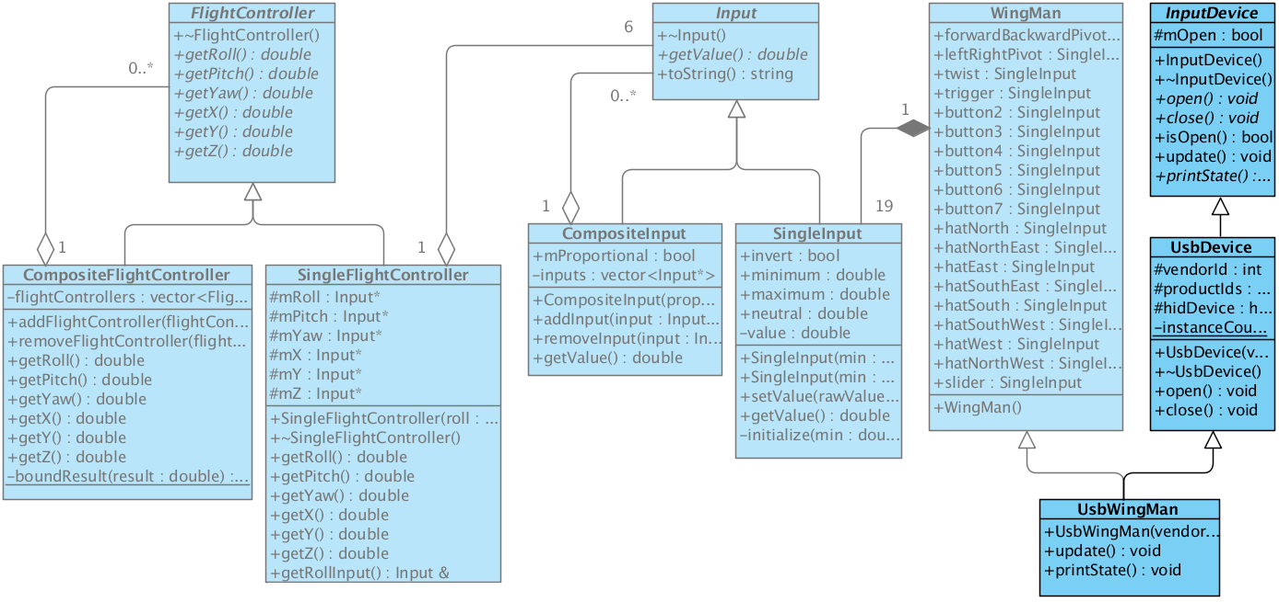
Hardware Interface Layer
Contains the root class, a class for each type of communication medium, and a class for each specific physical device
Specific device classes combine a communication medium with an input layout from the input abstraction layer

Slide 17
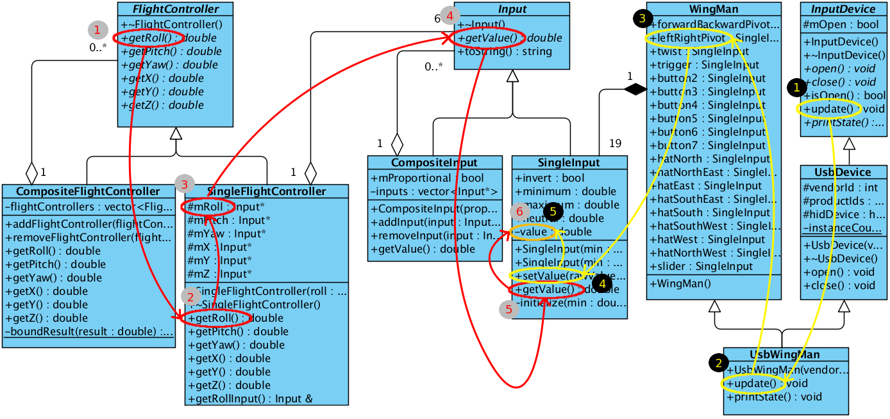
Data Flow
The critical element is the “value” field within the SingleInput class. This field is updated when InputDevice::update() is called, which causes the specific device instance to read from the device, decode the data, and update its various Inputs. This value is ultimately returned by FlightController::getRoll().

Slide 18
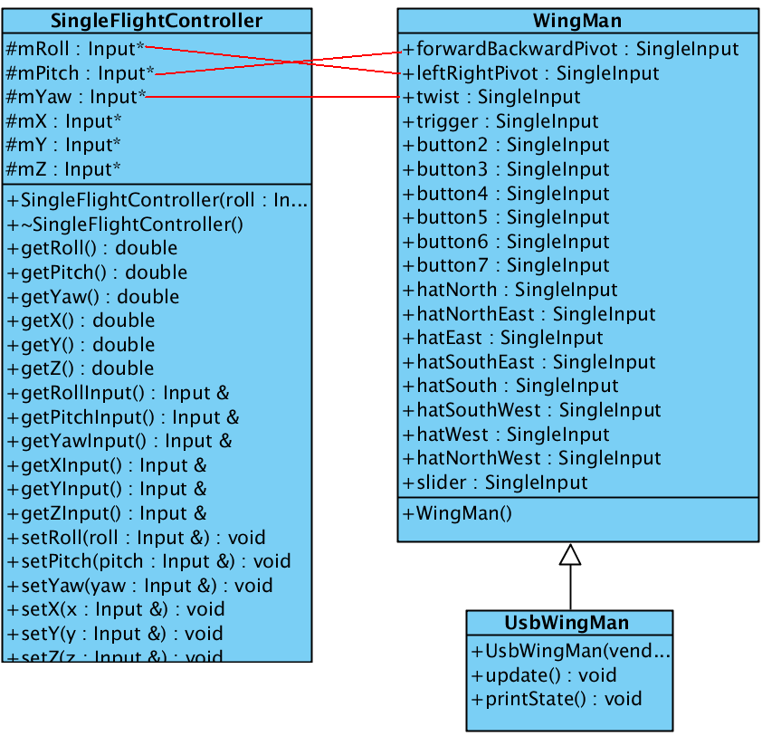
Wiring the Connections
But how does getRoll() know to call getValue() from the leftRightPivot Input of WingMan? Someone has to tell it!
SingleFlightController fc;
UsbWingMan wingMan;
fc.setRoll(
wingMan.leftRightPivot);
fc.setPitch(
wingMan.forwardBackwardPivot);
fc.setYaw(wingMan.twist);

Slide 19
Wiring the Connections
Complete flexibility in interpreting device inputs
Supports dynamic reassignment
Mappings can be written in C++ (if unlikely to change) or Python (if you want to change axes from run to run)
Controllers can provide pre-configured mappings via static factory methods (if we feel that's appropriate)

Slide 20
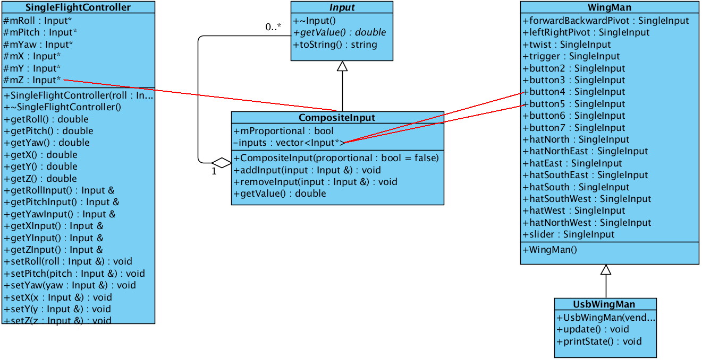
Creating Composite Inputs
Use two buttons to command one axis:
SingleFlightController fc;
UsbWingMan wingMan;
CompositeInput zInput;
zInput.addInput(wingMan.button4);
zInput.addInput(wingMan.button5);
wingMan.button5.invert = true;
fc.setZ(zInput);

Slide 21
Creating Composite Inputs
Recall that all inputs return a value in [-1, 1]
Buttons are either pressed (1) or not pressed (-1)
The CompositeInput from the previous slide will return 1 when button4 is pressed, -1 when button5 is pressed, and 0 when neither is pressed
The FlightController does not care (or need to know) whether we use a single n-ary input or a composite of binary inputs

Slide 22
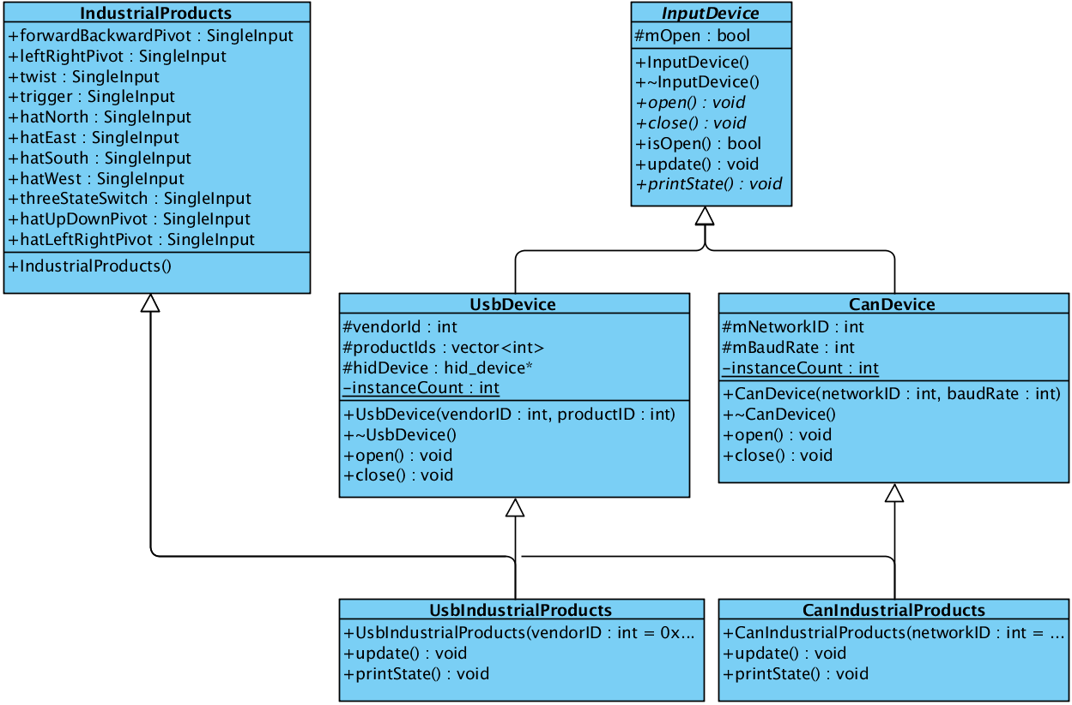
Sharing Input Layouts
Eliminates code replication
Allows code (outside of the hardware interface layer) to generically handle any particular input layout irrespective of its communication medium

Slide 23
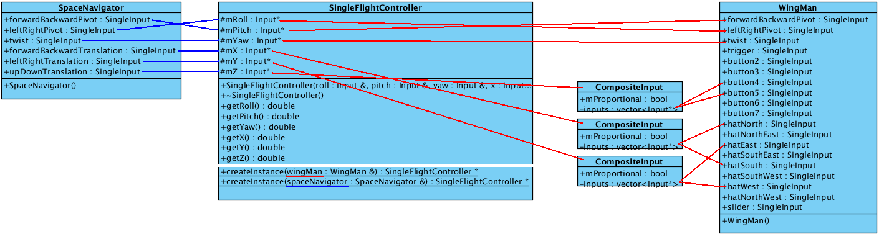
Providing Default Mappings Via Factory Methods
SingleFlightController* SingleFlightController::createInstance(WingMan& wingMan) {
CompositeInput* x = new CompositeInput();
x->addInput(wingMan.hatNorth);
x->addInput(wingMan.hatSouth);
wingMan.hatSouth.invert = true;
CompositeInput* y = new CompositeInput();
y->addInput(wingMan.hatWest);
y->addInput(wingMan.hatEast);
wingMan.hatEast.invert = true;
CompositeInput* z = new CompositeInput();
z->addInput(wingMan.button4);
z->addInput(wingMan.button5);
wingMan.button5.invert = true;
return new SingleFlightController(wingMan.leftRightPivot,
wingMan.forwardBackwardPivot, wingMan.twist, *x, *y, *z);
}
SingleFlightController* SingleFlightController::createInstance(SpaceNavigator& spaceNavigator) {
return new SingleFlightController(
spaceNavigator.leftRightPivot,
spaceNavigator.forwardBackwardPivot,
spaceNavigator.twist,
spaceNavigator.forwardBackwardTranslation,
spaceNavigator.leftRightTranslation,
spaceNavigator.upDownTranslation);
}

Slide 24
Adding a New Device to the Hierarchy
Create a new communication medium class if the device's communication medium is not already represented
Create a new input layout class if the device's input layout is not already represented
Create a new device class that inherits from the classes in the two previous steps
Implement logic to read and decode data from the device and to update the inputs
Provide default mappings by adding factory methods to the controller classes that this device will support, if desired

Slide 25
Adding a New Controller to the Hierarchy
Determine the list of inputs that the control system requires
Create a new composite design pattern that consists of the abstract base class {Name}Controller, the implementing class Single{Name}Controller, and the composite class Composite{Name}Controller by following the structure of the existing controllers
Provide default mappings by adding factory methods for the input layouts that this controller will support, if required

Slide 26
An Example – RATS SIM_MMSEV
//S_define
CompositeFlightController compositeFlightController;
CompositeCameraController compositeCameraController;
std::vector<InputDevice*> inputDevices;
...
(“initialization”) openDevices();
(hardwareRate, “scheduled”) updateDevices();
(flightRate, “scheduled”) flightControlSystem.controlFlight(compositeFlightController);
(cameraRate, “scheduled”) cameraControlSystem.controlCamera(compositeCameraController);
...
void addDevice(InputDevice& inputDevice) {
inputDevices.push_back(inputDevice);
}
void openDevices() {
for (std::vector<InputDevice*>::iterator i = inputDevices.begin(); i != inputDevices.end(); ++i) {
(*i)->open();
}
}
void updateDevices() {
for (std::vector<InputDevice*>::iterator i = inputDevices.begin(); i != inputDevices.end(); ++i) {
(*i)->update();
}
}

Slide 27
An Example – RATS SIM_MMSEV
#input.py (assumes simObject is the name of an instantiation of the class on the previous slide)
# Open device on CAN network 0
device0 = trick.CanIndustrialProducts(0)
device0.thisown = 0
simObject.addDevice(device0)
# Open device on CAN network 1
device1 = trick.CanIndustrialProducts(1)
device1.thisown = 0
simObject.addDevice(device1)
# Use factory methods to create FlightControllers with default mappings for the devices
flightController0 = trick.SingleFlightController.createInstance(device0)
flightController0.thisown = 0
flightController1 = trick.SingleFlightController.createInstance(device1)
flightController1.thisown = 0
# Add the flight controllers to the simulation composite flight controller
simObject.compositeFlightController.addFlightController(flightController0)
simObject.compositeFlightController.addFlightController(flightController1)
# Use factory methods to create CameraControllers with default mappings for the devices
cameraController0 = trick.SingleCameraController.createInstance(device0)
cameraController0.thisown = 0
cameraController1 = trick.SingleCameraController.createInstance(device1)
cameraController1.thisown = 0
# Add the Camera controllers to the simulation composite Camera controller
simObject.compositeCameraController.addCameraController(CameraController0)
simObject.compositeCameraController.addCameraController(CameraController1)

Slide 28
An Example – RATS SIM_MMSEV
// Flight control system code
void controlFlight(FlightController& flightController) {
// get the commanded inputs
double roll = flightController.getRoll();
double pitch = flightController.getPitch();
double yaw = flightController.getYaw();
double x = flightController.getX();
double y = flightController.getY();
double z = flightController.getZ();
// control logic code
...
}
// Camera control system code
void controlCamera(CameraController& cameraController) {
// get the commanded inputs
double pan = flightController.getPan();
double tilt = flightController.getTilt();
double spin = flightController.getSpin();
double zoom = flightController.getZoom();
// control logic code
...
}
The arguments to these functions are the CompositeFlightController and CompositeCameraController from the S_define.

